Slide 1
League of Legends Player Analytics
Project 1
IMGD 2905

Slide 2
Overview
Set up tools for game analytics pipeline
Apply to Riot's League of Legends
Pipeline:
Basic queries this project, but preparation for more advanced in project 3

Slide 3
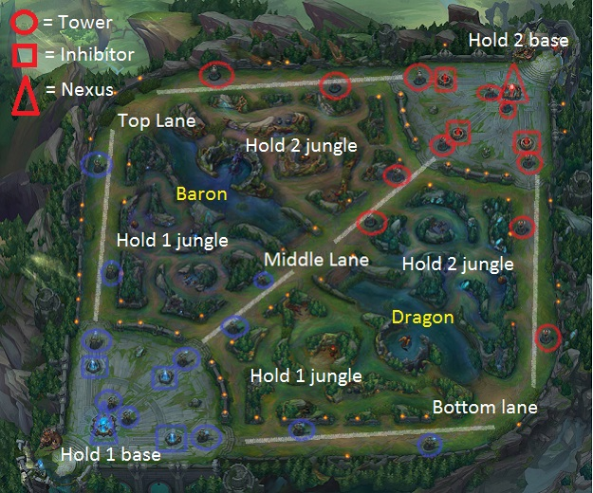
League of Legends
Most popular game in world [1]
Played by more than 27 million people each day
Professional leagues (e-Sports)
32 million viewers 2014 at World Championships
8.5 million simultaneous (compare to 16 million for soccer World Cup)
Team versus team game (5v5)
Teams based on player ranking (~25 ranks)
Players each choose 1 Champion
Over 130 choices
10 unique per game
Champions have abilities and level up in game
Player can buy items to enhance Champion
[1] Raptr - The Offical Blog (2015). Most Played Games: November 2015. http: //goo.gl/bVytCX

Slide 4
Parts
Part 0 - Setup
Part 1 - Matches Played
Part 2 - Champions Played
Part 3 - Compare Players
Part 4 - Match Data
Writeup
Submission
Grading

Slide 5
Part 0 - Setup
Named “part 0” since don’t write up → but critical for rest of projects!
http://web.cs.wpi.edu/~imgd2905/d17/projects/proj1/setup.html
Install Python
Windows or Linux (or Mac?)
Get Riot API Key
Install RiotWatcher
Test It Out (hello.py) ← Fix before proceeding!
Install spreadsheet

Slide 6
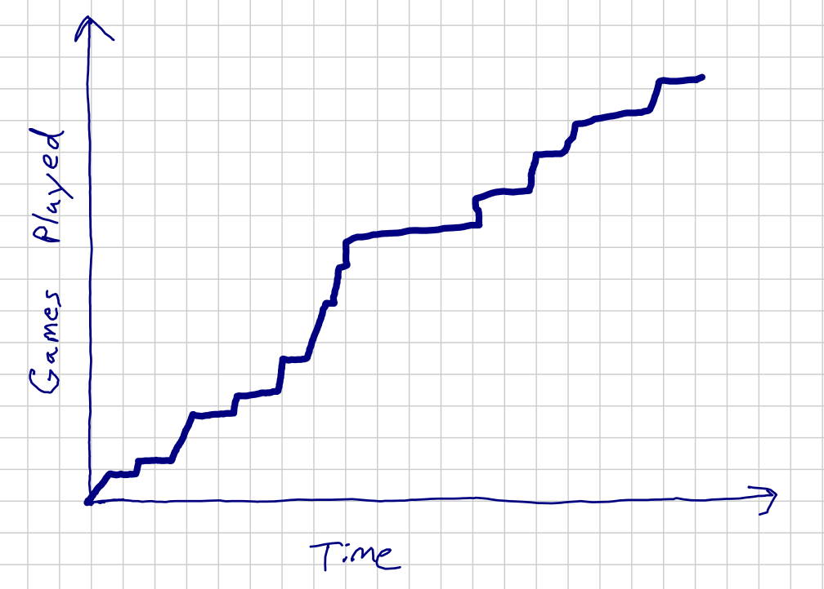
Part 1 – Matches Played
Player “Faker” (the “god” of League)
See “basic.py”
Understand each line
Copy and modify to get data needed
Output in comma separated values (“csv”)
Graph in Excel
Days, Match,
0.00, 0,
0.03, 1,
0.06, 2,
0.39, 3,
0.42, 4,
1.01, 5,
1.05, 6,
...

Slide 7
Part 2 – Champions Played
Champion Faker played most
Obtain from Champion ids
Compute “mode”
Mode() in Excel
Cross-reference with static champion list (static_get_champion_list(), match[‘champion’])
Commonly needed
E.g., Leona is 89
Compare oldest half and newest half
→ Was there a change?
67,
236,
119,
67,
64,
67,
25,
202,
...

Slide 8
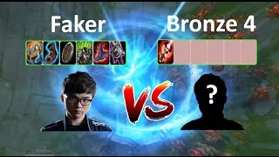
Part 3 – Compare Players
Repeat above analysis but for additional player
e.g., another professional or your friend
Must have done competitive/ranked matches
Re-inforce above methodology
Graph with 2 trend lines, table with 2 players
https://www.downlossless.net/videos/lol-best-moments-106-faker-vs-bronze-4-player-league-of-legends-15u5n4h594h4d6f6b6x4e6.html

Slide 9
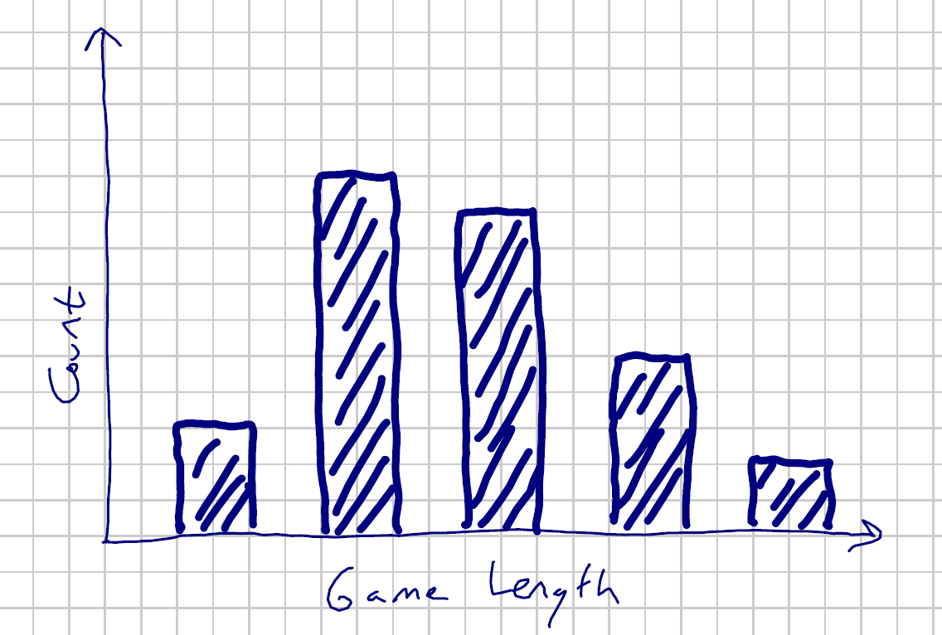
Part 4 – Match Data
Length of Faker’s matches
Histogram
Need to pull out full match data
Summary statistics
Min
Max
Mean
Standard Deviation
for match in match_list:
fullMatch = r_w.get_match(match['matchId'])

Slide 10
Write Up
Short report
Content key, but structure and writing matter
Consider:
Ease of extracting information
Organization
Concise and precise
Clarity
Grammar/English
Graphs/tables:
Number and caption
Referred to by number
Labeled axes.
Explained trend lines
Message

Slide 11
Grading
Part 1 (Matches) - 60%
Part 2 (Champs) - 20%
Part 3 (Compare) - 13%
Part 4 (Durations) - 7%
All visible in report!
(Late – 10% per day)

Slide 12
Rubric
100-90. The submission clearly exceeds requirements. All parts of the project have been completed or nearly completed. The report is clearly organized and well-written, graphs and tables are clearly labeled and described and messages provided about each part of the analysis.
89-80. The submission meets requirements. The first 3 parts of the project have been completed or nearly completed, but not part 4. The report is organized and well-written, graphs and tables are labeled and described and messages provided about most of the analysis.
79-70. The submission barely meets requirements. The first 2 parts of the project have been completed or nearly completed, but not parts 3 or 4. The report is semi-organized and semi-well-written, graphs and tables are somewhat labeled and described, but parts may be missing. Messages are not always clearly provided for the analysis.
69-60. The project fails to meet requirements in some places. The first part of the project has been completed or nearly completed, but not parts 2, 3 or 4. The report is not well-organized nor well-written, graphs and tables are not labeled or may be missing. Messages are not always provided for the analysis.
59-0. The project does not meet requirements. No part of the project has been completed. The report is not well-organized nor well-written, graphs and tables are not labeled and/or are missing. Messages are not consistently provided for the analysis.

