Slide 1

TagPro Analytics
Grading Postmortem
Project 3
IMGD 2905

Slide 2
Overall
Good
Bad
Projects improving!
Clearer charts, better descriptions
Same grades, but stricter criteria
Some people still making same mistakes
  Double-check old guidelines!
New problems to note
  This deck

Slide 3
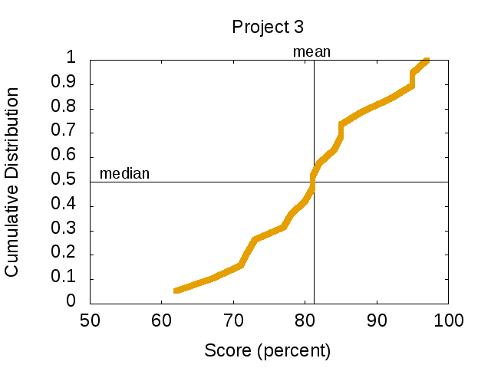
Grade Distribution

Slide 4
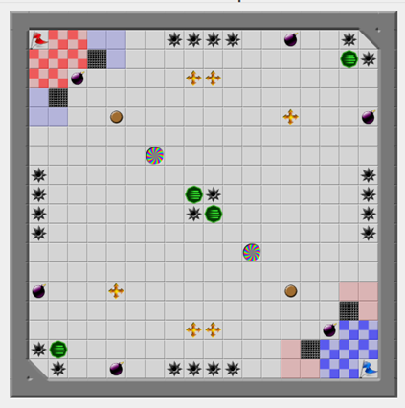
Nice Variety of Maps!

Slide 5
Some Beautiful Charts

Slide 6
Some Beautiful Charts

Slide 7
Some Beautiful Charts

Slide 8
Some Beautiful Charts

Slide 9
Don’t Use Smoothed Lines
What’s wrong with this chart?

Slide 10
Don’t Use Smoothed Lines
Impossible!
What’s wrong with this chart?

Slide 11
Dates for Volatile Data Sets
Downloaded and analyzed:
http://www.cs.wpi.edu/~imgd2905/d17/projects/proj3/tagpro-data.zip
What’s wrong with that?

Slide 12
Dates for Volatile Data Sets
Downloaded and analyzed:
http://www.cs.wpi.edu/~imgd2905/d17/projects/proj3/tagpro-data.zip
What’s wrong with that?
Data set changed over time! Added data pretty much every day from Friday, March 31st to Friday April 7th
When data set was downloaded may impact results
  Especially data that shows outliers (e.g., min/max)
Maybe true of TagPro datasets, too!

Slide 13
Include Testing Details
Here is my map
Here is the analysis of gameplay on my map
What’s missing?

Slide 14
Include Testing Details
Here is my map
Here is the analysis of gameplay on my map
What’s missing?
Number of players (e.g., 2v2)
Number of map runs (e.g., 2)
TagPro experience of players
Ditto for TagPro matches downloaded.
  “Downloaded 1000 matches”
  Ok, but which 1000?

Slide 15
Write Succinctly
What’s wrong with this?
“I decided that I wanted to investigate the number of pops that a player had while moving the balloon in the map”

Slide 16
Write Succinctly
Everything is “I decided” and probably “I wanted”!
What’s wrong with this?
“I decided that I wanted to investigate the number of pops that a player had while moving the balloon in the map”
Better?
That’s what the player always does!

Slide 17
Write Succinctly
What’s wrong with this?
“I decided that I wanted to analyze the number of pops that a player had while moving the balloon in the map”
Better?
“I analyzed pops”
Even better, dive right in:
“Figure X shows pop analysis”

Slide 18
Let the Analysis do the Talking
“The chart is interesting because …”
  What’s wrong with this?

Slide 19
Let the Analysis do the Talking
“The chart is interesting because …”
  What’s wrong with this?
Let the reader decide if the chart is interesting!
If you make interesting charts, the messages will speak for themselves

Slide 20
Let the Analysis do the Talking
“I was surprised by the result…”
  What’s wrong with this?

Slide 21
Let the Analysis do the Talking
“I was surprised by the result…”
  What’s wrong with this?
You may have been surprised, the reader may not
Also, if you setup the problem, the reader will be with you
  e.g., Motivate why pops may increase with spikes. Analyze. Show chart. Pops don’t increase with pops. → Reader will be surprised!

Slide 22
Sanity Check
What’s wrong with this chart?

Slide 23
Sanity Check
What’s ½ a capture?
That’s only 10 seconds!
What’s wrong with this chart?

Slide 24
Sanity Check
“… expanded with 1000 games”
What’s wrong with this chart?

Slide 25
Sanity Check
There are not 1000 games here!
“… expanded with 1000 games”
Note, matches 1-1000 not 1000 games!
What’s wrong with this chart?

