Slide 1
League of Legends Game Analytics
Grading Postmortem
Project 4
IMGD 2905

Slide 2
Overall
Good
Bad
Projects still improving, (albeit more slowly)
Better analysis text
Some stagnation in improvement
Attendance in class?
Attention to detail?
New problems to note
This deck
Notes
Former criteria still pertain!
→ Review
Attention to detail is important!
If do not understand comments, or what is missing or how to fix
→ Come see me

Slide 3
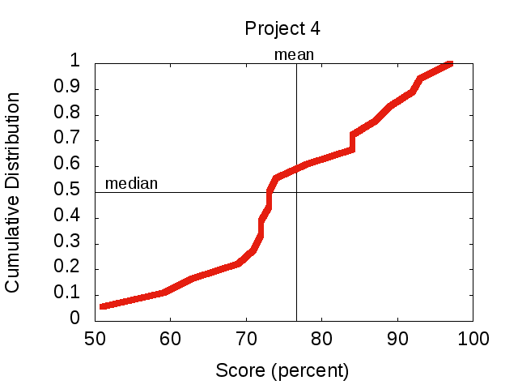
Grade Distribution

Slide 4
Nice Charts!

Slide 5
Nice Charts!

Slide 6
Nice Charts!

Slide 7
Nice Charts!

Slide 8
Nice Charts!

Slide 9
Details Missing on Data Collection
What’s missing?
“I analyzed a League of Legends summoner.”

Slide 10
Details Missing on Data Collection
What’s missing?
“I analyzed a League of Legends summoner.”
Summoner profile
Minimum: Name
Better: Rank
Even Better: dates of match numbers pulled
Even Betterer: actual match numbers pulled

Slide 11
It’s All Relative
“Winners have about 12k more gold than losers”
What’s missing?

Slide 12
It’s All Relative
“Winners have about 12k more gold than losers”
What’s missing?
How does this compare to total gold?
How much does this matter in-game (e.g., how much do items cost)?

Slide 13
Make Comparisons Easy for Reader
What’s wrong with this?
“Figure 9 shows game duration in minutes versus total gold earned per match. It is the same graph as Figure 2, only using Summoner B versus Summoner A as the seed. Compared to Figure 2, the data in Figure 9 is …”

Slide 14
Make Comparisons Easy for Reader
What’s wrong with this?
“Figure 9 shows game duration in minutes versus total gold earned per match. It is the same graph as Figure 2, only using Summoner B versus Summoner A as the seed. Compared to Figure 2, the data in Figure 9 is …”
Figure 2 was many pages ago! Reader can’t remember, need to flip pages, and still hard to compare!
Put figures next to each other. Or, if possible, same graph separate trend lines!

Slide 15
Side by Side Comparisons
What’s wrong with these?

Slide 16
Side by Side Comparisons
What’s wrong with these?
Different x-range
Different sizes
Can’t compare y-axis (only able to do one axis at a time)
Better:
One graph, multiple trend lines

Slide 17
KDA versus Rank
What’s wrong with just presenting this chart without additional information?

Slide 18
KDA versus Rank
What’s wrong with just presenting this chart without additional information?
How many players at each rank? (akin to sample size)
And what’s the spread?

Slide 19
KDA versus Rank
Improvement?
Table 1 shows the number of players from each rank that were in the 100 matches gathered. There were only 4 bronze players in any of the 100 matches, and only 1 challenger, so they are removed in the following analysis.

Slide 20
KDA versus Rank
Improvement?
Order of ranks (consider)
Table 1 shows the number of players from each rank that were in the 100 matches gathered. There were only 4 bronze players in any of the 100 matches, and only 1 challenger, so they are removed in the following analysis.

Slide 21
Hedges and Intensifiers
What’s wrong with this?
“This proves that the team with more gold always wins the game”
What’s wrong with this?
“This data might suggest that the team with more gold may possibly win some of the games”

Slide 22
Hedges and Intensifiers
What’s wrong with this?
“This proves that the team with more gold always wins the game”
What’s wrong with this?
“This data might suggest that the team with more gold may possibly win some of the games”
Better:
“This data suggests the team with more gold usually wins the game”
Important to strike tone – give reader confidence in analysis
Don’t overstate so reader confident (character)
Don’t be so uncertain that reader doesn’t believe
Hedge: “suggest”, “might”, “may” – qualifies uncertainty
Intensifier: “prove”, “always” – increase certainty
Other hedges and intensifiers?

Slide 23
Hedges and Intensifiers
Intensifiers:
Very, quite, clearly, certainly, always, prove, crucial, central…
Hedges:
Usually, often, sometimes, possibly, most, many might, could, suggest, indicate …
Confident writers use hedges more often then intensifiers
Becomes more persuasive!
e.g., readers see sentence that begins “Undoubtedly”, “Clearly”, “There is no question” … reflexively think opposite!

Slide 24
Final Thoughts
Give everything second look, critical eye
Can this be better? Clearer? Fewer words? Missing details?
More is not better
Attention to detail important

