Slide 1
League of Legends Game Analytics
Project 4
IMGD 2905

Slide 2
Overview
Re-use League of Legends pipeline for more in-depth game analytics
Pipeline:
Additional analysis of: gold, skill, “seed”

Slide 3
Parts
Part 0 - Setup
Part 1 - Gold
Part 2 - Skill
Part 3 - Seed
Part 4 - PuckHunt
Writeup
Submission
Grading

Slide 4
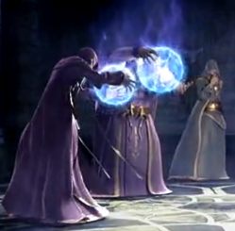
Part 0 - Setup
Named “part 0” since don’t write up → but critical for rest of project!
Refresh:
http://web.cs.wpi.edu/~imgd2905/d17/projects/proj1/setup.html
Select new summoner
Must have 100+ ranked matches
Cannot use Faker
Scripts to:
Get summoner information
Get list of 100 matches (Classic 5v5)
Get full match statistics on each match
http://vignette3.wikia.nocookie.net/leagueoflegends/images/b/b2/Summoners.png/revision/latest?cb=20100816174916

Slide 5
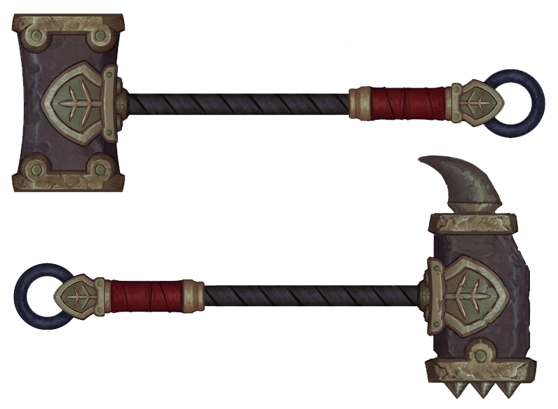
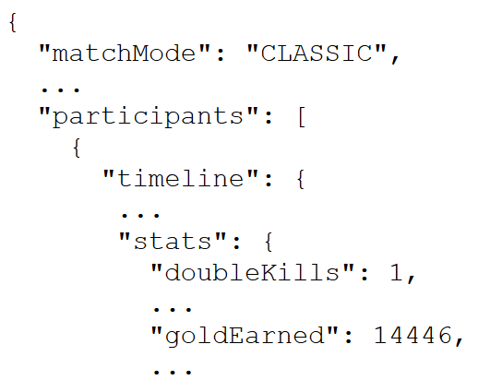
Part 1 – The Golden Rule (1 of 2)
Gold earned over time, and for killing monsters and opposing Champions
Gold important → buy items (e.g., weapons or armor) → makes Champions tougher
Do gold analysis
Total gold per match
Gold per Champ
http://am-a.akamaihd.net/image?f=http://news.cdn.leagueoflegends.com/public/images/articles/2014/november_2014/CHAMPUP/PoppyHammers.png&resize=819:

Slide 6
Part 1 – The Golden Rule (2 of 2)
Chart (e.g., histogram, cumulative distribution)
Measure of central tendency and spread
Gold per match versus duration
Duration as in Project 1
Chart (e.g., scatter plot)
Team gold difference versus win percent
Tally Team 0 gold, Team 1 gold
Chart with analysis of how often more == win

Slide 7
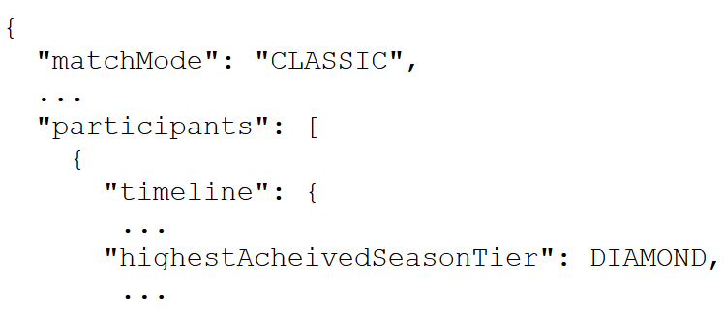
Part 2 – It’s Skill, not Luck (1 of 2)
Not a lot of “random” in League of Legends
Suggests skill is an aspect (tactics and strategy)
What are some differences in match data for higher ranked players versus lower ranked players?
Rank of players
Matches with summoner, 10 per game
Ranks: bronze, silver, gold, platinum, diamond, master, challenger

Slide 8
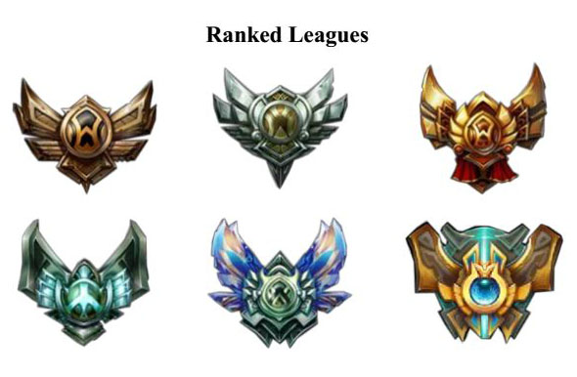
Part 2 – It’s Skill, not Luck (2 of 2)
Gold versus Rank
Chart (e.g., box chart), with spread (e.g., error bars)
KDA versus Rank
Kills, deaths, assists. Ratio.
Chart for spread and central tendency
Creep Score (CS) versus Rank
Minions killed
Chart for spread and central tendency
https://people.rit.edu/~rcd7972/230/project1/media/riven.png
http://cdn.garenanow.com/webupdate/live/lolphweb/news/2014%20February/26/Rank%20Leagues.JPG

Slide 9
Part 3 – A Bad Seed?
100 matches, 1000 players
But based on summoner chosen
How much does that matter?
Swap data with classmate – Part 1 or Part 2
Not “raw” data, but ready to draw charat
Compare to your data
e.g., side by side or two trend lines
http://vignette3.wikia.nocookie.net/leagueoflegends/images/b/b2/Summoners.png/revision/latest?cb=20100816174916
http://vignette3.wikia.nocookie.net/leagueoflegends/images/b/b2/Summoners.png/revision/latest?cb=20100816174916

Slide 10
Part 4 – PuckHunt
Your Data
Average time to hit target versus delay
All Data, one of:
Average time to hit versus speed (impulse)
Number of trigger pulls versus delay
Number of trigger pulls versus speed
Thumbstick movement versus delay
Thumbstick movement versus speed
Distributions of catch times for delay and/or speed
Another aspect of your own choosing

Slide 11
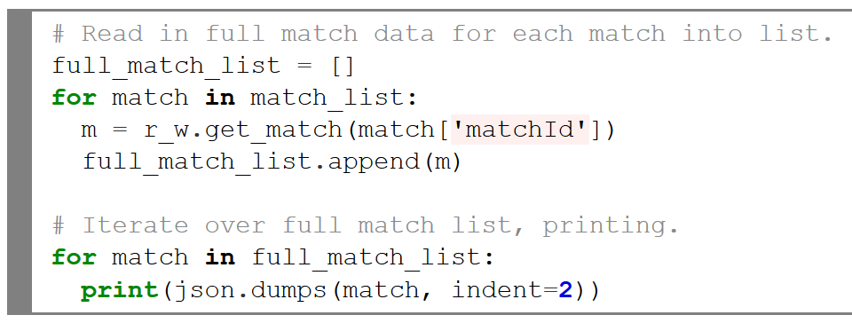
Hints
Remember to sleep
Instead of pulling each time, consider:
or

Slide 12
Write Up
Report
Methodology
Sections with analysis
All previous guidelines on charts, analysis, dissemination hold!
Don’t need to describe PuckHunt methodology

Slide 13
Grading
Part 1 – Gold 40%
Part 2 – Skill 30%
Part 3 – Compare 20%
Part 4 – PuckHunt 10%

Slide 14
Rubric
100-90. The submission clearly exceeds requirements. All parts of the project have been completed or nearly completed. The report is clearly organized and well-written, charts and tables are clearly labeled and described and messages provided about each part of the analysis.
89-80. The submission meets requirements. The first 3 parts of the project have been completed or nearly completed, but not part 4. The report is organized and well-written, charts and tables are labeled and described and messages provided about most of the analysis.
79-70. The submission barely meets requirements. The first 2 parts of the project have been completed or nearly completed, but not all of parts 3 or 4. The report is semi-organized and semi-well-written, charts and tables are somewhat labeled and described, but parts may be missing. Messages are not always clearly provided for the analysis.
69-60. The project fails to meet requirements in some places. The first part of the project has been completed or nearly completed, but not all of part 2 and not parts 3 or 4. The report is not well-organized nor well-written, charts and tables are not labeled or may be missing. Messages are not always provided for the analysis.
59-0. The project does not meet requirements. No part of the project has been completed, or only part 1. The report is not well-organized nor well-written, charts and tables are not labeled and/or are missing. Messages are not consistently provided for the analysis.

