Slide 1
U-Pick Game Analytics
Project 5
IMGD 2905

Slide 2
Overview
Analytics on game of your choosing!
Pick game
Determine pipeline
Plan analysis (charts)
Propose
Do it!
Write it up
Solo or group of 2

Slide 3
Parts
Part 1 - Proposal
Part 2 - Project
Hints
Writeup
Submission
Grading

Slide 4
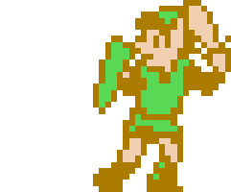
Proposal
Due 1/3rd of the way in
Written, turned in
“Look before you leap” – investigate game, and game data, before using
Allow for feedback – adjust scope and content
http://www.multifacet-software.com/assets/images/projectproposal.jpg
?
http://bridgepartnersconsulting.com/_ui/img/insights/Look-Before-Leap_Hero-Image.jpg

Slide 5
Proposal – Heading
Project title (creativity welcome)
Student name(s)
Solo
Group of two, max
http://inspectorgrapes.com/uploads/3/4/9/8/34985878/2000897_orig.png

Slide 6
Proposal – Game Overview
Previous Game
New Game
(Note, must do all new analysis!)
Brief description of game and gameplay
As relates to analysis

Slide 7
Proposal – Pipeline
Game
Raw Data
Extracted Data
Analysis
Brief description of pipeline
New scripts/tools needed
Playtesting needed (as appropriate)
Data available for analysis
Details on exact fields (e.g., game duration)
Details on format (e.g., json)

Slide 8
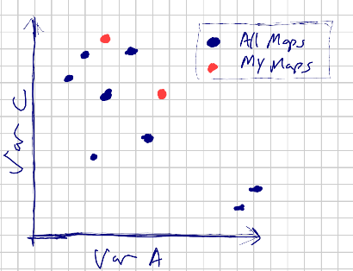
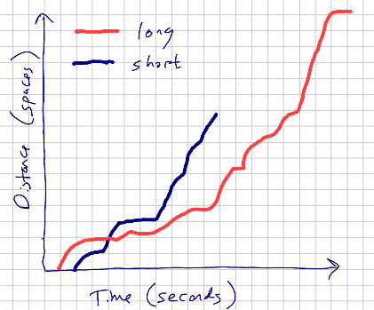
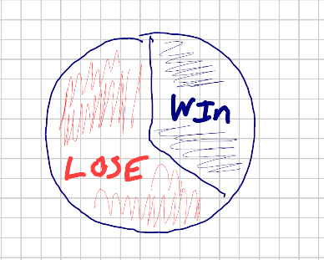
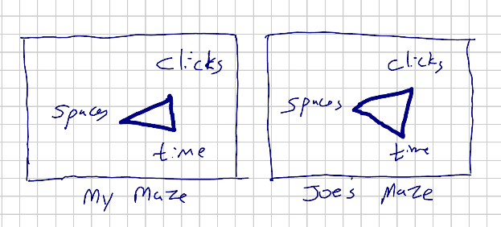
Proposal – Charts
Hand drawn
Show intended visual analysis
Labeled axes
No numbers, units
Clearly depict trends/relationships
Minimum 3 charts
Minimum 3 different kinds
(Bonus: +3 if one additional chart is normal probability plot)
Tables where appropriate
Examples
Important for planning
Drives methodology, data wrangling

Slide 9
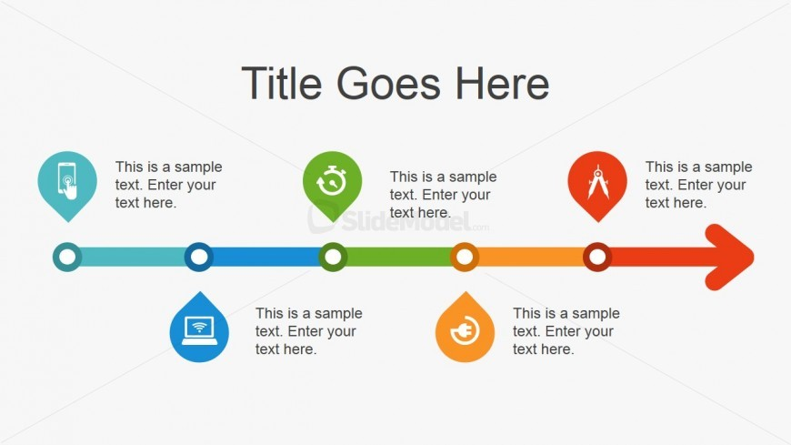
Proposal – Timeline
Major tasks
Team? → Particularly important to coordinate
Timeline for Awesome Project
Gather Game Data
Analyze Score
Second Draft Done
Analyze Duration
First Draft Done

Slide 10
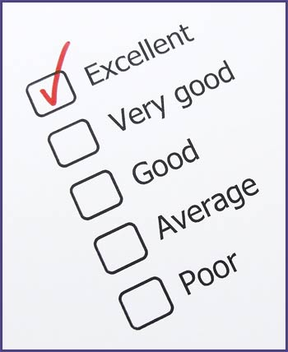
Proposal – Grading Guide
Points to be allocated
Based on amount of effort, relevance to class
e.g., game setup, data pipeline, analysis of players
Emphasis must prioritize final analysis
Some leeway
Note, entire contributions in final report
Submit final version of guide with report
Revised to reflect actual
http://www.dentonisd.org/cms/lib/TX21000245/Centricity/Domain/8618/grades2.jpg
See examples:
Project 1
Project 2
Project 3
Project 4

Slide 11
Proposal – Notes
“Size” about same as previous projects
(i.e., plan on about 10 hours per person total, including proposal)
Unlike previous, you “figure out” analytics pipeline
Suggests slightly less analysis (i.e., fewer charts)
Unless TagPro, Mazetool or League of Legends, since known pipeline
Group project about 50% “bigger” than solo project
Proposal text about 1-2 pages at most
But doc longer with charts and screen shots
https://goo.gl/efReCu

Slide 12
Hints
Many possible suitable games
Can run ideas by me (in person or via email) before
Access to data is key
Remember, new game takes time
Data available (e.g., score?, duration?)
Format of data (e.g., json? log files?)
Scripts needed?
Your own game ok
But emphasis must be analytics
Not instrumenting game
Not developing game
Playtesting to gather data cannot be major
http://blueclay.com.au/wp-content/uploads/2013/10/hints-and-tips-2.jpg

Slide 13
Writeup
Report on analysis
Describe game
Describe methodology
Organize analysis results
Provide grading guide
Can re-use proposal, as appropriate
All guidelines (writing, charts) hold!
http://ec.europa.eu/environment/waste/reporting/images/173649127.jpg

Slide 14
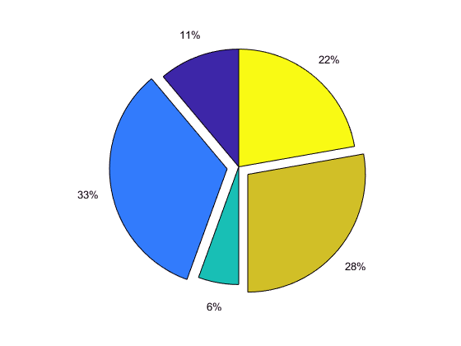
Grading
Part 1 – Proposal 20%
Part 2 – Report 80%
Broken down by your grading guide
Must have 3 charts minimum, 3 different types
https://www.mathworks.com/help/examples/graphics/win64/CreatePieChartExample_02.png

Slide 15
Rubric
100-90. The submission clearly exceeds requirements. All parts of the project have been thoroughly completed. The proposal and report are clearly organized and well-written, charts and tables are clearly labeled and described and messages provided about each part of the analysis.
89-80. The submission meets requirements. All parts of the project have been completed or nearly completed. The proposal and report are organized and well-written, charts and tables are clearly labeled and described and messages provided about each part of the analysis.
79-70. The submission barely meets requirements. Most parts of the project are completed or nearly completed, but some may be missing. The proposal and report are somewhat disorganized or not well-written. Charts and tables are clearly labeled, but there may be issues with the description and messages provided about each part of the analysis.
69-60. The project fails to meet requirements in some places. Not all parts of the project are completed. The proposal and report are disorganized and not well-written. Charts and tables are not clear nor up to standards described in class. Messages are not always provided for the analysis.
59-0. The project does not meet requirements. Many parts of the project are not completed. The proposal and report are disorganized and poorly written. Charts and tables are not clear nor up to standards described in class. Messages are generally not provided for the analysis.

