Slide 1
Introduction
IMGD 2905

Slide 2
What is data analysis for game development?

Slide 3
What is data analysis for game development?
Using game data to inform the game development process
Where does this data come from?
→ Users playing game
  Quantitative (instrumented)
  Qualitative (subjective evaluation)
  (But often lots more of the former!)

Slide 4
What can game analysis do for game development?

Slide 5
What can game analysis do for game development?
Improve level design – e.g., see where players are getting stuck
Focus development on critical content – e.g., see what game modes or characters are not used
Balance gameplay – e.g., tune parameters for more competitive and fun combat
Broaden appeal – e.g., hear if content/story is engaging or repulsing

Slide 6
Why is data analysis for game development needed?

Slide 7
Why is data analysis for game development needed?
Challenge
  Games gotten larger and more complex
    Number of reachable states, characters
  Need for metrics to make sense of player behavior has increased
Opportunity
  New technologies enable aggregation, access and analysis

Slide 8
IMGD 2905 – Doing Data Analysis for Game Development
Data analysis pipeline – get data from games, through analysis, to stakeholders
Summary statistics – central tendencies of data
Visualization of data – how to display analysis, illustrate messages
Statistical tests – quantitatively determine relationships (e.g., correlation)
  Probability needed as foundation
Regression – model relationships
More advanced topics (e.g., ML,
Data management …)
For this class:
  Described in lecture
  Read about in book
  Applied in projects

Slide 9
Foundations for Data Analysis for Game Development at WPI
Statistics classes
  MA 2610 Applied Statistics for Life Sciences
  MA 2611 Applied Statistics I
  MA 2612 Applied Statistics II
Probability classes
  MA 2621 Probability for Applications
Data Science minor
  MA, CS, BUS
  DS 3001 Foundations of Data Science
Data Mining
  CS 4445 Data Mining and Knowledge Discovery in Databases
Other
  CS 1004 Introduction to Programming for Non-Majors
  CS 3431 Database Systems I
Note – other Stats and Probability classes are primarily geared for Math majors

Slide 10
Outline
Overview (done)
Game Analytics Pipeline (next)
Game Data Analysis Examples

Slide 11
Sources of Game Data
Quantitative (Objective)
Qualitative (Subjective)
Internal Testing
  Developers
  QA
External Testing
  Usability testing
  Beta tests
  Long-term play data
Surveys
Reviews
Online communities
Post mortems
How to get from data to dissemination?
→ Game analytics pipeline
Notes:
List from: https://games.soe.ucsc.edu/sites/default/files/p940-hullett_0.pdf

Slide 12
Game Analytics Pipeline
Game
Exploratory Graphs/Stats
Analysis
Extracted Data
Statistical Tests
Raw Data
Charts and Tables
Dissemination
Presentation
Report

Slide 13








Game Analytics Pipeline - Example
Analysis
Dissemination
Project 1!

Slide 14
Game Analytics Tools
Games – breadth of experience with games, specific experience with game to be analyzed
Statistics – measures of central tendency, measures of spread, statistical tests
Probability – rules, distributions
Data Visualization – bar chart, scatter plot, histogram, error bars
Technical Writing and Presentation – white paper, technical talk; audience is peer group, developers, boss

Slide 15
Outline
Overview (done)
Game Analytics Pipeline (done)
Game Data Analysis Examples (next)

Slide 16

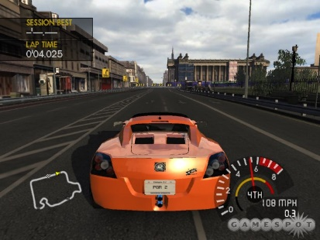

Example:
Project Gotham Racing 4
K. Hullett, N. Nagappan, E. Schuh, and J. Hopson. “Data Analytics for Game Development”, International Conference on Software Engineering (ICSE), May, 2011, Waikiki, Honolulu, HI, USA
http://dl.acm.org/citation.cfm?id=1985952
Publisher – Microsoft 2007
  134 vehicles, 9 locations, 10 game modes
Analyzed data
  (Authors worked at Microsoft)
  3.1 million log entries, 1000s of users

Slide 17
Project Gotham Racing 4:
Results
Game Mode Races % Total
OFFLINE_CAREER 1479586 47.63%
PGR_ARCADE 566705 18.24%
NETWORK_PLAY 584201 18.81%
SINGLE_PLAYER_PLAY 185415 5.97%
….
NET_TOURNY_ELIM 2713 0.09%
Thoughts?
What are some main messages?
Group Races % Total
STREET_RACE 795334 25.60%
NET_STREET_RACE 543491 17.50%
ELIMINATION 216042 6.95%
HOTLAP 195949 6.31%
…
TESTTRACK_TIME 7484 0.24%
CAT_N_MOUSE_FREE 3989 0.13%
CAT_N_MOUSE 53 0.00%

Slide 18
Project Gotham Racing 4:
Results
Game Mode Races % Total
OFFLINE_CAREER 1479586 47.63%
PGR_ARCADE 566705 18.24%
NETWORK_PLAY 584201 18.81%
SINGLE_PLAYER_PLAY 185415 5.97%
….
NET_TOURNY_ELIM 2713 0.09%
Mode
  Offline career dominates
  Network tournament hardly used
Events
  Street race and network street race dominate
  Cat and mouse never used
Vehicles (not shown)
  1/3 used in less than 0.1% of races
Group Races % Total
STREET_RACE 795334 25.60%
NET_STREET_RACE 543491 17.50%
ELIMINATION 216042 6.95%
HOTLAP 195949 6.31%
…
TESTTRACK_TIME 7484 0.24%
CAT_N_MOUSE_FREE 3989 0.13%
CAT_N_MOUSE 53 0.00%

Slide 19
Project Gotham Racing 4:
Conclusion
Content underused - 30-40% of content in less than 1% of races
Use to shift emphases for DLC, next version
  Asset creation costs significant, so even 25% reduction noticeable
Other (not shown)
  Encouraging new players to play career mode
    Increasing likelihood of continuing play
  Encouraging new players to stay with F Class longer
    Rather than move to more difficult to control A Class

Slide 20

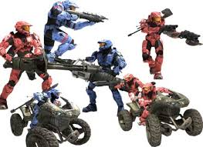

Example:
Halo 3
B. Phillips. “Peering into the Black Box of Player Behavior: The Player Experience Panel at Microsoft Game Studios”. Game Developers Conference (GDC), 2010. http://www.gdcvault.com/play/1012387/Peering-into-the-Black-Box
Publisher – Microsoft 2007
  Achievements: single player missions, challenges such as finding skulls, multiplayer accomplishments…
Analyzed data
  (Author worked at Microsoft)
  18,0000 players

Slide 21
Halo 3: Results
Thoughts?
What are some main messages?
Notes:
T. Zimmermann, B. Phillips, N. Nagappan, and C. Harrison. “Data-Driven Games User Research”, ACM CHI 2012, May 5-10, 2012, Austin, TX, USA. https://goo.gl/d1rpHo

Slide 22
Halo 3: Results
73% of players completed campaign
  Can compare to other Xbox games
Took 26 days to accomplish
Double that time for all original content
DLC provides users up to 2 years of content
Good Descriptive Example
Notes:
T. Zimmermann, B. Phillips, N. Nagappan, and C. Harrison. “Data-Driven Games User Research”, ACM CHI 2012, May 5-10, 2012, Austin, TX, USA. https://goo.gl/d1rpHo

Slide 23

Example: League of Legends
Mark Claypool, Jonathan Decelle, Gabriel Hall, and Lindsay O'Donnell. “Surrender at 20? Matchmaking in League of Legends,” In Proceedings of the IEEE Games, Entertainment, Media Conference (GEM), Toronto, Canada, October 2015. Online at: http://www.cs.wpi.edu/~claypool/papers/lol-matchmaking/
Publisher – Riot Games 2009
  Rank: ~5 Tiers, 5 divisions each → 25
User study (52 players)
  Play LoL in controlled environment
  Record objective data
    (e.g., player rank and game stats)
  Provide survey for subjective data
    (e.g., match balance and enjoyment)
???
Fun
Sweet spot
Too hard!
Just right!
Too easy!
Game Balance

Slide 24
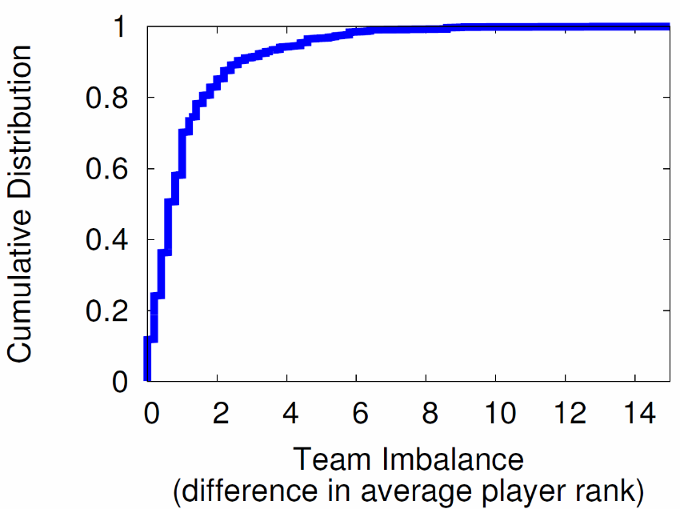
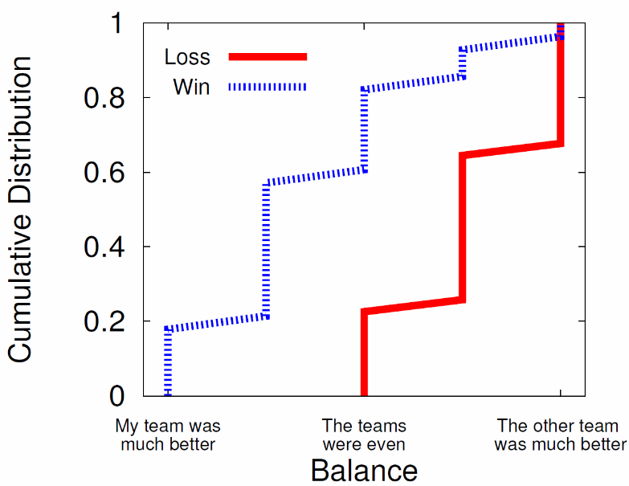
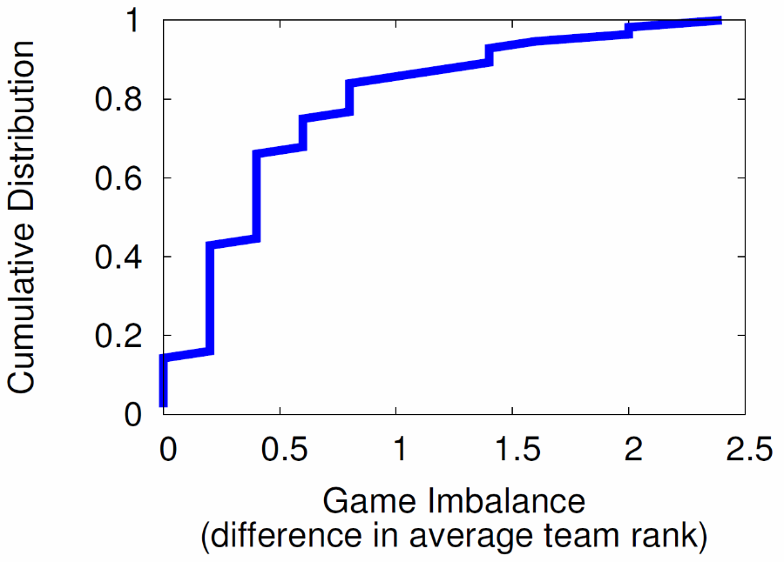
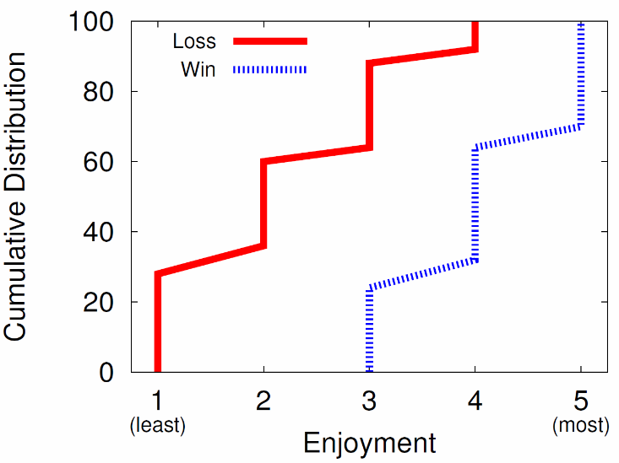
League of Legends: Results
Main messages?
Main messages?
Objective
Subjective
Main messages?
Main messages?

Slide 25
League of Legends: Results
Win? Game is balanced
Lose? Game is imbalanced
Most teams are balanced
But about 10% more than 3 from mean
Objective
Subjective
Win? Game is fun (70%), never not fun
Lose? Game is almost never fun (90%)
Most games evenly matched
But about 5% difference of 2 from mean

Slide 26
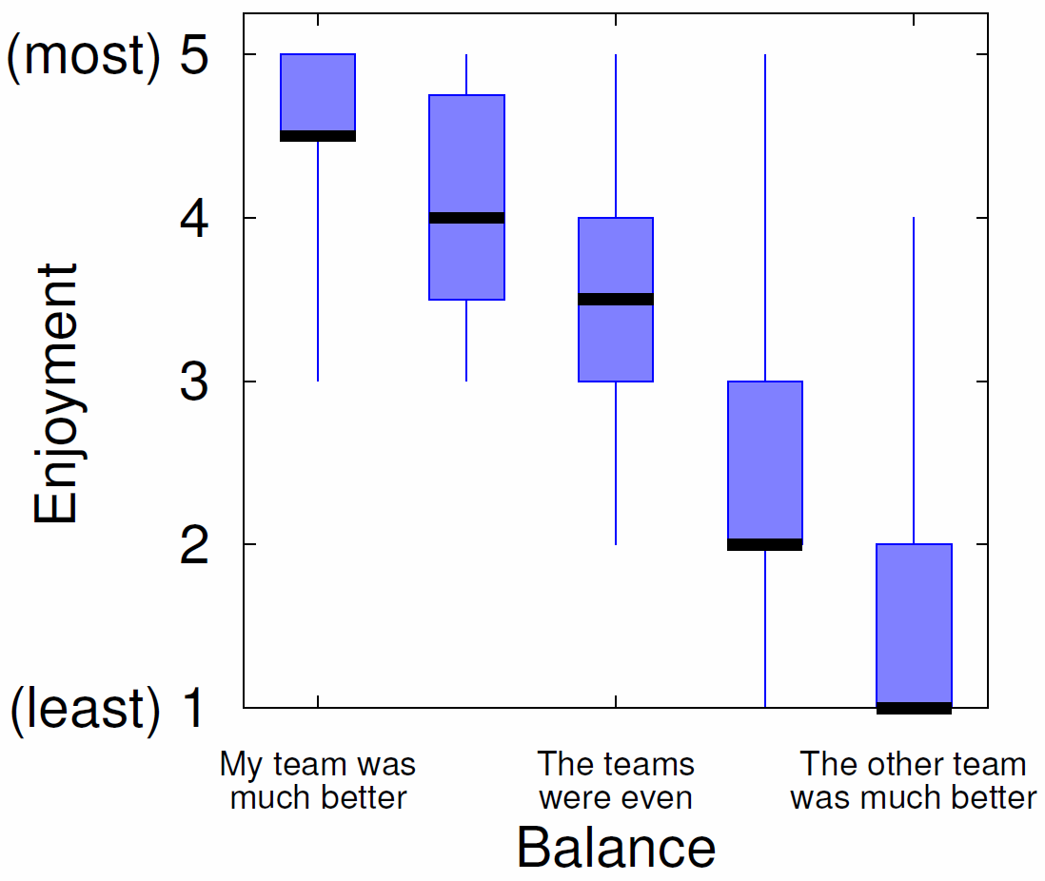
League of Legends: Results
Fun
Sweet spot
Game Balance
Sweet spot?
Fun
Game Balance
Imbalance in player’s favor the most fun!

Slide 27
League of Legends: Conclusion
Objective
Subjective
Teams are balanced
  50% players within 1 rank of each other
Games are balanced
  80% teams within 1 average rank of each other
Games are not balanced
When players win, perceive slight imbalance
When players lose, perceive large imbalance
Players enjoy winning more than losing (no surprise)
(Surprise!) Players most enjoy matches imbalanced in their favor!
Matchmaking systems may want to consider - e.g., balance not so important, as long as player not always on imbalanced side

Slide 28
Summary
Data analysis for games increasingly important
  Has potential to improve game development
Knowledge and skills required
  Scripting
  Statistics
  Data analysis
  Writing and presentation

