Slide 1
Review Data
IMGD 2905

Slide 2
What are two main sources for data for game analytics?

Slide 3
What are two main sources for data for game analytics?
Quantitative – instrumented game
Qualitative – subjective evaluation

Slide 4
What steps are in the game analytics pipeline?

Slide 5
What steps are in the game analytics pipeline?
Game (instrumented)
Data (collected from players)
Extracted data (e.g., from scripts)
Analysis
Statistics, Charts, Tests
Dissemination
Report
Talk

Slide 6
What is population versus sample?

Slide 7
What is population versus sample?
Population – all members of group pertaining to study
Sample – part of population selected for analysis

Slide 8
What is probability sampling?

Slide 9
What is probability sampling?
Probability sampling - sampling considering likelihood of selection
Consider likelihood as part of population

Slide 10
What is a Pareto chart? When used?

Slide 11
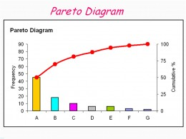
What is a Pareto chart? When used?
Bar chart, arranged most to least frequent
Line showing cumulative percent
Helps identify most common
https://goo.gl/S7qDTJ

Slide 12
When should you not use pie chart?

Slide 13
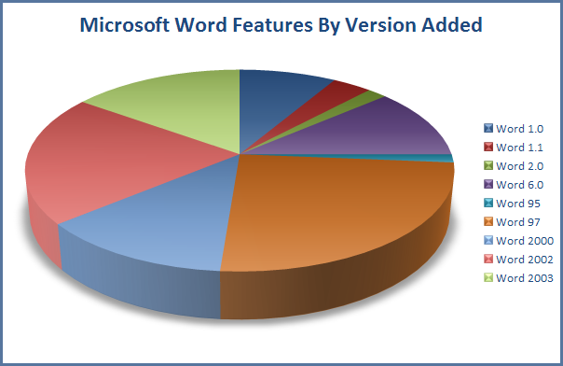
When should you not use pie chart?
When too many slices
http://cdn.arstechnica.net/FeaturesByVersion.png

Slide 14
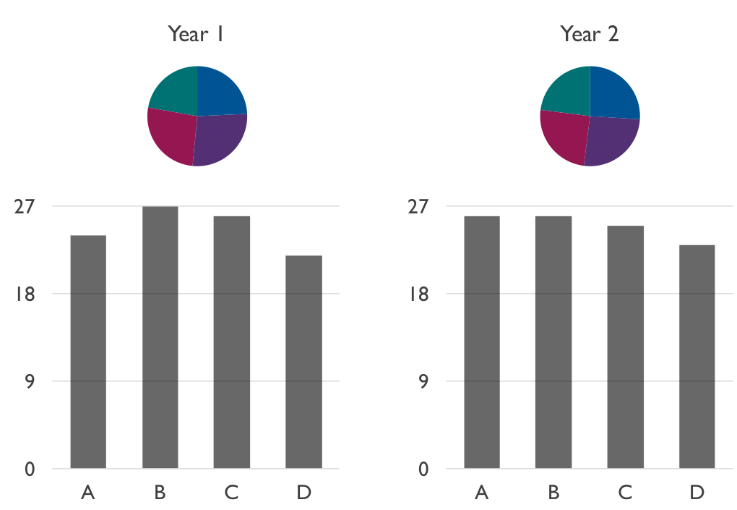
When should you not use pie chart?
(Often) when comparing pies

Slide 15
Which Measure of Central Tendency to Use? Why?

Slide 16
What are Quartiles?

Slide 17
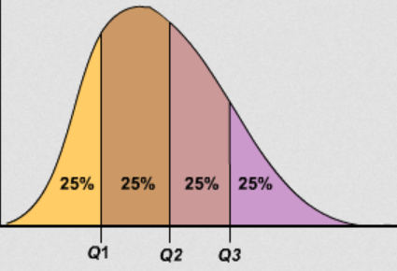
What are Quartiles?

Slide 18
Describe how to Compute Variance

Slide 19
Describe how to Compute Variance
Compute mean
Compute how far each sample value is from mean. Square this.
Add these up.
Divide by number of samples.

Slide 20
Describe what Standard Deviation is in Words

Slide 21
Describe what Standard Deviation is in Words
“The ‘average’ of how far each sample point is from the mean”

Slide 22
Empirical Rule
1000 data points
Mean of 50
Standard deviation of 10
How many points are between 20-80?
How many points are between 40-60?
Between 40-60?

Slide 23
Empirical Rule
1000 data points
Mean of 50
Standard deviation of 10
How many points are between 20-80?
Nearly all (99.7%), so only about 3 outside
How many points are between 40-60?
About 700 (68%)
Between 40-60?
About 950 (95%)

Slide 24
Rank the Following High to Low in Susceptibility to Outliers
Measure of Variation
Most to Least
Semi-interquartile Range
Range
Coefficient of Variation

Slide 25
Rank the Following High to Low in Susceptibility to Outliers
Measure of Variation
Most to Least
Semi-interquartile Range
Range
Coefficient of Variation
Range
Coefficient of Variation
Semi-interquartile Range

Slide 26
Probability
In probability, what is an exhaustive set of events?

Slide 27
Probability
In probability, what is an exhaustive set of events?
A set of all possible outcomes of an experiment or observation
e.g., coin: events {heads, tails}
e.g., picking champion in LoL: events {Darius, Leona, Fizz, …} (all possible Champions listed)

Slide 28
Broadly, What are 3 Ways to Assign Probabilities?

Slide 29
Broadly, What are 3 Ways to Assign Probabilities?
Classical (theory)
Empirical (by measurement/observation)
Subjective (hunch – sometimes guided by a bit of theory)

Slide 30
Probability
Draw 2 cards. What is the probability of drawing 2 Jacks?

Slide 31
Probability
Draw 2 cards. What is the probability of drawing 2 Jacks?
P(2J) = P(J) x P(J | J)
= 2/5 x 1/4
= 1/10

Slide 32
Probability
Draw 3 cards. What is the probability of not drawing at least one King?

Slide 33
Probability
Draw 3 cards. What is the probability of not drawing at least one King?
P(K’) x P(K’ | K’) x P(K’ | K’K’)
= 3/5 x 2/4 x 1/3
= 6/60
= 1/10

Slide 34
What are the characteristics of an experiment with a binomial distribution of outcomes?

Slide 35
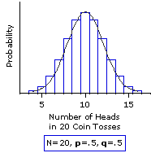
What are the characteristics of an experiment with a binomial distribution of outcomes?
Experiment consists of n independent, identical trials
Each trial results in only success or failure
Random variable of interest (X) is number of S’s in n trials
http://www.vassarstats.net/textbook/f0603.gif

Slide 36
What are the characteristics of an experiment with a Poisson distribution of outcomes?

Slide 37
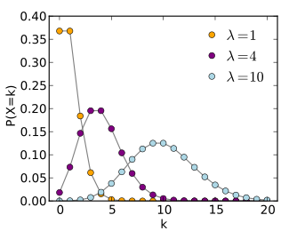
What are the characteristics of an experiment with a Poisson distribution of outcomes?
Interval (e.g., time) with units
Probability of event same for all interval unit
Number of events in one unit independent of others
Events occur singly (not simultaneously)
Phrase people use is “random arrivals”

Slide 38
What is the Standard Normal Distribution?

Slide 39
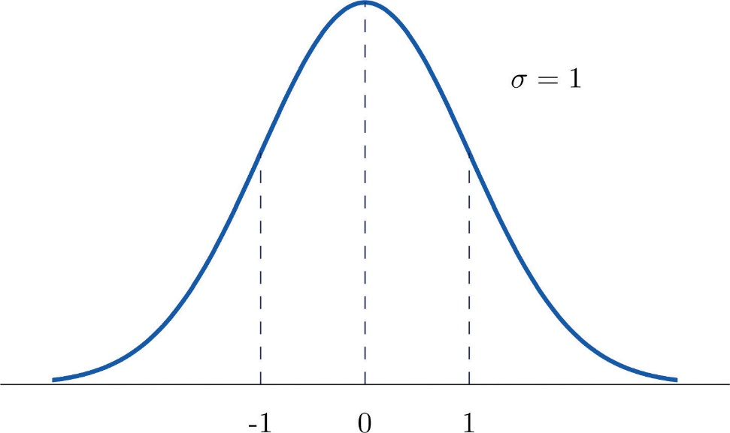
What is the Standard Normal Distribution?
Normal distribution
Mean μ = 0
Std dev σ = 1

Slide 40
Sampling Error
What is the sampling error?

Slide 41
Sampling Error
What is the sampling error?
Error from estimating population parameters from sample statistics
The size of the error is based on what two main factors?

Slide 42
Sampling Error
What is the sampling error?
Error from estimating population parameters from sample statistics
The size of the error is based on what two main factors?
Population variance
Number of samples

Slide 43
Confidence Intervals
What is a confidence interval? Give an example

Slide 44
Confidence Intervals
What is a confidence interval? Give an example
Range of values with specific certainty that population parameter is within
95% confidence interval for time to complete a level in Super Mario: [1.25 minutes, 1.75 minutes]
What is the size of confidence interval based on?

Slide 45
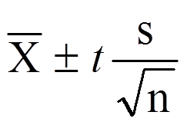
Confidence Intervals
What is a confidence interval? Give an example
Range of values with specific certainty that population parameter is within
95% confidence interval for time to complete a level in Super Mario: [1.25 minutes, 1.75 minutes]
What is the size of confidence interval based on?
Confidence (1-α)
Standard error (number of samples) standard deviation

