Slide 1
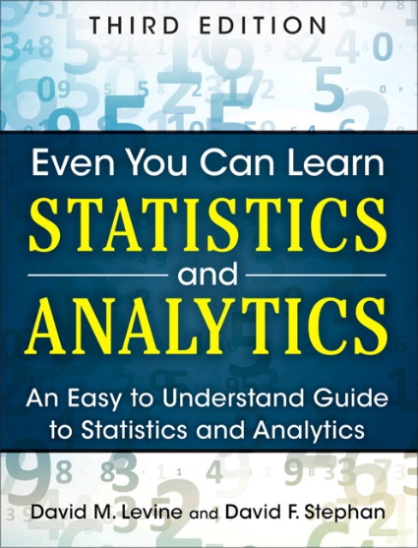
Inferential Statistics
IMGD 2905
Chapter 6 & 7

Slide 2
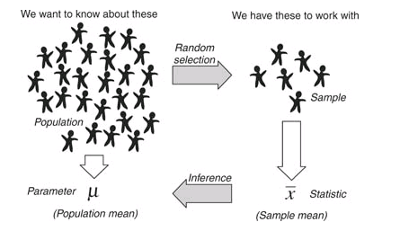
Overview
Use statistics to infer population parameters
http://3.bp.blogspot.com/_94E2PdKwaXE/S-xQRuoiKAI/AAAAAAAAABY/xvDRcG_Mcj0/s1600/120909_0159_1.png

Slide 3
Overview
Use statistics to infer population parameters
http://3.bp.blogspot.com/_94E2PdKwaXE/S-xQRuoiKAI/AAAAAAAAABY/xvDRcG_Mcj0/s1600/120909_0159_1.png
Inferential statistics

Slide 4
Outline
Overview (done)
Foundation (next)
Confidence Intervals
Hypothesis Testing

Slide 5
Dice Rolling (1 of 4)
Have 1d6, sample (i.e., roll 1 die)
What is probability distribution of values?

Slide 6
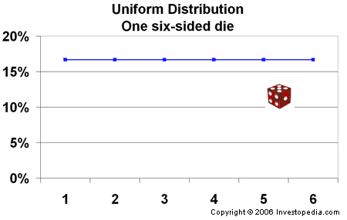
Dice Rolling (1 of 4)
Have 1d6, sample (i.e., roll 1 die)
What is probability distribution of values?
“Square“ distribution
http://www.investopedia.com/articles/06/probabilitydistribution.asp

Slide 7
Dice Rolling (2 of 4)
Have 1d6, sample twice and sum (i.e., roll 2 dice)
What is probability distribution of values?

Slide 8
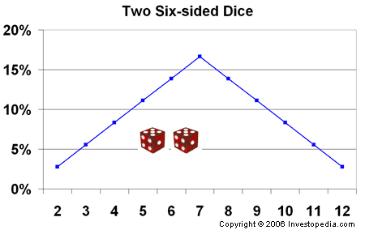
Dice Rolling (2 of 4)
Have 1d6, sample twice and sum (i.e., roll 2 dice)
What is probability distribution of values?
“Triangle“ distribution
http://www.investopedia.com/articles/06/probabilitydistribution.asp

Slide 9
Dice Rolling (3 of 4)
Have 1d6, sample thrice and sum (i.e., roll 3 dice)
What is probability distribution of values?

Slide 10
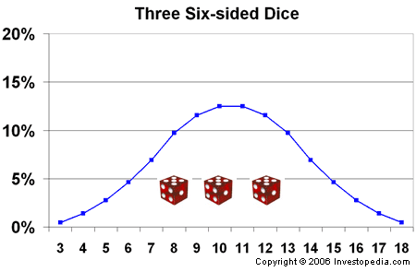
Dice Rolling (3 of 4)
Have 1d6, sample thrice and sum (i.e., roll 3 dice)
What is probability distribution of values?
What’s happening to the shape?
http://www.investopedia.com/articles/06/probabilitydistribution.asp

Slide 11
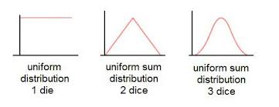
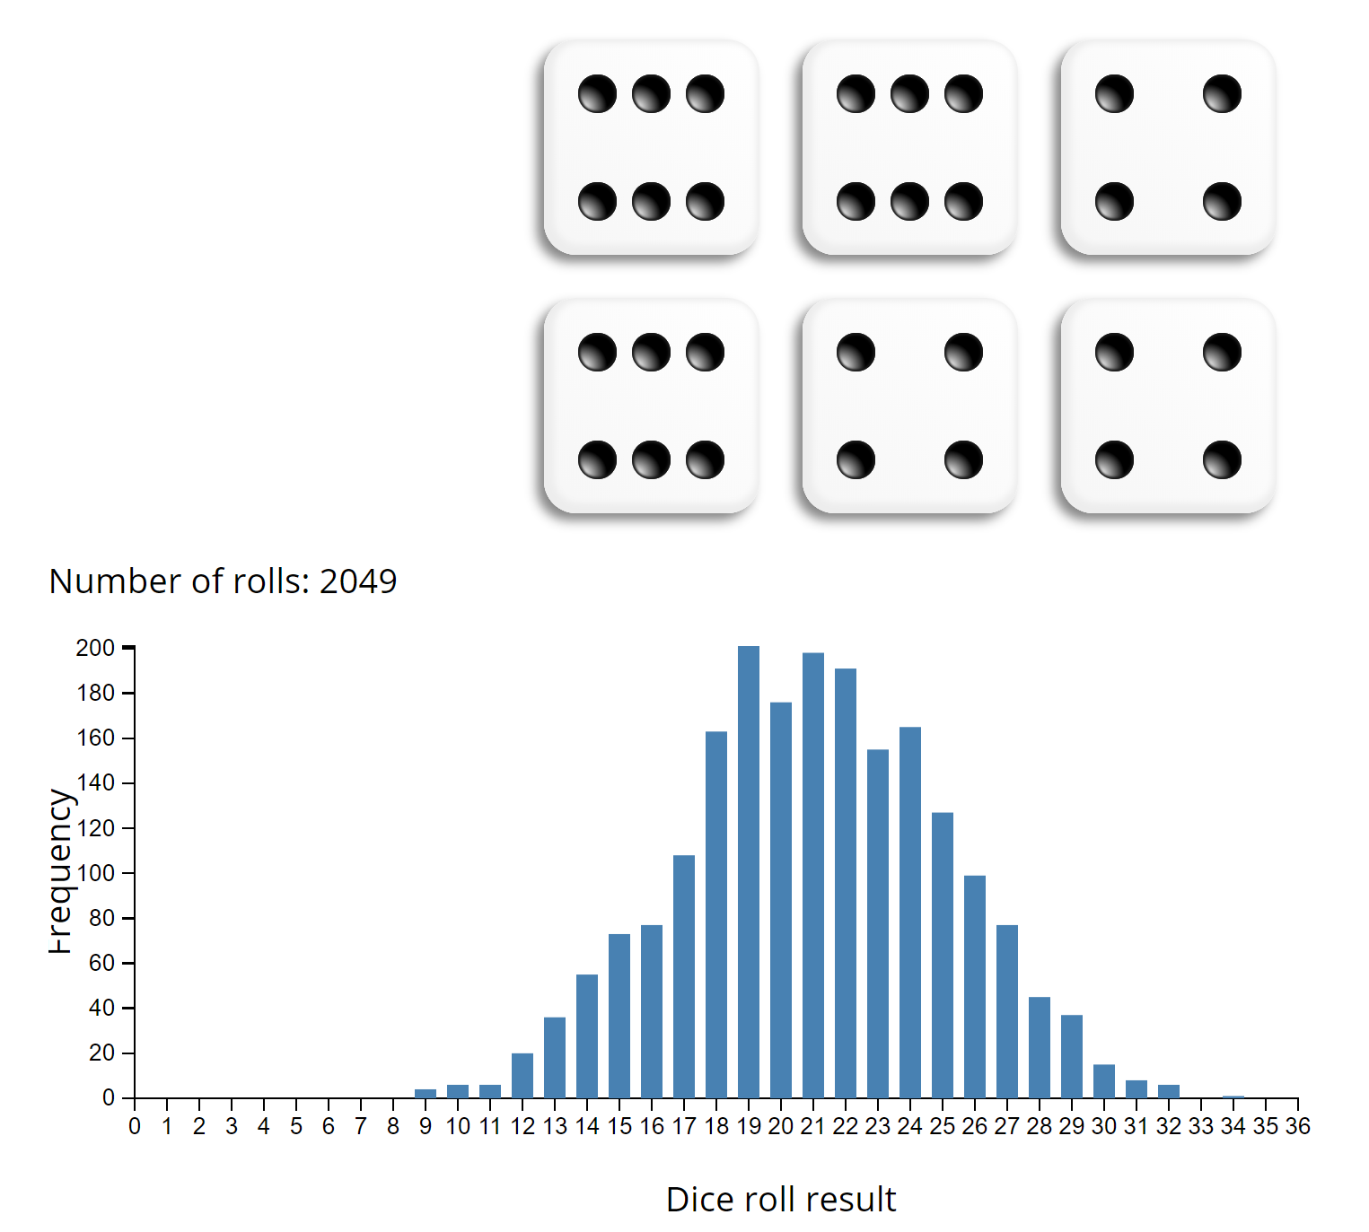
Dice Rolling (3 of 4)
Have 1d6, sample thrice and sum (i.e., roll 3 dice)
What is probability distribution of values?
What’s happening to the shape?
https://academo.org/demos/dice-roll-statistics/
Try rolling dice yourself!

Slide 12
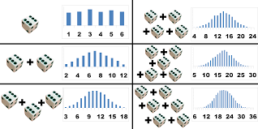
Dice Rolling (4 of 4)
Same holds for general experiments with dice (i.e., observing sample sum and mean of dice rolls)
Resulting sum/mean follows a normal distribution
→ Even though base distribution is uniform!
http://www.muelaner.com/uncertainty-of-measurement/
Ok, neat – for “square” distributions.
But what about experiments with other distributions?

Slide 13
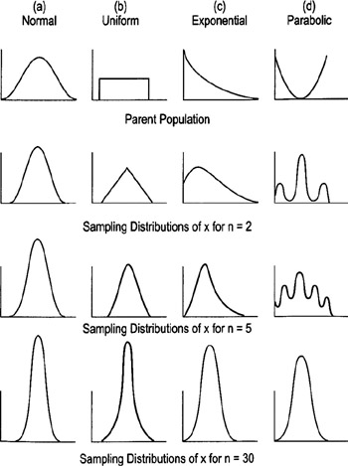
Sampling Distributions
With large “enough” sample size, looks “bell-shaped” → Normal!
How many is large enough?
30 (15 if symmetric distribution)
Central Limit Theorem
Sum of independent variables tends towards Normal distribution
http://flylib.com/books/2/528/1/html/2/images/figu115_1.jpg

Slide 14
Why do we care about sample means following Normal distribution?
What if we had only a sample mean and no measure of spread
e.g., mean rank for Overwatch is 50
What can we say about population mean?
Not a whole lot!
Yes, population mean could be 50. But could be 100. How likely are each?
→ No idea!

Slide 15
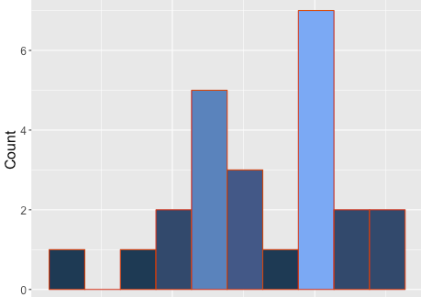
Why do we care about sample means following Normal distribution?
What if we had only a sample mean and no measure of spread
e.g., mean rank for Overwatch is 50
What can we say about population mean?
Not a whole lot!
Yes, population mean could be 50. But could be 100. How likely are each?
→ No idea!
Sample mean
Population mean?

Slide 16
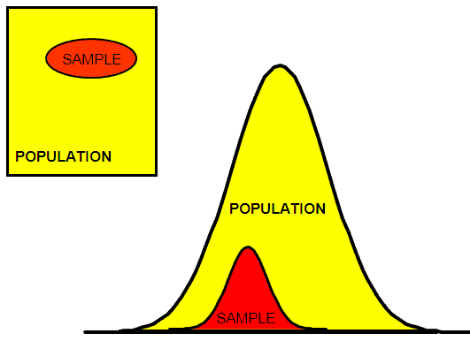
Why do we care about sample means following Normal distribution?
Remember this?
http://www.six-sigma-material.com/images/PopSamples.GIF
With mean and standard deviation
Allows us to predict range to bound population mean

Slide 17
Why do we care about sample means following Normal distribution?
Sample mean
Note, actual population mean (probably) in this range!
Probable range of population mean

Slide 18
Outline
Overview (done)
Foundation (done)
Confidence Intervals (next)
Hypothesis Testing

Slide 19
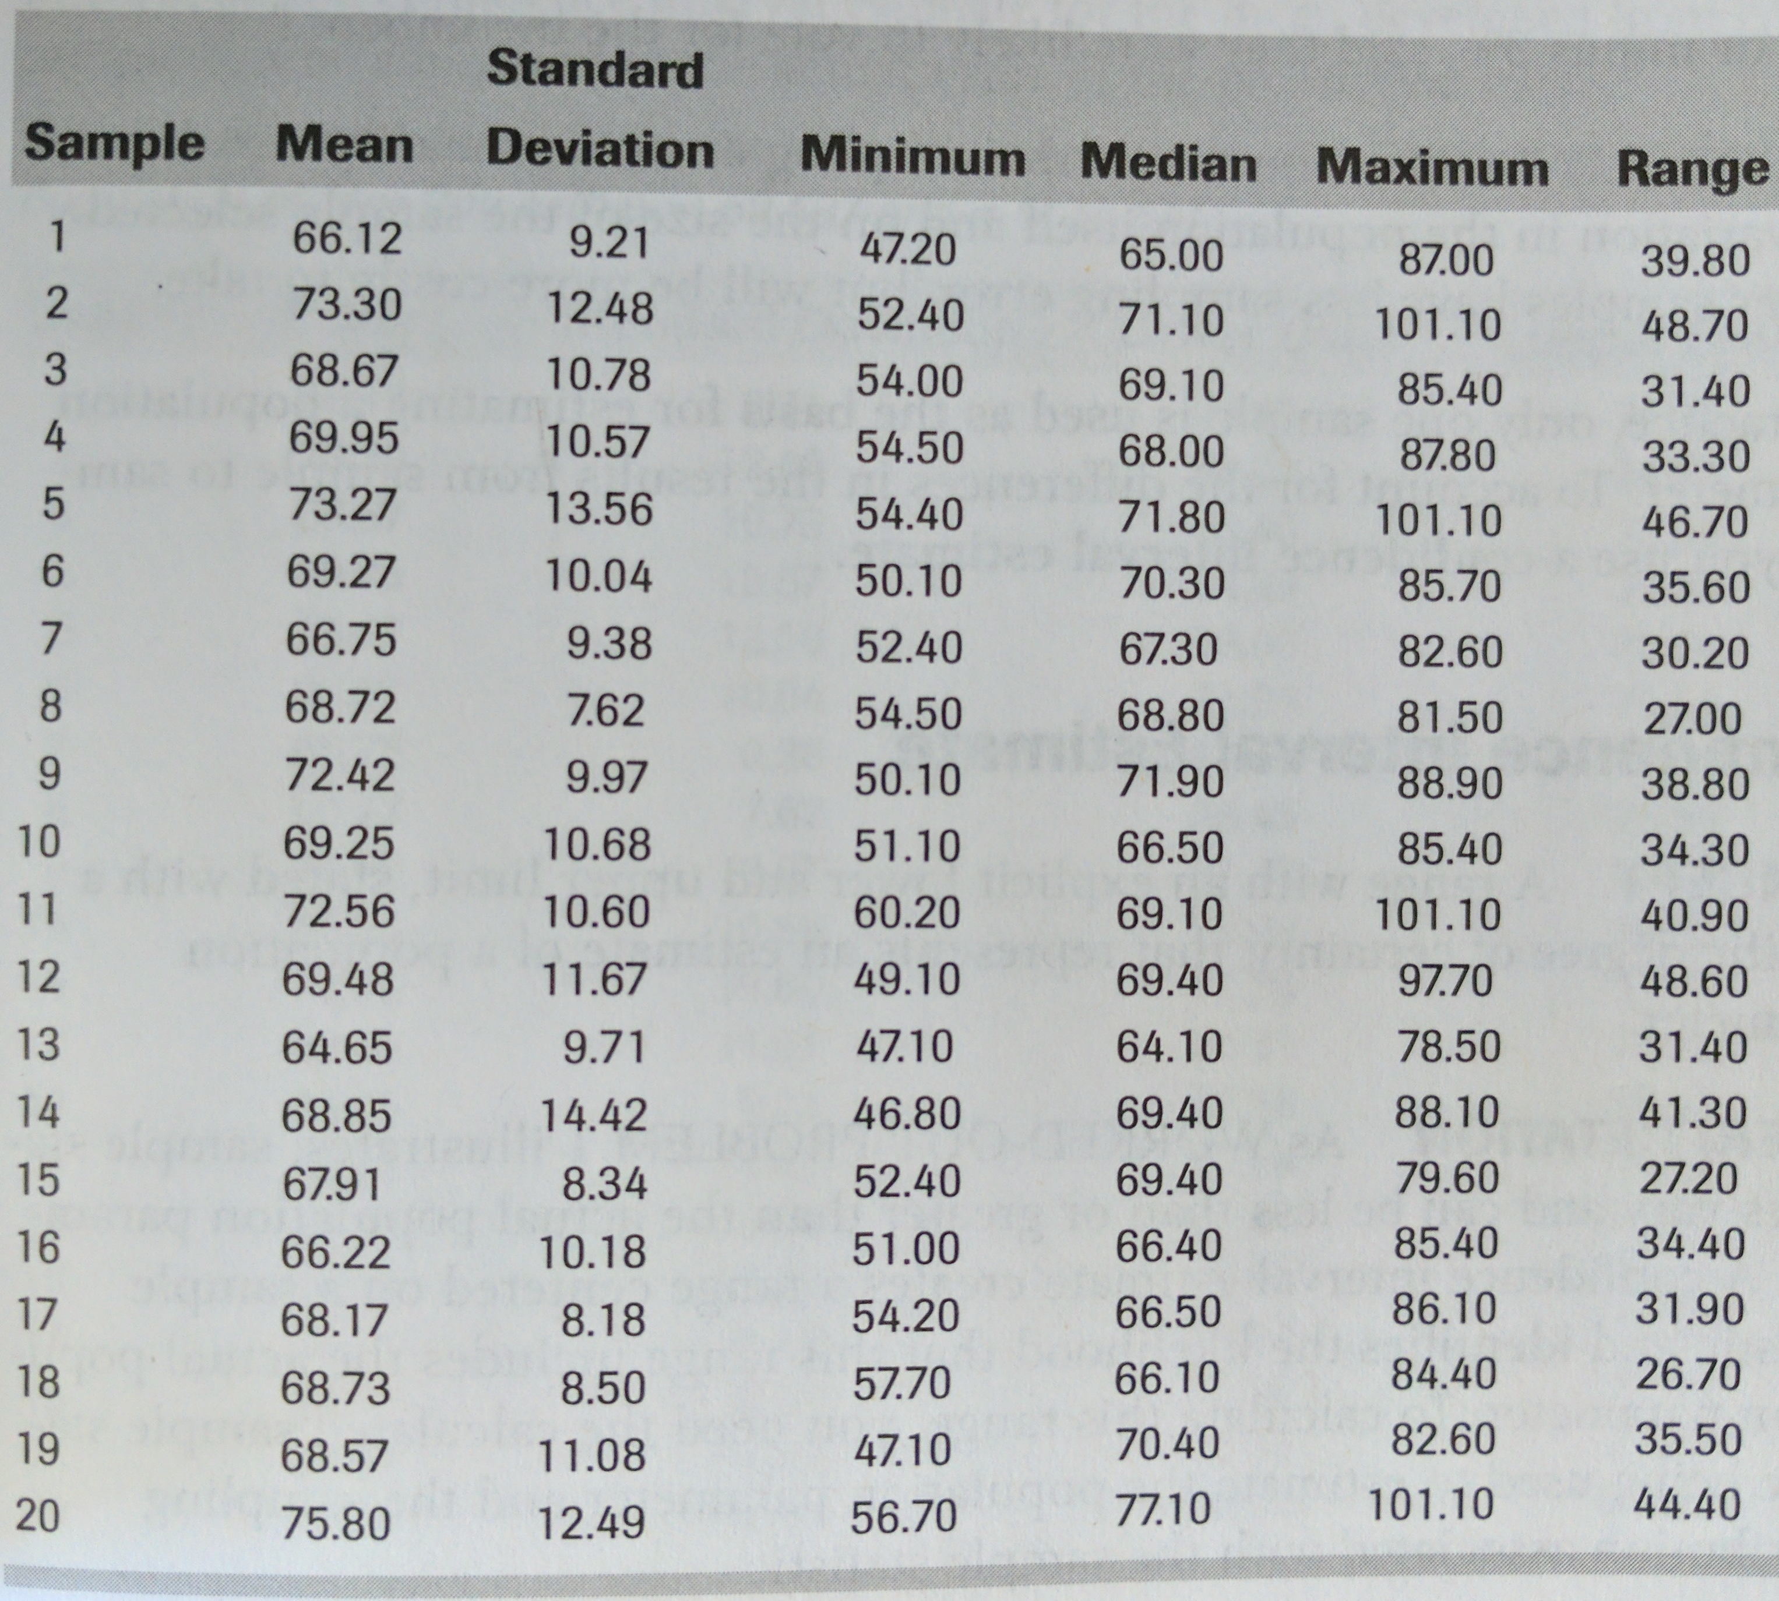
Sampling Error (1 of 2)
Population of 200 game durations
Mean μ = 69.637
Std Dev σ = 10.411
Experiment N=20 samples
Each 15 game durations (with replacement)
Table on right has 20 experiments
Observations?
Stats ($\overline{x}$, s) differ each time!
Sometimes higher, sometimes lower than population (μ , σ)
Sample range varies a lot more than sample standard deviation
Population mean (μ) always within sample range

Slide 20
Sampling Error (1 of 2)
Population of 200 game durations
Mean μ = 69.637
Std Dev σ = 10.411
Experiment N=20 samples
Each 15 game durations (with replacement)
Table on right has 20 experiments
Observations?
Stats ($\overline{x}$, s) differ each time!
Sometimes higher, sometimes lower than population (μ , σ)
Sample range varies a lot more than sample standard deviation
Population mean (μ) always within sample range
This variation→ Sampling error

Slide 21
Sampling Error (2 of 2)
Error from estimating population parameters from sample statistics is sampling error
Exact error often cannot be known (do not know population parameters)
But size of error based on:
Variation in population (σ) itself – more variation, more sample statistic variation (s)
Sample size (N) – larger sample, lower error
Q: Why can’t we just make sample size super large?
How much does it vary? → Standard error

Slide 22
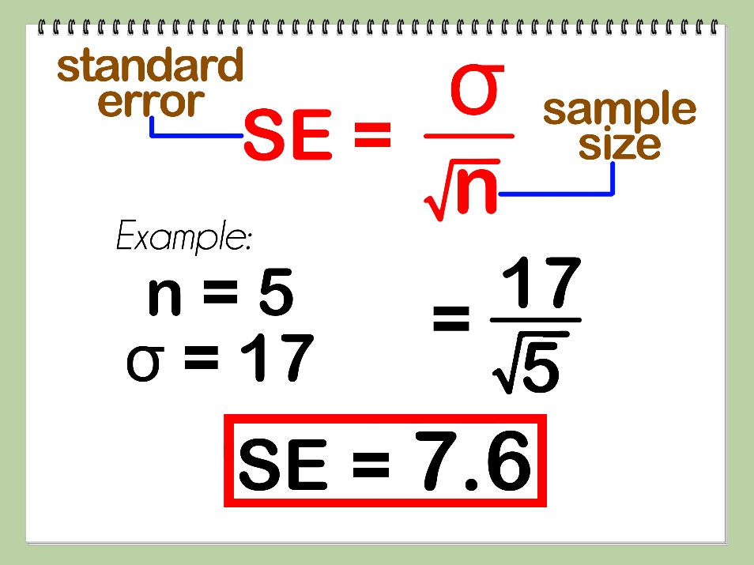
Standard Error (1 of 2)
Amount sample means will vary from sample to sample
Standard deviation of the sample means
Also, likelihood that sample statistic is near population parameter
Depends upon sample size (N)
Depends upon standard deviation (s)
So what? Can reason about population mean
e.g., 95% confident that sample mean is within ~ 2 SE’s
(where does this come from?)
(Example next)

Slide 23
Standard Error (1 of 2)
Amount sample means will vary from sample to sample
Standard deviation of the sample means
Also, likelihood that sample statistic is near population parameter
Depends upon sample size (N)
Depends upon standard deviation (s)
So what? Can reason about population mean
e.g., 95% confident that sample mean is within ~ 2 SE’s
(where does this come from?)
(Example next)

Slide 24
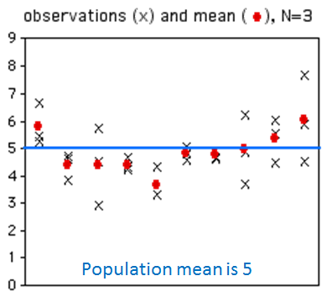
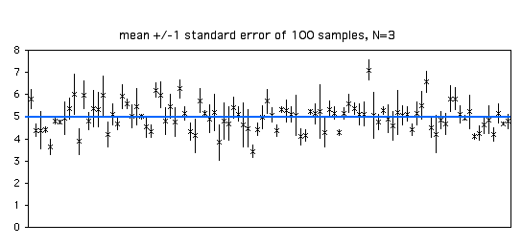
Standard Error (2 of 2)
standard error, 100 samples, N=3
If N = 20:
What will happen to x’s?
What will happen to dots?
If N=20:
what will happen to means?
What will happen to bars?
http://www.biostathandbook.com/standarderror.html

Slide 25
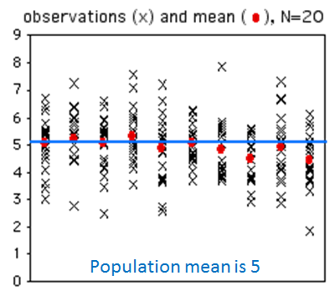
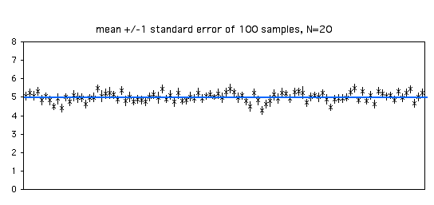
Standard Error (2 of 2)
standard error, 100 samples, N=3
standard error, 100 samples, N=20
Estimate population parameter → confidence interval
http://www.biostathandbook.com/standarderror.html

Slide 26
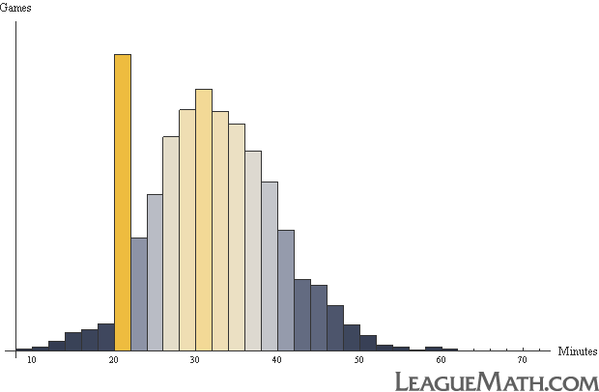
Confidence Interval
Range of values with specific certainty that population parameter is within
e.g., 90% confidence interval for mean League of Legends match duration: [28.5 minutes, 32.5 minutes]
Have sample of durations
Compute interval containing mean population duration (μ)
(with 90% confidence)
In general:
probability of μ in interval [c₁,c₂] with A confidence
28.5
32.5

Slide 27
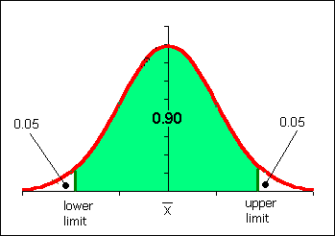
Confidence Interval for Mean
Probability of μ in interval [c₁,c₂]
P(c₁ < μ < c₂) = 1-α
[c1, c2] is confidence interval
α is significance level
100(1-α) is confidence level
Typically want α small so confidence level 90%, 95% or 99% (more on effect later)
Say, α = 0.1. Could do k experiments (size n), find sample means, sort
Graph distribution
Interval from distribution:
Lower bound: 5%
Upper bound: 95%
→ 90% confidence interval
We have to do k experiments, each of size n?
http://www.comfsm.fm/~dleeling/statistics/notes009_normalcurve90.png

Slide 28
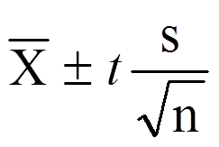
Confidence Interval Estimate
Estimate interval from 1 experiment, size n
Compute sample mean ($\overline{x}\text{)}$, sample standard error (SE)
Multiply SE by t distribution
Add/subtract from sample mean
→ Confidence interval
Ok, what is t distribution?
Function, parameterized by α and n
e.g., mean 30.5
t x SE = 2
30.5 - 2 = 28.5
30.5 + 2 = 32.5
[28.5, 32.5]
28.5
32.5

Slide 29
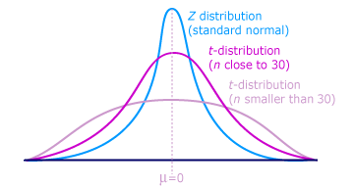
t distribution
Looks like standard normal, but bit “squashed”
Gets more squashed as n gets smaller
Note, can use standard normal (z distribution) when large enough sample size (N = 30+)
aka student’s t distribution (“student” was anonymous name used when published by William Gosset)
http://ci.columbia.edu/ci/premba_test/c0331/images/s7/6317178747.gif

Slide 30
Confidence Interval Example
(Unsorted)
Game Time
Suppose gathered game times in a user study (e.g., for your MQP!)
Can compute sample mean, yes
But really want to know where population mean is
→ Bound with confidence interval
4.4
3.8
2.8
4.2
2.8
2.9
1.9
5.9
3.9
3.2
4.1
5.3
3.6
5.1
2.7
3.9
3.9
3.2
4.1
3.3
2.8
4.2
3.1
4.5
4.5
4.8
4.9
5.1
3.7
3.4
5.6
3.1

Slide 31
Confidence Interval Example
(Sorted)
Game Time
$\overline{x}$ = 3.90, stddev s=0.95, n=32
A 90% confidence interval (α is 0.1) for population mean (μ):
3.90 $±$ $\frac{1.696×0.95}{\sqrt{32}}$
= [3.62, 4.19]
With 90% confidence, μ in that interval. Chance of error 10%.
But, what does that mean?
1.9
2.7
2.8
2.8
2.8
2.9
3.1
3.1
3.2
3.2
3.3
3.4
3.6
3.7
3.8
3.9
3.9
3.9
4.1
4.1
4.2
4.2
4.4
4.5
4.5
4.8
4.9
5.1
5.1
5.3
5.6
5.9
Lookup 1.645 in table, or
=TINV(0.1,31)
(See next slide for depiction of meaning)

Slide 32
Meaning of Confidence Interval (α)
μ
If 100 experiments and confidence level is 90%:
90 cases interval includes μ, in 10 cases not include μ
f(x)
Experiment/Sample Includes μ?
1 yes
2 yes
3 no
… e.g.,
100 yes α =0.1
Total yes > 100 (1-α) 90
Total no < 100 α 10

Slide 33
How does Confidence Interval Size Change?
With sample size (N)
With confidence level (1-α)
Look at each separately next

Slide 34
How does Confidence Interval Change (1 of 2)?
What happens to confidence interval when sample size (N) increases?
Hint: think about Standard Error

Slide 35
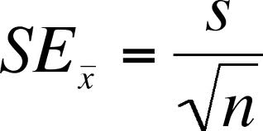
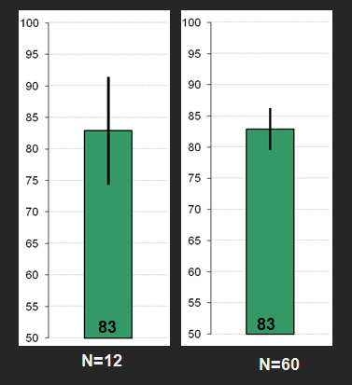
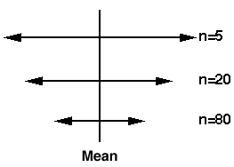
How does Confidence Interval Change (1 of 2)?
What happens to confidence interval when sample size (N) increases?
Hint: think about Standard Error

Slide 36
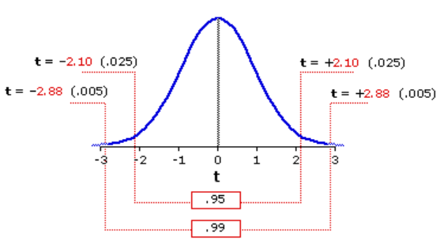
How does Confidence Interval Change (2 of 2)?
What happens to confidence interval when confidence level (1-α) increases?
90% CI = [6.5, 9.4]
90% chance population value is between 6.5, 9.4
95% CI = [6.1, 9.8]
95% chance population value is between 6.1, 9.8
Why is interval wider when we are “more” confident?
http://vassarstats.net/textbook/f1002.gif

Slide 37
How does Confidence Interval Change (2 of 2)?
What happens to confidence interval when confidence level (1-α) increases?
90% CI = [6.5, 9.4]
90% chance population value is between 6.5, 9.4
95% CI = [6.1, 9.8]
95% chance population value is between 6.1, 9.8
Why is interval wider when we are “more” confident? See distribution on the right
http://vassarstats.net/textbook/f1002.gif

Slide 38
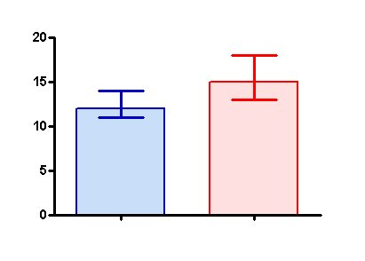
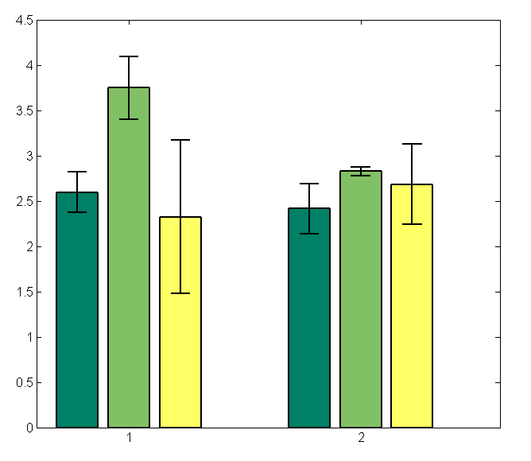
Using Confidence Interval (1 of 2)
Indicator of spread → Error bars
CI more informative than standard deviation
Standard deviation doesn’t change with N
→ CI indicates range of population parameter
Make sure sample size N=30+ (N=15+ if somewhat normal.
Any N if know distro is normal)

Slide 39
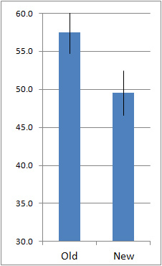
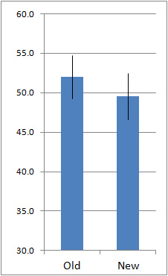
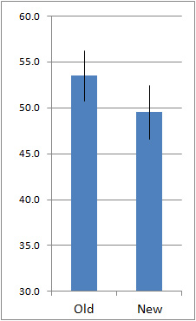
Using Confidence Interval (2 of 2)
https://measuringu.com/ci-10things/
No overlap
Large overlap
Some overlap
Compare two alternatives, quick check for statistical significance
No overlap? → 90% confident difference (at α = 0.10 level)
Large overlap (50%+)? → No statistically significant diff (at α = 0.10 level)
Some overlap? → more tests required

Slide 40
Statistical Significance versus Practical Significance (1 of 2)
Warning: may find statistically significant difference.
That doesn’t mean it is important.
It’s a Honey of an O
Latency can Kill?

Slide 41
Statistical Significance versus Practical Significance (1 of 2)
Warning: may find statistically significant difference.
That doesn’t mean it is important.
It’s a Honey of an O
Latency can Kill?
Boxes of Cheerios, Tastee-O’s both target 12 oz.
Measure weight of 18,000 boxes
Using statistics:
Cheerio’s heavier by 0.002 oz.
And statistically significant (α=0.99)!
But … 0.0002 is only 2-3 O’s. Customer doesn’t care!

Slide 42
Statistical Significance versus Practical Significance (2 of 2)
Warning: may find statistically significant difference.
That doesn’t mean it is important.
It’s a Honey of an O
Latency can Kill?
Boxes of Cheerios, Tastee-O’s both target 12 oz.
Measure weight of 18,000 boxes
Using statistics:
Cheerio’s heavier by 0.002 oz.
And statistically significant (α=0.95)!
But … 0.0002 is only 2-3 O’s. Customer doesn’t care!
Lag in League of Legends
Pay $$ to upgrade Ethernet from 100 Mb/s to 1000 Mb/s
Measure ping to LoL server for 20,000 samples
Using statistics
Ping times improve 0.8 ms
And statistically significant (α=0.99)!
But … humans cannot notice 1 ms difference!

Slide 43
What Confidence Level to Use (1 of 2)?
Often see 90% or 95% (or even 99%) used
Choice based on loss if wrong (population parameter is outside), gain if right (parameter inside)
If loss is high compared to gain, use higher confidence
If loss is low compared to gain, use lower confidence
If loss is negligible, lower is fine
Example (loss high compared to gain):
Hairspray, makes hair straight, but has chemicals
Want to be 99.99% confident it doesn’t cause cancer
Example (loss low compared to gain):
Hairspray, makes hair straight, only uses water
Ok to be 75% confident it straightens hair

Slide 44
What Confidence Level to Use (2 of 2)?
Often see 90% or 95% (or even 99%) used
Choice based on loss if wrong (population parameter is outside), gain if right (parameter inside)
If loss is high compared to gain, use higher confidence
If loss is low compared to gain, use lower confidence
If loss is negligible, lower is fine
Example (loss negligible):
Lottery ticket costs $1, pays $5 million
Chance of winning is 10⁻⁷ (50% payout, so 1 in 10 million)
To win with 90% confidence, need 9 million tickets
No one would buy that many tickets ($9 mil to win $5mil)!
So, most people happy with 0.01% confidence

Slide 45
Outline
Overview (done)
Foundation (done)
Confidence Intervals (done)
Hypothesis Testing (next)

Slide 46
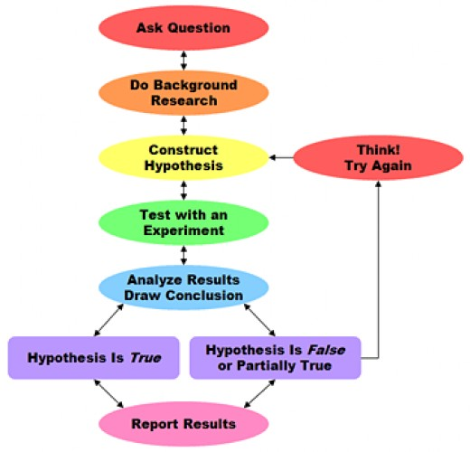
Hypothesis Testing
Term arises from science
State tentative explanation → hypothesis
Devise experiments to gather data
Data supports or rejects hypothesis
Statisticians have adopted to test using inferential statistics
→ Hypothesis testing
Just brief overview here → Conversant
Chapters 8 & 9 in book have more
http://s1.hubimg.com/u/4205792_f520.jpg

Slide 47
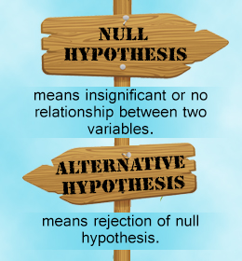
Hypothesis Testing Terminology
Null Hypothesis (H₀) – hypothesis that no significance difference between measured value and population parameter (any observed difference due to error)
e.g., population mean time for Riot to bring up NA servers is 4 hours
Alternative Hypothesis – hypothesis contrary to null hypothesis
e.g., population mean time for Riot to bring up NA servers is not 4 hours
Care about alternate, but test Null
If data supports, alternate not true
If data rejects, alternate may be true
Why Null and alternate?
Remember, data doesn’t “prove” hypothesis
Can only reject it (at certain significance)
So, reject Null
P-value – smallest level that can reject H₀
“If p-value is low, then H₀ must go”
How “low” based on “risk” of being wrong (like conf. interval)
http://www.buzzle.com/img/articleImages/605910-49223-57.jpg

Slide 48
Hypothesis Testing Steps
State hypothesis (H) and null hypothesis (H₀)
Evaluate risks of being wrong (based on loss and gain), choosing significance (α) and sample size
Collect data (sample), compute statistics
Calculate p-value based on test statistic and compare to α
Make inference
Reject H₀ if p-value less than α
So, H may be right
Do not reject H₀ if p-value greater than α
So, H may not be right

Slide 49
Hypothesis Testing Steps (Example)
State hypothesis (H) and null hypothesis (H₀)
H: Mario level takes less than 5 minutes to complete
H₀: Mario level takes 5 minutes to complete (H₀ always has =)
Evaluate risks of being wrong (based on loss and gain), choosing significance (α) and sample size (N)
Player may get frustrated, quit game, so α = 0.1
Not sure of normally distributed, so 30 (Central Limit Theorem)
Collect data (sample), compute statistics
30 people play level, compute average minutes, compare to 5
Calculate p-value based on test statistic and compare to α
p-value = 0.002, α = 0.01
Make inference
Here: p-value less than α → REJECT H₀, so H may be right
Note, would not have rejected H₀ if p-value greater than α

Slide 50
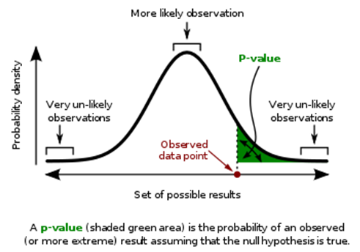
Calculating P-value
probability density of each outcome, computed under Null hypothesis
p-value is area under curve past observed data point (e.g., sample mean)
https://en.wikipedia.org/wiki/P-value

