Slide 1
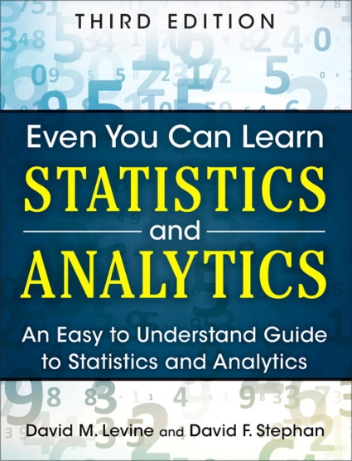
Probability
IMGD 2905
Chapters 4 & 5

Slide 2
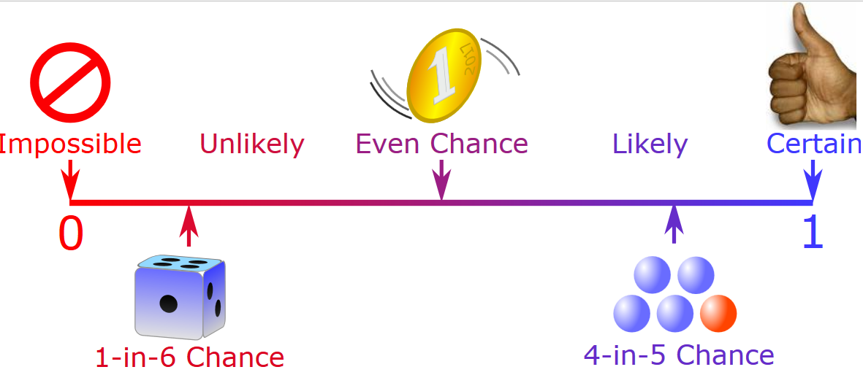
Overview
Statistics important for game analysis
Probability important for statistics
So, understand some basic probability
Also, probability useful for game development
What are some examples of probabilities needed for game development?
https://www.mathsisfun.com/data/images/probability-line.svg

Slide 3
Overview
Statistics important for game analysis
Probability important for statistics
So, understand some basic probability
Also, probability useful for game development
Probability attack will succeed
Probability loot from enemy contains rare item
Probability enemy spawns at particular time
Probability action (e.g., building a castle) takes particular amount of time
Probability players at server
https://www.mathsisfun.com/data/images/probability-line.svg

Slide 4
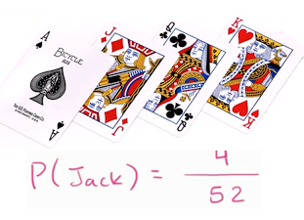
Probability Introduction
Probability – way of assigning numbers to outcomes to express likelihood of event
Event – outcome of experiment or observation
Elementary – simplest type for given experiment. independent
Joint/Compound – more than one elementary
Roll die (d6) and get 6
elementary event
Roll die (d6) and get even number
compound event, consists of elementary events 2, 4, and 6
Pick card from standard deck and get queen of spades
elementary event
Pick card from standard deck and get face card
compound event
Observe players logging in to MMO and see if two people log in less than 15 minutes apart after midnight
compound event
https://cdn.kastatic.org/googleusercontent/Z0TuLq2KolavsrfDXSbLqi0S-wnlCrC13cKGG68wK9ljrTiXzRqvfq7IpWNzcwgzlpEOI8YmMafp4K4zO0sanvXu

Slide 5
Outline
Introduction (done)
Probability (next)
Probability Distributions

Slide 6
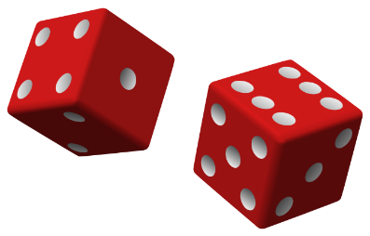
Probability – Definitions
Exhaustive set of events – set of all possible outcomes of experiment/observation
Mutually exclusive sets of events – elementary events that do not overlap
Roll d6: Events: 1, 2, 3, 4, 5, 6
exhaustive, mutually exclusive
Roll d6: Events: get even number, get number divisible by 3, get a 1 or get a 5
exhaustive, but overlap
Observe logins: time between arrivals <10 seconds, 10+ and <15 seconds inclusive, or 15+ seconds
exhaustive, mutually exclusive
Observe logins: time between arrivals <10 seconds, 10+ and <15 seconds inclusive, or 10+ seconds
exhaustive, but overlap

Slide 7
Probability – Definition
Probability – likelihood of event to occur,
ratio of favorable cases to all cases
Set of rules that probabilities must follow
Probabilities must be between 0 and 1 (but often written/said as percent)
Probabilities of set of exhaustive, mutually exclusive events must add up to 1
e.g., d6: events 1, 2, 3, 4, 5, 6. Probability of 1/6th to each
→ legal set of probabilities
e.g., d6: events 1, 2, 3, 4, 5, 6. Probability of ½ to roll 1, ½ to roll 2, and 0 to all the others
→ Also legal set of probabilities
Not how honest d6’s behave in real life!
https://goo.gl/iy3YGr
So, how to assign probabilities?

Slide 8
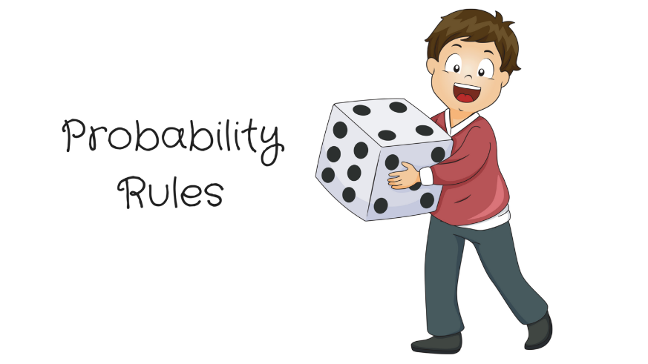
How to Assign Probabilities?
http://static1.squarespace.com/static/5a14961cf14aa1f245bc3942/5a1c5e8d8165f542d6db3b0e/5acecc7f03ce64b9a46d99c6/1529981982981/Michael+Jordan+%2833%29.png?format=1500w
https://newvitruvian.com/images/marbles-clipart-bag-marble-4.png

Slide 9
Assigning Probabilities
Classical (by theory)
In many cases, exhaustive, mutually exclusive outcomes equally likely → assign each outcome probability of 1/n
e.g., d6: 1/6, Coin: prob heads ½, tails ½, Cards: pick Ace 1/13
Empirically (by observation)
Obtain data through measuring/observing
e.g., Watch how often people play FIFA 18 in lab versus some other game. Say, 30% FIFA. Assign that as probability
Subjective (by hunch)
Based on expert opinion or other subjective method
e.g., e-sports writer says probability Fnatic (League team) will win World Championship is 25%

Slide 10
Rules About Probabilities (1 of 2)
Complement: A an event. Event “A does not occur” called complement of A, denoted A’
P(A’) = 1 - P(A)
e.g., d6: P(6) = 1/6, complement is P(6’) and probability of not 6 is 1-1/6, or 5/6
Note: when using p, complement is often q
Mutually exclusive: Have no simple outcomes in common – can’t both occur in same experiment
P(A or B) = P(A) + P(B)
e.g., d6: P(3 or 6) = P(3) + P(6) = 1/6 + 1/6 = 2/6

Slide 11
Rules About Probabilities (2 of 2)
Independence: One occurs doesn’t affect probability that other occurs
e.g., 2d6: A= die 1 get 5, B= die 2 gets 6. Independent, since result of one roll doesn’t affect roll of other
Probability both occur P(A and B) = P(A) x P(B)
e.g., 2d6: prob of “snake eyes” is P(1) x P(1) = 1/6 x 1/6 = 1/36
Not independent: One occurs affects probability that other occurs
Probability both occur P(A and B) = P(A) x P(B | A)
Where P(B | A) means the prob B given A happened
e.g., MMO has 10% mages, 40% warriors, 80% Boss defeated. Probability Boss fights mage and is defeated?
You might think that = P(mage) x P(defeat B) = .10 * .8 = .08
But likely not independent. P(defeat B | mage) < 80%. So, need non-independent formula P(mage)* P(defeat B | mage)
(Also cards – see next slide)

Slide 12
Probability Example
Probability drawing King?

Slide 13
Probability Example
Probability drawing King?
P(K) = ¼
Draw, put back. Now?

Slide 14
Probability Example
Probability drawing King?
P(K) = ¼
Draw, put back. Now?
P(K) = ¼
Probability not King?

Slide 15
Probability Example
Probability drawing King?
P(K) = ¼
Draw, put back. Now?
P(K) = ¼
Probability not King?
P(K’) = 1-P(K) = ¾
Draw, put back. 2 Kings?

Slide 16
Probability Example
Probability drawing King?
P(K) = ¼
Draw, put back. Now?
P(K) = ¼
Probability not King?
P(K’) = 1-P(K) = ¾
Draw, put back. 2 Kings?

Slide 17
Probability Example
Draw. King or Queen?
Probability drawing King?
P(K) = ¼
Draw, put back. Now?
P(K) = ¼
Probability not King?
P(K’) = 1-P(K) = ¾
Draw, put back. 2 Kings?
P(K) x P(K) = ¼ x ¼ = 1/16

Slide 18
Probability Example
Draw. King or Queen?
P(K or Q) = P(K) + P(Q)
= ¼ + ¼ = ½
Probability drawing King?
P(K) = ¼
Draw, put back. Now?
P(K) = ¼
Probability not King?
P(K’) = 1-P(K) = ¾
Draw, put back. 2 Kings?
P(K) x P(K) = ¼ x ¼ = 1/16

Slide 19
Probability Example
Draw. King or Queen?
P(K or Q) = P(K) + P(Q)
= ¼ + ¼ = ½
Draw, put back. Not King either card?
Probability drawing King?
P(K) = ¼
Draw, put back. Now?
P(K) = ¼
Probability not King?
P(K’) = 1-P(K) = ¾
Draw, put back. 2 Kings?
P(K) x P(K) = ¼ x ¼ = 1/16

Slide 20
Probability Example
Draw. King or Queen?
P(K or Q) = P(K) + P(Q)
= ¼ + ¼ = ½
Draw, put back. Not King either card?
P(K’) x P(K’) = ¾ x ¾ = 9/16
Draw, don’t put back. Not King either card?
Probability drawing King?
P(K) = ¼
Draw, put back. Now?
P(K) = ¼
Probability not King?
P(K’) = 1-P(K) = ¾
Draw, put back. 2 Kings?
P(K) x P(K) = ¼ x ¼ = 1/16

Slide 21
Probability Example
Draw. King or Queen?
P(K or Q) = P(K) + P(Q)
= ¼ + ¼ = ½
Draw, put back. Not King either card?
P(K’) x P(K’) = ¾ x ¾ = 9/16
Draw, don’t put back. Not King either card?
P(K’) x P(K’ | K’) = ¾ x (1-1/3)
= ¾ x 2/3
= 6/12 = ½
Draw, don’t put back. King 2nd card?
Probability drawing King?
P(K) = ¼
Draw, put back. Now?
P(K) = ¼
Probability not King?
P(K’) = 1-P(K) = ¾
Draw, put back. 2 Kings?
P(K) x P(K) = ¼ x ¼ = 1/16

Slide 22
Probability Example
Draw. King or Queen?
P(K or Q) = P(K) + P(Q)
= ¼ + ¼ = ½
Draw, put back. Not King either card?
P(K’) x P(K’) = ¾ x ¾ = 9/16
Draw, don’t put back. Not King either card?
P(K’) x P(K’ | K’) = ¾ x (1-1/3)
= ¾ x 2/3
= 6/12 = ½
Draw, don’t put back. King 2nd card?
P(K’) x P(K | K’) = ¾ x ⅓ = 3/12 = ¼
Probability drawing King?
P(K) = ¼
Draw, put back. Now?
P(K) = ¼
Probability not King?
P(K’) = 1-P(K) = ¾
Draw, put back. 2 Kings?
P(K) x P(K) = ¼ x ¼ = 1/16

Slide 23
Outline
Intro (done)
Probability (done)
Probability Distributions (next)

Slide 24
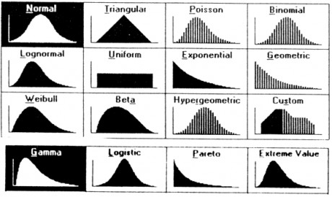
Probability Distributions
Probability distribution – values and likelihood of those values that random variable can take
Why? If can model mathematically, can use to predict occurrences
e.g., probability slot machine pays out on given day
e.g., probability game server hosts player today
e.g., probability certain game mode is chosen by player
Also, some statistical techniques for some distributions only
https://goo.gl/jqomFI
Types discussed:
Uniform (discrete)
Binomial (discrete)
Poisson (discrete)
Normal (continuous)
Remember empirical rule?
What distribution did it apply to?

Slide 25
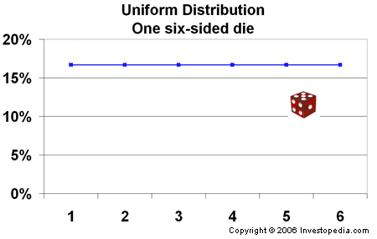
Uniform Distribution
“So what?”
Can use known formulas

Slide 26
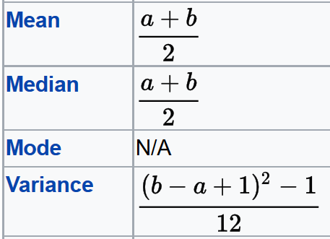
Uniform Distribution
“So what?”
Can use known formulas
Mean = (1 + 6) / 2 = 3.5
Variance = ((6 – 1 + 1)² – 1)/12
= 2.9
Std Dev = sqrt(Variance) = 1.7

Slide 27
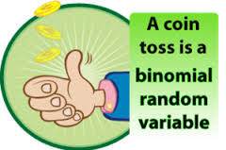
Binomial Distribution Example (1 of 3)
How to assign probabilities?
Suppose toss 3 coins
Random variable
X = number of heads
Want to know probability of exactly 2 heads
P(X=2) = ?

Slide 28
Binomial Distribution Example (1 of 3)
How to assign probabilities?
Could measure (empirical)
Q: how?
Could use “hunch” (subjective)
Q: what do you think?
Could use theory (classical)
Math using our probability rules (not shown)
Enumerate (next)
Suppose toss 3 coins
Random variable
X = number of heads
Want to know probability of exactly 2 heads
P(X=2) = ?

Slide 29
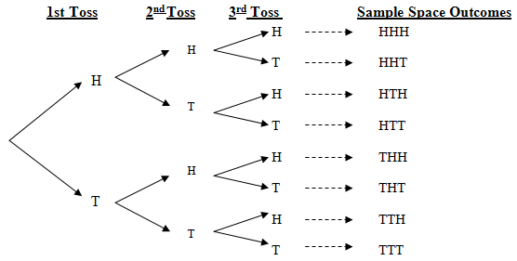
Binomial Distribution Example (2 of 3)
http://web.mnstate.edu/peil/MDEV102/U3/S25/Cartesian3.PNG
All equally likely (p is 1/8 for each)
→ P(HHT) + P(HTH) + P(THH) = 3/8
Can draw histogram of number of heads

Slide 30
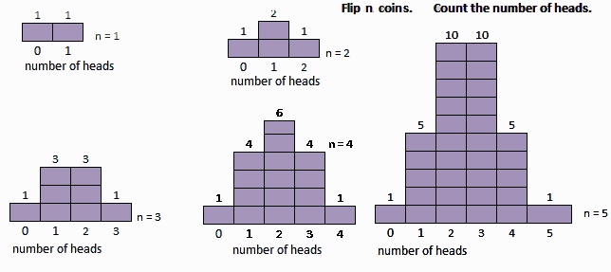
Binomial Distribution Example (3 of 3)
http://www.mathnstuff.com/math/spoken/here/2class/90/binom2.gif
These are all binomial distributions

Slide 31
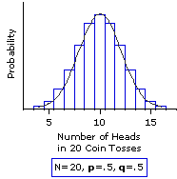
Binomial Distribution (1 of 2)
In general, any number of trials (n) & any probability of successful outcome (p) (e.g., heads)
Characteristics of experiment that gives random number with binomial distribution:
Experiment consists of n identical trials.
Trials are independent
Each trial results in only two possible outcomes, S or F
Probability of S each trial is same, denoted p
Random variable of interest (X) is number of S’s in n trials
http://www.vassarstats.net/textbook/f0603.gif

Slide 32
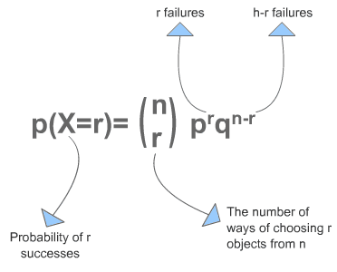
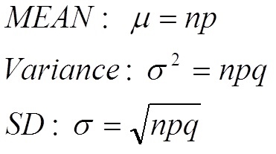
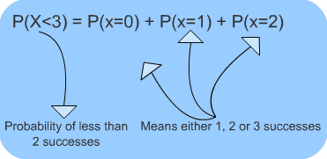
Binomial Distribution (2 of 2)
“So what?”
Can use known formulas
http://www.s-cool.co.uk/gifs/a-mat-sdisc-dia08.gif
Excel: binom.dist()
binom.dist(x,trials,prob,cumulative)
– 2 heads, 3 flips
=binom.dist(2,3,0.5,FALSE)
=0.375 (i.e., 3/8)
http://www.s-cool.co.uk/gifs/a-mat-sdisc-dia12.gif

Slide 33
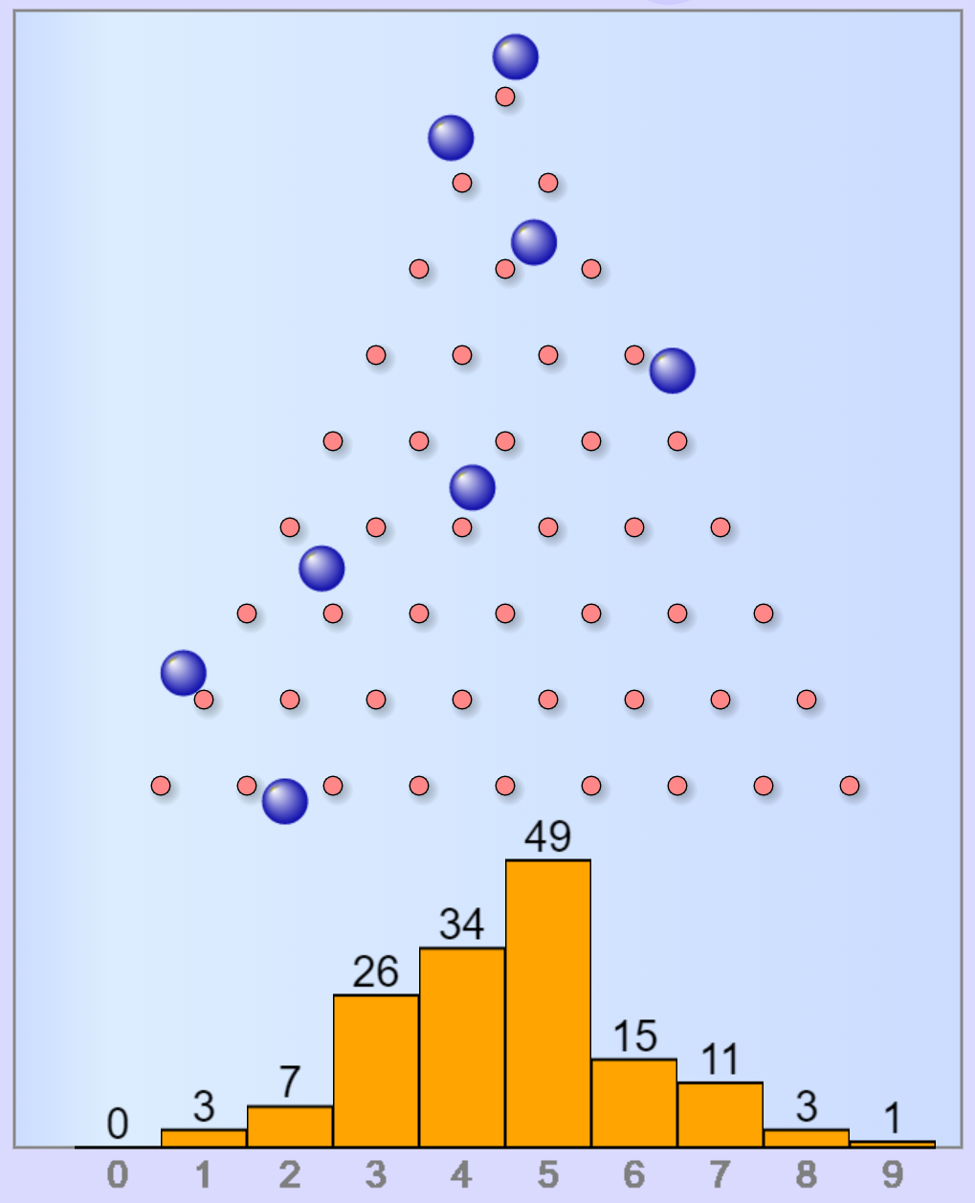
Binomial Distribution Example
Each row is like a coin flip
right = “heads”
left = “tails”
Bottom axis is number of heads
Can compute P(X) by:
bin(X) / sum(bin(0) + bin(1) + …)
https://www.mathsisfun.com/data/quincunx.html

Slide 34
Poisson Distribution
Distribution of probability of events occurring in certain interval (broken into units)
Interval can be time, area, volume, distance
e.g., number of players arriving at server lobby in 5-minute period between noon-1pm
Requires
Probability of event same for all time units
Number of events in one time unit independent of number of events in any other time unit
Events occur singly (not simultaneously). In other words, as time unit gets smaller, probability of two events occurring approaches 0

Slide 35
Poisson Distributions?
Not Poisson
Could Be Poisson
Number of people arriving at restaurant during dinner hour
People frequently arrive in groups
Number of students register for course in BannerWeb per hour on first day of registration
Prob not equal – most register in first few hours
Not independent – if too many register early, system crashes
Number of groups arriving at restaurant during dinner hour
Number of logins to MMO during prime time
Number of defects (bugs) per 100 lines of code
People arriving at cash register (if they shop individually)
Phrase people use is random arrivals

Slide 36
Poisson Distribution
Distribution of probability of events occurring in certain interval
http://www.dummies.com/education/math/business-statistics/how-to-compute-poisson-probabilities/

Slide 37
Poisson Distribution Example
Number of games student plays per day averages 1 per day
Number of games played per day independent of all other days
Can only play one game at a time
What’s probability of playing 2 games tomorrow?
In this case, the value of λ = 1, want P(X=2)

Slide 38
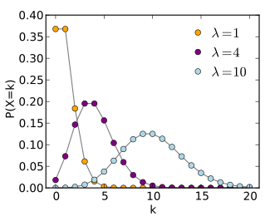
Poisson Distribution
“So what?” → Known formulas
Mean = λ
Variance = λ
Std Dev = sqrt (λ)
Excel: poisson.dist()
poisson.dist(x,mean,cumulative)
mean 1 game per day, chance for 2?
= poisson.dist(2,1,false)
= 0.18394
X )
x
e.g., May want to know most likelihood of 1.5x average people arriving at server

Slide 39
Expected Value
Expected value of discrete random variable is value you’d expect after many experimental trials. i.e., mean value of population
Value: x₁ x₂ x₃ … x_{n}
Probability: P(x₁) P(x₂) P(x₃) … P(x_{n})
Compute by multiplying each by probability and summing
μ_{x} = E(X) = x₁P(x₁) + x₂P(x₂) + … + x_{n}P(x_{n})
= Σ x_{i}P(x_{i})

Slide 40
Expected Value Example – Gambling Game
Pay $3 to enter
Roll 1d6 → 6? Get $7 1-5? Get $1
What is expected payoff? Expected net?
Outcome Payoff P(x) xP(x)
1-5 $1 5/6 $5/6
6 $7 1/6 $7/6
E(x) = $5/6 + $7/6 = $12/6 = $2
E(net) = E(x) - $3 = $2 - $3 = 0

Slide 41
Expected Value Example – Gambling Game
Pay $3 to enter
Roll 1d6 → 6? Get $7 1-5? Get $1
What is expected payoff? Expected net?
Outcome Payoff P(x) xP(x)
1-5 $1 5/6 $5/6
6 $7 1/6 $7/6
E(x) = $5/6 + $7/6 = $12/6 = $2
E(net) = E(x) - $3 = $2 - $3 = 0

Slide 42
Expected Value Example – Gambling Game
Pay $3 to enter
Roll 1d6 → 6? Get $7 1-5? Get $1
What is expected payoff? Expected net?
Outcome Payoff P(x) xP(x)
1-5 $1 5/6 $5/6
6 $7 1/6 $7/6
E(x) = $5/6 + $7/6 = $12/6 = $2
E(net) = E(x) - $3 = $2 - $3 = 0

Slide 43
Expected Value Example – Gambling Game
Pay $3 to enter
Roll 1d6 → 6? Get $7 1-5? Get $1
What is expected payoff? Expected net?
Outcome Payoff P(x) xP(x)
1-5 $1 5/6 $5/6
6 $7 1/6 $7/6
E(x) = $5/6 + $7/6 = $12/6 = $2
E(net) = E(x) - $3 = $2 - $3 = $-1

Slide 44
Outline
Intro (done)
Probability (done)
Probability Distributions
Discrete (done)
So far random variable could take only discrete set of values
Q: What does that mean?
Q: What other distributions might we consider?

Slide 45
Outline
Intro (done)
Probability (done)
Probability Distributions
Discrete (done)
Continuous (next)

Slide 46
Continuous Distributions
Many random variables are continuous
e.g., recording time (time to perform service) or measuring something (height, weight, strength)
For continuous, doesn’t make sense to talk about P(X=x) → continuum of possible values for X
Mathematically, if all non-zero, total probability infinite (this violates our rule)
So, continuous distributions have probability density, f(x)
→ How to use to calculate probabilities?
Don’t care about specific values
e.g., P(Height = 60.1946728163 inches)
Instead, ask about range of values
e.g., P(59.5” < X < 60.5”)
Uses calculus (integrate area under curve) (not shown here)
What continuous distribution is especially important?

Slide 47
Continuous Distributions
Many random variables are continuous
e.g., recording time (time to perform service) or measuring something (height, weight, strength)
For continuous, doesn’t make sense to talk about P(X=x) → continuum of possible values for X
Mathematically, if all non-zero, total probability infinite (this violates our rule)
So, continuous distributions have probability density, f(x)
→ How to use to calculate probabilities?
Don’t care about specific values
e.g., P(Height = 60.1946728163 inches)
Instead, ask about range of values
e.g., P(59.5” < X < 60.5”)
Uses calculus (integrate area under curve) (not shown here)
What continuous distribution is especially important? → the Normal Distribution

Slide 48
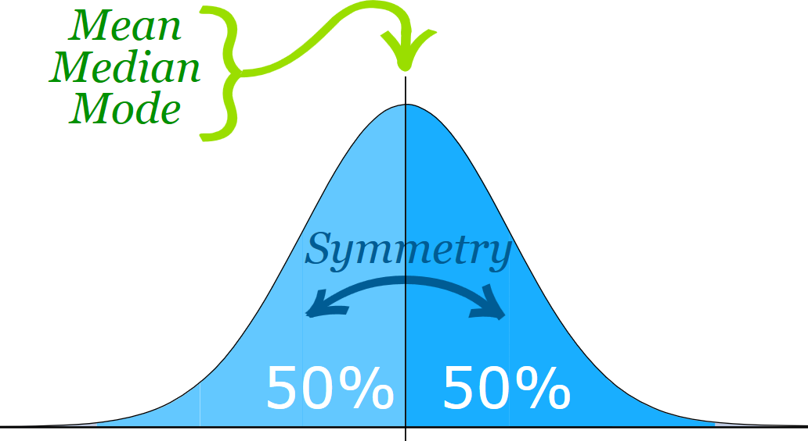
Normal Distribution (1 of 2)
“Bell-shaped” or “Bell-curve”
Distribution from -∞ to +∞
Symmetric
Mean, median, mode all same
Mean determines location, standard deviation determines “width”
Super important!
Lots of distributions follow a normal curve
Basis for inferential statistics (e.g., statistical tests)
“Bridge” between probability and statistics
50% area to left
50% area to right
-∞
+∞
https://www.mathsisfun.com/data/images/normal-distribution-2.svg
Aka “Gaussian” distribution

Slide 49
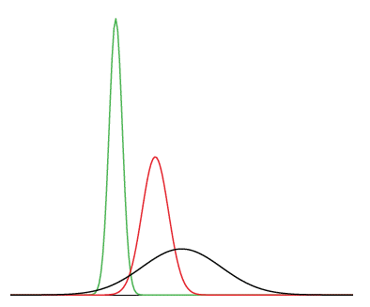
Normal Distribution (2 of 2)
Many normal distributions (see right)
However, “the” normal distribution refers to standard normal
Mean (μ) = 0
Standard deviation (σ) = 1
Can convert any normal to the standard normal
Given sample mean (x̅)
Sample standard dev. (s)
green - mean -3, std dev 0.5
red - mean 0, std dev 1
black - mean 2, std dev 3
(Next)
=norm.dist()

Slide 50
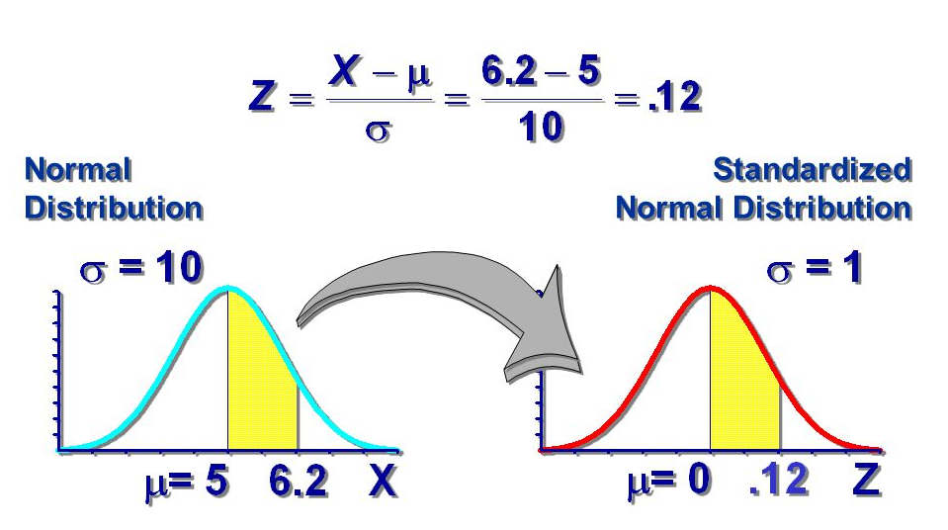
Standard Normal Distribution
Standardize
Subtract sample mean (x̅)
Divide by sample standard deviation (s)
Mean μ = 0
Standard Deviation σ = 1
Total area under curve = 1
Sounds like probability!
Remember the
Z-score?
Use to predict how likely an observed sample is given population mean
(next)
http://images.slideplayer.com/10/2753952/slides/slide_2.jpg

Slide 51
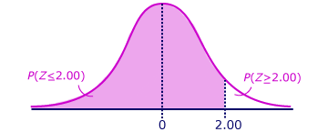
Using the Standard Normal
Z = (x - x̅) / s
= (30 - 24) / 3
= 2
Want to know P(Z > 2)
Suppose Heroes of the Storm Hero released once every 24 days on average, standard deviation of 3 days
What is the probability Hero released 30+ days?
x = 30, x̅ = 24, s = 3
http://ci.columbia.edu/ci/premba_test/c0331/s6/s6_4.html
Use table (Z-table). Or Empirical Rule?

Slide 52
Using the Standard Normal
Z = (x - x̅) / s
= (30 - 24) / 3
= 2
Want to know P(Z > 2)
Suppose Heroes of the Storm Hero released once every 24 days on average, standard deviation of 3 days
What is the probability Hero released 30+ days?
x = 30, x̅ = 24, s = 3
http://ci.columbia.edu/ci/premba_test/c0331/s6/s6_4.html
=norm.dist(x,mean,stddev,cumulative)
=norm.dist(30,24,3,false)
Use table (Z-table). Or Empirical Rule?
Use table (Z-table). Or Empirical Rule?
→ 5% / 2 = 2.5% likely (actual is 2.28%)

Slide 53
Test for Normality
Why?
Can use Empirical Rule
Use some inferential statistics (parametric tests)
How? Several ways. One:
Normal probability plot – graphical technique to see if data set is approximately normally distributed (next)

Slide 54
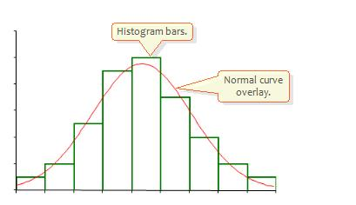
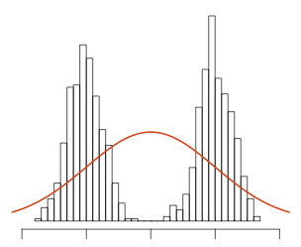
Normality Testing with a Histogram
Use histogram shape to look for “bell curve”
http://2.bp.blogspot.com/_g8gh7I4zSt4/TR85eGJlMfI/AAAAAAAAAQs/PaOHJsjonPM/s1600/histo.JPG
http://seankross.com/img/biqq.png
Yes
No

Slide 55
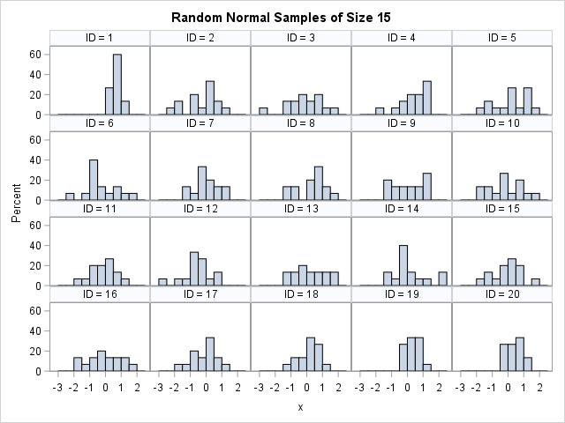
Normality Testing with a Histogram
http://www.sascommunity.org/planet/blog/category/statistical-thinking/
Q: What distributions are these from? Any normal?

Slide 56
Normality Testing with a Histogram
http://www.sascommunity.org/planet/blog/category/statistical-thinking/
They are all from normal distribution! Suffer from:
Binning (not continuous)
Few samples (15)

Slide 57
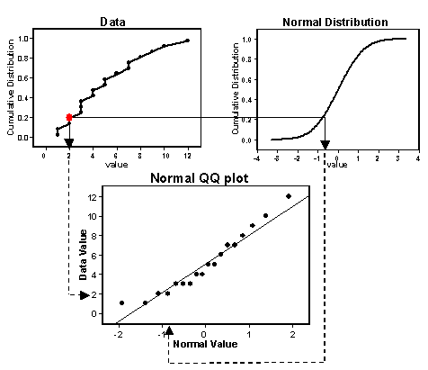
Normality Testing with a Quantile-Quantile Plot
Quantiles of one versus another
If line → same distribution
Order data
Compute Z scores (normal)
Plot data (y-axis) versus Z (x-axis)
Normal? → line
https://goo.gl/rLLSIQ

Slide 58
Quantile-Quantile Plot Example
Do the following values come from a normal distribution?
7.19, 6.31, 5.89, 4.5, 3.77, 4.25, 5.19, 5.79, 6.79
Order data
Compute Z scores
Plot data versus Z
Show each step, next
http://www.statisticshowto.com/q-q-plots/

Slide 59
Quantile-Quantile Plot Example – Order Data
Unordered
Ordered (low to high)
7.19
6.31
5.89
4.50
3.77
4.25
5.19
5.79
6.79
3.77
4.25
4.50
5.19
5.89
5.79
6.31
6.79
7.19
N = 9 data points
http://www.statisticshowto.com/q-q-plots/

Slide 60
Quantile-Quantile Plot Example – Compute Z scores
Divide into
N+1 = 10
10% = ?
20% = ?
30% = ?
40% = ?
50% = 0
60% = ?
70% = ?
80% = ?
90% = ?
Lookup in Z-table
Want Z-score for that segment
http://www.statisticshowto.com/q-q-plots/

Slide 61
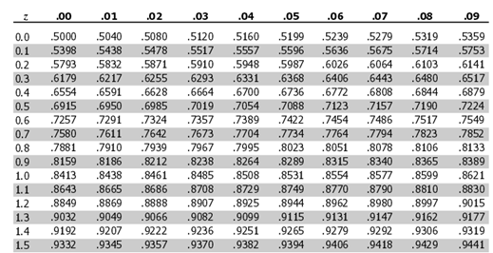
Z-Table
Tells what cumulative percentage of the standard normal curve is under any point (Z-score). Or, P(-∞ to Z)
e.g., 80%?
Find closest value in table to desired percent
10% = -1.28
20% = -0.84
30% = -0.52
40% = -0.25
50% = 0
60% = 0.25
70% = 0.52
80% = 0.84
90% = 1.28
=NORMSINV(area) – provide Z for area under standard normal curve
=NORMSINV(.80)
=0.841621
(Note: Above for positive Z-scores – also negative tables, or diff from 50%)

Slide 62
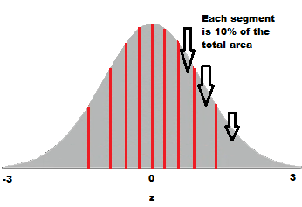
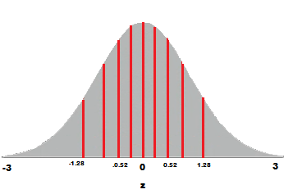
Quantile-Quantile Plot Example – Compute Z scores
10% = -1.28
20% = -0.84
30% = -0.52
40% = -0.25
50% = 0
60% = 0.25
70% = 0.52
80% = 0.84
90% = 1.28
(Only some points shown)

Slide 63
Quantile-Quantile Plot Example – Plot
http://www.statisticshowto.com/q-q-plots/
Linear? → Normal

Slide 64
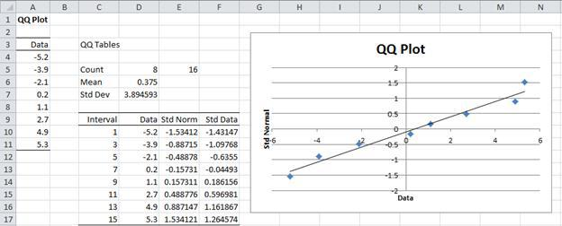
Quantile-Quantile Plots in Excel
Mostly, a manual process. Do as per above.
Example of step by step process (with spreadsheet):
http://facweb.cs.depaul.edu/cmiller/it223/normQuant.html
https://i2.wp.com/www.real-statistics.com/wp-content/uploads/2012/12/qq-plot-normality.jpg

Slide 65
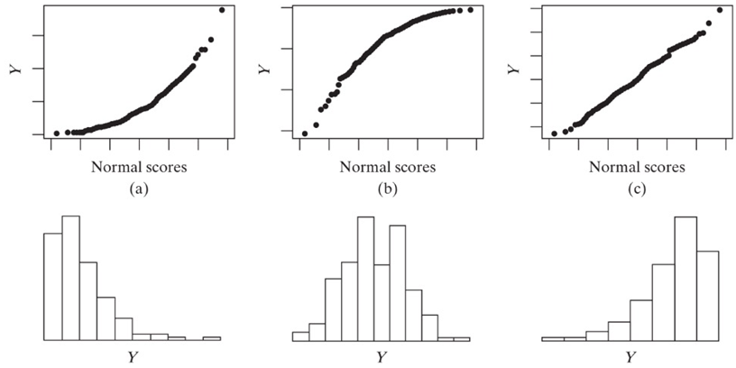
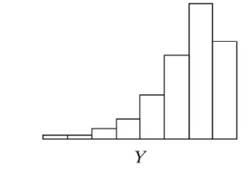
Examples of Normality Testing with a Quantile-Quantile Plot
http://d2vlcm61l7u1fs.cloudfront.net/media%2Fb95%2Fb953e7cd-31c3-45b0-a8ec-03b0e81c95d1%2Fphp2Y86od.png

