Slide 1
Review
IMGD 2905

Slide 2
What are two main sources for data for game analytics?

Slide 3
What are two main sources for data for game analytics?
Quantitative – instrumented game
Qualitative – subjective evaluation

Slide 4
What steps are in the game analytics pipeline?

Slide 5
What steps are in the game analytics pipeline?
Game (instrumented)
Data (collected from players playing game)
Extracted data (e.g., from scripts)
Analysis
Statistics, Charts, Tests
Dissemination
Report
Talk, Presentation

Slide 6
What is population versus sample?

Slide 7
What is population versus sample?
Population – all members of group pertaining to study
Sample – part of population selected for analysis

Slide 8
What is probability sampling?

Slide 9
What is probability sampling?
Probability sampling – sampling considering likelihood of selection
Likelihood as part of population

Slide 10
What is a Pareto chart? When used?

Slide 11
What is a Pareto chart? When used?
Bar chart, arranged most to least frequent
Line showing cumulative percent
Helps identify most common, relative amounts
https://goo.gl/S7qDTJ

Slide 12
When should you not use pie chart?

Slide 13
When should you not use pie chart?
When too many slices
http://cdn.arstechnica.net/FeaturesByVersion.png

Slide 14
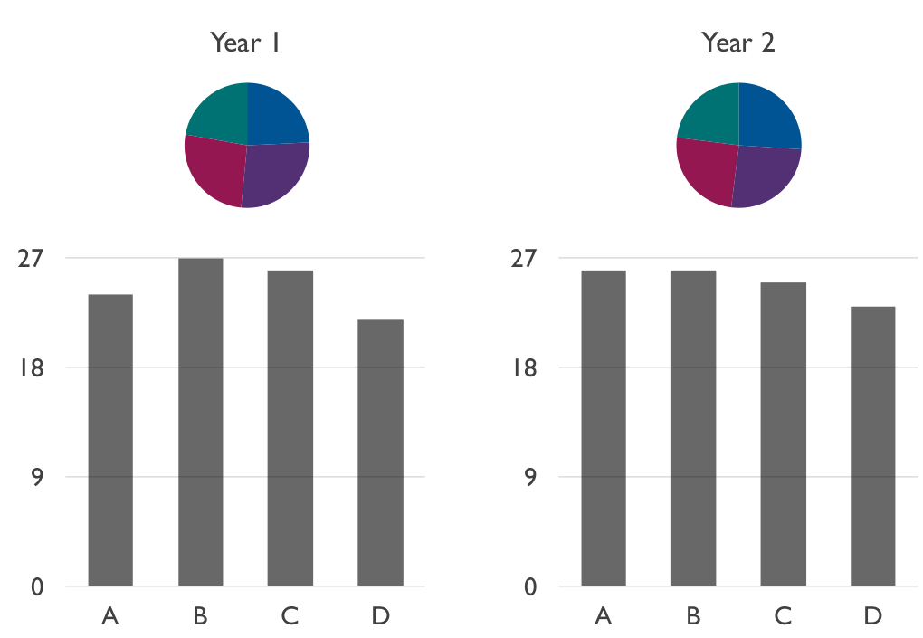
When should you not use pie chart?
(Often) when comparing pies

Slide 15
What is a heat map? Describe an example

Slide 16
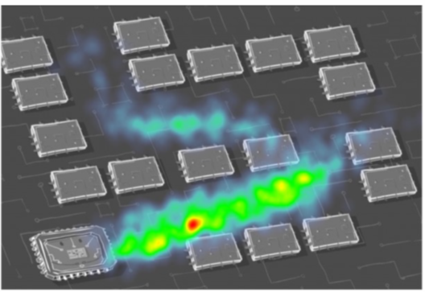
What is a heat map? Describe an example
Map where data represented as colors

Slide 17
Provide three guidelines for good charts

Slide 18
Provide three guidelines for good charts
Require minimum effort from reader
Maximize information
Minimize ink
Use commonly accepted practices
Avoid ambiguity

Slide 19
Which Measure of Central Tendency to Use? Why?

Slide 20
What are Quartiles?

Slide 21
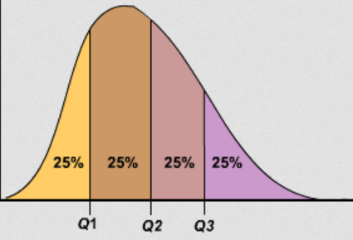
What are Quartiles?
Three values that divide population into four equal sized groups

Slide 22
Describe how to Compute Variance

Slide 23
Describe how to Compute Variance
Compute mean.
Take a sample and compute how far it is from mean. Square this.
Repeat #2 for each sample.
Add up all.
Divide by number of samples (-1).

Slide 24
In Probability, what is an Exhaustive Set of Events? Give an Example.

Slide 25
In Probability, what is an Exhaustive Set of Events? Give an Example.
A set of all possible outcomes of an experiment or observation
e.g., coin: events {heads, tails}
e.g., d6: events {even number, odd number}
e.g., picking Hero in HOTS: events {LiLi, Ana, Malfurion, …} (all possible Champions listed)

Slide 26
Broadly, What are 3 Ways to Assign Probabilities? Give examples.

Slide 27
Broadly, What are 3 Ways to Assign Probabilities? Give examples.
Classical (theory)
e.g., equal likelihood d6, so P(1) = 1/6th
Empirical (by measurement/observation)
Probability of 1 min service rate at DD by observing service rates for 1 hour
Subjective (hunch – sometimes guided by a bit of theory)
Probability of Iceland winning World Cup by deep analysis of teams and competition

Slide 28
Probability
Draw 2 cards simultaneously. What is the probability of drawing 2 Jacks?

Slide 29
Probability
Draw 2 cards simultaneously. What is the probability of drawing 2 Jacks?
P(2J) = P(J) x P(J | J)
= 2/5 x 1/4
= 1/10

Slide 30
Probability
Draw 3 cards simultaneously. What is the probability of not drawing at least one King?

Slide 31
Probability
Draw 3 cards simultaneously. What is the probability of not drawing at least one King?
P(K’) x P(K’ | K’) x P(K’ | K’K’)
= 3/5 x 2/4 x 1/3
= 6/60
= 1/10

Slide 32
What Kind of Probability Distribution is:
Rolling one 6-sided dice (d6)?
Uniform (or “square”)
The number of 1’s when rolling 20 d4’s?
Binomial
The number of people that buy glazed donuts every 5 minutes at DD?
Poisson

Slide 33
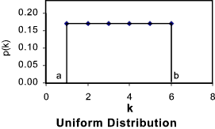
What Kind of Probability Distribution is:
Rolling one 6-sided dice (d6)?
Uniform (or “square”)
The number of 1’s when rolling 20 d4’s?
Binomial
The number of people that buy glazed donuts every 5 minutes at DD?
Poisson
http://tinyurl.com/y4j5u64d

Slide 34
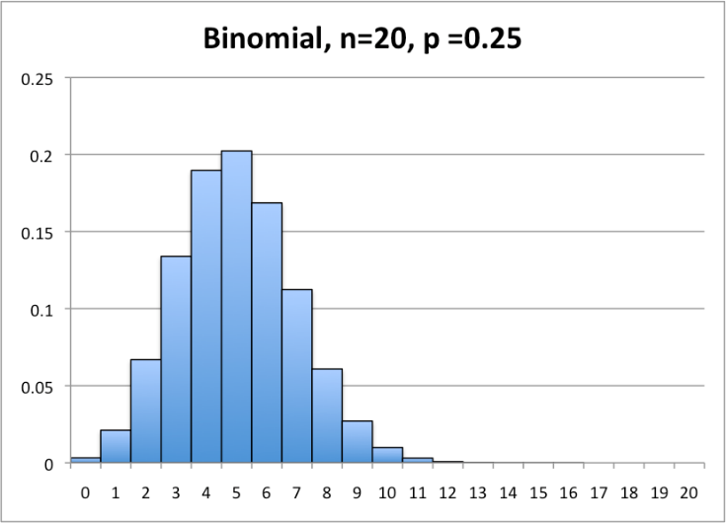
What Kind of Probability Distribution is:
Rolling one 6-sided dice (d6)?
Uniform (or “square”)
The number of 1’s when rolling 20 d4’s?
Binomial
The number of people that buy glazed donuts every 5 minutes at DD?
Poisson
http://tinyurl.com/y4j5u64d
http://statistics.wikidot.com/local--files/ch6/binomial.png

Slide 35
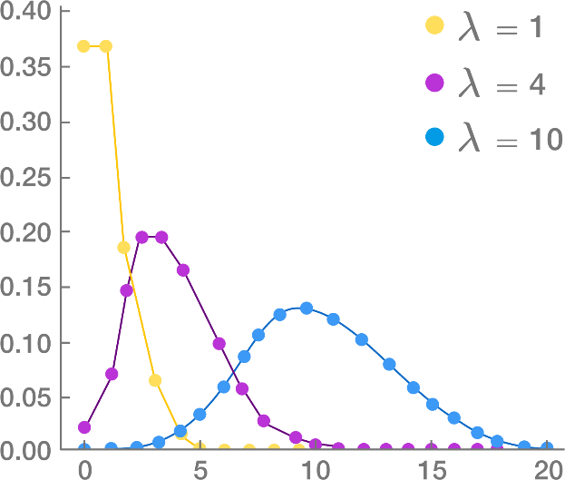
What Kind of Probability Distribution is:
Rolling one 6-sided dice (d6)?
Uniform (or “square”)
The number of 1’s when rolling 20 d4’s?
Binomial
The number of people that buy glazed donuts every 5 minutes at DD?
Poisson
http://tinyurl.com/y4j5u64d
http://tinyurl.com/y4682dvh
http://statistics.wikidot.com/local--files/ch6/binomial.png

Slide 36
What are the characteristics of an experiment with a binomial distribution of outcomes?

Slide 37
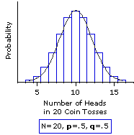
What are the characteristics of an experiment with a binomial distribution of outcomes?
Experiment consists of n independent, identical trials
Each trial results in only success or failure (probability p for success for each)
Random variable of interest (X) is number of successes in n trials
http://www.vassarstats.net/textbook/f0603.gif

Slide 38
What are the characteristics of an experiment with a Poisson distribution of outcomes?

Slide 39
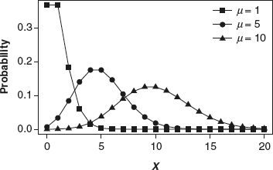
What are the characteristics of an experiment with a Poisson distribution of outcomes?
Interval (e.g., time) with units
Probability of event same for all interval units
Number of events in one unit independent of others
Events occur singly (not simultaneously)
Random variable of interest (X) is number of events that occur in an interval
http://methods.sagepub.com/images/virtual/encyc-of-research-design/p1043-1.jpg
Phrase people use is “random arrivals”

Slide 40
What is the Standard Normal Distribution?

Slide 41
What is the Standard Normal Distribution?
Normal distribution
Mean μ = 0
Std dev σ = 1
μ = 0

Slide 42
What is a Quantile-Quantile Plot?

Slide 43
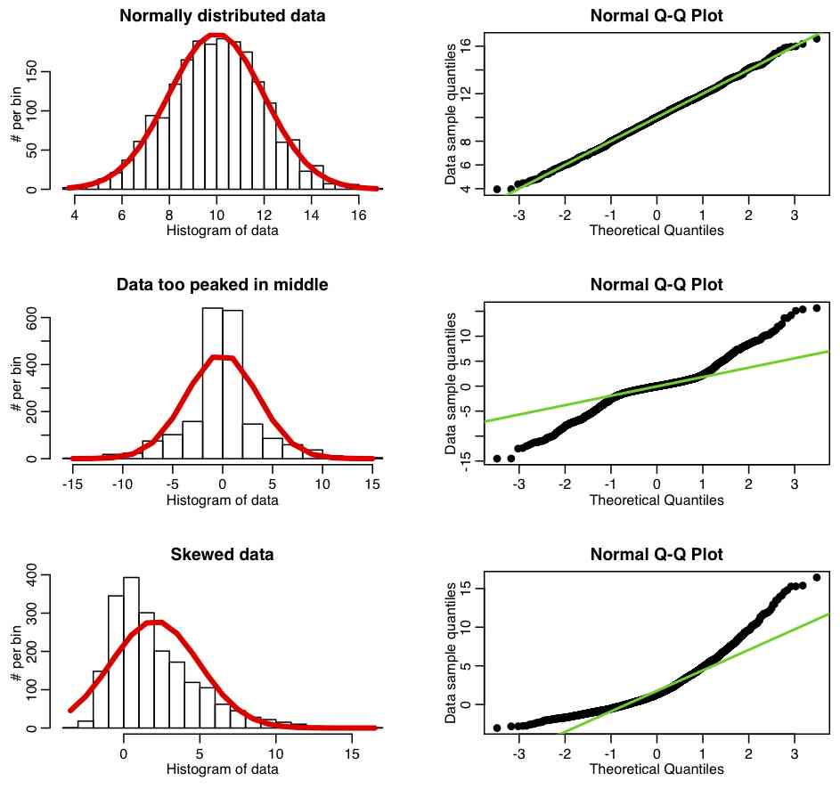
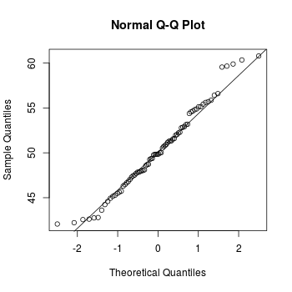
What is a Quantile-Quantile Plot?
Scatter chart showing quantiles (percentiles) of one distribution versus quantiles (percentiles) of another
Typically with a horizontal line “fit” to points
http://sherrytowers.com/wp-content/uploads/2013/08/qqplot_examples.jpg
http://www.cookbook-r.com/Graphs/Q-Q_plot/figure/unnamed-chunk-3-1.png
How to read? → On line, distributions are similar

Slide 44
What is the Central Limit Theorem?
Given population
If take large enough sample size
What does probability of sample means look like?
→ What is Distribution shape?

Slide 45
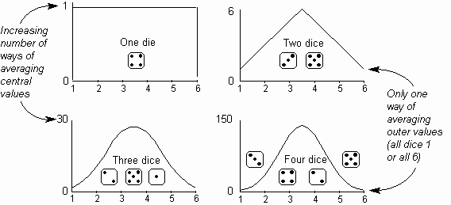
What is the Central Limit Theorem?
Given population
If take large enough sample size
What does probability of sample means look like?
→ Distributed Normally
How big is “enough”?
http://home.ubalt.edu/ntsbarsh/Dice_001.gif

Slide 46
What is the Central Limit Theorem?
Given population
If take large enough sample size
What does probability of sample means look like?
→ Distributed Normally
How big is “enough”?
30
(15)
Does underlying distribution matter?
http://home.ubalt.edu/ntsbarsh/Dice_001.gif

Slide 47
What is the Central Limit Theorem?
Given population
If take large enough sample size
What does probability of sample means look like?
→ Distributed Normally
How big is “enough”?
30
(15)
Does underlying distribution matter?
No
(see next slide)
http://home.ubalt.edu/ntsbarsh/Dice_001.gif

Slide 48
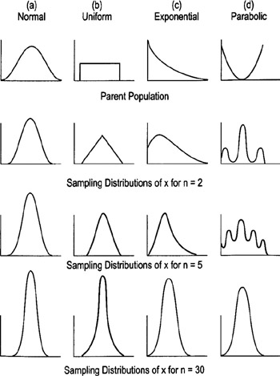
Underlying Distribution does not Matter
Why do we care?
→ Can apply rules (e.g., empirical rule) to Normal Distributions!
http://flylib.com/books/2/528/1/html/2/images/figu115_1.jpg

Slide 49
Sampling Error
What is sampling error?

Slide 50
Sampling Error
What is sampling error?
Error from estimating population parameters from sample statistics
Size of error is based on what two main factors?

Slide 51
Sampling Error
What is sampling error?
Error from estimating population parameters from sample statistics
Size of the error is based on what two main factors?
Population variance
Sample size (N)

Slide 52
Statistic versus Sample Size
Suppose wanted to know likelihood that WPI student played Heroes of the Storm
Ask N people, count “yes” and divide by N
Ask 1 person?
Ask 2 people?
Ask 100 people?
What does graph
of “yes” probability
versus N people look
like?

Slide 53
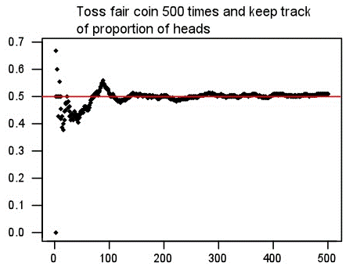
Statistic versus Sample Size
Suppose wanted to know likelihood that WPI student played Heroes of the Storm
Ask N people, count “yes” and divide by N
Ask 1 person?
Ask 2 people?
Ask 100 people?
What does graph
of “yes” probability
versus N people look
like?
Probability “yes”
Number of people asked

Slide 54
Confidence Intervals
What is a confidence interval? Give an example

Slide 55
Confidence Intervals
What is a confidence interval? Give an example
Range of values with specific certainty that population parameter is within
95% confidence interval for mean time to complete a level in Super Mario: [1.25 minutes, 1.75 minutes]
What is the size of confidence interval based on?

Slide 56
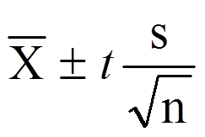
Confidence Intervals
What is a confidence interval? Give an example
Range of values with specific certainty that population parameter is within
95% confidence interval for mean time to complete a level in Super Mario: [1.25 minutes, 1.75 minutes]
What is the size of confidence interval based on?
Confidence (1-α)
Standard error (N, number of items in sample) (standard deviation)

Slide 57
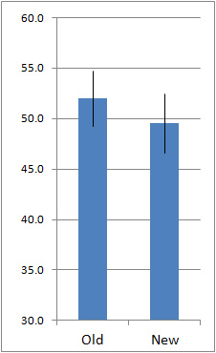
Interpreting Confidence Intervals
Assume bars are conference intervals
Interpret difference in old versus new

Slide 58
Interpreting Confidence Intervals
Assume bars are conference intervals
Interpret difference in old versus new
Large overlap
No statistically significant difference (at given α level)
Helpful hint: ignore sample means. Think about population means for Old and New

Slide 59
Hypothesis Testing
What is the Null Hypothesis?
No significance difference between measured value and population parameter
What is the Alternate Hypothesis?
Contrary to null hypothesis (i.e., there is a difference)
Which do we test and why?
Test Null
Data can only reject hypothesis, not prove
→ Reject Null

Slide 60
Hypothesis Testing
What is the Null Hypothesis?
No significance difference between measured value and population parameter
What is the Alternate Hypothesis?
Contrary to null hypothesis (i.e., there is a difference)
Which do we test and why?
Test Null
Data can only reject hypothesis, not prove
→ Reject Null

Slide 61
Hypothesis Testing
What is the Null Hypothesis?
No significance difference between measured value and population parameter
What is the Alternate Hypothesis?
Contrary to null hypothesis (i.e., there is a difference)
Which do we test and why?
Test Null
Data can only reject hypothesis, not prove
→ Reject Null

Slide 62
Hypothesis Testing
Gathered data, computed sample mean, created Null hypothesis (H₀), chose significance (α = 0.01)
Calculate p-value = 0.05
Make inference: CAN or CANNOT reject H₀?
CANNOT reject H₀
What does that mean?
May be no difference between sample mean and population mean (at 0.01 significance)

Slide 63
Hypothesis Testing
Gathered data, computed sample mean, created Null hypothesis (H₀), chose significance (α = 0.01)
Calculate p-value = 0.05
Make inference: CAN or CANNOT reject H₀?
CANNOT reject H₀
What does that mean?
May be no difference between sample mean and population mean (at 0.01 significance)

Slide 64
Hypothesis Testing
Gathered data, computed sample mean, created Null hypothesis (H₀), chose significance (α = 0.01)
Calculate p-value = 0.05
Make inference: CAN or CANNOT reject H₀?
CANNOT reject H₀
What does that mean?
May be no difference between sample mean and population mean (at 0.01 significance)

Slide 65
Regression
What is the role of regression in data analytics?
To predict an unobserved value from a mathematical model
What is simple linear regression?
A linear model relating two variables/factors
m is slope, b is y-intercept
Y = mX + b

Slide 66
Regression
What is the role of regression in data analytics?
To predict an unobserved value from a mathematical model
What is simple linear regression?
A linear model relating two variables/factors
m is slope, b is y-intercept
Y = mX + b

Slide 67
Regression
What is the role of regression in data analytics?
To predict an unobserved value from a mathematical model
What is simple linear regression?
A linear model relating two variables/factors
m is slope, b is y-intercept
Y = mX + b

Slide 68
Regression
If the market value of a house can be represented by the model:
value = 32673 + 35.036 x (square feet)
How do you interpret the model? How can you use it?
Intercept is 32673. Base house value is $32k.
Slope is 35.036. Every square foot increases house value by $35
Given square feet, predict value: 1800 sq feet
value = 32,673 + 35.036 x (1800) = $95,737.80

Slide 69
Regression
If the market value of a house can be represented by the model:
value = 32673 + 35.036 x (square feet)
How do you interpret the model? How can you use it?
Intercept is 32673. Base house value is $32k.
Slope is 35.036. Every square foot increases house value by $35
Given square feet, predict value: 1800 sq feet
value = 32,673 + 35.036 x (1800) = $95,737.80

Slide 70
What are Residuals?

Slide 71
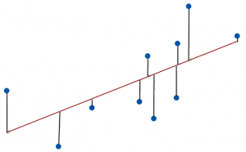
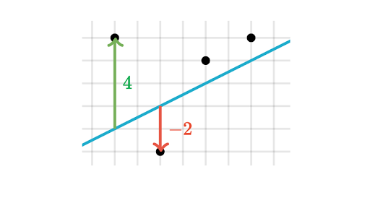
What are Residuals?
A residual is difference between observed value and predicted value
Vertical distance between a data point and regression line

Slide 72
What is Residual Analysis?

Slide 73
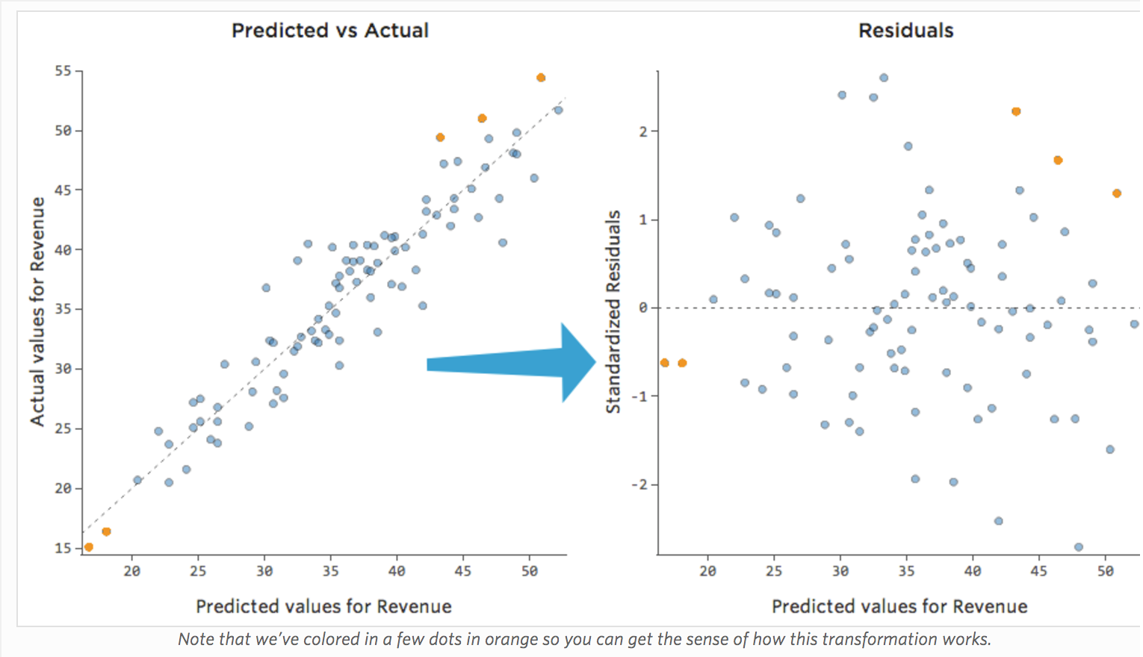
What is Residual Analysis?
https://www.qualtrics.com/support/stats-iq/analyses/regression-guides/interpreting-residual-plots-improve-regression/
Chart residuals on vertical axis and independent variable on horizontal axis. No pattern? → Linear ok

Slide 74
What is Least Squares Line?

Slide 75
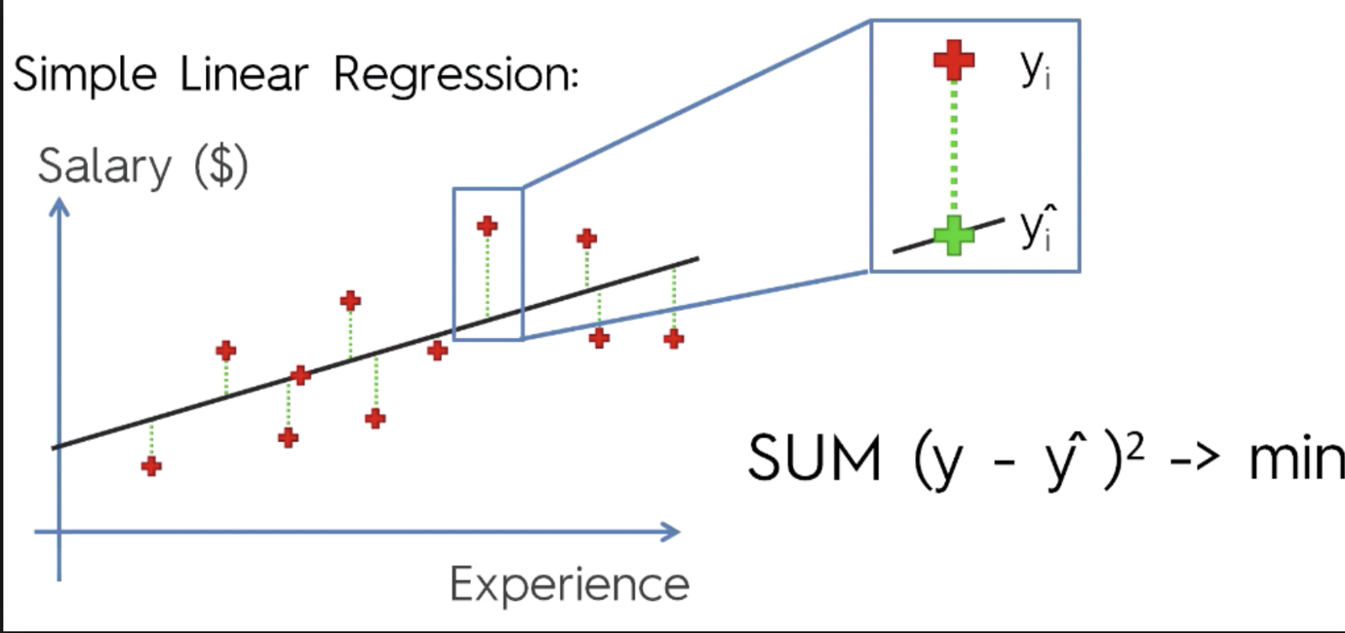
What is Least Squares Line?
Line that minimizes sum squared error
Y = mX + b
https://cdn-images-1.medium.com/max/1600/1*AwC1WRm7jtldUcNMJTWmiA.png

Slide 76
What is the Coefficient of Determination (R²)?

Slide 77
What is the Coefficient of Determination (R²)?
Proportion of variance in the dependent variable predictable by the independent variable
Percentage of variance explainable by model
$$R2=\frac{SSR}{SST}=1−\frac{SSE}{SST}$$

Slide 78
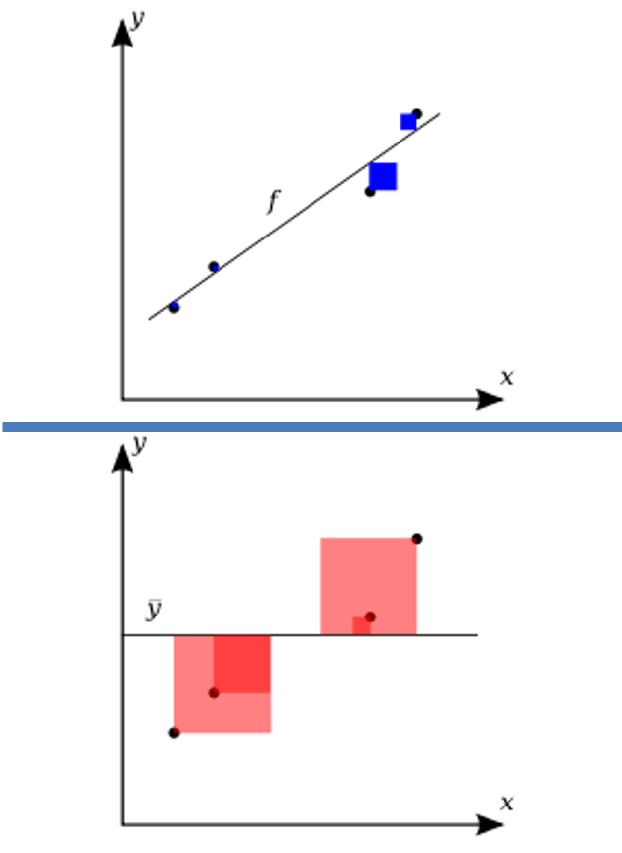
What is the Coefficient of Determination (R²)?
Variation in observed data model cannot explain (error)
R² = 1 -
Total variation in observed data
https://upload.wikimedia.org/wikipedia/commons/thumb/8/86/Coefficient_of_Determination.svg/400px-Coefficient_of_Determination.svg.png

Slide 79
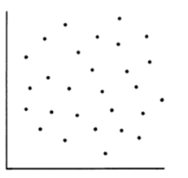
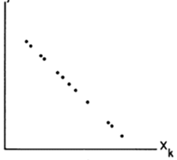
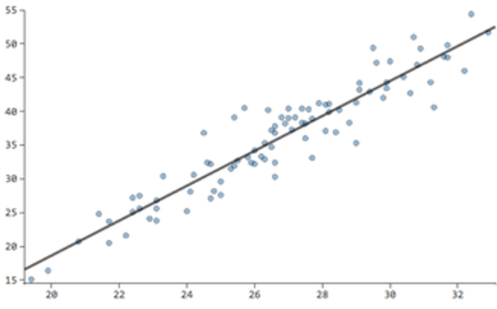
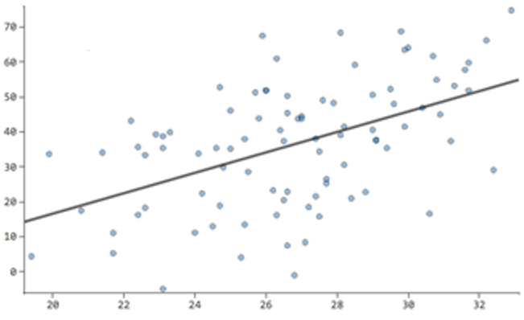
What is a the value of R²?

Slide 80
What is a the value of R²?
R² = 0
R² = 1
R² = 0.8
R² = 0.2

