Slide 1
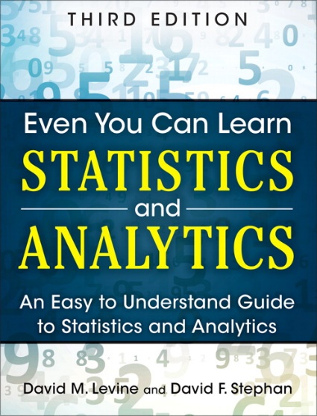
Descriptive Statistics
IMGD 2905
Chapter 3

Slide 2
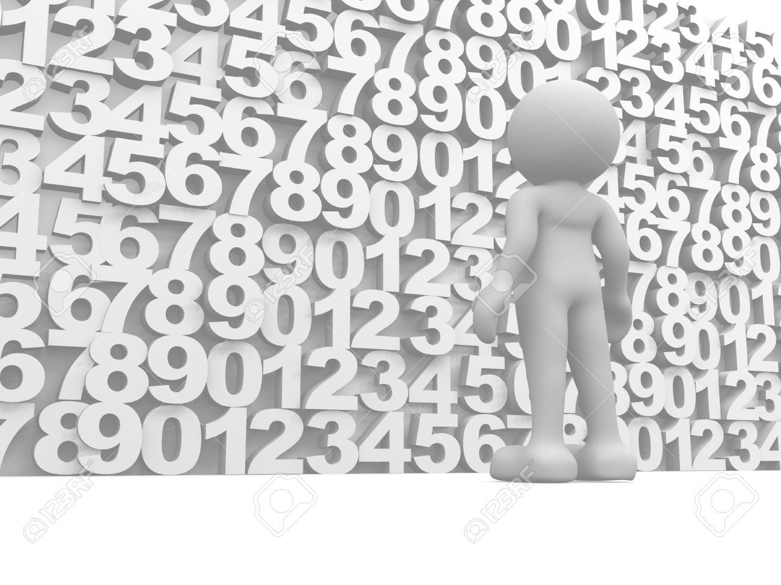
Summarizing Data
With lots of playtesting, there is a lot of data
  This is a good thing!
But raw data is just a pile of numbers
  Rarely of interest
  Or even sensible
Q: How to summarize all this information?

Slide 3
Summarizing Data
With lots of playtesting, there is a lot of data
  This is a good thing!
But raw data is just a pile of numbers
  Rarely of interest
  Or even sensible
Q: How to summarize all this information?
Measures of central tendency
Examples?

Slide 4
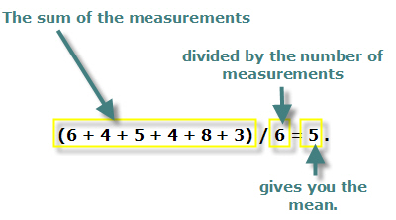

Measure of Central Tendency: Mean
Also called the “arithmetic mean” or “average”
In Excel, =AVERAGE(range)
  =AVERAGEIF() – averages if numbers meet certain condition
http://www.cdn.sciencebuddies.org/Files/463/9/MeanEquation.jpg

Slide 5
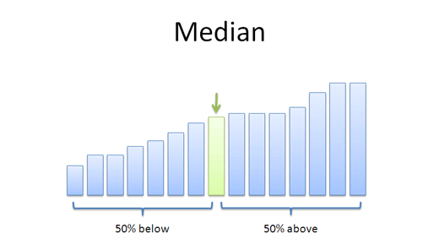

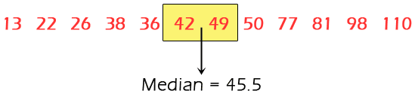
Measure of Central Tendency: Median
Sort values low to high and take middle value
https://www.mathsisfun.com/definitions/images/median.gif
https://betterexplained.com/wp-content/uploads/average/median.png
http://www.nedarc.org/statisticalHelp/basicStatistics/measuresOfCenter/images/median.gif
In Excel, =MEDIAN(range)

Slide 6
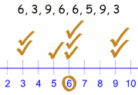
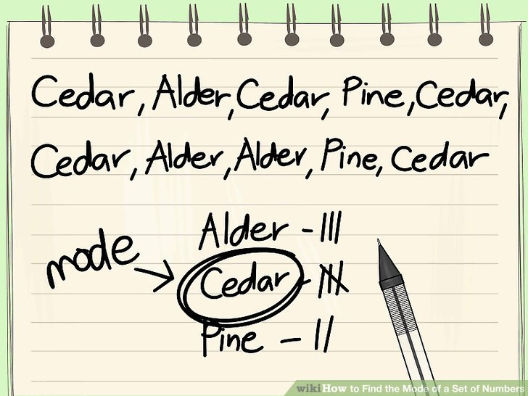
Measure of Central Tendency: Mode
Number which occurs most frequently
Not too useful in many cases
→ Best use for categorical data
  e.g., most popular Hero group in Heroes of the Storm
In Excel, =MODE()
http://pad3.whstatic.com/images/thumb/c/cd/Find-the-Mode-of-a-Set-of-Numbers-Step-7.jpg/aid130521-v4-728px-Find-the-Mode-of-a-Set-of-Numbers-Step-7.jpg

Slide 7
Depiction: Mean, Median, Mode?
frequency
frequency
(a)
frequency
(b)
(c)
frequency
frequency
(d)
(d)

Slide 8
Depiction: Mean, Median, Mode?
mean
median
mode
modes
frequency
mean
median
frequency
no mode
(a)
frequency
mean
median
(b)
mode
mode
(c)
median
median
frequency
frequency
mean
mean
(d)
(d)

Slide 9
Which to Use, Mean, Median, Mode?

Slide 10
Which to Use, Mean, Median, Mode?
Mean many statistical tests with sample
  Estimator of population mean
  Uses all data
Median is useful for skewed data
  e.g., income data (US Census) or housing prices (Zillo)
  e.g., Overwatch team (6 players): 5 people level 5, 1 person level 275
    Mean is 50 - not so useful since no one at this level
    Median is 5 - more representative
  Does not use all data. “Resistant” to extremes (e.g., 275)
  But what if were exam scores? Hard to “bring up” grade
Mode is useful primarily for categorical data only
  Most played League champion, most popular maze, …

Slide 11
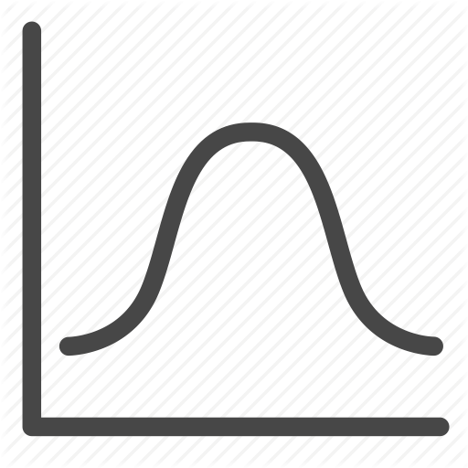
Other Measures of Position
May not always want center
  e.g., want to know best League Champions
What other positions may be desired?
?

Slide 12
Other Measures of Position
May not always want center
  e.g., want to know best League Champions
Maximum / Minimum
  Not discussed more
Trimmed Mean
Quartiles
Percentiles
?

Slide 13
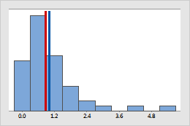
Trimmed Mean
Take “trimming” off top and bottom (typically 5% or 10%)
  Reduces effects of extreme values, like median
In Excel, =TRIMMEAN(array,percent)
Blue – original mean
Red – trimmed mean
http://support.minitab.com/en-us/minitab/17/histogram_mean_vs_trimmed_mean.png

Slide 14
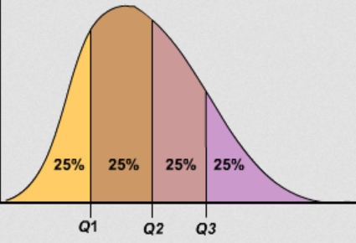
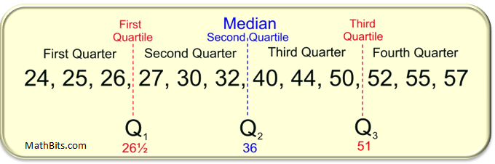
Quartiles
Sort values
First quartile (Q1) is 25% from bottom
Third quartile (Q3) is 75% from bottom
(What is second quartile?)
In Excel, =QUARTILE(array,n)
https://mathbitsnotebook.com/Algebra1/StatisticsData/quartileboxview2.png
https://www.hackmath.net/images/quartiles.png

Slide 15

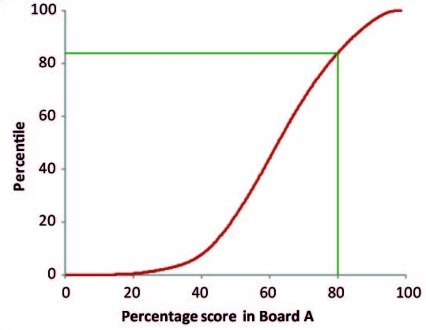
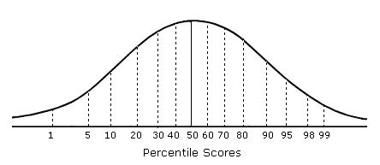
Percentiles
Generalization of quartiles
N^{th} percentile is data point n% from bottom of data
Interpolate as for first quartile
In Excel, =PERCENTILE(array,k) (k: 0 to 1)
https://www.mathsisfun.com/data/images/percentile-80.svg
http://www.psychometric-success.com/images/AA1301.gif
http://www.isical.ac.in/~jeexiiscore_normal/PercentilesAdvantages.htm

Slide 16
Summarizing Data, Part 2
Ok, pile of numbers can now be summarized as one number
  Mean, median, mode
But is that enough?
Q: What other major aspect of numbers haven’t we summarized?

Slide 17
Summarizing Data, Part 2
Ok, pile of numbers can now be summarized as one number
  Mean, median, mode
But is that enough?
Q: What other major aspect of numbers haven’t we summarized?
Measures of variation
(aka measures of dispersion, or measures of spread)

Slide 18
Summarizing Data, Part 2
“Then there is the man who drowned crossing a stream
with an average depth of six inches.” – W.I.E. Gates
Summarizing by single number rarely enough → need statement about variation
Frequency
Frequency
mean
mean
Player High Score
Player High Score
Above: does single number (mean) tell you enough about data?

Slide 19
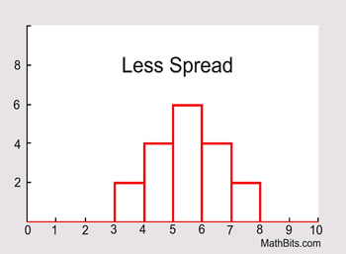
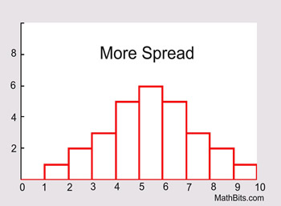
Variation Overview (1 of 3)
Is data clumped or spread out?
https://mathbitsnotebook.com/Algebra1/StatisticsData/STSpread.html

Slide 20
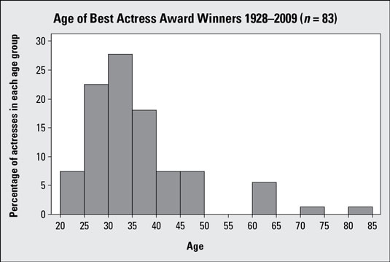
Variation Overview (2 of 3)
Is data clumped or spread out?

Slide 21
Variation Overview (3 of 3)
Is data clumped or spread out?
“Motion and Scene Complexity for Streaming Video Games”
Notes:
Mark Claypool. Motion and Scene Complexity for Streaming Video Games, In Proceedings of the 4th ACM International Conference on the Foundations of Digital Games (FDG), Florida, USA, April 2009. Online at: http://www.cs.wpi.edu/~claypool/papers/game-motion/

Slide 22
What are Some Measures of Variation?

Slide 23
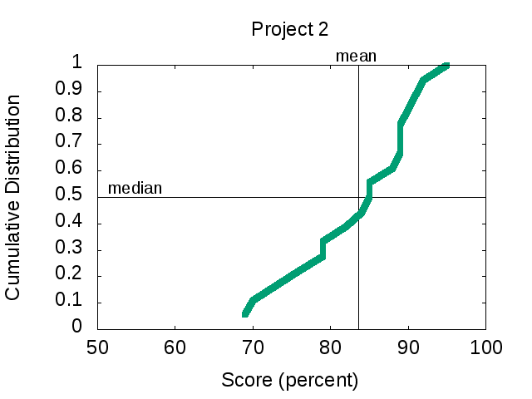
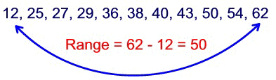
Range
Difference between smallest and largest value
Somewhat obvious, but doesn’t tell you much about “clumping”
  Minimum may be zero
  Maximum can be from outlier
    Event not related to phenomena studied (e.g., 0 on project)
  Maximum gets larger with # samples, so no “stable” point
In Excel, =MAX(array)-MIN(array)
Range = 96 – 69
= 27
Min
Max
http://idolosol.com/images/range-3.jpg

Slide 24
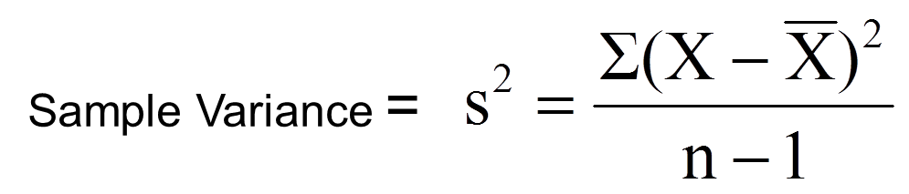
Variance
Compute mean of sample
Compute how far each value in sample is from mean
  Some can be less than mean, some greater
  → So square this difference (why square?)
Divide by number of sample values – 1
  The “-1” corrects “bias” when trying to estimate population variance using sample variance
“sum up all”
“mean”

Slide 25
Variance Example
Sample kills in League of Legends match
  12, 20, 16, 18, 19
  What is sample variance?
First, mean = 85 / 5 = 17
Kills X – mean (X – mean)²
12 -5 25
20 3 9
16 -1 1
18 1 1
19 2 4
s² = (25 + 9 + 1 + 1 + 4) / (5 – 1) = 40 / 4 = 10 kills squared
In Excel, =VAR(array)
“Larger” means “more spread”
… but units odd

Slide 26
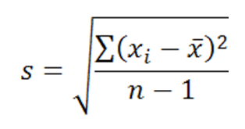
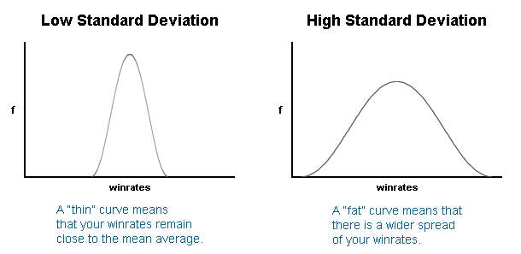
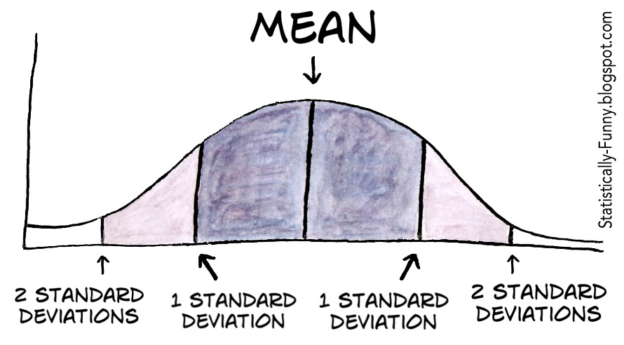
Standard Deviation
Square-root of variance
Usually, use standard deviation instead of variance
  Why? → Same units as data (e.g., “kills” in previous example)
Can compare standard deviation to mean (coefficient of variation, next)
But first:
  Mendenhall’s Empirical Rule
  Z-score
s

Slide 27
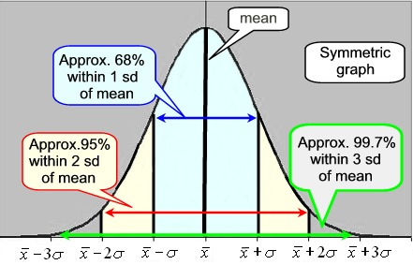
Mendenhall’s Empirical Rule
About 68% data within one standard deviation of mean
  interval between mean-s and mean+s contains about 68% of data
About 95% within 2 standard deviations of mean
Almost all data within 3 standard deviations of mean
https://mathbitsnotebook.com/Algebra1/StatisticsData/normalgrapha.jpg
Rule assumes normal (“Bell curve”) distribution

Slide 28
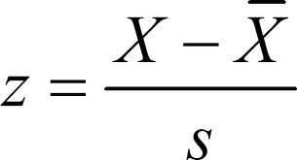
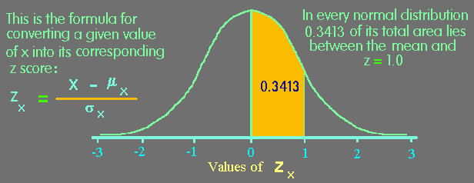
Z-Score
Measure of how “far” from center (mean) single data point is
  Not measure of dispersion for whole data set
Example
Mean 469
Std dev 119
X 650
Z-score for X?
(650 – 469)/119 1.52
https://www.animatedsoftware.com/pics/stats/sgzscor2.gif

Slide 29
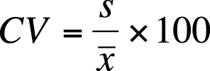
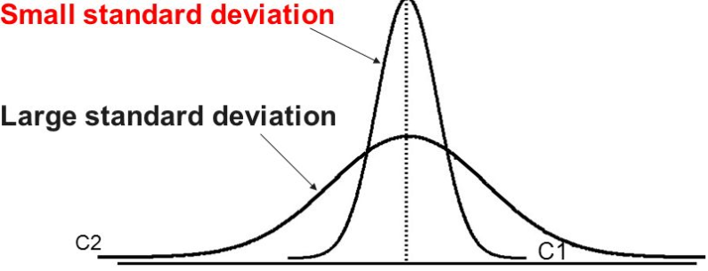
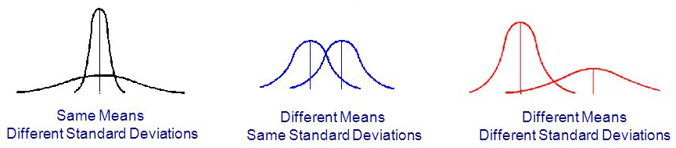
Coefficient of Variation (CV)
Size of standard deviation relative to mean
  e.g., large sd & large mean, not so spread
  but large sd & small mean, more spread
Standard deviation divided by mean
  Can do this since same units!
CV is “unit-less”, so measure of spread independent of quantity
  E.g. seconds, clicks, spaces
  Shown as percent (multiply by 100)
http://images.slideplayer.com/35/10391754/slides/slide_59.jpg
http://goo.gl/wrfVtH

Slide 30
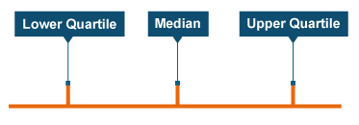
Semi-Interquartile Range
½ distance between Q3 (75th percentile) and Q1 (25th percentile)
Guideline: use semi-interquartile (SIQR) for index of dispersion whenever using median as index of central tendency
Q1
Q3
http://www.bbc.co.uk/staticarchive/9629000486ef4b1a40efa565c162cb779e0bd82c.png
Q3 – Q1
2

Slide 31
Index of Variation Example
(sorted)
Lap Times
First, sort. Then, compute:
  Mean = 4.4
  Min = 1.9, Max = 5.9
  Median = [16 / 2] = 8th = 4.5
  Q1 = 16 / 4 = 8th = 4.1
  Q3 = 3 * 16 / 4 = 12th = 5.1
SIQR = (Q3 - Q1) / 2 = 0.5
Variance = 0.96
Stddev = 0.98
CV = stddev/mean = 0.22
Range = max – min = 4
1.9
2.7
3.9
4.1
4.2
4.2
4.4
4.5
4.5
4.8
4.9
5.1
5.1
5.3
5.6
5.9

Slide 32
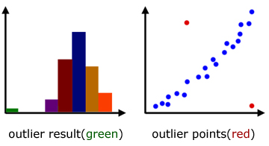
Ranking of Affect by Outliers?
Measure of Variation
Most to Least
Variance
Range
Standard Deviation
Coefficient of Variation
Semi-interquartile Range
?
http://www.a-levelmathstutor.com/images/statistics/outliers-graph01.jpg

Slide 33
Ranking of Affect by Outliers?
Measure of Variation
Most to Least
Variance
Range
Standard Deviation
Coefficient of Variation
Semi-interquartile Range
Range susceptible
Variance
  Standard Deviation
  Coefficient of Variation
SIQR resistant
http://www.a-levelmathstutor.com/images/statistics/outliers-graph01.jpg

Slide 34
Index of Variation Summary
Ranking of affect by outliers
  Range susceptible
  Variance
    Standard deviation
    Coefficient of variation
  Semi-interquartile range resistant
Note, all only applied to quantitative data!
  For categorical data, can’t quantify spread since no ‘distance’ between
  Instead, give number of categories for given percentile of samples
    e.g., “90% of samples are in 3 categories”
    (Pareto chart provides this)

Slide 35
Depicting Variation in Charts
Histogram (done)
Cumulative distribution (done)
Box-and-Whiskers (new)
Error Bars (new)

Slide 36
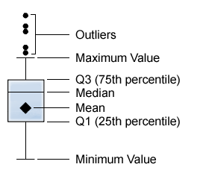
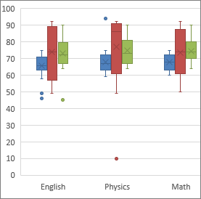
Box-and-Whiskers Chart
Way of showing variation
Highlight middle 50% (interquartile range, IQR)
  “Box”
Lines go to smallest non-outlier
  “Whiskers”
Points indicate outliers
Middle line shows median
Sometimes with mean
Outlier? → Data value “way out there”, “far” from the rest
  Formally, 1.5+ IQRs away from quartile
Available in Excel 2016
http://support.sas.com/documentation/cdl/en/vaug/65747/HTML/default/images/boxplot.png
Sometimes called “boxplot”
https://support.office.com/en-us/article/Create-a-box-and-whisker-chart-62f4219f-db4b-4754-aca8-4743f6190f0d

Slide 37
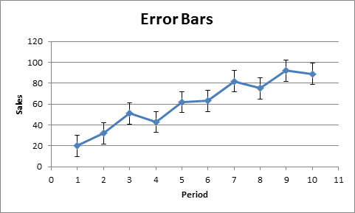
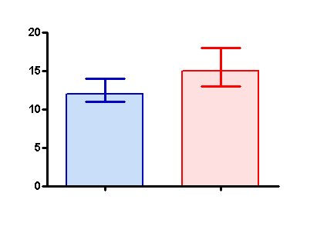
Error Bars
Line through graph point parallel to axis with “caps”
Denotes uncertainty (variation) in value
Excel: click “+” → “Error Bars” → “type”
Often:
  1 standard deviation
Can be (discuss later):
  1 standard error
  1 confidence interval
State clearly!
https://s3.amazonaws.com/cdn.graphpad.com/faq/804/images/804b.jpg
http://www.excel-easy.com/examples/images/error-bars/error-bars.png

