Slide 1
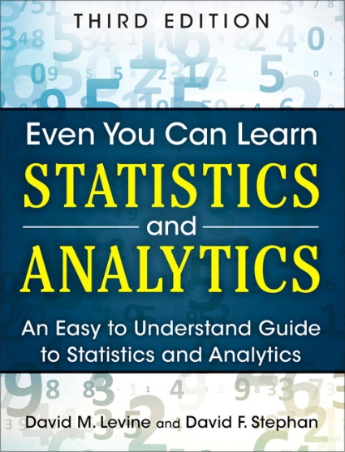
Fundamentals of Statistics
IMGD 2905
Chapter 1

Slide 2
Why Do We Need Statistics?
445 446 397 226
388 3445 188 1002
47762 432 54 12
98 345 2245 8839
77492 472 565 999
1 34 882 545 4022
827 572 597 364
Aggregate data into meaningful information.
Ok, but what are statistics?
→ First, some key words

Slide 3
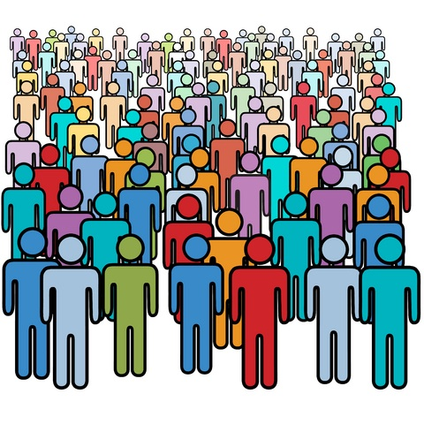
Key Words
Population – all members of group pertaining to a study
Q: examples?
http://www.mycariboonow.com/wp-content/uploads/2016/02/Population.jpg

Slide 4
Key Words
Population – all members of group pertaining to a study
e.g., every person in IMGD 2905 in D-term
e.g., every League of Legends player in the world
In many cases, impossible to survey a population!
Typical for game analytics → want to understand/improve game for all
http://www.mycariboonow.com/wp-content/uploads/2016/02/Population.jpg
Q: So … what to do?

Slide 5
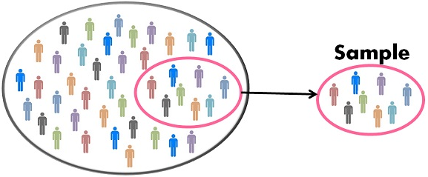
Key Words
Sample – part of population selected for analysis
e.g., all League of Legends players at WPI
e.g., students in first row in IMGD 2905
Q: Is sample same as population?
Is it representative?
http://keydifferences.com/wp-content/uploads/2016/04/census-vs-sample.jpg

Slide 6
Key Words
Sample – part of population selected for analysis
e.g., all League of Legends players at WPI
e.g., students in first row in IMGD 2905
Q: Is sample same as population?
Is it representative?
http://keydifferences.com/wp-content/uploads/2016/04/census-vs-sample.jpg
Often hope sample is representative of population. …
(e.g., poll: “did you finish chart for Project 2, Part 1?”)
But Is it? → method to obtain sample is important! (We won’t talk much about this right now, however.)

Slide 7
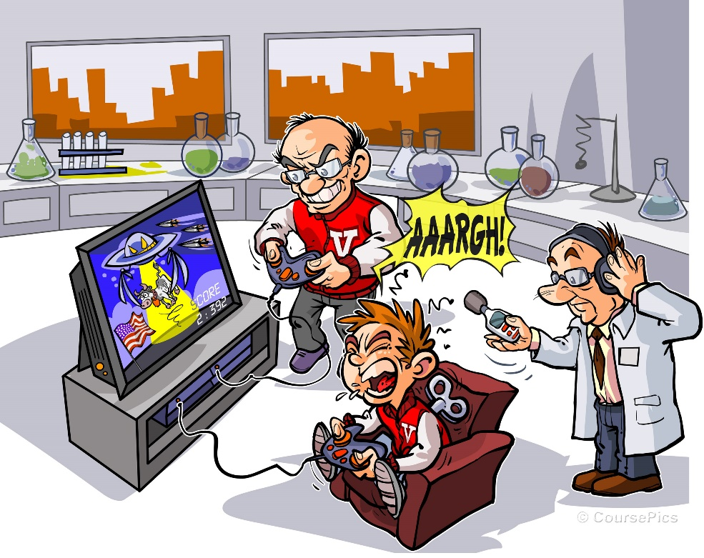
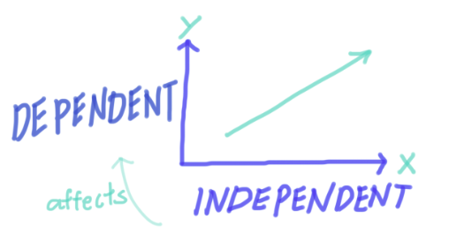
More Key Words
Variable – characteristic of individuals in population analyzing
e.g., time spent in competitive mode in Starcraft 2
e.g., vehicle choice in Grand Theft Auto (GTA)
Independent variable is inherent in population, versus dependent variable that want to assess
http://tinyurl.com/y4b3hj7k
https://dqm1v390v3ac1.cloudfront.net/screen_shot_2017-10-31_at_3.54.16_pm_2.png
https://www.coursepics.com/wp-content/uploads/2016/11/Independent-and-Dependent-Variable.jpg

Slide 8
More Key Words
Observation – all variable values for sample
e.g., League of Legends competitive hours/week and Champion most played could be (2 observations)
“Player A: Leona, 2 hours”
“Player B: Teemo, 7.5 hours”
Can be continuous (time) or discrete (Champions)
Often, data in grid
Observation in rows
Variables in columns
Format works well for spreadsheet
Consider our project 1 → LoL data!
Player Hours Champ
A 2 Leona
B 7.5 Teemo

Slide 9
Putting It Together
Designing Super Mario World levels
What are some dependent variables?
What are some independent variables?
What are some variables?
What are some observations?
https://tinyurl.com/trb4h7v
Q: Breakout rooms? Participants →
https://tinyurl.com/s8tcprt

Slide 10
Putting It Together
Designing Super Mario World levels
What are some dependent variables?
What are some independent variables?
What are some variables?
What are some observations?
Time, Deaths/fails, Fun …
Koopas, power ups, gap lengths …
Time spent getting coins, Number of jumps …
A, 10s, 12 jumps

Slide 11
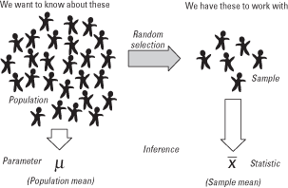
Even More Key Words
Parameter – measure of dependent variable for population
e.g., average crashes in Mario Cart level for everyone
Usually what we want to know, but can’t get easily
Statistic – measure of dependent variable in sample
e.g., average crashes in Mario Cart level for IMGD 2905 class
Statistics – set of numerical methods for getting information about population based on data from sample, usually to get information about population parameters
“Statistics - a branch of mathematics dealing with the collection, analysis, interpretation, and presentation of masses of numerical data.”
-- Merriam-Webster dictionary
https://qph.ec.quoracdn.net/main-qimg-058791361f10bc9a0339823e1e01d3ec

Slide 12
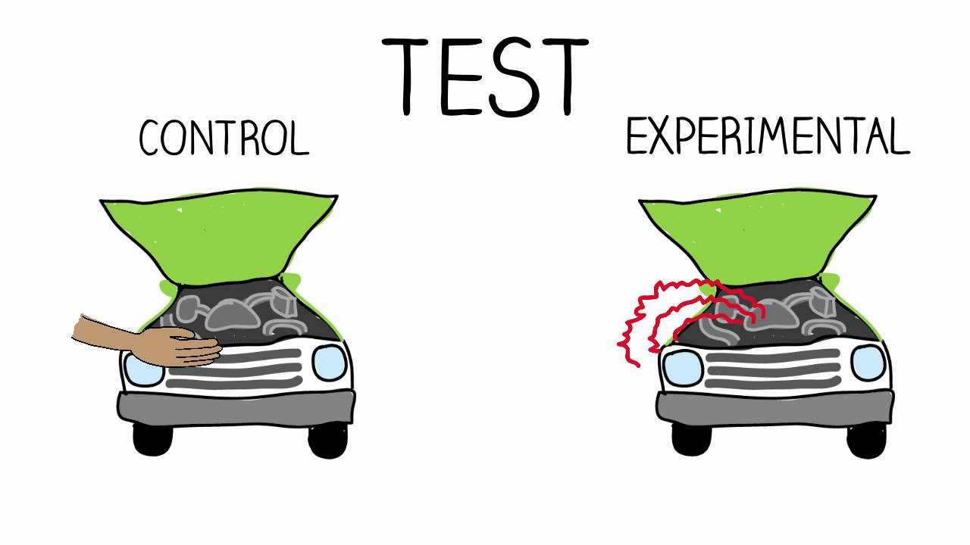
Sources of Data
Published – generally made available from those that collected it
e.g., Riot’s League of Legends data
e.g., Metacritic’s reviews and ratings
e.g., HOTS Logs dataset on Heroes of the Storm
Experiments – multiple trials to collect data from sample
Can be in laboratory or “real world” setting
e.g., play shooter, add lag and play again
Survey – ask people to answer questions
e.g., self-rating as gamer, difficulty with level, …
Ethical issues with stress and use of data
→ Institute Review Board (IRB) for approval with human subjects
https://i.ytimg.com/vi/qtLnBz6lbRQ/maxresdefault.jpg
http://www.mayersmemorial.com/pictures/content/122253.jpg

Slide 13
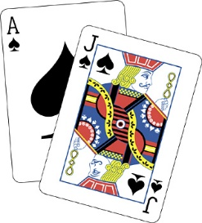
Sampling Concepts
https://tinyurl.com/y4nu9ckf
https://tinyurl.com/y4nu9ckf
Sampling – process by which members of population are selected for sample
e.g., choose ½ class based on seat, or choose ½ class based on alphabet
Probability sampling – sampling considering likelihood of selection
e.g., survey for intended Champ, ask ½ class, but when tournament starts, result different. Why? → sample didn’t consider League players! (e.g., often similar analogy for voter polls)
e.g., voluntary polls/surveys
Use probability sampling whenever possible, but sometimes it is not (cost) or not known
Sampling with replacement – once sample, put back in pool
e.g., die roll to see which attack boss makes
Sampling without replacement – once sample, won’t sample again
e.g., user survey – don’t allow to submit twice
e.g., deck of 52 cards for blackjack
https://tinyurl.com/y3ndyrom

Slide 14
Using Sample Data
Word “sample” comes from same root word as “example”
Similarly, one sample does not prove a theory, but rather is an example
Basically, in general, definite statement cannot be made about characteristics of all systems
Instead, make probabilistic statement about range of most systems
→ That’s where statistics come in!
Statistics – set of numerical methods for getting information about population based on data from sample, usually to get information about population parameters

