Slide 1
Review
IMGD 2905

Slide 2
What are two main sources for data for game analytics?

Slide 3
What are two main sources for data for game analytics?
Quantitative – instrumented game
Qualitative – subjective evaluation

Slide 4
What steps are in the game analytics pipeline?

Slide 5
What steps are in the game analytics pipeline?
Game (instrumented)
Data (collected from players playing game)
Extracted data (e.g., from scripts)
Analysis
Statistics, Charts, Tests
Dissemination
Report
Talk, Presentation

Slide 6
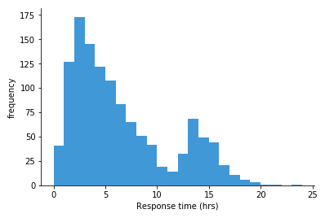
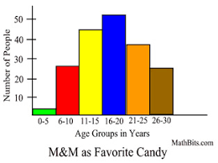
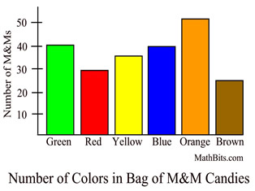
Which Measure of Central Tendency to Use? Why?

Slide 7
What are Quartiles?

Slide 8
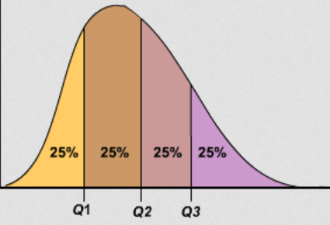
What are Quartiles?
Three values that divide population into four equal sized groups

Slide 9
Describe how to Compute Variance

Slide 10
Describe how to Compute Variance
Compute mean.
Take a sample and compute how far it is from mean. Square this.
Repeat #2 for each sample.
Add up all.
Divide by number of samples (-1).

Slide 11
Self Review
Mendenhall’s Empirical Rule

Slide 12
What can you interpret from Z-score?

Slide 13
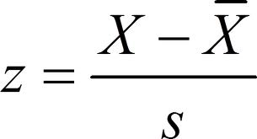
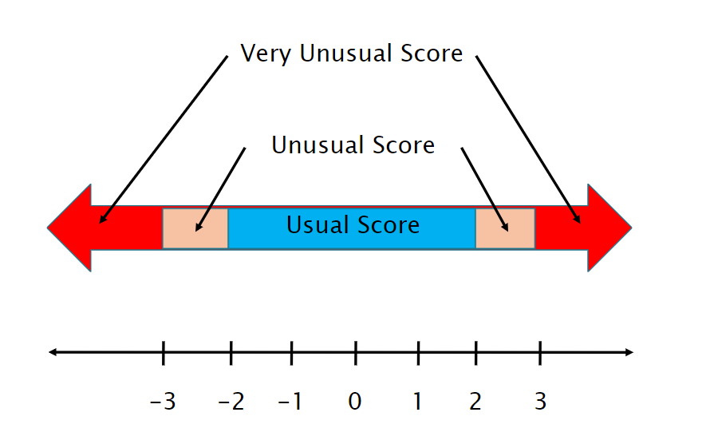
What can you interpret from Z-score?
Where (above or below) score is relative to the median
How “unusual” a score is

Slide 14
What is population versus sample?

Slide 15
What is population versus sample?
Population – all members of group pertaining to study
Typically want parameter of this group
Sample – part of population selected for analysis
Typically compute statistic to estimate parameter

Slide 16
What is probability sampling?

Slide 17
What is probability sampling?
Probability sampling – selecting members from the population group while considering the likelihood of selection
Likelihood as part of population

Slide 18
What is a Variable in Statistics?

Slide 19
What is a Variable in Statistics?
Any characteristics that can be measured, classified or counted
Examples: age, eye color, income, high score, kill-death ratio, vehicle type
e.g., time spent in competitive mode in Starcraft 2
e.g., vehicle choice in Grand Theft Auto (GTA)
Variables in columns
Independent variable is inherent in population, versus dependent variable that want to assess
Player Hours Champ
A 2 Leona
B 7.5 Teemo

Slide 20
What is a Pareto chart? When used?

Slide 21
What is a Pareto chart? When used?
Bar chart, arranged most to least frequent
Line showing cumulative percent
Helps identify most common, relative amounts
https://goo.gl/S7qDTJ

Slide 22
When should you not use pie chart?

Slide 23
When should you not use pie chart?
When too many slices
http://cdn.arstechnica.net/FeaturesByVersion.png

Slide 24
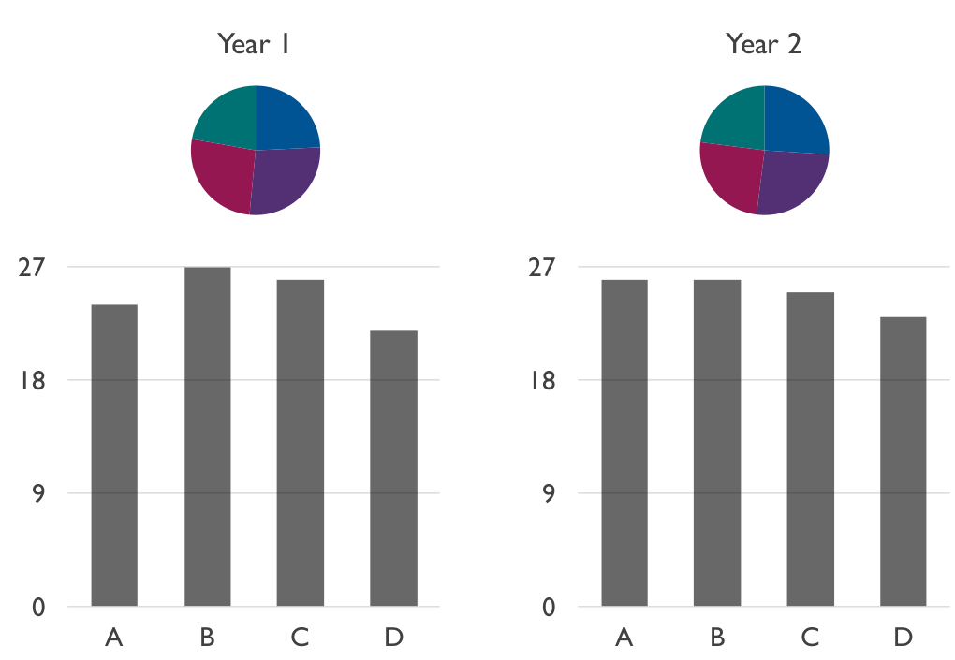
When should you not use pie chart?
(Often) when comparing pies

Slide 25
What is a heat map? Describe an example

Slide 26
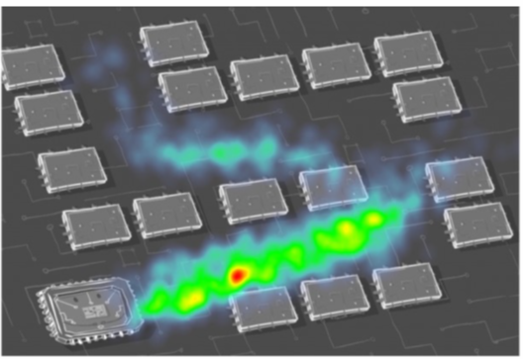
What is a heat map? Describe an example
Map where data represented as colors
Typically, greater values → brighter intensity colors

Slide 27
Provide three guidelines for good charts

Slide 28
Provide three guidelines for good charts
Require minimum effort from reader
Maximize information
Minimize ink
Use commonly accepted practices
Avoid ambiguity

Slide 29
In Probability, what is an Exhaustive Set of Events? Give an Example.

Slide 30
In Probability, what is an Exhaustive Set of Events? Give an Example.
A set of all possible outcomes of an experiment or observation
e.g., coin: events {heads, tails}
e.g., d6: events {even number, odd number}
e.g., picking Champion in LoL: events {Shen, Teemo, Leona, …} (all possible Champions listed)

Slide 31
What Numeric Values do Probabilities take?

Slide 32
What Numeric Values do Probabilities take?
Probabilities must be between 0 and 1 (but often written/said as percent)
Probabilities of set of exhaustive, mutually exclusive events must add up to 1

Slide 33
Probability
Poll 1!
Draw 1 card. What is the probability drawing a Jack?

Slide 34
Probability
Poll 1!
Draw 1 card. What is the probability drawing a Jack?
P(J) =
2 favorable outcomes /
5 total outcomes
= 2/5

Slide 35
Probability
Poll 2!
Draw 2 cards simultaneously. What is the probability of drawing 2 Jacks?

Slide 36
Probability
Poll 2!
Draw 2 cards simultaneously. What is the probability of drawing 2 Jacks?
P(2J) = P(J) x P(J | J)
= 2/5 x 1/4
= 1/10

Slide 37
Probability
Poll 3!
Draw 3 cards simultaneously. What is the probability of not drawing at least one King?

Slide 38
Probability
Poll 3!
Draw 3 cards simultaneously. What is the probability of not drawing at least one King?
P(K’) x P(K’ | K’) x P(K’ | K’K’)
= 3/5 x 2/4 x 1/3
= 6/60
= 1/10

Slide 39
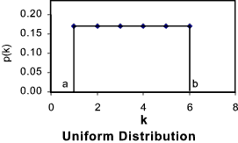
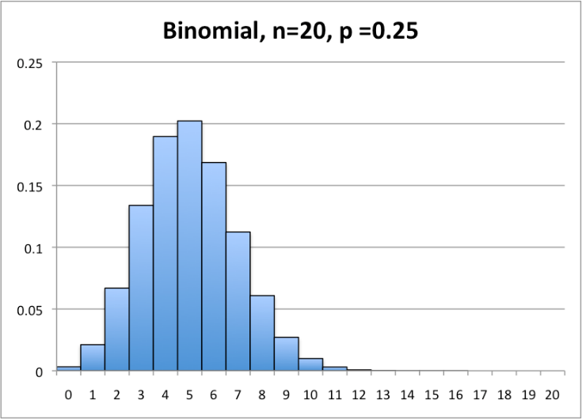
What Kind of Probability Distribution is:
Rolling one 6-sided dice (d6)?
Uniform (or “square”)
Number of 1s when rolling 20 4-sided dice (d4)?
Binomial
http://tinyurl.com/y4j5u64d
http://statistics.wikidot.com/local--files/ch6/binomial.png

Slide 40
What Kind of Probability Distribution is:
Rolling one 6-sided dice (d6)?
Uniform (or “square”)
Number of 1s when rolling 20 4-sided dice (d4)?
Binomial
http://tinyurl.com/y4j5u64d
http://statistics.wikidot.com/local--files/ch6/binomial.png

Slide 41
What Kind of Probability Distribution is:
Rolling one 6-sided dice (d6)?
Uniform (or “square”)
Number of 1s when rolling 20 4-sided dice (d4)?
Binomial
http://tinyurl.com/y4j5u64d
http://statistics.wikidot.com/local--files/ch6/binomial.png

Slide 42
What are the characteristics of an experiment with a binomial distribution of outcomes?

Slide 43
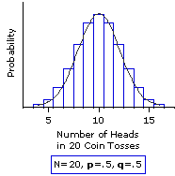
What are the characteristics of an experiment with a binomial distribution of outcomes?
Experiment consists of n independent, identical trials
Each trial results in only success or failure (probability p for success for each)
Random variable of interest (X) is number of successes in n trials
http://www.vassarstats.net/textbook/f0603.gif

Slide 44
What are the characteristics of an experiment with a Poisson distribution of outcomes?

Slide 45
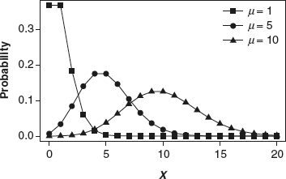
What are the characteristics of an experiment with a Poisson distribution of outcomes?
Interval (e.g., time) with units
Probability of event same for all interval units
Number of events in one unit independent of others
Events occur singly (not simultaneously)
Random variable of interest (X) is number of events that occur in an interval
http://methods.sagepub.com/images/virtual/encyc-of-research-design/p1043-1.jpg
Phrase people use is “random arrivals”

Slide 46
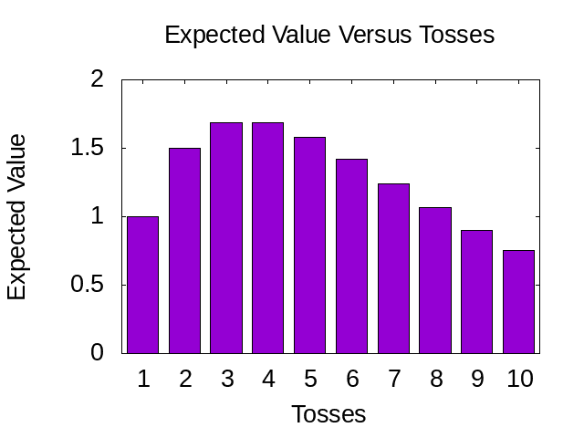
Expected Value
What is average if don’t bust?
A = HT + TH + HH = (1 + 1 + 2) / 3 = 4/3
What is the expected value after 1 toss?
E(X) = P(TT) * 0 + (1- P(TT)) * 4/3
= ¾ * 4/3
= 1
2 tosses?
E(X) = (1-P(TT))² * (4/3 * 2)
= ¾ * ¾ * 8/3
= 1.5
3 tosses?
E(X) = (1-P(TT))³ * (4/3 * 3)
= ¾ * ¾ * ¾ * 12/3
= 1.6875
Toss: Flip 2 coins
Each Head gives 1 point
2 Tails → bust, turn over
Poll!
BEST_BOT?

Slide 47
Expected Value
What is average if don’t bust?
A = HT + TH + HH = (1 + 1 + 2) / 3 = 4/3
What is the expected value after 1 toss?
E(X) = P(TT) * 0 + (1- P(TT)) * 4/3
= ¾ * 4/3
= 1
2 tosses?
E(X) = (1-P(TT))² * (4/3 * 2)
= ¾ * ¾ * 8/3
= 1.5
3 tosses?
E(X) = (1-P(TT))³ * (4/3 * 3)
= ¾ * ¾ * ¾ * 12/3
= 1.6875
Toss: Flip 2 coins
Each Head gives 1 point
2 Tails → bust, turn over
Poll!
BEST_BOT?

Slide 48
Expected Value
What is average if don’t bust?
A = HT + TH + HH = (1 + 1 + 2) / 3 = 4/3
What is the expected value after 1 toss?
E(X) = P(TT) * 0 + (1- P(TT)) * 4/3
= ¾ * 4/3
= 1
2 tosses?
E(X) = (1-P(TT))² * (4/3 * 2)
= ¾ * ¾ * 8/3
= 1.5
3 tosses?
E(X) = (1-P(TT))³ * (4/3 * 3)
= ¾ * ¾ * ¾ * 12/3
= 1.6875
Toss: Flip 2 coins
Each Head gives 1 point
2 Tails → bust, turn over
Poll!
BEST_BOT?

Slide 49
Expected Value
What is average if don’t bust?
A = HT + TH + HH = (1 + 1 + 2) / 3 = 4/3
What is the expected value after 1 toss?
E(X) = P(TT) * 0 + (1- P(TT)) * 4/3
= ¾ * 4/3
= 1
2 tosses?
E(X) = (1-P(TT))² * (4/3 * 2)
= ¾ * ¾ * 8/3
= 1.5
3 tosses?
E(X) = (1-P(TT))³ * (4/3 * 3)
= ¾ * ¾ * ¾ * 12/3
= 1.6875
Toss: Flip 2 coins
Each Head gives 1 point
2 Tails → bust, turn over
BEST_BOT?

Slide 50
Expected Value
What is average if don’t bust?
A = HT + TH + HH = (1 + 1 + 2) / 3 = 4/3
What is the expected value after 1 toss?
E(X) = P(TT) * 0 + (1- P(TT)) * 4/3
= ¾ * 4/3
= 1
2 tosses?
E(X) = (1-P(TT))² * (4/3 * 2)
= ¾ * ¾ * 8/3
= 1.5
3 tosses?
E(X) = (1-P(TT))³ * (4/3 * 3)
= ¾ * ¾ * ¾ * 12/3
= 1.6875
Toss: Flip 2 coins
Each Head gives 1 point
2 Tails → bust, turn over
BEST_BOT?

Slide 51
What is the Standard Normal Distribution?

Slide 52
What is the Standard Normal Distribution?
Normal distribution
Mean μ = 0
Std dev σ = 1
μ = 0

Slide 53
What is the Central Limit Theorem?
Given population
If take large enough sample size
What does probability of sample means look like?
→ What is Distribution shape?

Slide 54
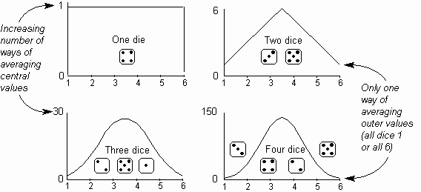
What is the Central Limit Theorem?
Given population
If take large enough sample size
What does probability of sample means look like?
→ Distributed Normally
How big is “enough”?
http://home.ubalt.edu/ntsbarsh/Dice_001.gif

Slide 55
What is the Central Limit Theorem?
Given population
If take large enough sample size
What does probability of sample means look like?
→ Distributed Normally
How big is “enough”?
30
(15)
Does underlying distribution matter?
http://home.ubalt.edu/ntsbarsh/Dice_001.gif

Slide 56
What is the Central Limit Theorem?
Given population
If take large enough sample size
What does probability of sample means look like?
→ Distributed Normally
How big is “enough”?
30
(15)
Does underlying distribution matter?
No
(see next slide)
http://home.ubalt.edu/ntsbarsh/Dice_001.gif

Slide 57
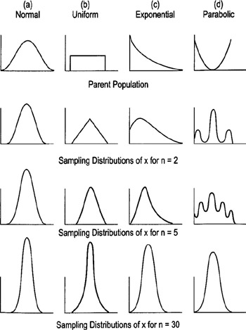
Underlying Distribution does not Matter
Why do we care?
→ Can apply rules (e.g., empirical rule) to Normal Distributions!
http://flylib.com/books/2/528/1/html/2/images/figu115_1.jpg

Slide 58
Sampling Error
What is sampling error?

Slide 59
Sampling Error
What is sampling error?
Error from estimating population parameters from sample statistics
Size of error is based on what two main factors?

Slide 60
Sampling Error
What is sampling error?
Error from estimating population parameters from sample statistics
Size of error is based on what two main factors?
Population variance
Sample size (N)

Slide 61
Statistic versus Sample Size
Suppose wanted to know likelihood that WPI student played Hearthstone
Ask N people, count “yes” and divide by N
Ask 1 person?
Ask 2 people?
Ask 100 people?
What does graph
of “yes” probability
versus N people look
like?

Slide 62
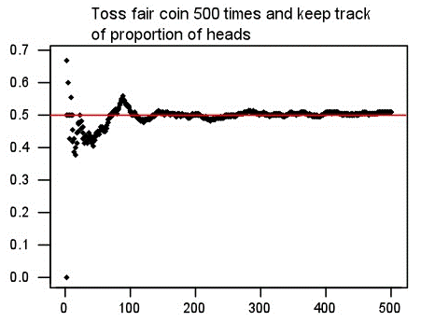
Statistic versus Sample Size
Suppose wanted to know likelihood that WPI student played Hearthstone
Ask N people, count “yes” and divide by N
Ask 1 person?
Ask 2 people?
Ask 100 people?
What does graph
of “yes” probability
versus N people look
like?
Probability “yes”
Number of people asked

Slide 63
Confidence Intervals
What is a confidence interval? Give an example

Slide 64
Confidence Intervals
What is a confidence interval? Give an example
Range of values with specific certainty that population parameter is within
95% confidence interval for mean time to complete a level in Super Mario: [1.25 minutes, 1.75 minutes]
What is the size of confidence interval based on?

Slide 65
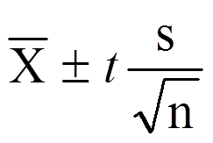
Confidence Intervals
What is a confidence interval? Give an example
Range of values with specific certainty that population parameter is within
95% confidence interval for mean time to complete a level in Super Mario: [1.25 minutes, 1.75 minutes]
What is the size of confidence interval based on?
Confidence (1-α)
Standard error (N, number of items in sample) (standard deviation)

Slide 66
Confidence Intervals
What is a confidence interval? Give an example
Range of values with specific certainty that population parameter is within
95% confidence interval for mean time to complete a level in Super Mario: [1.25 minutes, 1.75 minutes]
What is the size of confidence interval based on?
Confidence (1-α)
Standard error (N, number of items in sample) (standard deviation)

Slide 67
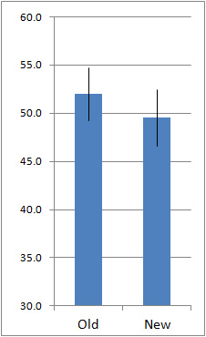
Interpreting Confidence Intervals
Assume bars are conference intervals
Interpret difference in old versus new

Slide 68
Interpreting Confidence Intervals
Assume bars are conference intervals
Interpret difference in old versus new
Large overlap
No statistically significant difference (at given α level)
Helpful hint: ignore sample means. Think about population means for Old and New

Slide 69
Hypothesis Testing
Studio has new model for Hero
Want to see if played more often
Steps?
Gather data
Compute sample mean
Set hypotheses
Test (compute p value)
Analyze results to accept or reject

Slide 70
Hypothesis Testing
Studio has new model for Hero
Want to see if played more often
Steps?
Gather data
Compute sample mean
Set hypotheses
Test (compute p value)
Analyze results to accept or reject

Slide 71
Hypothesis Testing
What is the Null Hypothesis?
No significance difference between measured value and population parameter
What is the Alternate Hypothesis?
Contrary to null hypothesis (i.e., there is a difference)
Which do we test and why?
Test Null
Data can only reject hypothesis, not prove
→ Reject Null

Slide 72
Hypothesis Testing
What is the Null Hypothesis?
No significance difference between measured value and population parameter
What is the Alternate Hypothesis?
Contrary to null hypothesis (i.e., there is a difference)
Which do we test and why?
Test Null
Data can only reject hypothesis, not prove
→ Reject Null

Slide 73
Hypothesis Testing
What is the Null Hypothesis?
No significance difference between measured value and population parameter
What is the Alternate Hypothesis?
Contrary to null hypothesis (i.e., there is a difference)
Which do we test and why?
Test Null
Data can only reject hypothesis, not prove
→ Reject Null

Slide 74
Hypothesis Testing
Gathered “new” data, computed sample mean, created Null hypothesis (H₀), chose significance (α = 0.01)
Calculate p value = 0.05
Make inference: CAN or CANNOT reject H₀?
CANNOT reject H₀
What does that mean?
May be no difference between sample mean and population mean (at 0.01 significance)

Slide 75
Hypothesis Testing
Gathered “new” data, computed sample mean, created Null hypothesis (H₀), chose significance (α = 0.01)
Calculate p value = 0.05
Make inference: CAN or CANNOT reject H₀?
CANNOT reject H₀
What does that mean?
May be no difference between sample mean and population mean (at 0.01 significance)

Slide 76
Hypothesis Testing
Gathered “new” data, computed sample mean, created Null hypothesis (H₀), chose significance (α = 0.01)
Calculate p value = 0.05
Make inference: CAN or CANNOT reject H₀?
CANNOT reject H₀
What does that mean?
May be no difference between “new” mean and population mean (at 0.01 significance)

Slide 77
Regression
What is the purpose of regression in data analytics?
To predict an unobserved value from a mathematical model
What is simple linear regression?
A linear model relating two variables/factors
m is slope, b is y-intercept
Y = mX + b

Slide 78
Regression
What is the purpose of regression in data analytics?
To predict an unobserved value from a mathematical model
What is simple linear regression?
A linear model relating two variables/factors
m is slope, b is y-intercept
Y = mX + b

Slide 79
Regression
What is the purpose of regression in data analytics?
To predict an unobserved value from a mathematical model
What is simple linear regression?
A linear model relating two variables/factors
m is slope, b is y-intercept
Y = mX + b

Slide 80
Regression
If market value of a house can be represented by the model:
value = 32673 + 35.036 x (square feet)
How do you interpret the model? How can you use it?
Intercept is 32673. Base house value is $32k.
Slope is 35.036. Every square foot increases house value by $35
Given square feet, predict value: 1800 sq feet
value = 32,673 + 35.036 x (1800) = $95,737.80

Slide 81
Regression
If market value of a house can be represented by the model:
value = 32673 + 35.036 x (square feet)
How do you interpret the model? How can you use it?
Intercept is 32673. So, base house value is $33k.
Slope is 35.036. So, every square foot increases house value by $35
Given square feet, predict value: 1800 sq feet
value = 32673 + 35.036 x (1800) = $95,737.80

Slide 82
What are Residuals?

Slide 83
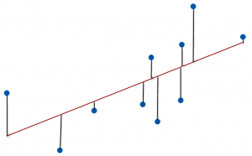
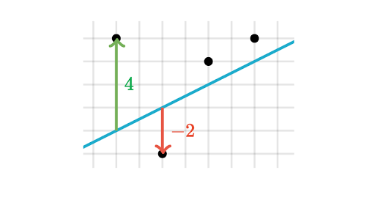
What are Residuals?
A residual is difference between observed value and predicted value
Vertical distance between a data point and regression line

Slide 84
What is Residual Analysis?

Slide 85
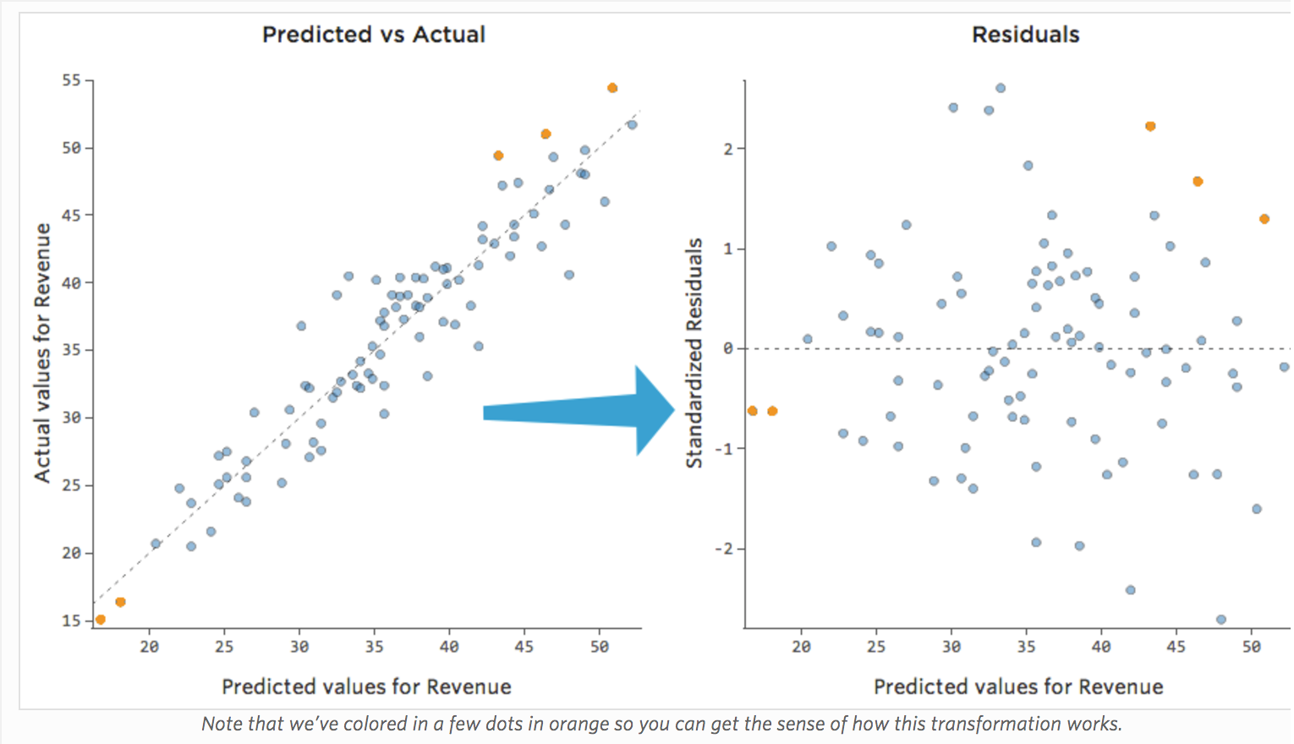
What is Residual Analysis?
https://www.qualtrics.com/support/stats-iq/analyses/regression-guides/interpreting-residual-plots-improve-regression/
Chart residuals on vertical axis and independent variable on horizontal axis. No pattern? → Linear ok

Slide 86
What is Least Squares Line?

Slide 87
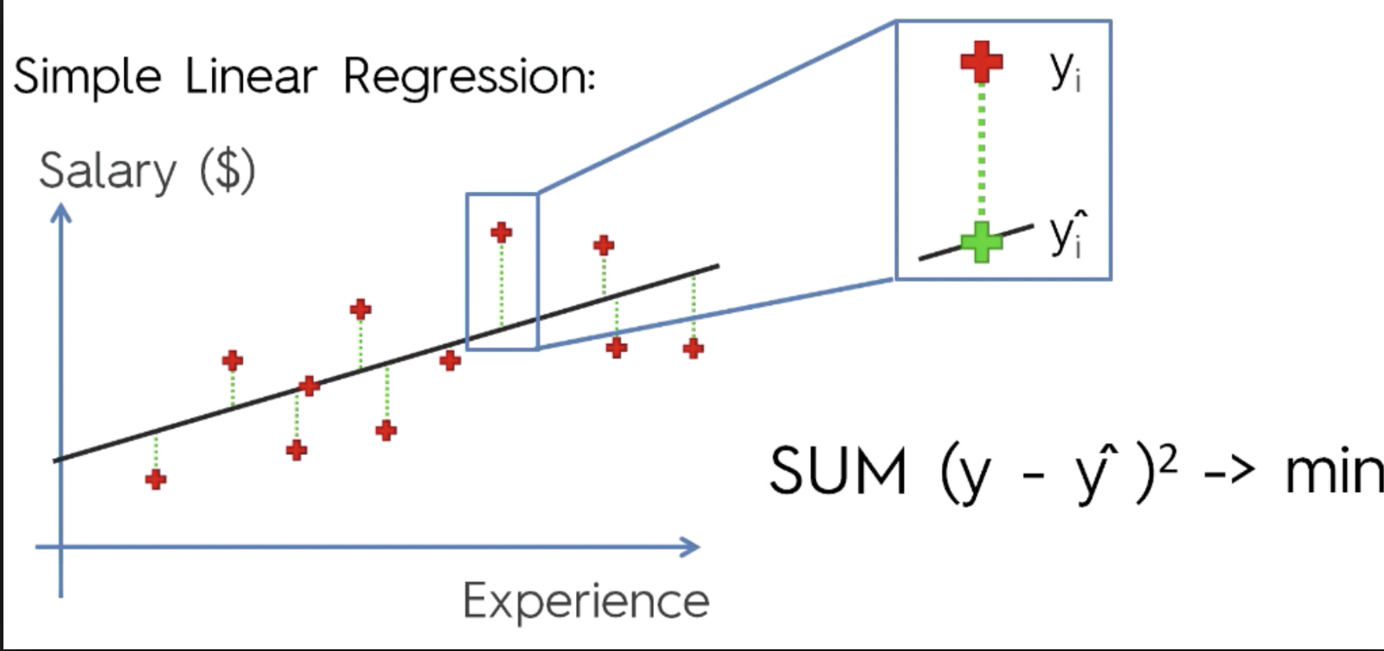
What is Least Squares Line?
Line that minimizes sum squared error
Y = mX + b
https://cdn-images-1.medium.com/max/1600/1*AwC1WRm7jtldUcNMJTWmiA.png

Slide 88
What is the Coefficient of Determination (R²)?

Slide 89
What is the Coefficient of Determination (R²)?
Proportion of variance in the dependent variable predictable by the independent variable
Percentage of variance explainable by model
$$R2=\frac{SSR}{SST}=1−\frac{SSE}{SST}$$

Slide 90
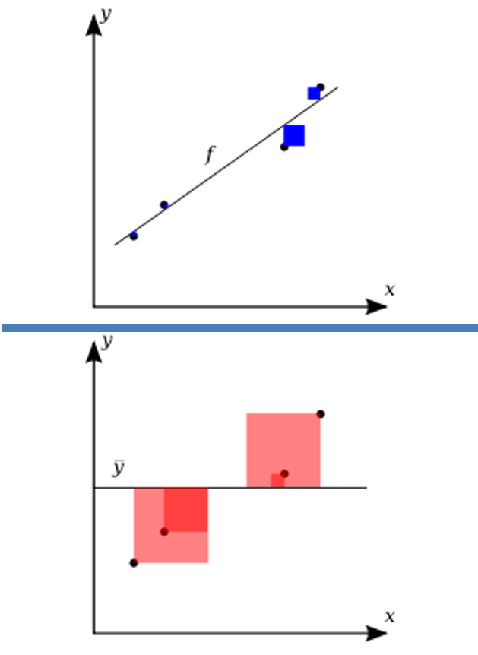
What is the Coefficient of Determination (R²)?
Variation in observed data model cannot explain (error)
R² = 1 -
Total variation in observed data
https://upload.wikimedia.org/wikipedia/commons/thumb/8/86/Coefficient_of_Determination.svg/400px-Coefficient_of_Determination.svg.png

Slide 91
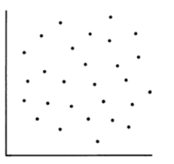
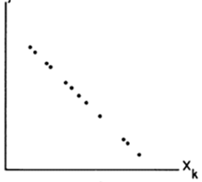
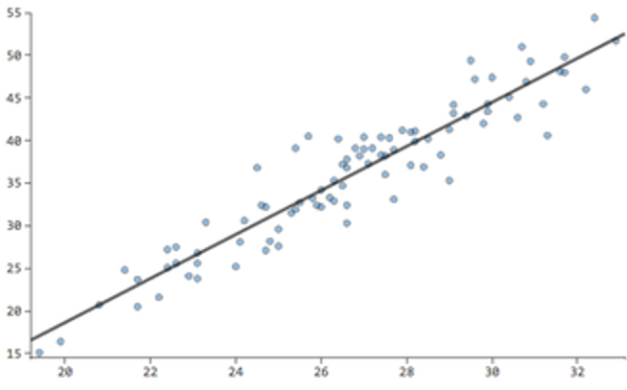
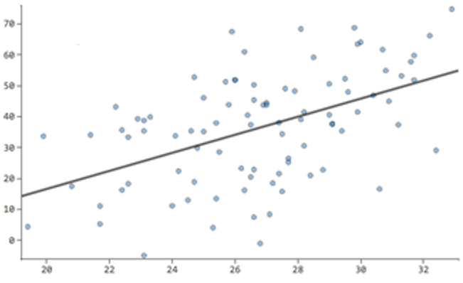
What is the value of R²? (of R?)

Slide 92
What is the value of R²? (of R?)
R² = 0
R² = 1
R² = 0.8
R² = 0.2

