Slide 1
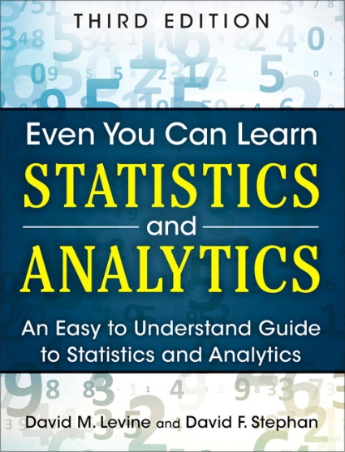
Fundamentals of Statistics
IMGD 2905
Chapter 1

Slide 2
Why Do We Need Statistics?
Aggregate data into meaningful information.
445 446 397 226
388 3445 188 1002
47762 432 54 12
98 345 2245 8839
77492 472 565 999
1 34 882 545 4022
827 572 597 364
(meaningful
Info Here)
Ok, but what are statistics?
→ First, some key words

Slide 3
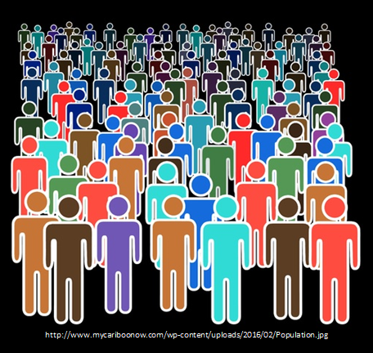
Key Words
Population – all members of group pertaining to a study
Q: examples?

Slide 4
Key Words
Population – all members of group pertaining to a study
e.g., every person in IMGD 2905 in D-term
e.g., every League of Legends player in the world
In many cases, impossible to survey a population!
Typical for game analytics → want to understand/improve game for all
Q: what to do?

Slide 5
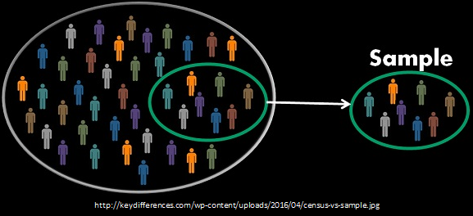
Key Words
Sample – part of population selected for analysis
e.g., all League of Legends players at WPI
e.g., students in first row in IMGD 2905
Q: Is sample same as population?
Is it representative?

Slide 6
Key Words
Sample – part of population selected for analysis
e.g., all League of Legends players at WPI
e.g., students in first row in IMGD 2905
Want sample to be representative of population. …
(e.g., poll: “did you finish chart for Project 2, Part 1?”)
But Is it? → method to obtain sample is important! (We won’t talk much about this right now, however.)

Slide 7
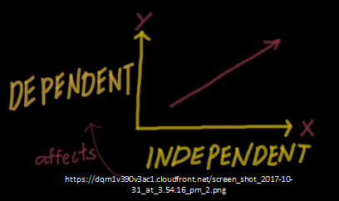
More Key Words
Variable – characteristic of individuals in population analyzing
e.g., time in competitive mode in Starcraft 2
e.g., vehicle choice in Grand Theft Auto (GTA)
Independent variable is inherent in population (or world), versus dependent variable that want to assess
https://www.coursepics.com/wp-content/uploads/2016/11/Independent-and-Dependent-Variable.jpg

Slide 8
More Key Words
Observation – all variable values for sample
e.g., LoL competitive hours/week and Champion most played could be (2 observations)
“Player A: Leona, 2 hours”
“Player B: Teemo, 7.5 hours”
Can be continuous (time) or discrete (Champions)
Often, data in grid
Observation in rows
Variables in columns
Format works well for spreadsheet
Consider our project 1 → LoL data!
Player Hours Champ
A 2 Leona
B 7.5 Teemo

Slide 9
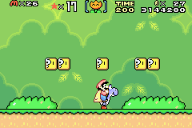
Putting It Together
https://tinyurl.com/trb4h7v
https://tinyurl.com/s8tcprt
Designing Super Mario World levels
What are some dependent variables?
What are some independent variables?
What are some variables?
pent getting coins, Number of jumps
What are some observations?
s

Slide 10
Putting It Together
https://tinyurl.com/trb4h7v
https://tinyurl.com/s8tcprt
Designing Super Mario World levels
What are some dependent variables?
Time, Deaths/fails, Fun
What are some independent variables?
Koopas, platforms, experience, age
What are some variables?
Time spent getting coins, Number of jumps
What are some observations?
10s, 12 jumps

Slide 11
Even More Key Words
Parameter – measure of dependent variable for population
e.g., average crashes in Mario Cart level for everyone
Usually what we want to know, but can’t get easily
Statistic – measure of dependent variable in sample
e.g., average crashes in Mario Cart level for IMGD 2905 class
Statistics – set of numerical methods for getting information about population based on data from sample, usually to get information about population parameters

Slide 12
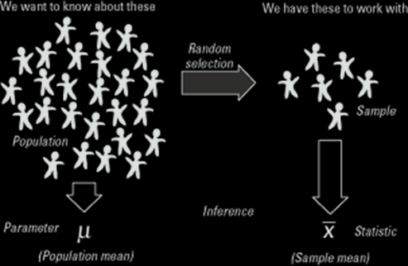
Even More Key Words
“Statistics - a branch of mathematics dealing with the collection, analysis, interpretation, and presentation of masses of numerical data.” -- Merriam-Webster dictionary
We want to know about this
We have this to
work with
Random
selection
Parameter
Statistic
https://qph.ec.quoracdn.net/main-qimg-058791361f10bc9a0339823e1e01d3ec

Slide 13
Sources of Data
Published – generally made available from those that collected it
e.g., Riot’s League of Legends data
e.g., Metacritic’s reviews and ratings
e.g., HOTS Logs dataset on Heroes of the Storm
Experiments – multiple trials to collect data from sample
Can be in laboratory or “real world” setting
e.g., play shooter, add lag and play again
Survey – ask people to answer questions
e.g., self-rating as gamer, difficulty with level, …
Ethical issues with stress and use of data
→ Institute Review Board (IRB) for approval with human subjects
http://www.mayersmemorial.com/pictures/content/122253.jpg

Slide 14
Sampling Concepts (1 of 2)
https://tinyurl.com/y4nu9ckf
https://tinyurl.com/y4nu9ckf
Sampling – process by which members of population are selected for sample
e.g., choose ½ class based on seat, or choose ½ class based on alphabet
Probability sampling – sampling considering likelihood of selection
e.g., survey for intended Champ, ask ½ class, but when tournament starts, result different. Why? → sample didn’t consider League players! (e.g., often similar analogy for voter polls)
e.g., voluntary polls/surveys
Use probability sampling whenever possible, but sometimes it is not (cost) or not known

Slide 15
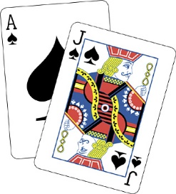
Sampling Concepts (2 of 2)
https://tinyurl.com/y4nu9ckf
https://tinyurl.com/y4nu9ckf
Sampling with replacement – once sample, put back in pool
e.g., die roll to see which attack boss makes
Sampling without replacement – once sample, won’t sample again
e.g., user survey – don’t allow to submit twice
e.g., deck of 52 cards for blackjack
https://tinyurl.com/y3ndyrom

Slide 16
Using Sample Data
Word “sample” comes from same root word as “example”
Similarly, one sample does not prove a theory, but rather is an example
Basically, in general, definite statement cannot be made about characteristics of all systems
Not: “Without a doubt, all players ...”
Instead: “The sample suggests players …”
Instead, make probabilistic statement about range of most systems
→ That’s where statistics come in!

Slide 17
Summary
Statistics – set of numerical methods for getting information about population based on data from sample, usually to get information about population parameters

