Slide 1
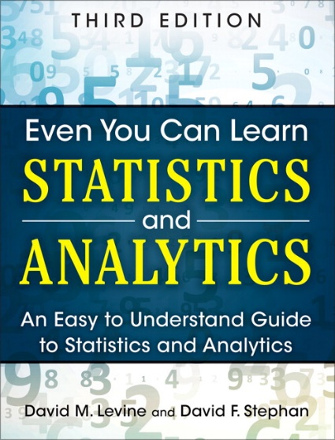
Presenting Data
IMGD 2905
Chapter 2

Slide 2
Outline
Types of Charts (next)
Game Analytics Examples
Guidelines for Charts

Slide 3
“Right” Chart Depends on Variable Type
Variable – characteristic of individuals in population analyzing
Variables
Qualitative
Quantitative
Ordered
Unordered
Discrete
Continuous

Slide 4
“Right” Chart Depends on Variable Type
Qualitative (Categorical) variables
  Can have states or subclasses
    e.g., position: [striker, goalie, midfield]
  Can be ordered or unordered
    e.g., bronze, silver, gold → ordered
    e.g., support, warrior, specialist → unordered
Variables
Qualitative
Quantitative
Ordered
Unordered
Discrete
Continuous

Slide 5
“Right” Chart Depends on Variable Type
Quantitative (Numeric) variables
  Numeric levels
  Discrete or continuous
    e.g., goals in season, speed in meters
    e.g., takedowns, win percentage
Variables
Qualitative
Quantitative
Ordered
Unordered
Discrete
Continuous

Slide 6
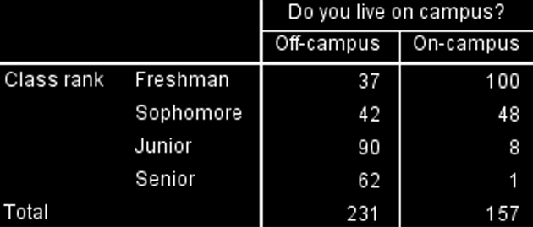
Tables
Generally, independent variable in left column and dependent variables next
Number & caption
Units labeled
Few/no lines
  Use bold
Table 1. Number of student on campus and off by year
Make sure to consider message. Often much clearer in chart!

Slide 7
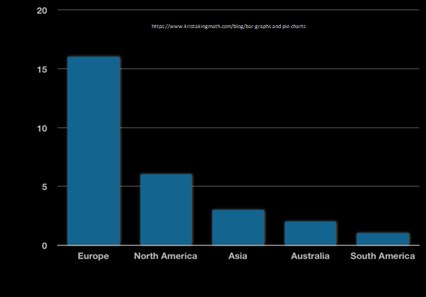
Categorical: Bar Chart (1 of 3)
Chart containing rectangles (“bars”) where length represents count, amount, or percent (aka “column chart”)
Better than table for comparing numbers
Number of Olympics Hosted

Slide 8
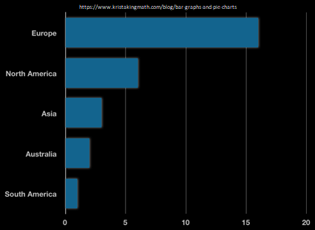
Categorical: Bar Chart (2 of 3)
Horizontal (good if many observations)
Number of Olympics Hosted

Slide 9
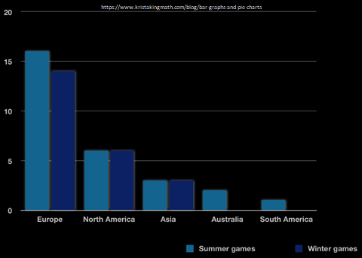
Categorical: Bar Chart (3 of 3)
Compare per observations
Number of Olympics Hosted

Slide 10
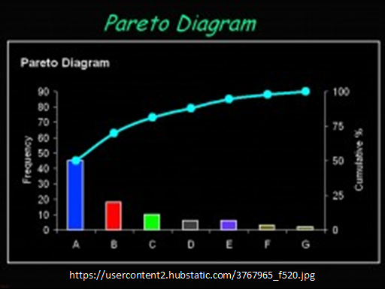
Categorical: Pareto Chart
Bar chart, arranged most to least frequent
Line showing cumulative percent
Helps identify most common, and by how much
Sort by column D (Data -> Sort high to low)
New column E for percent [=D2/SUM(D$2:D$11)]
Note: $ “locks” value in (e.g., D$2 versus D2)
New column F for running [=SUM(E$2:E2)]
Select B, D and F. Insert “combo chart”
Demo: imgdpops.xlsx

Slide 11
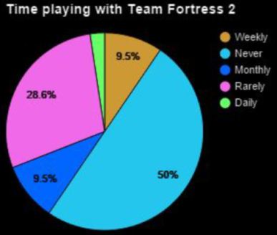
Categorical: Pie Chart
Wedge-shaped areas (“pie slices”) – represent count, amount or percent of each category from whole
Compare relative amounts at a glance
Best if few slices since quantifying “size” of pie difficult
Comparing pies also difficult
“The Effects of Latency and Jitter on a First Person Shooter: Team Fortress 2”
Demo: imgdpops.xlsx
http://www.cs.wpi.edu/~claypool/iqp/tf2/
Notes:
Joseph Blackman, Stephen Lafortune, and Adam Myers. The Effects of Latency and Jitter on a First Person Shooter: Team Fortress 2, Interactive Qualifying Project IQP-MLC-LJ15, Worcester Polytechnic Institute, Spring 2016. (Advisor Mark Claypool) Online at: http://www.cs.wpi.edu/~claypool/iqp/tf2/
Figure 5.1: Age and Experience Distributions of Participants

Slide 12
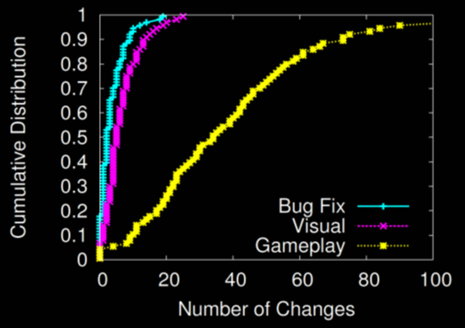
Cumulative Distribution
Cumulative amount of data with value or less
Easy to see min, max, median
Compare shapes of distributions
Select column R (Bug Fixes)
Sort low to high
New column S for percent [=ROW()/164]
Select column → paste down all
Select both column R and S
Insert → Scatter plot with lines
Demo: lol-patches.xlsx
Notes:
Artian Kica, Andrew La Manna, Lindsay O'Donnell, Tom Paolillo and Mark Claypool. Nerfs, Buffs and Bugs - Analysis of the Impact of Patching on League of Legends, In Proceedings of the 2nd International Workshop on Collaboration and Gaming (CoGames), Orlando, Florida, USA, October 31 - November 4, 2016. Online at: http://www.cs.wpi.edu/~claypool/papers/lol-crawler/

Slide 13
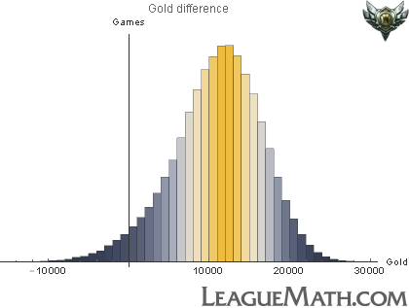
Histogram (1 of 3)
Gold Difference by Winning Team
10000 0 10000 20000 30000
Notes:
Demo: grades.xlsx
Select GPA data
Insert → Statistics Chart → Histogram
Can adjust bins, overflow/underflow

Slide 14
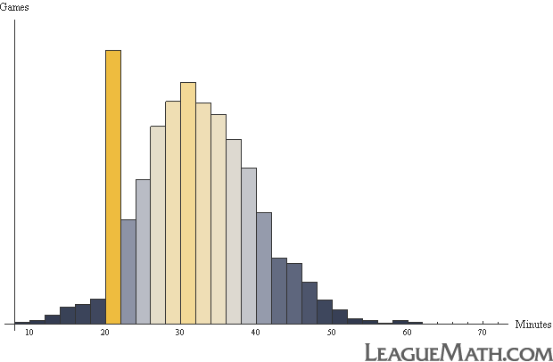
Histogram (2 of 3)
Game Length
http://www.leaguemath.com/early-vs-late-game-champions/
10 2 0 30 40 50 60 70
Notes:
Demo: grades.xlsx
Select GPA data
Insert → Statistics Chart → Histogram
Can adjust bins, overflow/underflow

Slide 15
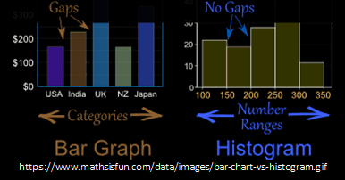
Histogram (3 of 3)
Bar chart for grouped numerical data
  No (or small) gaps btwn adjacent bars
Notes:
Demo: grades.xlsx
Select GPA data
Insert → Statistics Chart → Histogram
Can adjust bins, overflow/underflow

Slide 16
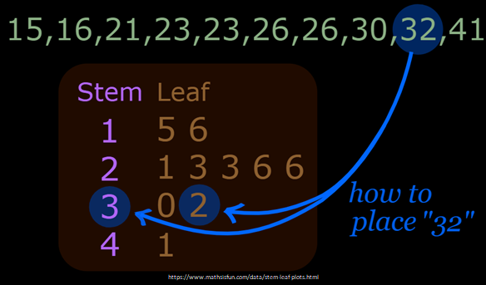
Stem and Leaf Display
“Histogram-lite” for analysis w/out software
  e.g., points on homework

Slide 17
Stem and Leaf Display
“Histogram-lite” for analysis w/out software
  e.g., points on homework

Slide 18
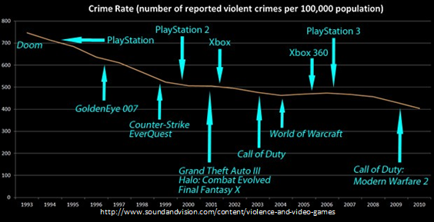
Time Series Plot
Associate data with date / time
Line graph with dates (proportionally spaced!)
Notes:
Demo: majors.xlsx
Sel. year and majors
Insert → Line Chart
→ More Line Charts

Slide 19
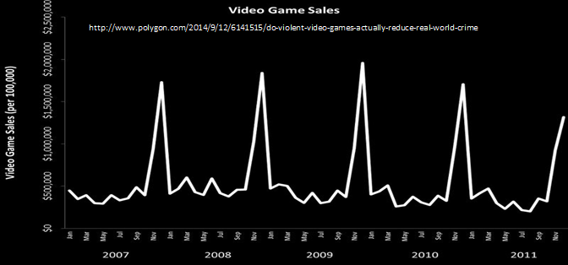
Time Series Plot
Associate data with date / time
Line graph with dates (proportionally spaced!)

Slide 20
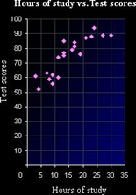
Scatter Plot
Two numerical variables, one on each axis
Reveal 2D patterns in relationship
Setup “right” models (later)
Notes:
Demo: lol-rates.xlsx
Select two of {win, pick, ban}
Insert → scatter plot

Slide 21
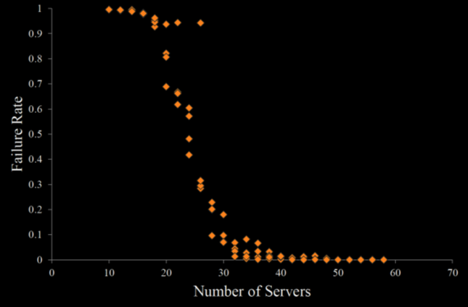
Scatter Plot
“Intelligent Simulation of Worldwide Application Distribution for OnLive's Server Network”
http://www.cs.wpi.edu/~claypool/mqp/onlive/
Notes:
Samuel Jaffe, Brendan Stephen, and Thinh Nguyen. Intelligent Simulation of Worldwide Application Distribution for OnLive's Server Network, Major Qualifying Project E-project-033014-145824, Computer Science, Spring 2014. (Advisors Mark Claypool and David Finkel) Online at: http://www.cs.wpi.edu/~claypool/mqp/onlive/
Figure 25: Failure Rate vs. Number of AppHosts with 1000 second average session length

Slide 22
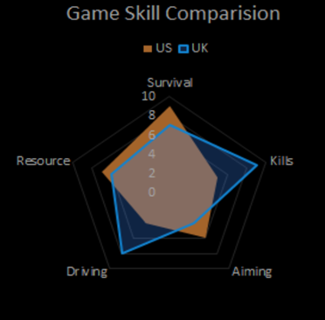
Radar Plot
PUBG game comparison
Aka “star charts” or “kiviat plots”
Good for quick visual comparison, especially when axes unequal
Notes:
Demo: lol-rates.xlsx
Select top line {win, pick, ban} + 3 row s (Ctrl-select)
Insert → Other → Radar scatter plot
Note: need to normalize data to scale Axes
Insert column E (“B Norm”)
=E2/MAX(E$2:E42)
Copy and paste down

Slide 23
Many More Charts!
https://en.wikipedia.org/wiki/Chart
Bubble
Waterfall
Tree
Gap
Polar
Violin
Candlestick
Kagi
Gantt
Nolan
Pert
Smith
Skyline
Vowel
Nomogram
Natal
If common chart effective for message, use
Otherwise, learn/use other charts as needed
But remember – may need to explain how to read

Slide 24
Outline
Types of Charts (done)
Game Analytics Examples (next)
Guidelines for Charts

Slide 25
Game Analytics Charts
Gunter Wallner and Simone Kriglstein. “An Introduction to Gameplay Data Visualization”, Game Research Methods, pages 231-250, ETC Press, ISBN: 978-1-312-88473-1, 2015. http://dl.acm.org/citation.cfm?id=2812792
Player choices (e.g., build units)
Density of activities (e.g., where spend time on map)
Movement through levels

Slide 26
Player Choices – Pie-Chart Overlay
(Custom game, comparative study)

Slide 27
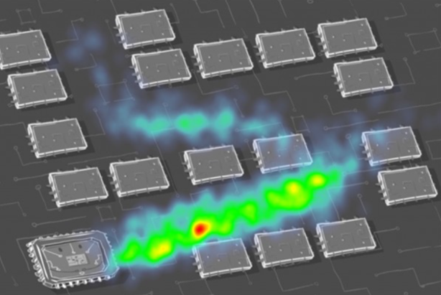
Player Location –
Heat Map (1 of 2)

Slide 28
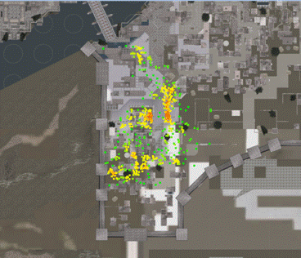
Player Location –
Heat Map (2 of 2)
Assassin’s Creed
Where play testers failed
Result: Make red areas easier
http://www.gamasutra.com/blogs/JonathanDankoff/20140320/213624/Game_Telemetry_with_DNA_Tracking_on_Assassins_Creed.php

Slide 29
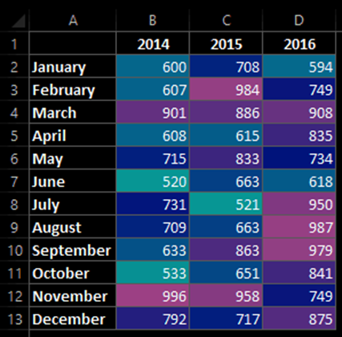
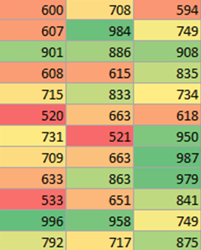
Note, Heat Map for Tables, Too!
Red means sales are low
Excel tutorial at: https://trumpexcel.com/heat-map-excel/

Slide 30
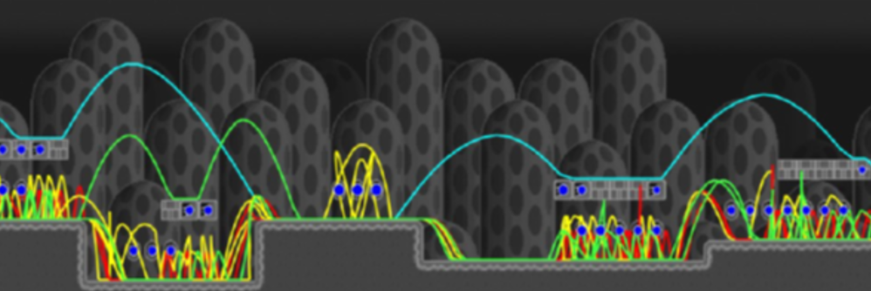
Movement (1 of 3)
(game: Infinite Mario, clone of Super Mario Bros.)

Slide 31
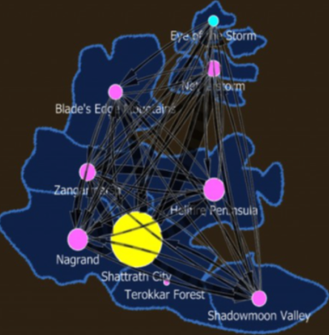
Movement (2 of 3)
(game: World of Warcraft)

Slide 32
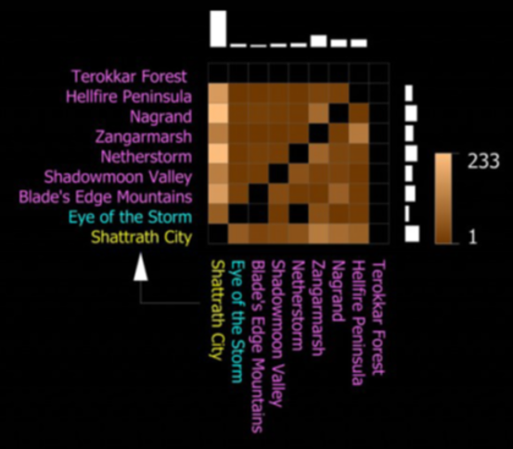
Movement (3 of 3)
(game: World of
Warcraft)

Slide 33
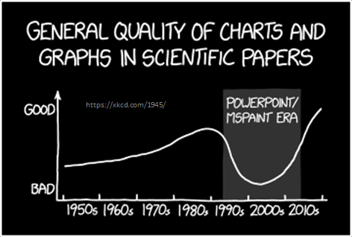
Outline
Types of Charts (done)
Game Analytics Examples (done)
Guidelines for Charts (next)

Slide 34
Guidelines for Good
Charts (1 of 7)
Require minimum effort from reader
  Perhaps most important metric
  Given two, can pick one that takes less reader effort
a
a
b
c
b
c
Direct Labeling
Legend Box
e.g.,

Slide 35
Guidelines for Good
Charts (2 of 7)
Maximize information
  Make self-sufficient
  Key words in place of symbols
    e.g., “Gold IV” and not “Player A”
    e.g., “Daily Games Played” not “Games Played”
  Axis labels as informative as possible
    e.g., “Game Time (seconds)” not “Game Time”
  Help by using captions (or title, if stand-alone)
    e.g., “Game time in seconds versus player skill in total hours played”
http://www.phplot.com/phplotdocs/conc-labels.html

Slide 36
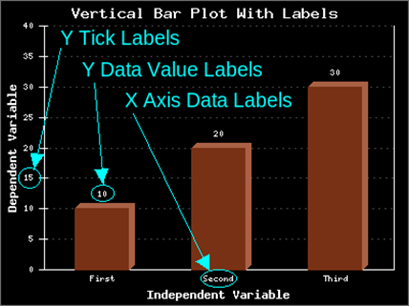
Guidelines for Good
Charts (2 of 7)
Maximize information
http://www.phplot.com/phplotdocs/conc-labels.html

Slide 37
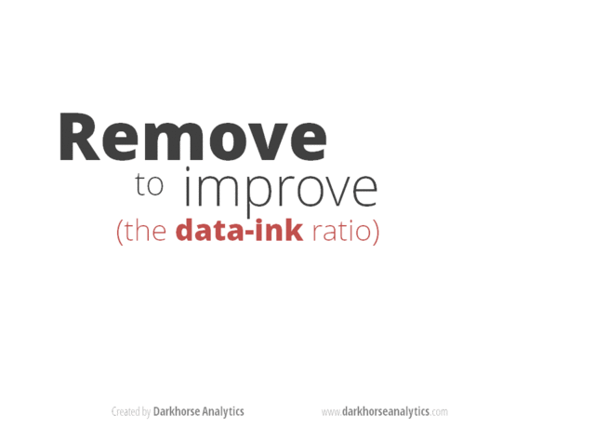
Guidelines for
Good Charts (3 of 7)
Minimize ink
https://www.slideshare.net/NicoleMarinsek/darkhorse-line-chart

Slide 38
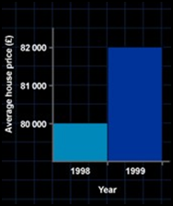
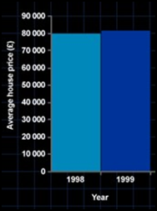
Guidelines for Good
Charts (4 of 7)
Use commonly accepted practices
  Present what people expect
  e.g., origin at (0,0)
  e.g., independent (cause) on x-axis, dependent (effect) on y-axis
  e.g., x-axis scale is linear
  e.g., increase left to right, bottom to top
  e.g., scale divisions equal, proportional
Departures permitted but require extra effort from reader → so use sparingly!
vs.

Slide 39
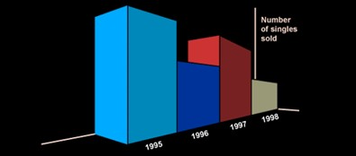
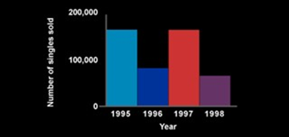
Guidelines for Good
Charts (5 of 7)
Avoid ambiguity
  Show coordinate axes
    at right angles
  Show origin
    usually at (0,0)
  Identify individual curves and bars
    With key/legend or label
  Do not plot multiple variables on same chart
    Single y-axis
vs.
http://www.carltonassociatesinc.com/images/confusion-new.jpg

Slide 40
Guidelines for Good Charts (6 of 7)
Don’t connect categorical data with lines
  Lines joining successive points signify that they can be approximately interpolated
  If don’t have meaning, should not use line chart
- No linear relationship between e.g, champion types
Instead, use column chart
Don’t connect with lines
Assists
jungle
top
mid
support

Slide 41
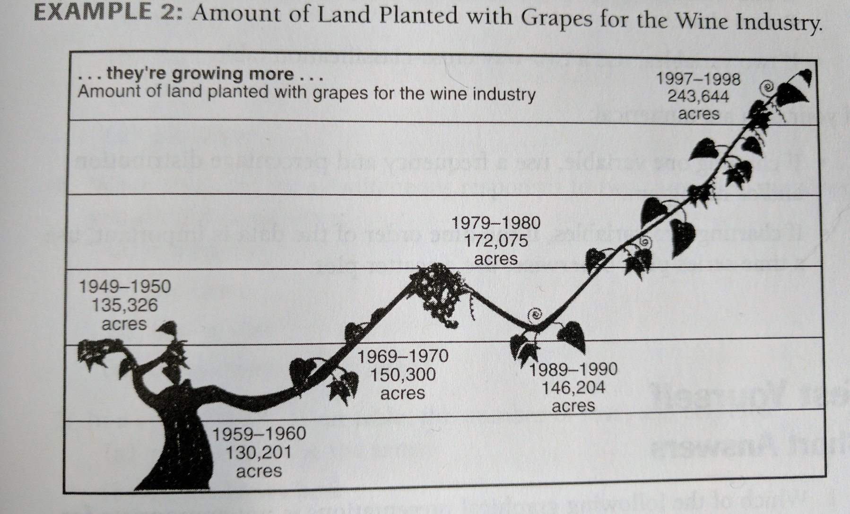
Guidelines for Good
Charts (7 of 7)
Can deceive as easily as can convey meaning
Missing x-axis (1997 too far over)
Missing y-axis hard to compare (1950 height > 1970)
Data points unclear

Slide 42
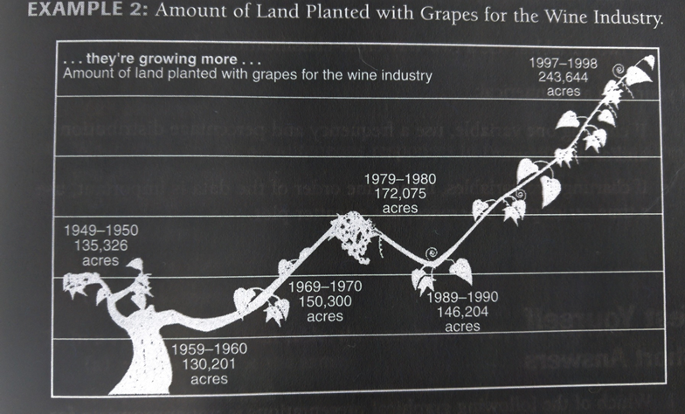
Guidelines for Good
Charts (7 of 7)
Can deceive as easily as can convey meaning
Missing x-axis (1997 too far over)
Missing y-axis hard to compare (1950 height > 1970)
Data points unclear

Slide 43
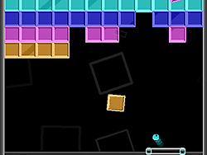
Breakout 2
Identify problems. Write them down.
After 2 minutes, compare. Discuss differences.
Write down combined set
Icebreaker, Groupwork, Questions
https://web.cs.wpi.edu/~imgd2905/d20/breakout/breakout-1.html

Slide 44
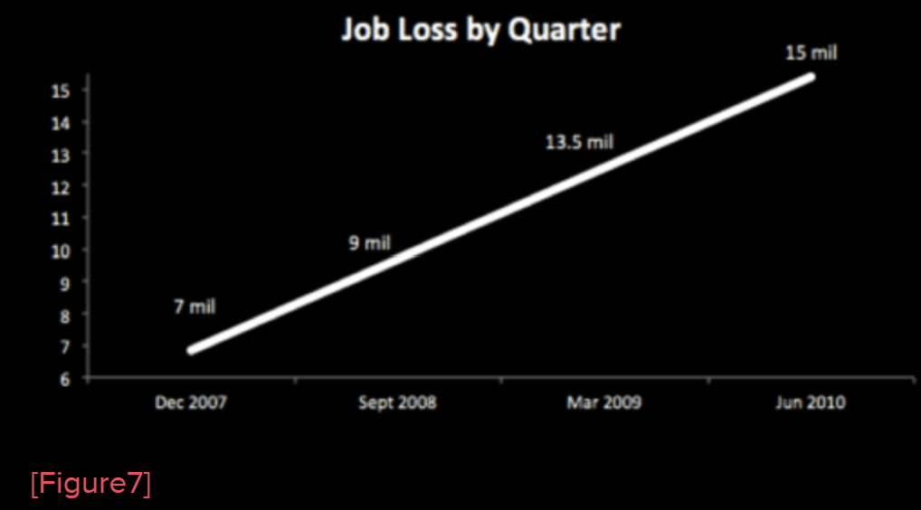
Breakout 2

Slide 45
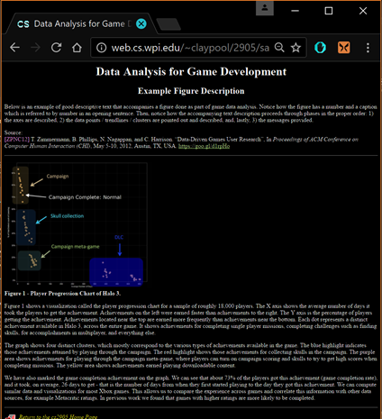
Describing Chart
“Formula”
  Describe all axes
    E.g., “The x-axis is time since game began, in seconds”
  Describe data sets/trendlines
    E.g., “The blue dots are the average maze completion time”
  Then provide message
    E.g., “Notice how the red bar is higher than the blue, indicating that …”
http://web.cs.wpi.edu/~imgd2905/d21/samples/analysis-example.html

Slide 46
Checklist for Good
Charts (1 of 2)
Axes
  Are both axes labeled?
  Are axis labels self-explanatory and concise?
  Are scale and divisions shown on both axes?
  Are min and max ranges appropriate?
  Are units indicated?
Lines/Curves/Points
  Is number of lines/curves reasonably small?
  Are curves labeled?
  Are all symbols clearly distinguishable?
  Is concise, clear legend provided?
  Does the legend obscure any data?
Information
  If y-axis is variable, is indication of spread (error bars) shown?
  Are grid lines required to read data (if not, then remove)?
Notes:
Based on Raj Jain, The Art of Computer Systems Performance Analysis, Box 10.1

Slide 47
Checklist for Good
Charts (2 of 2)
Scale
  Are units increasing left to right (x-axis) and bottom to top (y-axis)?
  Do all charts use the same scale?
  Are scales contiguous?
  Is bar chart order systematic/deliberate?
  Are bars appropriate width, spacing?
Overall
  Does whole chart add information to reader?
  Are there no curves/symbols/text that can be removed and still have same information?
  Does the chart have title or caption (not both)?
  Is chart self-explanatory and concise?
  Do variables plotted give more information than alternatives?
  Is chart referenced and discussed in any accompanying report?
Notes:
Based on Raj Jain, The Art of Computer Systems Performance Analysis, Box 10.1

Slide 48

Guidelines for Good
Charts (Summary)
For each chart, go over “checklist”
The more “yes” answers, the better
  Remember, while guidelines, art and not science
  So, may consciously decide not to follow these guidelines if better without them → but have good reason!
In practice, takes several trials before arriving at “best” chart
Want to present message the most: accurately, simply, concisely, logically
Accompany with description! Text or verbal
  Remember, audience/reader has not seen! – Make sure to introduce

