Slide 1
League of Legends Analytics
Project 1
IMGD 2905

Slide 2
Overview
Set up part of game analytics pipeline
Apply to Riot Game’s League of Legends
Pipeline:
Basic analysis this project, but repeat (reinforcement) + more later projects
E.g., front end involves some scripting in Python
Goal of this (and most) projects → time with tools

Slide 3
Parts
Part 0 - Learn LoL, Prepare Setup
Part 1 – Damage versus Gold
Part 2 – Kills and Assists by Role
Part 3 – Champion Winrate
Part 4 – Your Choice Analysis
Writeup
(Submission and Grading)

Slide 4
Part 0 – Learn LoL, Prepare Setup
Named “part 0” since don’t write up → but foundational for rest of projects!
Learn LoL
Install Spreadsheet
Download dataset
Analyze

Slide 5
Part 0 – Learn League of Legends (1 of 2)
Multiplayer online battle arena PC game
5v5 match
Each player controls 1 Champion (can pick from 148)
Five roles: ADC, Jungle, Mid, Support, Top
Champions upgraded with combat XP and gold
New ability
Augment existing ability
Stats on kills, deaths, assists, damage …

Slide 6
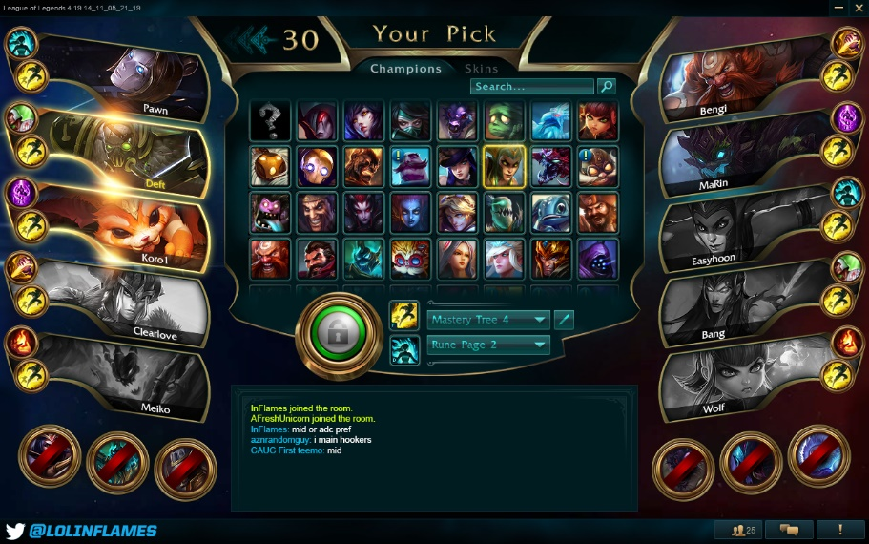
Part 0 – Learn League of Legends (2 of 2)
https://euw.leagueoflegends.com/en/game-info/get-started/new-player-guide/
Guide:

Slide 7
Parts
Part 0 - Learn LoL, Prepare Setup
Part 1 – Damage versus Gold
Part 2 – Kills and Assists by Role
Part 3 – Champion Winrate
Part 4 – Your Choice Analysis
Writeup
(Submission and Grading)

Slide 8
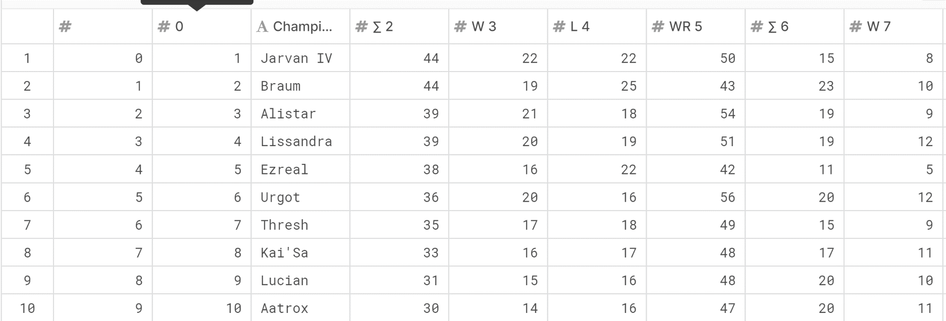
Part 0 – Prepare Analysis Setup
lec_matchdata.csv - Match data on all the regular season games.
lec_playerdata.csv - Data on each individual player in the regular season games.
lec_championdata.csv - Champion data on the in-game LoL Champions played with various performance stats.
Install spreadsheet
Download dataset
Try it out
https://www.kaggle.com/stephenofarrell/league-of-legends-european-championship-2019
lec_matchdata.csv
lec_playerdata.csv
lec_championdata.csv
Spreadsheet of data in columns

Slide 9
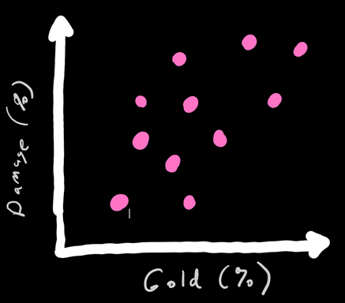
Part 1 – Damage versus Gold
Gold – used to buy items, make powerful
Damage – inflict on opponents
Scatter plot
Comma Separated Values (csv)
Chart
Select columns
Charts
DMG%, Gold%,
34.6, 29.6,
31.8, 28.1,
31.3, 30.2,
Explore
What are trends? Outliers?
Writeup

Slide 10
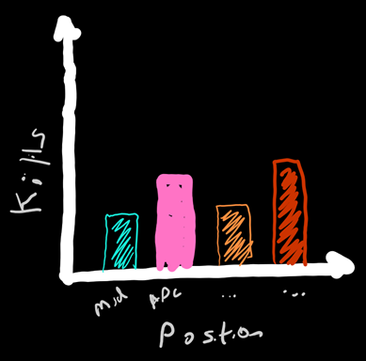
Part 2 – Kills and Assists by Role
But only 2 groups
ADC
Support
Compute averages
Position, Overall
Chart and Table
Sort by column
Select some rows (e.g., ADC)
Copy
Summary stats
Can make separate “sheets”
Explore
Differences? Explain?
Writeup

Slide 11
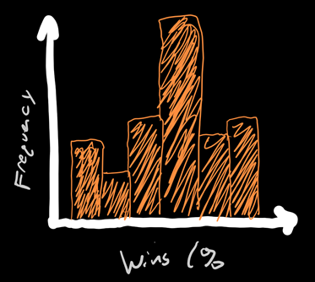
Part 3 – Champion Winrate
Analyze winrates
Histogram
10% bin size
Chart
Drawing histogram
F1 help, too
“How to make a histogram”
Explore
Bin size difference? Ends?
Writeup

Slide 12
Part 4 – Your Choice
Pick other data not yet analyzed
Analyze
Chart
Table
Summary stats
E.g., other game stats (Deaths), roles (Jungle versus Mid), Champion selection rate, Game data (3rd data set) …

Slide 13
Write Up (1 of 2)
Short report
Content key, but structure and writing matter
Consider:
Ease of extracting information
Organization
Concise and precise
Clarity
Grammar/English

Slide 14
Write Up (2 of 2)
Graphs/tables:
Number and caption
Referred to by number
Labeled axes
Explained trend lines
Message
Whatever document tool you want (e.g., Word, markdown)
→ Generate PDF

Slide 15
Hints
Tips from previous years
http://web.cs.wpi.edu/~imgd2905/d21/projects/proj1/#hints
Use as “checklist”!
For most issues, will not be much penalty (yet)
Learning analytics pipeline is iterative
Will teach and reinforce
But start instilling good habits!
https://i0.wp.com/www.johnhardingestates.co.uk/wp-content/uploads/2018/02/John-Harding-Estates-Hints-and-Tips.png?fit=600%2C419

Slide 16
Grading
Part 1 (D vs G) 30%
Part 2 (KA vs R) 30%
Part 3 (Wr HG) 20%
Part 4 (Choice) 10%
Misc 10%
All visible in
report!

Slide 17
Rubric
100-90. The submission clearly exceeds requirements. All parts of the project have been completed or nearly completed. The report is clearly organized and well-written, charts and tables are clearly labeled and described and messages provided about each part of the analysis.
89-80. The submission meets requirements. The first 2 parts of the project have been completed well, but not parts 3 or 4. The report is organized and well-written, charts and tables are labeled and described and messages provided about most of the analysis.
79-70. The submission barely meets requirements. The first 2 parts of the project have been completed or nearly completed, but not parts 3 or 4. The report is semi-organized and semi-well-written, charts and tables are somewhat labeled and described, but parts may be missing. Messages are not always clearly provided for the analysis.
69-60. The project fails to meet requirements in some places. The first part of the project has been completed or nearly completed, and maybe some of part 2, but not parts 3 or 4. The report is not well-organized nor well-written, charts and tables are not labeled or may be missing. Messages are not always provided for the analysis.
59-0. The project does not meet requirements. No part of the project has been completed. The report is not well-organized nor well-written, charts and tables are not labeled and/or are missing. Messages are not consistently provided for the analysis.

