Slide 1
Mazetool Analytics
Project 2
IMGD 2905

Slide 2
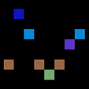
Overview
Use complete game analytics pipeline
Get “arms around” full pipeline: simple game and level to how it went (adding game and scripting!)
New skills
Apply to Mazetool (Perlenspiel game)
Here, have control over game level, access and understanding to “full” game
Reinforce analytics skills (scripts, data, tools) → preparing for own exploration

Slide 3
Mazetool (1 of 2)
Simple maze game
Get 10 gold pieces
Get to exit
Can create own level!
Re-generate maze
Move gold
Move start and exit
https://ps3.perlenspiel.net/examples/mazetool/mazetool.html

Slide 4
Mazetool (2 of 2)
Provides events:
Clicks
Gold
Exit
Data:
Time
Spaces
https://ps3.perlenspiel.net/examples/mazetool/mazetool.html

Slide 5
Parts
Part 0 – Design, Play, Tools
Part 1 – Maze Running
Part 2 – Win Tally
Part 3 – Maze Time
Part 4 – Maze Analysis
Hints
Writeup and Submission
Grading

Slide 6
Part 0 – Design (1 of 2)
Read Mazetool documentation
Play to understand game
3 to 5 random levels
2 to 4 custom levels
Look at data (email) → understand content related to player experience
Design one maze for user study
When tested (by you)
→ “Save”

Slide 7
Part 0 – Design (2 of 2)
Take screenshot
Decide time to “win”
Determine shortest path in spaces
Determine by either:
Measuring by running
Estimate based on spaces and speed
Determine fewest clicks
Unlike for Project 1, you do write up Part 0!

Slide 8
Part 0 – Play
Visit (note URL different!)
Use list of usernames
Shuffled
Enter first name
Play once!
Refresh browser
Repeat for all
https://tinyurl.com/playmazes

Slide 9
Part 0 –Tools (2 of 3)
Python
Scripting language
Easy for beginners
Powerful for expert users
Good data analytics tool
Good for some in-game behaviors, too

Slide 10
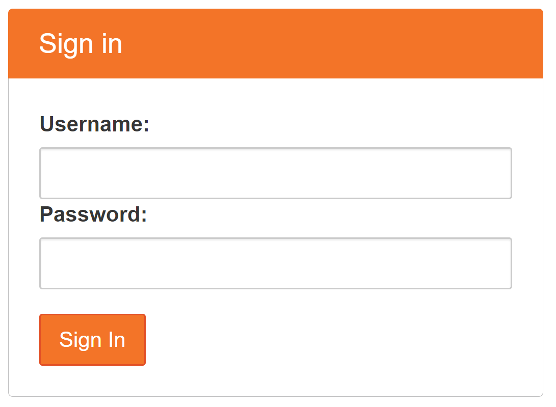
Part 0 –Tools (2 of 3)
Jupyter Notebooks
Environment for data analysis with Python
[JupyterHub]

Slide 11
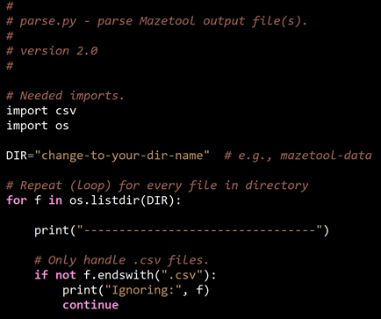
Part 0 – Tools (3 of 3)
Upload “sample.csv”
Apply “parse.py”
Make sure it works
Understand each line!
Extract maze data (email)
Multiple files this time
→ Will modify for your analysis (see next slide)
Gold (time number):
01.586 1
01.786 2
…
38.518 10
-----------
Clicks (time spaces):
00.800 0
2.653 10
…
1:10.071 188
-----------
Exit (time spaces):
1:15.022 238

Slide 12
Part 0 – Useful Extensions
Write to file
http://web.cs.wpi.edu/~imgd2905/d21/projects/proj2/#write
Convert time to single number
http://web.cs.wpi.edu/~imgd2905/d21/projects/proj2/#time
Zip/Unzip
https://web.cs.wpi.edu/~imgd2905/d21/projects/proj2/setup-python.html#tips
Python Help? → Office Hours, ARC

Slide 13
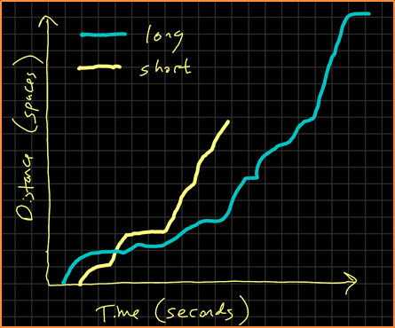
Part 1 – Maze Running
Select “short” and “long” runs
Draw time series chart
(Note Web page tip on “additional trend line”)

Slide 14
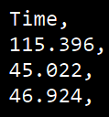
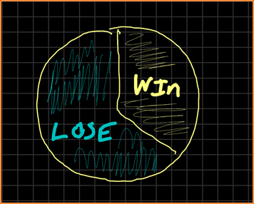
Part 2 – Win Tally
Based on your “win” time, compute tally
=IF(A1 < 30, "yes", "no")
Draw pie chart

Slide 15
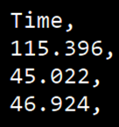
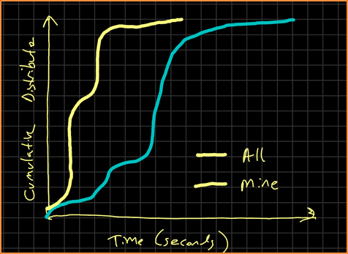
Part 3 – Maze Time
Analyze completion times
Your maze compared to all (minus your) maze
Sort low to high
Compute percent
Draw cumulative
distribution chart

Slide 16
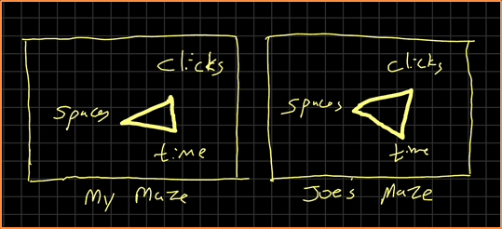
Part 4 – Maze Analysis
Compare your maze, with all mazes, and three other mazes
Maximum: clicks, time, spaces
Report in table
Normalize
Draw radar chart
Clicks, Spaces, Time,
7, 128, 72,

Slide 17
Hints
All Mazetool data will be available online
Note download time!
Keep organized!
One script, one task
Name script, output, Excel same (e.g., exit-times)
README.txt with notes
Watch font sizes → readable! Chart checklist
Python functions (totally optional)
seconds = getSeconds(row[“time”])
Pay attention to Project 1 comments!

Slide 18
Write Up (1 of 2)
Short report
Content key, but structure and writing matter
Consider:
Ease of extracting information
Organization
Concise and precise
Clarity
Grammar/English

Slide 19
Write Up (2 of 2)
Part 0 – Level design, too
Sections
Brief method, chart, message
Charts/tables:
Number and caption
Referred to by number
Labeled axes
Explained trend lines
Chart checklist
Message
Submit online via Canvas (PDF)

Slide 20
Grading
Part 0 (Level Design) - 10%
Part 1 (Maze Runs) - 35%
Part 2 (Win Tally) - 25%
Part 3 (Maze Times) - 20%
Part 4 (Maze Compare) - 10%
All visible in report!
(Late – 10% per day)

Slide 21
Rubric
100-90. The submission clearly exceeds requirements. All Parts of the project have been completed or nearly completed. The report is clearly organized and well-written, charts and tables are clearly labeled and described and messages provided about each Part of the analysis.
89-80. The submission meets requirements. Parts 0-3 of the project have been completed or nearly completed, but perhaps not Part 4. The report is organized and well-written, charts and tables are labeled and described and messages provided about most of the analysis.
79-70. The submission barely meets requirements. Parts 0-2 parts of the project have been completed or nearly completed, and some of Part 3, but not Part 4. The report is semi-organized and semi-well-written, charts and tables are somewhat labeled and described, but parts may be missing. Messages are not always clearly provided for the analysis.
69-60. The project fails to meet requirements in some places. Parts 0-1 of the project has been completed or nearly completed, and some of Part 2, but not Parts 3 or 4. The report is not well-organized nor well-written, charts and tables are not labeled or may be missing. Messages are not always provided for the analysis.
59-0. The project does not meet requirements. Besides Part 0, and maybe Part 1, no other part of the project has been completed. The report is not well-organized nor well-written, charts and tables are not labeled and/or are missing. Messages are not consistently provided for the analysis.

