Slide 1
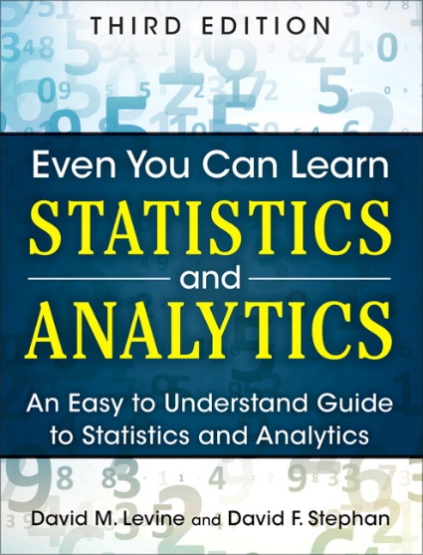
Simple Linear Regression
IMGD 2905
Chapter 10

Slide 2
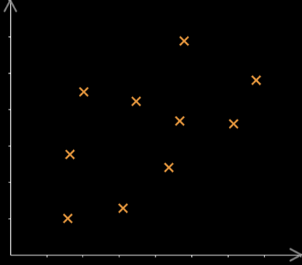
Motivation
Have data (sample, x’s)
Want to know likely value of next observation (Y)
E.g., playtime versus skins owned
A – reasonable to compute mean (with confidence interval)
B – could do same, but there appears to be relationship between X and Y!
→ Predict B
e.g., “trendline” (regression)
B
Y
Q: Given previous Y’s, what is likely next Y?
A
X

Slide 3
Motivation
Have data (sample, x’s)
Want to know likely value of next observation (Y)
E.g., playtime versus skins owned
A – reasonable to compute mean (with confidence interval)
B – could do same, but there appears to be relationship between X and Y!
→ Predict B
e.g., “trendline” (regression)
Y
A
X

Slide 4
Motivation
Have data (sample, x’s)
Want to know likely value of next observation (Y)
E.g., playtime versus skins owned
A – reasonable to compute mean (with confidence interval)
B – could do same? there appears to be relationship between X and Y!
→ Predict B
e.g., “trendline” (regression)
B
Y
A
X

Slide 5
Motivation
Have data (sample, x’s)
Want to know likely value of next observation (Y)
E.g., playtime versus skins owned
A – reasonable to compute mean (with confidence interval)
B – could do same, but there appears to be relationship between X and Y!
→ Predict B
e.g., “trendline” (regression)
B
Y
A
X

Slide 6
Motivation
Have data (sample, x’s)
Want to know likely value of next observation (Y)
E.g., playtime versus skins owned
A – reasonable to compute mean (with confidence interval)
B – could do same, but there appears to be relationship between X and Y!
→ Predict B
e.g., “trendline” (regression)
B
Y
A
X

Slide 7
Overview
Broadly, two types of prediction techniques:
Regression – mathematical equation to model, use model for predictions
We’ll discuss simple linear regression
Machine learning – branch of AI, use computer algorithms to determine relationships (predictions)
CS 4342 Machine Learning

Slide 8
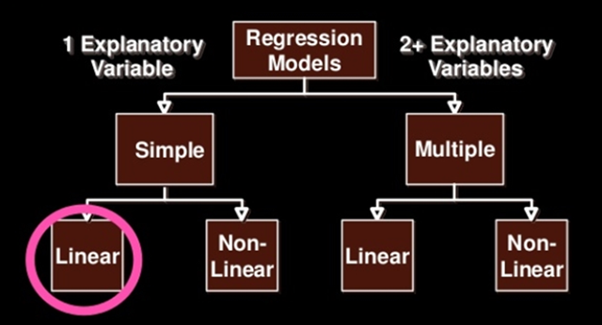
Types of Regression Models
Explanatory variable explains dependent variable
Variable X (e.g., skill level) explains Y (e.g., KDA)
Can have 1 (simple) or 2+ (multiple)
Linear if coefficients added, else Non-linear
Notes:
27

Slide 9
Outline
Introduction (done)
Simple Linear Regression (next)
Linear relationship
Residual analysis
Fitting parameters
Measures of Variation
Misc

Slide 10
Simple Linear Regression
Goal – find a linear (line) relationship between two values
E.g., KDA and skill, time and car speed
First, make sure relationship is linear! How?
→ Scatterplot
(c) no clear relationship
(b) not a linear relationship
(a) linear relationship – proceed with linear regression

Slide 11
Simple Linear Regression
Goal – find a linear (line) relationship between two values
E.g., KDA and skill, time and car speed
First, make sure relationship is linear! How?
→ Scatterplot
(c) no clear relationship
(b) not a linear relationship
(a) linear relationship – proceed with linear regression

Slide 12
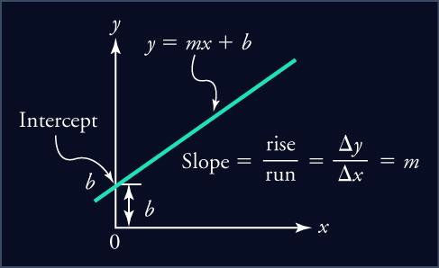
Linear Relationship
From algebra: line in form
m is slope, b is y-intercept
Slope (m) is amount Y increases when X increases by 1 unit
Intercept (b) is where line crosses y-axis, or y-value when x = 0
Y = mX + b

Slide 13
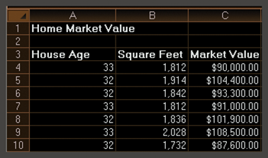
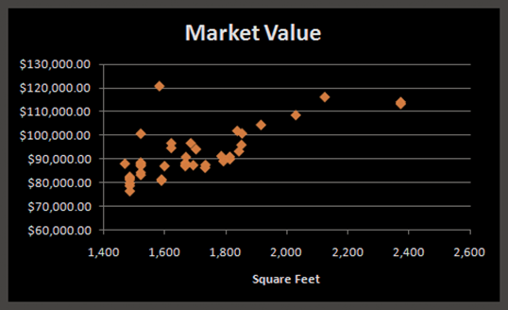
Simple Linear Regression Example
Size of house related to its market value
X = square footage
Y = market value ($)
Scatter plot (42 homes) indicates linear trend

Slide 14
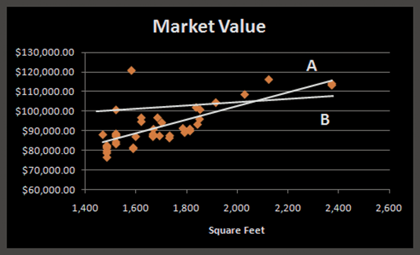
Simple Linear Regression Example
Two possible lines shown below (A and B)
Want to determine best regression line
Line A looks a better fit to data
But how to know?
Y = mX + b
A
B

Slide 15
Simple Linear Regression Example
Two possible lines shown below (A and B)
Want to determine best regression line
Line A looks a better fit to data
But how to know?
Y = mX + b
Line that gives best fit to data is one that minimizes prediction error
Least squares line
(more later)
A
B

Slide 16
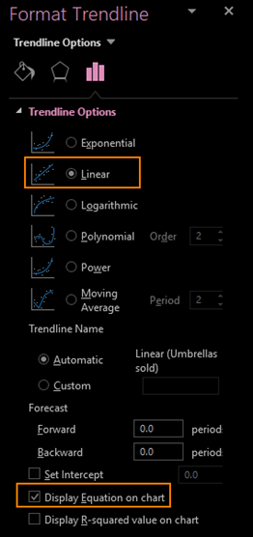
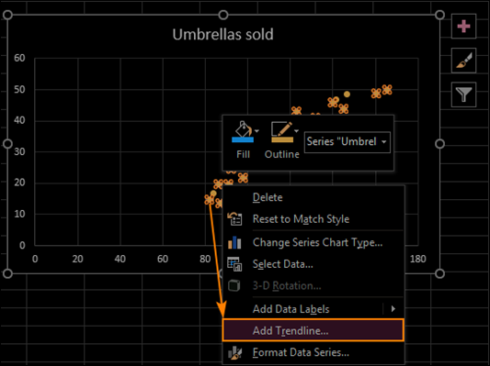
Simple Linear Regression Example Chart
Scatterplot
Right click → Add Trendline

Slide 17
Simple Linear Regression Example Formulas
=SLOPE(C4:C45,B4:B45)
Slope → 35.036
=INTERCEPT(C4:C45,B4:B45)
Intercept → 32,673
Estimate Y when X = 1800 square feet?
Y = 35.036 x (1800) + 32,673 = $95,737.80

Slide 18
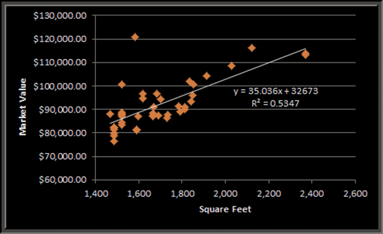
Simple Linear Regression Example
Market value = 32673 + 35.036 x (square feet)
Predicts market value better than just average
Y = 35.036 X + 32673
But before use, examine residuals

Slide 19
Outline
Introduction (done)
Simple Linear Regression
Linear relationship (done)
Residual analysis (next)
Fitting parameters
Measures of Variation
Misc

Slide 20
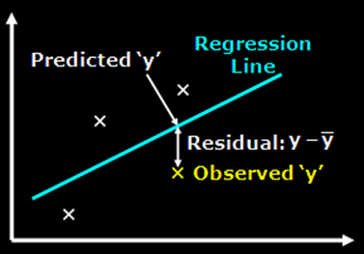
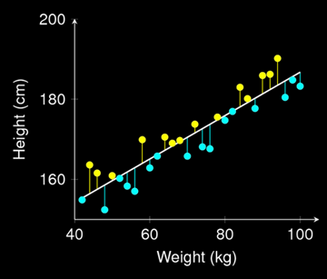
Residual Analysis
Before predicting, confirm linear regression assumptions hold
Variation around line is normally distributed
Variation equal for all X
Variation independent for all X
How? Compute residuals (error in prediction)
→ Chart

Slide 21
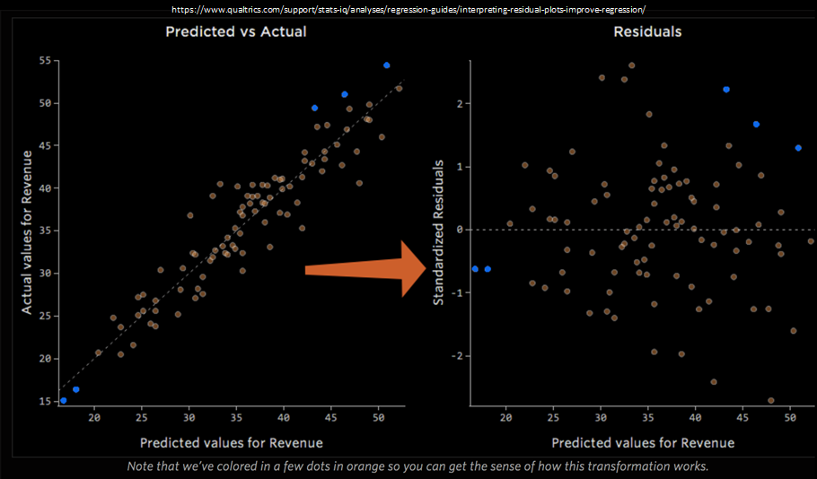
Residual Analysis
Variation around line normally distributed?
Variation equal for all X?
Variation independent for all X?
https://www.qualtrics.com/support/stats-iq/analyses/regression-guides/interpreting-residual-plots-improve-regression/

Slide 22
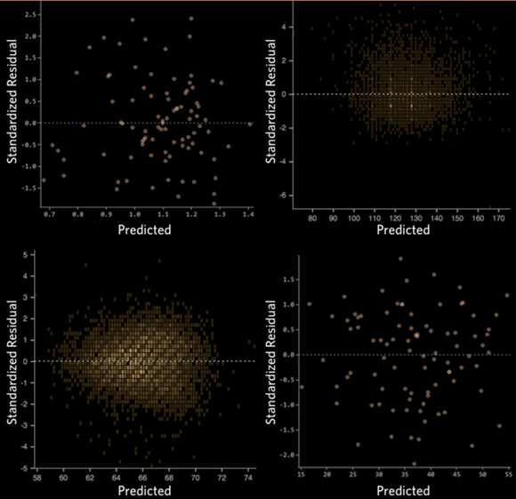
Residual Analysis – Good
https://www.qualtrics.com/support/stats-iq/analyses/regression-guides/interpreting-residual-plots-improve-regression/
Clustered towards middle
No clear pattern
Symmetrically distributed

Slide 23
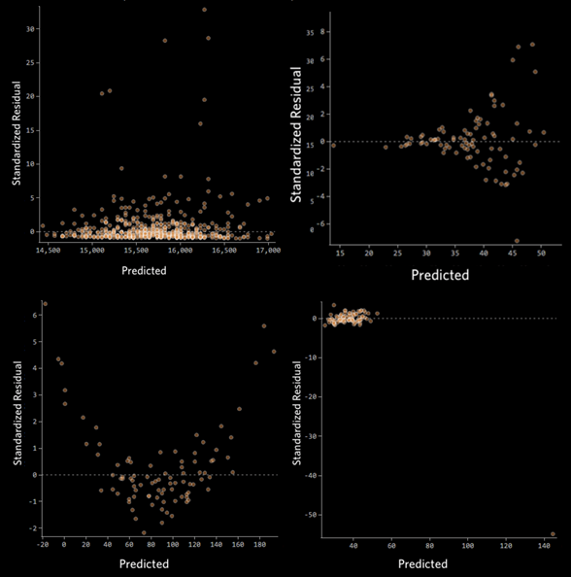
Residual Analysis – Bad
https://www.qualtrics.com/support/stats-iq/analyses/regression-guides/interpreting-residual-plots-improve-regression/
Clear shape
Patterns
Outliers
Note: could do normality test (QQ plot)

Slide 24
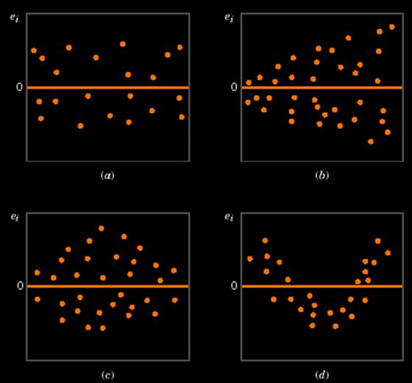
Residual Analysis – Summary
Regression assumptions:
Normality of variation around regression
Equal variation for all y values
Independence of variation
___________________
(a) ok
(b) funnel
(c) double bow
(d) nonlinear

Slide 25
Outline
Introduction (done)
Simple Linear Regression
Linear relationship (done)
Residual analysis (done)
Fitting parameters (next)
Measures of Variation
Misc

Slide 26
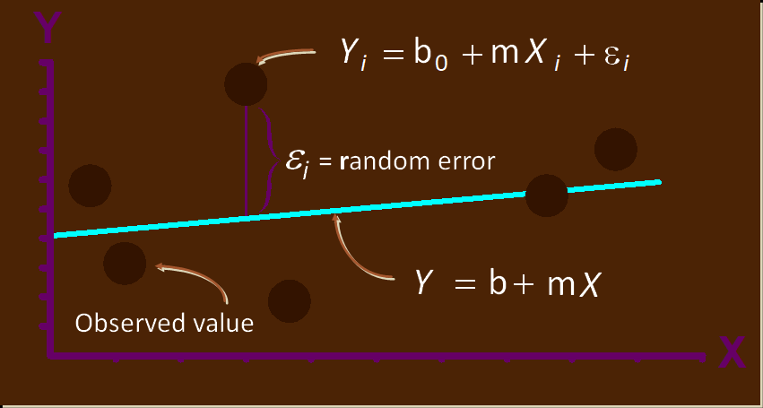
Linear Regression Model
Y
}
X
Notes:
35

Slide 27
Fitting the Best Line
Plot all (X_{i}, Y_{i}) Pairs
Y
60
40
20
0
X
0
20
40
60
https://www.scribd.com/presentation/230686725/Fu-Ch11-Linear-Regression

Slide 28
Fitting the Best Line
Plot all (X_{i}, Y_{i}) Pairs
Draw a line. But how do we know it is best?
https://www.scribd.com/presentation/230686725/Fu-Ch11-Linear-Regression
Y
60
40
20
0
X
0
20
40
60
https://www.scribd.com/presentation/230686725/Fu-Ch11-Linear-Regression

Slide 29
Fitting the Best Line
Plot all (X_{i}, Y_{i}) Pairs
Draw a line. But how do we know it is best?
Y
60
40
20
Slope changed
0
X
Intercept unchanged
0
20
40
60
https://www.scribd.com/presentation/230686725/Fu-Ch11-Linear-Regression

Slide 30
Fitting the Best Line
Plot all (X_{i}, Y_{i}) Pairs
Draw a line. But how do we know it is best?
Slope unchanged
Y
60
Intercept changed
40
20
0
X
0
20
40
60
https://www.scribd.com/presentation/230686725/Fu-Ch11-Linear-Regression

Slide 31
Fitting the Best Line
Plot all (X_{i}, Y_{i}) Pairs
Draw a line. But how do we know it is best?
Y
60
Intercept changed
40
20
Slope changed
0
X
0
20
40
60
https://www.scribd.com/presentation/230686725/Fu-Ch11-Linear-Regression

Slide 32
Linear Regression Model
Relationship between variables is linear function, but with error term
Population Y-Intercept
Population Slope
Random Prediction Error
Y
=
b
+
m
X
+
ε
i
0
i
i
Want error as small as possible
Dependent (response) Variable (e.g., kills)
Independent (explanatory) Variable (e.g., skill level)

Slide 33
Least Squares Line
Want to minimize difference between actual y and predicted ŷ
Add up ε_{i} for all observed y’s
But positive differences offset negative ones
(remember when this happened for variance?)
→ Square the errors! Then minimize (Calculus)
Minimize:
Take derivative
Set to 0 and solve
Notes:
49

Slide 34
Least Squares Line Graphically
https://www.scribd.com/presentation/230686725/Fu-Ch11-Linear-Regression
Notes:
52

Slide 35
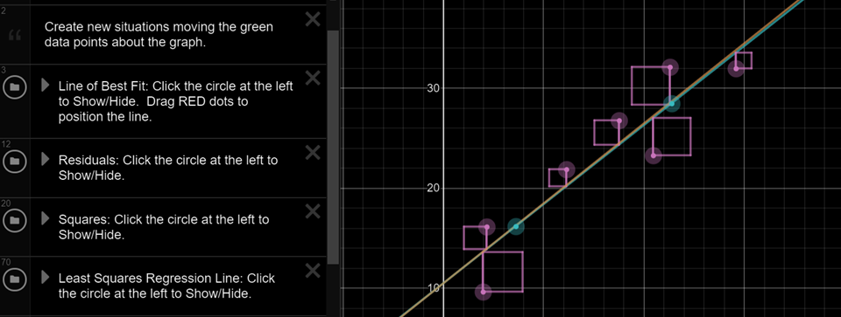
Least Squares Line Graphically
https://www.desmos.com/calculator/zvrc4lg3cr

Slide 36
Outline
Introduction (done)
Simple Linear Regression (done)
Measures of Variation (next)
Coefficient of Determination
Correlation
Misc

Slide 37
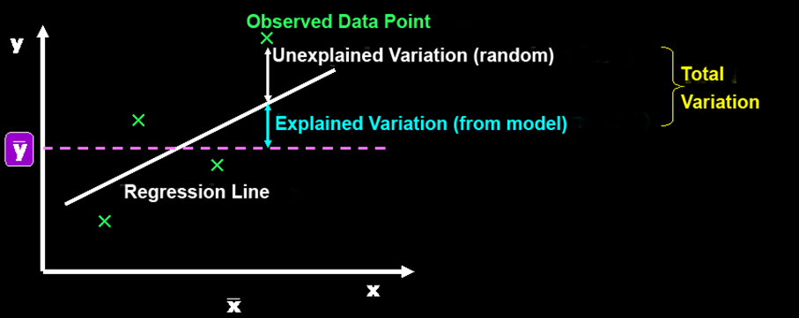
Measures of Variation
Several sources of variation in y
Error in prediction (unexplained)
Variation from model (explained)
Break this down (next)

Slide 38
Sum of Squares of Error
Dependent variable
Independent variable (x)
Least squares regression line with lowest total sum of squared prediction errors
Sum of Squares of Error, or SSE
Measure of unexplained variation

Slide 39
Sum of Squares Regression
Dependent variable
Population mean: y
Independent variable (x)
Differences between prediction and population mean
Gets at variation due to X & Y
Sum of Squares Regression, or SSR
Measure of explained variation

Slide 40
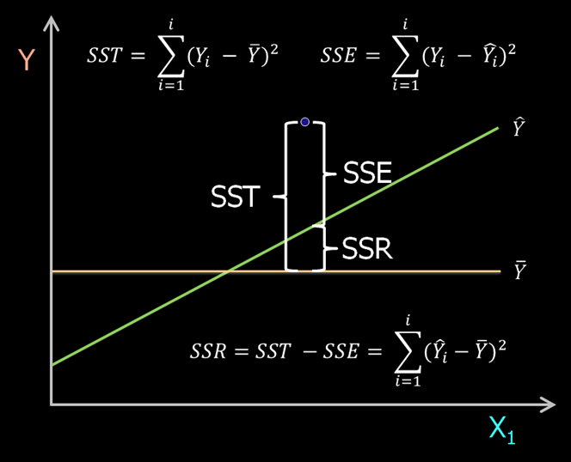
Sum of Squares Total
Total Sum of Squares, or SST = SSR + SSE

Slide 41
Coefficient of Determination
Proportion of total variation (SST) explained by the regression (SSR) is known as the Coefficient of Determination (R²)
$$R2=\frac{SSR}{SST}=1−\frac{SSE}{SST}$$
Ranges from 0 to 1 (often said as a percent)
1 – regression explains all of variation
0 – regression explains none of variation

Slide 42
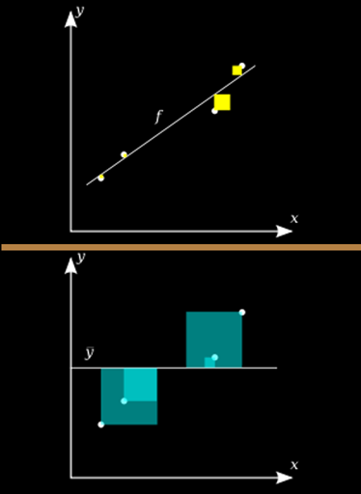
Coefficient of Determination – Visual Representation
Variation in observed data model cannot explain (error)
R² = 1 -
Total variation in observed data

Slide 43
Coefficient of Determination Example
How “good” is regression model? Roughly:
0.8 <= R² <= 1 strong
0.5 <= R² < 0.8 medium
0 <= R² < 0.5 weak

Slide 44
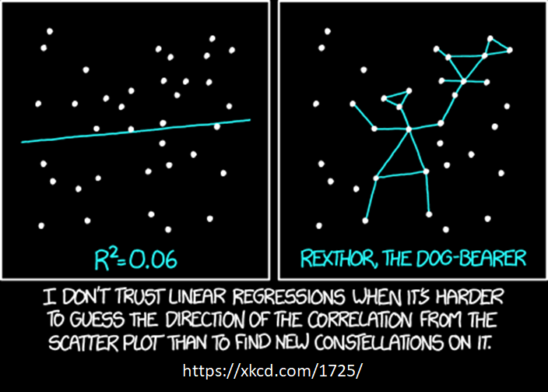
How “good” is the Regression Model?

Slide 45
Relationships Between X & Y
Strong relationships
Weak relationships
y
y
x
x
y
y
x
x

Slide 46
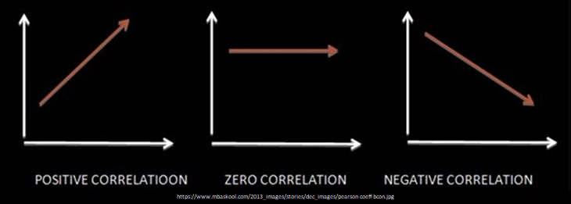
Relationship Strength and Direction – Correlation
Correlation measures strength and direction of linear relationship
-1 perfect neg. to +1 perfect pos.
Sign is same as regression slope
Denoted R. Why? R = $\sqrt{R2}$
Pearson’s Correlation Coefficient
Vary together
Vary Separately

Slide 47
Correlation Examples
y
y
y
x
x
x
r = -1
r = -.6
r = 0
y
y
Also, a measure
of “Effect Size”
x
x
r = +.3
r = +1

Slide 48
Breakout 7
Introduction
If needed ... Introduce yourselves!
Icebreaker: What game are you looking forward to playing this summer?
Groupwork
Think, discuss, write down – email answers
Correlation
Consider scatterplots
Estimate correlation
https://web.cs.wpi.edu/~imgd2905/d21/breakout/breakout-7.html

Slide 49
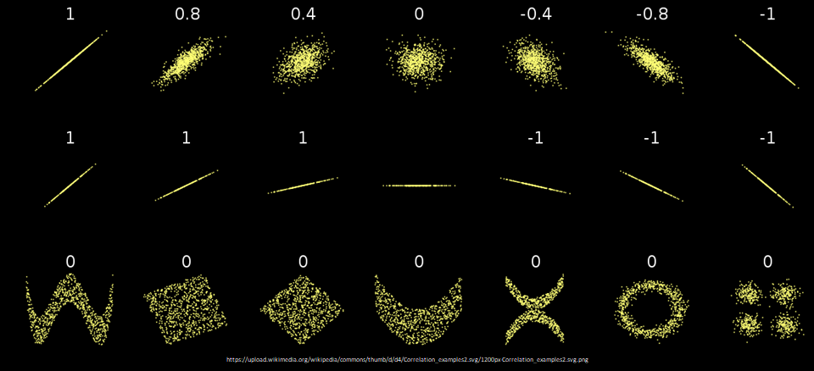
Correlation Examples
?? ?? ?? ?? ?? ?? ??
?? ?? ?? ?? ?? ?? ??
?? ?? ?? ?? ?? ?? ??

Slide 50
Correlation Examples

Slide 51
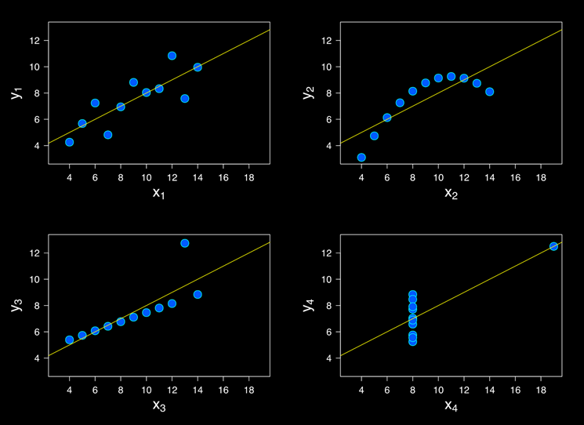
Correlation Examples

Slide 52
Correlation Examples
Anscombe’s Quartet
Summary stats:
Mean_{x} 9
Mean_{y} 7.5
Var_{x} 11
Var_{y} 4.125
Model: y=0.5x+3
R² = 0.69

Slide 53
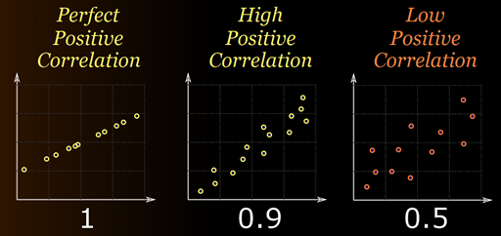
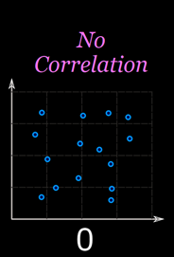
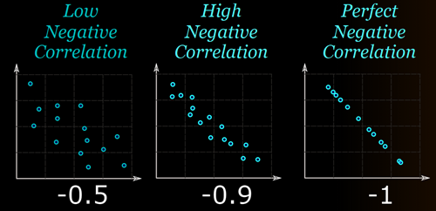
Correlation Summary
https://www.mathsisfun.com/data/correlation.html

Slide 54
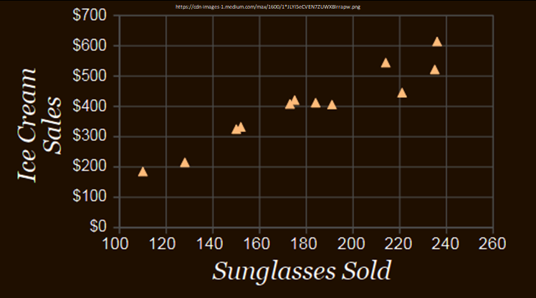
Correlation is not Causation
Buying sunglasses causes people to buy ice cream?

Slide 55
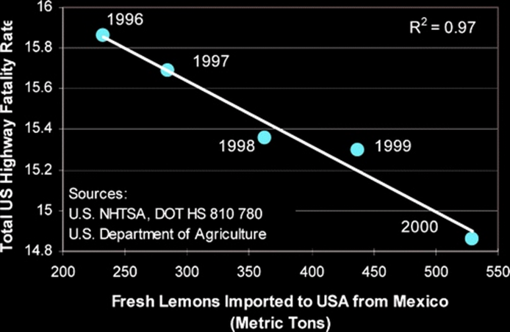
Correlation is not Causation
Importing lemons causes fewer highway fatalities?

Slide 56
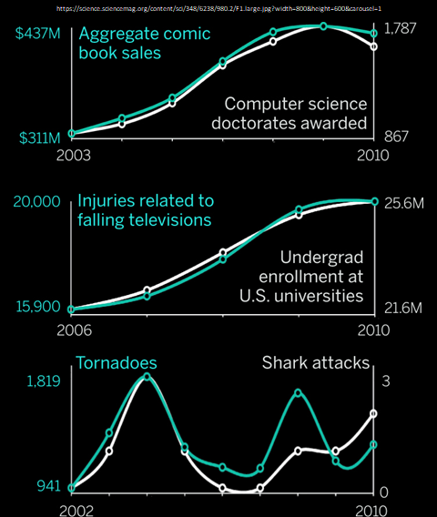
Correlation is not Causation

Slide 57
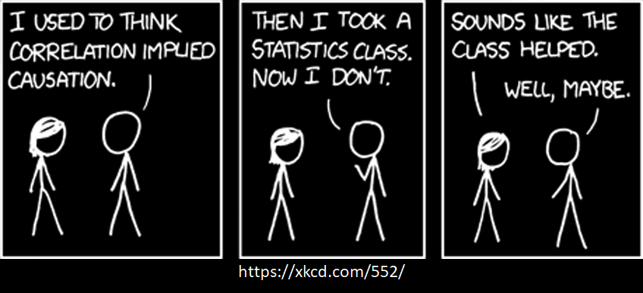
Correlation is not Causation

Slide 58
Outline
Introduction (done)
Simple Linear Regression (done)
Measures of Variation (done)
Misc (next)
Extrapolation and Interpolation
Confidence Intervals
Model fitting

Slide 59
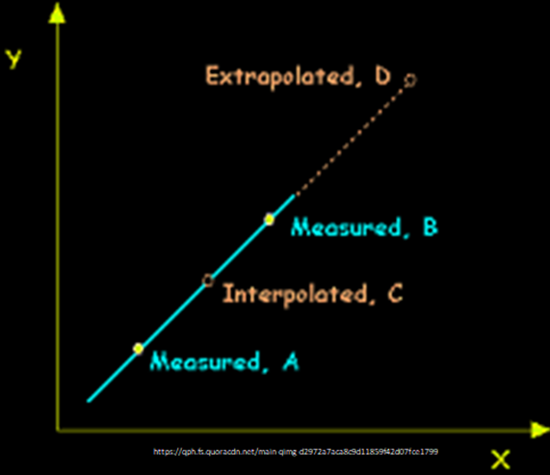
Extrapolation versus Interpolation
Prediction
Interpolation – within measured X-range
Extrapolation – outside measured X-range

Slide 60
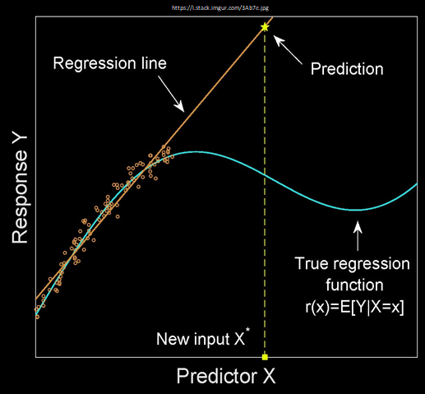
Be Careful When Extrapolating
If extrapolate, make sure have reason
to assume model continues

Slide 61
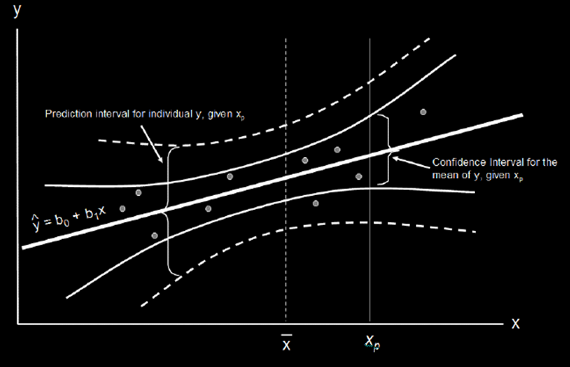
Prediction and Confidence Intervals (1 of 2)
Prediction interval
for X_{i}
Confidence interval
for mean
https://cdn-images-1.medium.com/max/1600/1*vcbjVR7uesKhVM1eD9IbEg.png

Slide 62
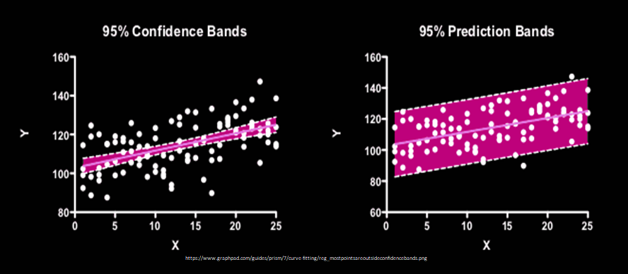
Prediction and Confidence Intervals (2 of 2)

Slide 63
Beyond Simple Linear Regression
Multiple regression – more parameters beyond just X
Book Chapter 11
More complex models – beyond just
Y = mX + b

Slide 64
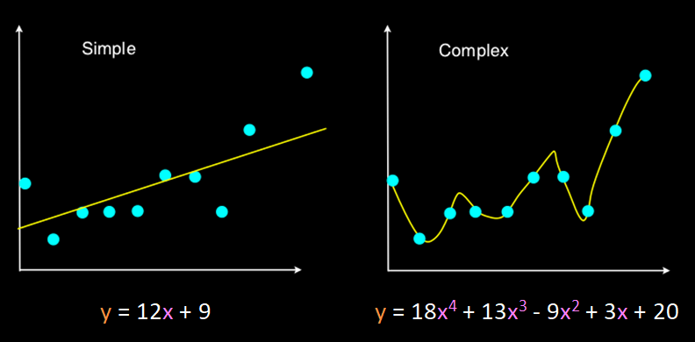
More Complex Models
Higher order polynomial model has less error
→ A “perfect” fit (no error)
How does a polynomial do this?

Slide 65
Graphs of Polynomial Functions
Higher degree, more potential “wiggles”
But should you use?

Slide 66
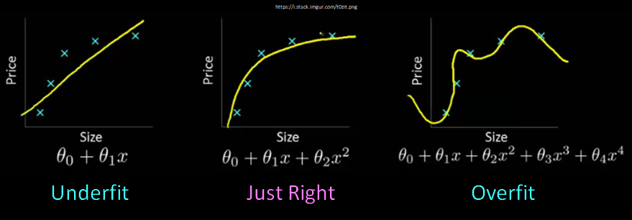
Underfit and Overfit
Overfit analysis matches data too closely, more parameters than justified
Underfit analysis does not adequately match since parameters are missing
→ Both models fit well, but don’t predict well (i.e., non-observed values)
Just right – fit data well “enough” with as few parameters as possible (parsimonious - desired level of prediction with as few terms as possible)

Slide 67
Summary
Can use regression to predict un-measured values
Before fit
Visual relationship (scatter plot) and residual analysis
Strength of fit – Coefficient of Determination (R²) and correlation (R)
Beware
Correlation is not causation
Extrapolation
Higher order, more complex models can fit better
Beware of overfit → less predictive power

