Slide 1
Data Analysis for Game Development
Administrative
IMGD 2905

Slide 2
Outline
Background
Admin Stuff
Motivation
Objectives

Slide 3
Professor Background (Who am I?)
Mark Claypool (professor, “Mark”)
Professor, Computer Science
Director, Interactive Media and Game Development
Research interests
Multimedia performance
Congestion control (protocols, AQM)
Wireless networking
Network games
Currently playing

Slide 4
Student Background (Who are you?)
Year?
Major?
IMGD Art or Tech
Other
Background?
Statistics
Probability
Tools?
Python
Excel
Platform of Choice?
Windows
Linux
Mac

Slide 5
Classes
In-person (yay!)
No online options
Miss?
Slides are available
See classmates for notes
Masks? (poll/survey)
Lectures, Q&A, Intro to projects
Group work …
Let’s be flexible! Let’s see this goes, what’s going well, what is not and adjust!

Slide 6
Syllabus Stuff
http://www.cs.wpi.edu/~imgd2905/d22
Linked from Canvas Web page
Class: M, T, Th, F 10-10:50am
Office hours (Zoom): TBA
Zoom or in-person
Or by appointment
Email: claypool@cs.wpi.edu (me)
Discord server
Invite code on Canvas page

Slide 7
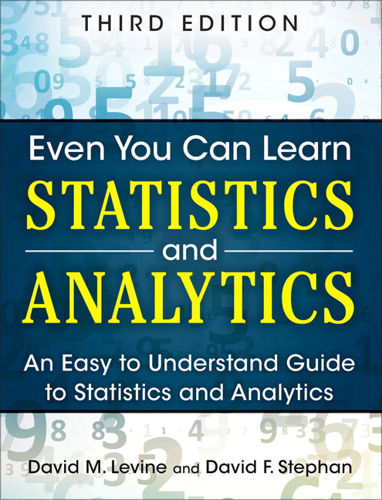
Text Book
D.M. Levine and D.F. Stephan
“Even You Can Learn Statistics and Analytics”
3rd ed. Pearson, 2015
Unfortunate name, but good content → depth to provide foundation for analytics
Good examples, but not game-centric

Slide 8
Class Topics
Data analysis tools and pipeline
Statistics
Visualizing and presenting data
Probability
Hypothesis testing
Regression
Apply topics to game data!
Commercial and custom
New and old

Slide 9
Course Structure
Prerequisites
College algebra
No {programming, stats, probability} expected
No game analytics experience required
Grading
Projects (60%)
Homework (30%)
Participation (10%)
On the Canvas Website:
https://canvas.wpi.edu/courses/33416
Authenticate with WPI login and password
http://idwbi.com/wp-content/uploads/2017/01/database-Schema.png

Slide 10
Projects
4 projects, 60% of grade total
Last project slightly larger
Do game analysis on actual game data!
Use game analytics pipeline
Typical flow for game (and other) analytics
Common tools used for analytics
Multiple instances of analysis
Apply, become skilled with methods of synthesis, interpretation, dissemination
Project 1 – today!
https://www.shareicon.net/download/2015/12/06/683311_board.svg

Slide 11
Homework
Written problem set
From the book, Web, made up
Solve with pencil and paper
Or calculators
Or Excel

Slide 12
Participation
Showing up to class matters
Come to class!
Being engaged in class matters
Don’t multi-task!
Ask questions, answer questions
Weekly “survey” → get your feedback on how the class is going!
8% of your grade
But much bigger indirect effect!

Slide 13
Playtesting
Engage with WPI IMGD community
Playing and testing each other’s games
Useful for development, research
Focus groups
Interviews
User studies
Two (10-30 min.) sessions
2% of your grade

Slide 14
Slides
On the class Web page
PowerPoint and PDF
Caution! Don’t rely upon slides alone! Use them as supplementary material
(come to class)
https://cdn4.iconfinder.com/data/icons/documents-letters-and-stationery/400/doc-18-512.png

Slide 15
Timeline
Tentative timeline for dates for exams and projects
In order to help you plan
http://www.cs.wpi.edu/~imgd2905/d22/timeline.html
Will notify if update

Slide 16
Why This Class?

Slide 17
Why This Class?
Goals
Objectives
Gain proficiency using modern tools for data acquisition and analysis
Understand basic probability and statistics as it applies to data analysis
Develop skills for presenting game data analysis both orally and in written form
Use spreadsheet to analyze and visualize game data
Use scripting language to extract and clean data recorded from game
Apply summary statistics to game data
Compute probability distributions for game data
Write reports with graphs and tables illustrating analysis of game data
Present game dataset report using appropriate visual aids

Slide 18
Why This Class? – Other
WPI IMGD requirements
Gotta take Math/Quantitative Science
Statistics and Probability useful for game design and development
Game Analytics similar to other forms of analytics (e.g., Data Science)
Fun!
Game analysis increasingly important (jobs!)

Slide 19
Jobs
Game Play Data Analyst, Sony Interactive Entertainment
Duties
Advise, define implement gameplay data to ensure understanding of player experience
Provide insights that impact game design and improve quality
Create and maintain player segmentation that allows understanding of engagement and spending
Mine data sets and develop dashboard for live service teams, game developers
Devise and implement A/B experiments to test acquisition, engagement
Present finding and provide recommendations
Requirements
BS/BA degree Stats, Math, Econ, CS or related
Experience with SQL
Experience with data visualization packages
Experience with statistical software
Experience with Amazon cloud services
Have created and presented visualizations and insights to various business groups
Passion for video games preferred

Slide 20
Jobs
Analyst, Riot Games
Duties
Aggregate and analyze petabytes of game data from various sources
Prep data for deeper analysis and/or reporting
Organize collected data into reliable intel that informs Rioters to improve player experience
Work with decision-makers to understand goals, identify opportunities, and inform decisions across company
Create awesome
Requirements
BS/BA degree Stats, Math, Econ, CS or related
Graduate degree preferred
Business savvy
Technically adept
SQL, Python
Excel, PowerPoint
Communicator
Reports clear, and concise
Presentations to variety of audiences

