Slide 1
PlayerUnknown’s Battlegrounds (PUBG) Analytics
Postmortem
Project 1
IMGD 2905

Slide 2
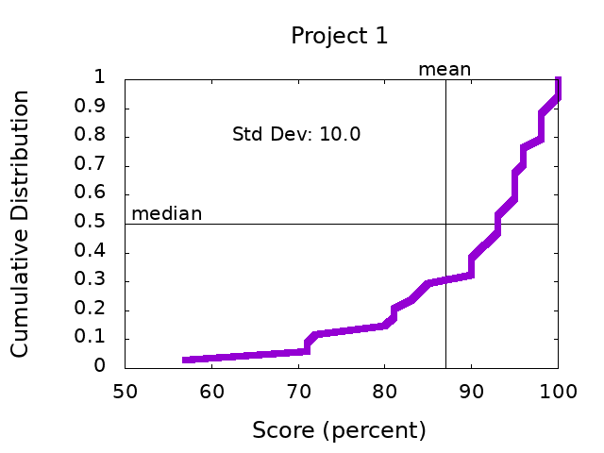
Scores

Slide 3
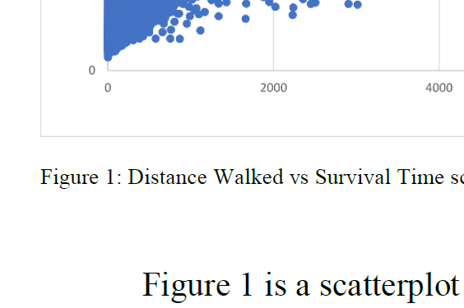
General Comments
Structure – Headings per section, Title
Avoid “you”, casual writing
All figures need numbers and captions (no title)
“Figure 1. Distance Walked versus Time”
Refer to figure by number
“Figure 1 shows the relationship between…”
Describe axes and data BEFORE messages
Make figure fonts similar size to text font

Slide 4
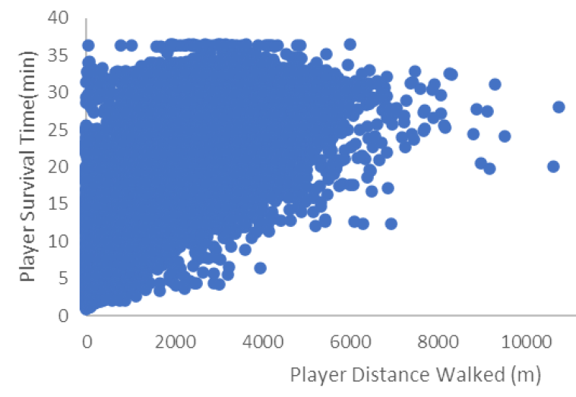
Part 1 – Fight or Flight
Y-axis versus X-axis
Dependent versus Independent
Time versus Distance
Need both versus distance and versus damage

Slide 5
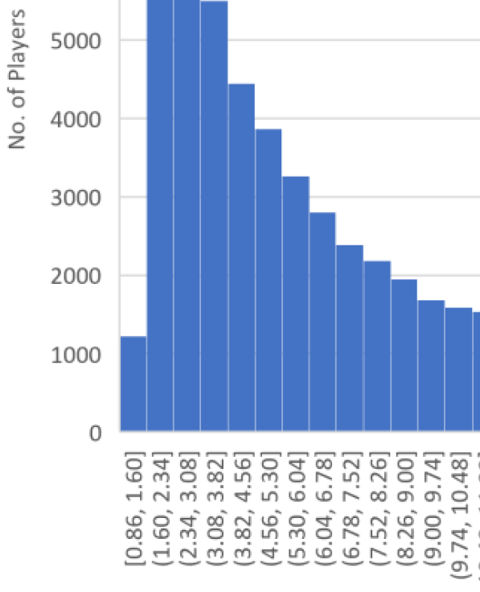
Part 2 – Game Time Analysis
Histogram bins
Boundary and frequency
Give your tables some love, too!
Watch spacing
Limit horizontal lines

Slide 6
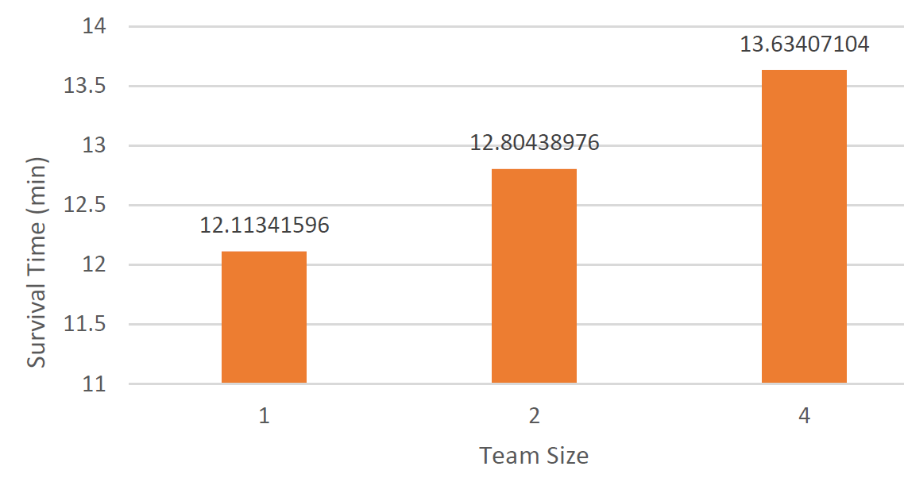
Part 3 – Champion Winrate (1 of 2)
(0,0) origin
Digits of precision

Slide 7
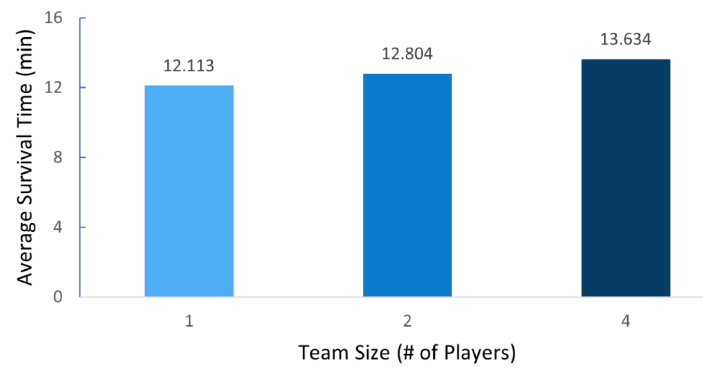
Part 3 – Champion Winrate (2 of 2)
Mind the
gap!

Slide 8
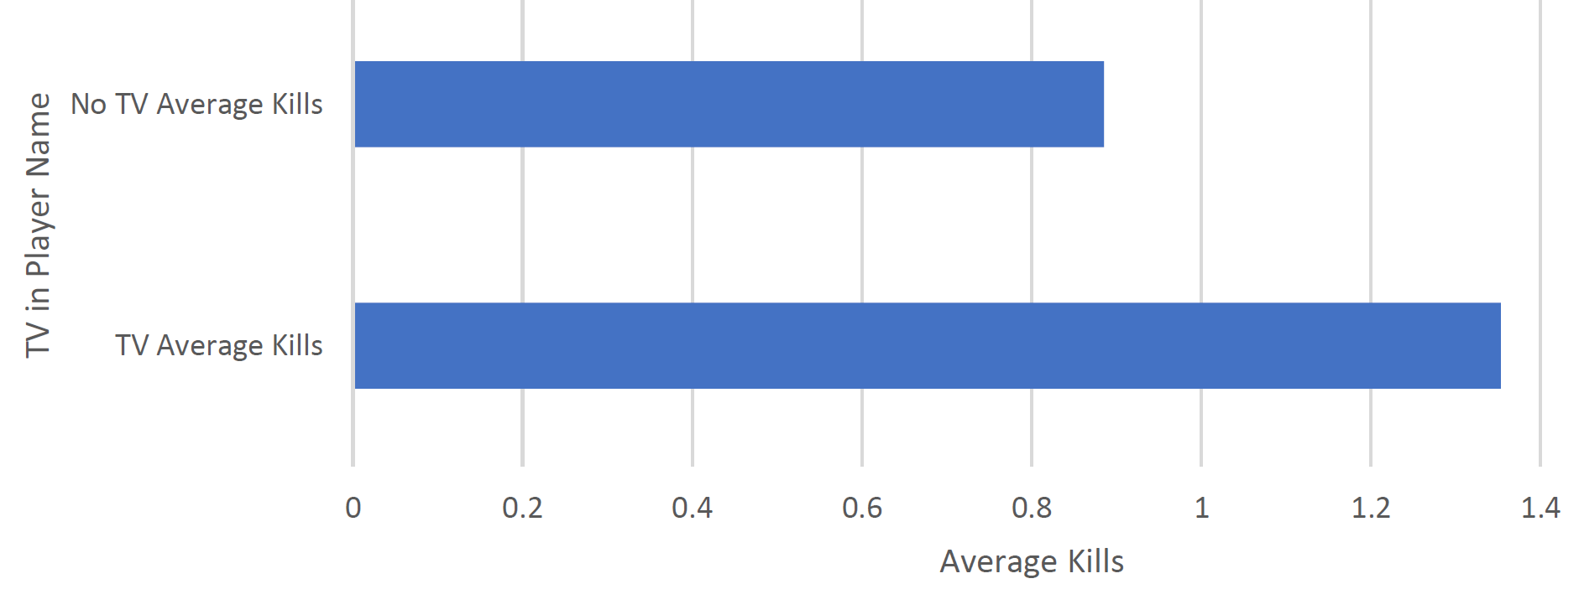
Part 4 – Your Choice
Kills versus team size (4x)
Survival time versus kills (4x)
Damage versus kills (3x)
Kill distribution (2x)
Kills versus placement
Kills versus survival time (2x)
Assists versus placement (2x)
Damage versus team size
Team placement versus survival time (2x)
Damage distribution for winners
Placement versus distance walked (2x)
Distance driven versus team size
Placement versus team size
Survival time versus team size
Game size versus game time
Down but Not Out (revivals) versus placement
Assists versus team size
Kills for streamers versus non-streamers (“TV” in name)
https://static1.squarespace.com/static/5947dbd14f14bc4eadcd0267/t/5a0d98c6ec212d61eecd0878/1510840528600/TOEFL+Question+analysis

Slide 9
Next Steps
Read over comments on your report
Ask if you have questions
Incorporate general and specific tips into next project!
Re-review before turning in Project 2
https://i0.wp.com/www.johnhardingestates.co.uk/wp-content/uploads/2018/02/John-Harding-Estates-Hints-and-Tips.png?fit=600%2C419

