Slide 1
Hearthstone Analytics
Postmortem
Project 3
IMGD 2905

Slide 2
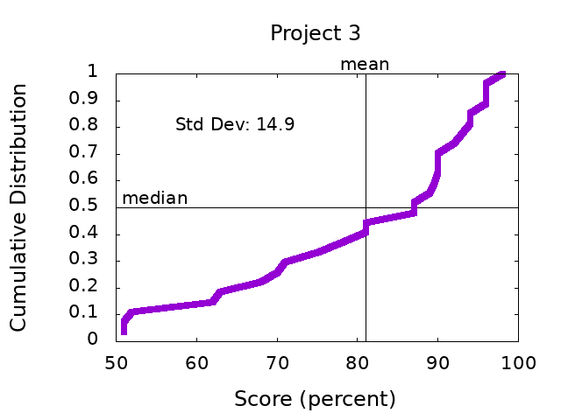
Scores
n: 27
min: 51
max: 98
mode: 3 @
(96,90)
median: 87
mean: 80.9
stdev: 14.63

Slide 3
General Comments
Some excellent chart techniques – properly selected, can differentiate trends, messages clear
Charts are 10 times better than just tables (a picture says a 1000 words)
Tables to provide summary statistics, charts for messages
Provide background information (methods)
Game description (no penalty)
Dataset (where obtained, no penalty), including month and year
Size of dataset (e.g., number of games, no penalty)
Consider (next slides):
a) ease of extracting information (units)
b) depth of analysis
c) combination of elements

Slide 4
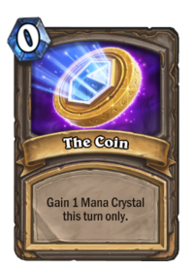
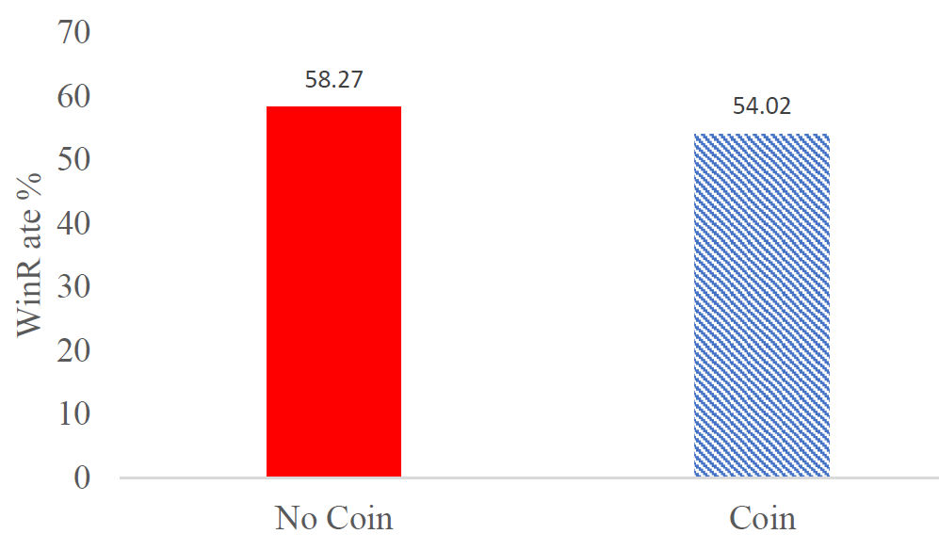
Part 1 – The Coin
Main player vs Opponent
They are both equal for analysis
i.e., main player winning isn’t of interest
Either can have coin
Want to know how many times (nocoin + win) versus (nocoin + lose)
But count isn’t particularly useful
→ Use units easy to understand: percent

Slide 5
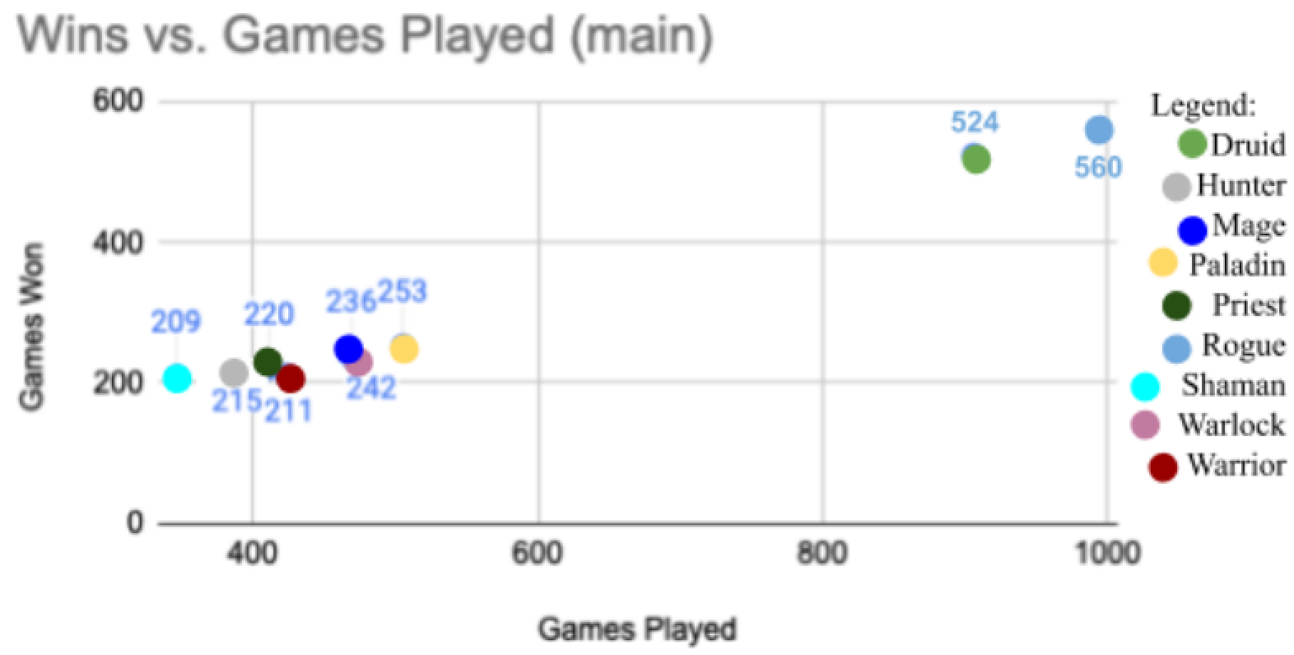
Part 2 – Heroes
Count of Heroes
Pick rate of Heroes
Win rate of Heroes
Column charts fine
Consider order
But, could show distributions
Relationship between win rate and pick rate
Variation?
Correlation?

Slide 6
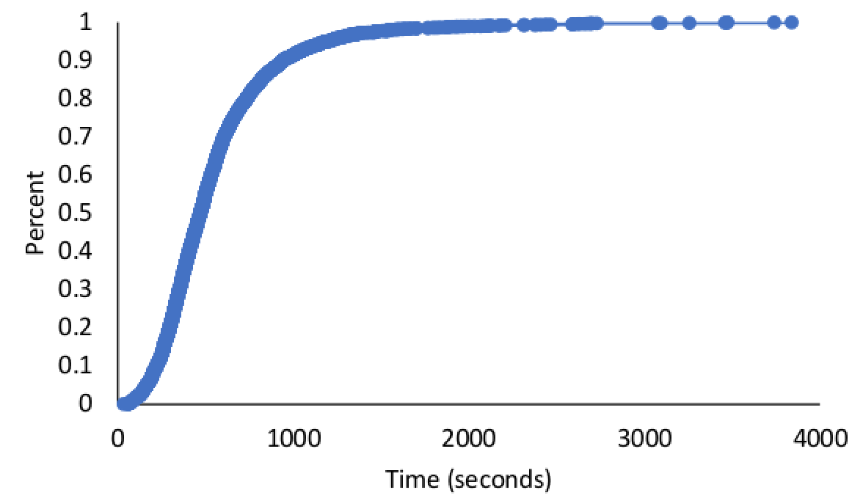
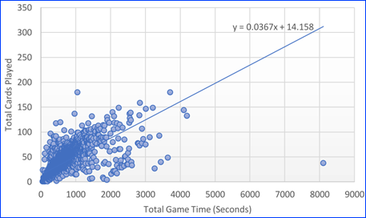
Part 3 – Play Rates
Length of games
Cards played
Rate of play
Average ok
Measure of spread!
Distributions better
Boxplot or Histogram or CDF
Rate
Cards per second?
0.05 cards/second (awkward)
Cards per minute or seconds per card
Chart!

Slide 7
Part 4 - Choice
Hero popularity over time (5+)
Effect of Coin on each Hero (3+)
Cards or Deck win rate/lose rate details (3+)
Hero win rate over time (1+)
Game length by Hero (1+)
Player rank by Hero choice (1+)
https://danielfast.files.wordpress.com/2014/03/choice-7697215_s.jpg

Slide 8
Next Steps
These slides posted on Proj 3 Web page
Read over comments on your report
Ask if you have questions
Incorporate general and specific tips into next project!
Re-review before turning in Project 4
Keep up the good work!
https://i0.wp.com/www.johnhardingestates.co.uk/wp-content/uploads/2018/02/John-Harding-Estates-Hints-and-Tips.png?fit=600%2C419

