Slide 1
Review
IMGD 2905

Slide 2
What are two main types of data for game analytics?

Slide 3
What are two main types of data for game analytics?
Quantitative – objective data from the game, often from instrumention (code to write/log data), typically players playing the game
Qualitative – subjective evaluation, typically from players during or after gameplay

Slide 4
What steps are in the game analytics pipeline?

Slide 5
What steps are in the game analytics pipeline?
Game (instrumented)
Data (collected from players playing game)
Extracted data (e.g., from scripts)
Analysis
Statistics, Charts, Tests
Dissemination
Report
Talk, Presentation

Slide 6
What is population versus sample?

Slide 7
What is population versus sample?
Population – all members of group pertaining to study
Typically want parameter of this group
Sample – part of population selected for analysis
Typically compute statistic to estimate parameter

Slide 8
What is probability sampling?

Slide 9
What is probability sampling?
Probability sampling – selecting members from the population group while considering the likelihood of selection
Likelihood as part of population

Slide 10
What is a Variable in Statistics?

Slide 11
What is a Variable in Statistics?
Any characteristics that can be measured, classified or counted
Examples: age, eye color, income, high score, kill-death ratio, vehicle type
e.g., time spent in competitive mode in Starcraft 2
e.g., vehicle choice in Grand Theft Auto (GTA)
Variables in columns
Independent variable is inherent in population, versus dependent variable that want to assess
Player Hours Champ
A 2 Leona
B 7.5 Teemo

Slide 12
What is a Pareto chart? When used?

Slide 13
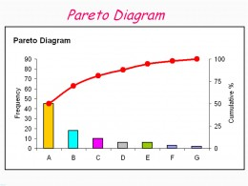
What is a Pareto chart? When used?
Bar chart, arranged most to least frequent
Line showing cumulative percent
Helps identify most common, relative amounts
https://goo.gl/S7qDTJ

Slide 14
When should you not use pie chart?

Slide 15
When should you not use pie chart?
When too many slices (more than 3)
When comparing sizes of slices/wedges
http://cdn.arstechnica.net/FeaturesByVersion.png

Slide 16
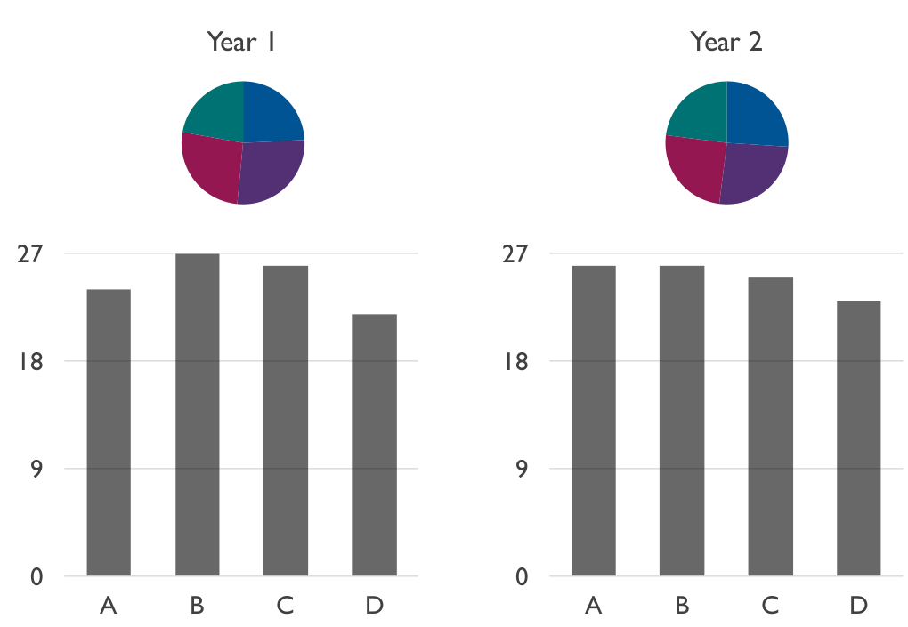
When should you not use pie chart?
(Often) when comparing pies

Slide 17
What is a heat map? Describe an example

Slide 18
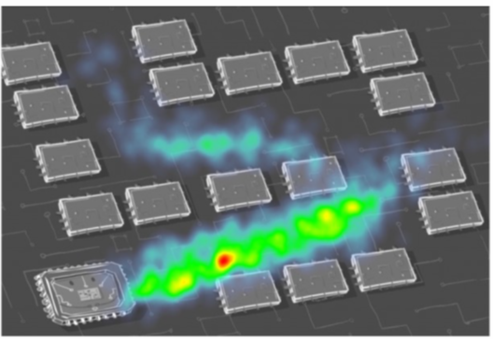
What is a heat map? Describe an example
Map where data represented as colors
Typically, greater values → brighter intensity colors

Slide 19
Provide three guidelines for good charts

Slide 20
Provide three guidelines for good charts
Require minimum effort from reader
Maximize information
Minimize ink
Use commonly accepted practices
Avoid ambiguity

Slide 21
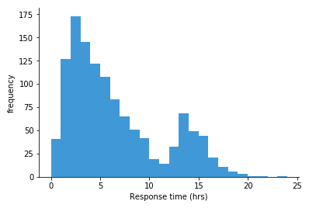
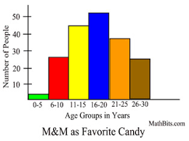
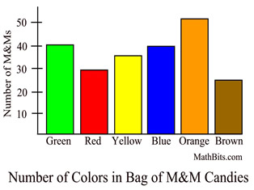
Which Measure of Central Tendency to Use? Why?

Slide 22
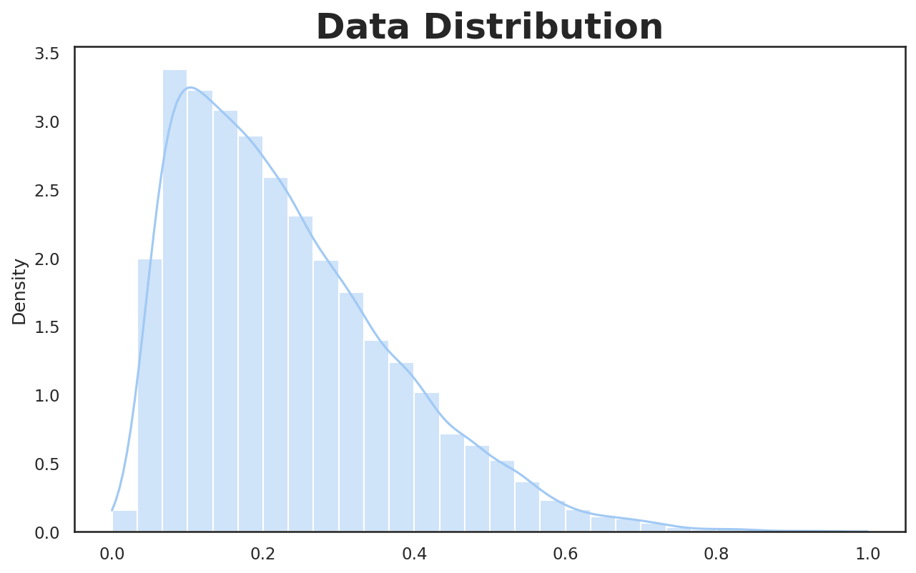
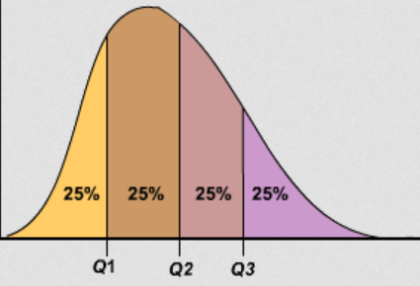
What are Quartiles?
Three values that divide population into four equal sized groups

Slide 23
Describe how to Compute Variance
Compute mean.
Take a sample and compute how far it is from mean. Square this.
Repeat #2 for each sample.
Add up all.
Divide by number of samples (-1).

Slide 24
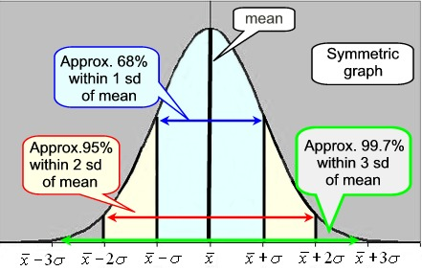
What is Mendenhall’s Empirical Rule?
https://mathbitsnotebook.com/Algebra1/StatisticsData/normalgrapha.jpg

Slide 25
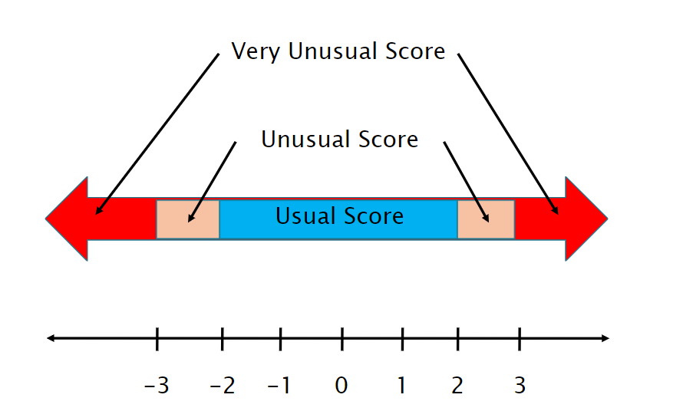
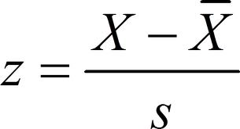
What can you interpret from Z-score?
Z₁ = 0.5? Z₂ = -3.2?
How “unusual” a score is
Where (above or below) score is relative to the average (mean) and spread (std dev)
Z₂
Z₁

Slide 26
In Probability, what is an Exhaustive Set of Events? Give an Example.
A set of all possible outcomes of an experiment or observation
e.g., coin: events {heads, tails}
e.g., d6: events {even number, odd number}
e.g., picking Champion in LoL: events {Shen, Teemo, Leona, …} (all possible Champions listed)

Slide 27
What Numeric Values do Probabilities take? (Hint: we had two rules)
Probabilities must be between 0 and 1 (but often written/said as percent)
Probabilities of set of exhaustive, mutually exclusive events must add up to 1

Slide 28
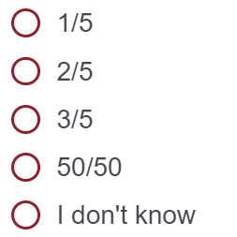
Probability
Draw 1 card. What is the probability drawing a Jack?
Poll 1!
https://web.cs.wpi.edu/~imgd2905/d22/polls.html

Slide 29
Probability
Draw 1 card. What is the probability drawing a Jack?
P(J) =
2 favorable outcomes /
5 total outcomes
= 2/5

Slide 30
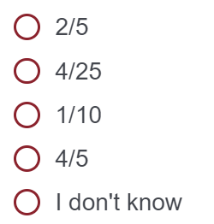
Probability
Draw 2 cards simultaneously. What is the probability of drawing 2 Jacks?
Poll 2!
https://web.cs.wpi.edu/~imgd2905/d22/polls.html

Slide 31
Probability
Draw 2 cards simultaneously. What is the probability of drawing 2 Jacks?
P(2J) = P(J) x P(J | J)
= 2/5 x 1/4
= 1/10

Slide 32
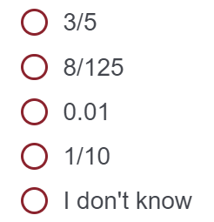
Probability
Draw 3 cards simultaneously. What is the probability of not drawing at least 1 King?
Poll 3!
https://web.cs.wpi.edu/~imgd2905/d22/polls.html

Slide 33
Probability
Draw 3 cards simultaneously. What is the probability of not drawing at least 1 King?
P(K’) x P(K’ | K’) x P(K’ | K’K’)
= 3/5 x 2/4 x 1/3
= 6/60
= 1/10

Slide 34
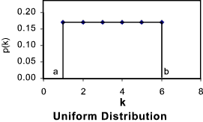
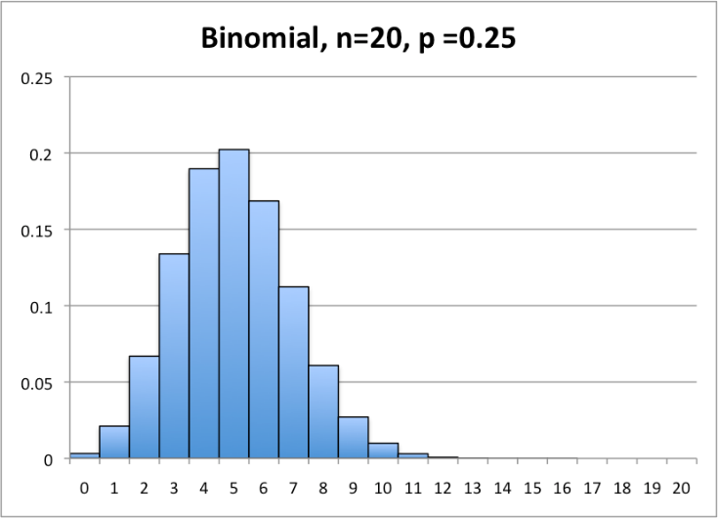
What Kind of Probability Distribution is:
Rolling one 6-sided dice (d6)? Can you draw it?
Uniform (or “square”)
Number of 1s when rolling 20 4-sided dice (d4)?
Binomial
http://tinyurl.com/y4j5u64d
http://statistics.wikidot.com/local--files/ch6/binomial.png

Slide 35
What Kind of Probability Distribution is:
Rolling one 6-sided dice (d6)? Can you draw it?
Uniform (or “square”)
Number of 1s when rolling 20 4-sided dice (d4)? Can you draw it?
Binomial
http://tinyurl.com/y4j5u64d
http://statistics.wikidot.com/local--files/ch6/binomial.png

Slide 36
What Kind of Probability Distribution is:
Rolling one 6-sided dice (d6)? Can you draw it?
Uniform (or “square”)
Number of 1s when rolling 20 4-sided dice (d4)? Can you draw it?
Binomial
http://tinyurl.com/y4j5u64d
http://statistics.wikidot.com/local--files/ch6/binomial.png

Slide 37
What are the characteristics of an experiment with a binomial distribution of outcomes?

Slide 38
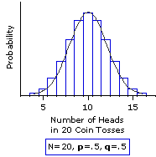
What are the characteristics of an experiment with a binomial distribution of outcomes?
Experiment consists of n independent, identical trials
Each trial results in only success or failure (probability p for success for each)
Random variable of interest (X) is number of successes in n trials
http://www.vassarstats.net/textbook/f0603.gif

Slide 39
What are the characteristics of an experiment with a Poisson distribution of outcomes?

Slide 40
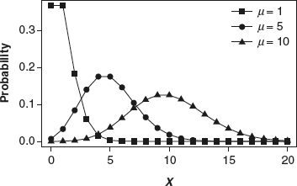
What are the characteristics of an experiment with a Poisson distribution of outcomes?
Interval (e.g., time) with units
Probability of event same for all interval units
Number of events in one unit independent of others
Events occur singly (not simultaneously)
Random variable of interest (X) is number of events that occur in an interval
http://methods.sagepub.com/images/virtual/encyc-of-research-design/p1043-1.jpg
Phrase people use is “random arrivals”

Slide 41
Expected Value
What is the formula for expected value?
μ_{x} = E(X) = ???

Slide 42
Expected Value
What is the formula for expected value?
μ_{x} = E(X) = x₁P(x₁) + x₂P(x₂) + … + x_{n}P(x_{n})

Slide 43
Expected Value
What is the formula for expected value?
Toss: Flip 2 coins
Each Head gives 1 point
2 Tails → bust, turn over
μ_{x} = E(X) = x₁P(x₁) + x₂P(x₂) + … + x_{n}P(x_{n})

Slide 44
Expected Value
What is the formula for expected value?
What is the expected value after 1 toss?
Toss: Flip 2 coins
Each Head gives 1 point
2 Tails → bust, turn over
μ_{x} = E(X) = x₁P(x₁) + x₂P(x₂) + … + x_{n}P(x_{n})
Poll!

Slide 45
Expected Value
What is the formula for expected value?
What is the expected value after 1 toss?
Toss: Flip 2 coins
Each Head gives 1 point
2 Tails → bust, turn over
μ_{x} = E(X) = x₁P(x₁) + x₂P(x₂) + … + x_{n}P(x_{n})
E(X) = 0*P(TT) + 1*P(HT) + 1*P(TH) + 2*P(HH)
= 1/4 + 1/4 + 2/4
= 4/4
= 1

Slide 46
Expected Value
What is the formula for expected value?
What is the expected value after 1 toss?
Toss: Flip 2 coins
Each Head gives 1 point
2 Tails → bust, turn over
μ_{x} = E(X) = x₁P(x₁) + x₂P(x₂) + … + x_{n}P(x_{n})
E(X) = 0*P(TT) + 1*P(HT) + 1*P(TH) + 2*P(HH)
= 1/4 + 1/4 + 2/4
= 4/4
= 1
After 2 tosses?
E(X) = x₁P(bust) + x₂P(bust’)

Slide 47
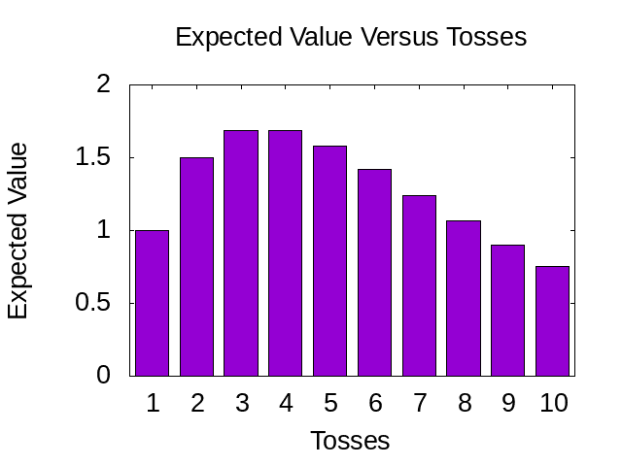
Expected Value
What is average if don’t bust?
A = HT + TH + HH = (1 + 1 + 2) / 3 = 4/3
What is the expected value after 1 toss?
E(X) = P(TT) * 0 + (1- P(TT)) * 4/3
= ¾ * 4/3
= 1
2 tosses?
E(X) = (1-P(TT))² * (4/3 * 2)
= ¾ * ¾ * 8/3
= 1.5
3 tosses?
E(X) = (1-P(TT))³ * (4/3 * 3)
= ¾ * ¾ * ¾ * 12/3
= 1.6875
Toss: Flip 2 coins
Each Head gives 1 point
2 Tails → bust, turn over
Poll!
BEST_BOT?

Slide 48
Expected Value
What is average if don’t bust?
A = HT + TH + HH = (1 + 1 + 2) / 3 = 4/3
What is the expected value after 1 toss?
E(X) = P(TT) * 0 + (1- P(TT)) * 4/3
= ¾ * 4/3
= 1
2 tosses?
E(X) = (1-P(TT))² * (4/3 * 2)
= ¾ * ¾ * 8/3
= 1.5
3 tosses?
E(X) = (1-P(TT))³ * (4/3 * 3)
= ¾ * ¾ * ¾ * 12/3
= 1.6875
Toss: Flip 2 coins
Each Head gives 1 point
2 Tails → bust, turn over
Poll!
BEST_BOT?

Slide 49
Expected Value
What is average if don’t bust?
A = HT + TH + HH = (1 + 1 + 2) / 3 = 4/3
What is the expected value after 1 toss?
E(X) = P(TT) * 0 + (1- P(TT)) * 4/3
= ¾ * 4/3
= 1
2 tosses?
E(X) = (1-P(TT))² * (4/3 * 2)
= ¾ * ¾ * 8/3
= 1.5
3 tosses?
E(X) = (1-P(TT))³ * (4/3 * 3)
= ¾ * ¾ * ¾ * 12/3
= 1.6875
Toss: Flip 2 coins
Each Head gives 1 point
2 Tails → bust, turn over
BEST_BOT?

Slide 50
Expected Value
What is average if don’t bust?
A = HT + TH + HH = (1 + 1 + 2) / 3 = 4/3
What is the expected value after 1 toss?
E(X) = P(TT) * 0 + (1- P(TT)) * 4/3
= ¾ * 4/3
= 1
2 tosses?
E(X) = (1-P(TT))² * (4/3 * 2)
= ¾ * ¾ * 8/3
= 1.5
3 tosses?
E(X) = (1-P(TT))³ * (4/3 * 3)
= ¾ * ¾ * ¾ * 12/3
= 1.6875
Toss: Flip 2 coins
Each Head gives 1 point
2 Tails → bust, turn over
Poll!
BEST_BOT?

Slide 51
Expected Value
What is average if don’t bust?
A = HT + TH + HH = (1 + 1 + 2) / 3 = 4/3
What is the expected value after 1 toss?
E(X) = P(TT) * 0 + (1- P(TT)) * 4/3
= ¾ * 4/3
= 1
2 tosses?
E(X) = (1-P(TT))² * (4/3 * 2)
= ¾ * ¾ * 8/3
= 1.5
3 tosses?
E(X) = (1-P(TT))³ * (4/3 * 3)
= ¾ * ¾ * ¾ * 12/3
= 1.6875
Toss: Flip 2 coins
Each Head gives 1 point
2 Tails → bust, turn over
BEST_BOT?

Slide 52
Expected Value
What is average if don’t bust?
A = HT + TH + HH = (1 + 1 + 2) / 3 = 4/3
What is the expected value after 1 toss?
E(X) = P(TT) * 0 + (1- P(TT)) * 4/3
= ¾ * 4/3
= 1
2 tosses?
E(X) = (1-P(TT))² * (4/3 * 2)
= ¾ * ¾ * 8/3
= 1.5
3 tosses?
E(X) = (1-P(TT))³ * (4/3 * 3)
= ¾ * ¾ * ¾ * 12/3
= 1.6875
Toss: Flip 2 coins
Each Head gives 1 point
2 Tails → bust, turn over
BEST_BOT?

Slide 53
What is the Standard Normal Distribution?

Slide 54
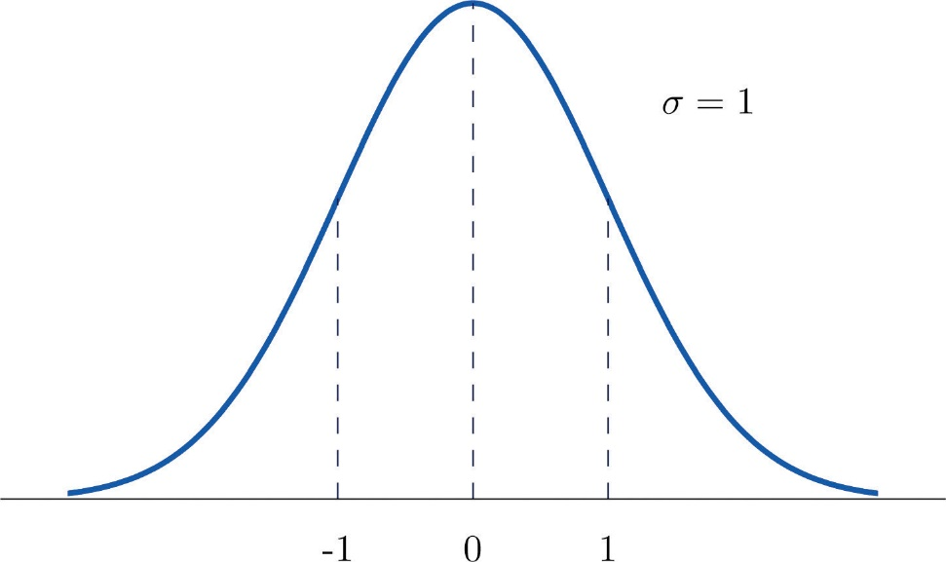
What is the Standard Normal Distribution?
Normal distribution
Mean μ = 0
Std dev σ = 1
σ = 1
μ = 0

Slide 55
What is the Central Limit Theorem?
Given population
If take large enough sample size
What does probability of sample means look like?
→ What is Distribution shape?

Slide 56
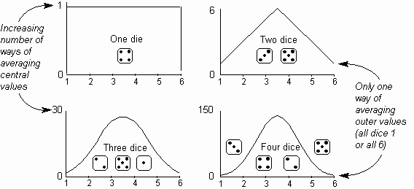
What is the Central Limit Theorem?
Given population
If take large enough sample size
What does probability of sample means look like?
→ Distributed Normally
How man is “large enough”?
http://home.ubalt.edu/ntsbarsh/Dice_001.gif

Slide 57
What is the Central Limit Theorem?
Given population
If take large enough sample size
What does probability of sample means look like?
→ Distributed Normally
How man is “large enough”?
30
(15)
Does underlying distribution matter?
http://home.ubalt.edu/ntsbarsh/Dice_001.gif

Slide 58
What is the Central Limit Theorem?
Given population
If take large enough sample size
What does probability of sample means look like?
→ Distributed Normally
How man is “large enough”?
30
(15)
Does underlying distribution matter?
No
(see next slide)
http://home.ubalt.edu/ntsbarsh/Dice_001.gif

Slide 59
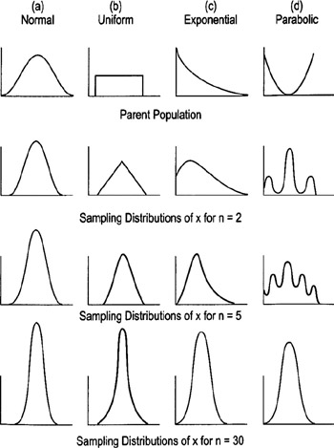
Underlying Distribution does not Matter
Why do we care?
→ Can apply rules (e.g., empirical rule) to Normal Distributions!
http://flylib.com/books/2/528/1/html/2/images/figu115_1.jpg

Slide 60
Sampling Error
What is sampling error?

Slide 61
Sampling Error
What is sampling error?
Error from estimating population parameters from sample statistics
Size of error is based on what two main factors?

Slide 62
Sampling Error
What is sampling error?
Error from estimating population parameters from sample statistics
Size of error is based on what two main factors?
Population variance (e.g., σ)
Sample size (N)

Slide 63
Statistic versus Sample Size (N)
Suppose wanted to know likelihood that WPI student played Hearthstone
Ask N people, count “yes” and divide by N
Ask 1 person?
Ask 2 people?
Ask 100 people?
What does graph
of “yes” probability
versus N people look
like?

Slide 64
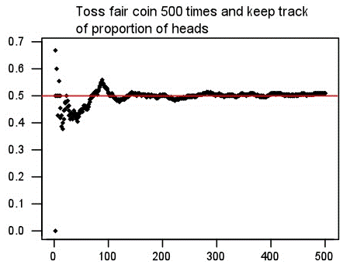
Statistic versus Sample Size (N)
Suppose wanted to know likelihood that WPI student played Hearthstone
Ask N people, count “yes” and divide by N
Ask 1 person?
Ask 2 people?
Ask 100 people?
What does graph
of “yes” probability
versus N people look
like?
Probability “yes”
Number of people asked

Slide 65
Groupwork
https://web.cs.wpi.edu/~imgd2905/d22/groupwork/8-review/handout.html

Slide 66
Confidence Intervals
What is a confidence interval? Give an example

Slide 67
Confidence Intervals
What is a confidence interval? Give an example
Range of values with specific certainty that population parameter is within
95% confidence interval for mean time to complete a level in Super Mario: [1.25 minutes, 1.75 minutes]
What is the size of confidence interval based on?

Slide 68
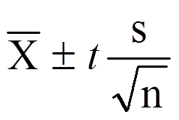
Confidence Intervals
What is a confidence interval? Give an example
Range of values with specific certainty that population parameter is within
95% confidence interval for mean time to complete a level in Super Mario: [1.25 minutes, 1.75 minutes]
What is the size of confidence interval based on?
Confidence (1-α)
Standard error (N, number of items in sample) (standard deviation)

Slide 69
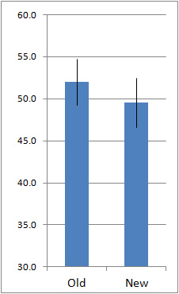
Interpreting Confidence Intervals
Assume bars are conference intervals
Interpret difference in old versus new

Slide 70
Interpreting Confidence Intervals
Assume bars are conference intervals
Interpret difference in old versus new
Large overlap
No statistically significant difference (at given α level)
Helpful hint: ignore sample means. Think about population means for Old and New

Slide 71
Hypothesis Testing
Studio has new model for Hero
Want to see if played more often
Steps?
Gather data
Compute sample mean
Set hypotheses
Test (compute p value)
Analyze results to accept or reject

Slide 72
Hypothesis Testing
Studio has new model for Hero
Want to see if played more often
Steps?
Gather data
Compute sample mean
Set hypotheses
Test (compute p value)
Analyze results to accept or reject

Slide 73
Hypothesis Testing
What is the Null Hypothesis?
No significance difference between measured value and population parameter
What is the Alternate Hypothesis?
Contrary to null hypothesis (i.e., there is a difference)
Which do we test and why?
Test Null
Data can only reject hypothesis, not prove
→ Reject Null

Slide 74
Hypothesis Testing
What is the Null Hypothesis?
The measured statistic is the same as the population parameter (i.e., x̄ = μ)
What is the Alternate Hypothesis?
Contrary to null hypothesis (i.e., there is a difference in the two (x̄ != μ))
Which do we test and why?
Test Null
Data can only reject hypothesis, not prove
→ Reject Null

Slide 75
Hypothesis Testing
What is the Null Hypothesis?
The measured statistic is the same as the population parameter (i.e., x̄ = μ)
What is the Alternate Hypothesis?
Contrary to null hypothesis (i.e., there is a difference in the two (x̄ != μ))
Which do we test and why?
Test Null
Data can only reject hypothesis, not prove
→ Reject Null

Slide 76
Hypothesis Testing
Gathered “new” data, computed sample mean, created Null hypothesis (H₀), chose significance (α = 0.01)
Calculate p value = 0.05
Make inference: CAN or CANNOT reject H₀?
CANNOT reject H₀
What does that mean?
May be no difference between sample mean and population mean (at 0.01 significance)

Slide 77
Hypothesis Testing
Gathered “new” data, computed sample mean, created Null hypothesis (H₀), chose significance (α = 0.01)
Calculate p value = 0.05
Make inference: CAN or CANNOT reject H₀?
CANNOT reject H₀
What does that mean?
May be no difference between sample mean and population mean (at 0.01 significance)

Slide 78
Hypothesis Testing
Gathered “new” data, computed sample mean, created Null hypothesis (H₀), chose significance (α = 0.01)
Calculate p value = 0.05
Make inference: CAN or CANNOT reject H₀?
CANNOT reject H₀
What does that mean?
May be no difference between “new” mean and population mean (at 0.01 significance)

Slide 79
Regression
What is the purpose of regression in data analytics?
To predict an unobserved value from a mathematical model
What is simple linear regression?
A linear model relating two variables/factors
m is slope, b is y-intercept
Y = mX + b

Slide 80
Regression
What is the purpose of regression in data analytics?
To predict an unobserved value from a mathematical model
What is simple linear regression?
A linear model relating two variables/factors
m is slope, b is y-intercept
Y = mX + b

Slide 81
Regression
What is the purpose of regression in data analytics?
To predict an unobserved value from a mathematical model
What is simple linear regression?
A linear model relating two variables/factors
m is slope, b is y-intercept
Y = mX + b

Slide 82
Regression
If market value of a house can be represented by the model:
value = 32673 + 35.036 x (square feet)
How do you interpret the model? How can you use it?
Intercept is 32673. Base house value is $32k.
Slope is 35.036. Every square foot increases house value by $35
Given square feet, predict value: 1800 sq feet
value = 32,673 + 35.036 x (1800) = $95,737.80

Slide 83
Regression
If market value of a house can be represented by the model:
value = 32673 + 35.036 x (square feet)
How do you interpret the model? How can you use it?
Intercept is 32673. So, base house value is $33k.
Slope is 35.036. So, every square foot increases house value by $35
Given square feet, predict value: 1800 sq feet
value = 32673 + 35.036 x (1800) = $95,737.80

Slide 84
What are Residuals?

Slide 85
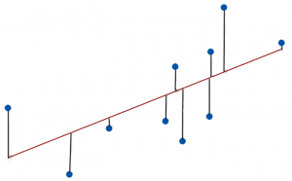
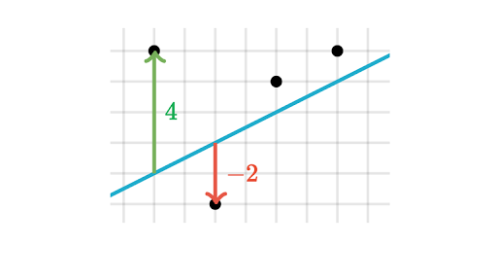
What are Residuals?
A residual is difference between observed value and predicted value
Vertical distance between a data point and regression line

Slide 86
What is Residual Analysis?

Slide 87
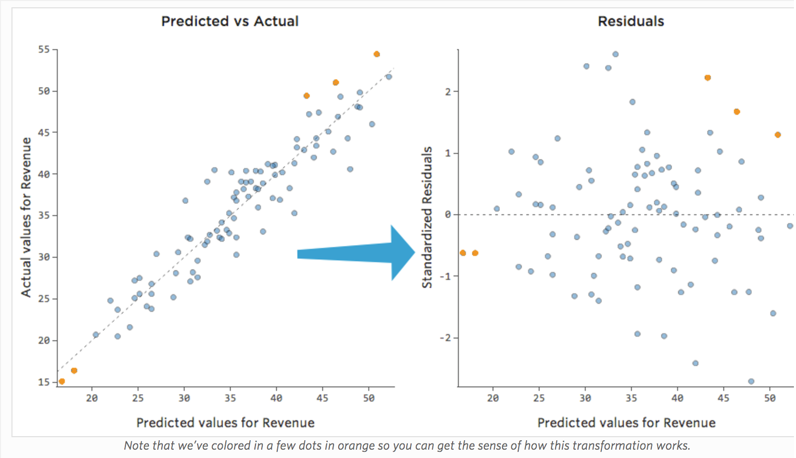
What is Residual Analysis?
https://www.qualtrics.com/support/stats-iq/analyses/regression-guides/interpreting-residual-plots-improve-regression/
Chart residuals on vertical axis and independent variable on horizontal axis. No pattern? → Linear ok

Slide 88
What is a Least Squares Line?

Slide 89
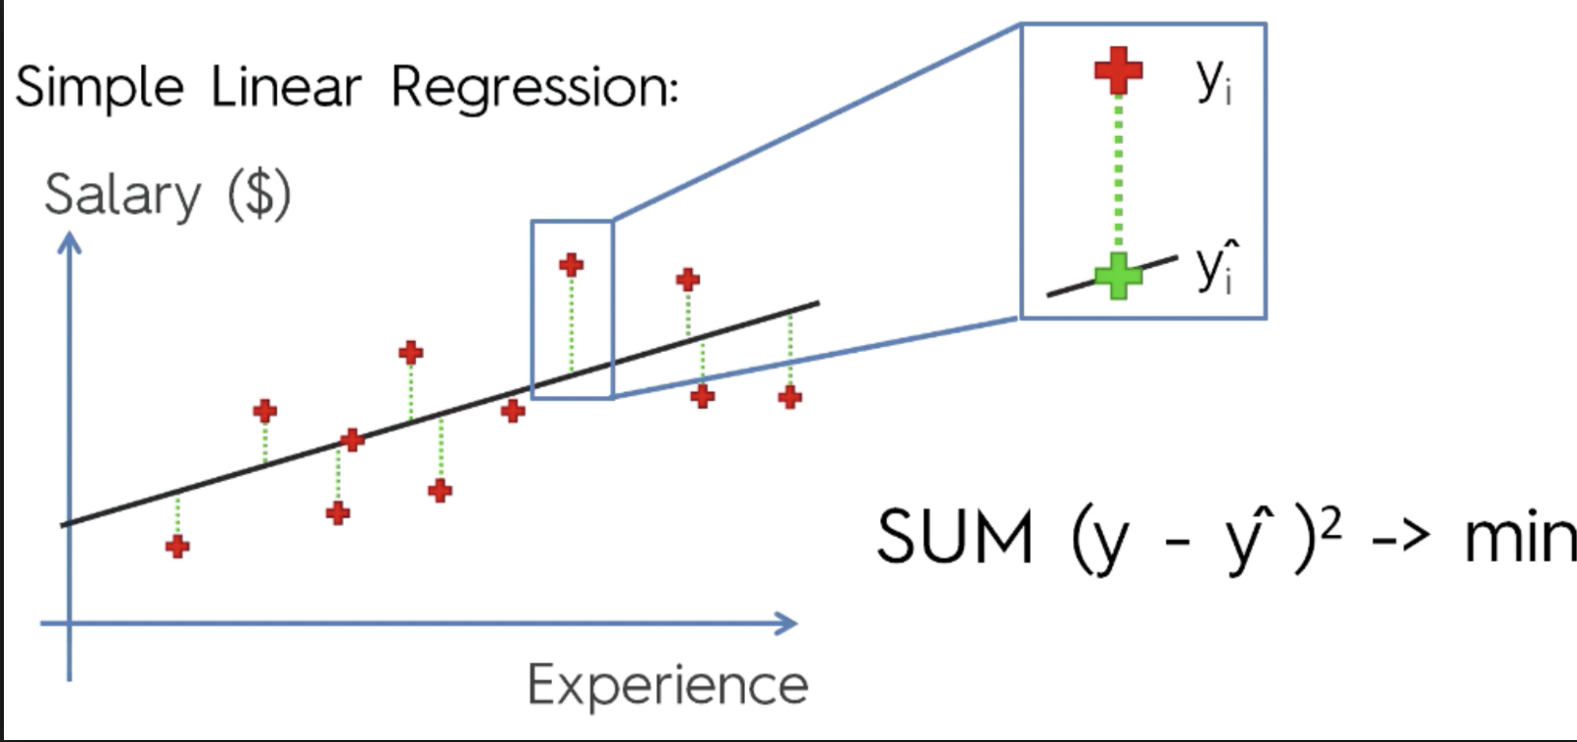
What is a Least Squares Line?
Line that minimizes sum squared error
Y = mX + b
https://cdn-images-1.medium.com/max/1600/1*AwC1WRm7jtldUcNMJTWmiA.png

Slide 90
What is the Coefficient of Determination (R²)?

Slide 91
What is the Coefficient of Determination (R²)?
Proportion of variance in the dependent variable predictable by the independent variable
Fraction (percentage) of variance explainable by model
$$R2=\frac{SSR}{SST}=1−\frac{SSE}{SST}$$

Slide 92
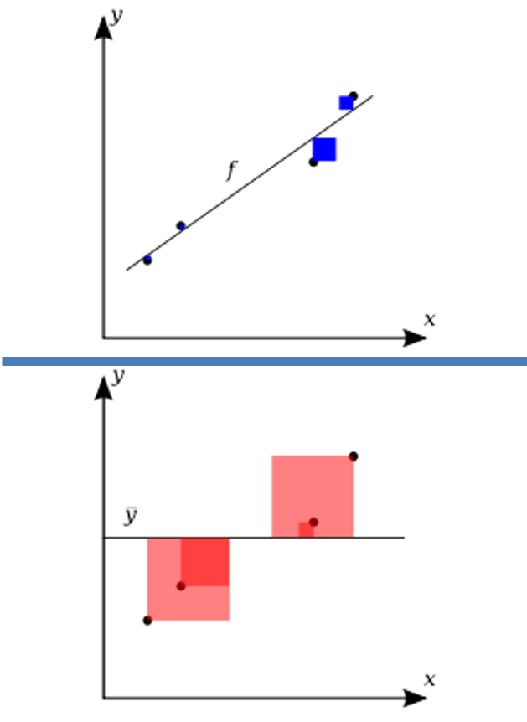
What is the Coefficient of Determination (R²)?
Variation in observed data model cannot explain (error)
R² = 1 -
Total variation in observed data
https://upload.wikimedia.org/wikipedia/commons/thumb/8/86/Coefficient_of_Determination.svg/400px-Coefficient_of_Determination.svg.png

Slide 93
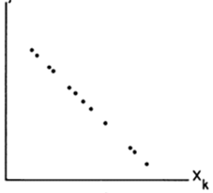
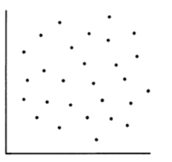
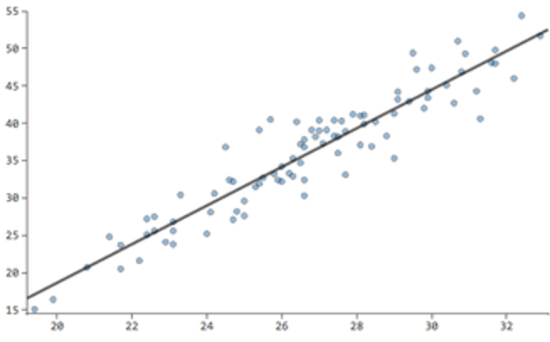
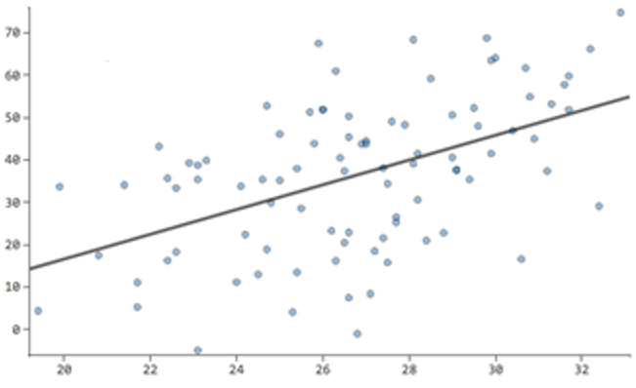
What is the value of R²?
of R?
R² = 1
R² = 0
R = -1
R = 0
R² = 0.8
R² = 0.2
R = 0.9
R = 0.4

