Slide 1
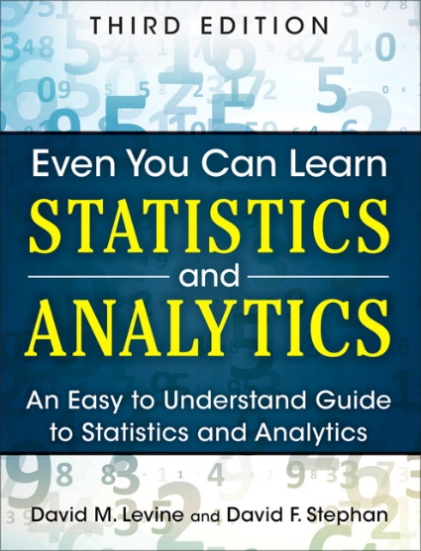
Simple Linear Regression
IMGD 2905
Chapter 10

Slide 2
Motivation
Have data (sample, x’s. e.g., playtime)
Want to know likely value of next observation (A)
A. Compute mean y-value (with confidence interval)
Predict A
But what if have additional information?
E.g., playtime versus skins owned
→ Better prediction!
x
x
x
x
Y
x
A?
x
x
x

Slide 3
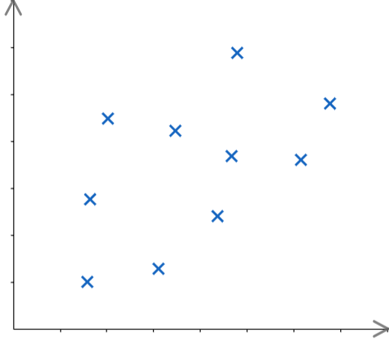
Motivation
Have data (sample, x’s), based on X
E.g., playtime versus skins owned
Want to know likely value of next observation (Y)
A – reasonable to compute mean y-value (with confidence interval)
B – could do same, but there appears to be relationship between X and Y!
→ Predict B (here, use X data to predict Y)
e.g., “trendline” (regression)
B
Y
A
X

Slide 4
Overview
Broadly, two types of prediction techniques:
Regression – mathematical equation to model, then use model for predictions
We’ll discuss simple linear regression
Machine learning – branch of AI, use computer algorithms to determine relationships (predictions)
CS 4342 Machine Learning

Slide 5
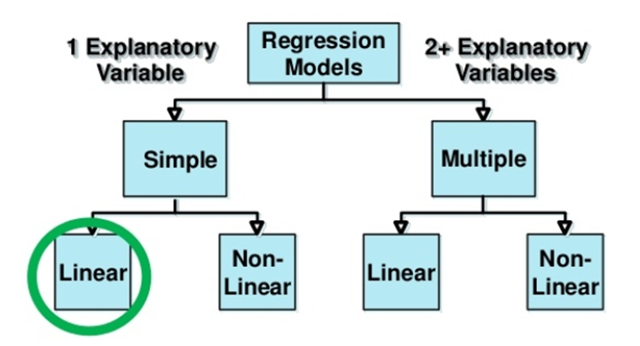
Types of Regression Models
Explanatory variable explains dependent variable
Variable X (e.g., skill level) explains Y (e.g., KDA)
Can have 1 (simple) or 2+ (multiple)
Linear if coefficients added, else Non-linear
Notes:
27

Slide 6
Outline
Introduction (done)
Simple Linear Regression (next)
Linear relationship
Residual analysis
Fitting parameters
Measures of Variation
Misc

Slide 7
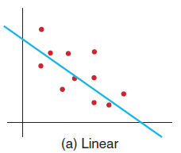
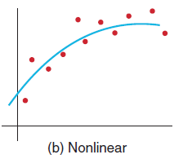
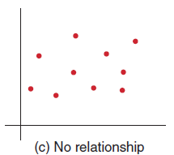
Simple Linear Regression
Goal – find a linear (line) relationship between two values
E.g., travel time and car speed, KDA and skill,
First, make sure relationship is linear! How?
→ Scatterplot
(c) no clear relationship
(b) not a linear relationship
(a) linear relationship – proceed with linear regression

Slide 8
Linear Relationship
From algebra: line in form
m is slope, b is y-intercept
Slope (m) is amount Y increases when X increases by 1 unit (specifying units important!)
Intercept (b) is where line crosses y-axis, or where y-value when x = 0
Y = mX + b
https://www.scribd.com/presentation/230686725/Fu-Ch11-Linear-Regression

Slide 9
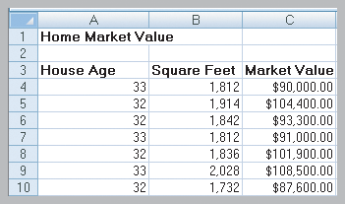
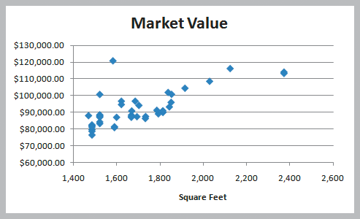
Simple Linear Regression Example
Size of house related to its market value.
X = square footage
Y = market value ($)
Scatter plot (42 homes)
indicates linear trend

Slide 10
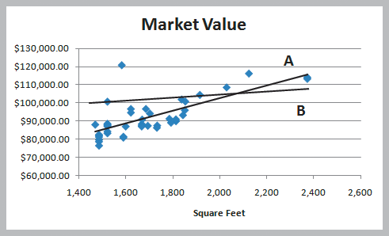
Simple Linear Regression Example
Two possible lines shown below (A and B)
Want to determine best regression line
Line A looks a better fit to data
But how to know?
Y = mX + b

Slide 11
Simple Linear Regression Example
Two possible lines shown below (A and B)
Want to determine best regression line
Line A looks a better fit to data
But how to know?
Y = mX + b
Line that gives best fit to data is one that minimizes prediction error
Least squares line
(more later)

Slide 12
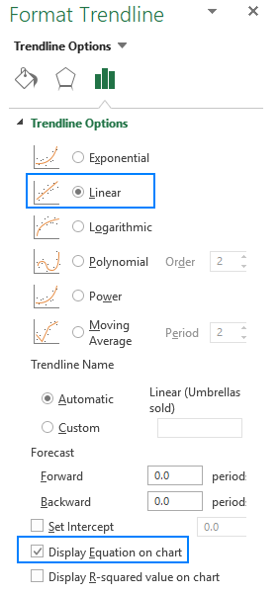
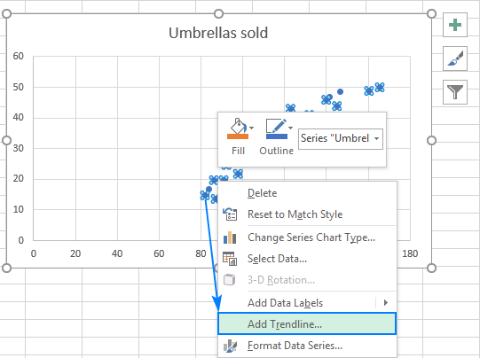
Simple Linear Regression Example Chart
Scatterplot
Right click → Add Trendline

Slide 13
Simple Linear Regression Example Formulas
=SLOPE(C4:C45,B4:B45)
→ Slope = 35.04
=INTERCEPT(C4:C45,B4:B45)
→ Intercept = 32,600
Estimate Y when X = 1800 square feet
Y = 32,600 + 35.04 x (1800) = $95,672

Slide 14
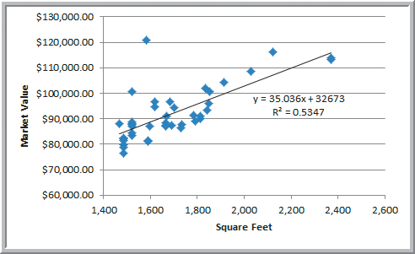
Simple Linear Regression Example
Market value = 32600 + 35.04 x (square feet)
Predicts market value better than just average
But before use, examine residuals

Slide 15
Groupwork
Simple Linear Regression
https://web.cs.wpi.edu/~imgd2905/d23/groupwork/11-regression/handout.html

Slide 16
Groupwork
In simple linear regression, the y-intercept (b) represents the:
predicted value of Y
change in Y per unit change in X
predicted value of Y when X=0
variation around the line
A simple linear regression model for predicting a player's points (Y) is 6 X + 10, where X is the player's level.
How many more points can a player expect to get when they level up?
How many points can a level 10 player expect to get?

Slide 17
Outline
Introduction (done)
Simple Linear Regression
Linear relationship (done)
Residual analysis (next)
Fitting parameters
Measures of Variation
Misc

Slide 18
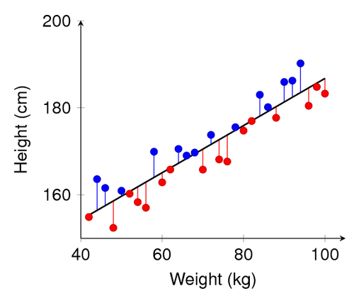
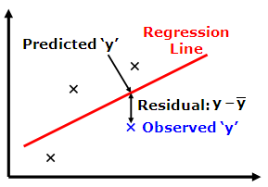
Residual Analysis
Before predicting, confirm that linear regression assumptions hold
Variation around line is normally distributed
Variation equal for all X
Variation independent for all X
How? Compute residuals (error in prediction)
→ Residuals Chart

Slide 19
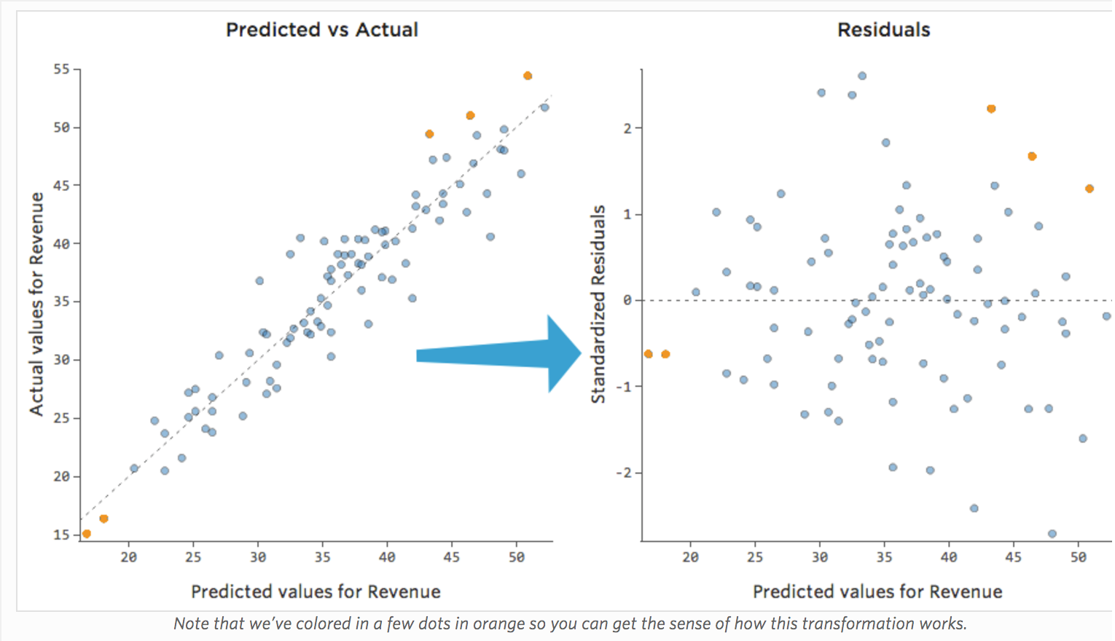
Residual Analysis
https://www.qualtrics.com/support/stats-iq/analyses/regression-guides/interpreting-residual-plots-improve-regression/
Variation around line normally distributed ?
Variation equal for all X
Variation independent for all X?
No clear pattern

Slide 20
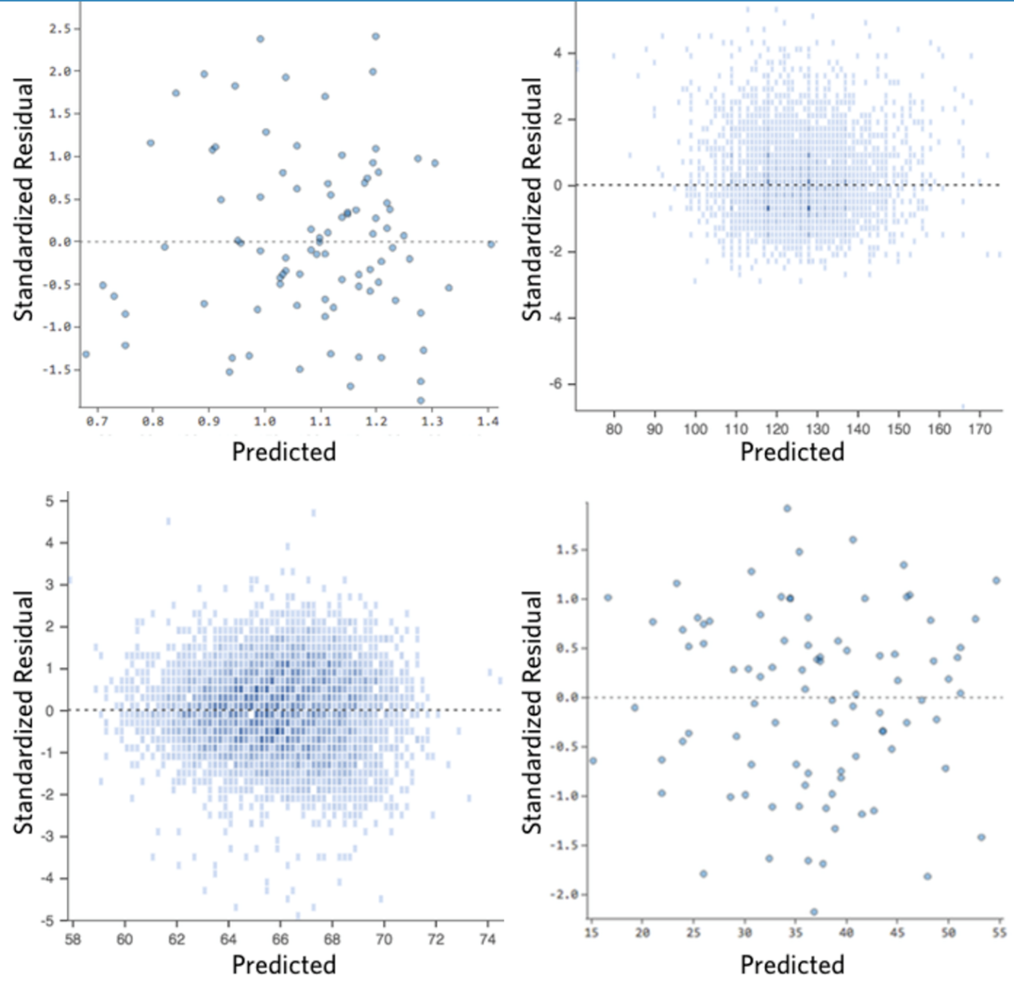
Residual Analysis – Good
https://www.qualtrics.com/support/stats-iq/analyses/regression-guides/interpreting-residual-plots-improve-regression/
Clustered towards middle, ok since need normally distributeds
Symmetrically distributed
No clear pattern

Slide 21
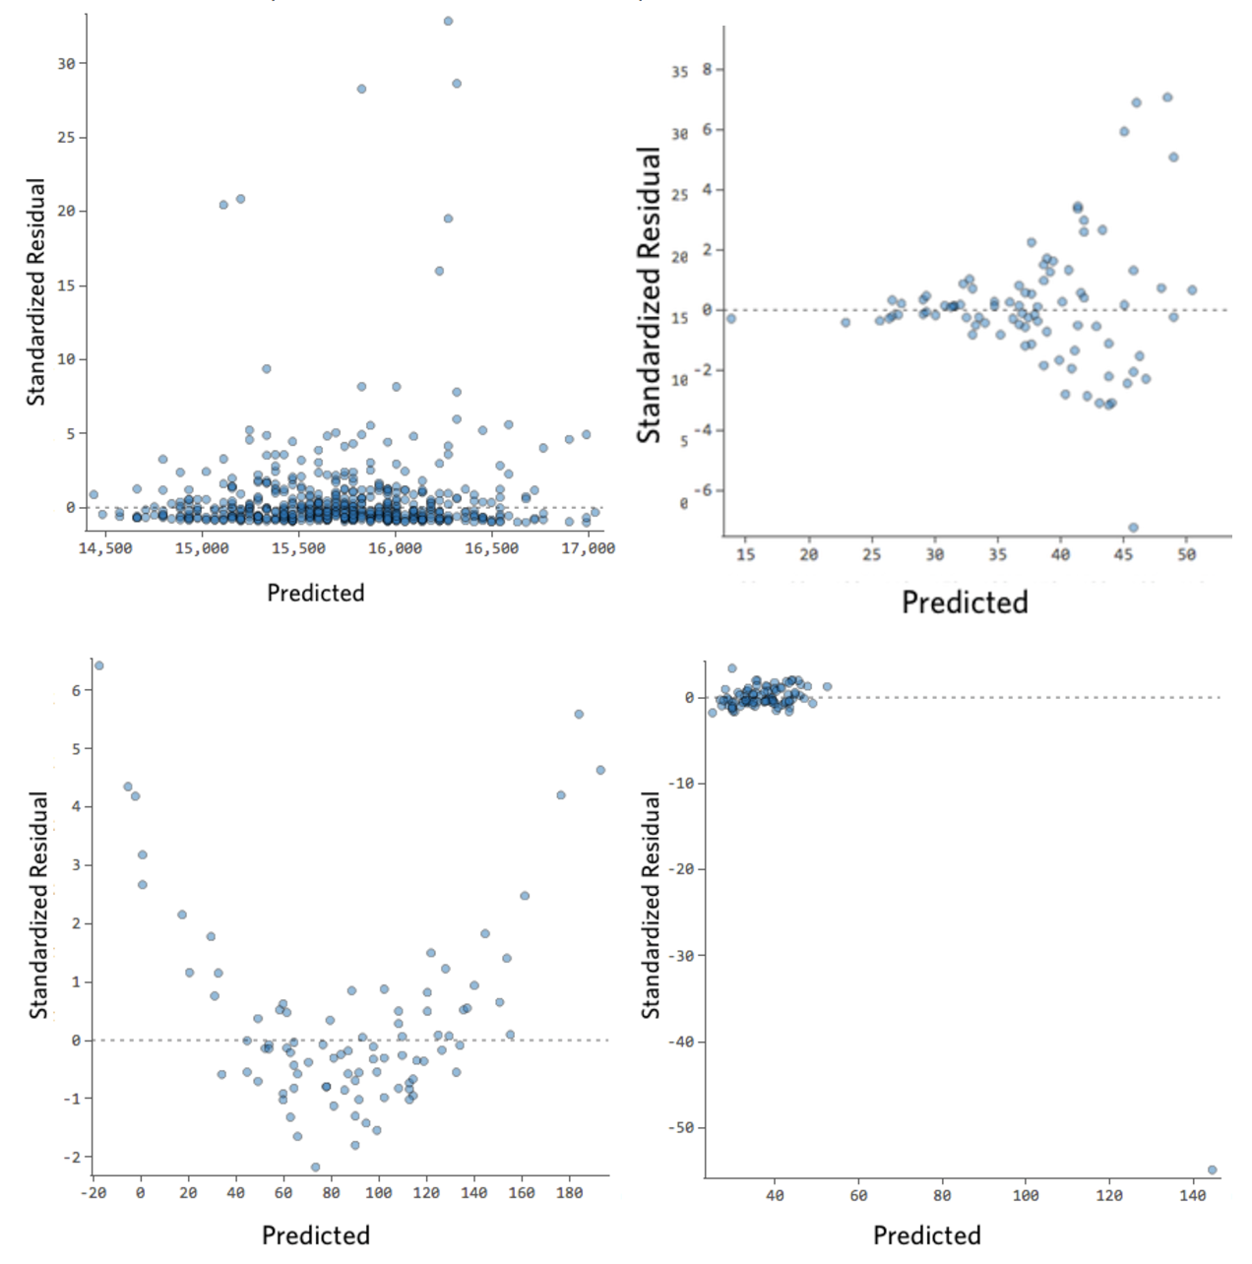
Residual Analysis – Bad
https://www.qualtrics.com/support/stats-iq/analyses/regression-guides/interpreting-residual-plots-improve-regression/
Clear shape
Outliers
Patterns!
Note: could do normality test (QQ plot)

Slide 22
Outline
Introduction (done)
Simple Linear Regression
Linear relationship (done)
Residual analysis (done)
Fitting parameters (next)
Measures of Variation
Misc

Slide 23
Linear Regression Model
Y
=
b
+
m
X
+
ε
i
0
i
i
ε_{i} = random error
Y
=
b
+
m
X
Observed value
https://www.scribd.com/presentation/230686725/Fu-Ch11-Linear-Regression
Random error associated with each observation
(Residual)
Notes:
35

Slide 24
Fitting the Best Line
Plot all (X_{i}, Y_{i}) Pairs
Y
60
40
20
0
X
0
20
40
60
https://www.scribd.com/presentation/230686725/Fu-Ch11-Linear-Regression

Slide 25
Fitting the Best Line
Plot all (X_{i}, Y_{i}) Pairs
Draw a line. But how do we know it is best?
Y
60
40
20
0
X
0
20
40
60
https://www.scribd.com/presentation/230686725/Fu-Ch11-Linear-Regression

Slide 26
Fitting the Best Line
Plot all (X_{i}, Y_{i}) Pairs
Draw a line. But how do we know it is best?
Y
60
Slope changed
40
20
0
X
Intercept unchanged
0
20
40
60
https://www.scribd.com/presentation/230686725/Fu-Ch11-Linear-Regression

Slide 27
Fitting the Best Line
Plot all (X_{i}, Y_{i}) Pairs
Draw a line. But how do we know it is best?
Y
Slope unchanged
60
40
20
Intercept changed
0
X
0
20
40
60
https://www.scribd.com/presentation/230686725/Fu-Ch11-Linear-Regression

Slide 28
Fitting the Best Line
Plot all (X_{i}, Y_{i}) Pairs
Draw a line. But how do we know it is best?
Y
Slope changed
60
40
20
Intercept changed
0
X
0
20
40
60
https://www.scribd.com/presentation/230686725/Fu-Ch11-Linear-Regression

Slide 29
Linear Regression Model
Relationship between variables is linear function
Population Y-Intercept
Population Slope
Random Prediction Error
Want error as small as possible
Y
=
b
+
m
X
+
ε
i
0
i
i
Dependent (response) Variable (e.g., kills)
i-th observation / prediction
Independent (explanatory) Variable (e.g., skill level)

Slide 30
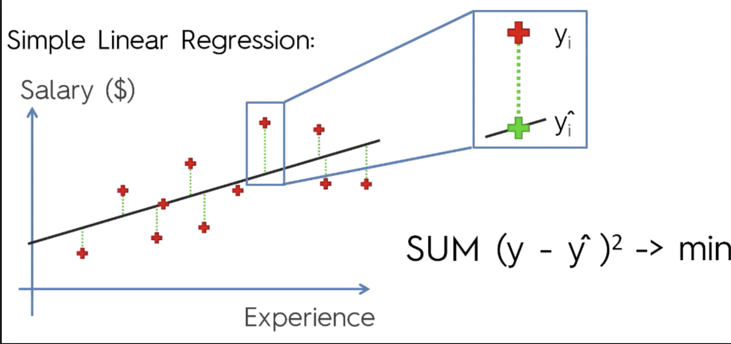
Least Squares Line
Want to minimize difference between actual y and predicted ŷ
Add up ε_{i} for all observed y’s
But positive differences offset negative ones!
(remember when this happened for variance?)
→ Square the errors! Then, minimize (using Calculus)
Minimize:
Take derivative
Set to 0 and solve
https://cdn-images-1.medium.com/max/1600/1*AwC1WRm7jtldUcNMJTWmiA.png
Notes:
49

Slide 31
Least Squares (LS) Line Graphically
https://www.scribd.com/presentation/230686725/Fu-Ch11-Linear-Regression
Notes:
52

Slide 32
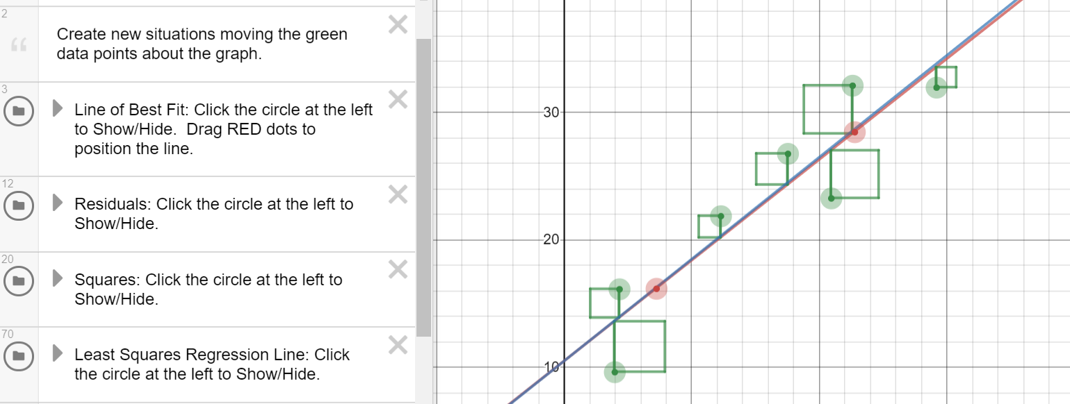
Least Squares Line Graphically – Interactive Demo
https://www.desmos.com/calculator/zvrc4lg3cr

Slide 33
Outline
Introduction (done)
Simple Linear Regression (done)
Measures of Variation (next)
Coefficient of Determination
Correlation
Misc

Slide 34
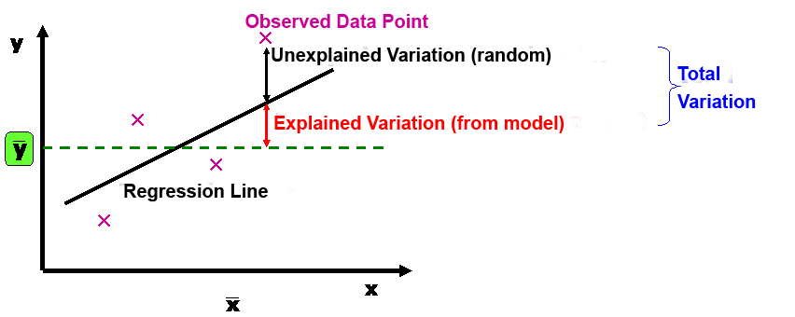
Measures of Variation
Several sources of variation in y
Error in prediction (unexplained)
Variation from model (explained)
Break this down (next)

Slide 35
Sum of Squares of Error (SSE)
Dependent variable (y)
Independent variable (x)
Least squares regression selects line with lowest total sum of squared prediction errors
Sum of Squares of Error, or SSE
Measure of unexplained variation

Slide 36
Sum of Squares Regression (SSR)
Dependent variable (y)
Population mean: y
Independent variable (x)
Differences between prediction and population mean
Gets at variation due to X & Y
Sum of Squares Regression, or SSR
Measure of explained variation

Slide 37
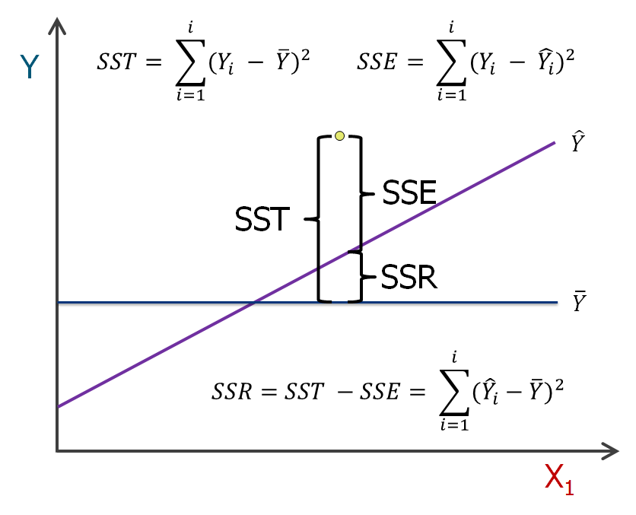
Sum of Squares Total
Total Sum of Squares, or SST = SSR + SSE

Slide 38
Coefficient of Determination
Proportion of total variation (SST) explained by the regression (SSR) is known as the Coefficient of Determination (R²)
$$R2=\frac{SSR}{SST}=1−\frac{SSE}{SST}$$
Ranges from 0 to 1 (often said as a percent)
1 – regression explains all of variation
0 – regression explains none of variation

Slide 39
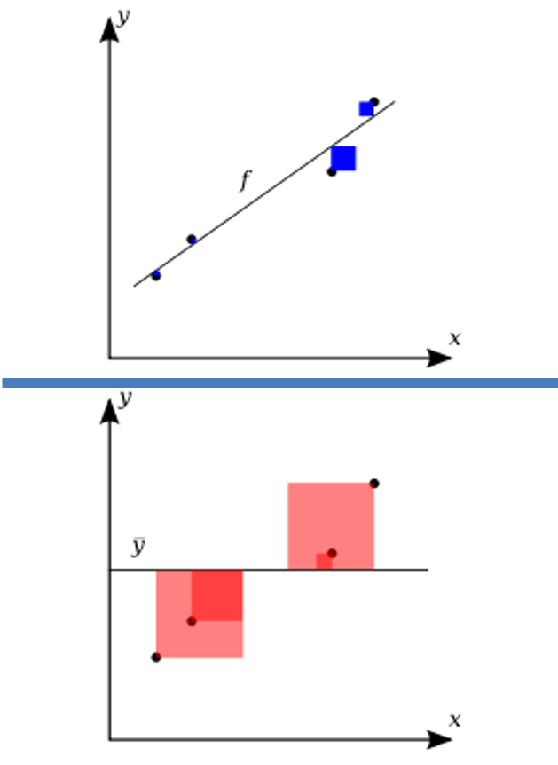
Coefficient of Determination – Visual Representation
Variation in observed data model cannot explain (error)
Smaller is better
R² = 1 -
Total variation in observed data
Larger is better
https://upload.wikimedia.org/wikipedia/commons/thumb/8/86/Coefficient_of_Determination.svg/400px-Coefficient_of_Determination.svg.png

Slide 40
Coefficient of Determination Example
How “good” is regression model? Roughly:
0.8 ≤ R² ≤ 1 strong

Slide 41
Coefficient of Determination Example
How “good” is regression model? Roughly:
0.8 ≤ R² ≤ 1 strong
0.5 ≤ R² < 0.8 medium
0 ≤ R² < 0.5 weak

Slide 42
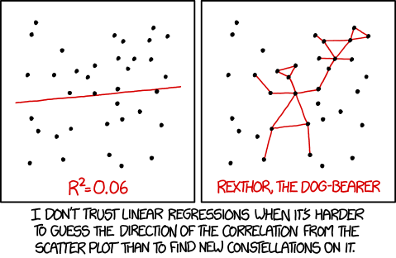
How “Good” is the Regression Model?
https://xkcd.com/1725/

Slide 43
Relationships Between X & Y
Strong relationships
Weak relationships
y
y
x
x
y
y
x
x

Slide 44
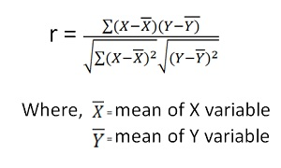
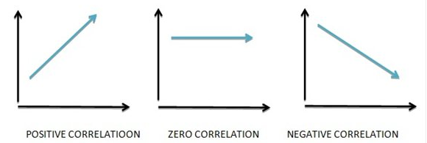
Relationship Strength and Direction – Correlation
Correlation measures strength and direction of linear relationship
-1 perfect neg. to +1 perfect pos.
Sign is same as regression slope
Denoted R. Why? Square R = R²
Pearson’s Correlation Coefficient
Vary together
Vary Separately
https://www.mbaskool.com/2013_images/stories/dec_images/pearson-coeff-bcon.jpg

Slide 45
Correlation Examples
y
y
y
x
x
x
r = -1
r = -.6
r = 0
y
y
x
x
r = +.3
r = +1

Slide 46
Groupwork
Introduction
Icebreaker: What game are you looking forward to playing this summer?
Groupwork
Think, discuss, write down – qualtrics
Correlation
Consider scatterplots
Estimate correlation
https://web.cs.wpi.edu/~imgd2905/d23/groupwork/12-correlation/handout.html

Slide 47
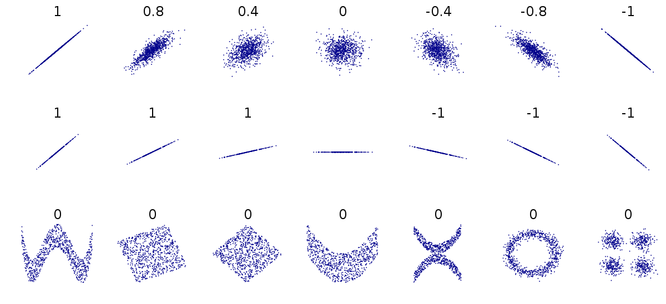
Correlation Examples
?? ?? ?? ?? ?? ?? ??
?? ?? ?? ?? ?? ?? ??
?? ?? ?? ?? ?? ?? ??
https://upload.wikimedia.org/wikipedia/commons/thumb/d/d4/Correlation_examples2.svg/1200px-Correlation_examples2.svg.png

Slide 48
Correlation Examples
?? ?? ?? ?? ?? ?? ??
?? ?? ?? ?? ?? ?? ??
https://upload.wikimedia.org/wikipedia/commons/thumb/d/d4/Correlation_examples2.svg/1200px-Correlation_examples2.svg.png

Slide 49
Correlation Examples
0
?? ?? ?? ?? ?? ?? ??
https://upload.wikimedia.org/wikipedia/commons/thumb/d/d4/Correlation_examples2.svg/1200px-Correlation_examples2.svg.png

Slide 50
Correlation Examples
0
https://upload.wikimedia.org/wikipedia/commons/thumb/d/d4/Correlation_examples2.svg/1200px-Correlation_examples2.svg.png

Slide 51
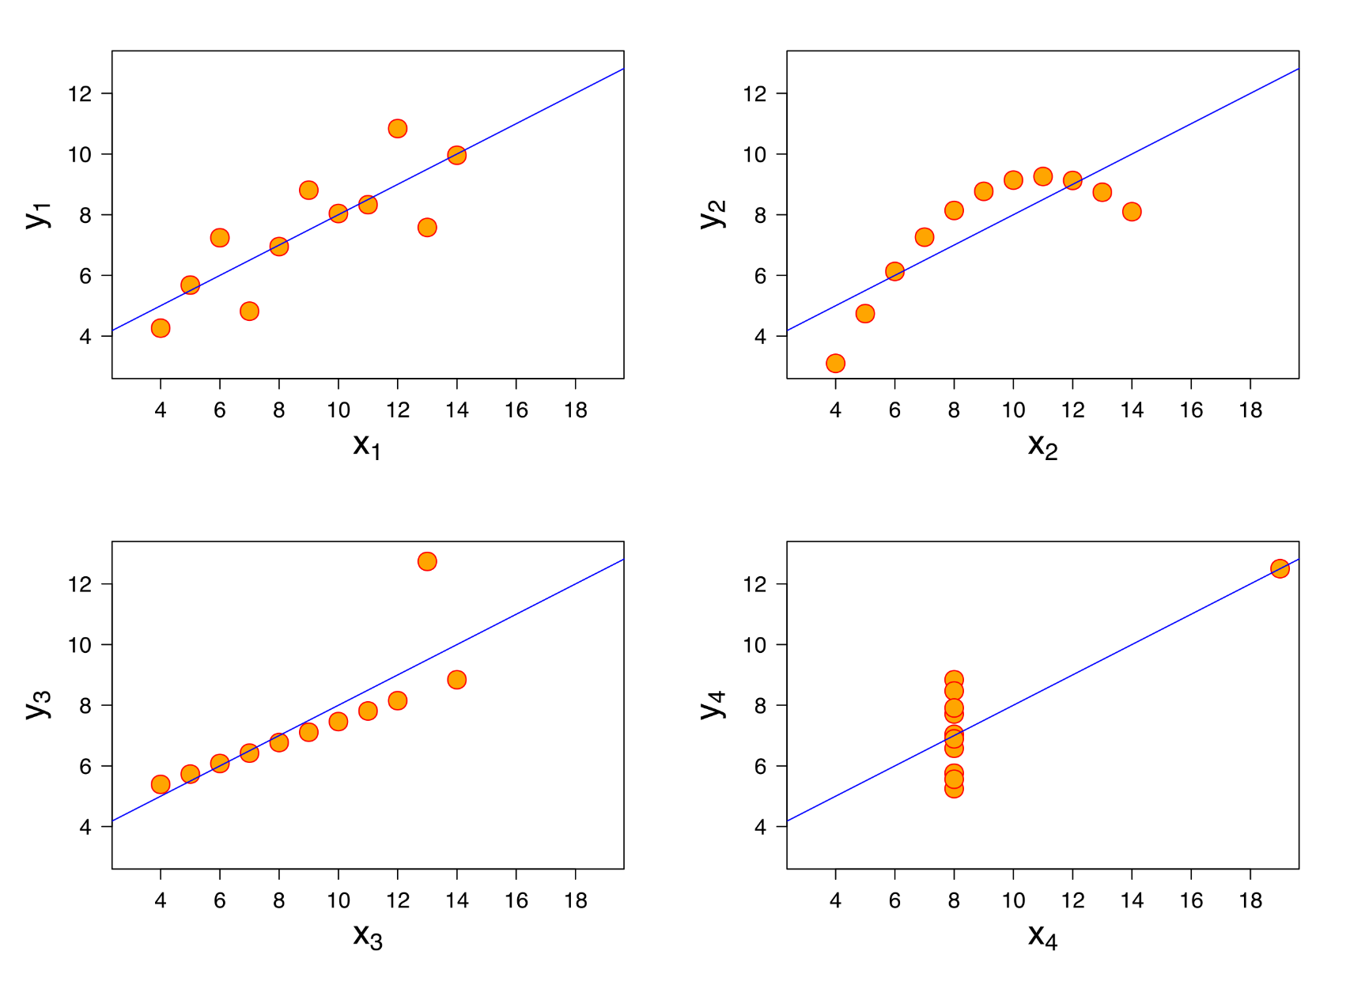
Correlation Examples
(Note, would want to use residual analysis before using predictions!)

Slide 52
Correlation Examples
(Note, would want to use residual analysis before using predictions!)
R = 0.82
R = 0.82
Anscombe’s Quartet
https://en.wikipedia.org/wiki/Anscombe%27s_quartet
Summary stats:
Mean_{x} 9
Mean_{y} 7.5
Var_{x} 11
Var_{y} 4.125
Model: y=0.5x+3
R = 0.82
R = 0.82
R² = 0.69

Slide 53
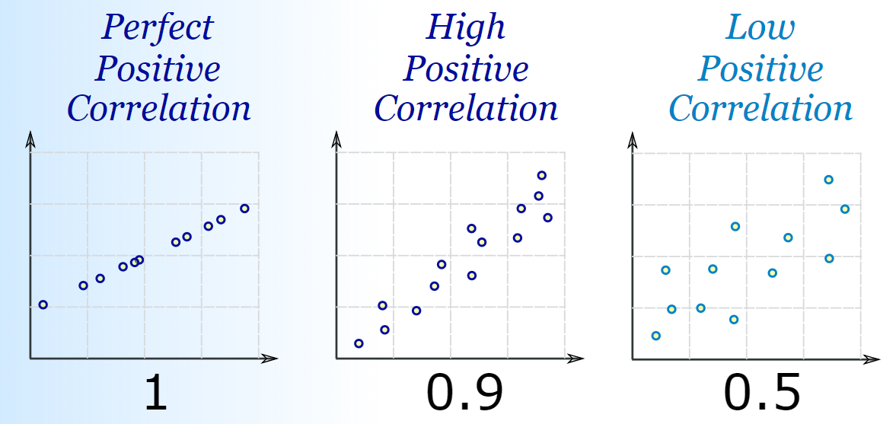
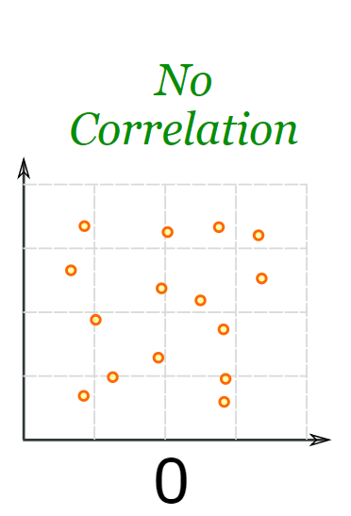
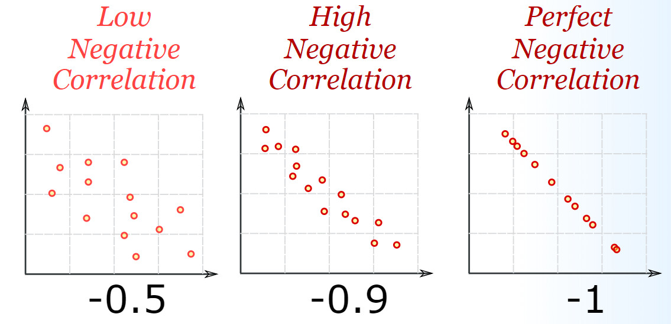
Correlation Summary
https://www.mathsisfun.com/data/correlation.html

Slide 54
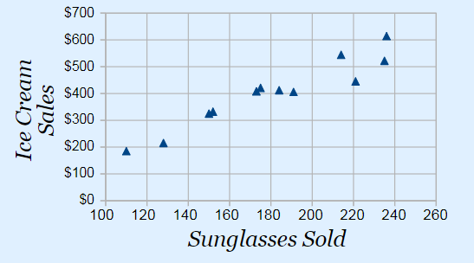
Correlation is not Causation
https://cdn-images-1.medium.com/max/1600/1*JLYI5eCVEN7ZUWXBIrrapw.png
Buying sunglasses causes people to buy ice cream?

Slide 55
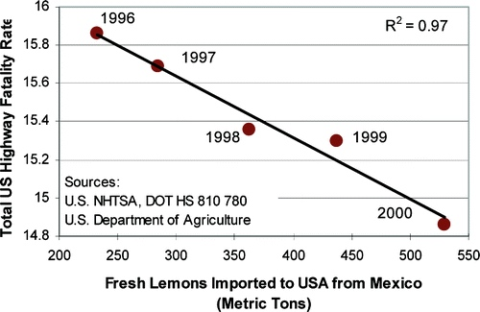
Correlation is not Causation
Importing lemons causes fewer highway fatalities?

Slide 56
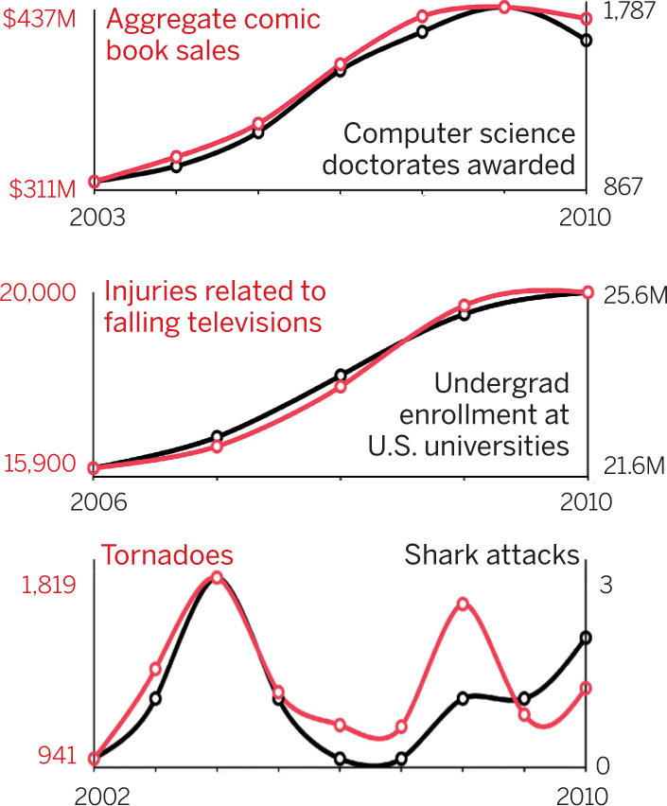
Correlation is not Causation
https://science.sciencemag.org/content/sci/348/6238/980.2/F1.large.jpg?width=800&height=600&carousel=1

Slide 57
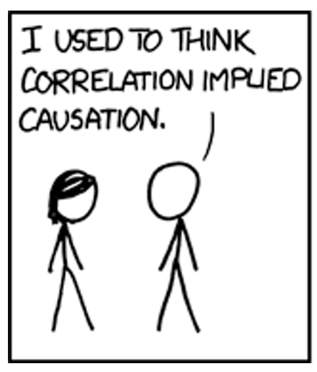
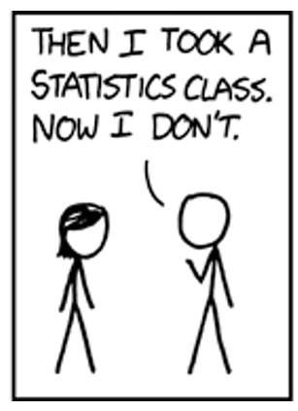
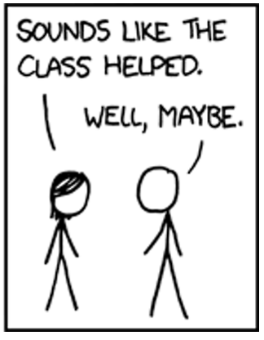
Correlation is not Causation
https://xkcd.com/552/

Slide 58
Outline
Introduction (done)
Simple Linear Regression (done)
Measures of Variation (done)
Misc (next)

Slide 59
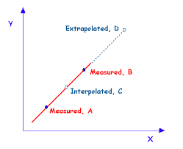
Extrapolation versus Interpolation
Prediction
Interpolation – within measured X-range
Extrapolation – outside measured X-range
https://qph.fs.quoracdn.net/main-qimg-d2972a7aca8c9d11859f42d07fce1799

Slide 60
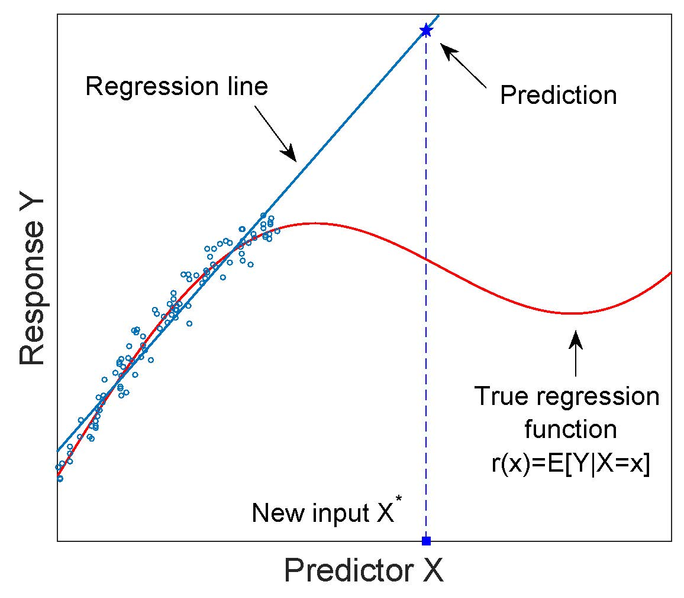
Be Careful When Extrapolating
https://i.stack.imgur.com/3Ab7e.jpg
If extrapolate, make sure have reason to assume model continues

Slide 61
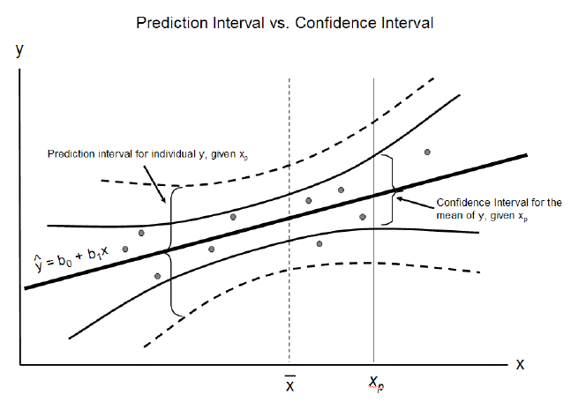
Prediction and Confidence Intervals (1 of 2)
95% of values within
95% of regressions within
https://cdn-images-1.medium.com/max/1600/1*vcbjVR7uesKhVM1eD9IbEg.png

Slide 62
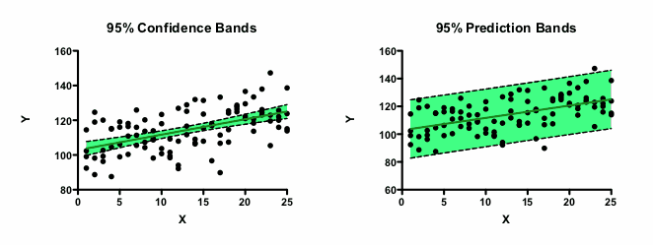
Prediction and Confidence Intervals (2 of 2)
https://www.graphpad.com/guides/prism/7/curve-fitting/reg_mostpointsareoutsideconfidencebands.png

Slide 63
Multiple Independent Variables
Chronic heart disease (CHD) correlates with smoking
R² = 0.5
But what about other 50%
Correlation with exercise? Cholesterol?
Multiple Linear Regression
Chapter 11

Slide 64
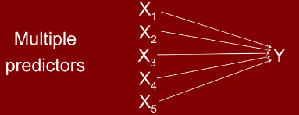
Single Linear Regression → Multiple Linear Regression
Use several independent variables to predict dependent variable
Weights each predictor based on strength of relationship
Makes adjustments for inter-relationships among predictors
Gives overall fit (R²)
Note: Need independent variables not highly related to each other
Y = b₀ + b₁X₁ + b₂X₂ + b₃X₃ .. b_{n}X_{n}

Slide 65
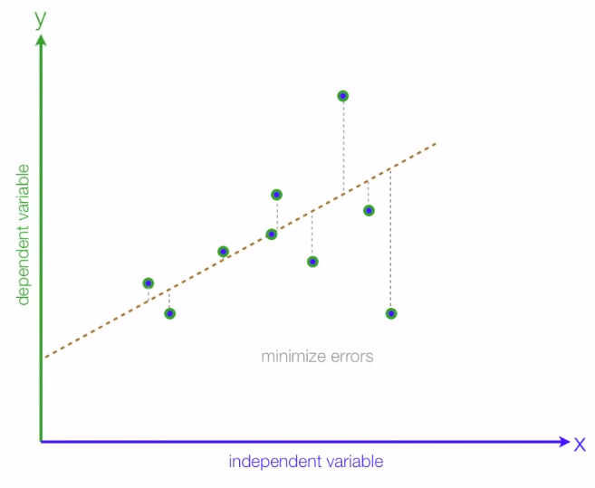
Multiple Linear Regression
Example: hours studied and pre-tests affect final score
y = b0 + b1*X1
+ b2*X2 + E
b2
b1
final grade
X2
pre-tests taken
X1
study hours

Slide 66
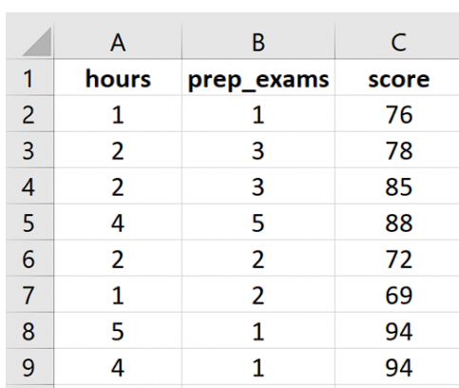
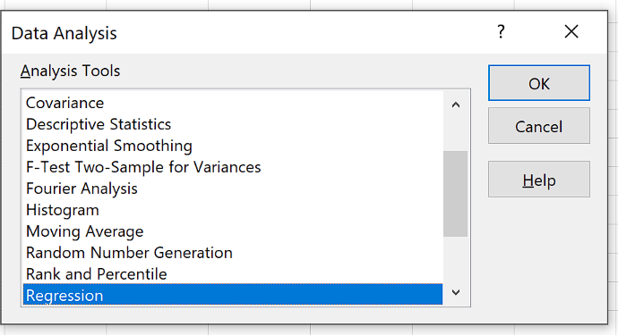
Multiple Linear Regression Example (1 of 2)
https://www.statology.org/multiple-linear-regression-excel/
Hours studied and prep exams taken → exam score
20 students

Slide 67
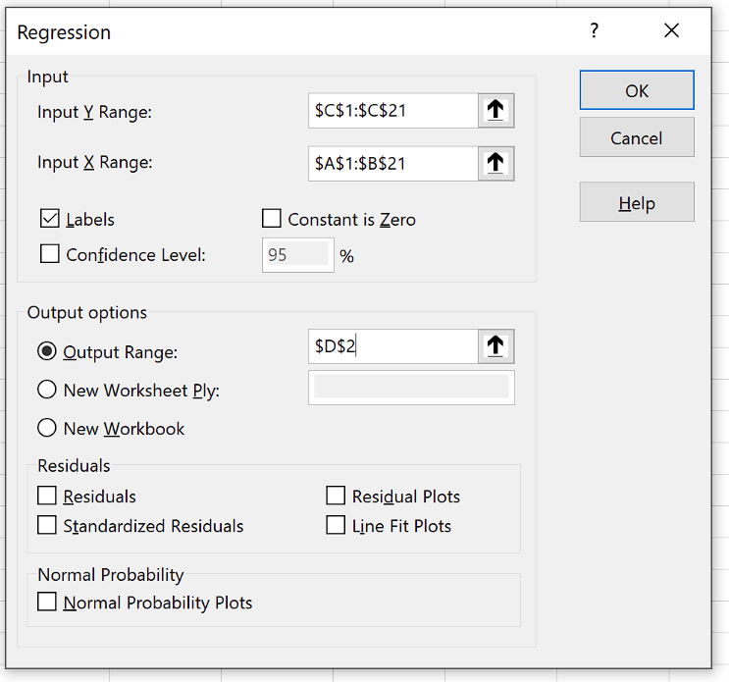
Multiple Linear Regression Example (2 of 2)
Independent variable
Covers both independent variables

Slide 68
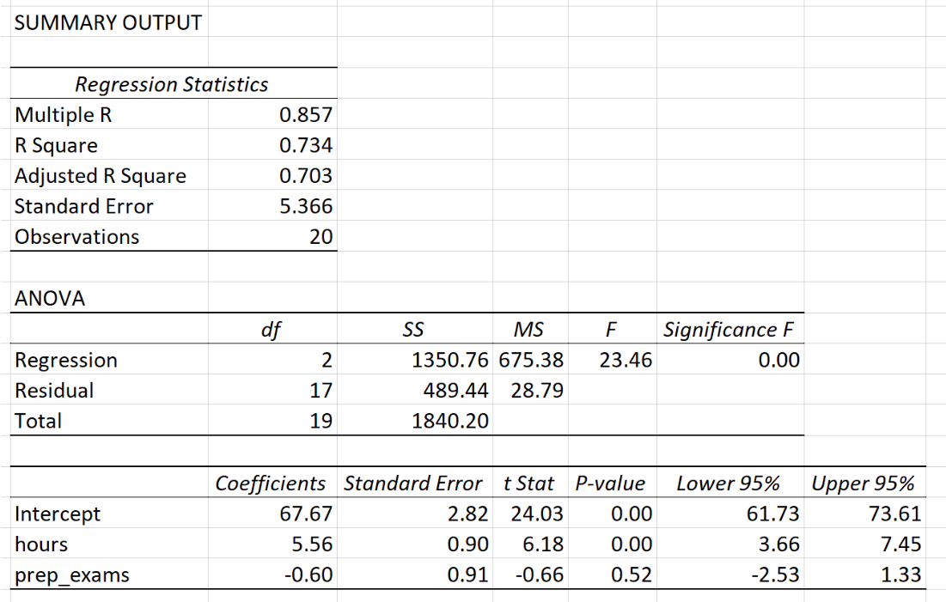
Interpret
R² 0.734
Overall significant (p < 0.05)
Hours significant
Prep exams not significant
Base score without prep 67.67
Each hour gains 5.56 percent
Score = 67.67 + 5.56 x hours – 0.60 x prep_exams

Slide 69
Beyond Linear Regression
https://medium.freecodecamp.org/learn-how-to-improve-your-linear-models-8294bfa8a731
Linear Quadratic Root Cubic
More complex models – beyond just linear
Y = mX + b

Slide 70
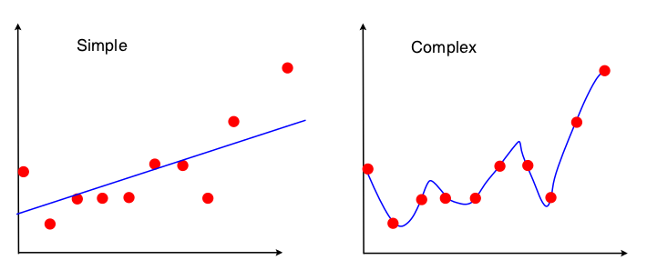
More Complex Models
y = 12x + 9
y = 18x⁴ + 13x³ - 9x² + 3x + 20
Higher order polynomial model has less error
→ A “perfect” fit (no error)
How does a polynomial do this?

Slide 71
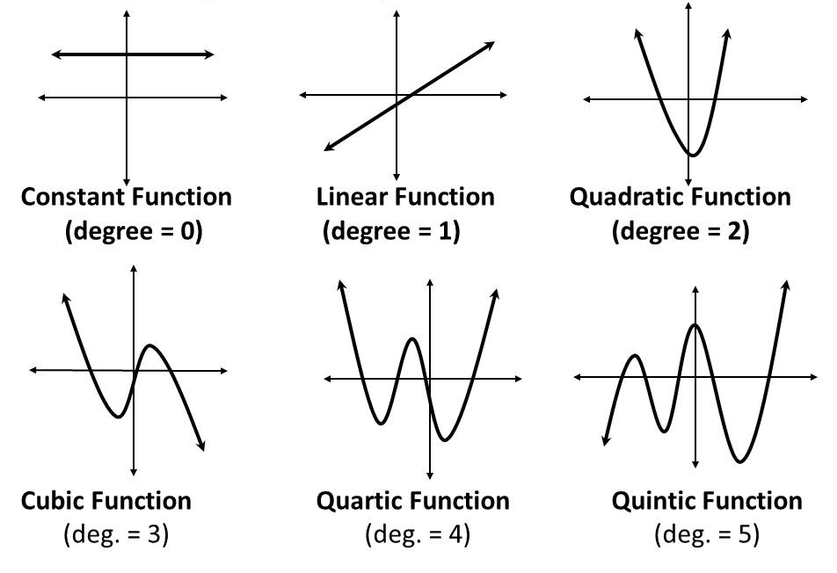
Graphs of Polynomial Functions
https://cdn-images-1.medium.com/max/2400/1*pjIp920-MZdS_3fLVhf-Dw.jpeg
Higher degree, more potential “wiggles”
But should you use?

Slide 72
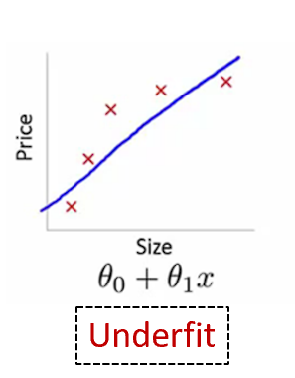
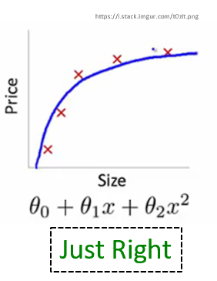
Underfit and Overfit
Test → Cross Validation
Overfit analysis matches data too closely with more parameters than can be justified
Underfit analysis does not adequately match data since parameters are missing
→ Both models fit well, but do not predict well (i.e., for non-observed values)
Just right – fit data well “enough” with as few parameters as possible (parsimonious - desired level of prediction with as few terms as possible)

Slide 73
Cross Validation (1 of 2)
Use to build model
Compute accuracy

Slide 74
Cross Validation (2 of 2)
Repeat for different slices
Overfit and Underfit will both have lower accuracy than “just right”

Slide 75
Summary
Can use regression to predict un-measured values
Before fit
Visual relationship (scatter plot) and residual analysis
Strength of fit – R² and correlation (R)
Beware
Correlation is not causation
Extrapolation
Higher order, more complex models can fit better
Beware of overfit → less predictive power
https://d3h0owdjgzys62.cloudfront.net/images/3963/live_cover_art/thumb2x/summary_final.png

