Slide 1
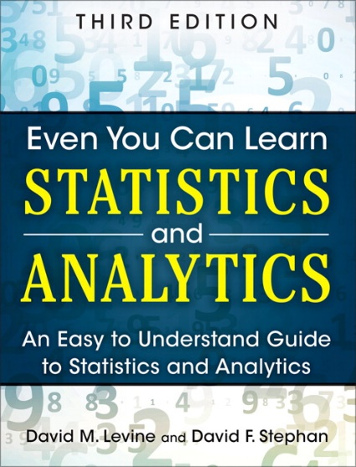
Descriptive Statistics
IMGD 2905
Chapter 3

Slide 2
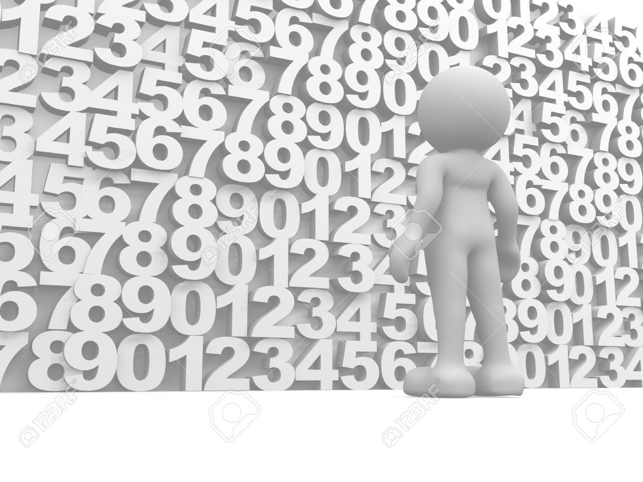
Summarizing Data
With lots of playtesting, there is a lot of data
  This is a good thing!
But raw data is often just a pile of numbers
  Rarely of interest
  Or even sensible
Q: How to summarize all this information?

Slide 3
Summarizing Data
With lots of playtesting, there is a lot of data
  This is a good thing!
But raw data is often just a pile of numbers
  Rarely of interest
  Or even sensible
Q: How to summarize all this information?
Measures of central tendency
Examples? Pros and Cons?

Slide 4
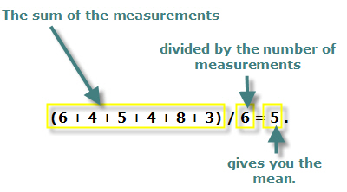

Measure of Central Tendency: Mean
Also called the “arithmetic mean” or “average”
In Excel, =AVERAGE(range)
  =AVERAGEIF() – averages if numbers meet certain condition
http://www.cdn.sciencebuddies.org/Files/463/9/MeanEquation.jpg

Slide 5
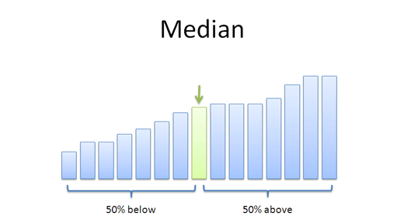

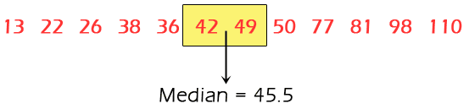
Measure of Central Tendency: Median
Sort values low to high and take middle value
https://www.mathsisfun.com/definitions/images/median.gif
https://betterexplained.com/wp-content/uploads/average/median.png
http://www.nedarc.org/statisticalHelp/basicStatistics/measuresOfCenter/images/median.gif
In Excel, =MEDIAN(range)

Slide 6
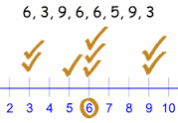
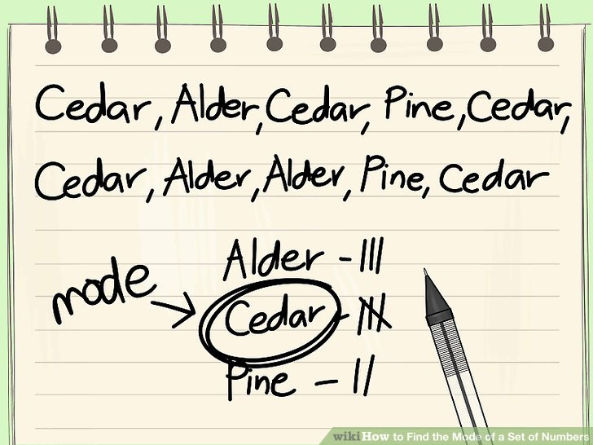
Measure of Central Tendency: Mode
Number which occurs most frequently
Not so useful in many cases
→ Best use for categorical data
  e.g., most popular Champion group in League of Legends
In Excel, =MODE()
http://pad3.whstatic.com/images/thumb/c/cd/Find-the-Mode-of-a-Set-of-Numbers-Step-7.jpg/aid130521-v4-728px-Find-the-Mode-of-a-Set-of-Numbers-Step-7.jpg

Slide 7
Depiction: Mean, Median, Mode?
mean
median
mode
modes
frequency
mean
median
frequency
no mode
(a)
frequency
mean
median
(b)
mode
mode
(c)
median
median
frequency
frequency
mean
mean
(d)
(e)

Slide 8
Which to Use, Mean, Median, Mode?
Mean many statistical tests with sample
  Estimator of population mean
  Uses all data
Median can be useful for skewed data
  e.g., income data (US Census) or housing prices (Zillo)
  e.g., Overwatch team (6 players): 5 people level 5, 1 person level 275
    Mean is 50 - not so useful since no one at this level
    Median is 5 - more representative
  Does not use all data. “Resistant” to extremes (e.g., 275)
  But what if were exam scores? Hard to “bring up” grade
Mode can be useful primarily for categorical data
  Most played League champion, most popular maze, …

Slide 9
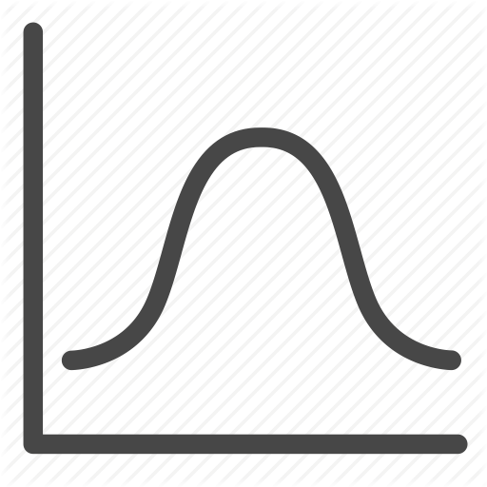
Other Measures of Position?
May not always want center
  e.g., what weapon that gets most kills in PUBG
What other positions may be desired?
?

Slide 10
Other Measures of Position
May not always want center
  e.g., want to know best LoL Champions
Maximum / Minimum
  Not discussed more
Trimmed Mean
Quartiles
Percentiles
?

Slide 11
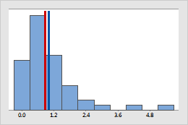
Trimmed Mean
Take “trimming” off top and bottom (typically 5% or 10%)
  Reduces effects of extreme values, like median
In Excel, =TRIMMEAN(array,percent)
Blue – original mean
Red – trimmed mean
http://support.minitab.com/en-us/minitab/17/histogram_mean_vs_trimmed_mean.png

Slide 12
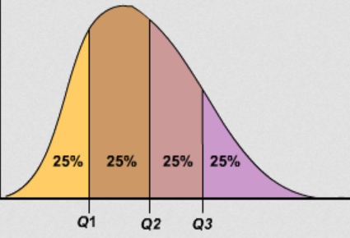
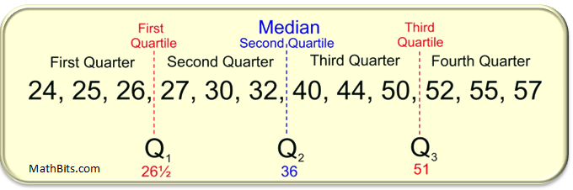
Quartiles
Sort values
First quartile (Q1) is 25% from bottom
Third quartile (Q3) is 75% from bottom
(What is second quartile?)
In Excel, =QUARTILE(array,n)
https://mathbitsnotebook.com/Algebra1/StatisticsData/quartileboxview2.png
https://www.hackmath.net/images/quartiles.png

Slide 13

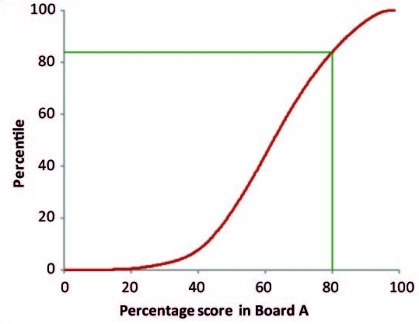
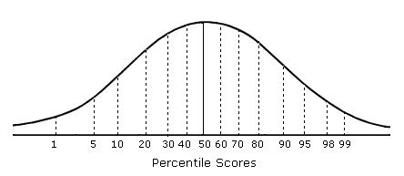
Percentiles
Generalization of quartiles
N^{th} percentile is data point n% from bottom of data
Interpolate as for first quartile
In Excel, =PERCENTILE(array,k) (k: 0 to 1)
https://www.mathsisfun.com/data/images/percentile-80.svg
http://www.psychometric-success.com/images/AA1301.gif
http://www.isical.ac.in/~jeexiiscore_normal/PercentilesAdvantages.htm

Slide 14
Summarizing Data, Part 2
Ok, pile of numbers can now be summarized as one number
  Mean, median, mode
But is that enough?
Q: What other major aspect of numbers haven’t we summarized?
Measures of variation
(aka measures of dispersion, or measures of spread)

Slide 15
Summarizing Data, Part 2
“Then there is the man who drowned crossing a stream
with an average depth of six inches.” – W.I.E. Gates
Summarizing by single number rarely enough → need statement about dispersion (aka variation)
Frequency
Frequency
mean
mean
Player High Score
Player High Score
Above: does single number (mean) tell you enough about data?

Slide 16
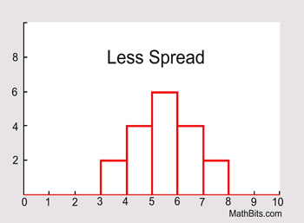
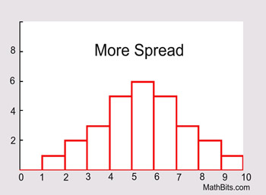
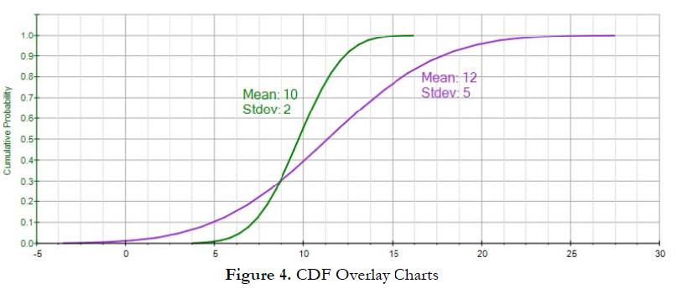
Dispersion Overview (1 of 3)
Is data clumped or spread out?
https://mathbitsnotebook.com/Algebra1/StatisticsData/STSpread.html
http://rovdownloads.com/blog/tips-on-interpreting-pdf-cdf-and-icdf-3/

Slide 17
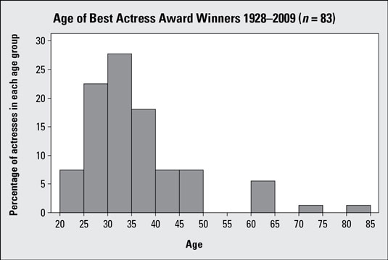
Dispersion Overview (2 of 3)
Is data clumped or spread out?

Slide 18
Dispersion Overview (3 of 3)
Is data clumped or spread out?
“Motion and Scene Complexity for Streaming Video Games”
Notes:
Mark Claypool. Motion and Scene Complexity for Streaming Video Games, In Proceedings of the 4th ACM International Conference on the Foundations of Digital Games (FDG), Florida, USA, April 2009. Online at: http://www.cs.wpi.edu/~claypool/papers/game-motion/

Slide 19
What are Some Measures of Dispersion? → Groupwork
http://rovdownloads.com/blog/tips-on-interpreting-pdf-cdf-and-icdf-3/

Slide 20

Groupwork
Group A: 0 6 12 18 26
Group B: 0 18 20 22 26
Different ways to report dispersion with one number?
What are pros and cons of each?
Icebreaker, Groupwork, Questions
https://web.cs.wpi.edu/~imgd2905/d23/groupwork/3-dispersion/handout.html

Slide 21
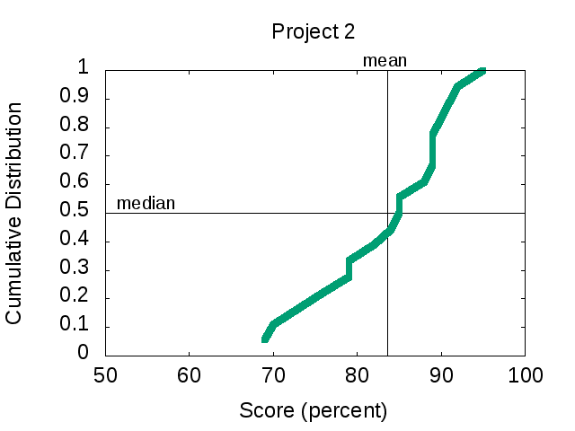
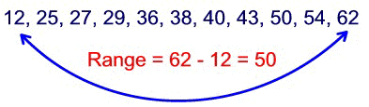
Range
Difference between smallest and largest value
Somewhat obvious, but doesn’t tell you much about “clumping”
  Minimum may be zero
  Maximum can be from outlier
    Event not related to phenomena studied (e.g., 0 on project)
  Maximum gets larger with # samples, so no “stable” point
In Excel, =MAX(array)-MIN(array)
Range = 96 – 69
= 27
Min
Max
http://idolosol.com/images/range-3.jpg

Slide 22
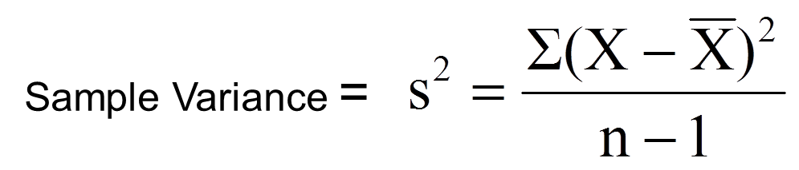
Variance
Compute mean of sample
Compute how far each value in sample is from mean
  Some can be less than mean, some greater
  → So square this difference (what does squaring do?)
Divide by number of sample values – 1
  The “-1” corrects “bias” when trying to estimate population variance using sample variance
“sum up all”
“mean”

Slide 23
Variance Example
Sample kills in PUBG matches
  12, 20, 16, 18, 19
  What is sample variance?
First, mean = 85 / 5 = 17
Kills X – mean (X – mean)²
12 -5 25
20 3 9
16 -1 1
18 1 1
19 2 4
s² = (25 + 9 + 1 + 1 + 4) / (5 – 1) = 40 / 4 = 10 kills squared
“Larger” means “more spread”
… but units odd
In Excel, =VAR(array)

Slide 24
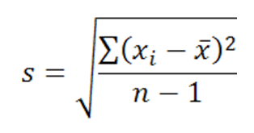
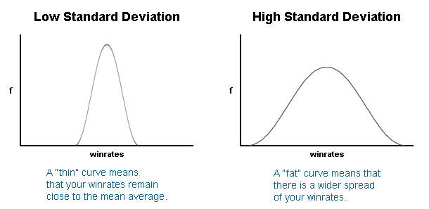
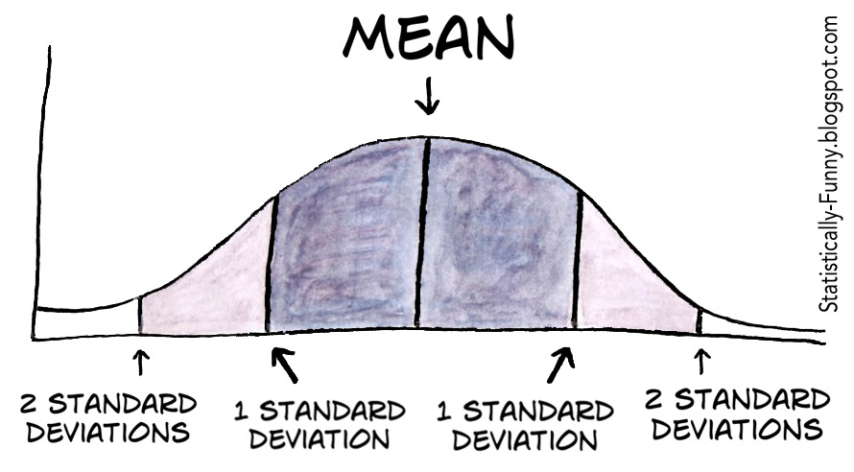
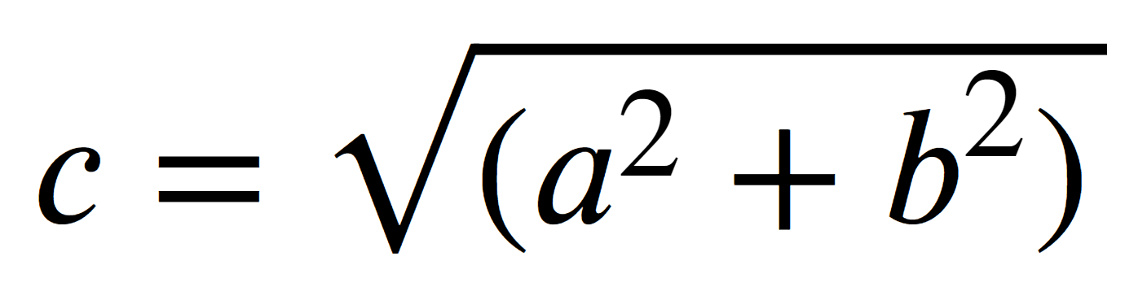
Standard Deviation
Square-root of variance
Usually, use standard deviation instead of variance
  Why? → Same units as data (e.g., “kills” in previous example)
Can compare standard deviation to mean (coefficient of variation, next)
But first:
  Mendenhall’s
  Empirical Rule
  Z-score
s
  Average “distance” of points from mean

Slide 25
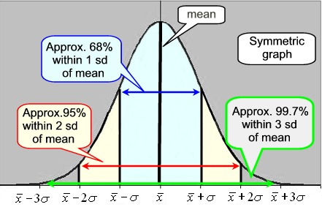
Mendenhall’s Empirical Rule
About 68% data within one standard deviation of mean
  interval between mean-s and mean+s contains about 68% of data
About 95% within 2 standard deviations of mean
Almost all data within 3 standard deviations of mean
https://mathbitsnotebook.com/Algebra1/StatisticsData/normalgrapha.jpg
Rule holds for normal (“Bell curve”) distribution

Slide 26
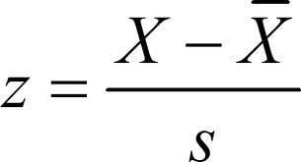
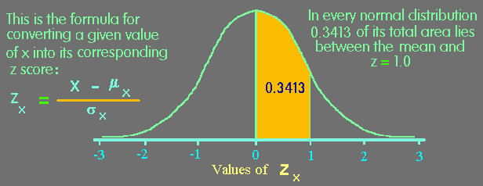
Z-Score
Measure of how “far” from center (mean) single data point is
  Not measure of dispersion for whole data set
Example
Mean 469
Std dev 119
X 650
Z-score for X?
(650 – 469)/119 1.52
https://www.animatedsoftware.com/pics/stats/sgzscor2.gif

Slide 27
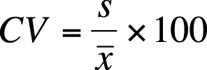
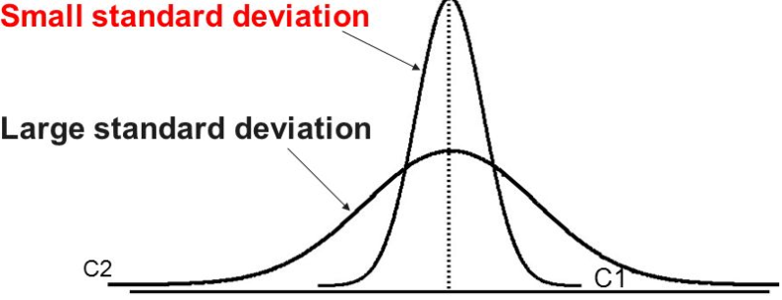
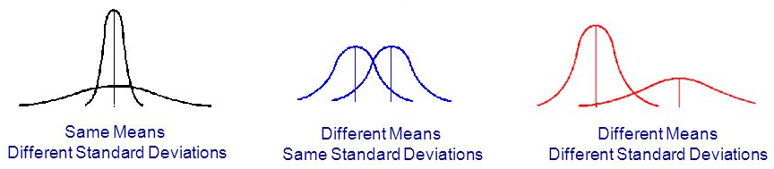
Coefficient of Variation (CV)
Size of standard deviation relative to mean
  e.g., large sd & large mean, not so spread
  but large sd & small mean, more spread
Standard deviation divided by mean
  Can do this since same units!
CV is “unit-less”, so measure of spread independent of quantity
  E.g. seconds, clicks, spaces
  Shown as percent (multiply by 100)
http://images.slideplayer.com/35/10391754/slides/slide_59.jpg
What is the relative CV for each curve?
http://goo.gl/wrfVtH

Slide 28
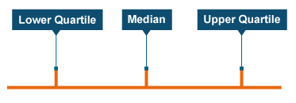
Semi-Interquartile Range
½ distance between Q3 (75th percentile) and Q1 (25th percentile)
Guideline: use semi-interquartile (SIQR) for index of dispersion whenever using median as index of central tendency
Q1
Q3
http://www.bbc.co.uk/staticarchive/9629000486ef4b1a40efa565c162cb779e0bd82c.png
Q3 – Q1
2

Slide 29
Index of Dispersion Example
(sorted)
Lap Times
First, sort. Then, compute:
  Mean = 4.4
  Min = 1.9, Max = 5.9
  Median = [16 / 2] = 8th = 4.5
  Q1 = 16 / 4 = 8th = 4.1
  Q3 = 3 * 16 / 4 = 12th = 5.1
SIQR = (Q3 - Q1) / 2 = 0.5
Variance = 0.96
Stddev = 0.98
CV = stddev/mean = 0.22
Range = max – min = 4
1.9
2.7
3.9
4.1
4.2
4.2
4.4
4.5
4.5
4.8
4.9
5.1
5.1
5.3
5.6
5.9

Slide 30
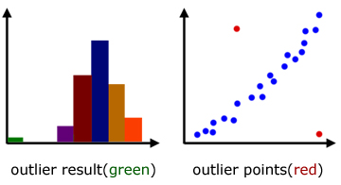
Groupwork
Rank measures of dispersion by sensitivity to outliers
  CoV
  Range
  Std Dev
  Semi-interquartile Range
https://web.cs.wpi.edu/~imgd2905/d23/groupwork/4-outlier-effect/handout.html
http://www.a-levelmathstutor.com/images/statistics/outliers-graph01.jpg

Slide 31
Ranking of Affect by Outliers?
Measure of Dispersion
Most to Least
Range
Standard Deviation
Coefficient of Variation
Semi-interquartile Range
?
http://www.a-levelmathstutor.com/images/statistics/outliers-graph01.jpg

Slide 32
Ranking of Affect by Outliers?
Measure of Dispersion
Most to Least
Range
Standard Deviation
Coefficient of Variation
Semi-interquartile Range
Range susceptible
Variance
  Standard Deviation
  Coefficient of Variation
SIQR resistant
Only for quantitative data!
  categorical can’t quantify spread since no ‘distance’
  Instead, give categories for given percentile of samples
    e.g., “90% of samples are in 3 categories” (Pareto chart)
http://www.a-levelmathstutor.com/images/statistics/outliers-graph01.jpg

Slide 33
Depicting Dispersion in Charts
Histogram
Cumulative distribution
Box-and-Whiskers
Error Bars

Slide 34
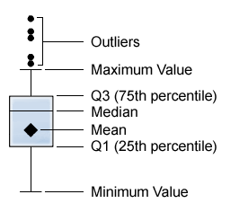
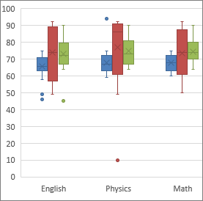
Box-and-Whiskers Chart
Way of showing variation
Highlight middle 50% (interquartile range, IQR)
  “Box”
Lines go to smallest non-outlier
  “Whiskers”
Points indicate outliers
Middle line shows median
Sometimes with mean
Outlier? → Data value “way out there”, “far” from the rest
  Formally, 1.5+ IQRs away from quartile
Available in Excel
http://support.sas.com/documentation/cdl/en/vaug/65747/HTML/default/images/boxplot.png
Also called “boxplot”
https://support.office.com/en-us/article/Create-a-box-and-whisker-chart-62f4219f-db4b-4754-aca8-4743f6190f0d

Slide 35
Cumulative Distribution
Cumulative amount of data with value or less
Easy to see min, max, median
Compare shapes of distributions
Demo: lol-patches.xlsx
Select column R (Bug Fixes)
Sort low to high
New column S for percent [=ROW()/164]
Select column → paste down all
Select both column R and S
Insert → Scatter plot with lines
“Nerfs, Buffs and Bugs - Analysis of the Impact of Patching on League of Legends”
http://www.cs.wpi.edu/~claypool/papers/lol-crawler/
Notes:
Artian Kica, Andrew La Manna, Lindsay O'Donnell, Tom Paolillo and Mark Claypool. Nerfs, Buffs and Bugs - Analysis of the Impact of Patching on League of Legends, In Proceedings of the 2nd International Workshop on Collaboration and Gaming (CoGames), Orlando, Florida, USA, October 31 - November 4, 2016. Online at: http://www.cs.wpi.edu/~claypool/papers/lol-crawler/

Slide 36
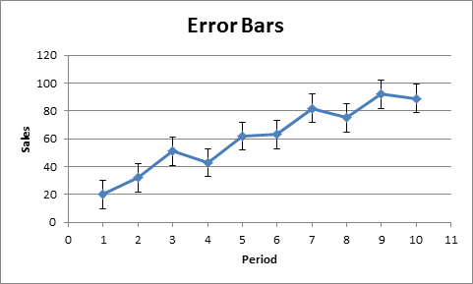
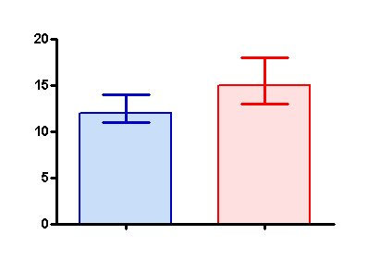
Error Bars for Columns and Points
Line through graph point parallel to axis with “caps”
Denotes uncertainty (variation) in value
Excel: click “+” → “Error Bars” → “type”
Often:
  1 standard deviation
Can be (discuss later):
  1 standard error
  1 confidence interval
State clearly!
https://s3.amazonaws.com/cdn.graphpad.com/faq/804/images/804b.jpg
http://www.excel-easy.com/examples/images/error-bars/error-bars.png

