Slide 1

Introduction
IMGD 2905

Slide 2


Groupwork
What is data analysis for game development?
Where does this data come from?
What can game analysis do for game development?
Icebreaker, Groupwork, Questions
https://web.cs.wpi.edu/~imgd2905/d23/groupwork/1-introduction/handout.html

Slide 3
What is data analysis for game development?

Slide 4


What is data analysis for game development?
Using game data to inform the game development process
Where does this data come from?
→ Players, actually playing game
  Quantitative (instrumented)
  Qualitative (subjective evaluation)
  (But often lots more of the former!)
https://cdn0.iconfinder.com/data/icons/big-data-2-1/128/Data-Integration-process-database-collection-512.png
https://cdn2.iconfinder.com/data/icons/sports-and-games-5-1/48/216-512.png

Slide 5
What can game analysis do for game development?

Slide 6
What can game analysis do for game development?
Improve level design – e.g., see where players are getting stuck
Focus development on critical content – e.g., see what game modes or characters are not used
Balance gameplay – e.g., tune parameters for more competitive and fun combat
Broaden appeal – e.g., hear if content/story is engaging or repulsing
Note: game data often informs players, too
  Analytics not dissimilar

Slide 7
Why is data analysis for game development needed?

Slide 8
Why is data analysis for game development needed?
Challenge
  Games gotten larger and more complex
    Number of reachable states, characters
    → Game balance harder to achieve
  Need for metrics to make sense of player behavior has increased
Opportunity
  New technologies enable collecting data, aggregation, access and analysis

Slide 9
IMGD 2905 – Doing Data Analysis for Game Development
Data analysis pipeline – get data from games, through analysis, to stakeholders
Summary statistics – central tendencies of data
Visualization of data – how to display analysis, illustrate messages
Statistical tests – quantitatively determine relationships (e.g., correlation)
  Probability needed as foundation (also used for game rules)
Regression – model relationships
Hint at more advanced topics
  e.g., ML, Data management …
For this class:
  Described in lecture
  Read about in book
  Applied in projects and homework

Slide 10
Foundations for Data Analysis @ WPI
Statistics classes
  MA 2610 Applied Statistics for Life Sciences
  MA 2611 Applied Statistics I
  MA 2612 Applied Statistics II
Probability classes
  MA 2621 Probability for Applications
Data Science (minor and major)
  DS 1010 Introduction to Data Science
  DS 2010 Modeling and Data Analysis
  DS 3010 Computational Data Intelligence
  DS 4433/CS4433 Big Data Management and Analytics
Data Mining
  CS 4445 Data Mining and Knowledge Discovery in Databases
Other
  CS 1004 Introduction to Programming for Non-Majors
  CS 3431 Database Systems I
Note – other Stats and Probability classes are primarily geared for Math majors

Slide 11
Outline
Overview (done)
Game Analytics Pipeline (next)
Game Data Analysis Examples

Slide 12


Sources of Game Data
Quantitative (Objective)
Qualitative (Subjective)
Internal Testing
  Developers
  QA
External Testing
  Usability testing
  Beta tests
  Long-term play data
Surveys
Reviews
Online communities
Postmortems
https://tinyurl.com/y3gaja4j
How to get from data to dissemination?
→ Game analytics pipeline
https://cdn.lynda.com/course/699344/699344-636703722500462287-16x9.jpg
Notes:
List from: https://games.soe.ucsc.edu/sites/default/files/p940-hullett_0.pdf

Slide 13
Game Analytics Pipeline
Game
Exploratory Graphs/Stats
Analysis
Extracted Data
Statistical Tests
Raw Data
Charts and Tables
Dissemination
Presentation
Report

Slide 14









Game Analytics Pipeline – Example
Analysis
Track-o-Bot
Dissemination
Project 3!

Slide 15

Game Analytics Components
Games – breadth of experience with games, specific experience with game to be analyzed
Tools – import, clean, filter, format data so can analyze
Statistics – measures of central tendency, measures of spread, statistical tests
Probability – rules, distributions
Data Visualization – bar chart, scatter plot, histogram, error bars
Technical Writing and Presentation – white paper, technical talk; audience is peer group, developers, boss

Slide 16
Outline
Overview (done)
Game Analytics Pipeline (done)
Game Data Analysis Examples (next)
  Table
  Scatter plot
  Boxplot

Slide 17

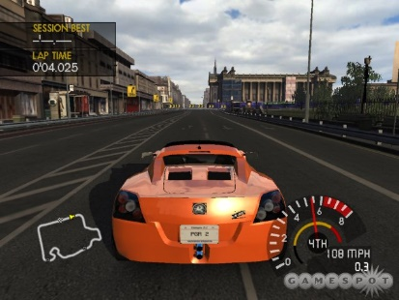

Example:
Project Gotham Racing 4
K. Hullett, N. Nagappan, E. Schuh, and J. Hopson. “Data Analytics for Game Development”, International Conference on Software Engineering (ICSE), May, 2011, Waikiki, Honolulu, HI, USA
http://dl.acm.org/citation.cfm?id=1985952
Publisher – Microsoft 2007
  134 vehicles, 9 locations, 10 game modes
Analyzed data
  (Authors worked at Microsoft)
  3.1 million log entries, 1000s of users

Slide 18
Project Gotham Racing 4:
Results
Game Mode Races % Total
OFFLINE_CAREER 1479586 47.63%
PGR_ARCADE 566705 18.24%
NETWORK_PLAY 584201 18.81%
SINGLE_PLAYER_PLAY 185415 5.97%
….
NET_TOURNY_ELIM 2713 0.09%
Thoughts?
What are some main messages?
Group Races % Total
STREET_RACE 795334 25.60%
NET_STREET_RACE 543491 17.50%
ELIMINATION 216042 6.95%
HOTLAP 195949 6.31%
…
TESTTRACK_TIME 7484 0.24%
CAT_N_MOUSE_FREE 3989 0.13%
CAT_N_MOUSE 53 0.00%

Slide 19
Project Gotham Racing 4:
Results
Game Mode Races % Total
OFFLINE_CAREER 1479586 47.63%
PGR_ARCADE 566705 18.24%
NETWORK_PLAY 584201 18.81%
SINGLE_PLAYER_PLAY 185415 5.97%
….
NET_TOURNY_ELIM 2713 0.09%
Mode
  Offline career dominates
  Network play not well-used
Events
  Street race and network street race dominate
  Cat and mouse almost never used
Vehicles (not shown)
  1/3 used in less than 0.1% of races
Group Races % Total
STREET_RACE 795334 25.60%
NET_STREET_RACE 543491 17.50%
ELIMINATION 216042 6.95%
HOTLAP 195949 6.31%
…
TESTTRACK_TIME 7484 0.24%
CAT_N_MOUSE_FREE 3989 0.13%
CAT_N_MOUSE 53 0.00%

Slide 20

Project Gotham Racing 4:
Conclusion
Content underused - 30-40% of content in less than 1% of races
Use to shift emphasis to DLC, next version
  Asset creation costs significant, so even 25% reduction noticeable
Other (not shown)
  Encouraging new players to play career mode
    Increasing likelihood of continuing play
  Encouraging new players to stay with F Class longer
    Rather than move to more difficult to control A Class

Slide 21

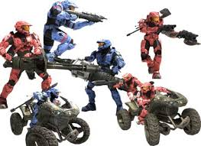
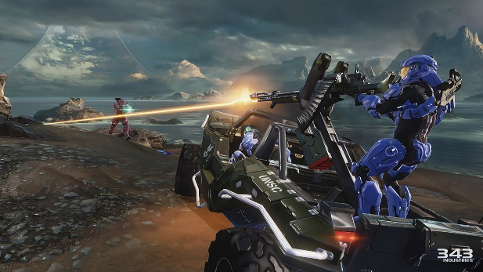
Example:
Halo 3
B. Phillips. “Peering into the Black Box of Player Behavior: The Player Experience Panel at Microsoft Game Studios”, Game Developers Conference (GDC), 2010. http://www.gdcvault.com/play/1012387/Peering-into-the-Black-Box
Publisher – Microsoft 2007
  Achievements: single player missions, challenges such as finding skulls, multiplayer accomplishments…
Analyzed data
  (Author worked at Microsoft)
  18,0000 players

Slide 22
Halo 3: Results
Thoughts?
What are some main messages?
Notes:
T. Zimmermann, B. Phillips, N. Nagappan, and C. Harrison. “Data-Driven Games User Research”, ACM CHI 2012, May 5-10, 2012, Austin, TX, USA. https://goo.gl/d1rpHo

Slide 23
Halo 3: Results
73% of players completed campaign
  Can compare to other Xbox games
Took 26 days to accomplish
Double that time for all original content
DLC provides users up to 2 years of content
Good Descriptive Example
Notes:
T. Zimmermann, B. Phillips, N. Nagappan, and C. Harrison. “Data-Driven Games User Research”, ACM CHI 2012, May 5-10, 2012, Austin, TX, USA. https://goo.gl/d1rpHo

Slide 24

Example: League of Legends
Mark Claypool, Jonathan Decelle, Gabriel Hall, and Lindsay O'Donnell. “Surrender at 20? Matchmaking in League of Legends,” In Proceedings of the IEEE Games, Entertainment, Media Conference (GEM), Toronto, Canada, October 2015. Online at: http://www.cs.wpi.edu/~claypool/papers/lol-matchmaking/
Publisher – Riot Games 2009
  Rank: ~5 Tiers, 5 divisions each → 25
User study (52 players)
  Play LoL in controlled environment
  Record objective data
    (e.g., player rank and game stats)
  Provide survey for subjective data
    (e.g., match balance and enjoyment)
???
Fun
Sweet spot
Too hard!
Just right!
Too easy!
Game Balance

Slide 25
League of Legends: Results
Team Imbalance
(difference in average player rank)
Min: 0
Median: 0.75
Max: 15
Objective
Main Messages?
Game Imbalance
(difference in average team rank)
Min: 0
Median: 0.5
Max: 2.5
Main Messages?

Slide 26
League of Legends: Results
Team Imbalance
(difference in average player rank)
Min: 0
Median: 0.75
Max: 15
Objective
Most teams are balanced
Over half less thant 1
Game Imbalance
(difference in average team rank)
Min: 0
Median: 0.5
Max: 2.5
Most games evenly matched
Over half less than 0.5

Slide 27
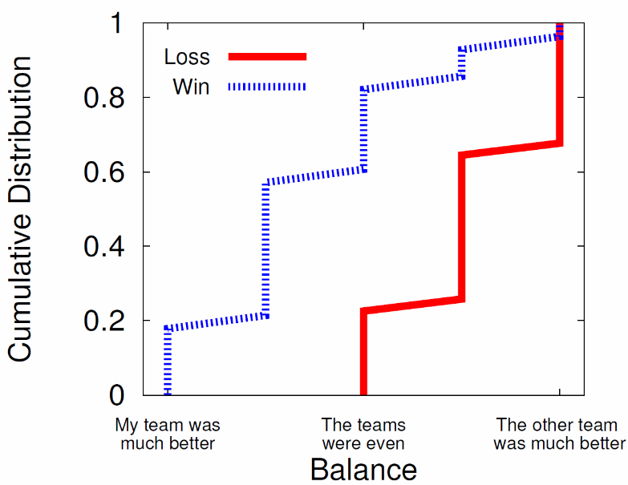
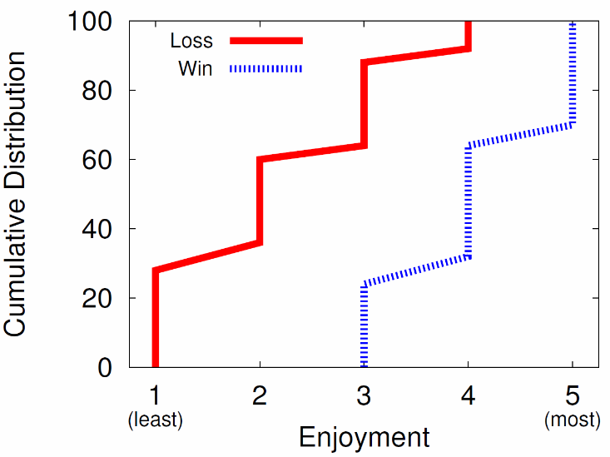
League of Legends: Results
Main messages?
Team Imbalance
(difference in average player rank)
Min: 0
Median: 0.75
Max: 15
Objective
Most teams are balanced
Over half less thant 1
Subjective
Game Imbalance
(difference in average team rank)
Min: 0
Median: 0.5
Max: 2.5
Main messages?
Most games evenly matched
Over half less than 0.5

Slide 28
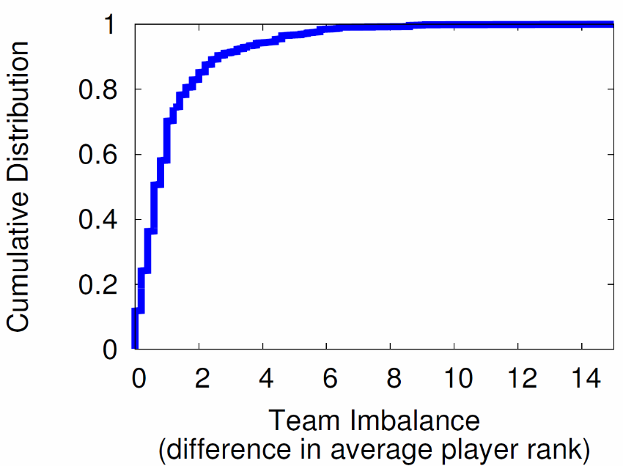
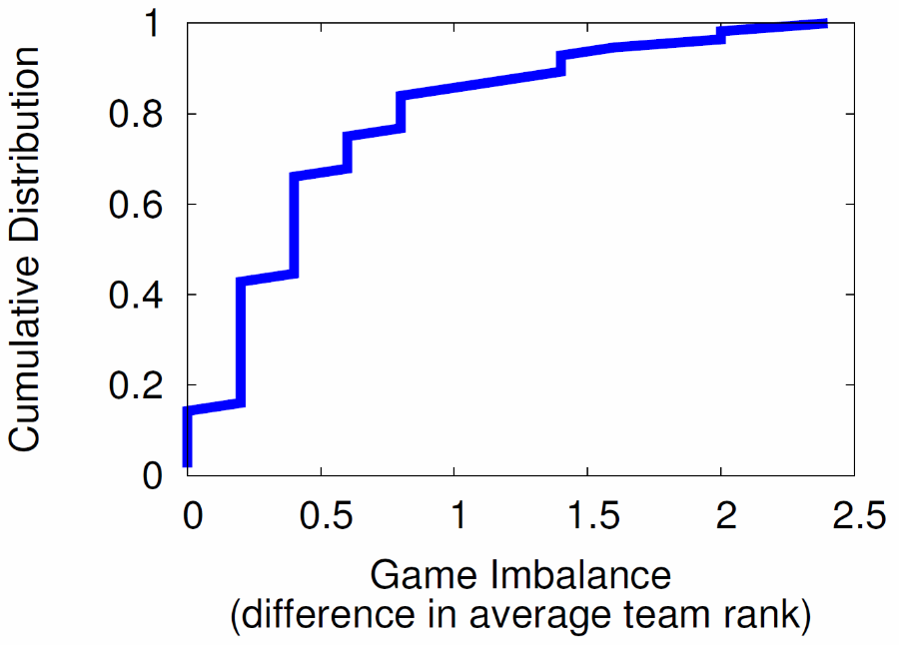
League of Legends: Results
Win? Game is balanced
Lose? Game is imbalanced
Most teams are balanced
But about 10% more than 3 from mean
Objective
Subjective
Win? Game is fun (70%), never not fun
Lose? Game is almost never fun (90%)
Most games evenly matched
But about 5% difference of 2 from mean

Slide 29
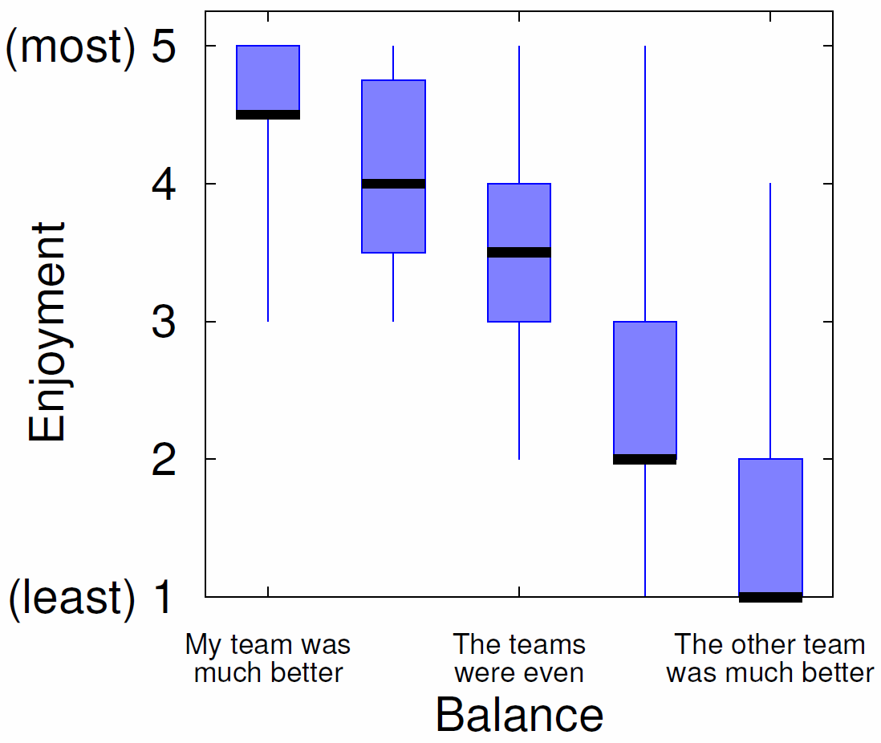
League of Legends: Results
Fun
Sweet spot
Game Balance
Sweet spot?
Fun
Game Balance
Imbalance in player’s favor the most fun!
Matchmaking systems may want to consider - e.g., balance not so important, so long as player not always on imbalanced side

Slide 30


Summary
Data analysis for games increasingly important
  Has potential to improve game development
Knowledge and skills required
  Scripting
  Statistics
  Data analysis
  Writing and presentation
https://1kabswnt2ua3ivl0cuqv2f17-wpengine.netdna-ssl.com/wp-content/uploads/2014/06/Skills.jpg
“Let’s get to it, already!”
-- Tracer (Overwatch)

