Slide 1
Project 1
Catch a Dragonfly
Due: August 30th, 11:59pm

Slide 2
Overview
Goal is to get used to Dragonfly
2D (text-based graphics) game engine
from game programmer’s perspective
Work through tutorial making a game
Saucer Shoot
Objectives
Learn how to develop game using a game engine
Provide foundational knowledge for your engine (Project 2)
Provide ideas of scope for your game (Project 3)

Slide 3
What Does “Text-based” Look Like?

Slide 4
Setup
Project 1 Web page has link to Dragonfly Web page
Dragonfly Web page is password protected
Login is your CCC username, plus password
e.g. Login: “johndoe” then password “johndoe”
Download the Dragonfly game engine (dragonfly-v1.8.zip)
Linux (32-bit and 64-bit)
Cygwin (64-bit)

Slide 5
Setup
Setup environment
Path to Dragonfly pre-compiled library (e.g. /home/johndoe/dragonfly/libdragonfly.a)
Path to Dragonfly header files (*.h, e.g. /home/johndoe/dragonfly/)
Where?
FL222, FLA21 → installed Cygwin, 64-bit
CCC → login to ccc.wpi.edu, Linux 64-bit
Setup your own environment (see README)
Compiler (e.g. g++ or MinGW)
For Makefile → make and makedepend
Libncurses development environment
If Cygwin, -DCYGWIN needed

Slide 6
Tutorial
Saucer Shoot, on Dragonfly Web page
Work through start to finish
“Cook-book” like, but with some explanations
Note: Need Sprite package (sprites.zip)
Note: Have source code if stuck (gameX.zip)
You CANNOT just turn in the included source code!
Internal understanding not necessarily needed
That will come during the term
Basic external understanding expected
Needed for extending the Saucer Shoot game

Slide 7
A 10,000-Foot View of Game Code
Startup Game Engine
Initialize graphics, input devices, file logging
Populate World with Objects
Player object (Hero), Saucers
Run Game
Move objects, get input, send events to objects (e.g. collisions), draw screen (objects draw themselves)
Shutdown

Slide 8
Core Attributes of Engine in Tutorial
Startup
Managers
Resource loading (sprites)
Objects
Static (Hero, Stars)
Dynamic (Saucers, Bullets)
Events
Built-in: Keyboard, Collision
Custom: Nuke
Not explicit, but also: Debugging (own code), logfiles

Slide 9
Extending the Game
Add additional code (and sprites, if needed)
An extra “10%” functionality
Additional weapons (e.g. Missile with explosion)
Additional bad-guys (e.g. UFO that zig-zags)
Lives or Health for Hero (with status)
See end of Tutorial for suggestions

Slide 10
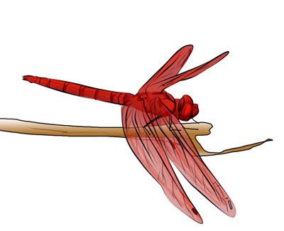
Why ASCII?
Conceptually easy
(x,y) location, all cells
Platform independent (mostly)
Curses (Ncurses) ported nearly everywhere
All modern terminal windows support
e.g. Linux/Mac shell
e.g. Windows command prompt
Reduce temptation to spend time on art
“Programmer art” is ok!

Slide 11
ASCII Graphics
How do you animate something?
Update display, making changes often enough
Full-motion video about 30 frames per second (fps)
Dragonfly does 30 updates/second (→ can potentially update frame each update)
Taking a Walk
0
|
|
Taking a Walk
0
|
/ \
Taking a Walk
0
|
|

Slide 12
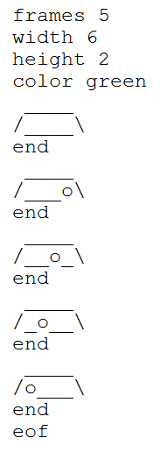
ASCII Graphics
Sprite file with fixed format
Note, must be exact (spaces)
Included sprites (sprites.zip) all work with tutorial
“Debugging” art → if cut-and-paste or create own and doesn’t load, see “dragonfly.log” for messages

Slide 13
Only ASCII? Check out Star Wars
,-'//__\\`-.
,' ____ `.
/ / ,-.-. \
(/# /__`-'_| || || )
||# []/()] O || || |
__`------------------'__
|--| |<=={_______}=|| |--|
| | |-------------|| | |
| | |={_______}==>|| | |
| | | |: _ :| || | |
> _| |___|:===:| || |__<
:| | __| |: - :| || | |:
:| | ==| |: _ :| || | |:
:| | ==|_|:===:|___||_| |:
:| |___|_|:___:|___||_| |:
:| ||| ||/_\|| ||| -| |:
;I_|||[]_||\_/|| ||| -|_I;
|_ |__________________| _|
| `\\\___|____|____/_//' |
J : | \____/ | : L
_|_: | |__| | :_|_
-/ _-_.' -/ \- `.-_- \-
/______\ /______\ /______\
http://www.asciimation.co.nz/

Slide 14
Note “Pixels” of Resolution
Don’t have to limit to 80x24!
(Above, about 200x60. My screen, 600x400 → nearly VGA)

Slide 15
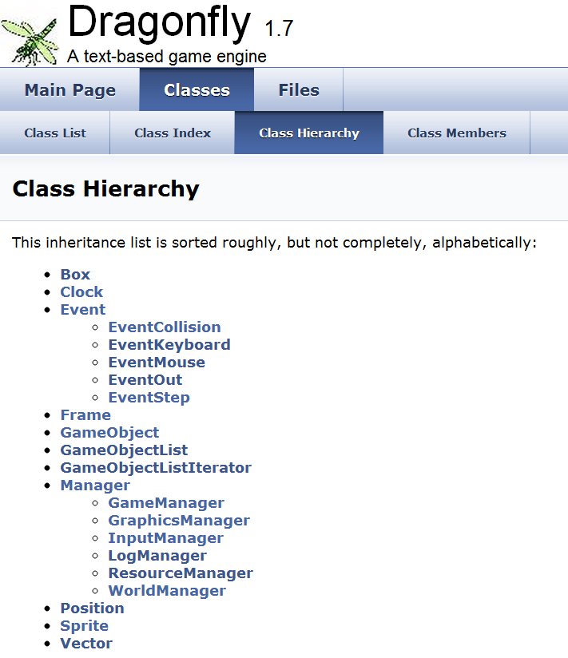
Document Browser

Slide 16
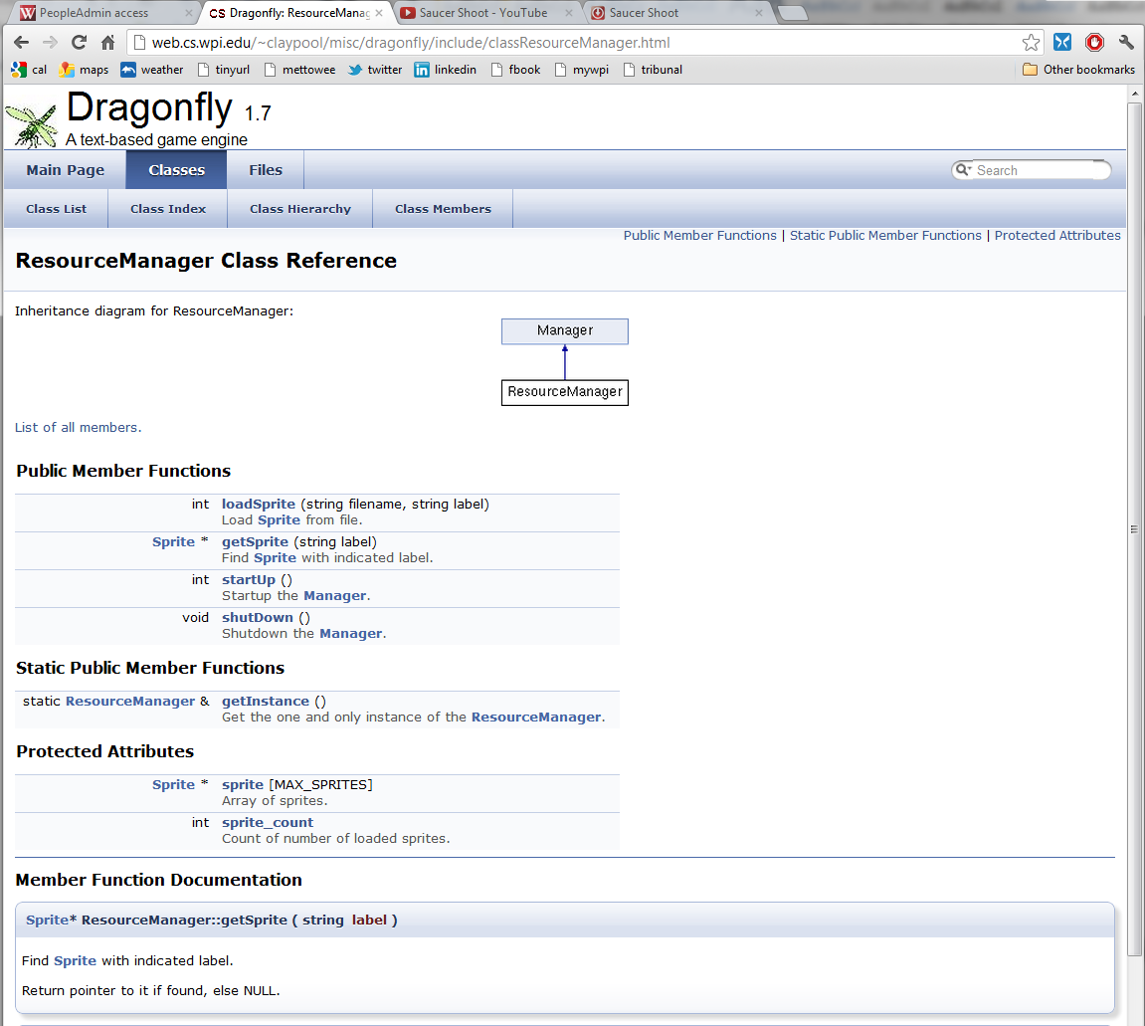

Slide 17
Hand In (1 of 2)
Source code package
All code necessary to build your game (well-structured, commented)
Any other support files, including .h files.
All sprites that are needed (including Dragonfly sprites)
A Makefile for building your utilities.
You do NOT need to turn in any Dragonfly headers or libraries
README file explaining:
Platform
Files
Code structure
How to compile
Anything else needed to understand (and grade) your game
GAME file providing:
Short description of additional 10% extension
Detail functionality added from player's prospective
Briefly indicate code written

Slide 18
Hand In (2 of 2)
When ready, upload (WinSCP) to ccc.wpi.edu
mkdir lastname-proj1
cp * lastname-proj1
tar czvf proj1-lastname.tgz lastname-proj1
Submit your assignment (proj1-lastname.tgz):
/cs/bin/turnin submit imgd3000 proj1 proj1-lastname.tgz
Verify
/cs/bin/turnin verify imgd3000 project1
Turnin help at
http://www.cs.wpi.edu/Resources/turnin.html
Due at mid-night (11:59pm)

Slide 19
Grading
Tutorial 40%
Customization 50%
Documentation 10%

