Slide 1
Project 2
Dragonfly

Slide 2
Overview
Goal is to build your own Dragonfly
2D (text-based graphics) game engine
Objectives
Learn how game engine works from ground up
Provide in-depth understanding of your engine to enable development of your game (Project 3)
Become better programmer

Slide 3
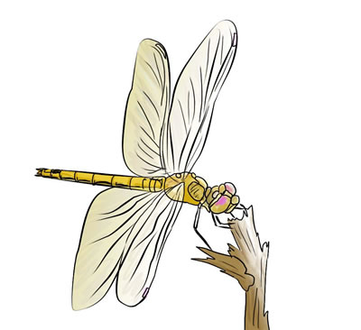
Dragonfly Parts (1 of 2)
A: Dragonfly Egg: September 11th, 11:59pm
B: Dragonfly Naiad: September 19th, 11:59pm
C: Dragonfly: September 24th, 11:59pm
All build towards fully working, full-featured game engine
Part A is foundational
Part B is fully working
Part C is full-featured

Slide 4
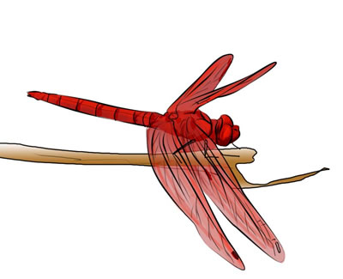
Dragonfly Parts (2 of 2)
Completing through Part B will enable Project 3
Earn a “B” grade for Project 2
Completing through Part C will enable additional game engine features (e.g. animated sprites)
Potential for “A” grade for Project 2
Important! Tested, trusted robust code that implements A and B much better than buggy, unreliable code that attempts part C
Work alone (Project 3 in teams)
Can collaborate for debugging, discussion but all coding done separately (do not send/swap code!)

Slide 5
Part A – Dragonfly Egg
Start and stop gracefully
Log time-stamped messages to file
Adding and removing of game objects
Objects have 2d game world positions
Running a game loop with:
A fixed rate (e.g. 30 Hz)
Updates sent to all objects each tick
Note! No visual depiction needed for Part A!
→ Output to screen or, better, logfile via LogManager

Slide 6
Part A Classes
LogManager
singleton
startup and shutdown
time
flexible means of data entry (integers, strings, ...)
Clock
milliseconds of resolution for timing
Position
(x,y) location
GameManger
singleton
startup and shutdown
game loop
Object
position
event handler
ObjectList
store 1+ Objects
add, remove Object
ObjectListIterator
iterate through ObjectList
WorldManager
store all game programmer game objects
add, remove game objects
can send an event to all game objects
Event
getting/setting type
(Note, not necessarily in order of implementation!)

Slide 7
Part A – Grading
LogManager 10%
Clock 10%
Position 5%
GameManager 10%
(Game) Object 10%
ObjectList 10%
Iterator 10%
WorldManager 10%
Event 5%

Slide 8
Part B – Dragonfly Naiad
Output
Support 2d (ascii) characters
Clean refresh each game loop
Support color
Input
Accept non-blocking keyboard and mouse input
Send event to interested game objects
Collisions
Detect between solid objects (note, need "solid" attribute for game objects)
Send event to both objects
Misc
Deferred, batch removal of game objects (markForDelete)
Support event filtering, where game objects register when interested
Provide "altitude" attribute for game objects for layered drawing
Send "outofbounds" event when objects off screen

Slide 9
Part B – Classes
Manager (base class)
Support event filt (register, unregister, onEvent)
GameManager
Modify game loop
Get input (InputManager)
Have objects draw themselves (WorldManager)
Refresh screen (GraphicsManager)
GraphicsManager
Singleton
Startup and shutdown
Draw character at (x,y) with/without color
Detect and store horiz and vert screen size
SwapBuffers to refresh display to latest world
InputManager
Singleton
Startup and shutdown
Allow registration for only valid events
Support keyboard and mouse input
EventKeyboard
Getting/setting type
Getting/setting key pressed
WorldManager
Batched removal in update (markForDelete)
Support boundary limits (equal to screen limits)
Detect collisions (sending events to both)
Move objects
If out of bounds, provide event
If solid, provide collisions (detection and events)
Draw method, where all objects draw themselves
Altitude , where lowest objects drawn first
GameObject
Solidness
Altitude
EventOut
Getting/setting type
EventCollision
Getting/setting type
Getting/setting both objects in collision
Getting/setting collision position
EventMouse
Getting/setting type
Getting/setting mouse action (button)
Getting/setting (x,y) location on screen
(Note, not necessarily in order of implementation!)

Slide 10
Part B – Grading
Manager 10%
GameManager 5%
GraphicsManager 25%
InputManager 25%
WorldManager 25%
GameObject and Events 10%

Slide 11
Part C - Dragonfly
Sprites
Provide multi-character frame
Associate 1+ frames one object
Play frames in sequence to achieve animation
Resource Management
Read sprite data from file
Bounding boxes
Game objects larger than single character (movement and collisions)
Bounding box associated with Sprite
Camera Control
Game world larger than screen (viewport)
View port movement around game world
Object Control
Support "velocity" for game objects with automatic updates
View Objects
Support “display” objects that don’t interact with game world objects
Misc
Gracefully handle kill signal
Random number seeding

Slide 12
Part C – Classes
ResourceManager
Singleton
Startup and shutdown
Load Sprites from file
Find Sprites with given labels
Sprite
Width, height
Label
Color
Frame count and frame
Frame
Width, height
Data
Box
Corner, position
EventView
tag, value, delta
GameObject
Support Sprites
Centered
Animation rate (slowdown)
Gettting/setting bounding box
Centered based on Sprite
Getting/setting x-velocity, y-velocity
ViewObjects
Getting/setting location
Getting/setting border, color and display string
EventHandler
WorldManager
Modify collision detection for box intersection
Add camera (viewport) control
Get/set view
Translate world (x,y) to view (x,y)
Modify update to support velocities

Slide 13
Part C - Grading
ResourceManager 25%
Sprite 15%
Frame 6%
Box 6%
Object, Game Object, View Object 5%
WorldManager 20%
EventView 3%

Slide 14
Development
Must be C++
Can be Linux or Windows with Cygwin
Certain to support curses (project 2b, project 2c)
Consider Eclipse or Visual Studio if want IDE
Where?
FL222, FLA21 → Cygwin, 64-bit
CCC → login to ccc.wpi.edu, Linux 64-bit
Or, setup your own environment (e.g. Eclipse or Visual Studio)
Must have curses support (consider pdcurses, cygwin)
TA needs to grade
If in doubt, ask!

Slide 15
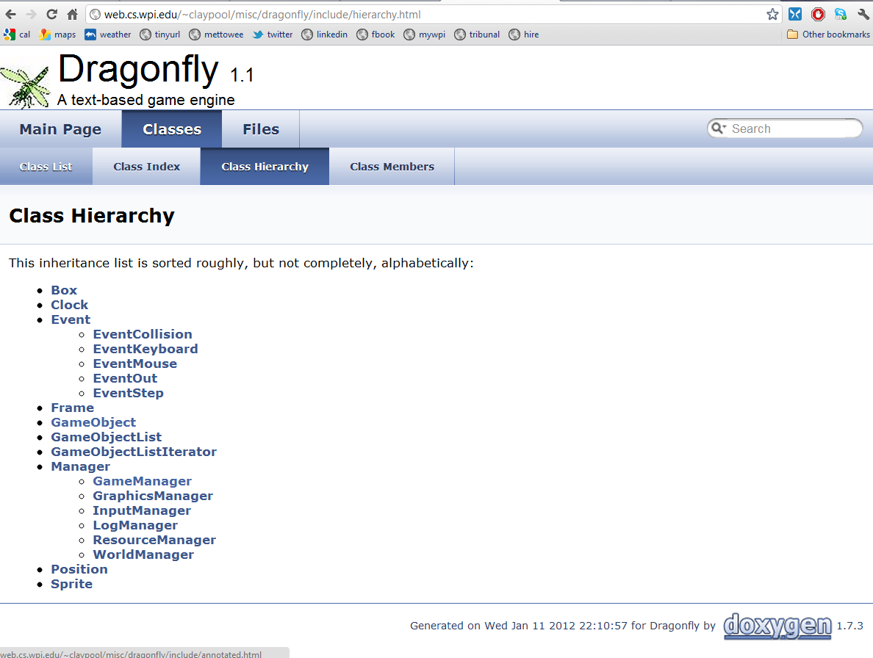
Resources
Slides

Slide 16
Hand In (1 of 2)
Source code package
All code necessary to build your game (well-structured, commented)
Any other support files, including .h files.
A Makefile or project for building your utilities.
Game program(s)
Game code illustrating functionality
Should be accompanied by what to see in log files
README file explaining:
Platform
Files
Code structure
How to compile
Anything else needed to understand (and grade) your game

Slide 17
Hand In (2 of 2)
When ready, upload (WinSCP) to CCC machine
mkdir lastname-proj2a
cp * lastname-proj2a
tar czvf proj2a-lastname.tgz lastname-proj2a
Submit your assignment (proj2a-lastname.tgz):
/cs/bin/turnin submit imgd3000 project2a proj2a-lastname.tgz
Verify
/cs/bin/turnin verify imgd3000 project2a
Help at
http://www.cs.wpi.edu/Resources/turnin.html
Due at midnight (11:59pm)
(Modify for 2b, 2c)

