Slide 1
Project 3
Dragonfly Spawn

Slide 2
Overview
Goal is to build a game from scratch using your own Dragonfly game engine
Objectives
Build a game of your own creation
Go through (an abbreviated) game development process
Re-enforce your knowledge of game engines by using one you built
Become a better programmer
Potential portfolio piece / job interview topic
You know all aspects (process, engine, game code)!

Slide 3
Dragonfly Spawn (1 of 3)
Plan: Friday, September 28th, 11:59pm
Alpha: Thursday, October 4th, 11:59pm
Final playable: Tuesday, October 9th, 11:59pm
Presentation: Thursday, October 11th, 1:00pm
All work to original, playable, balanced game
Milestones are intended to have you work towards final game
All parts graded separately, but combined to provide single grade

Slide 4
Dragonfly Spawn (2 of 3)
Work in teams for this project!
Team size is 2 (not 1, not 3) → 2!
Form team on your own (quickly!)
Can partition development work as you see fit
But recommendation is equal participation in all phases of project
E.g. Both brainstorm idea, design game, write plan, design code, implement classes …
Ideally, team has full knowledge of all parts of process and development

Slide 5
Dragonfly Spawn (3 of 3)
Development in C++, using your game engine
Pick “best” one of two built
If needed, can merge best implementations of parts of each (e.g. LogManager from 1, Resource Manager from 2)
Under exceptional circumstances, you may use Project 1 Dragonfly
Only if features needed (but can design game around)
Or if neither Project 2b complete
Note, you do not want to spend time fixing/debugging your engine!
There is too much to do for Project 3!

Slide 6
Plan (1 of 3)
Create plan for your game
End result is short document
In less than 1 week!
Description of game
Technical challenges
Significant artistic aspects (Sprites or other)
Mini-milestones needed to complete
(Major milestones are set for you)

Slide 7
Plan (2 of 3)
Game Name - a catchy, descriptive name for your game.
Team - names and email of both team members. Include team name!
Genre - brief, one sentence/phrase of game genre.
Game Description - short, one paragraph description of game.
Technical Features - list of specific, significant technical features game will include.
Artistic Assets - list of significant artistic assets in game. Sizes and frames of animation should be estimated.
Note, emphasis should not be on “art”!

Slide 8
Plan (3 of 3)
Implementation Plan – short description of how you will implement technical features.
If re-use code/art from elsewhere, clearly indicate and attribute.
Distribution of Work - broadly, what team member is responsible for what aspects of project.
I.e. assign a name next to tasks!
Joint responsibility can be indicated, if appropriate.
Remember, despite distribution, everyone should understand and help (as appropriate) with all parts of game!
Schedule - milestones to be met for your game development.
Major milestones (plan, alpha, final) are fixed, but smaller milestones should be specified, appropriate for your project

Slide 9
Suggested Plan for Your Plan
Form team (today!)
Brainstorm (tomorrow or wednesday!)
Make design decisions
Partition work
Write
Exchange writing → Edit!
Combine
Turn in (Friday!)

Slide 10
Alpha
Due about 1 week after Plan
All required features implemented
May not be working entirely correctly
Game code tested to eliminate critical gameplay flaws
Minor glitches/bugs present
Compile cleanly, runnable
May have separate programs for separate parts (e.g. some code illustrating weapons, other code bad guys)
Not yet balanced, nor levels designed
Placeholder assets ok (e.g. simple square for Sprite)

Slide 11
Final
All content complete – design, code and art.
Tested thoroughly for bugs, both major and minor
No visual and gameplay glitches
Don’t underestimate time for this final polish!
Code should compile cleanly and be easily runnable
Upon game startup → instructions how to play
Gameplay balanced
Appropriate difficulty for beginners and/or early gameplay
Increased difficulty as game progresses
Clear ending condition, with ability to exit easily and cleanly

Slide 12
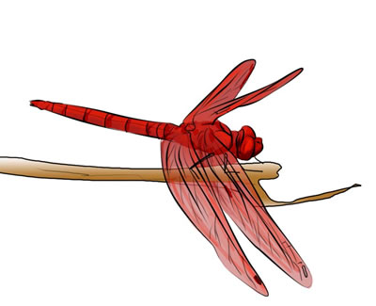
“Design” Document
All details in your Plan
Updated to reflect game as actually built
E.g. functionality and milestones updated
E.g. Work responsibilities updated
Major deviations from original plan noted, explained (if needed)

Slide 13
Promotional Materials
Materials for Web page / Portfolio
Image - create/select representative image (scaled to 200x150 pixels)
Screenshot, logo or some other graphic
Description - title, development team and short (100 word) description
Should include game features, can include significant technical features
Video – Short (1-2 minute) video illustrating gameplay
Can provide music sound-track or voice narration
Won’t turnin video, but give link (e.g. YouTube)
May use materials during your presentation, as appropriate

Slide 14
Advice
Know the limits of your engine
Work on mechanics first
Decide on “unit height” early through testing → critical for Sprites, but also speed, balance, etc.
Design software classes
Use iterative development (upcoming topic)
Should always have build that compiles, plays
Concentrate on core, then required, then desired (if time)

Slide 15
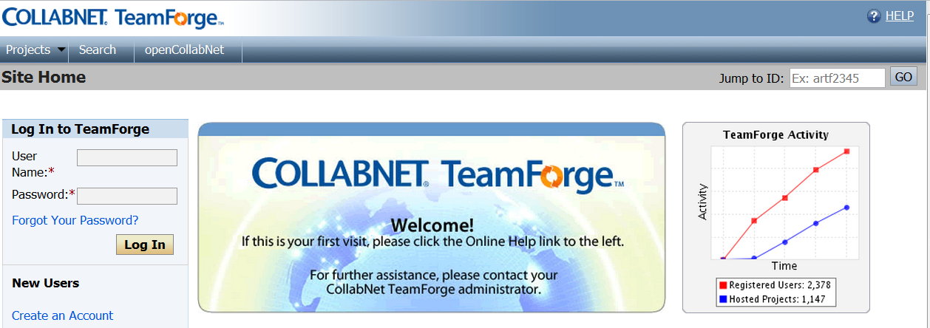
Resources (1 of 3)
WPI’s Fusionforge (http://fusion.wpi.edu)
Login with WPI credentials (guide in upper right)
Use for code and assets

Slide 16
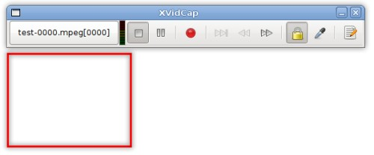
Resources (2 of 3)
Video Capture Windows → Camtasia
Video Capture Linux → xvidcap

Slide 17
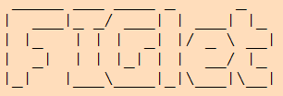
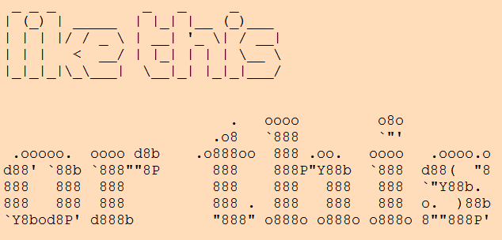
Resources (3 of 3)
Large Text Banners →
Asciimator.net

Slide 18
Hand In
Plan
Document (Word, PDF or Text)
Alpha
Source code package
Final
Source code, promotional materials, …
(Detail “final” on slides, but see Web page for other deliverables for Plan, Alpha)

Slide 19
FINAL Hand In (1 of 3)
Source code package
All code necessary to build your game engine, including .h files.
A Makefile or project file for building your game engine.
A game code package
All code necessary to build your game.
Note! Make sure your code is well-structured and commented
Any other support files, including .h files.
A Makefile or project file for building your game.

Slide 20
FINAL Hand In (2 of 3)
A README file explaining: platform, files, code structure, how to compile, and anything else needed to understand (and grade) your game.
A VIDEO file providing a link to an online (e.g. YouTube) video of your project.
A DESIGN document
Details from PLAN but updated
Word, PDF or text

Slide 21
FINAL Hand In (3 of 3)
When ready, upload (WinSCP) to CCC machine
mkdir lastname-proj3-final
cp * lastname-proj3-final
tar czvf proj1-lastname.tgz lastname-proj3-final
Submit your assignment (proj1-lastname.tgz):
/cs/bin/turnin submit imgd3000 project3final proj3-final-lastname.tgz
Verify
/cs/bin/turnin verify imgd3000 project3final
Help at
http://www.cs.wpi.edu/Resources/turnin.html
Due at midnight (11:59pm)

Slide 22
Presentation
Present game in class
Intro
Introduce team
High concept of game
Summary of major features core ideas
Most time spent demonstrating game!
Highlighting technical aspects needed as show them
Both team members should talk
Arrange in advance who says what
Bring laptop/ test on podium computer ahead of time!
Embarrassing things can happen when you don't try out!
Total time 5 minutes (final exam last)
Plan accordingly
Practice! Many times → content, timing and transitions down

Slide 23
Grading
Plan 10%
Alpha 25%
Final Playable 40%
Design 10%
Presentation 10%
Promo 5%
(See Rubric online)

