Slide 1

Dragonfly

Slide 2
Goals
Understand use of Dragonfly from game programmer’s perspective
  Mostly, Project 1
Provide overview of Dragonfly architecture
  Classes, design
Discuss details needed to fully implement Dragonfly classes

Slide 3
Outline – Part I
Saucer Shoot (next)
Overview
Managers
Logfile Management
Game Management

Slide 4
Saucer Shoot
\
~==-
/
____
/__o_\
ResourceManager &rm = ResourceManager::getInstance();
Sprite *p_temp_sprite;
p_temp_sprite = rm.getSprite("ship");
setSprite(p_temp_sprite);
setSpriteSlowdown(3);
What is this code doing?
What about the last line?
What if the sprite is not found? What code should be added?

Slide 5
Saucer Shoot
\
~==-
/
____
/__o_\
When is this method called?
What is the code doing?
What other “events” might there be?
int Saucer::eventHandler(Event *e) {
if (e->getType() == OUT_EVENT) {
out();
return 1;
}
return 0;
}

Slide 6
Saucer Shoot
\
~==-
/
____
/__o_\
Hero::~Hero() {
InputManager &input_manager = InputManager::getInstance();
input_manager.unregisterInterest(this, KEYBOARD_EVENT);
}
When is the above code called?
What is it doing?
Why not just have the game engine “unregister” automatically?
  Hint: think about tradeoffs for convenience vs. system cost!

Slide 7
Saucer Shoot
\
~==-
/
____
/__o_\
void Explosion::step() {
time_to_live--;
if (time_to_live <= 0){
WorldManager &world_manager=WorldManager::getInstance();
world_manager.markForDelete(this);
}
}
What is time_to_live here? What is it set to initially?
What is happening when time_to_live is 0?
Why not just call own destructor? i.e.
  this->~Saucer()

Slide 8
C++: Do Not Explicitly Call Destructor
What if allocated via new (as in Saucer Shoot)?
Remember, delete p does two things
  Calls destructor code
  Deallocates memory
Bob *p = new Bob();
p->~Bob(); // should you do this?
Bob *p = new Bob();
…
delete p; // automagically calls p->~Bob()

Slide 9
Destructors and Dragonfly
Don’t call destructor explicitly!
For memory allocated by new, use delete when possible
For game engine (Dragonfly), want engine to release memory
  Use WorldManager::markForDelete()
  → Engine will release next game step

Slide 10
Outline – Part I
Saucer Shoot (done)
Overview (next)
Managers
Logfile Management
Game Management

Slide 11
Dragonfly Game Engine
GAME CODE
Saucer: move()
Hero: kbd()
Star: onEvent()
Explosion: step()
DRAGONFLY
DrawCharacter
InsertObject
LoadSprite
GetKey
MoveObject
SendEvent
COMPUTER PLATFORM
Allocate memory
Clear display
File open/close
Get keystroke

Slide 12
Dragonfly Classes
Managers
Game objects
Support classes
LogManager
Manager
ResourceManager
WorldManager
GraphicsManager
InputManager
GameManager
ObjectList
GameObject
ObjectListIterator
Sprite
Clock
Box
Frame
Vector
ViewObject
Object
Position
SceneGraph
Line
Event
EventStep
EventMouse
EventCollision
EventOut
EventKeyboard

Slide 13
Engine Support Systems - Managers
Support systems that manage crucial tasks
  Handling input, Rendering graphics, Logging data
  …
Many interdependent, so startup order matters
  e.g. Log file manager needed first since others log messages
  e.g. Graphics manager may need memory allocated for sprites, so needs Memory manager first
Often, want only 1 instance of each Manger
  e.g. Undefined if two objects managing the graphics
How to enforce only 1 instance in C++?

Slide 14
Managers in C++: Global Variables?
Could make Managers global variables (e.g. outside of main())
  Constructors called before main(), destructors when main() ends
Then, declare global variable:
  RenderManager render_manager;
However, order of constructor/destructor unpredictable
  E.g. RenderManager r; GraphicsManager g;
  Could call g::g() before r::r()!
Plus, explicit globals difficult from library
  Names could be different in user code
Instead, how about static variables inside a function?
Notes:
Gregory, Chapter 5

Slide 15
Managers in C++: Static Variables?
Remember, static variables retain value after method terminates
Static variables inside method not created until method invoked
Use inside Manager class method to “create” manager → the Singleton
void stuff() {
static int x = 0;
cout << x;
x++;
}
main() {
stuff(); // prints 0
stuff(); // prints 1
}

Slide 16
Managers: C++ Singletons
Idea - compiler won’t allow (so have only 1)
  MySingleton s;
Instead:
  MySingleton &s= MySingleton::getInstance();
Guarantees only 1 copy of MySingleton will exist
class MySingleton {
private:
// Private constructor
MySingleton();
// Can’t assign or copy
MySingleton(MySingleton const& copy);
MySingleton& operator=(MySingleton const& copy);
public:
// return the 1 and only instance of MySingleton
static MySingleton& getInstance() {
static MySingleton instance;
return instance;
}
};
Use for Dragonfly Managers
However, also want to explicitly control when starts (not at first getInstance()) call)
→ Use startUp() and shutDown() for each

Slide 17

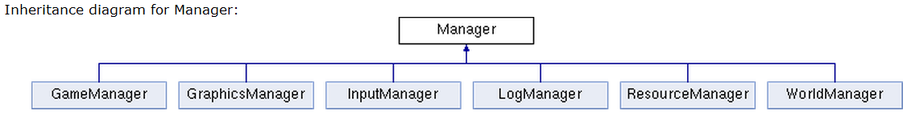
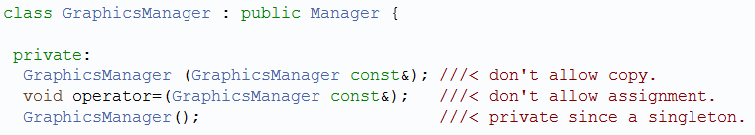
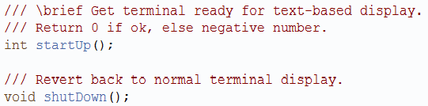
The Manager Interface
All Dragonfly “managers” inherit from this class

Slide 18
Outline – Part I
Saucer Shoot (done)
Overview (done)
Managers (done)
Logfile Management (next)
Game Management

Slide 19
Game Engine Messages
If all goes well, only want game output
But during development, often not the case
  Even for players, may have troubles running game
Generally, need help debugging
Debuggers are useful tools, but some bugs not easy to find in debugger
  Some bugs timing dependent, only happen at full speed
  Some bugs caused by long sequence of events, hard to trace by hand
Most powerful debug tool can still be “print” messages (e.g. printf())
However, standard printing difficult when graphical display
One Solution → Print to file

Slide 20
The LogManager - Functionality
Manages output to log file
  Upon startup → open file
  Upon shutdown → close file
Attributes
  Need file handle
What else?
  Method for general-purpose messages via writeLog()
    E.g. “Player is moving”
    E.g. “Player is moving to (x,y)” with x and y passed in
  Associate time with each message
    Could be in “game time” (e.g. game loop iterations)
    Could be in “real time” (i.e. wall-clock → we’ll do this)

Slide 21
General Purpose Output
For writeLog(), using printf() one of the most versatile
  But takes variable number of arguments
  printf(“Bob wrote 123 lines”); // 1 arg
  printf(“%s wrote %d lines”, “Bob”, 123); // 3 args
Solution → allow variable number of arguments passed into writeLog()
Specify with “…”:
void writeLog(const char *fmt, …) {
  …
}

Slide 22
General Purpose Output
Need <stdarg.h>
Create a va_list
  Structure gets initialized with arguments
va_start() with name of last known arg
Can then do printf(), but with va_list
  vfprintf()
    Uses macros to increment across args
va_end() when done
#include <stdio.h>
#include <stdarg.h>
void writeLog(const char* fmt, ... ) {
fprintf( stderr, “Error: ” );
va_list args;
va_start( args, fmt);
vfprintf( stderr, fmt, args );
va_end( args );
}

Slide 23
Nicely Formatted Time String
Time functions not immediately easy to read
  time() returns seconds since Jan 1, 1970
  time_t time(time_t *t);
  localtime() converts calendar time struct to local time zone, returning pointer
  struct tm *localtime (time_t *p_time);
Combine to get user-friendly time string (e.g. “07:53:30”)
Wrap in method, getTimeString()
  Use in writelog()
  Put in “utility.cpp” with “utility.h”
  → will add more to it later
// return a nicely-formatted time string: HH:MM:SS
// note: needs error checking!
char *getTimeString() {
static char time_str[30];
struct tm *p_time;
time_t t;
time(&t);
p_time = localtime(&t);
// 02 gives two digits, %d for integer
sprintf(time_str, "%02d:%02d:%02d",
p_time -> tm_hour,
p_time -> tm_min,
p_time -> tm_sec);
return time_str;
}

Slide 24
Flushing Output
Data written to file buffered in user space before going to disk
If process terminates without file close, data not written. e.g.:
  fprintf(fp, “Doing stuff”);
  // program crashes (e.g. segfault)
  “Doing stuff” string passed, but won’t appear in file
Can add option to fflush() after each write
  Data from all user-buffered data goes to OS
  Note, incurs overhead, so perhaps only when debugging → remove for “gold master” release
    Could “compile in” with #ifdef directives (see below)

Slide 25
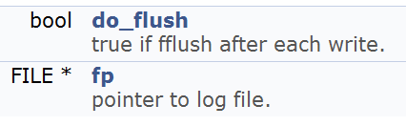
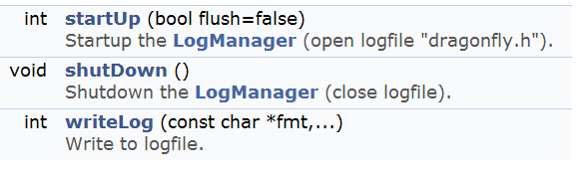
The LogManager
Protected attributes:
Public methods:
Default is not to flush, but can change at start up

Slide 26
Once-only Header Files
LogManager used by many objects (status and debugging). So, all #include “LogManager.h”
During compilation, header file processed twice
  Likely to cause error, e.g. when compiler sees class definition twice
  Even if does not, wastes compile time
Solution? → "wrapper #ifndef"

Slide 27
Once-only Header Files
When header included first time, all is normal
  Defines FILE_FOO_SEEN
When header included second time, FILE_FOO_SEEN defined
  Conditional is then false
  So, preprocessor skips entire contents → compiler will not see it twice
// File foo
#ifndef FILE_FOO_SEEN
#define FILE_FOO_SEEN
(the entire file)
#endif // !FILE_FOO_SEEN
Convention:
  User header file, name should not begin with _ (underline)
  System header file, name should begin with __ (double underline) [Used for Dragonfly]
  Avoids conflicts with user programs
  For all files, name should contain filename and additional text

Slide 28
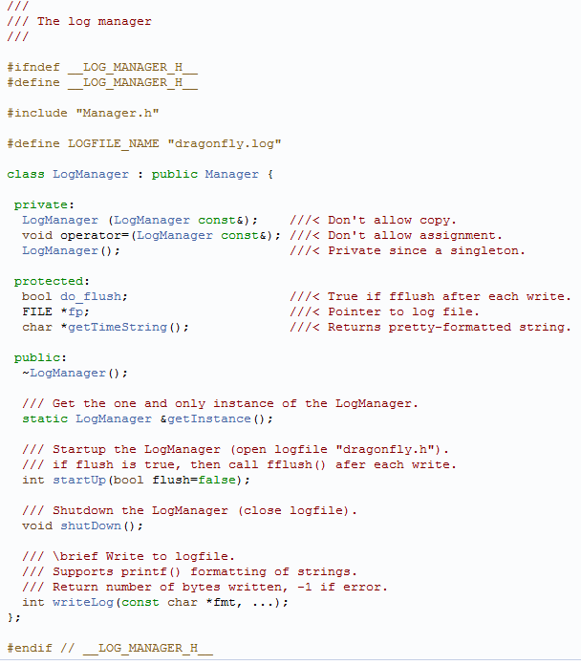
The LogManager – Complete Header File
(MLC: needs updating)

Slide 29
Using the LogManager - Example
Convention: class name, method name
  Ease of finding code when debugging
LogManager &log_manager = LogManager::getInstance();
…
log_manager.writeLog( // 1 arg
“GraphicsManager::startUp(): Current window set”);
…
log_manager.writeLog( // 3 args
"GraphicsManager::startUp(): max X is %d, max Y is %d",
max_x, max_y);
07:53:30 *****************************************************
07:53:30 ** Dragonfly version 1.2 **
07:53:30 Log Manager started
07:53:31 GraphicsManager::startUp(): Current window set
07:53:31 GraphicsManager::startUp(): max X is 80, max Y is 24

Slide 30
Controlling Verbosity Level
Lots of printfs() all over to fix and develop, so would be nice to leave them there
  Could be needed later!
  But noisy
Can control via engine setting
  → verbosity setting
int g_verbosity = 0; // user can chnge
…
void LogManager::writeLog(
int verbosity,
char *fmt, …) {
// Only print when level high enough
if (g_verbosity > verbosity) {
va_list args;
…
}
}
Verbosity level still has run-time overhead
  Can remove with conditional compilation

Slide 31
Conditional Compilation
#if, #ifdef, #ifndef, #else, #elif, #endif
Often used for platform-specific code
Also, control verbosity and debug messages (DEBUG1, DEBUG2…)
#ifdef LINUX
Linux specific code here
#elif WIN32
Windows specific code
#endif
#ifdef DEBUG1
LogManager &log_manager = LogManager::getInstance();
log_manager.writeLog(
"WorldManager::markForDelete(): will delete object %d",
p_go -> getId());
#endif

Slide 32
Development
Create Manager base class
Create LogManager derived class
Implement writeLog()
  Test
Implement getTimeString()
  Test
Make sure solid before going on
  Many of your other objects will use!

Slide 33
Outline – Part I
Saucer Shoot (done)
Overview (done)
Managers (done)
Logfile Management (done)
Game Management (next)
  Clock
  GameManager

Slide 34
Saucer Shoot
\
~==-
/
____
/__o_\
void Star::out() {
WorldManager &world_manager = WorldManager::getInstance();
pos.setX(world_manager.getBoundary().getHorizontal() + random()%20);
pos.setY(random() % world_manager.getBoundary().getVertical());
setXVelocity(-1.0 / (random()%10 + 1));
}
When does the above code get called?
What is the above code doing?
Saucers, and Bullets and Hero use WorldManager::moveObject() …
Should a Star? Why or why not?

Slide 35
The Game Loop
The Game Manager “runs” the game:
While (game not over) {
Get input from keyboard/mouse
Update world state
Draw new screen to back buffer
Swap back buffer to current buffer
}
10,000 foot view of game loop
Each iteration a “step” or a “tick”
How fast will the above loop run?
  Note, early games just moved objects fixed amount each loop
  → On faster computers, objects moved faster!
How to slow it down?

Slide 36
The Game Loop with Timing
While (1) {
Get input from keyboard/mouse
Update world state
Draw new screen to back buffer
Swap back buffer to current buffer
Measure how long last loop took
Sleep for (TARGET_TIME – elapsed)
}
But what is TARGET_TIME?
Frame rate is how often images updated to player → Unit is Hertz (Hz) or frames per second (fps)
  30 frames/second typically full-motion video
Time between frames is frame time or delta time
At 30 fps, frame time is 1/30 or 33.3 milliseconds
  Milliseconds are a common unit for game engines
Why do we care about frame rate? Often drives game loop rate (not many reasons to go faster than full-motion video rate)
Ok, how to measure computer time?

Slide 37
Measuring Computer Time
time() returns seconds since Jan 1, 1970
  Resolution of 1 second. Maybe fine for LogManager, but far too coarse for game loop.
Modern CPUs have high-resolution timer
  Hardware register that counts CPU cycles
  3 GHz processor, timer goes 3 billion times/sec, so resolution is 0.333 nanoseconds → Plenty of precision!
  64-bit architecture → wraps about every 195 years
  32-bit architecture → every 1.4 seconds
System calls vary with platform. e.g.:
  Win32 AP → QueryPerformanceCounter() to get value, and QueryPerformanceFrequency() to get rate
  Xbox 360 and PS3 → mftb (move from time base register)
  Linux → clock_gettime() to get value (link with –lrt)

Slide 38
Measuring Computer Time
64-bit high precision, more than needed so 32-bit could be ok
  However, still want to measure 64-bit if wrapping a problem
  Typical unit of 1/300th second is sometimes used (can slow down 30fps animation to 1/10th, for example)
Beware storing as floating point as distributes bits between mantissa and exponent so precision varies over time
For debugging breakpoints, may want to put in check to see if “large” gap (then assume breakpoint) and not necessarily that a lot of game time should have passed
  Otherwise, traced debugging will see “jump” in game

Slide 39
Game Engine Need
Use accurate measure of time to find elapsed time since last call
Method:
  Time before (clock.delta())
  Do processing stuff (render, compute, etc.)
  Time after (clock.split())
  Compute elapsed time (after – before)
  Can then sleep/pause for right amount (whatever is left)
  Or “catch up” with object updates if it took too long
→ So, how to measure elapsed time? On Windows? Linux?

Slide 40
Compute Elapsed Time – Linux (Cygwin)
// compile with -lrt
#include <time.h>
struct timespec curr_ts, prev_ts;
clock_gettime(CLOCK_REALTIME, &prev_ts); // start timer
// do something ...
clock_gettime(CLOCK_REALTIME, &curr_ts); // stop timer
// compute elapsed time in microseconds
long int curr_microsec, prev_microsec;
curr_microsec = curr_ts.tv_sec*1000000 + curr_ts.tv_nsec/1000;
prev_microsec = prev_ts.tv_sec*1000000 + prev_ts.tv_nsec/1000;
long int elapsed_time = curr_microsec - prev_microsec;

Slide 41
Compute Elapsed Time - Windows
#include <iostream>
#include <windows.h>
LARGE_INTEGER frequency; // in ticks per second
LARGE_INTEGER t1, t2; // in total ticks
double elapsed_time; // in microseconds
QueryPerformanceFrequency(&frequency); // determine CPU freq
QueryPerformanceCounter(&t1); // start timer
// do something ...
QueryPerformanceCounter(&t2); // stop timer
// compute elapsed time in microseconds
elapsed_time = (t2.QuadPart-t1.QuadPart) * 1000000.0 / frequency.QuadPart;
Notes:
Good example at: http://www.decompile.com/cpp/faq/windows_timer_api.htm

Slide 42
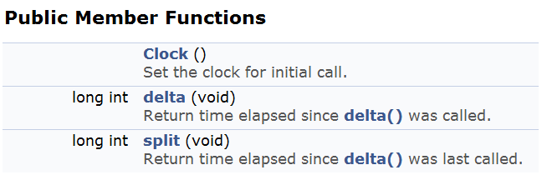
The Clock Class
Use to find elapsed time since last call
  For Dragonfly, this is sufficient
  More general purpose could provide “game time” and allow time scaling
Use to know how long game loop took
  Can then pause/sleep for the right amount (what is remaining of frame time/TARGET_TIME)
  Or “catch up” if it took too long

Slide 43
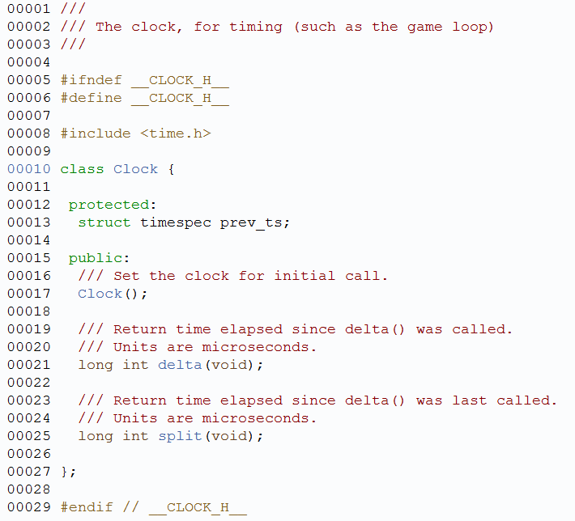
Clock.h

Slide 44
Additional Timing Topics (1 of 2)
At end of game loop, need to sleep for whatever is remaining (elapsed – delta)
  Roughly, milliseconds of granularity
On Linux/Unix (and Cygwin)
  usleep() → microseconds (need <unistd.h>)
  e.g. usleep(20000) // sleep for 20 millisec
On Windows
  Sleep() → milliseconds (need <windows.h>)
  e.g. Sleep(20) // sleep for 20 millisec

Slide 45
Additional Timing Topics (2 of 2)
What happens if game engine cannot keep up (i.e. elapsed > TARGET_TIME)?
  Generally, frame rate must go down
  But does game play (e.g. saucer speed)?
Could have GameManager provide a “step” event more than once, as required
  But note, if step events are taking the most time, this could exacerbate problem!
Could have elapsed time so object positions could be adjusted accordingly
  move_x = ((int) elapsed / TARGET) + 1
  position.setX(old_x + move_x)
Could be provided by Clock class
  But Dragonfly does not do this

Slide 46

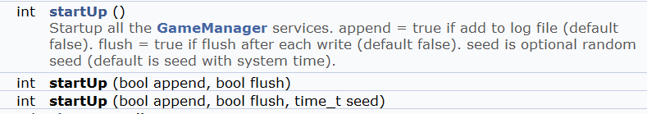

GameManager (1 of 3)
Method to execute (start) running game loop
Method to startup/shutdown all other managers
  (As of now, just have LogManager)
Other

Slide 47
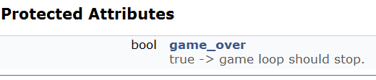

GameManager (2 of 3)
Ability for game code to indicate game is over:
When true, game loop should stop and run() should return

Slide 48



Game Manager (3 of 3)
“Helper” functions for game programmer
Could set target frame time. Public method:
May be useful to know target time
  Protected attribute
  Public method

Slide 49
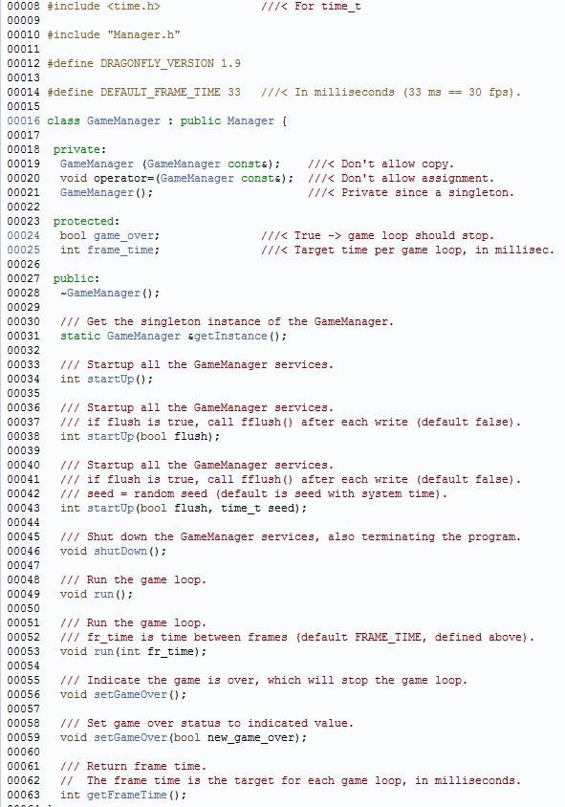
GameManager.h
Version number
Can flush log file
(Random numbers later)

Slide 50
Development
Create Clock class
Test
  Use printf() , cout for output
Create GameManager class
  Contructor starts LogManager
  Destructor stops LogManager
Implement game loop inside run
  Uses Clock
Test
  Use LogManager for output
Add additional functionality
  Frame time
  Startup parameters (flush? → boolean)
Make sure solid before going on
  Will drive entire game!

Slide 51
Outline – Part I
Saucer Shoot (done)
Overview (done)
Managers (done)
The LogManager (done)
The GameManager (done)

Slide 52
Outline – Part II
Game Objects (next)
  Position
  Object
The Game World
Events
WorldManager

Slide 53
Game Objects
Fundamental game programmer abstraction for items in game
  Opponents (e.g. Saucers)
  Player characters (e.g. Hero)
  Obstacles (e.g. Walls)
  Projectiles (e.g. Bullets)
  Other (e.g. Explosions, Score indicator, …)
Game engine needs to access (e.g. to get position) and update (e.g. change position)
  → Core attribute is location in world, or position

Slide 54
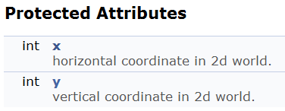
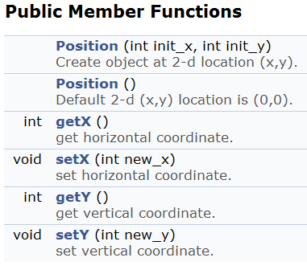
Position Class
By having a Position class rather than (x,y) integers → a game (or game engine) could inherit to add z coordinate

Slide 55
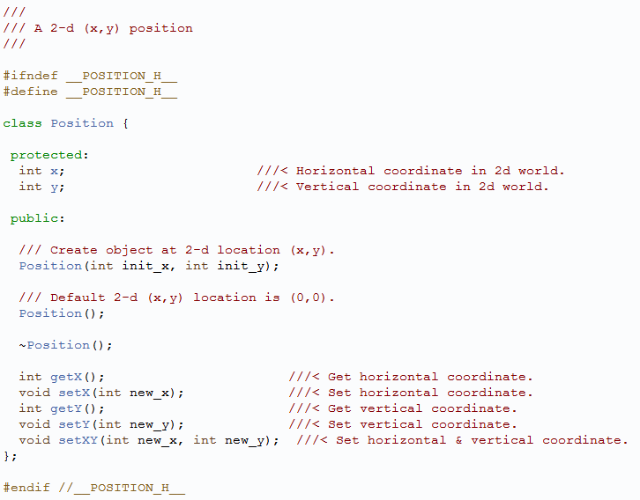
Position.h

Slide 56



Game Object
Ability to set and get position
Ability to set and get type (string for readability, flexibility)
  Typically, set in constructor of specific object
    e.g. Saucer::Saucer()
Ability to set and get id (globally unique)
  Set in WorldManager when object is loaded
ID and type are mostly useful for debugging, but may have other uses from game programmer perspective
Will have other attributes later
  E.g. altitude, solidness, sprite, bounding boxes…
Note: name class “Object”
  Will derive two types – GameObjects and ViewObjects later

Slide 57
Outline – Part II
Game Objects (done)
The Game World (next)
  Lists of game objects
  Updating game objects
Events
WorldManager

Slide 58
REVIEW
What does the header file for the Manager class look like?
Is a Manager.cpp file needed? Why or why not?
Any other methods suggested?

Slide 59
Lists of Game Objects (1 of 2)
Different kinds of lists might want. e.g.
  List of all solid objects
  List of all objects within radius of explosion
  List of all Saucer objects
WorldManager will store, respond to queries
Lists should be efficient (e.g. avoid copying objects)
Updating objects in lists should update objects in game world
In general, libraries could be an option (e.g. STL list class)
  But, for Dragonfly, want to understand implementation implications of object lists since significant impact on performance → build your own

Slide 60
Lists of Game Objects (2 of 2)
Different implementation choices possible, but suggest array for ease of implementation. Integer example below
int item[MAX];
int count;
Constructor():
count = 0;
// same for clear()
bool remove(int x) {
for (int i=0; i<count; i++) {
if (item[i] == x) {
// found so scoot over
for (int j=i; j<count; j++)
item[j] = item[j+1];
count--;
return true; // found
}
}
return false; // not found
}
bool insert(int x) {
// check if room
if (count == MAX)
return false;
item[count] = x;
count++
}

Slide 61
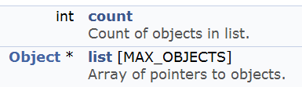
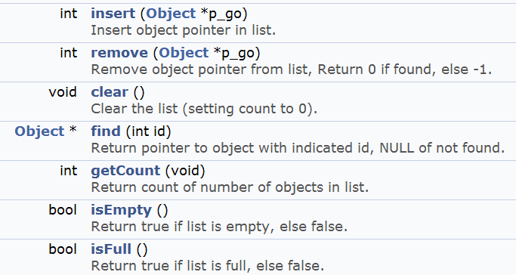
ObjectList
Will have pointers to game Objects (Q: why pointers?)
Public methods:

Slide 62
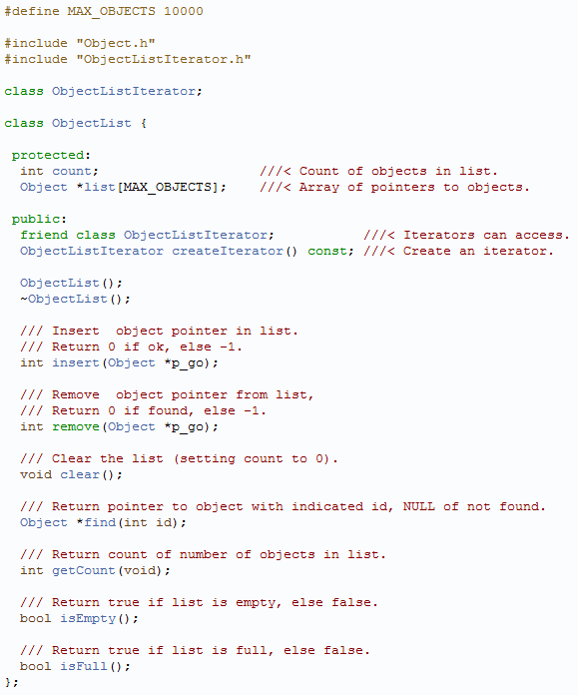
ObjectList.h
Needed for forward reference
Iterator
Q: what is an iterator?

Slide 63
Iterators
Iterators “know” how to traverse through container class
  Decouples container implementation with traversal
Can have more than one instance for given list, each keeping position
Note, adding or deleting to list while iterating may cause unexpected results
  Should not “crash”, but may skip items
Steps
  Understand container class (e.g. Stack)
  Design an iterator class for container class
  Add iterator materials
    Iterator as friend
    createIterator() method for container class
  Clients ask container object to create iterator object
  Clients use first(), isDone(), next(), and currentItem() to access
Notes:
http://sourcemaking.com/design_patterns/iterator

Slide 64
Example: Stack Iterator
// Step 2. Design an "iterator"
class StackIter {
class const Stack *stk;
int index;
public:
StackIter(const Stack *s) { stk = s; }
void first() { index = 0; }
void next() { index++; }
bool isDone() { return index == stk->sp + 1; }
int currentItem() { return stk->items[index]; }
};
Stack s;
// Step 4. Create iterator
StackIter si(&s);
// Step 5. Use iterator
si.first();
while (!si.isDone()) {
int item = si.currentItem();
si.next();
}
// Step 1. Understand your container class
class Stack {
int items[10];
int sp;
public:
Stack() { sp = - 1; }
void push(int in) { items[++sp] = in; }
int pop() { return items[sp--]; }
bool isEmpty() { return (sp == - 1); }
// Step 3. Add iterator material
friend class StackIter;
StackIter *createIterator()const {
return new StackIter(this);
}
};

Slide 65
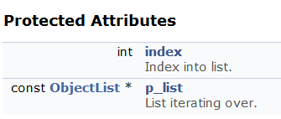
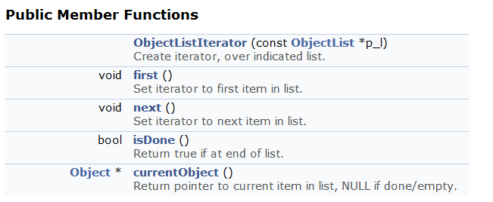
ObjectListIterator

Slide 66
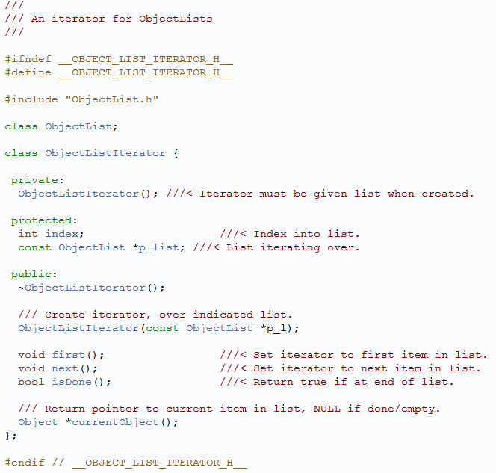
ObjectListIterator.h
Needed for forward reference

Slide 67
Updating Game World
Games are … dynamic, real-time, agent-based computer simulation
  Well researched Computer Science topic
As a developer, you can study wider field
  Agent-based simulations
  Discrete-event simulations
For now, concentrate on updating game objects

Slide 68

Updating Game Objects
Every engine updates game objects – one of its core functionalities, provides interaction:
  Makes game dynamic – objects can change (e.g. state, position)
  Makes game interactive – can respond to player input
While representation at given time is static, can think of world as dynamic, where game engine samples
  S_{i}(t) denotes state of object i a time t
  This helps conceptually when engine cannot “keep up”
So, update is determining current state S_{i}(t) given state at previous time, S_{i}(t - Δt)
  Clock should provide Δt
  (Dragonfly assumes Δt is constant, 33 ms default)
  (Dragonfly assumes engine can always “keep up”)

Slide 69
Simple Approach (1 of 3)
Iterate over game object collection, calling Update()
  Update() declared in base object, declared virtual
Do this once per game loop (i.e. once per frame)
Derived game objects (e.g. Saucer) provide custom implementation of Update() to do what they need
Pass in Δt so objects know how much time has passed
virtual void Update(int Δt)
  (Again, Dragonfly assumes this is constant so Δt not passed)
Note, Update() could pass to component objects, too
  E.g. Update() to car sends it to riders and mounted gun
Seems ok, right? But the devil is in the details …

Slide 70
Simple Approach (2 of 3)
Note, game world manager has subsystems that operate on behalf of objects
  Animate, emit particle effects, play audio, compute collisions …
Each has internal state, too, that is updated over time
  Once or a few times per frame
Could do these subsystem updates in Update() for each object

Slide 71
Simple Approach (3 of 3)
(1)
(2)
virtual void Tank::Update(int dt) {
// update state of tank itself
moveTank(dt);
rotateTurret(dt);
fireCannon(dt);
// update low-level engine subsystems
p_animationSystem -> Update(dt);
p_collisionSystem -> Update(dt);
p_audioSystem -> Update(dt)
}
// game loop
while(1) {
inputManager.getUserInput();
int dt = clock.getDelta();
for each game object // iterator
gameObject.Update(dt);
graphicsManager.swapBuffers();
}
So, what’s wrong with above?
Most engine subsystems operate in batched mode → consider rendering subsystem, for efficiency
  e.g. if do all render operations at once, can cull occluded objects
Also, order may matter
  E.g. can’t compute cat skeleton position until know human
So, efficiency and functionality demand alternate solution!

Slide 72
Simple Fix for Batch Updates (1 of 2)
Engine allows all objects to request rendering services in Update(), but rendering itself is deferred
(next slide)
virtual void Tank::Update(int dt) {
// update the tank
moveTank(dt);
rotateTurret(dt);
fireCannon(dt);
// control properties, but do
// not update
if (didExplode)
p_animationSystem ->
PlayAnimation(“explosion”);
if (isVisbile) {
p_collisionSystem -> Activate();
p_renderingSystem -> Show()
}
}

Slide 73
Simple Fix for Batch Updates (2 of 2)
Game loop now updates subsystems at once
Benefits
  Better cache coherency
  Minimal duplication of computations
  Reduced re-allocation of resources (used by subsystems when invoked)
  Efficient pipelining
    Most render systems can pipeline if pipe filled
// game loop
while(1) {
inputManager.getUserInput();
int dt = clock.getDelta();
// objects update themselves
for each game object // iterator
gameObject.Update(dt);
// then update subsystems
p_animationSystem -> Update(dt);
p_collisionSystem -> Update(dt);
p_audioSystem -> Update(dt)
graphicsManager.swapBuffers();
}

Slide 74
Adding Support for Phased Updates (1 of 2)
Engine systems may have dependencies
  e.g. Physics manager may need to go first before can apply rag-doll physics animation
And subsystems may need to run more than once
  e.g. Ragdoll physics before physics simulation and then after collisions
// game loop
while(1) {
…
// then update subsystems
p_animationSystem -> CalculateIntermediatePoses(dt);
p_ragDollSystem -> ApplySkeletons(dt);
p_physicsEngine -> Simulate(dt);
p_collisionSystem -> DetectResolveCollisions(dt);
p_ragDollSystem -> ApplySkeletons(dt);
…
Game objects may need to add Update() information more than once
  E.g. before each Ragdoll computation and after

Slide 75
Adding Support for Phased Updates (2 of 2)
Provide “hooks” for game objects to have multiple updates
// game loop
while(1) {
…
for each game object
gameObject.PreAnimUpdate(dt);
p_animationSystem -> CalculateIntermediatePoses(dt);
for each game object
gameObject.PostAnimUpdate(dt);
p_ragDollSystem -> ApplySkeletons(dt);
p_physicsEngine -> Simulate(dt);
p_collisionSystem -> DetectResolveCollisions(dt);
p_ragDollSystem -> ApplySkeletons(dt);
for each game object
gameObject.FinalUpdate(dt);
…
(Note: iterating over all objects multiple times can be expensive → we’ll fix later)

Slide 76
Beware “One Frame Off” Bugs
Abstract idea has all objects simultaneously updated each step
  In practice, happens serially
Can cause confusion and source of bugs if objects query each other
  E.g. B looks at A for own velocity. May depend if A has been updated or not. May need to specify when via timestamp
The states of all game objects are consistent before and after the update loop, but they may be inconsistent during it.

Slide 77
Outline – Part II
Game Objects (done)
The Game World (done)
Events (next)
WorldManager

Slide 78
Events
Games are inherently event-driven
An event is anything that happens that an object may need to take note of
  e.g. explosion, pickup health pack, run into enemy
Generally, engine must
  A) Notify interested objects
  B) Arrange for those objects to respond
  → Call this event handling
Different objects respond in different ways (or not at all)
So, how to manage event handling?

Slide 79
Simple Approach
Notify game object that event occurs by calling method in each object
e.g. explosion, send event to all objects within radius
  virtual function named onExplosion()
void Explosion::Update() {
// …
if (explosion_went_off) {
GameObjectList damaged_objects;
g_world.getObjectsInSphere(
damage_radius, &damaged_objects);
for (each object in damaged_objects)
object.onExplosion(*this);
}
}
Statically typed late binding
  “Late binding” since compiler doesn’t know which → only known at runtime
  “Statically typed” since knows which type when object known
    E.g. Tank → Tank::onExplosion(), Crate → Crate:onExplosion()
So, what’s the problem?

Slide 80
Statically-Typed is Inflexible
Base object must declare onExplosion(), even if not all objects will use
  In fact, in many games, there may be no explosions!
Worse → base object must declare virtual functions for all possible events in game!
Makes difficult to add new events since must be known at engine compile time
  Can’t make events in game code or even with World editor
Need dynamically typed late binding
  Some languages support natively (e.g. C# delegates)
  Others (e.g. C++) must implement manually
How to implement?
  → add notion of function call in object and pass object around
  Often called message passing

Slide 81
Encapsulating Event in Object
Components
Advantages
Type (e.g. explosion, health pack, collision …)
Arguments (e.g. damage, healing, with what …)
Could implement args as linked list
Args may have various types
Single event handler
  Since type encapsulated, only method needed is
  virtual void onEvent(Event *p_e);
Persistence
  Event data can be retained say, in queue, and handled later
Blind forwarding
  An object can pass along event without even “knowing” what it does (the engine does this!)
  E.g. “dismount” event can be passed by vehicle to all occupants
struct Event {
EventType type;
int num_args;
EventArg args[MAX];
}
Note, this is also called the Command pattern

Slide 82
Event Types (1 of 2)
enum EventType {
LEVEL_STARTED;
PLAYER_SPAWNED;
ENEMY_SPOTTED;
EXPLOSION;
BULLET_HIT:
…
}
One approach is to match each
type to integer
  Simple and efficient (integers are
  fast)
Problem
  Events are hard-coded, meaning adding new events hard
  Enumerators are indices so order dependent
    If someone adds one in the middle data stored in files gets messed up
This works usually for small demos but doesn’t scale well

Slide 83
Event Types (2 of 2)
Encode via strings (e.g. string event_type)
Good:
  Totally free form (e.g. “explosion” or “collision” or “boss ate my lunch”) so easy to add
  Dynamic – can be parsed at run-time, nothing pre-bound
Bad:
  Potential name conflicts (e.g. game code inadvertently uses same name as engine code)
  Events would fail if simple typo (compiler could not catch)
  Strings “expensive” compared to integers
Overall, extreme flexibility makes worth risk by many engines

Slide 84
Event Types as Strings
To help avoid problems, can build tools
  Central dbase of all event types → GUI used to add new types
  Conflicts automatically detected
  When adding event, could “paste” in automatically, to avoid human typing errors
While setting up such tools good, significant development “cost” should be considered

Slide 85
Event Arguments
Easiest is have new type of event class for each unique event
Objects get parent Event, but can check type to see if this is, say, an “explosion event” → if so, Object is ExplosionEvent
class ExplosionEvent : public Event {
float damage;
point center;
float radius;
}

Slide 86
Chain of Responsibility (1 of 2)
Game objects often dependent upon each other
  E.g. “dismount” event passed to cavalry needs to go to rider only
  E.g. “heal” event given to soldier does not need to go to backpack
Can draw graph of relationship
  E.g. Vehicle ← Soldier ← Backpack ← Pistol
May want to pass events along from one in chain to another
  Passing stops at end of chain
  Passing stops if event is “consumed”

Slide 87
Chain of Responsibility (2 of 2)
virtual bool SomeObject ::onEvent(Event *p_event) {
// call base class’ handler first
if (BaseClass:onEvent(p_event)) {
return true; // if base consumed, we are done
}
// Now try to handle the event myself
if (p_event -> getType() == EVENT_ATTACK) {
respondToAttack(p_event -> getAttackInfo());
return false; // ok to forward to others
} else if (p_event -> getType() == EVENT_HEALTH_PACK) {
addHealth(p_event -> getHealthPack().getHealth());
return true; // I consumed event, so don’t forward
} … else {
return false; // I didn’t recognize this event
}
}
(Almost right → actually, need to upcast the event call – see later slides)

Slide 88
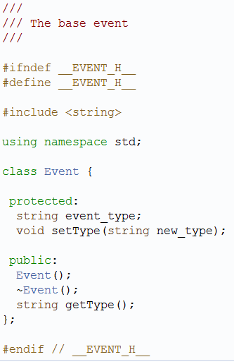
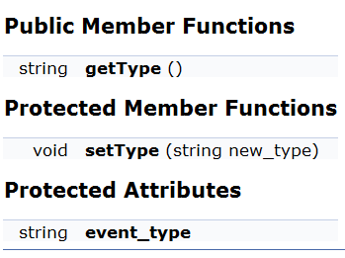
Events in Dragonfly
Engine has base class
Type is a string
  Flexible for game programmer to define however meaningful
    e.g. NUKE_EVENT == “nuke”
  Note: using namespace std;
Event.h

Slide 89
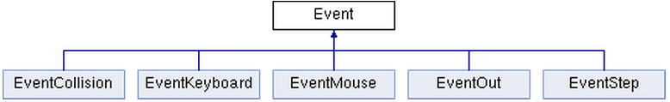
Events in Dragonfly
Specific events inherit from it
Engine defines a few used by most games
Will define most as needed, but do EventStep now

Slide 90
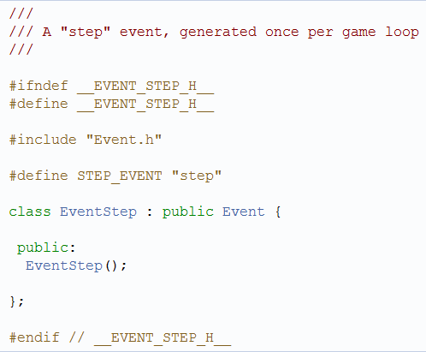
Step Event
Generated by GameManager every game loop
  Send to all (interested) game Objects
Constructor just sets type to STEP_EVENT
EventStep.h

Slide 91
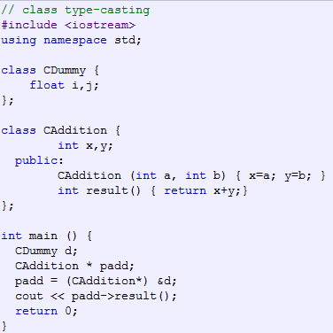
Runtime Type Casting
short a=2000; int b; b = (int) a;
Want to convert Event to EventStep
  If Event handler in game code (e.g. Saucer.cpp)
C++ strongly typed → conversion to another type needs to be made explicit
Note, can lead to run-time errors that are syntactically correct
  Objects not compatible, so
    padd->result()
  run-time error
Different modifiers to casting can help prevent errors
  We’ll just discuss static cast
dynamic_cast <new_type> (expression)
static_cast <new_type> (expression)
reinterpret_cast <new_type> (expression)
Usage: (new_type) expression
Notes:
http://www.cplusplus.com/doc/tutorial/typecasting/

Slide 92
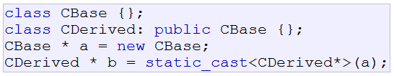
Static Cast
Conversions between related classes
  derived to base
  base to derived
In Dragonfly → Game code event handler to cast to right event object once know type
Bullet.cpp
int Bullet::eventHandler(Event *e) {
…
if (e->getType() == COLLISION_EVENT) {
EventCollision *p_collision_event =
static_cast <EventCollision *> (e);
hit(p_collision_event);
return 1;
}
…
}
Equivalent to C-style, traditional cast:
EventCollision *p_collision_event =
(EventCollision *) e;

Slide 93
Ok, What Do We Have?
Game objects
Lists of game objects
Iterators for game objects
Events
Means of passing them to game objects
→ Ready for World Manager!

Slide 94
Outline – Part II
Game Objects (done)
The Game World (done)
Events (done)
WorldManager (next)

Slide 95
Saucer Shoot
Remember this?
populateWorld() {
…
new Saucer;
…
}
Why didn’t we grab the Saucer pointer? Isn’t there a memory leak?

Slide 96
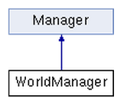
WorldManager (1 of 2)
Dragonfly Egg
Later
Manages game objects
  Insert, Remove, Move…
Provides “step” events to objects
Also manages world attributes (size, view, etc.)
Organizes drawing of objects
Provides “collision” and “outofbounds” events

Slide 97



WorldManager (2 of 2)
ObjectList getAllObjects(void)
Return a list of all game world objects
int insertObject(Object *p_o)
Add object to game world
int removeObject(Object *p_o)
Remove object from game world
void update()
Update world, sending step event to all objects
int markForDelete()
Indicate object is to be deleted at end of current game update
Return 0 if ok, else -1

Slide 98
Modifications to Game Object
Needs eventHandler →
  Virtual so derived classes can redefine
  Return 0 if ignored, else return 1
  Default is to ignore everything
Need to modify constructor
  WorldManager &game_world = WorldManager::getInstance();
  game_world.insertObject(this);
Need to modify destructor
  WorldManager &game_world = WorldManager::getInstance();
  game_world.removeObject(this);
Remember in Saucer Shoot?
  new Saucer; // without grabbing return value
  → Now you know how

Slide 99
Need for Deferred Deletion
Each step of game loop, iterate over all objects → send “step” event
An object may be tempted to delete itself or another
  e.g. when a collision occurs
  e.g. after a fixed amount of time
But may be in the middle of iteration! Other object may still act on same event
  e.g. for collision, eventHandler() for both objects called, even if one “deletes” another
Implement deferred deletion → WorldManager::markForDelete()

Slide 100
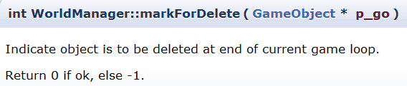

WorldManager:markForDelete
// object might already have been marked, so only add once
create GameObjectListIterator i(&del)
i.first()
while not i.isDone()
if i.currentObj() == p_go then // object already in list
return 0
i.next()
end while
del.insert(p_go)
And modify WorldManager::update()

Slide 101
WorldManager:update
// Send “step” event
create EventStep s
onEvent (&s)
// Delete all marked objects
create GameObjectListIterator i(&del)
i.first()
while not i.isDone()
delete i.currentObj()// Remember, object destructor
// calls world_manager:removeObject()
i.next()
end while
del.clear() // Clear list for next step

Slide 102
WorldManager:update → Pseudo code
Create EventStep
Create ObjectListIterator on updates list
Set iterator to first Object from updates
While not done
  Get current Object
  Call eventHandler for Object with EventStep
  Set iterator to next Object from updates
End of while

Slide 103

Ready for Dragonfly Egg!
Start GameManager
  Starts LogManager
  Starts WorldManager
Populate world
  Create some game objects (derive from base class)
    Will add themselves to WorldManager in constructor
  Can set object positions
Run GameManager
  Will run game loop with controlled timing
  Each iteration, call WorldManager to update
WorldManager update will iterate through objects
  Send step event to each
Objects should handle step event
  Perhaps change position
Should be able to shutdown
  GameManager.setGameOver()
Gracefully shutdown Managers
All of this “observable” from log file (“dragonfly.log”)
Construct game code that shows all this working
  Include as part of your project
Make sure you test thoroughly!
  Foundational code for rest of engine
Complete by Tuesday
  Additional features coming

Slide 104
Outline – Part III
Filtering Events (next)
Managing Graphics
Managing Input
Moving Objects
Misc

Slide 105
Only Getting Some Events
Currently, all game objects get step event
  Some objects may not need updating each step (e.g. Hero from SaucerShoot for firing rate, Explosion for time-to-live
Generally, not all objects want all events
    E.g. Saucer, Star, Bullet
Unwanted events can be ignored, but inefficient
How to fix?

Slide 106
Indicating Interest in Events
Game objects can indicate interest in specific event type
  E.g. want “step” events or “keyboard” events
  Even user-defined events, e.g. “nuke” events
Game objects register with Manager that handles that event
  E.g. InputManager for keyboard, WorldManager for step
  Manager keeps list of such objects (GameObjectList)
When event occurs, Manager calls eventHandler() on only those objects that are interested
When object no longer interested, unregister interest
  Important! Otherwise, will “get” event, even if deleted
    Remember, GameObjectLists have pointers to objects!

Slide 107
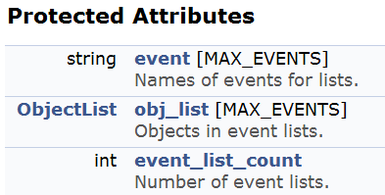
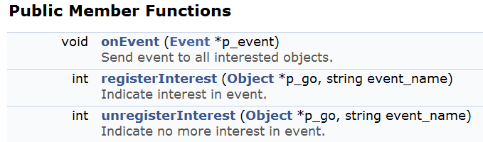
Interest Management in Manager
Need to store event
  string, since that is event type
Can be more than one event
(users could define many)
  Need a list of events
  Not needed by game code so simple array
Modify constructor to initialize
Register to add, unregister to remove

Slide 108
Manager:registerInterest → Pseudo code
int Manager::registerInterest(Object *p_o, string event_name);
// Check if previously added
  for i = 0 to event_list_count
    if event[i] == event_name
      Insert object into list
// Otherwise, this is a new event
Make sure not full (i.e. event_list_count < MAX)
event[event_list_count] ← event_name
Insert object into list
Increment event_list_count

Slide 109
Other Manager Functions
Manager::unregister() interest similar
Manager::onEvent()
  Move code from update loop in WorldManager to Manager::onEvent()
  WorldManager.update() would then call onEvent(), passing it a pointer to a “step” event
virtual bool Manager::isValid(string event_name)
  Manager should check isValid() in registerInterest() before adding
  Checks if event is allowed by the manager (base class always “true”)
  Virtual, so can be overwritten by child classes
  All Managers inherit this interface, so can use for other Managers
    E.g. will use for “keyboard” (InputManager)

Slide 110
Extend Object to Register Interest
Keeps track of what events registered for
Programmer does not need to
  Know what manager does what
  Does not need to unregister
However, programmer still can for flexibility

Slide 111
Extensions to Object

Slide 112
Outline – Part III
Filtering Events (done)
Managing Graphics (next)
  Curses
  GraphicsManager
Managing Input
Moving Objects
Misc

Slide 113
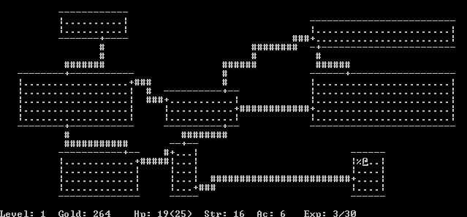
Curses History
Originally, BSD release, then AT&T System V, done 1990’s
NCurses - freeware clone of curses, still maintained
PDCurses - public domain for Windows, still maintained
Rogue a popular curses game
  Favorite on college computer systems, in 1980’s
  Spawned “dungeon crawler” trope, influenced games such as Diablo

Slide 114
Text-based Graphics with Curses
Cursor control involves raw terminal codes to draw/display characters anywhere on visible display
  Can become complicated, quickly
Curses is library of wrappers for these codes
  (Curses – a pun on “cursor control”)
Functionality
  Manipulate cursor placement
  Create windows
  Produce colors
  …
More than needed for Dragonfly → We’ll learn just what is needed for a game engine

Slide 115
Enabling Curses
Header:
#include <curses.h>
(or <ncurses/curses.h> in Cygwin, hence
-DCYGWIN flag in Makefile)
Linker:
-lncurses
WINDOW is structure defined for image routines
  Functions pass pointers to such structures
Can draw on it, but not “real” window
  To make display relevant, use: wrefresh()

Slide 116
Defined in Curses
int LINES – number of lines in terminal
int COLS – number of columns in terminal
ERR – returned by most routines on error (-1)
OK – value returned by most routines on success
Colors: COLOR_BLACK, COLOR_RED, COLOR_GREEN, COLOR_YELLOW, COLOR_BLUE, COLOR_MAGENTA, COLOR_CYAN, COLOR_WHITE

Slide 117
Starting Up
Setup curses - initscr();
  Allocate space for curses data structures
  Determine terminal characteristics
  Clear screen
  Returns pointer to default window
  Typically, very first curses instruction
Note, for shut down (restore terminal to default)
endwin();
Create a full-sized window
WINDOW *window = newwin(0,0,0,0);
Leave cursor where it ends
leaveok(window, TRUE);

Slide 118
Using Curses
Get terminal size
getmaxyx(stdscr, max_y, max_x);
  (Note! a macro, so don’t need &max_y, &max_x)
  (Note! curses has y-values before x-values!)
Make characters bold
wattron(window, A_BOLD);
Note, could set window foreground and background colors with
assume_default_colors(fg, bg)
  Default for color terminal is WHITE on BLACK

Slide 119
Life is Better with Color
Check for color
if (has_colors() == TRUE)
Then enable color
start_color();
Set pairs via: init_pair(num, fg, bg)
  Num is 1+
E.g.
init_pair(COLOR_RED, COLOR_RED, COLOR_BLACK);
init_pair(COLOR_GREEN,COLOR_GREEN, COLOR_BLACK);
…

Slide 120
Drawing with Curses
Note! All curses functions use (y, x) as coordinates
Draw single character
mvwaddch(window, y, x, char)
Draw string
mvwaddstr(window, y, x, char *)
If color, turn on color pair:
wattron(window, COLOR_PAIR(num))
Then, turn off
wattroff(window, COLOR_PAIR(num))
Clearing the screen
werase(window)

Slide 121
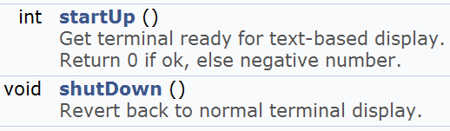
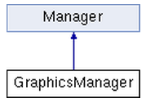
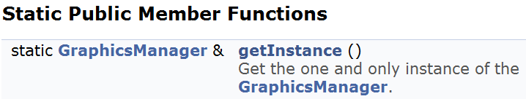
Managing Graphics
Ok, have enough curses for a game engine
  Time for the GraphicsManager!
Inherit from Manager
Singleton

Slide 122
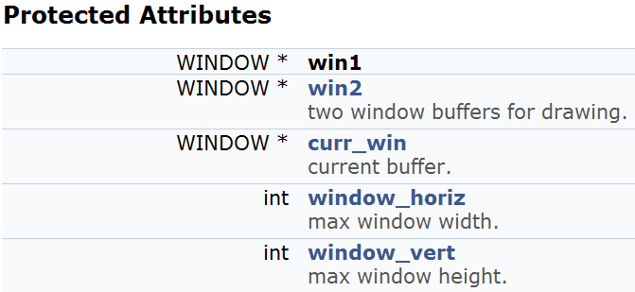
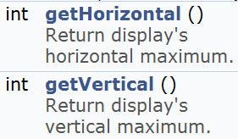

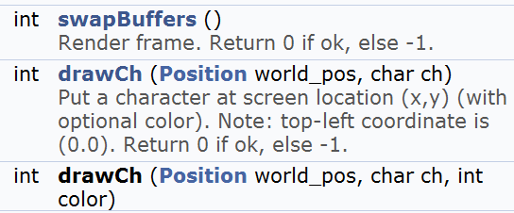
GraphicsManager

Slide 123
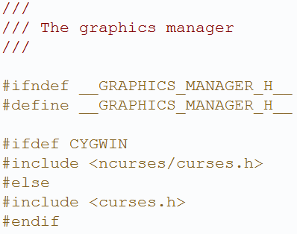

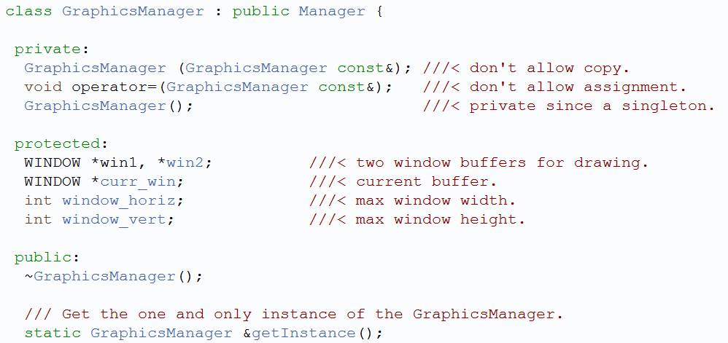
GraphicsManager.h

Slide 124
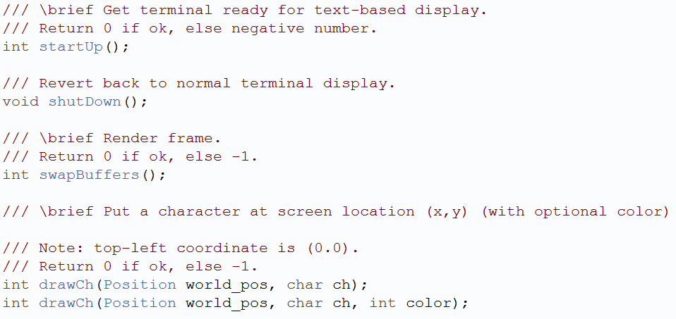
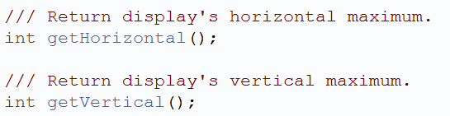
GraphicsManager.h

Slide 125
GraphicsManager:startUp
Initialize curses
Get maximum terminal window size
Create two windows:
  One for current buffer being displayed
  The other for next buffer being drawn
Create third window pointer that switches between the two, representing current window
Let cursor remain where it is (cursor not really used for most games) (note, will “turn off” cursor in InputManager)
If terminal supports color
  Enable colors
  Setup color pairs
Make all characters bold (just looks better)
shutDown() → Just needs to clean up curses

Slide 126
GraphicsManager:drawCh
Enable color using wattron()
  Note, may want to #define COLOR_DEFAULT
Draw character, using mvwaddch()
Turn off color using wattroff()
Note, later will make drawFrame() for Sprite frame, but that will still call drawCh()
Could make drawStr() and drawNum() functions, if needed

Slide 127
GraphicsManager:swapBuffers
Want to render current buffer, clear previous buffer to prepare for drawing
wrefresh() for current window
Clear other window
Set current window to other window
(Note, for this and other functions, should error check and log appropriately!)

Slide 128
Using the GraphicsManager (1 of 2)
Add draw method to GameObject
  virtual void draw()
  Does nothing in base class, but game code can override
Add draw() method to WorldManager
  get iterator for list of game objects
  while (not done iterating)
  get current game object
  current game object → draw()
  increment iterator
void Star::draw() {
GraphicsManager &graph_mgr = GraphicsManager::getInstance();
graph_mgr.drawCh(pos, STAR_CHAR);
}
Example

Slide 129
Using the GraphicsManager (2 of 2)
Modify GameManager, game loop
  Call WorldManager.draw()
  Call to GraphicsManager.swapBuffers() at end of game loop
Later, will add support for Sprites

Slide 130
Outline – Part III
Filtering Events (done)
Managing Graphics (done)
Managing Input (next)
  Overview
  Curses for Input
  InputManager
  Input Events
Moving Objects
Misc

Slide 131
The Need to Manage Input
Game could poll device directly. E.g. see if press “space” then perform “jump”
Positives
  Simple (I’ve done this myself for many games)
Drawbacks
  Device dependent. If device swapped (e.g. for joystick), game won’t work.
  If mapping changes (e.g. “space” becomes “fire”), game must be recompiled
  If duplicate mapping (e.g. “left-mouse” also “jump”), must duplicate code
Role of Game Engine is to avoid such drawbacks, specifically in the InputManager

Slide 132
Input Workflow
User provides input via device (e.g. button press)
Engine detects input has occurred
  Determines whether to process at all (e.g. perhaps not during a cut-scene)
If input is to be processed, decode data from device
Encode into abstract, device-independent form suitable for game

Slide 133
Input Map
Game engine exposes all forms of input
Game code maps input to specific game action
When game code gets specific input, looks in input map for action it corresponds to
  If none, ignore
  If action, invoke particular action
User can redefine controls on-the-fly
Walk forward Keypress W, Keypress UP, Mouse wheel up
Walk backward Keypress S, Keypress DN, Mouse wheel down
Turn left Keypress A, Keypress LF, or Mouse scroll left
Turn right Keypress D, Keypress RT, or Mouse scroll right
Fire weapon Keypress SPACE, Mouse left-click

Slide 134
Managing Input
Must receive from device (see Workflow above)
Must notify objects (provide action)
Manager must “understand” low level details of device to produce meaningful Event
Event must include enough details specific for device
  e.g. keyboard needs key value pressed
  e.g. mouse needs location, button action

Slide 135
Checking startUp Status
  Note, curses needs to be initialized before InputManager can start
    → New startUp dependency order for Dragonfly
    LogManager
    GraphicsManager
    InputManager
  Build means of checking start up status in Manager
  Protected Attribute
    bool is_started (set to false in constructor)
  Once startUp() successfully called, set to true
  Method to query
    bool isStarted()

Slide 136
Curses for Game-Type Input (1 of 2)
Curses needs to be initialized
Note: Use stdscr for window to get default window, affects all
Normal terminal input buffers until \n or \r, so disable.
cbreak();
nodelay(window, TRUE);
Disable newline so can detect “enter” key
nonl();
Turn off the cursor
curs_set(0);
Disable character echo:
    noecho();
Enable mouse events – setup mask
mmask_t_ mask = BUTTON1_CLICKED | BUTTON3_CLICKED;
mousemask(mask, NULL)
Enable keypad
keypad(window, TRUE);

Slide 137
Curses for Game-Type Input (2 of 2)
To get character (non-blocking)
int c = getch()
If not ERR, then a valid char
Check if mouse
MEVENT m_event;
if (c==KEY_MOUSE) and (getmouse(&m_event) == OK) {
if (m_event.bstate & BUTTON1_CLICKED) {
x = m_event.x
y = m_event.y
…
  Note! Mouse must have click, too, to get (does not return for mouse movement only)
Else keyboard (c has value)

Slide 138
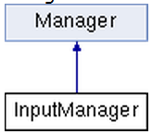
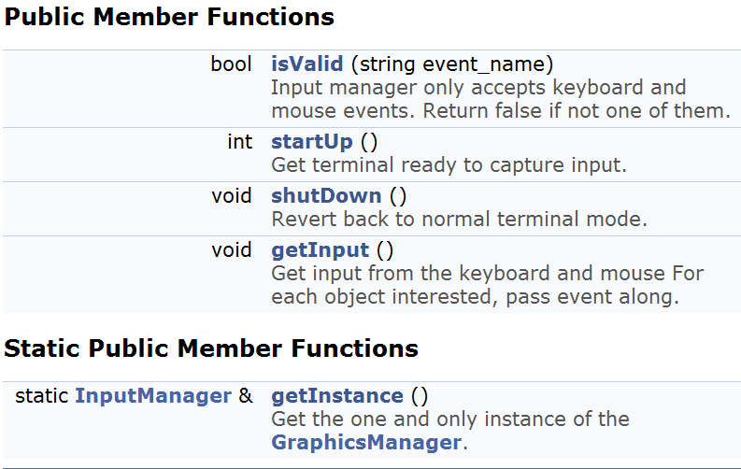
InputManager

Slide 139
InputManager:startUp
Check that GraphicsManager is started
  If not, return error code
Enable keypad
Disable line buffering
Turn off newline on output
Disable character echo
Turn off cursor
Set no delay
Enable mouse events
Set is_started to true

Slide 140
InputManager:ShutDown
Turn on cursor
Note: assume InputManager shuts down before GraphicsManager, so InputManager doesn’t call endwin()
Set is_started to false

Slide 141
InputManager:getInput
Get character (note, not continuous mouse input)
Check if mouse
  If so, check if valid mouse action
    If so, then create EventMouse (x, y and action)
    Send EventMouse to interested objs (onEvent())
  Else ignore
Else (is keyboard)
  Create EventKeyboard (character)
  Send EventKeyboard to interested objs (onEvent())

Slide 142
InputManager:isValid
InputManager only handles some events
  Object can’t register for, say, user-defined events from InputManager
  For some engines, Input manager may not handle mouse events
(Remember, isValid() called by Manager before allowing registerInterest())
For return of isValid(string event_name):
  Check if event_name is known (KEYBOARD_EVENT or MOUSE_EVENT)
    → Return true
  Else
    → Return false

Slide 143
Using the InputManager
Modify game loop in GameManger to get input
Game Objects will need to register for interest
  Example:
Need to create Events that can be passed to interested game Objects
  EventKeyboard
  EventMouse
// Get input
InputManager &input_manager = InputManager::getInstance();
input_manager.getInput();
registerInterest(KEYBOARD_EVENT);

Slide 144
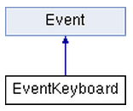
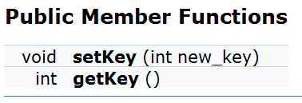
EventKeyboard
Inherited from base Event

Slide 145
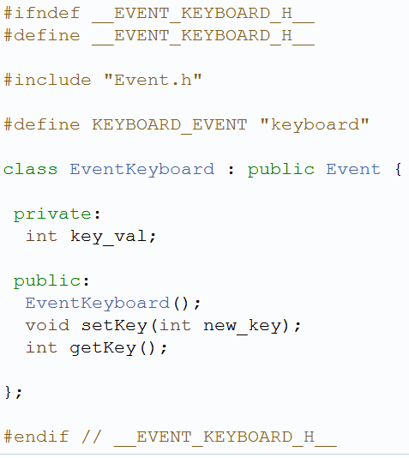
EventKeyboard.h

Slide 146
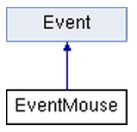
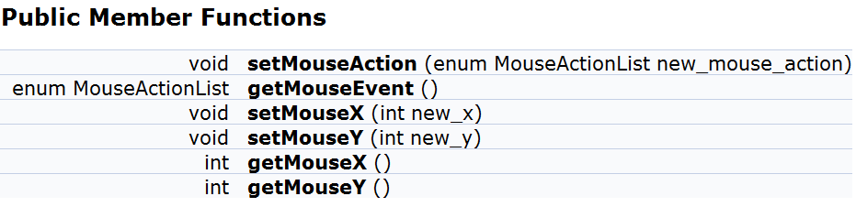
EventMouse
Inherited from base Event
Define mouse actions
enum MouseActionList {
LEFT_BUTTON_CLICK,
RIGHT_BUTTON_CLICK,
UNDEFINED
};

Slide 147
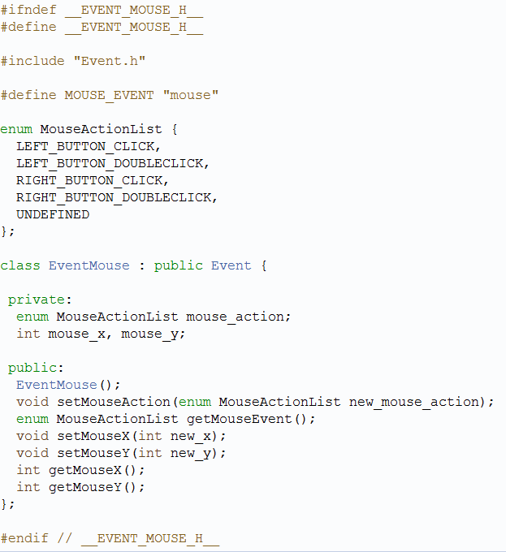
EventMouse.h
enum MouseActionList {
LEFT_BUTTON_CLICK,
RIGHT_BUTTON_CLICK,
UNDEFINED
};

Slide 148
Extend Object to registerInterest()
Recognize keyboard event → register with InputManager
Recognize mouse event → register with InputManager

Slide 149
Outline – Part III
Filtering Events (done)
Managing Graphics (done)
Managing Input (done)
Moving Objects (next)
  Velocity
  Collisions
  World boundaries
Misc

Slide 150
Velocity
Up to now, need to update
movement/location
in game code
→ every step
Instead, have Engine do work → Automatically update object positions based on velocity: direction and speed
In Saucer::move():
…
move_countdown--;
if (move_countdown > 0)
return;
move_countdown = move_slowdown;
…

Slide 151
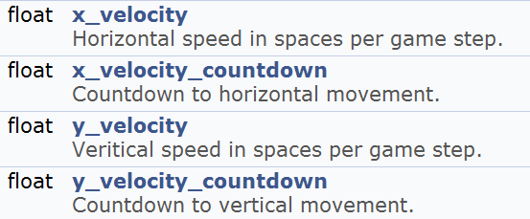

Extend Object
Protected Attributes
Methods

Slide 152
Object:getXVelocityStep
// see if there is an x-velocity
if (!x_velocity)
return 0
// see if time to move
x_velocity_countdown--
if (x_velocity_countdown > 0)
return 0
// ok, time to move, so figure out how far
int step = 0
do {
x_velocity_countdown += fabs(1/x_velocity)
(x_velocity < 0) ? step-- : step++
} while (x_velocity_countdown <= 0)
return step
(And do same for y-velocity)

Slide 153
Update WorldManager:update
After onEvent(“step”)
// Update object positions based on their velocities
ObjectListIterator i(&updates)
// iterate through all objects
Object *p_o = i.currentObj()
x = p_o->getXVelocityStep() // see how far moved x
y = p_o->getYVelocityStep() // see how far moved y
if did move → Position new_pos(
p_o->getPosition().getX() + x,
p_o->getPosition().getY() + y)
moveObject() to new_pos
// end iterate

Slide 154
Using Velocity - Example
In Saucer.cpp:
// set movement in horizontal direction
setXVelocity(-0.25); // 1 space left every 4 frames
No need to handle “step” event
No need for move_slowdown, move_countdown
(Future work could extend to acceleration)

Slide 155
Outline – Part III
Filtering Events (done)
Managing Graphics (done)
Managing Input (done)
Moving Objects (next)
  Velocity
  Collisions
  World boundaries
Misc

Slide 156
Saucer Shoot
\
~==-
/
____
/__o_\
(For this example, assume objects are 1 square)
A Bullet is at (12, 10)
A Saucer is at (13, 10)
During the next step (game loop iteration), is there a collision?
If no, when will there be a collision?
If yes, how many collision events does the Bullet get? How many does the Saucer get?

Slide 157
Collision Detection
Determining objects collide not as easy as it seems
  Geometry can be complex (beyond squares or spheres)
  Objects can move fast
  Can be many objects (say, n)
    Naïve solution O(n²) time complexity → every object can potentially collide with every other
Two basic techniques
  Overlap testing
    Detects whether a collision has already occurred
  Intersection testing
    Predicts whether a collision will occur in the future
Notes:
Rabin, Introduction to Game Development, Ch 4.2, 1st edition

Slide 158
Overlap Testing
Most common technique used in games
  Relatively easy (conceptually and in code)
  But may exhibit more error than intersection testing
Concept
  Every step, test every pair of objects to see if volumes overlap. If yes → collision!
  Report event occurred to both objects
  Easy for simple volumes like spheres, harder for polygonal models
What else to report?
  Collision time – when did the collision take place
  Collision normal vector (needed for physics actions)

Slide 159
Overlap Testing: Collision Time
Collision time calculated by moving object back in time until right before collision
  Move forward or backward ½ step, called bisection
Get within a delta (close enough)
  Can use distance moved in first step, to help “how close”
In many cases, usually 5 iterations is pretty close
Q: when might overlap testing fail?

Slide 160
Overlap Testing: Limitations
Fails with objects that move too fast (relative to size)
Possible solutions
Game design constraint on speed of objects (e.g. fastest object moves smaller distance (per step) than thinnest object)
  May not be practical for all games
Reduce game loop step size
  Adds overhead since more computation
  Or, could have different step size for different objects (more complex)

Slide 161
Intersection Testing
Predict collisions
Extrude geometry in direction of movement
  E.g. swept sphere turns into a “capsule” shape
Then, see if overlap
When predicted:
  Move simulation to time of collision
  Resolve collision (e.g. send collision event to objects)
  Simulate remaining time step

Slide 162
Dealing with Complexity
Complex geometry must be simplified
  Complex 3D object can have 100’s or 1000’s of polygons
  Testing intersection of each costly
Reduce number of object pair tests
  There can be 100’s or 1000’s of objects
  Remember, if test all, O(n²) time complexity

Slide 163
Complex Geometry: Bounding Volume
(1 of 3)
Bounding volume is simple geometric shape that approximates object
  E.g. approximate spikey object with ellipsoid
Note, does not need to encompass, but might mean some contact not detected
  May be ok for some games

Slide 164
Complex Geometry: Bounding Volume
(2 of 3)
Testing cheaper
  If no intersection with bounding volume → no more testing required
  If is intersection, then could be collision → more refined testing next
Commonly used bounding volumes
  Sphere – if distance between centers less than sum of Radii then no collision
  Box – axis-aligned (lose fit) or oriented (tighter fit)

Slide 165
Complex Geometry: Bounding Volume
(3 of 3)
For complex object, can fit several bounding volumes around unique parts
  e.g. For avatar, boxes around torso and limbs, sphere around head
Can use hierarchical bounding volume
  e.g. large sphere around whole avatar
    If intersect, refine with more refined bounding boxes

Slide 166
Complex Geometry: Minkowski Sum
(1 of 2)
Take sum of two convex volumes to create new volume
  Sweep origin (center) of X all over Y

Slide 167
Complex Geometry: Minkowski Sum
(2 of 2)
Test if single point in X in new volume, then collide
  Take center of sphere at t₀ to center at t₁
  If line intersects new volume, then collision

Slide 168
Reduced Collision Tests: Partitioning
Partition space so only test objects in same cell
  If N objects, then sqrt(N) x sqrt(N) cells to get linear complexity
But what if objects don’t align nicely?
  What if all objects in same cell? (same as no cells)

Slide 169
Reduced Collision Tests: Plane Sweep
Many objects tend to stay in same place
  So, don’t need to test all pairs
Record bounds of objects along axes
Any objects with overlap on all axes should be tested further
Time consuming part is sorting bounds
  Quicksort O(nlog(n))
  But, since objects don’t move, can do better if use Bubblesort to repair after move → about O(n)

Slide 170
Collision Resolution (1 of 2)
Once detected, must take action to resolve
  But effects on trajectories and objects can differ
e.g. Two billiard balls collide
  Calculate ball positions at time of impact
  Impart new velocities on balls
  Play “clinking” sound effect
e.g. Rocket slams into wall
  Rocket disappears
  Explosion spawned and explosion sound effect
  Wall charred and area damage inflicted on nearby characters
e.g. Character walks through invisible wall
  Magical sound effect triggered
  No trajectories or velocities affected

Slide 171
Collision Resolution (2 of 2)
Prologue
  Collision known to have occurred
  Check if collision should be ignored
  Else other events might be triggered
    Send collision notification messages
Collision
  Place objects at point of impact
  Assign new velocities
    Using physics or some other decision logic
Epilog
  Propagate post-collision effects
  Possible effects
    Destroy one or both objects
    Play sound effect
    Inflict damage
Many effects (e.g. sound) can be either in pro- or epilogue

Slide 172
Collision Detection Summary
Test via overlap or intersection (prediction)
Control complexity
  Shape with bounding volume
  Number with cells or sweeping
When collision: prolog, collision, epilog

Slide 173
Collisions in Dragonfly
Detection
Resolution
Overlap testing
Dragonfly Naiad has single “point” objects
  Collision between objects means they occupy the same space
Dragonfly simplifies geometry with bounding box
  Collision means boxes overlap, no refinement
Detection only when moving object
  Note: alternative could have objects move themselves, then would test all objects
Disallow move
  Object stays in original location
  Extend Object
  is_solid attribute
  Create EventCollision
  Extend WorldManager
  isCollision() method
  moveObj() method

Slide 174
Collidable Entities
Not all objects are collidable entities
  e.g. HUD elements (player menus, scores)
  e.g. Stars (in Project 1)
Add notion of “solidness”
  Collisions only occur between solid objects
An object that is solid automatically is “interested” in collisions
  Alternative design would have objects register for interest in collisions
Solid objects that are HARD cannot occupy the same space, while solid objects that are SOFT can (but still collide)
Extend Object to support solidness
  HARD, SOFT, SPECTRAL (not solid)

Slide 175


Extend Object
enum Solidness {
HARD, // objects cause collisions and impede
SOFT, // objects cause collisions, don’t impede
SPECTRAL// objects don’t cause collisions
};
(Can define in “Object.h”)
Set to HARD in constructor (default)
Next, create a collision event → EventCollision

Slide 176



EventCollision
Note, says “GameObject” but you may just have “Object”

Slide 177

Collision.h

Slide 178
Extend WorldManager
New Methods
positionsIntersect() – see if two positions intersect
  Can replace with boxIntersectsBox() later
isCollision() – detect collision at position
  returns list of all solid (HARD or SOFT) game objects that collide with
moveObject() – if no collision, move an object
  return if allowed

Slide 179
WorldManager:positionsIntersect
bool positionsIntersect(
Position p1,
Position p2)
if p1.getX() == p2.getX() and
p1.getY() == p2.getY() then
return true
else
return false
end if

Slide 180

WorldManager:isCollision
ObjectList collision_list // make empty list
GameObjectListIterator i over all GameObjects
while not i.done()
GameObject *p_temp_go = i.currentObj()
if (p_temp_go != p_go) then // don’t consider self
if (positionsIntersect(p_temp_go -> getPos(), where) then
if (p_temp_go -> isSolid()) then
add p_temp_go to collision_list
end if
end if
end if
i.next()
end while
return collision_list

Slide 181
WorldManager:moveObject
If no collision with solid, move ok else don't move object. If p_go is Spectral, move ok. Return 0 if move ok, else -1 if collision with solid.
if p_go->isSolid() then // need to be solid for collisions
GameObject *p_temp_go;
ObjectList list = isCollision(p_go, where) // collide? Empty if not
if !list.isEmpty() then
// iterate over list
EventCollision c (p_go, p_temp_go, where) // create event
p_go -> eventHandler (&c) // send to obj
p_temp_go -> eventHanlder (&c) // send to other obj
if p_go HARD and p_temp_go HARD then do_move = false
// end iterate over list
if do_move is false then return -1 // move not allowed
end if
end if // isSolid()
p_go -> setPos(where) // if here, no collision so allow move
return 0 // move was ok

Slide 182
Outline – Part III
Filtering Events (done)
Managing Graphics (done)
Managing Input (done)
Moving Objects (next)
  Collisions
  World boundaries
Misc

Slide 183
World Boundaries
Generally, game objects expected to stay within world
  May be “off screen” but still within game world
Object that was inside game world boundary that moves out receives “outofbounds” event
  Move still allowed
  Objects can ignore event
Create “out of bounds” event → EventOut

Slide 184



EventOut
Inherit from base Event class

Slide 185
Generating “Out of Bounds” Events
Get boundary of screen with queries
  Note: in Part 3, will have View and Boundary in WorldManager. For Part 2, use GraphicsManager:
  GraphicsManager::getHorizontal()
  GraphicsManager::getVertical()
Modify WorldManager::moveObject()
  Put after move is allowed
  If object inside boundary then moves outside → send “out of bounds” event
EventOut ov;
p_go -> eventHanlder(&ov);
Note, only want to send once!
  If stays outside and moves, no additional events

Slide 186
Outline – Part III
Filtering Events (done)
Managing Graphics (done)
Managing Input (done)
Moving Objects (done)
Misc (next)
  Layers

Slide 187
Drawing in Layers
Up to now, no easy way to make sure one object drawn before another
  e.g. If tried Saucer Shoot, Star may be on top of Hero
Provide means to control levels of object’s display order → Altitude
Draw “low altitude” objects before higher altitude objects
  Higher altitude objects in same location will overwrite lower ones before screen refresh
Is this a 3rd dimension? Not really since all in same plane for collisions

Slide 188


Implementing Altitude in Dragonfly
Provide “altitude” attribute for game Object
  Default to “middle”
Provide MAX_ALITITUDE 4 in WorldManager.h
In WorldManager::draw(), add outer loop around drawing all objects
for alt from 0 to MAX_ALTITUDE
// normal iteration through all objects
if (p_temp_go -> getAltitude() == alt)
// draw
Q: What is the “cost” of doing altitude? – Can fix later

Slide 189
Outline – Part III
Filtering Events (done)
Managing Graphics (done)
Managing Input (done)
Moving Objects (done)
Misc (next)
  Layers

Slide 190
Ready for Dragonfly Naiad!
Objects register for interest in events (e.g. “step”)
Objects can draw themselves
  2D graphics in color
Interested objects can get input from keyboard, mouse
Engine moves Objects → velocity
Objects that move off world get “out of bounds” event
Objects have solidness
  Soft, hard, spectral
Objects that collide get collision event
  Can react accordingly
  Non-solid objects don’t get
Safe removal of objects at end of world update
Objects can appear higher/lower than others
  5 layers
Can be used to make a game!
E.g. Consider Saucer Shoot without sprites

Slide 191
Outline – Part IV
Resource Management (next)
  Offline (tool chain)
  Online (runtime)
  ResourceManager
Using Sprites
Bounding Boxes
Camera Control
View Objects
Misc

Slide 192
Managing Resources
Games have wide variety of resources
  Often called assets or media
  E.g. meshes, textures, shader programs, animations, audio clips, level layouts, dialog snippets …
→ Resource Management
Sometimes, single subsystem handles all formats
Other times, disparate collection of subsystems
  Different authors, time periods
  Different developers, functionality
Offline – tools to create, store and archive during game creation
Online – loading, unloading, manipulation when game is running
Notes:
Gregory, Game Engine Architecture, Chapter 6

Slide 193


Off-line Resource Management
Revision control for assets
  Small project → simple files stored and shared
  But larger, usually 3D, project needs structure
Tools help control → Resource Database (e.g. Perforce)
  May have customized wrappers/plugins to remove burden from artists

Slide 194
Resource Database
Need: create, delete and inspect resources
Move from one location to another (e.g. to different artists/developers as needed)
Cross-reference other resource (e.g. mesh/animations used by a level)
Retain integrity (add/delete) and revisions (who made change, why)
Searching and querying

Slide 195

Dealing with Data Size
C++ code small, relative to impact size
Art assets can be large
  Copies to/from server can be expensive (delay)
Deal with it (inefficient), or only have access to assets of need (limited vision)
Art-specific tools (e.g. Alienbrain)

Slide 196
Asset Conditioning (Tool Chain)
Most assets need to be modified/conditioned to get into game engine
Means to do that varies across game dev projects
  e.g. could embed format conversion notes in header files, versus stand-alone script for each file
Exporters – take out of native format (e.g. Maya) via plugin (often custom)
Resource compilers – re-arrange format (e.g. “massage” mesh triangles into strips, or compress bitmap)
Resource linkers – compile into single, large source (e.g. mesh files with skeleton and animations)
Dependencies may matter (e.g. build skeleton before process animation) , so tool needs to support

Slide 197
Outline – Part IV
Resource Management
  Offline (tool chain) (done)
  Online (runtime) (next)
  ResourceManager
Using Sprites
Bounding Boxes
Camera Control
View Objects
Misc

Slide 198
Runtime Resource Management
One copy of each resource in memory
  Manage memory resources
Manage lifetime (remove if not needed)
Handle composite resources
  E.g. 3d model with mesh, skeleton, animations…
Custom processing after loading (if needed)
Provide single, unified interface which other engine components can access
Handle streaming (asynchronous loading) if engine supports

Slide 199
Runtime Resource Management
“Understand” format of data
  E.g. PNG or Text-sprite file
Globally-unique identifier
  So assets can be accessed by objects
Usually load when needed (but sometimes in advance)
Removing hard (when done?)
  E.g. some models used in multiple levels
→ Can use reference count
  E.g. load level and all models with count for each. As level exits, decrease reference count. When 0, remove

Slide 200
Resource Management in Dragonfly
Only assets are sprites
  Text-based files
No offline management tools
  Such tool could help build, then save in right format
Runtime, must understand format and load
Need data structures (classes) for
  Frames (dimensions and data)
  Sprites (identifiers and frames)
Then, ResourceManager

Slide 201
Frames
____
/__o_\
Text
Variable sizes
  Rectangular
Note, in Dragonfly, frames don’t have color (nor do individual characters)
  But could be extended to support
.**
**.**
*.*
_____ _____ __ __
/ ___/____ ___ __________ _____ / ___// /_ ____ ____ / /_
\__ \/ __ `/ / / / ___/ _ \/ ___/ \__ \/ __ \/ __ \/ __ \/ __/
___/ / /_/ / /_/ / /__/ __/ / ___/ / / / / /_/ / /_/ / /_
/____/\__,_/\__,_/\___/\___/_/ /____/_/ /_/\____/\____/\__/
Arrow keys to move, Spacebar to fire, Enter for one nuke
\
~==-
/

Slide 202


Frame

Slide 203

Frame.h

Slide 204
Sprite
____
/____\
____
/___o\
____
/__o_\
____
/_o__\
____
/o___\
Sequence of Frames
In Dragonfly, Sprites have color
Note, Sprites are just repository for data
  Don’t know how to “draw” themselves
  Nor even what display rate is
  (That functionality with game Objects)
Need dimensions, number of frames, and ability to add/retrieve frames
\
~==-
/
\
==-
/

Slide 205



Sprite Class

Slide 206

Sprite.h
Need to understand Frames

Slide 207
Sprite: Constructor
Sprite::Sprite(int max_frames)
(No default constructor)
Initialize
  frame_count, width, height all 0
Create (using new) array of max_frames
  Make sure to delete in destructor
Set max_frame_count to be max_frames
Set color to be COLOR_DEFAULT (defined in GraphicsManager)
Want to define sprite delimiters in header file

Slide 208
Sprite:addFrame
(Frame new_frame) as parameter
Check if full (frame_count == max_frame_count)
  If so, return error
frame[frame_count] = new_frame
Increment frame_count
(Note, frames are numbered from 0)

Slide 209
Sprite:getFrame
(int frame_number) as parameter
Make sure frame_number in bounds (not negative, not equal to frame count)
  If so, return “empty” Frame
Return frame[frame_number]

Slide 210



ResourceManager
Inherit from Manager
  startUp, shutDown
Singleton

Slide 211
Reading Sprite from File
frames 5
width 6
height 2
color green
____
/____\
end
____
/___o\
end
____
/__o_\
end
____
/_o__\
end
____
/o___\
end
eof
Typical that image file has specific format
  Header
  Body
  Closing
Parse in pieces

Slide 212

ResourceManager:loadSprite
Open file
Read header
Make new Sprite (since know frame count)
Read frames, 1 by 1
  Add to Sprite
Close file
Add label
Note, error check throughout (file format, length of line, frame count
  Report line number error in log
  Clean up resources (delete Sprite, close file) as appropriate
Write “helper” functions

Slide 213

Basic File Reading in C++
ifstream
getline() to read line at a time
  Removes ‘\n’ delimiter
good() if still data

Slide 214
ResourceManager:loadSprite –
Helper Function
// Read a single line, expect “tag num” → return num
int readLineInt(ifstream *p_file,
int *p_line_number, const char *tag)
string line
getline() into line // error check: p_file->good()
if not line.compare(line, tag) // right tag?
  return error
atoi() on line.substr() to get number
  (e.g. atoi(line.substr(strlen(tag)+1).c_str()))
return number
(Can also make readLineStr() for color field)

Slide 215
ResourceManager:loadSprite –
Helper Function
// Read frame (up until “end”) → return frame
Frame readFrame(ifstream *p_file,
int *p_line_number, int width, int height)
string line, frame_str
For j from 1 to height
getline() into line // error check
If line width > width, return error (“empty” Frame)
frame_str += line
End for
getline() into line, check if “end” else return error
Create Frame (width, height, frame_str)
Return Frame

Slide 216
ResourceManager:loadSprite –
Helper Function
getline() removes newline delimiter (‘\n’)
Text file on Windows will still have carriage return (‘\r’)
  Will always be at the end
void discardCR(string &str)
If str[str.size() – 1] is ‘\r’
str.erase(str.size() - 1)
Call this with every line since will ignore if not there

Slide 217

ResourceManager:getSprite
for i from 0 to sprite_count
if label == sprite[i] -> getLabel()
return sprite[i]
end if
end for
return NULL // Sprite not found
Example game code:
ResourceManager &rm = ResourceManager::getInstance();
rm.loadSprite("sprites/saucer-spr.txt", "saucer");

Slide 218
Outline – Part IV
Resource Management (done)
Using Sprites (next)
Bounding Boxes
Camera Control
View Objects
Misc

Slide 219

Extend GraphicsManager
If frame is empty → return
If centered, y_offset = frame.getHeight / 2 // else 0
x_offset = frame.getWidth / 2 // else 0
string str = frame.getString // get frame data
For y from 1 to frame.getHeight // draw character by character
For x from 1 to frame.getWidth
Position temp_pos(world_pos.getX – x_offset + x,
world_pos.getY – y_offset + y)
drawCh(temp_pos, str[y * frame.getWidth + x], color)
End for x
End for y

Slide 220




Extend Object with Sprites
Add pointer to Sprite, get() and set() methods
Typically center sprite at object (x,y)

Slide 221



Object: Drawing Sprites (1 of 4)
Base class assumes Sprite for each object
  Extend draw() to draw frame, advance to next
Note, derived class can still define
  Make draw() virtual
  Can call parent draw() explicitly (Object::draw())
Since draw only 1 frame, keep track of latest

Slide 222
Object: Drawing Sprites (2 of 4)
If !p_sprite then do nothing // sprite not defined
graphics_manager.drawFrame(
position,
p_sprite->getframe(getSpriteIndex(), p_sprite->getColor())
next = p_obj -> getSpriteIndex() + 1
if next equals p_obj -> getFrameCount()
then next = 0
setSpriteIndex(next)

Slide 223


Object: Drawing Sprites (3 of 4)
Convenient for engine to slow down animation
  Alternative is to make a lot of “still” frames
  Still would be called to draw(), so expensive
Since draw() is called every game loop (step), make slowdown in units of frame time

Slide 224
Object: Drawing Sprites (4 of 4)
Add slowdown functionality to draw()
// advance sprite index, if appropriate
if getSpriteSlowdown() is 0 // means no animation
→ return
int count = getSpriteSlowdownCount()+1
if count == getSpriteSlowdown() then
setSpriteSlowdownCount(0)
else
setSpriteSlowdownCount(count)
end if

Slide 225
Outline – Part IV
Resource Management (done)
Using Sprites (done)
Bounding Boxes (next)
Camera Control
View Objects
Misc

Slide 226
Boxes
Can use boxes for several features
  Determine bounds of game object for collisions
  World boundaries
  Screen boundaries (for camera control)
Create 2d box class

Slide 227


Box

Slide 228

Box.h
Uses position

Slide 229


Extend Object “Size” to Box
Protected Attribute
Box box
Default to Sprite size
(Centered)

Slide 230
Boxes for Collisions
bool boxIntersectsBox(Box A, Box B)
Return true if boxes intersect else false
In WorldManager,
replace positionIntersect()
x-overlap
  Left of A in B? → B_{x1} <= A_{x1} <= B_{x2}
  Left of B in A? → A_{x1} <= B_{x1} <= A_{x2}
y-overlap
  Top of A in B? → B_{y1} <= A_{y1} <= B_{y2}
  Top of B in A? → A_{y1} <= B_{y1} <= A_{y2}
If (x-overlap) && (y-overlap) → return true
Otherwise, return false
Remember! In curses, we have "cells" on screen, so “width 1” would look like 2 here. So subtract 1 from horizontal and vertical

Slide 231
Utility Functions
Functions with many useful, helper functions
  Not a class (i.e. make utility.cpp, utility.h)
Prototypes:
bool valueInRange(int value, int min, int max);
  Is value between min and max?
bool boxContainsPoint(Box b, Position p);
  return true if Box contains Point
bool lineIntersectsLine(Line line1, Line line2);
  returns true if line segment line1 intersects line segment line2
bool lineIntersectsBox(Line line, Box b);
  return true if line segment intersects Box
bool circleIntersectsBox(Box box1, Box box2);
  return true if Circle intersects or contains Box
float worldDistance(Position p1, Position p2);
  return distance between any two points
Box getWorldBox(GameObject *p_go);
  convert relative bounding Box for a GameObject to absolute world Box

Slide 232
Outline – Part IV
Resource Management (done)
Using Sprites (done)
Bounding Boxes (done)
Camera Control (next)
View Objects
Misc

Slide 233
Boxes for Boundaries
World Boundary
View Boundary
Translating world coordinates to view coordinates

Slide 234


Extend/Modify WorldManager
Add world boundary limits with Box
  Used to only get screen size from GraphicsManager
Add additional Box for camera view
Methods
Attributes

Slide 235
Modify GameManager:startUp
Default world as large as window, player has a view of whole world
Position world_corner(0,0)
Box boundary(world_corner,
graphics_manager.getHorizontal()-1,
graphics_manager.getVertical()-1)
world_manager.setBoundary(boundary)
world_manager.setView(boundary)

Slide 236
Views
Game Objects have world (x,y) → need to translate to view/screen (x,y)
  In GraphicsManager before drawing on screen
(0,0)
World boundary
(10,3)
To get screen (x,y) → compute distance from origin
A → (5,7) and draw
B → (-2, 2) don’t draw
(x value too small)
C → (15, -1) don’t draw
(x value too large,
y value too small)
View boundary
C(25,2)
B(8,5)
A(15,10)

Slide 237
Utility: worldToView
Input → Position world_pos (in game world)
Output → Position view_pos (on screen)
Position corner= world_manager.getView().getCorner()
int view_x = corner.getX()
int view_y = corner.getY()
Position view_pos(world_pos.getX() - view_x, world_pos.getY() - view_y)
return view_pos

Slide 238
Modify GraphicsManager:drawCh
Get screen position from world position
Position screen_pos = worldToView(world_pos)
Then, call mvwaddch() normally but give it screen_pos instead of world_pos
Next → add condition in WorldManager to call draw() only when bounding box of object intersects view (next slide)

Slide 239
Modify WorldManager:draw
Inside “altitude” loop
// bounding box is relative to obj, so convert to world
Box box = p_temp_o -> getBox();
Position corner = box.getCorner();
corner.setX(corner.getX() + p_temp_o->getPosition().getX())
corner.setY(corner.getY() + p_temp_o->getPosition().getY())
box.setCorner(corner)
(Note: above could be utility! Box getWorldBox(Object *p_o) )
// only draw if the object would be visible
if (boxIntersectsBox(box, view)
p_temp_o -> draw()

Slide 240

Extend WorldManager
Object *p_view_following;
Allow game code to center view at specific point
Indicate object to follow (centered)

Slide 241

WorldManager:setViewPosition
// make sure horizontal not out of world boundaries
int x = view_pos.getX() – view.getHorizontal()/2;
if (x + view.getHorizontal() > boundary.Horizontal())
x = boundary.getHorizontal()–view.getHorizontal();
if (x < 0) // limit range to stay within world boundary
x = 0;
// make sure vertical not out of world boundaries
…
// set view
Position new_corner(x, y);
view.setCorner(new_corner);

Slide 242

WorldManager:setViewFollowing
// turn “off” view following by making NULL
if p_new_view_following == NULL then
p_view_following = NULL
return 0
end if
// Iterate over all objects, make sure new one legitimate
(if not found, return -1)
p_view_following = p_new_view_following
setViewPosition(p_view_following -> getPosition())
return 0

Slide 243
Modify WorldManager:moveObject
If successfully move (no collision) …
// if view is following this object,
// adjust view
if p_view_following == p_go then
setViewPosition(p_go->getPosition())
end if

Slide 244
Using Views –
An Example of Game-Code control
// Always keep the Hero centered in screen
void Hero::move(int dy) {
// move hero
Position new_pos(pos.getX(), pos.getY() + dy);
world_manager.moveObj(this, new_pos);
// adjust view
Box new_view = world_manager.getView();
Position corner = new_view.getCorner();
corner.setY(corner.getY() + dy);
new_view.setCorner(corner);
world_manager.setView(new_view);
}

Slide 245
Using Views –
An Example of Engine Control
In game.cpp, make world larger
// set world boundaries
Position corner(0,0);
Box boundary(corner, 80, 50);
world_manager.setBoundary(boundary);
In Hero.cpp constructor, set to follow Hero
world_manager.setViewFollowing(this);

Slide 246
Outline – Part IV
Resource Management (done)
Using Sprites (done)
Bounding Boxes (done)
Camera Control (done)
View Objects (next)
Misc
  Velocity
  Catching ctrl-C
  Random numbers

Slide 247
Different Object Types
“Game” objects – things that interact with each other in the game world (e.g. Saucers, Bullets, Hero)
“View” objects – things that don’t interact with game world objects and only display information to player (e.g. Score, Lives)
Create ViewObject
  Inherits from base Object class

Slide 248

View Objects (1 of 2)
// General location of ViewObject on screen
enum ViewObjectLocation {
TOP_LEFT,
TOP_CENTER,
TOP_RIGHT,
BOTTOM_LEFT,
BOTTOM_CENTER,
BOTTOM_RIGHT
};

Slide 249

ViewObjects (2 of 2)

Slide 250
ViewObject:constructor
// initialize Object attributes
setSolidness(SPECTRAL)
setAltitude(MAX_ALTITUDE)
setType("ViewObject")
// initialize ViewObject attributes
setValue(0)
setBorder(true)
setLocation(TOP_CENTER)
setColor(COLOR_DEFAULT)
// register interest in view events (EVENTVIEW)
registerInterest(VIEW_EVENT)

Slide 251
ViewObject:setLocation
// set position based on location
// if no border, shift closer to edge of screen
switch (location) {
case TOP_LEFT:
p.setXY(world_manager.getView().getHorizontal() * 1/6, 1);
getBorder() ? delta = 0 : delta = -1;
break;
case TOP_CENTER:
p.setXY(world_manager. getView().getHorizontal() * 3/6, 1);
getBorder() ? delta = 0 : delta = -1;
break;
case TOP_RIGHT:
p.setXY(world_manager.setView().getHorizontal() * 5/6, 1);
getBorder() ? delta = 0 : delta = -1;
break;
// same for bottom …
…
p.setY(p.getY() + delta); // shift, as needed, based on border
setPosition(p);

Slide 252
ViewObject:draw
// Display view_string + value
if has a border
temp_str = " "+getViewString()+" "+intToString(value)+""
else
temp_str = getViewString() + " " + intToString(value)
// Draw centered at position
Position pos = viewToWorld(getPosition());
graphics_manager.drawString(pos, temp_str, CENTER_JUSTIFIED, getColor());
if (border)
// draw box around display

Slide 253
Extend WorldManager
ViewObject could be entirely in game code, not in engine
  Provided as a convenience
One engine-specific component → WorldManager::draw()
  Always draw ViewObjects
if // Object in viewport?
boxIntersectsBox(box, view) ||
// is ViewObject?
dynamic_cast <ViewObject *> (p_temp_o)
then
p_temp_o -> draw();
end if

Slide 254


Receiving Events → EventView

Slide 255
ViewObject:eventHandler
// See if this is a "view" event
if (p_event -> getType() == VIEW_EVENT) {
EventView *p_ve = (EventView *) p_event;
// see if this event is meant for this object
if (p_ve -> getTag() == getViewString()) {
if (p_ve -> getDelta()) // a change in value
setValue(getValue() + p_ve->getValue());
else // new value
setValue(p_ve -> getValue());
return 1;
}
} else
return 0; // not handled

Slide 256

Dynamic Cast
Ensures that pointer cast is valid
Only for derived to base
Requires RTTI to keep track of dynamic types
  Sometimes off by default in compiler

Slide 257
Make Object Destructors Virtual
Since will “delete” in WorldManager (at end of via markForDelete() method update()), need to make sure right destructor is called
→ Do this with “virtual” keyword
virtual ~Object();
virtual ~ViewObject();
Otherwise, only “~Object()”called.
Note, parent destructor called automatically → don’t call explicitly!

Slide 258
Using ViewObjects → Points
#define POINTS_STRING "Points"
class Points : public ViewObject {
public: Points() { // constructor
setLocation(TOP_CENTER);
setViewString(POINTS_STRING);
setColor(COLOR_YELLOW);
}
int Points::eventHandler(Event *p_e) {
// Parent handles event if score update
if (ViewObject::eventHandler(p_e)) {return 1;}
// If step, increment score
if (p_e->getType() == STEP_EVENT) {
setValue(getValue() + 1/30th);
return 1;
}
…
};
In Saucer destructor:
// send "view" event with points to interested ViewObjects
EventView ev(POINTS_STRING, 10, true);
world_manager.onEvent(&ev);

Slide 259
Outline – Part IV
Resource Management (done)
Using Sprites (done)
Bounding Boxes (done)
Camera Control (done)
View Objects (done)
Misc (next)
  Catching ctrl-C
  Random numbers

Slide 260
The Need for Signal Handling
Control-C causes termination without notice
  Logfiles open (data not flushed), windows in uncertain state (e.g. cursor off)
Control-C → Gracefully shutdown
  Shutdown curses
  Close logfile
Linux/Unix (Cygwin) use sigaction()
Windows use SetConsoleCtrlHandler()
Semantics: interrupt current execution and go to function
  When function done, return (but can exit())

Slide 261
Modify GameManager:startUp – Unix (Cygwin, too)
#include <signal.h>
// Catch ctrl-C (SIGINT) and shutdown
struct sigaction action;
action.sa_handler = (void(*)(int)) doShutDown;
sigemptyset (&action.sa_mask);
action.sa_flags = 0; // SA_RESTART, resume // after done
sigaction (SIGINT, &action, NULL)
______________________
void doShutDown(void) → GameManager.shutdown()

Slide 262
Modify GameManager:startUp - Windows
#include <windows.h>
// Catch ctrl-C (SIGINT) and shutdown
SetConsoleCtrlHandler(doShutDown, TRUE);
_________________________________
BOOL WINAPI doShutDown(DWORD ctrl_type) {
if (ctrl_type == CTRL_C_EVENT) {
game_manager.shutDown();
return TRUE;
}
}
Also: CTRL_CLOSE_EVENT (program being closed), CTRL_LOGOFF_EVENT (user is logging off), CTRL_SHUTDOWN_EVENT (system shutdown)

Slide 263
Outline – Part IV
Resource Management (done)
Using Sprites (done)
Bounding Boxes (done)
Camera Control (done)
Misc (next)
  Catching ctrl-C
  Random numbers

Slide 264
Random Numbers and Games
Many games make heavy use of random numbers
  Adds non-determinism to opponent choices, starting locations, etc.
True randomness difficult for computers (can’t “roll dice”)
  Instead, psuedo-random → deterministic, but “looks” random to external tests
Want function that produces psuedo-random sequence
E.g. x_{n} = 5x_{n-1} + 1 mod 16
Say, x₀ = 5 → x₁ = 5(5) + 1 mod 16 = 26 mod 16 = 10
Sequence: 10, 3, 0, 1, 6, 15, 12, 13, 2, 11, 8, 9, 14 …
Hard to figure out what is next → Looks pretty random!
  And could start with different x₀ (or “seed”)

Slide 265
(Old) Random Number Functions
static unsigned long next = 1; // state
// Generate “random” number
int myrand(void) {
next = next * 1103515245 + 12345;
return((unsigned)(next/65536) % 32768);
}
// Seed to get different starting point
void mysrand(unsigned seed) {
next = seed;
}
_________________________________________
Note: with same seed will get same sequence! Useful for reproducing
Note: New are random() and srandom()
(Use mod/% to size )

Slide 266

Modify GameManager:startUp
Game code uses random()
Dragonfly only need to seed srandom()
  Provide option for game-code seed
Seed with system time (seconds since 1970)
srandom(time(NULL))
Includes needed: <time.h>, <stdlib.h>

Slide 267
Ready for Dragonfly!
Game objects have Sprites
  Animation
Game objects have bounding boxes
  Sprite sized
Collisions for boxes
View objects for display
  Have values, updatable via events
  HUD-type locations
Have camera control for world
  Subset of world
  Move camera, display objects relative to world
Game objects have velocity
  Automatic updating
Misc
  Support random seeds
  Handle ctrl-c

Slide 268
Part V
Scene Graphs (next)
Frame Rate Display and Capture
Splash Screen
Level Support
Dynamic Lists

Slide 269

Group Exercise (1)
Assume you want to SceneGraph for Dragonfly
Support: Altitude
  Keep current levels, but have more efficient data structure
Design SceneGraph
  Attributes (data structures)?
  Methods?
What existing code needs refactoring?
for alt = -MAX_ALTITUDE to MAX_ALTITUDE
// iterate through all objects
if (p_temp_go -> getAltitude() == alt)
// draw

Slide 270
Group Exercise (2)
Consider ViewObjects → what support should the Scene Graph provide?

Slide 271
Group Exercise (3)
Consider additional Scene Management functionality → More efficient collision detection
Consider simple first (list), then advanced (grid)
To support, what is needed …
  Attributes (data structures)?
  Methods?
What existing code needs refactoring?

Slide 272
Group Exercise (4)
Consider more advanced scene management (grid) with position information
To support, what is needed …
  Attributes (data structures)?
  Methods?
What existing code needs refactoring?

Slide 273
Group Exercise (5)
Consider views with SceneManager grid
  How can grid be used for more efficient drawing with views?
  How to combine with altitude?
Sketch out algorithm
(See notes: SCENE.txt)

Slide 274


SceneGraph in Dragonfly
Used when object attributes change

Slide 275
SceneGraph in Dragonfly - Discussion
How to get Objects added to “right” list? Consider insert/remove GameObject
  What attributes to pay attention to?
What happens when attributes change? What is the issue?
What assumptions can be made in designing a solution?

Slide 276
SceneGraph:GameObjects
Insert – add to right lists
game_objects.insert()
If solid → solid_game_objects.insert()
If visible → visible_game_object[altitude].insert()
  // note! check valid altitude else error
Remove – delete from all lists (note, on update don’t know “old” values)
game_objects.remove()
solid_game_objects.remove()
for visible_game_objects[altitude].remove
ViewObjects similar

Slide 277
SceneGraph:updateObject
Have Object. Find out what type of object → dynamic cast
GameObject *p_go = dynamic_cast <GameObject *> (p_o);
  Will be NULL if not type GameObject
If GameObject
removeGameObject // remove from all lists
insertGameObject // add to right lists
ViewObject *p_vo = dynamic_cast <ViewObject *> (p_o);
Else if ViewObject
…

Slide 278
Setting Object Attributes (1 of 2)
Altitude?
  Make altitude private
  Update object in GameObject.setAltitude()
  GameObject.setAltitude()
  Check if valid
  Tell WorldManager updated, so can fix SceneGraph
  world_manager.markForUpdate(this)
Repeat for solidness (GameObject), visiblity (Object)
Need to update WorldManager → markForUpdate() and update()

Slide 279
Setting Object Attributes (2 of 2)
What does markForUpdate() look like? → a lot like markForDelete()
  Check if already in (only add once)
  Add to list of pending updates
Modify WorldManager::update() (at end, before deletions)
  ObjectListIterator ui(&updates)
  for (ui. first(); !ui.isDone(); ui.next())
  scene_graph.updateObject(ui.currentObject())
  updates.clear()

Slide 280
Part V
Scene Graphs (done)
Frame Rate Display and Capture (next)
Splash
Level Support
Dynamic Lists

Slide 281



Frame Rate Display and Screen Capture in Games
Monitor frame rate
Capture output
Enable re-play

Slide 282
Frame Rate Display and Screen Capture in Dragonfly
Monitor frame rate and capture output → Engine
  Display frame rate (toggle hidden/visible)
  Capture output (toggle on/off)
Re-play captured output → Player
  VCR-like controls (FF, RW, Pause)
Q: how to monitor frame rate?
Q: how to capture output?

Slide 283
Screen Capture in Dragonfly
“Scrape” screen using curses
  Input character – “inch()”, set of functions
After wrefresh()
  Iterate over screen, width x height, calling mvwinch()
  Write each character to file
Header:
  Screen size (width, height) – both long integers
  [Could add: Frame time (in milliseconds)]
Data:
  Characters to draw – long integers (allows storage of attributes, such as color, bold)

Slide 284



Fraps – a ViewObject
Note: “visibility” a property of Object

Slide 285

Fraps.h

Slide 286

Fraps:Constructor
screen_fp ← null
  This gets set this when opening file
world_manager.registerInterest(STEP)
  Every step, will computer frame rate
input_manager.registerInterest(KEYBOARD)
Set defaults
  setLocation(TOP_RIGHT)
  setViewString(FRAPS_STRING)
  setColor(COLOR_GREEN)
  setRecord(do_record)
  setValue(30)

Slide 287
Fraps:doRecord
If (do_record)
  filename ← FRAPS_FILENAME + getTimeString()
  fopen(filename)
  max_y = graphics_manager.getVertical()
  max_x = graphics_manager.getHorizontal()
  fwrite(&max_x, screen_fp); fwrite(&max_y, screen fp)
Else
  fclose(screen_fp)
  screen_fp = NULL

Slide 288
Fraps:eventHandler (1 of 3)
If ViewObject::eventHandler(p_e) → return
If keyboard event, switch (key)
  Case 273 (f9) → setVisible(!isVisible())
  Case 276 (f12) → setRecord(!do_record)
If step event
  max_y = graphics_manager.getVertical()
  max_x = graphics_manager.getHorizontal()
  WINDOW *win = graphics_manager.getBackWindow()
  // NOTE! New method^^^^^^^^^^^^^^

Slide 289
Fraps:eventHandler (2 of 3)
// “scrape” screen, row by row
for y = 1 to max_y
for x = 1 to max_x
ch = mvwinch(win, y, x)
fwrite(ch, screen_fp)
end // for x
end // for y

Slide 290
Fraps:eventHandler (3 of 3)
// Compute frame rate (can do to nearest 5 fps, or EWMA)
delta = clock.delta()
If (delta > 0) → fr = 1000000 / delta()
setValue(fr) // ViewObject method
// color based on rate
setColor(GREEN)
if (fr < 25) → setColor(YELLOW)
if (fr < 15) → setColor(RED)
// recording has different visual indicator
if (do_record) → setColor(WHITE)

Slide 291
Using Fraps
Header file
#include “Fraps.h”
Before game_manager.run()
// Add fraps
Fraps *p_f = new Fraps(true);
If want to change defaults:
// Change settings
p_f -> setLocation(TOP_CENTER)
p_f -> setRecord(true)
Toggle: F9 to hide, F12 to record

Slide 292

Fraps in Action
http://www.youtube.com/watch?v=iXAlvxwiTwA

Slide 293
Fraps Player
Open file
Read header (width, height)
Initialize curses
Loop until done
  Erase old frame
  Read data
  Write on screen
  Refresh
  Get keyboard input
  Sleep
VCR – type controls a bit extra
  Adjust sleep time
  Rewind file, as needed
See: http://web.cs.wpi.edu/~claypool/misc/dragonfly/games/fraps-player/fraps-player.zip

Slide 294
Part V
Scene Graphs (done)
Frame Rate Display and Capture (done)
Splash Screen (next)
Level Support

Slide 295
Splash Screen in Dragonfly (1 of 2)
What is different about the Sprites for the Splash screen than for other sprites (e.g. Saucer’s)?
Why are they done this way?
What are the general elements needed?
  Splash (“Dragonfl”)
  SplashDragonfly (“y”)
  splash() utility

Slide 296
Splash Screen in Dragonfly (2 of 2)
Splash
  “load” sprite
  Set velocity to get to center of screen in ½ second
  If step → countdown to launch SplashDragonfly
  If keyboard → exit by setting game_manager.gameOver(true)
SplashDragonfly
  “load” sprite
  Set velocity to get to center of screen in 1 second
  If step → countdown to exit by setting game_manager.gameOver(true)
  If keyboard → exit by setting game_manager.gameOver(true)
splash()
  Make sure game manager started
  new Splash
  Game_manager.run()

Slide 297
Part V
Scene Graphs (done)
Frame Rate Display and Capture (done)
Splash Screen (done)
Level Support (next)
Dynamic Lists

Slide 298
Level Support (1 of 4)
Ability to have separate levels or rooms
Use for open menus, closing, etc.
Main interactions of objects should be same
Allow “populateWorld()” to setup all levels
  Then game runs through levels
  Contrast to SaucerShoot where one level “spawns” next
Consider: GameObjectList game_objects
Q: How to extend to support levels?

Slide 299
Level Support (2 of 4)
Array of each list
  E.g. GameObjectList game_objects[MAX_LEVELS]
Make level an attribute of WorldManager (or SceneGraph)
  E.g. int level
Make methods to change levels
  E.g. WorldManager.setLevel(int new_level)
Q: What about objects that want to stay around for multiple levels (e.g. Hero)?

Slide 300
Level Support (3 of 4)
Make level 0 “persistent” level
  Need to “add” this list to others
    E.g. WorldManager::getGameObjects() needs to return objects from current level and level 0
    Method “+” to ObjectList:
    ObjectList operator+(ObjectList);
Need attribute for objects setPersistent()
  Moves object from current level to level 0 (and vice versa when not persistent)
Q: Other code that needs refactoring? What about Managers?

Slide 301
Level Support (4 of 4)
Extend Manager base class to have levels
  string event[MAX_LEVELS][MAX_EVENTS];
  ObjectList obj_list[MAX_LEVELS][MAX_EVENTS]
Needs to get level from WorldManager
  world_manager.getLevel()
onEvent() methods sent to registered objects at current level and level 0
Q: What else? Could add methods to move objects across levels, but game code can do this
  world_manager.removeObject(this)
  world_manager.setLevel(new_level)
  world_manager.insertObject(this)

Slide 302
Using Level Support
E.g. Saucer Shoot

Slide 303
Level Support Summary
Need to be somewhat careful in indexing code in Manager, WorldManager and SceneGraph
  But compiler will help
Makes code a bit harder to read ;(
Quite a useful, flexible abstraction for game programmer

Slide 304
Part V
Scene Graphs (done)
Frame Rate Display and Capture (done)
Splash Screen (done)
Level Support (done)
Dynamic Lists (next)

Slide 305
Dynamic Lists (1 of 3)
ObjectLists are statically allocated
  Fixed size for SceneGraph
  With levels, that size at each level
Hopefully, big enough not to get full!
And tough to maker bigger
  Limit to object size at compile time
  Bigger lists need to be copied/allocated each list operation (e.g. return list of 2 items)
Is there a better way?
  Yes! List small, but expand when needed
  Roughly, if needed, double list size

Slide 306
Dynamic Lists (2 of 3)
Make lists dynamically allocated (e.g. new)
Declare list item as pointer to pointer
  Object **p_list
In constructor allocate memory
Want to use realloc() (C++ doesn’t have)
  So use malloc()
p_item = (Object **) malloc(sizeof(Object *));
In insert(), if isFull() then allocate more space
Object **p_temp_item;
p_temp_item = (Object **) realloc(p_item, 2 * sizeof(Object *) * max_count);
p_item = p_temp_item;
max_count *= 2;

Slide 307
Dynamic Lists (3 of 3)
Default copy and assignment “shallow”, so won’t copy dynamic memory (we want “deep”)
ObjectList::ObjectList(const ObjectList &other);
ObjectList &operator=(const ObjectList &rhs);
Copy - Deep copy
p_item = (Object **) malloc(sizeof(Object *) * other.max_count);
memcpy(p_item, other.p_item, sizeof(Object *) * other.max_count);
max_count = other.max_count;
count = other.count;
Assignment also needs:
  Check if not copy self
  Check if local memory allocated (then free)

