Slide 1
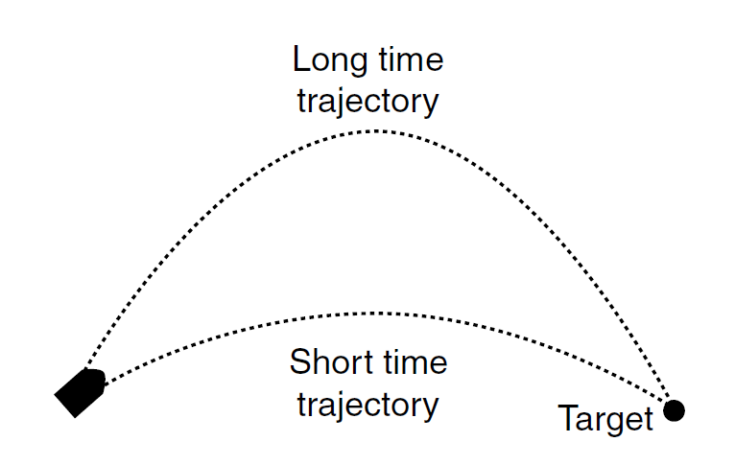
The Firing Solution
IMGD 4000
Due: optional, but no later than
May 5th, 11:59pm
Note! No “late” submission allowed for this project

Slide 2
Overview
Goal: Practice coding simple kinematics-based behavior using vectors in UE4
Optional
Extra 5% added to grade
Make simple demonstration of cannon hitting target
Cannon speed fixed
Target moveable
Cannon vector automatic to hit
Done solo

Slide 3
Details
Objects
Simple cylinder for cannon
Sphere for the projectile
Cube for target
All on a plane
Simple interface
e.g., arrow keys to move target
e.g., key press to fire cannon
Show movement of projectile in parabola
Challenge: Angle of cannon should automatically adjust so that projectile hits target
Uses minimum time
Indicate if target is out of range
3

Slide 4
Hints
See physics lecture notes
See Millington 3.5.3

Slide 5
Submission
Build Windows .exe
Put online for download at URL
Make README.txt with URL
Zip up source code only and README.txt
Submit zip via turnin

Slide 6
Grading
Rubric on Web page
Must get “C” or above to get any credit

