Slide 1
UE4 Quickstart
IMGD 4000
Due: March 25th, 11:59pm

Slide 2
Overview
Goal: Get up to speed with UE4
Adding code
Importing art assets
→ Not enough to master UE4, but enough so can get started making your own game!
Done solo (Game Project is in teams)
Setup UE4 development environment
Do editor tutorial
Do first person shooter tutorial
Extend fps game by 10%

Slide 3
UE4 Development Environment
Create Epic Games account
Download UE4 (Window or Mac)
Install compiler
Windows: Microsoft Visual Studio (Community version, should be free)
Mac: Xcode (v5.1+, also free)
Setup source control
WPI’s Fusion Forge and create account, register project
Choose subversion (svn) or git
(Will not have team for quickstart, but will for Game Project)

Slide 4
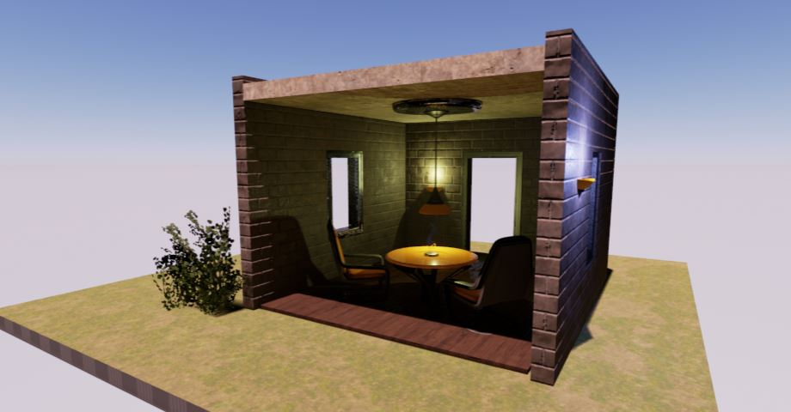
UE4 Editor
Unreal Editor Quick Start Guide
Create new project
Navigate panes
Create new level
Place and edit actors
Build and run level

Slide 5
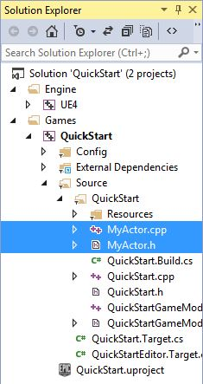
C++ in UE4
Unreal Programming Quick Start Guide
Create new project
Add new C++ class
Compile project
Add instance of class to level

Slide 6
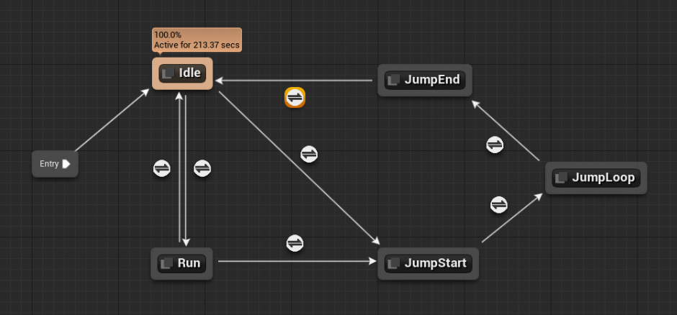
More C++ in UE4
First Person Shooter C++ Tutorial
Combination C++ and blueprints
Start with blank template
Create first person shooter
Character moves and strafes
With camera control
Projectiles
HUD and GameMode

Slide 7
Extend Tutorial Game
Extend FPS tutorial game in some fashion
Add code (C++ or blueprints) for meaningful functionality
Actual extension is up to you (see Hints)
Will indicate in documentation
How much? → 10%
Don’t get hung up on amount – use this project to learn as much as you can!

Slide 8
Hints
Tutorials mostly as-is, but be wary of different UE4 versions (e.g., I tested for v4.6.1)
Trouble getting started?
Save copy (in case “break” something)
Revisit tutorial (may have “plugged n chugged”)
Think about basic features from games you know and see if fit understanding (e.g., other weapons?)
See UE4 resources (vetted by staff)

Slide 9
Suggested Extensions
Lose energy and regain
Button to pickup objects (hold while moving)
Jetpack – button thrust moves up, release to let gravity work
Enemy – no AI, just shoot projectile. Add health for player
Enemy with AI – as above, but with AI controller, maybe navmesh
“Sticky” object (like Katamari)
Ammo packs. Spawn dynamically, player picks up
Minimap. Render with second camera in corner of screen
Trigger audio
Add second weapon with different capabilities
Add targets that span automatically
Your own great idea!
Some of the above can be combined for 10% (again, don’t get hung up on amount)

Slide 10
Submission
Include
Executable
Source Code
README – providing description of 10%
How? TBA (refer back to Web page later)

Slide 11
Grading
Tutorial 35%
Finish all tutorials, turn in code
Customization 60%
Extending game by ten-percent
Documentation 5%
README
Clearly structured commented code
See online for rubric

