Slide 1
Project Behavior Tree
IMGD 4000
Due: April 7th, 11:59pm

Slide 2
Overview
Implement basic behavior tree
Useful for achieving simple (and advanced) AI behavior
Built in to UE4, so especially good for UE games
Complete Behavior Tree Quick Start
Extend for “A” grade
Done solo, in UE4

Slide 3
Details (1 of 3)
Complete Behavior Tree Quick Start Guide
Provides
Environment with 2 avatars
Player controls one, AI the other
Player close & AI line of sight, AI chases
Player breaks line of sight, AI returns
"The Behavior Tree Quick Start Guide walks you through the process of creating a NavMesh, creating an AI Controller, creating a Character that will be controlled by that AI Controller, and creating all the parts necessary for a simple Behavior Tree."

Slide 4
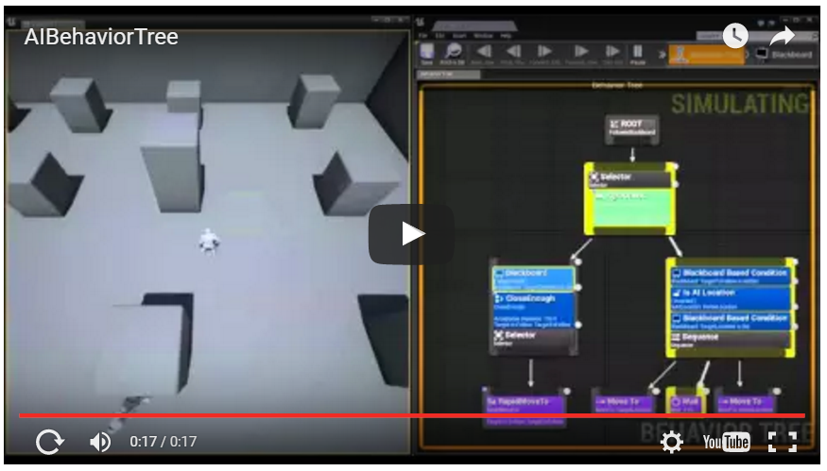
Details (2 of 3)
https://youtu.be/q6vTg2roI6k

Slide 5
Details (3 of 3)
Successful completion of above earns “B”
To achieve an “A” pick one of following
Game. Make basic game, with win/loss conditions (e.g., hide and seek with timer).
Search. Rather than just going last known location, AI wander before going home.
Wander. Rather than stand around at home, the AI could wander near home.
Patrol. Rather than waiting around home, patrol between 2+ locations.
Attack. Not just chase, but collide for damage. Need some indicator/message of hit and consequence (e.g., health).
Be prepared to:
Demo project
Answer questions about code

Slide 6
Hints (1 of 2)
Warning! Tested UE v4.9 (Windows)
YMMV for other versions
Assets provided for v4.9
Assets provided
Step #11, sub-step #5 (AgroCheck)
Download zip, extract to “Content/” folder

Slide 7
Hint (2 of 2)
Ditto for
Step #12, sub-step #5 (RapidMoveTo)
Step #13, sub-step #6 (CloseEnough)
If make own, add variables first!
Otherwise, some options not available
C++ and Behavior tree? See:
Victor's Behavior tree basic zombie

Slide 8
Submission
Executable (online, with URL)
Code (.cpp, .h, screenshots of blueprints)
→ Instruct Assist
Schedule demo
15 Minutes
Show project working
Answer questions about code

Slide 9
Grading
Basic Behavior 85%
Extension 15%

Slide 10
Rubric
100-90. The submission clearly meets requirements. The basic behavior in the tutorial is clearly visible. The extension (game or other behavior) is demonstrable and robust.
89-80. The submission meets requirements. The basic behavior in the tutorial is clearly visible. The extension (game or other behavior) is not complete and/or not robust.
79-70. The submission barely meets requirements. The submission meets requirements. The basic behavior in the tutorial is somewhat functional, but not complete. The extension (game or other behavior) is not started.
69-60. The submission fails to meet some requirements. The basic behavior in the tutorial is not functional, but aspects of the tutorial are evident through inspection. The extension (game or other behavior) is not started.
59-0. The submission fails to meet requirements. The submission fails to meet some requirements. The basic behavior in the tutorial is not functional and aspects of the tutorial are not started nor working. The extension (game or other behavior) is not started.

