Slide 1
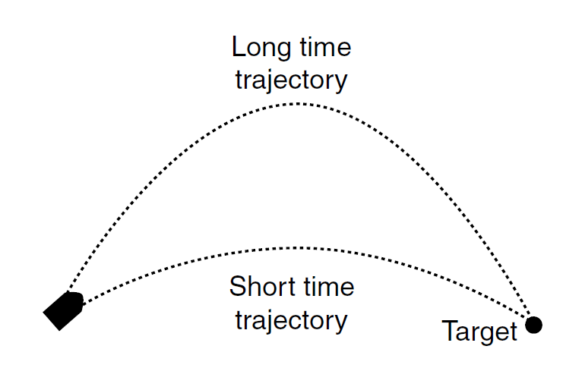
The Firing Solution
IMGD 4000
Due: April 21st, 11:59pm

Slide 2
Overview
Goal: Practice coding simple kinematics-based behavior using vectors in UE4
Make simple demonstration of cannon hitting target
Cannon speed fixed
Target moveable
Cannon vector automatic to hit
Extend – game or dodge behavior
Done solo

Slide 3
Details
Can be 2d or 3d
Objects
Simple cylinder (rectangle) for cannon
Sphere (circle) for the projectile
Cube (square) for target
All on a plane (line)
Simple interface
e.g., arrow keys to move target
e.g., key press to fire cannon
Show movement of projectile in parabola
Challenge: Angle of cannon should automatically adjust so that projectile hits target
Uses minimum time
Indicate if target is out of range
Extension
“Dodge” – a 2nd cannon for player, AI computes and moves
“Game” – game of your cration
3

Slide 4
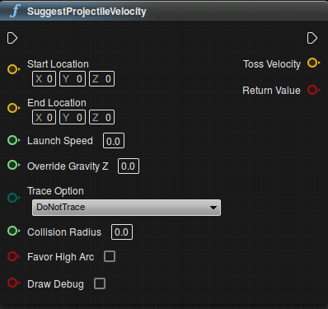
Hints
Start from one of:
Paper 2D Tutorial
First Person Shooter Tutorial
Blueprints or C++
“Suggest Projectile Velocity” … tempting, but wrong
See physics lecture notes
See Millington 3.5.3

Slide 5
Submission
Executable (online, with URL)
Code (.cpp, .h, screenshots of blueprints)
→ Instruct Assist
Schedule demo
15 Minutes
Show project working
Answer questions about code

Slide 6
Grading
Movable target 15%
Visible cannon 5%
Physics projectile 10%
Out of range indication 10%
Visible parabolic path 10%
Hitting target 40%
Extension 10%

Slide 7
Rubric
100-90. The submission clearly meets requirements. The cannon and target are all clearly visible. The target is easily controllable via mouse our keyboard. The cannon adjusts its firing vector to hit the target. The player can fire a projectile and the arc is readily visible as it moves to the target. Out of range targets are clearly indicated on the screen. The functionality is wrapped into a game or "dodge" is implemented that is demonstrable and robust.
89-80. The submission meets requirements. The cannon and target are all visible. The target is controllable via mouse our keyboard. The cannon adjusts its firing vector to hit the target. The player can fire a projectile and the arc is visible as move to the target. Out of range targets are undated on the screen. The functionality may be wrapped into a game-like environment or some aspect of "dodge" is implemented that is demonstrable and robust.
79-70. The submission barely meets requirements. The cannon and target are there but may not always be clearly visible. The target is controllable, but not easily. The cannon adjusts its firing vector to hit the target, but maybe not visibly. The player can fire a projectile but the projectile path is not clear. Out of range targets may not be indicated on the screen. There are no other game elements or dodge behavior implemented.
69-60. The project fails to meet some requirements. The cannon and target may not always be clearly visible. The target is not easily controllable. The cannon may not adjust its firing vector to hit the target. The player can fire a projectile but the projectile path is not clear. Out of range targets are not clearly indicated on the screen. The program may occasionally crash. There are no other game elements or dodge behavior implemented.
59-0. The project does not meet requirements. The cannon and target is not clearly visible. The target is not controllable. The cannon does not adjust its firing vector to hit the target. The player may fire a projectile but the projectile path is not clear. Out of range targets are not indicated on the screen. The program often crashes. There are no other game elements or dodge behavior implemented.

