Slide 1
Project Pathfinding
IMGD 4000
Due: March 28th, 11:59pm

Slide 2
Overview
Implement A*
Core pathfinding for games
Even if engine has A*, implementation helps with reinforcement
Extend paper 2d tutorial
Add waypoints, source destination, A* and path
A-grade needs smoothing or game
Done solo, in UE4

Slide 3
Submission
Include
Executable
Source Code
README – providing description of 10%
How?
Online submission
URL of .exe, Source code, README
Scheduled demo
(refer to Web page)

Slide 4
Details (1 of 3)
Add waypoints
Placeable on map in UE4 Level Editor
Enable connections
Automatic (e.g., based on distance)
Manual (in editor or in code)
With “cost” (e.g., distance or explicit)
Note: combined with waypoints, this really means creating a graph with nodes and edges
Select source & destination
Could be selected by mouse
Could be near dynamic objects (e.g., moveable)

Slide 5
Details (2 of 3)
Compute path
A*
Can use Internet references (and IMGD 3000), but code written must be your own
Depict path
e.g., Nodes connected by lines
Minimal is text of computed path on screen
e.g., AddOnScreenDebugMessage()

Slide 6
Details (3 of 3)
Successful completion of above earns “B”
To achieve an “A” pick one of following
Path smoothing
Note: requires obstacles
Make your project a game → be creative!
Simple game element/gameplay fine
Needs win/loss conditions
Be prepared to:
Demo project
Answer questions about code

Slide 7
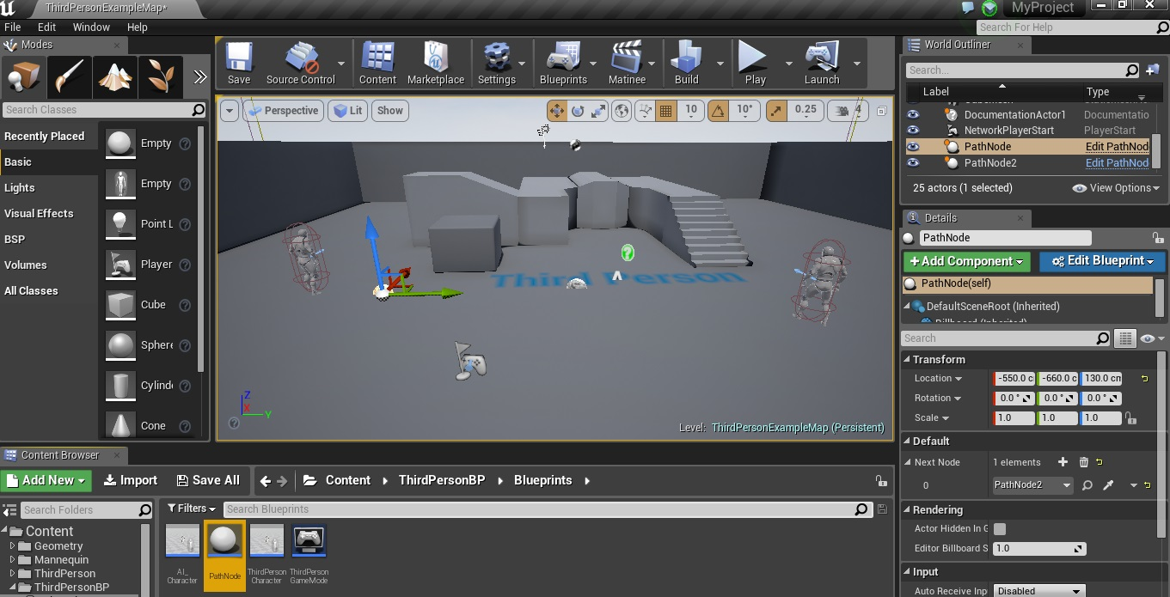
Hints (1 of 2)
Extend waypoints from Actor
Allows for visible element in level editor
C++ code for A*
See “Making Waypoints in UE4”

Slide 8
Hints (2 of 2)
Can show lines with “debug” library (e.g., DrawDebugLine()):
static void DrawDebugLine (
UObject *WorldContextObject,
const FVector LineStart,
const FVector LineEnd,
FLinearColor LineColor,
float Duration,
float Thickness);
// Draw a red line.
FVector start(0.0, 0.0, 0.0);
FVector end(0.0, 10.0, 0.0);
DrawDebugLine(GetWorld(), start, end,
FColor::Red, 1.0, 12);

Slide 9
Submission
Executable (online, with URL)
Code (.cpp, .h, screenshots of blueprints)
→ Instruct Assist
Schedule demo
15 Minutes
Show project working
Answer questions about code

Slide 10
Grading
Placeable Waypoints 5%
Waypoint Connections 20%
Selectable Source & Destination 10%
A* Pathfinding 35%
Path Depiction 20%
Path Smoothing or Game 10%

Slide 11
Rubric
100-90. The submission clearly meets requirements. The waypoints are placeable from the level editor. The source and destination are selectable. The resulting path is accurate and clearly visible. The path smoothing element is effective and demonstrable or the game implemented is playable with clear win/loss conditions.
89-80. The submission meets requirements. The waypoints are placeable from the level editor. The source or destination are selectable. The resulting path is accurate and mostly visible. The path smoothing element is not implemented effectively or is not clearly demonstrable or the game implemented is somewhat playable but may be missing clear win/loss conditions.
79-70. The submission barely meets requirements. The waypoints may not be (easily) placeable from the level editor. The source and destination is not selectable. The resulting path is inaccurate or not visible. The path smoothing element is not implemented and the game is not implemented
69-60. The submission fails to meet some requirements. Some combination of: a) the waypoints are not placeable from the level editor; b) the source and destination are not selectable; and/or c) the resulting path is inaccurate and not visible. The path smoothing element is not implemented and the game is not implemented.
59-0. The submission fails to meet requirements. The waypoints are not placeable from the level editor. The source and destination are not selectable. The resulting path is inaccurate and not visible. The path smoothing element is not implemented and the game is not implemented.

