Slide 1
UE4 Quickstart
IMGD 4000
Due: March 23rd, 11:59pm

Slide 2
Overview
Goal: Get up to speed with UE4
Adding code
Importing art assets
→ Not enough to master UE4, but enough so can get started making your own game!
Done solo
Projects 1-3 done solo, Game in teams
Setup UE4 development environment
Do editor tutorial
Do first person shooter (FPS) tutorial
Do paper 2d tutorial
Extend paper2d or FPS game by 10%

Slide 3
UE4 Development Environment
Create Epic Games account
Download UE4 (Window or Mac)
Install compiler
Windows: Microsoft Visual Studio (Community version, should be free)
Mac: Xcode (v5.1+, also free)
Setup source control (if do not already)
WPI’s Fusion Forge and create account, register project
Choose subversion (svn) or git
(Will not have team for Quickstart, but will for Game project)

Slide 4
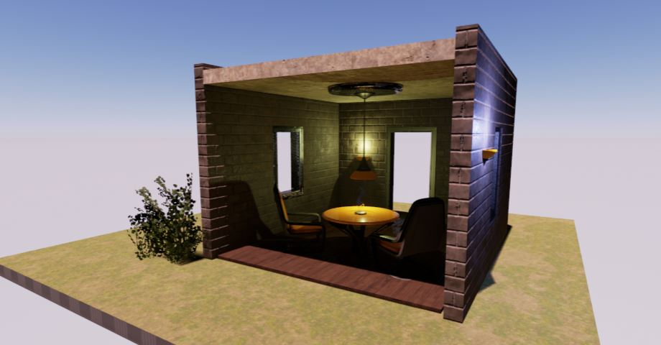
UE4 Editor
Guide: Level Designer Quick Start
Create new project
Navigate panes
Create new level
Place and edit actors
Build and run level

Slide 5
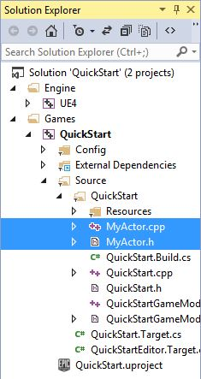
C++ in UE4
Guide: Unreal Programming Quick Start
Create new project
Add new C++ class
Compile project
Add instance of class to level

Slide 6
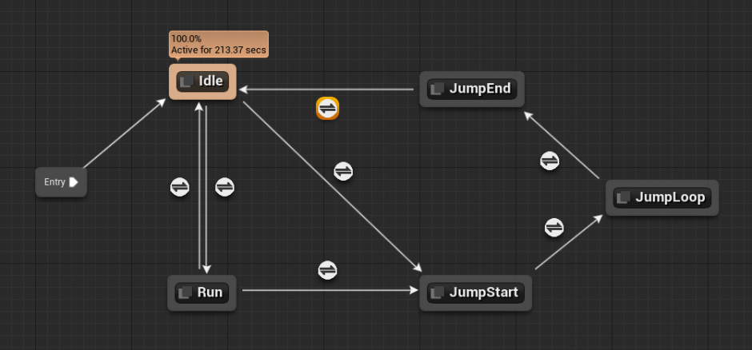
More C++ in UE4
Tutorial: First Person Shooter C++ Tutorial
Combination C++ and Blueprints
Start with blank template
Create first person shooter
Character moves and strafes
With camera control
Projectiles
HUD and GameMode
Although for FPS, 90% useful for 2d

Slide 7
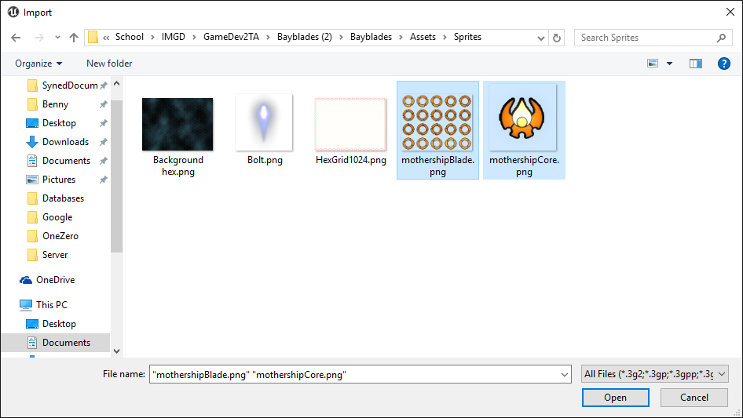
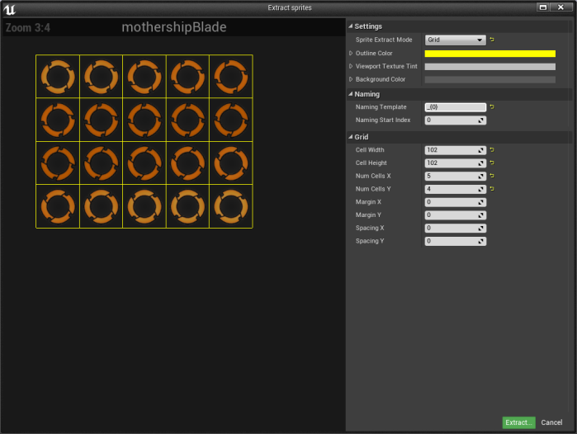
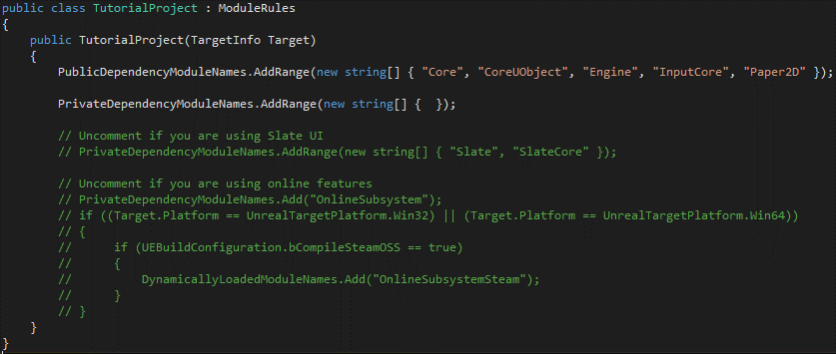
Paper 2D in UE 4
Quick intro to Paper 2d
Assumes done previous tutorials
Make basic start to game with ship that flies around
Setup sprites
Code ship movement
Setup level

Slide 8
Extend Tutorial Game
Extend FPS or Paper 2D tutorial game in some fashion
Add code (C++ or Blueprints) for meaningful functionality
Actual extension is up to you (see Hints)
Will indicate in documentation
How much? → 10%
Don’t get hung up on amount – use this project to learn as much as you can!

Slide 9
Hints
Tutorials mostly as-is, but be wary of different UE4 versions (e.g., tested for v4.6.1, v4.9)
Trouble getting started?
Save copy (in case “break” something)
Revisit tutorial (may have “plugged ‘n’ chugged”)
Think about basic features from games you know and see if fit understanding (e.g., other weapons?)
Stuck?
See UE4 resources (vetted by staff)

Slide 10
Suggested Extensions (FPS)
Lose energy and regain
Button to pickup objects (hold while moving)
Jetpack – button thrust moves up, release to let gravity work
Enemy – no AI, just shoot projectile. Add health for player
Enemy with AI – as above, but with AI controller, maybe navmesh
“Sticky” object (like Katamari)
Ammo packs. Spawn dynamically, player picks up
Minimap. Render with second camera in corner of screen
Trigger audio
Add second weapon with different capabilities
Add targets that span automatically
Your own great idea!
Many of the ideas above good for Paper 2D tutorial extensions as well
Some of the above combined for 10% (again, don’t get hung up on amount)

Slide 11
Submission
Include
Executable
Source Code
README – providing description of 10%
How?
Online submission
URL of .exe, Source code, README
Scheduled demo
(refer to Web page)

Slide 12
Grading
Tutorial 35%
Finish all tutorials, turn in code
Customization 60%
Extending game by ten-percent
Documentation 5%
README.txt
Clearly structured commented code

Slide 13
Rubric
100-90. The submission clearly exceeds requirements. The tutorial game works without problems. The custom extensions exhibit an unusually high degree of effort, thoughtfulness, technical ability and insight. Documentation is thorough and clear.
89-80. The submission meets requirements. The tutorial game works without problems. The custom extensions exhibit substantial effort, thoughtfulness, technical ability and/or insight. Documentation is adequate.
79-70. The submission barely meets requirements. The tutorial game may operate erratically. The custom extensions exhibit marginal effort, thoughtfulness, creativity and/or insight. Documentation is missing details needed to understand the contributions and/or to build the program.
69-60. The project fails to meet requirements in some places. The tutorial game may crash occasionally. The custom extensions are of minor scope, or exhibit perfunctory effort, thoughtfulness, technical ability and/or insight. Documentation is inadequate, missing key details needed to understand the contributions and/or to build the programs.
59-0. The project does not meet requirements. The tutorial game crashes consistently or does not compile. The custom extensions exhibit little or no evidence of effort, thoughtfulness, technical ability and/or insight. Documentation is woefully inadequate or missing.

