Slide 1
Basic Game AI
IMGD 4000
With material from: Ian Millington and John Funge. Artificial Intelligence for Games, Morgan Kaufmann, 2009. (Chapter 5)
Notes:
Original versions of these slides are courtesy professor Charles Rich, IMGD 4000 Technical Game Development II, B-term 2012.

Slide 2
What’s AI Part of a Game?
Everything that isn’t graphics (sound) or networking... (says an AI professor ☺ )
or physics (though sometimes lumped in)
usually via non-player characters
but sometimes operates more broadly, e.g.,
Civilization-style games (sophisticated simulations)
interactive storytelling (drama control)

Slide 3
“Levels” of Game AI
Basic
Decision-making techniques commonly used in almost all games
Advanced
Used in practice, but in more sophisticated games
Future
Not yet used, but explored in research

Slide 4
This Course
Basic game AI
Decision-making techniques commonly used in almost all games
Basic pathfinding (A*) (IMGD 3000)
Decision trees (this deck)
(Hierarchical) state machines (this deck)
Advanced game AI
Used in practice, but in more sophisticated games
Advanced pathfinding (other deck)
Behavior trees in UE4 (this deck)

Slide 5
Future Game AI?
Take IMGD 4100
“AI for Interactive Media and Games”
Fuzzy logic
More goal-driven agent behavior
Take CS 4341
“Artificial Intelligence”
Machine learning
Planning

Slide 6
Two Fundamental Types of AI Algorithms
Non-Search vs. Search
Non-Search: amount of computation is predictable
e.g., decision trees, state machines
Search: upper bound depends on size of search space (often large)
e.g., minimax, planning. Sometimes pathfinding
Scary for real-time games (or need ways to “short-circuit”, e.g., pathfind to closer node)
Need to otherwise limit computation (e.g., threshold, time-slice pathfinding)
Where’s the “knowledge”?
Non-Search: in the code logic (or external tables)
Search: in state evaluation and search order functions
Which one is better? Whichever has better knowledge. ;-)

Slide 7
How About AI Middleware (“AI Engines”)?
Recent panel at GDC AI Summit: “Why so wary of AI middleware?”
Only one panelist reported completely positive experience
Steve Gargolinski, Blue Fang (Zoo Tycoon, etc.)
Used Havok Behavior (with Physics)
Most industry AI programmers still write their own AI from scratch (or reuse their own code)
Damian Isla, Flame in the Flood, custom procedural content generation
So, we are going to look at coding details

Slide 8
AI Coding Theme (for Basic AI)
Use object-oriented paradigm
instead of...
A tangle of if-then-else statements

Slide 9
Outline
Introduction (done)
Decision Trees (next)
Finite State Machines (FSM)
Hierarchical FSM
Behavior Trees

Slide 10
First Basic AI Technique: Decision Trees
See code at: https://github.com/idmillington/aicore
src/dectree.cpp and src/demos/c05-dectree
Ian Millington and John Funge. Artificial Intelligence for Games, Morgan Kaufmann, 2009. (Chapter 5)

Slide 11
Decision Trees
Most basic of the basic AI techniques
Easy to implement
Fast execution
Simple to understand

Slide 12
Deciding How to Respond to an Enemy (1 of 2)
Leaves are actions
Interior nodes are decisions
if visible? { // level 0
if close? { // level 1
attack;
} else { // level 1
if flank? { // level 2
move;
} else { // level 2
attack;
}
}
} else { // level 0
if audible? { // level 1
creep;
}
}
visible?
no
yes
audible?
close?
no
no
yes
yes
flank?
creep
attack
no
yes
attack
move
Typically binary
(if multiple choices, can be converted to binary)

Slide 13
Deciding How to Respond to an Enemy (2 of 2)
Alternate form.
visible?
if visible? { // level 0
if close? { // level 1
attack;
} else if flank? { // level 1&2
move;
} else {
attack;
}
} else if audible? { // level 0&1
creep;
}
no
yes
audible?
close?
no
no
yes
yes
flank?
creep
attack
no
yes
attack
move
Harder to see “depth”!
What if need to modify?
e.g., if close, only flank if ally near
???

Slide 14
Modifying Deciding How to Respond to an Enemy
visible?
Alternate form. Harder to see “depth”!
no
yes
if visible? { // level 0
if close? { // level 1
attack;
} else if flank? { // level 1&2
move;
} else {
attack;
}
} else if audible? { // level 0&1
creep;
}
if visible? {
if close? {
attack;
} else {
if flank? {
move;
} else {
attack;
}
}
audible?
close?
no
no
yes
yes
???
???
creep
yes
attack
flank?
no
yes
attack
move
Modification restructures all below code! Code is brittle.
Solution? → Object-Oriented

Slide 15
O-O Decision Trees (Pseudo-Code)
no
yes
class Boolean : Decision // if yes/no
yesNode
noNode
class MinMax : Boolean // if range
minValue
maxValue
testValue
def getBranch()
if maxValue >= testValue >= minValue
return yesNode
else
return noNode
no
no
yes
yes
no
yes
class Node
def decide() // return action/decision
class Decision : Node // interior
def getBranch() // return a node
def decide()
return getBranch().decide()
class Action : Node // leaf
def decide() return this
// Define root as start of tree
Node *root
// Calls recursively until action
Action * action = root → decide()
action → doAction()

Slide 16
Building an O-O Decision Tree
visible = new Boolean...
audible = new Boolean...
close = new MinMax...
flank = new Boolean...
attack = new Attack...
move = new Move...
creep = new Creep...
visible.yesNode = close
visible.noNode = audible
audible.yesNode = creep
close.yesNode = attack
close.noNode = flank
flank.yesNode = move
flank.noNode = attack
...
visible?
no
yes
audible?
close?
no
no
yes
yes
flank?
creep
attack
no
yes
attack
move
...or a graphical editor

Slide 17
Modifying an O-O Decision Tree
visible = new Boolean...
audible = new Boolean...
close = new MinMax...
flank = new Boolean...
??? = new Boolean...
attack = new Action...
move = new Action...
creep = new Action...
visible.yesNode = close
visible.noNode = audible
audible.yesNode = creep
close.yesNode = attack
close.noNode = ???
???.yesNode = flank
flank.yesNode = move
flank.noNode = attack
...
visible?
no
yes
audible?
close?
no
no
yes
yes
???
creep
yes
attack
flank?
no
yes
attack
move

Slide 18
Decision Tree Performance
Individual node tests (getBranch) typically constant time (and fast)
Worst case behavior depends on depth of tree
longest path from root to action
Roughly “balance” tree (when possible)
not too deep, not too wide
make commonly used paths shorter
put most expensive decisions late
no
yes
no
no
yes
yes
no
yes

Slide 19
Outline
Introduction (done)
Decision Trees (done)
Finite State Machines (FSM) (next)
Hierarchical FSM
Behavior Trees

Slide 20
Second Basic AI Technique: (Hierarchical) Finite State Machines

Slide 21
Finite State Machines
Often AI as agents: sense, think, then act
But many different rules for agents
Ex: sensing, thinking and acting when fighting, running, exploring…
Can be difficult to keep rules consistent!
Try Finite State Machine
Natural correspondence between states and behaviors
Easy: to diagram, program, debug
Formally:
Set of states
A starting state
An input vocabulary
A transition function that maps inputs and current state to next state
(Game example next slide)

Slide 22
Finite State Machines
on guard
small enemy
fight
Acting done states
Sensing done by conditionals
Thinking done by transitions
large enemy
escaped
losing fight
run away
22

Slide 23
Hard-Coded Implementation
class Soldier
enum State
ON_GUARD
FIGHT
RUN_AWAY
currentState
def update()
if currentState == ON_GUARD {
if small enemy {
currentState = FIGHT
start Fighting
} else if big enemy {
currentState = RUN_AWAY
start RunningAway
}
} else if currentState == FIGHT {
if losing fight {
currentState = RUN_AWAY
start RunningAway
}
} else if currentState == RUN_AWAY {
if escaped {
currentState = ON_GUARD
start Guarding
}
}
on guard
small enemy
fight
large enemy
losing fight
escaped
run away

Slide 24
Hard-Coded State Machines
Easy to write (at the start)
Very efficient
Notoriously hard to maintain (e.g., modify and debug)

Slide 25
Cleaner & More Flexible O-O Implementation
class StateMachine
states
initialState
currentState = initialState
def update() // returns all actions needed this update
triggeredTransition = null
for transition in currentState.getTransitions() {
if transition.isTriggered() {
triggeredTransition = transition
break
}
}
if triggeredTransition != null {
targetState = triggeredTransition.getTargetState()
actions = currentState.getExitAction()
actions += targetState.getEntryAction()
currentState = targetState
return actions // list of actions for transitions
} else return currentState.getAction() // action this state
class State
def getAction()
def getEntryAction()
def getExitAction()
def getTransitions()
class Transition
def isTriggered()
def getTargetState()
on guard
small enemy
fight
large enemy
losing fight
escaped
run away

Slide 26
Combining Decision Trees & State Machines (1 of 2)
Why?
to avoid duplicating expensive tests in state machine. e.g., assuming “player in sight” is expensive
player in sight AND far
alarm
alert
player in sight AND near
defend

Slide 27
Combining Decision Trees & State Machines (2 of 2)
Use decision tree for transitions in state machine
yes
alarm
player in sight?
alert
far?
yes
no
no
defend

Slide 28
Outline
Introduction (done)
Decision Trees (done)
Finite State Machines (FSM) (done)
Hierarchical FSM (next)
Behavior Trees

Slide 29
Hierarchical State Machines
Why? → Could be interruptions, want to return but not to start
search
see trash
goto
trash
have trash
trash disposed
goto
disposal
e.g., robot can run out of power in any state.
Needs to recharge when out of power.
When charged, needs to return to previous state (e.g., may have trash or know where trash is).

Slide 30
Interruptions (e.g., Recharging)
recharge
recharge
(search)
(trash)
recharged
low power
recharged
low power
search
see trash
goto
trash
have trash
trash disposed
goto
disposal
recharged
low power
6 states needed → doubled!
recharge
(disposal)

Slide 31
Add Another Interruption (e.g., Baddies)
hide
(search/recharge)
all clear
battle
hide
hide
hide
hide
hide
12 states needed → doubled again!

Slide 32
Hierarchical State Machine
Leave any state in (composite) “clean” state when “low power”
“clean” remembers internal state and continues when back from “recharge’’
clean
low power
recharge
search
see trash
goto
trash
recharged
have trash
trash disposed
goto
disposal

Slide 33
Add Another Interruption (e.g., Baddies)
7 states needed (including composite) vs. 12
hide
(recharge)
battle
all clear
clean
low power
recharge
search
see trash
goto
trash
recharged
have trash
trash disposed
goto
disposal
battle
hide
all clear
(clean)
(Note: could have added another layer for only 6 states)

Slide 34
Cross-Hierarchy Transitions
Why?
Suppose want robot to “top off” battery (even if it isn’t low) when it doesn’t see any trash
clean
low power
recharge
search
see trash
goto
trash
recharged
have trash
trash disposed
goto
disposal

Slide 35
Cross-Hierarchy Transitions
no trash and less than 75% power
clean
low power
recharge
search
see trash
goto
trash
recharged
have trash
trash disposed
goto
disposal

Slide 36
HFSM Implementation Sketch
class State
// stack of return states
def getStates() return [this]
// recursive update
def update()
// rest same as flat machine
class Transition
// how deep this transition is
def getLevel()
// rest same as flat machine
struct UpdateResult // returned from update
transition
level
actions // same as flat machine
class HierarchicalStateMachine
// same state variables as flat machine
// complicated recursive algorithm*
def update ()
class SubMachine : HierarchicalStateMachine,
State
def getStates()
push this onto currentState.getStates()
*See full pseudo-code at http://web.cs.wpi.edu/~imgd4000/d16/slides/millington-hsm.pdf

Slide 37
Outline
Introduction (done)
Decision Trees (done)
Finite State Machines (FSM) (done)
Hierarchical FSM (done)
Behavior Trees (next)
In UE4
http://www.slideshare.net/JaeWanPark2/behavior-tree-in-unreal-engine-4

Slide 38
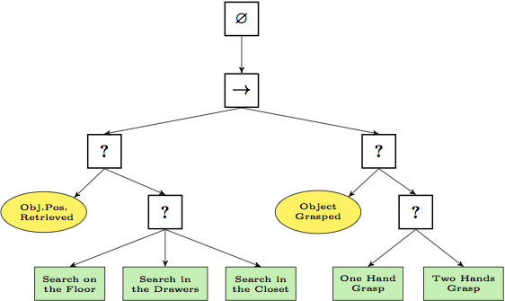
What is a Behavior Tree?
A model of plan execution
Switch between tasks in modular fashion
Similar to HFSM, but block is task not state
Early use for NPCs (Halo, Bioshock, Spore)
Tree – notes are root, control flow, execution
Search and grasp plan of two-armed robot
https://upload.wikimedia.org/wikipedia/commons/1/1b/BT_search_and_grasp.png

Slide 39
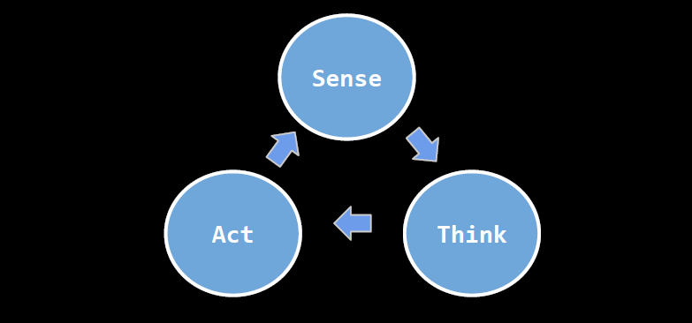
“Behavior” in Behavior Tree
Sense, Think, Act
Repeat

Slide 40
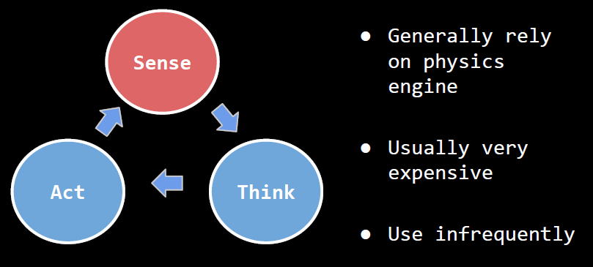
Sense

Slide 41
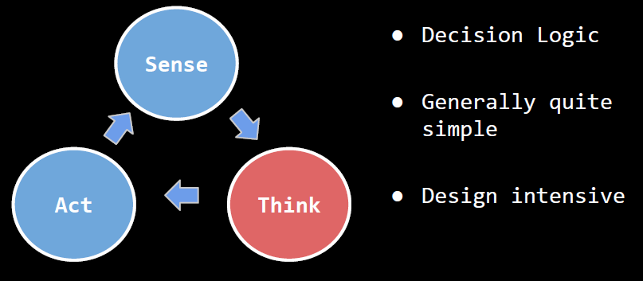
Think

Slide 42
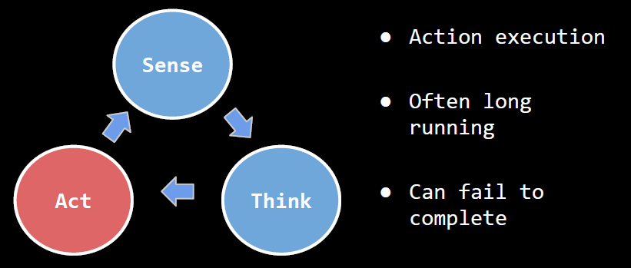
Act

Slide 43
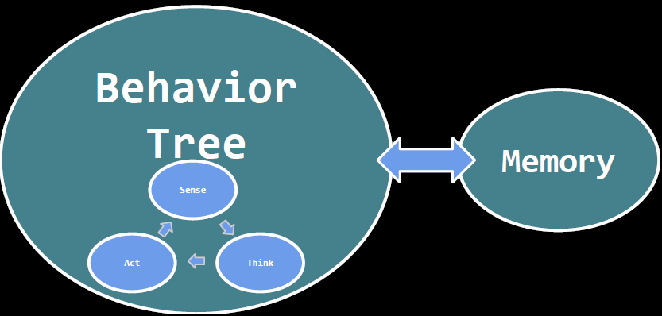
Behavior Tree with Memory
In UE4, the “Memory” is called “Blackboard”

Slide 44
UE4 Behavior Trees vs. Traditional
UE4 Event Driven
Do not poll for changes, but listen for events that trigger changes
UE4 “conditionals” not at leaf
Allows easier distinguish versus task
Allows them to be passive (event driven)
UE4 simplifies parallel nodes (typically confusing)
Simple parallel for concurrent tasks
Services for periodic tasks
https://docs.unrealengine.com/latest/INT/Engine/AI/BehaviorTrees/HowUE4BehaviorTreesDiffer/index.html

Slide 45
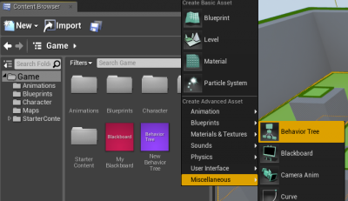
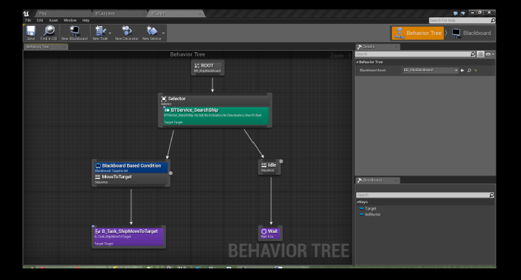
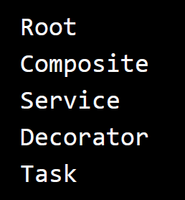
UE4 Behavior Tree
(Describe each next)

Slide 46
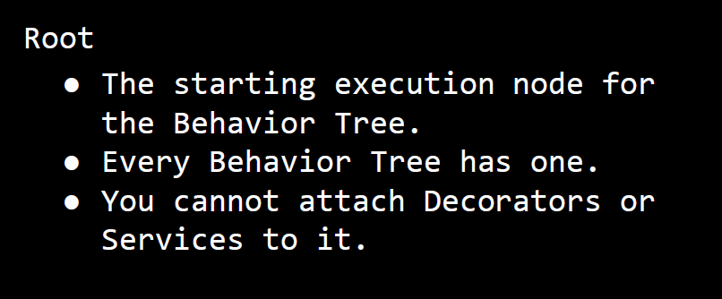
UE4 Behavior Tree - Root

Slide 47
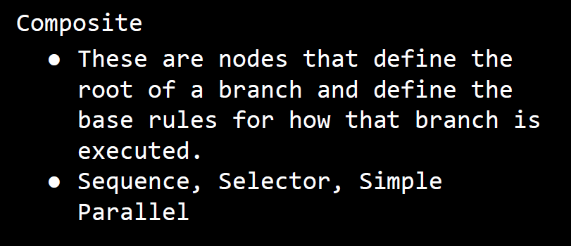
UE4 Behavior Tree - Composite
(Describe each next)

Slide 48
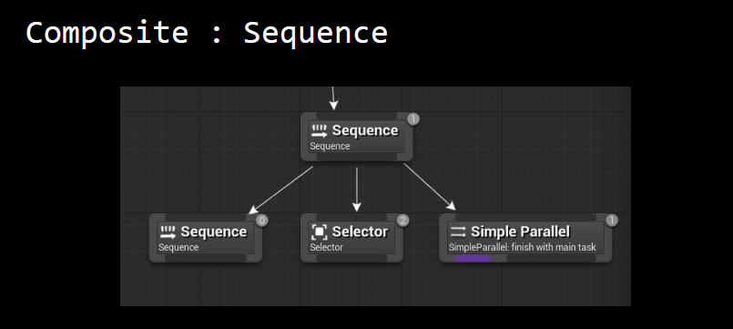
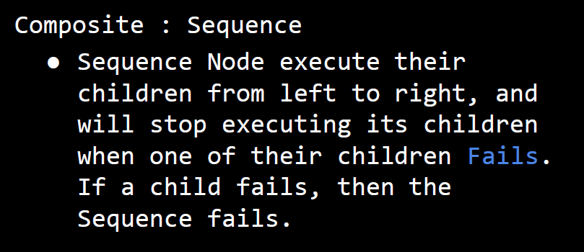
Composite - Sequence
“And”

Slide 49
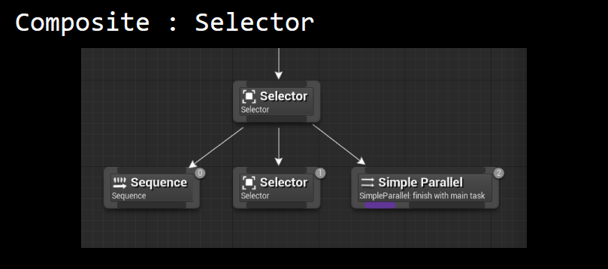
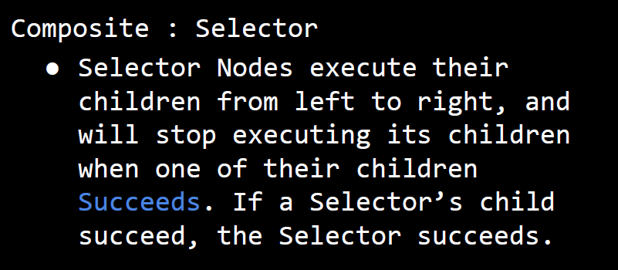
Composite - Selector
“Or”

Slide 50
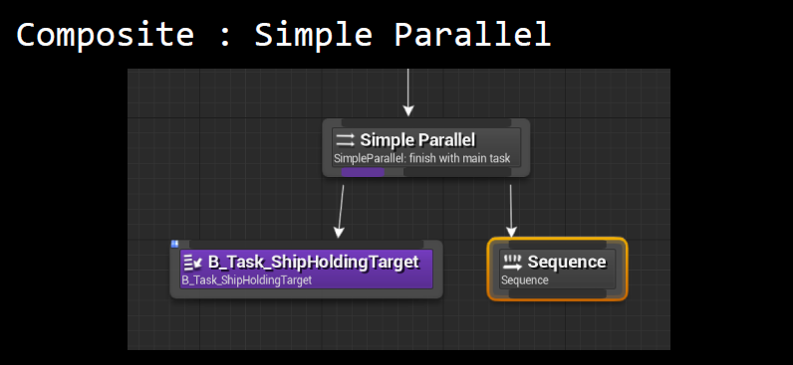
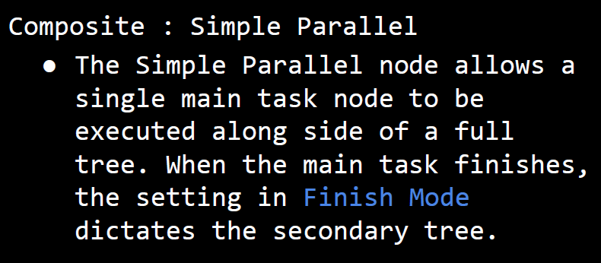
Composite – Simple Parallel

Slide 51
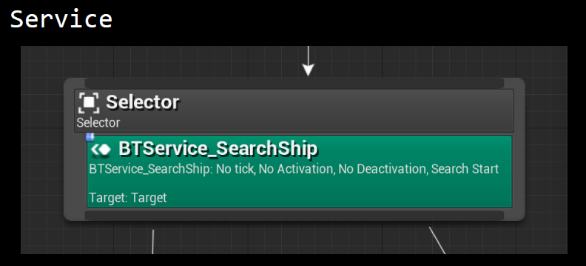
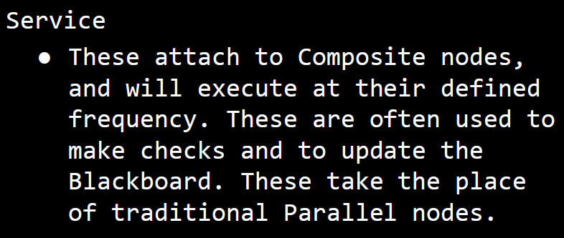
Service

Slide 52
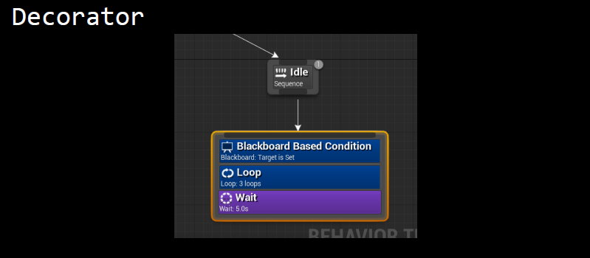
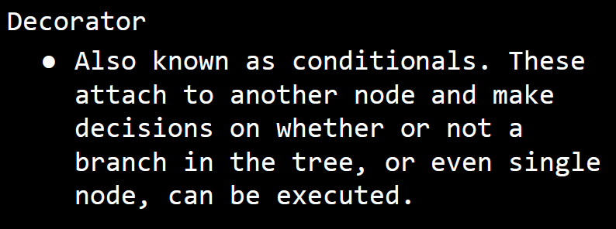
Decorators

Slide 53
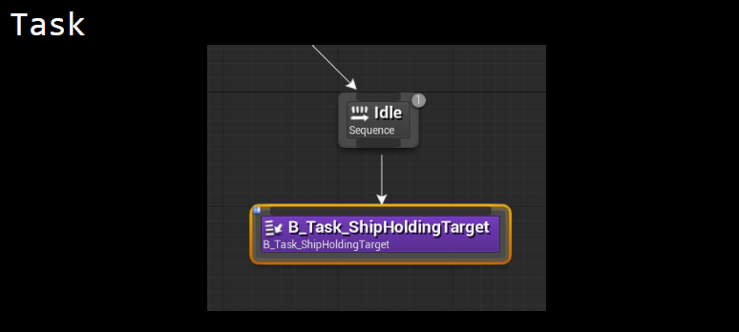
Task

Slide 54
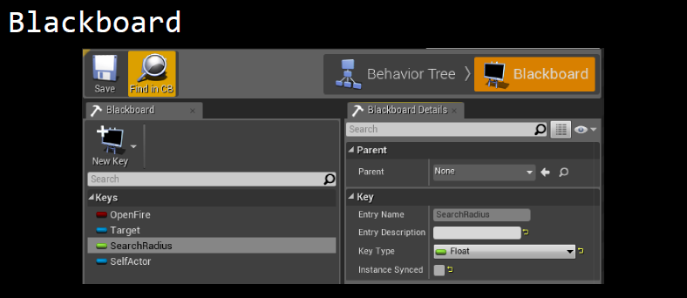
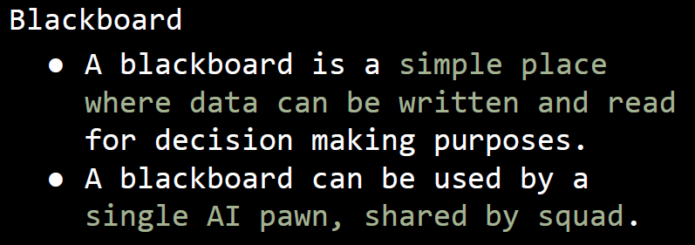
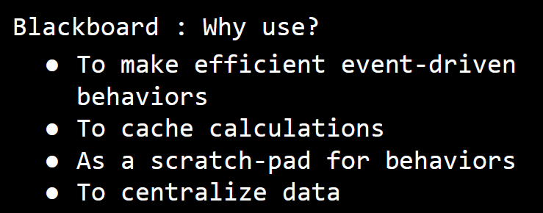
Blackboard (Memory)

Slide 55
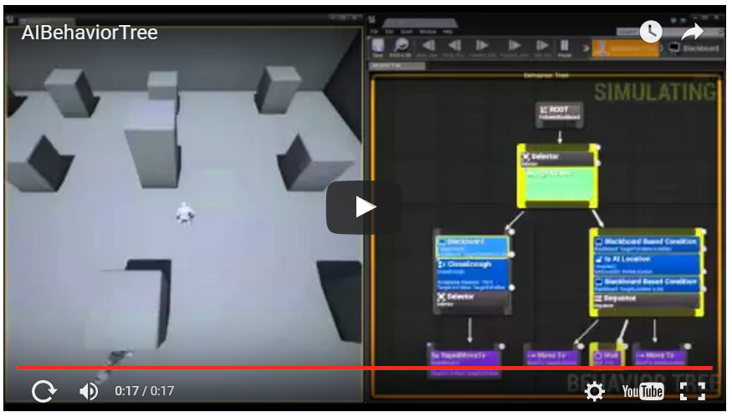
UE4 Behavior Tree Quick Start
https://youtu.be/q6vTg2roI6k
“The Behavior Tree Quick Start Guide walks you through the process of creating a NavMesh, creating an AI Controller, creating a Character that will be controlled by that AI Controller, and creating all the parts necessary for a simple Behavior Tree.”

Slide 56
Resource Links
HFSM from Millington and Funge
http://web.cs.wpi.edu/~imgd4000/d16/slides/millington-hsm.pdf
FSM from IMGD 3000
Slides
http://www.cs.wpi.edu/~imgd4000/d16/slides/imgd3000-fsm.pdf
Header files
http://dragonfly.wpi.edu/include/classStateMachine.html
UE4 Behavior Tree
Difference between BT and DT
http://gamedev.stackexchange.com/questions/51693/decision-tree-vs-behavior-tree
Quick Start
https://docs.unrealengine.com/latest/INT/Engine/AI/BehaviorTrees/QuickStart/

