Slide 1
Autonomous Movement
IMGD 4000
With material from: Millington and Funge, Artificial Intelligence for Games, Morgan Kaufmann 2009 (Chapter 3), Buckland, Programming Game AI by Example, Wordware 2005 (Chapter 3), http://opensteer.sourceforge.net and http://gamedevelopment.tutsplus.com/series/understanding-steering-behaviors--gamedev-12732
Notes:
Original versions of these slides are courtesy professor Charles Rich, IMGD 4000 Technical Game Development II, B-term 2012.

Slide 2
Introduction
Fundamental requirement in many games is to move characters (player avatar and NPC’s) around realistically and pleasantly
For some games (e.g., FPS) realistic NPC movement is pretty much core (along with shooting) → there is no higher level decision making!
At other extreme (e.g., chess), no “movement” per se → pieces just placed
Note: as for pathfinding, we’re going to treat everything in 2D, since most game motion in gravity on surface (i.e., 2 ½ D)

Slide 3
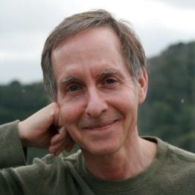
Craig Reynolds
Website: http://www.red3d.com/cwr/
The “giant” in this area – his influence cannot be overstated
1987: “Flocks, Herds and Schools: A Distributed Behavioral Model,” Computer Graphics
1998: Winner of Academy Award in Scientific and Engineering category
Recognition of “his pioneering contributions to the development of three-dimensional computer animation for motion picture production”
1999: “Steering Behaviors for Autonomous Characters,” Proc. Game Developers Conference
Left U.S. R&D group of Sony Computer Entertainment in April 2012 after 13 years
Now (2015) at SparX (eCommerce coding within Staples)

Slide 4
Outline
Introduction (done)
The “Steering” Model (next)
Steering Methods
Flocking
Combining Steering Forces

Slide 5
The “Steering” Model
Action Selection
Choosing goals and plans, e.g.
“go here”
“do A, B, and then C”
Steering
Calculate trajectories to satisfy goals and plans
Produce steering force that determines where and how fast character moves
Locomotion
Mechanics (“how”) of motion
Differs for characters, e.g., fish vs. horse (e.g., compare animations)
Independent of steering

Slide 6
The “Steering” Model – Example
Cowboys tend herd of cattle
Cow wanders away
Trail boss tells cowboy to fetch stray
Cowboy says “giddy-up” and guides horse to cow, avoiding obstacles
Trail boss decision represents action
Observes world – cow is missing
Setting goal – retrieve cow
Steering done by cowboy
Go faster, slower, turn right, left …
Horse implements locomotion
With signal, go in indicated direction
Account for mass when accelerating/turning
Provide animation
Note, depending upon the game, player could control boss or cowboy (or both)!

Slide 7
Action Selection
Done through variety of means…
e.g., decision tree or FSM
(see earlier slide deck)
Examples:
“Get health pack”
“Charge at enemy”
Player input
“Return to base”
“Fetch cow”
Action Selection

Slide 8
Locomotion Dynamics
Steering
Locomotion
class Body
// Point mass of rigid body
mass // scalar
position // vector
velocity // vector
// Orientation of body
heading // vector
// Dynamic properties of body
maxForce // scalar
maxSpeed // scalar
def update (dt) {
force = ...; // Combine forces from steering behaviors
acceleration = force / mass; // Update acceleration w/Newton's 2nd law
velocity += truncate ( acceleration * dt, maxSpeed ); // Update speed
position += velocity * dt; // Update position
if ( | velocity | > 0.000001 ) // If vehicle moving enough
heading = normalize ( velocity ); // Update heading to velocity vector
// render …
}
// Scale vector to appropriate size (max)
vector truncate(vector v, int max) {
float f;
f = max / v.getLength();
if (f < 1.0)
f = 1.0
v.scaleBy(f);
return v;
}

Slide 9
Individual Steering “Behaviors”
Compute forces
seek | flee
arrive | pursue
wander | evade
interpose | hide
avoid obstacles | follow path
Steering
Multiple behaviors combine forces (e.g., flocking)

Slide 10
So “Steering” in this Context Means
Making objects move by:
Applying forces
instead of
Directly transforming their positions
Why?
...because it looks much more natural
i.e., “steering” does not mean just using, say, the arrow/WASD keys to move an avatar, but doing motion by applying forces

Slide 11
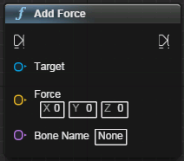
Adding Forces in UE4
Add force to a single rigid body
virtual void AddForce (Fvector Force, Fname BoneName)
Force – force vector to apply. Magnitude is strength of force
BoneName – name of body to apply it to (‘None’ to apply to root body)
void AMyCharacter::AddUpwardForce() {
const float ForceAmount = 20000.0f;
Fvector force(0.0f, 0.0f, ForceAmount);
Fname bone; // defaults to “NAME_None”
this->AddForce(force, bone);
}
Distance units are centimeters
i.e., earth gravity 981 cm/s²
C++
Note: max velocity property of object
Blueprints

Slide 12
Steering Methods
class Body {
def update (dt) {
force = ... // combine forces from steering behaviors
…
}
def seek (target) { ... return force; }
def flee (target) { ... return force; }
def arrive (target) { ... return force; }
def pursue (body) { ... return force; }
def evade (body) { ... return force; }
def hide (body) { ... return force; }
def interpose (body1, body2) { return force: }
def wander () { ... return force; }
def avoidObstacles () { ... return force; }
...
};
Forces returned by each method are combined (shown later)
Individual behaviors can be turned on/off (next slide)

Slide 13
Turning Steering Methods On & Off
Action Selection controls which steering behaviors on/off
class Body {
private:
bool seek_on;
public:
void setSeek(bool on=true);
bool doSeek();
…
}
vector Body::calcForce() {
if ( doSeek() ) {
force += seek();
…
}

Slide 14
Reference Code in C++
Complete example code for this unit from Buckland’s book can be downloaded from:
http://samples.jbpub.com/9781556220784/Buckland_SourceCode.zip
Folder for Chapter 3
See also learning guide’s “Understanding Steering Behaviors”:
http://gamedevelopment.tutsplus.com/series/understanding-steering-behaviors--gamedev-12732
Similar concepts, slightly different code implementation

Slide 15
Outline
Introduction (done)
The “Steering” Model (done)
Steering Methods (next)
Flocking
Combining Steering Forces

Slide 16
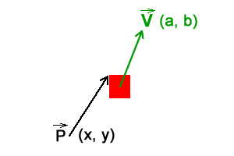
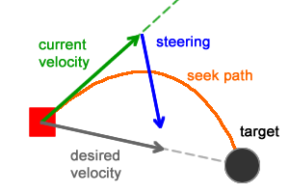
Seek: Steering Force
Note: treat position as a vector (direction is ignored)
target
velocity
desired velocity
steering force
def seek (target) {
// vector from here to target scaled by maxSpeed
desired = truncate ( target - position, maxSpeed );
// return steering force
return desired - velocity; // vector difference
}
Will result in smooth path!
DEMO
(Force: INS/DEL, Speed: HOME/END)

Slide 17
Problem with Seek?
What happens when reaches target?
How bad is it?

Slide 18
Problem with Seek
What happens when reaches target?
Overshoots target
How bad is it?
Amount of overshoot determined by ratio of maxSpeed to maximum force applied
Intuitively, should decelerate as gets closer to target
→ Arrive

Slide 19
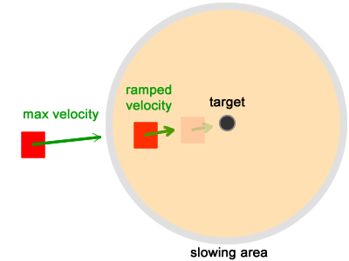
Arrive: Variant of Seek Behavior
When body is far away from target, it behaves just like seek, i.e., closes at maximum speed
Deceleration only when close to target, e.g., ‘speed’ reduced below ‘maxSpeed’ when within range

Slide 20
Arrive
target
velocity
distance
def arrive (target) {
distance = | target – position |; // distance to target
if ( distance == 0 ) return [0,0]; // if at target, stop
// slow down linearly with distance.
// DECELERATION allows tweaking (larger is slower)
speed = distance / DECELERATION;
// current speed cannot exceed maxSpeed
speed = min(speed, maxSpeed);
// vector from here to target scaled by speed
desired = truncate(target - position, speed);
// return steering force as in seek (note, if heading
// directly at target already, this just decelerates)
return desired - velocity;
}
desired velocity
steering force
Decelerates linearly.
Example: Max speed 4, initial distance 10.
DECELERATION
2 1
Dist Speed Speed
10 4 4
9 4 4
8 4 4
7 3.5 4
6 3 4
5 2.5 4
4 2 4
3 1.5 3
2 1 2
1 0.5 1
0 0 0
Note, when at target, desired velocity is zero.
→ Steering force becomes -velocity
Added to force, stops moving!
DEMO

Slide 21
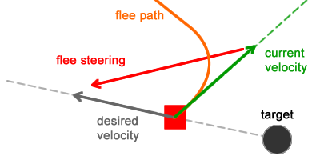
Flee: Opposite of Seek
velocity
desired velocity
target
Produces curved (orange) path
steering force
def flee (target) {
desired = truncate ( position - target, maxSpeed );
return desired - velocity;
}
Note: Buckland adds “range” to only flee if near, but that is really an Action Selection decision.
DEMO

Slide 22
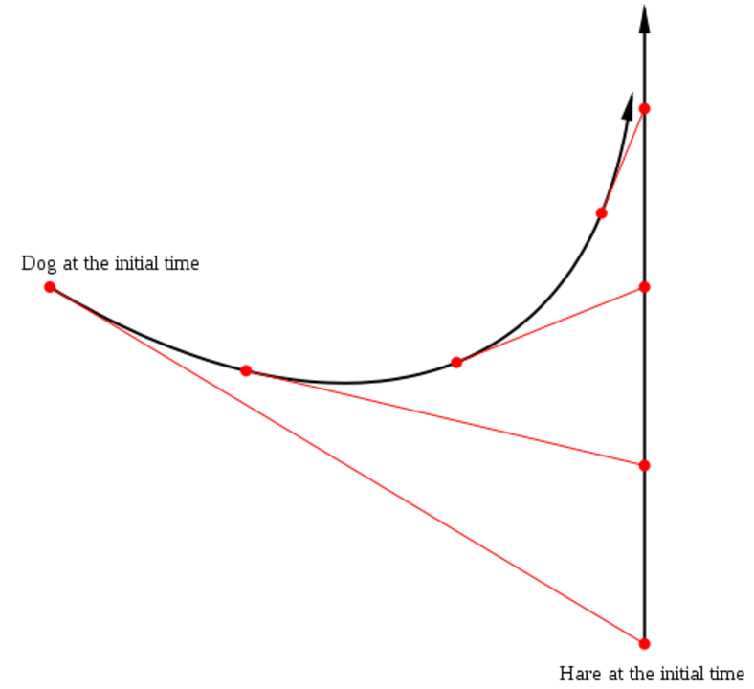
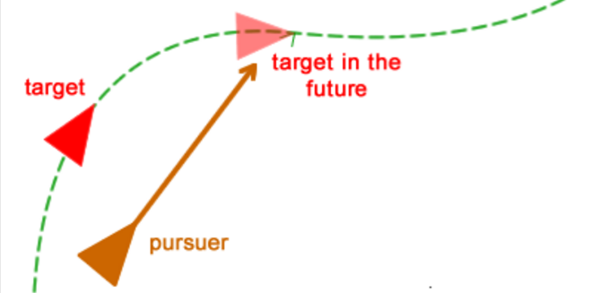
Seek and Ye Shall Find?
If seek moving target, will curve towards it
(Much like a dog chasing hare ☺)
Instead, seek to target location in the future
Note, depending upon speed and tick-rate, may not be smooth.
→Physics (see later slide deck)
https://en.wikipedia.org/wiki/Radiodrome

Slide 23
Pursue: Seek Predicted Position (1 of 2)
target
evader
velocity
desired velocity
Note:
Success of pursuit depends on how well can predict evader’s future position
Tradeoff of CPU time vs. accuracy
Special case: if evader almost dead ahead, just seek
pursuer
steering force

Slide 24
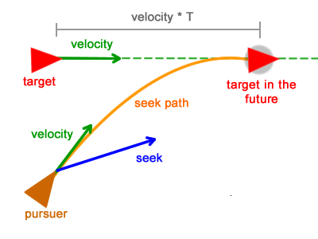
Pursue: Seek Predicted Position (2 of 2)
Longer distance, then higher time (dt)
Pursuer seek point far ahead
And vice-versa
def pursue (body) {
toBody = body.position - position;
// if within ~20 degrees ahead, simply seek
facing = computeFacing(heading, body);
if ( facing > -10 && facing < -10 )
return seek ( body.position );
// calculate lookahead time based on distance and speeds
// note: this could be hardcoded (e.g., 100 ms) or use more
// sophisticated prediction
dt = | toBody | / ( maxSpeed + | body.velocity | );
// seek predicted position, assuming body moves in straight line
// note: again, this could use more sophisticated prediction
return seek ( body.position + ( body.velocity * dt ) );
}
DEMO

Slide 25
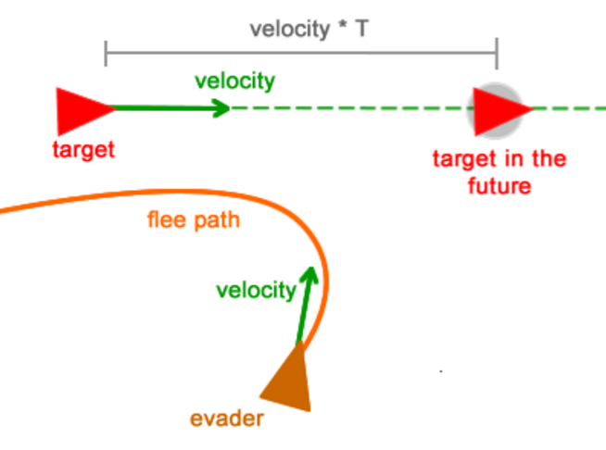
Don’t Just Flee, Evade!
Predict where target will be
Move in opposite direction

Slide 26
Evade: Opposite of Pursue (1 of 2)
target
pursuer
velocity
Almost same as pursue, but this time evader flees predicted position
evader
steering force
desired velocity

Slide 27
Evade: Opposite of Pursue (2 of 2)
def evade (body) {
toBody = body.position - position;
// no special case check for dead ahead
// calculate lookahead time based on distance and speeds
dt = | toBody | / ( maxSpeed + | body.velocity | );
// flee predicted position
return flee ( body.position + ( body.velocity * dt) );
}

Slide 28
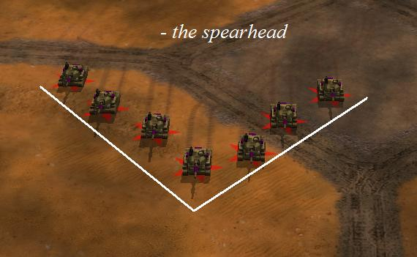
Pursue with Offset (1 of 2)
What if don’t want to intercept, but be near?
Marking an opponent in sports
Staying docked with moving spaceship
Shadowing an aircraft
Implementing battle formations
Solution → Pursue with Offset
Steering force to keep body at specified offset from target body
(This is not “flocking”, which we will see later)
CC Generals

Slide 29
Pursue with Offset (2 of 2)
target
offset
velocity
desired velocity
steering force
leader
pursuer
def pursue (body, offset) {
// calculate lookahead time based on distance and speeds
dt = | position - ( body.position + offset ) | /
(maxSpeed + | body.velocity | );
// arrive at predicted offset position (vs. seek)
return arrive ( body.position + offset + ( body.velocity * dt ));
}
DEMO

Slide 30
Interpose (1 of 3)
Similar to pursue
Return steering force to move body to midpoint of imaginary line connecting two bodies
Useful for:
Bodyguard taking a bullet
Soccer player intercepting pass
Like pursue, main trick is to estimate lookahead time (dt) to predict target point

Slide 31
Interpose (2 of 3)
(1) Bisect line between bodies
(2) Calculate dt to bisection point
(3) Target arrive at midpoint of predicted positions

Slide 32
Interpose (3 of 3)
def interpose (body1, body2) {
// lookahead time to current midpoint
dt = | body1.position + body2.position | / (2*maxSpeed);
// extrapolate body trajectories
position1 = body1.position + body1.velocity * dt;
position2 = body2.position + body2.velocity * dt;
// steer to midpoint
return arrive ( ( position1 + position2 ) / 2 );
}
DEMO

Slide 33
Wander
Goal is to produce steering force which gives impression of random walk though agent’s environment
Naive approach:
Calculate random steering force each update step
Produces unpleasant “jittery” behavior
Reynold’s approach:
Project circle in front of body
Steer towards randomly moving target constrained along perimeter of the circle

Slide 34
Wander
target
steering force
wander radius
wander radius
wander distance
wander distance

Slide 35
Wander
target
wander radius
// initial random point on circle
wanderTarget = ...;
def wander () {
// displace target random amount
wanderTarget += [ random(0, JITTER), random(0, JITTER) ];
// project target back onto circle
wanderTarget.normalize();
wanderTarget *= RADIUS;
// move circle wander distance in front of agent
wanderTarget += bodyToWorldCoord( [DISTANCE, 0] );
// steer towards target
return wanderTarget - position;
}
wander distance
DEMO

Slide 36
Individual Steering “Behaviors”
Compute forces
seek | flee
arrive | pursue
wander | evade
interpose | hide
avoid obstacles | follow path
Steering
Multiple behaviors combine forces

Slide 37
Path Following
Create steering force that moves body along a series of waypoints (open or looped)
Useful for:
Patrolling (guard duty) agents
Predefined paths through difficult terrain
Racing cars around a track
open path
looped path
A path can be described by an array of vectors.

Slide 38
Path Following: Using Seek
Invoke ‘seek’ on each waypoint until ‘arrive’ at finish (if any)
path = ...; // (circular) list of waypoints
current = path.first() ; // current waypoint vector
def followPath () {
if ( | current – position | < SEEK_DISTANCE )
if ( path.isEmpty() )
return arrive ( current );
else
current = path.next();
return seek (current);
}
Sensitive to SEEK_DISTANCE and ratio of maxForce to maxSpeed (in underlying locomotion model)
tighter path for interior corridors
looser for open outdoors
DEMO

Slide 39
Mini-Outline
Interacting with the Environment
Obstacle Avoidance
Hide
Wall Avoidance

Slide 40
Obstacle Avoidance
Treat obstacles as circular bounding volumes
Basic idea: extrude “detection box” (width of body, length proportional to speed) in front of body in direction of motion (like intersection testing)

Slide 41
Obstacle Avoidance Algorithm Overview
Find closest intersection point
Calculate steering force to avoid obstacle
(expand each next)

Slide 42
Obstacle Avoidance Algorithm (1 of 3)
Find closest intersection point
discard all obstacles which do not overlap with detection box
expand obstacles by half width of detection box
find intersection points of trajectory line and expanded obstacle circles
choose closest intersection point in front of body

Slide 43
Obstacle Avoidance Algorithm (2 of 3)
Calculate steering force
(a) combination of lateral and braking forces
(b) each proportional to body’s distance from obstacle (needs to react quicker if closer)
lateral force
braking force

Slide 44
Obstacle Avoidance Algorithm (3 of 3)
def computeAvoidForce ( closestObstacle ) {
// convert to “local” space, so object is at origin
// the closer it is, the stronger the force away
multiplier = 1 + ( box.getLength() – closestObstacle.getX() ) / box.getLength()
// calculate lateral force
force.y = ( closestObstacle().getRadius() – closestObstacle().getY() ) * multiplier
// apply braking force proportional to obstacles distance
brakingWeight = 2.0
force.x = ( closestObstacle().getRadius() – closestObstacle.getX() ) * brakingWeight
// convert vector back to world space
return vectorToWorld ( force )
}
DEMO

Slide 45
Hide
Attempt to position body so obstacle is always between itself and other body
Useful for:
NPC hiding from player
to avoid being shot by player
to sneak up on player (combine hide and seek)

Slide 46
Hide
for each obstacle, determine hiding spot (projected point opposite each obstacle)
if no hiding spots then invoke ‘evade’
else invoke ‘arrive’ to closest hiding spot

Slide 47
Hide - Possible Refinements
Action selection decisions to …
Only hide if can “see” other body
tends to look dumb (i.e., agent has no memory)
can improve by adding time constant, e.g., hide if saw other body in last <n> seconds
Only hide if can “see” other body and other body can “see” you
Add “panic distance” so if super close, then flee
DEMO

Slide 48
Wall Avoidance
Test for intersection of three “feelers” with wall (like cat whiskers)
Calculate penetration depth of closest intersection
Return steering force perpendicular to wall with magnitude equal to penetration depth
steering force
penetration depth
DEMO

Slide 49
Outline
Introduction (done)
The “Steering” Model (done)
Steering Methods (done)
Flocking (next)
Combining Steering Forces

Slide 50
“Flocking” = Group Steering Behaviors
Combination of three steering behaviors:
cohesion
separation
alignment
Each applied to all bodies based on neighbors
(next)
DEMO

Slide 51
Neighbors
neighborhood radius
Neighbors determined by distance (circle) from body
Variation:
Restrict neighborhood to field of view (e.g., 180 deg.) in front
(May be more realistic in some applications)

Slide 52
Separation (1 of 2)
Add force that steers body away from others in neighborhood

Slide 53
Separation (2 of 2)
Vector to each neighbor is normalized and divided by distance (i.e., stronger force for closer neighbors)
def separation () {
force = [0,0];
for each neighbor
direction = position - neighbor.position;
force += normalize(direction) / | direction |;
return force;
}
Divide by bigger number when farther, smaller number when closer

Slide 54
Alignment (1 of 2)
Attempt to keep body’s heading aligned with its neighbors headings

Slide 55
Alignment (2 of 2)
Return steering force to correct towards average heading vector of neighbors
def alignment () {
average = [0,0];
for each neighbor
average += neighbor.heading;
average /= |neighbors|;
return average - heading;
}
heading
average heading of neighbors
steering force

Slide 56
Cohesion
Produce steering force that moves body towards center of mass of neighbors
def cohesion () {
center = [0,0];
for each neighbor
center += neighbor.position;
center /= | neighbors |;
return seek (center);
}

Slide 57
Flocking Force Combination
Combine flocking forces with weights
Different weights give different behaviors
(Related to next topic)
Note, if isolated neighbor out of range, will do nothing
Add “wander” behavior
def flock () {
vector force = [0,0];
vector force =
separation() * separation_weight
+ alignment() * alignment_weight
+ cohesion() * cohesion_weight
+ wander() * wander_weight;
return force;
}
DEMO

Slide 58
Flocking – Summary
An “emergent behavior”
Looks complex and/or purposeful to observer
But actually driven by fairly simple rules
Component entities don’t have “big picture”
Tunable to different kinds of flocks
Often used in films
Bats and penguins in Batman Returns
Orc armies in Lord of the Rings

Slide 59
Outline
Introduction (done)
The “Steering” Model (done)
Steering Methods (done)
Flocking (done)
Combining Steering Forces (next)

Slide 60
Combining Steering Behaviors: Examples
FPS bots
Path following (point A to point B)
Obstacle avoidance (crates, barrels)
Pursue with offset (formation)
Separation
Animal simulation (e.g., sheep in RTS)
Wander
Obstacle avoidance (e.g., trees)
Flee (e.g., predator)

Slide 61
Combine Steering Forces
vector Body::calcForce() {
vector force;
force += wander();
force += avoidObstacles();
force += …
return truncate ( force, maxForce );
}
class Body {
def update (dt) {
force = calcForce();
…
}
def seek (target) { ... return force; }
def flee (target) { ... return force; }
def arrive (target) { ... return force; }
def pursue (body) { ... return force; }
def evade (body) { ... return force; }
def hide (body) { ... return force; }
def interpose (body1, body2) { ... return force: }
def wander () { ... return force; }
def avoidObstacles () { ... return force; }
...
};
Other choices for combination?

Slide 62
Combining Steering Forces
Two basic approaches:
Blending
Priorities
Advanced combined approaches:
Weighted truncated running sum with prioritization [Buckland]
Prioritized dithering [Buckland]
Pipelining [Millington]
All involve significant tweaking of parameters

Slide 63
Blending Steering
All steering methods are called, each returning a force (could be [0,0])
Forces combined as linear weighted sum:
w₁F₁ + w₂F₂ + w₃F₃ + ...
weights do not need to sum to 1
weights tuned by trial and error
Final result will be limited (truncated) by maxForce
vector Body::calcForce() {
vector force;
force += wander() * wander_weight;
force += avoidObstacles() * avoid_weight;
force += …
return truncate ( force, maxForce );
}

Slide 64
Blended Steering – Problems
Expensive, since all methods called every tick
Conflicting forces not handled well
Tries to “compromise”, rather than giving priority
e.g., avoid obstacle and seek, can end up partly penetrating obstacle
Very hard to tweak weights to work well in all situations
e.g., vehicle by wall and neighbors – separation force may be great so hits wall. If tweak avoid wall weight higher, when alone near wall may act odd
Note: can work well in limited cases (e.g., flocking) where there are few conflicts

Slide 65
Prioritized Steering
Intuition: Many of steering behaviors only return force in appropriate conditions
e.g., vehicle with separation, alignment, cohesion, wall avoidance, obstacle avoidance. Should give priority to wall avoidance and obstacle avoidance.
Algorithm:
Sort steering methods into priority order
Call methods one at a time until first one returns non-zero force
Apply that force and stop evaluation
Helps with consistent behavior
Plus saves CPU
DEMO – Big Shoal

Slide 66
Prioritized Steering – Variation
Add force. If less than maxForce, continue. Otherwise, stop evaluation and apply force.
Additional variation can apply weights to forces
Define groups of behaviors with blending inside each group and priorities between groups
vector Body::calcForce() {
vector force;
force += avoidObstacles() * avoid_weight;
if ( magnitude (force) >= maxForce )
return truncate ( force, maxForce );
force += wander() * wander_weight;
if ( magnitude (force) >= maxForce )
…
}

Slide 67
Prioritized Dithering (Reynolds)
In addition to priority order, associate a probability with each steering method
Use random number and probability to sometimes skip some methods in priority order (on some ticks)
Gives lower priority methods some influence without problems of blending
vector Body::calcForce() {
vector force;
prob_avoid = 0.9;
prob_wander = 0.2;
if ( random ( 0-1 ) < prob_avoid) {
force += avoidObstacles() * avoid_weight;
if ( magnitude (force) >= maxForce )
return truncate ( force, maxForce );
}
if ( random ( 0-1 ) < prob_wander) {
force += wander() * wander_weight;
if ( magnitude (force) >= maxForce )
…
}
}

Slide 68
Another Problem – Judder
Conflicting behaviors can alternate, causing “judder” (jitter/shudder – note, usually slight)
e.g., avoidObstacle and seek
avoidObstacle forces away from obstacle until it is out of range
seek pushes back into range
...
avoid
avoid
seek
t=1
t=2
t=3

Slide 69
Judder Solution – Smoothing
Simple hack (per Robin Green, Sony):
Decouple heading from velocity vector
Average heading over “several” ticks
Tune number of ticks for smoothing (keep small to minimize memory and CPU)
→ Smaller oscillations
Not perfect solution, but produces adequate results at low cost
avoid
avoid
seek
t=1
t=2
t=3
DEMO – Big Shoal vs. Another Big Shoal with Smoothing

