Slide 1
Advanced Pathfinding
IMGD 4000
With material from: Millington and Funge, Artificial Intelligence for Games, Morgan Kaufmann 2009 (Chapter 4) and Buckland, Programming Game AI by Example, Wordware 2005 (Chapter 5, 8).
Notes:
Original versions of these slides are courtesy professor Charles Rich, IMGD 4000 Technical Game Development II, B-term 2012.

Slide 2
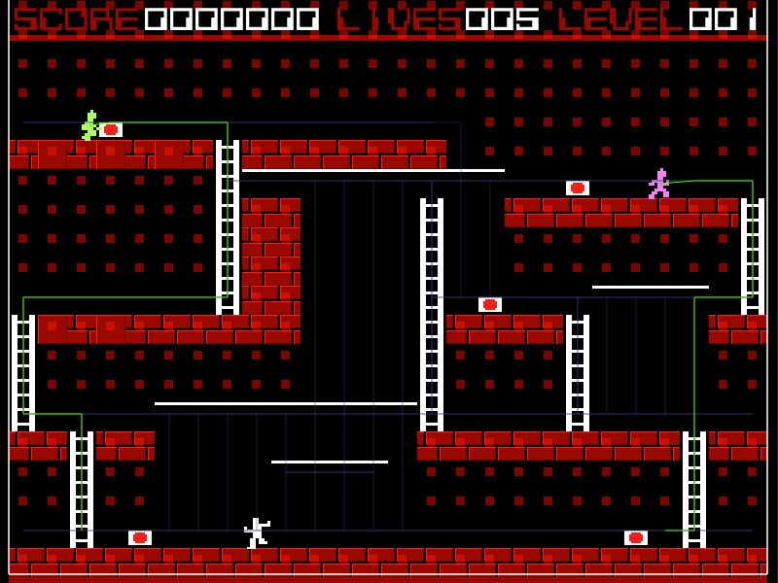
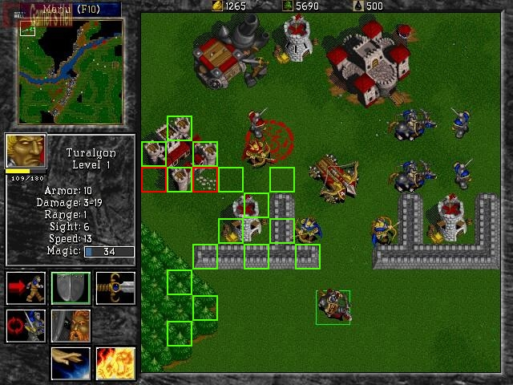
Finding a Path
Often seems obvious and natural in real life
e.g., Get from point A to B → go around lake
For computer controlled player, may be difficult
e.g., Going from A to B goes through enemy base!
Want to pick “best” path
Need to do it in real-time
http://www.rocket5studios.com/tutorials/make-a-2d-game-with-unity3d-using-only-free-tools-beginning-enemy-ai-with-a-pathfinding/
http://www.codeofhonor.com/blog/the-starcraft-path-finding-hack

Slide 3
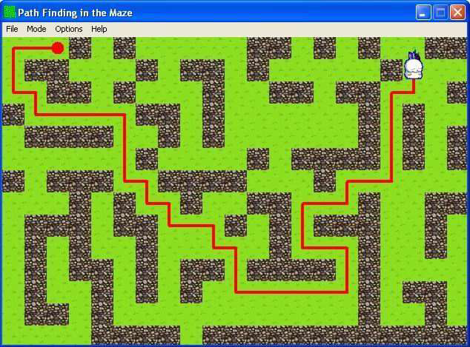
Finding a Path
Path – a list of cells, points or nodes that agent must traverse to get to from start to goal
Some paths are better than others
→ measure of quality
A* is commonly used heuristic search
Complete algorithm in that if there is path, will find
Using “distance” as heuristic measure, then guaranteed optimal
http://www.cognaxon.com/index.php?page=educational

Slide 4
A* Pathfinding Search
Covered in detail in IMGD 3000
http://web.cs.wpi.edu/~imgd4000/d16/slides/imgd3000-astar.pdf
Basic A* is a minimal requirement for solo project
You may use any reference code as a guide, but not copy and paste (cf. academic honesty policies)
An advanced pathfinding feature will be optional, but required for an A
This slide deck

Slide 5
Practical Path Planning
Sometimes, basic A* is not enough
Also, often need:
Navigation graphs
Points of visibility (pov) – lines connecting visible nodes
Navigation mesh (navmesh) – models traversable areas of virtual map
Path smoothing
Compute-time optimizations
Hierarchical pathfinding
Special case methods
Some of these count as optional requirement

Slide 6
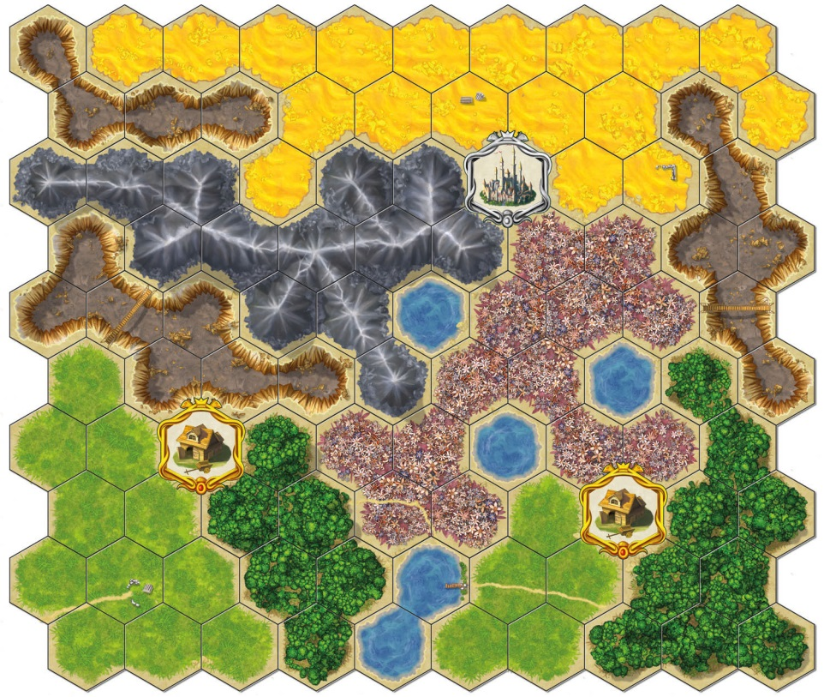
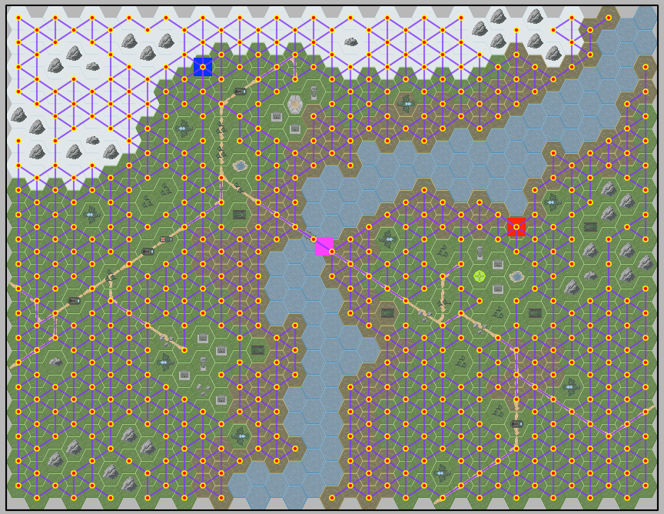
Tile-Based Navigation Graphs
Common, especially if environment already designed in squares or hexagons
Node center of cell; edges to adjacent cells
Each cell already labeled with material (mud, river, etc.)
Downside:
Can burden CPU and memory
e.g., Modest 100x100 cell map has 10,000 nodes and 78,000 edges!
Especially if multiple AI’s calling at same time
Most of slide deck is survey about how to do better...
http://opinionatedgamers.com/2011/12/07/review-of-kingdom-builder/
http://forum.cocos2d-objc.org/t/tilemapkit-complete-tiled-tmx-tilemap-support-including-hex-staggered-iso/17313

Slide 7
Outline
Introduction (done)
Navigation Graphs (next)
Navigation Mesh
Pathfinding Tuning
Pathfinding in UE4

Slide 8
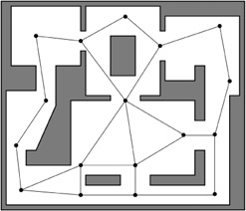
Point of Visibility (POV) Navigation Graph
Place graph nodes (usually by hand) at important points in environment
Such that each node has line of sight to at least one other node

Slide 9
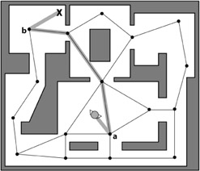
POV Navigation
Find closest visible node (a) to current location
Find closest visible node (b) to target location
Search for least cost path from (a) to (b), e.g. A*
Move to (a)
Follow path to (b)
Move to target location
Note, some “backtracking”
DEMO (COARSE)

Slide 10
Blind Spots in POV
No POV point is visible from red spots!
Easy to fix manually in small graphs
A problem in larger graphs
DEMO (COARSE)

Slide 11
POV Navigation
Advantage
Obvious how to build and expand
Disadvantages
Can have “blind spots”
Can have “jerky” (backtracking) paths
Can take a lot of developer time, especially if design is rapidly evolving
Problematic for random or user generated maps
Solutions
Automatically generate POV graphs
Make finer grained graphs
Path smoothing

Slide 12
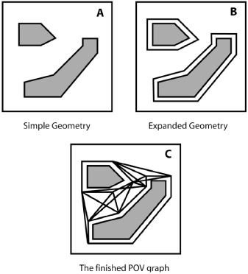
Automatic POV by Expanded Geometry
(A) Expand geometry
By amount proportional to bounding radius of moving agents
(B) Connect all vertices
(C) Prune non-line of sight points
→ Avoids objects hitting edges when pathing
Note: works best if bounding radius similar for all units

Slide 13
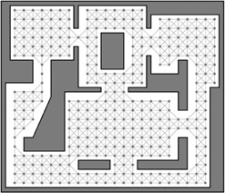
Finely Grained Graphs
Upside? Improves blind spots and path smoothness
Downside? Back to similar performance issues as tiled graphs
Upside? Can often generate automatically using “flood fill” (next slide)

Slide 14
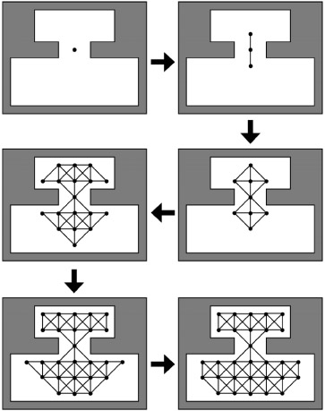
Flood Fill to Produce Finely Grained Graph
Place “seed” in graph
Expand outward
e.g., 8 directions
Making sure nodes and edges passable by bounding radius
Continue until covered
→ Produces a finely grained graph
Note, same algorithm used by “paint” programs to flood fill color

Slide 15
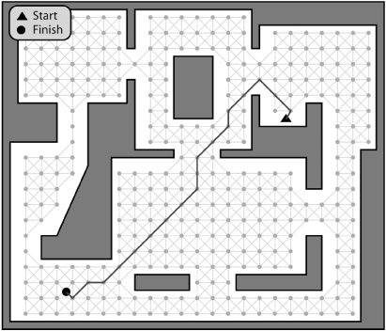
Path Finding in Finely Grained Graph
Use A* or Dijkstra depending on whether looking for specific or multiple general targets
e.g., Find exit? A* typically faster than Dijkstra’s since latter is exhaustive
e.g., Find one of many rocket launchers? A* would need to be re-run for each, then chose minimum.

Slide 16
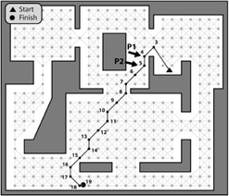
Problem: Kinky Paths
Problem: Path chosen “kinky”, not natural
Solution? Path smoothing.
- Simple fix to “penalize” change in direction
- Others work better (next)

Slide 17
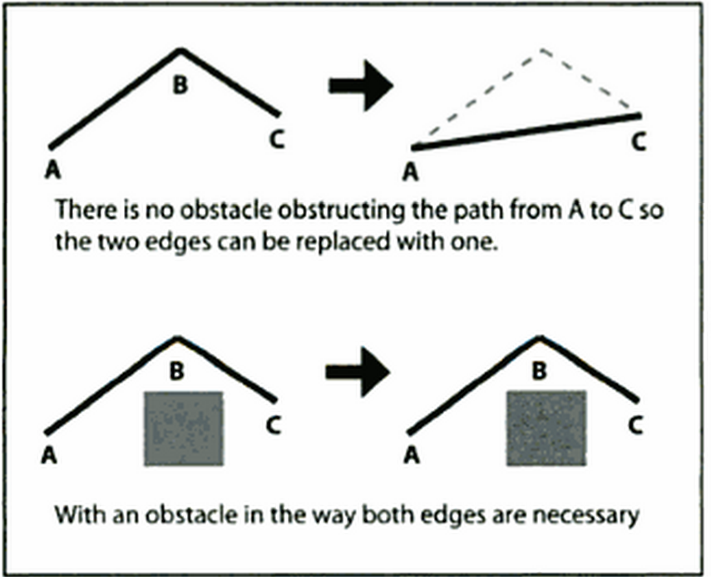
Simple Smoothing Algorithm (1 of 2)
Check for “passability” between adjacent edges
Also known as “ray-cast” since if can cast a ray between A and C then waypoint B is not needed

Slide 18
Simple Smoothing Algorithm (2 of 2)
Grab source E1
Grab destination E2
If agent can move between,
Assign destination E1 to destination E2
Remove E2
Advance E2
If agent cannot move
Assign E2 to E1
Advance E2
Repeat until destination E1 or destination E2 is endpoint
E1
E2
E1
E1
E2
E1

Slide 19
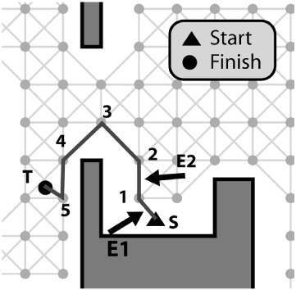
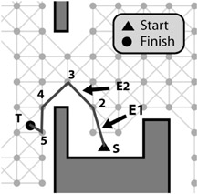
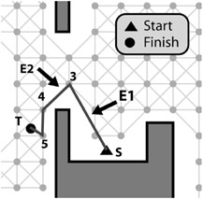
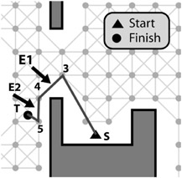
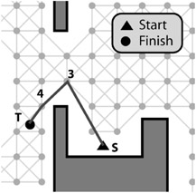
Path Smoothing Example
E1
DEMO (SMOOTH)

Slide 20
Outline
Introduction (done)
Navigation Graphs (done)
Navigation Mesh (next)
Pathfinding Tuning
Pathfinding in UE4

Slide 21
Navigation Mesh (NavMesh)
Partition open space into network of convex polygons
Why convex? → guaranteed path from any point to any point inside
Instead of network of points, have network of polygons
Can be automatically generated from arbitrary polygons
Becoming very popular (e.g., UE4)

Slide 22
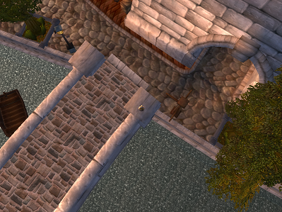
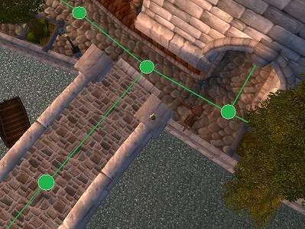
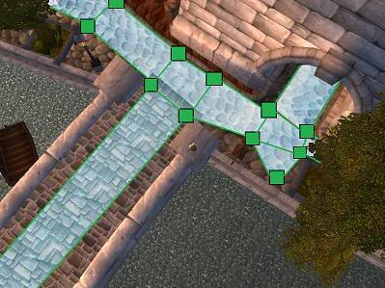
NavMesh Example (1 of 3)
Waypoint
(Part of Stormwind City in World of WarCraft)
NavMesh has more information (i.e., can walk anywhere in polygon)
NavMesh
http://www.ai-blog.net/archives/000152.html

Slide 23
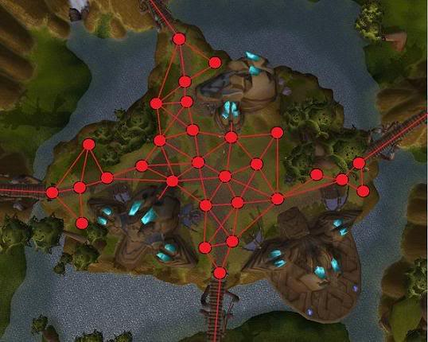
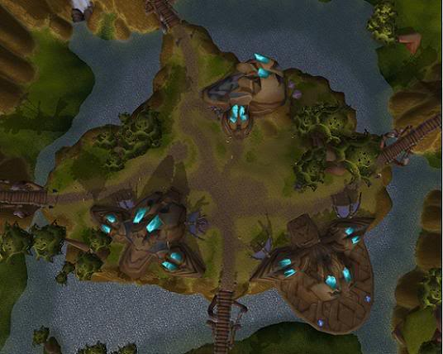
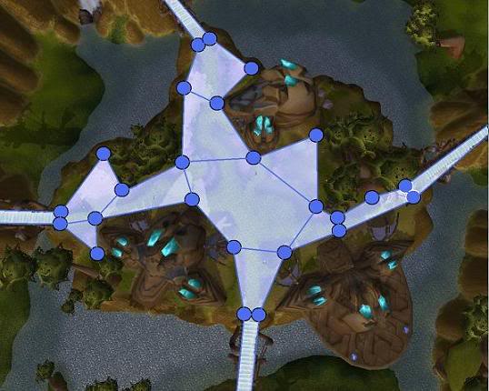
NavMesh Example (2 of 3)
Waypoint
(The town of Halaa in World of WarCraft, seen from above (slightly modified))
Waypoint needs lots of points
NavMesh needs fewer polygons to cover same area
NavMesh
http://www.ai-blog.net/archives/000152.html

Slide 24
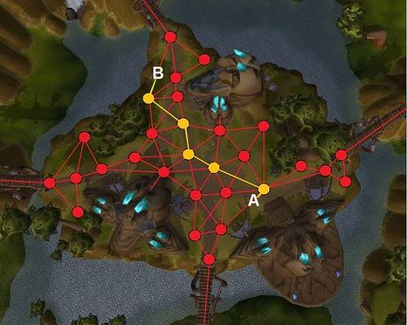
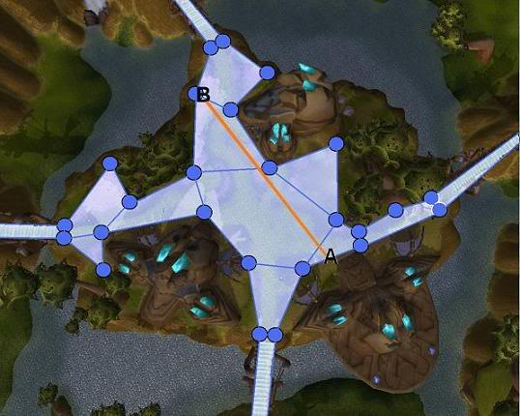
NavMesh Example (3 of 3)
Waypoint
(The town of Halaa in World of WarCraft, seen from above (slightly modified))
Plus smoothing, else zigzag
Note, smoothing for navmesh works, too
NavMesh
http://www.ai-blog.net/archives/000152.html

Slide 25
NavMesh Performance
But isn't it slower to do pathfinding on NavMesh?
No. NavMesh is also a graph, just like waypoints.
Difference? Navmesh has polygon at each graph node
A* runs on any graph
Square grid
Waypoint
Navmesh
(Illustration of graph (red) underlying a navigation mesh)
http://www.ai-blog.net/archives/000152.html

Slide 26
NavMesh with other Paths
NavMesh can be used with waypoints
Use waypoints for higher-order locations
E.g.,
Soldiers need patrol path
Old man needs fishing path
Cover points for hiding
NavMesh to get there
(Various terrain markers (AI hints) and NavMesh)
http://www.ai-blog.net/archives/000152.html

Slide 27
Outline
Introduction (done)
Navigation Graphs (done)
Navigation Mesh
Generating a NavMesh (next)
Pathfinding Tuning
Pathfinding in UE4

Slide 28
Generating NavMesh
Can be generated by hand
e.g., lay out polygons (e.g., squares) to cover terrain for map
Takes a few hours for typical FPS map
Can be generated automatically
Various algorithm choices
One example [Leo14]
[Leo14] Timothy Leonard. “Procedural Generation of Navigation Meshes in Arbitrary 2D Environments”, Open Journal Systems Game Behavior, Volume 1, Number 1, 2014.
Online: http://computing.derby.ac.uk/ojs/index.php/gb/article/view/13

Slide 29
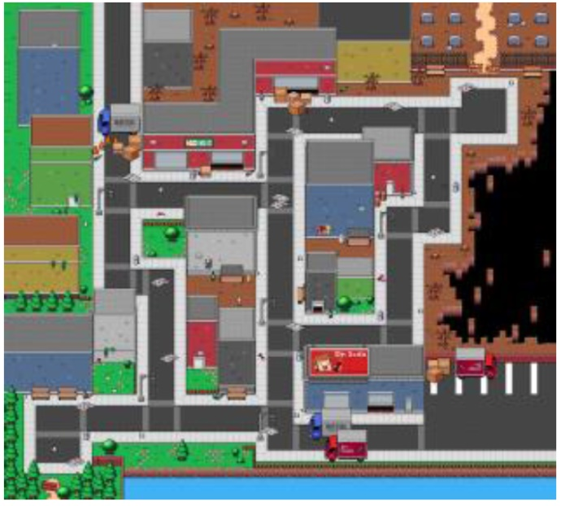
Generating NavMesh – Walkable Area
Base background (just for show)
Walkable area (white)
Use collision grid to compute walkable area
Prepare 2d array, one for each pixel
Sample each pixel → if collide, then black else white

Slide 30
Generating NavMesh – Contour
Run marching squares to get contour
“marching squares” is graphics algorithm that generates contours for 2d field
Parallelizes really well
Contour points used as vertices for triangles for NavMesh
After running marching squares. Purple dots show contour of walkable area.

Slide 31
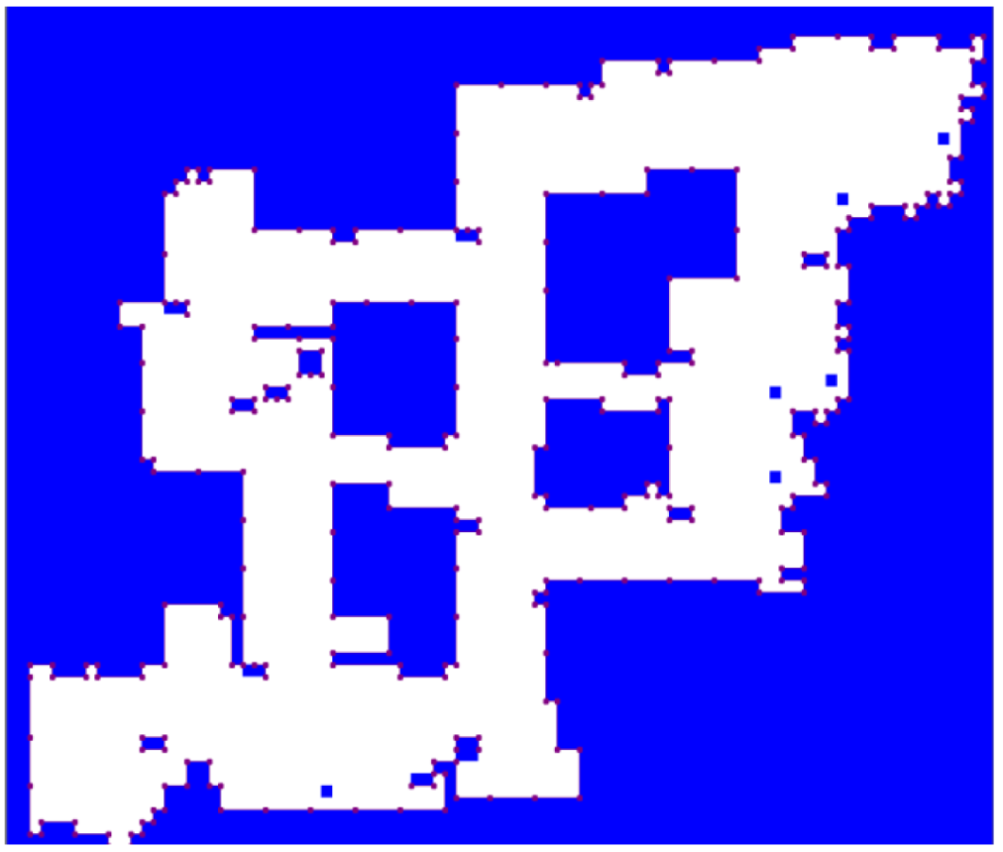
Generating NavMesh – Simplified Contour
Simplify contour by removing points along same horizontal/vertical line
Don’t remove all redundant points to avoid super-long edges (can produce odd navigation) in triangles
Define max distance between points
Simplifying contour points, max distance 128

Slide 32
Generating NavMesh – Triangles
Fit squares → Loop
Find point not in mesh
Create square at point
Expand until hits edge or other square
Done when no more points
Split squares into triangles
Connect triangle to all other triangles in neighbor squares
Now have graph for pathfinding (e.g., A*)
NavMesh generated using rectangle expansion. Red lines show neighbors.

Slide 33
Generating NavMesh – Path
Using mid-points, path will zig-zag (see right)
Solution? → Path smoothing
Simple ray-cast
Funnel
Path generated using midpoints of triangles

Slide 34
Generating NavMesh – Path Smoothing by Ray-cast
Ray-cast as for “simple” smoothing shown earlier (see right)
Path generated using ray-cast to remove unnecessary points

Slide 35
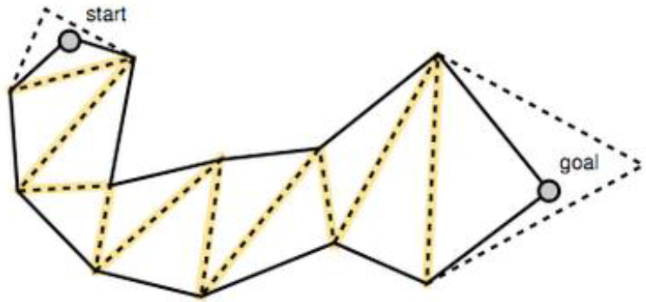
Generating Navmesh – Path Smoothing by Funnel
Smooth path from start to goal
Move edges along triangle
If can ray-cast, then not path “corner” so continue
If cannot, then found “corner”

Slide 36
Outline
Introduction (done)
Navigation Graphs (done)
Navigation Mesh (done)
Pathfinding Tuning (next)
Pathfinding in UE4

Slide 37
Possible Pathfinding Load Spikes
Could be many AI agents, all moving to different destinations
Each queries and computes independent paths
Can lead to spikes in processing time
→ Game loop can’t keep up!
Solution? Reduce CPU load by:
Pre-compute paths
Hierarchical pathfinding
Grouping
Time slice
(Talk about each briefly, next)

Slide 38
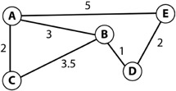
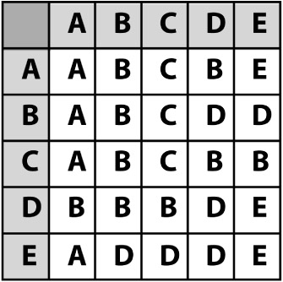
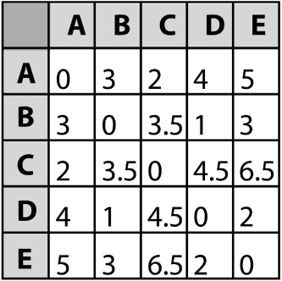
Reduce CPU Overhead – Precompute
If static paths, pre-generate paths and costs
(e.g., using Djikstra’s)
Time/space tradeoff
e.g., path A to D?
Shortest path table (next node)
Path cost table

Slide 39
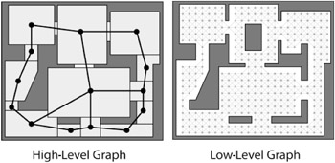
Reduce CPU Overhead – Hierarchical
Typically two levels, but can be more
First plan in high-level, then refine in low-level
E.g., Navigate (by car) Atlanta to Richmond
States Georgia and Virginia
State navigation: Georgia → South Carolina → North Carolina → Virginia
Fine grained pathfinding within state

Slide 40
Reduce CPU Overhead – Grouping
In many cases, individuals do not need to independently plan path
E.g., military has leader
So, only have leader plan path
Normal A*
Other units then follow leader
Using steering behaviors (later slide deck)
(Sketch of how next)

Slide 41
Reduce CPU Overhead – Time Slice (1 of 3)
Evenly divide fixed CPU pathfinding budget between all current callers
Must be able to divide up searches over multiple steps
Considerable work required!
But can be worth it since makes pathfinding load constant

Slide 42
Reduce CPU Overhead – Time Slice (2 of 3)
Pathfinding generalized
Grab next node from priority queue
Add node to shortest paths tree
Test to see if target
If not target, examine adjacent nodes, placing in tree as needed
Call above a “cycle”
Create generalized class so can call one cycle
(next slide)

Slide 43
Generalized Search Class
enum SearchType {Astar, Dijkstra};
enum SearchResult {found, not_found, incomplete};
class GraphSearch {
private:
SearchType search_type;
Position target;
public:
GraphSearch(SearchType type, Position target);
// Go through one search cycle. Indicate if found.
virtual SearchResult cycleOnce()=0;
virtual double getCost() const=0;
// Return list if edges (path) to target.
virtual std::list<PathEdge> getPath() const=0;
};
Derive specific search classes (A*, Dijkstra)
Each game loop, PathManager calls cycleOnce()
(If enough time, could call more than once)

Slide 44
Reduce CPU Overhead – Time Slice (2 of 3)
Create PathPlanner for Obj
Create PathManager to allocate cycles
PathPlanner registers with PathManager
Gets instance of path
Each tick, PathManager distributes cycles among all
When path complete, send message (event) to PathPlanner, which notifies Object
Objects to use for pathing
(See example next slide)

Slide 45
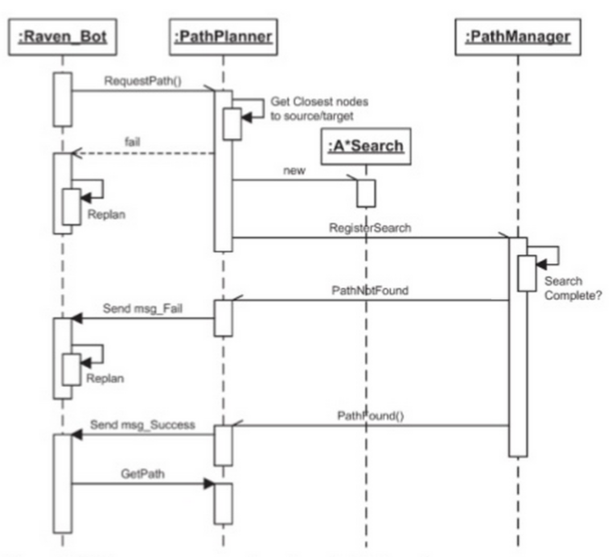
Time Slice Example
Object requests path to target
PathPlanner
Provides closest node
Creates search (A*, also could be Djikstra)
Registers with PathManager
PathManager
Allocates cycles among all searches
When done, returns path (or path not found)
PathPlanner
Notifies Object
Object requests path

Slide 46
Reduce CPU Overhead – Time Slice (3 of 3)
Note “time slicing” implies that caller may have to wait for answer
Wait time proportional to size of graph (number of cycles needed) and number of other Objects pathing
What should Object do while waiting for path?
Stand still → but often looks bad (e.g., player expects unit to move)
So, start moving, preferably in “general direction” of target
“Seek” as behavior (see later slide deck)
“Wander” as behavior (ditto)
When path returns, “smooth” to get to target (example next slide)

Slide 47
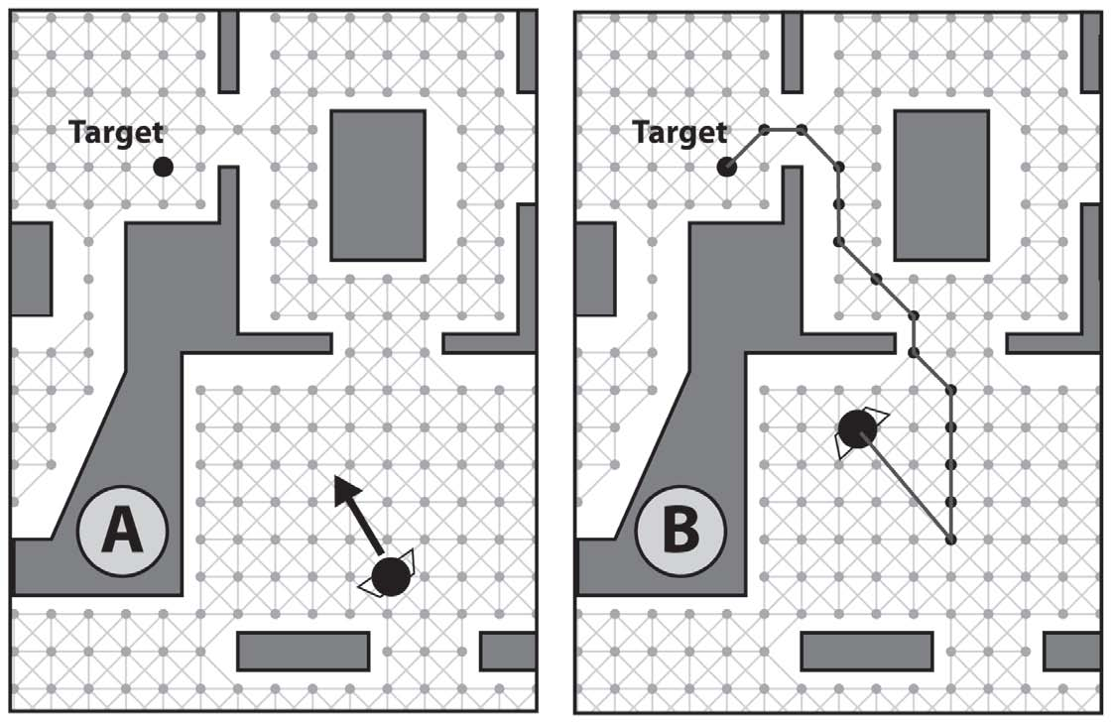
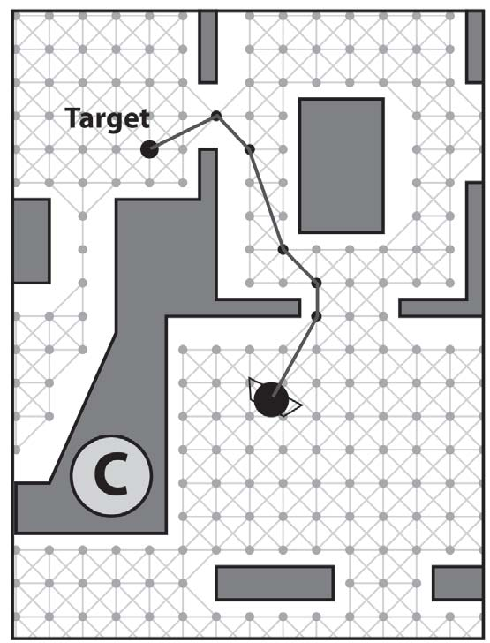
Time Slicing needs Smoothing
Object registers pathfinding to target
Starts seeking towards target
When path returns, Object will backtrack. Bad!
Solution? → Simple smoothing described earlier to remove
Without smoothing
Smoothed
DEMO (TIME-SLICING)

Slide 48
Time Slicing with Seek Fail
Seek direction
When waiting for path, head “wrong” direction
May even hit walls!
Looks stoopid
Alternative can be to return path to node closer to Object
Modify A* to return answer after X cycles/depth
Start moving along that path
Request rest of path
When complete path returned, adjust
Needed direction
Seek heads in obvious (to player) wrong direction

Slide 49
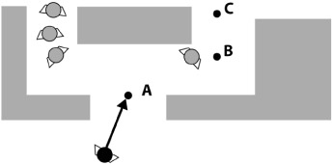
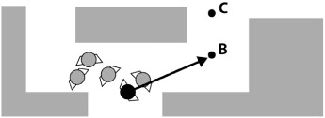
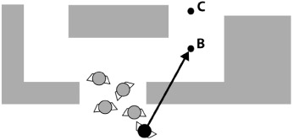
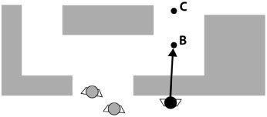
Getting Out of Stuck Situations
Object pathing to C
Reaches A, removes and B next
Other Objects “push” Object back
Object still heads to B but hits wall
DEMO (STUCK)

Slide 50
Getting Out of Stuck Situations
Calculate distance to Object’s next waypoint each update step
If this distance remains about same or consistently increases
Probably stuck
Replan
Alternatively – estimate arrival time at next waypoint
If takes longer, probably stuck
→ Replan

Slide 51
Advanced Pathfinding Summary
Not necessar to use all techniques in one game
Only use whatever game demands and no more
An advanced pathfinding feature is an optional project requirement
For reference C++ code see
http://samples.jbpub.com/9781556220784/Buckland_SourceCode.zip (Chapter 8 folder)

Slide 52
Outline
Introduction (done)
Navigation Graphs (done)
Navigation Mesh (done)
Pathfinding Tuning (done)
Pathfinding in UE4 (next)

Slide 53
Navigation in UE4
Has NavMesh
Auto generated initially
Tweaked by hand
NavLinkProxy to allow “jumping”
Auto re-generates when static objects move
(More in upcoming slides)

Slide 54
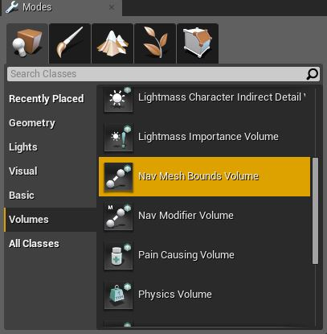
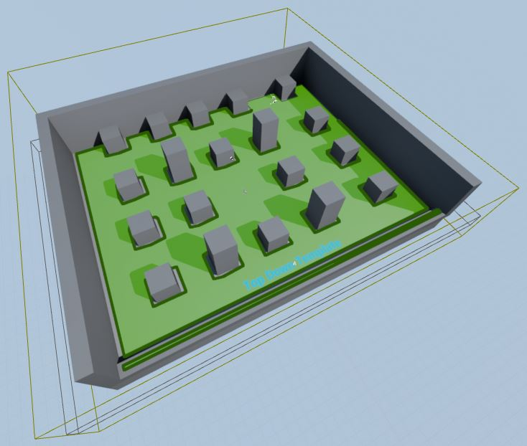
UE4 NavMesh
Modes Panel → Create → Volumes
Translate/scale to encapsulate walkable area
Press “P” to view
Green shows mesh

Slide 55
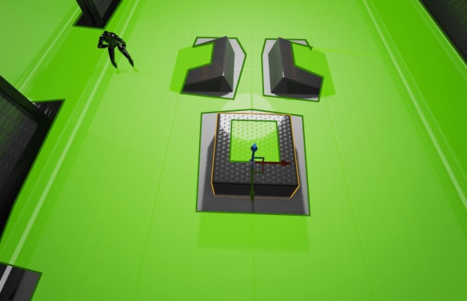
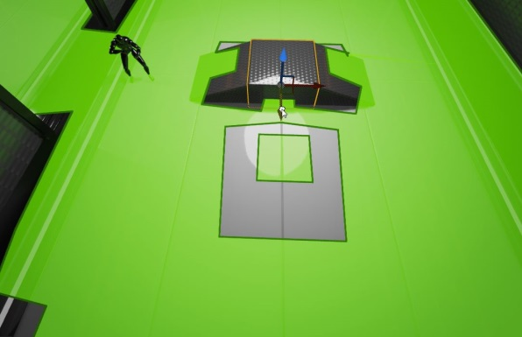
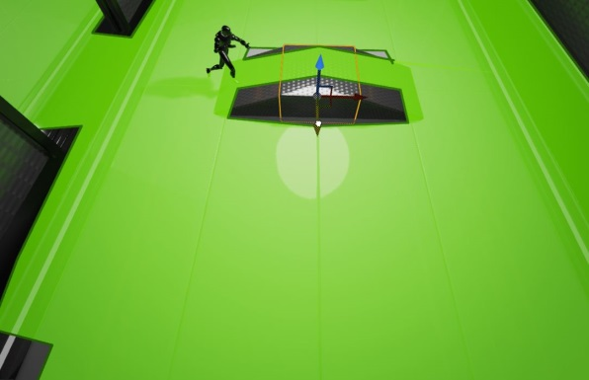
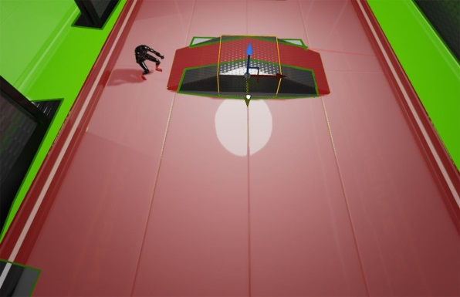
Automatic Update as Design Level
Move static mesh (bridge)
NavMesh automatic update

Slide 56
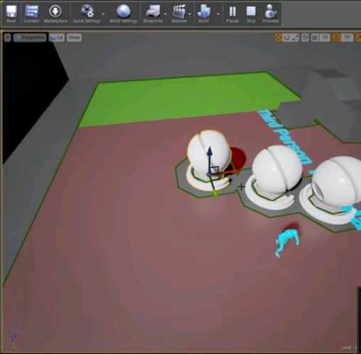
Automatic Update at Runtime
Edit → Project Settings →Navigation Settings → Rebuild at Runtime
Unreal Engine 4 Tutorial - NavMesh Rebuild Realtime
https://www.youtube.com/watch?v=UpbaCHTcNPA

Slide 57
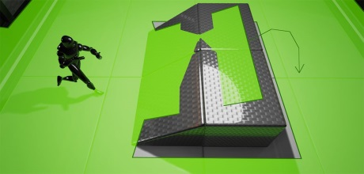
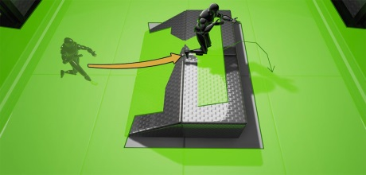
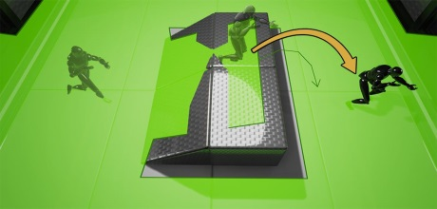
NavLinkProxy
Tell Pawns where can temporarily leave NavMesh (e.g., to jump off edges)
https://docs.unrealengine.com/latest/INT/Resources/ContentExamples/NavMesh/1_2/index.html

Slide 58
Use NavMesh with Character
Setup AI Character and AI Controller Blueprint
Place character in scene
“Move to location”
E.g., waypoints
“Move to actor”
E.g., follow or attach character
Unreal Engine 4 Tutorial - Basic AI Navigation
https://www.youtube.com/watch?v=-KDazrBx6IY

