Slide 1
AS-MAC: An Asynchronous Scheduled MAC Protocol for Wireless Sensor Networks
Beakcheol Jang, Jun Bum Lim, Mihail Sichitiu, NC State, Fifth IEEE Inernational Conference on Mobile Ad Hoc and Sensor Systems (MASS 2008)
Presenter: Bob Kinicki
PEDS November 1, 2010

Slide 2
AS-MAC Outline
Introduction to Wireless Sensor Networks (WSNs)
Related Work: Power Aware MAC Protocols
S-MAC, T-MAC, SCP-MAC
AS-MAC Design
Theoretical Analysis
Experiments
Conclusions

Slide 3
Wireless Sensor Networks
A distributed connection of nodes that coordinate to perform a common task.
In many applications, the nodes are battery powered and it is often very difficult to recharge or change the batteries.
Prolonging network lifetime is a critical issue.
Sensors often have long period between transmissions (e.g., in seconds).
Thus, a good WSN MAC protocol needs to be energy efficient.

Slide 4
Wireless Sensor Networks
Another attribute is scalability to change in network size, node density and topology.
In general, nodes can die, join later or be mobile.
Often high bandwidth is not important.
Nodes can take advantage of short-range, multi-hop communication to conserve energy.

Slide 5
Wireless Sensor Networks
Sources of energy waste:
Idle listening, collisions, overhearing and control overhead and overmitting.
Idle listening dominates (measurements show idle listening consumes between 50-100% of the energy required for receiving.)
Idle listening:: listen to receive possible traffic that is not sent.
Overmitting:: transmission of message when receiver is not ready.

Slide 6
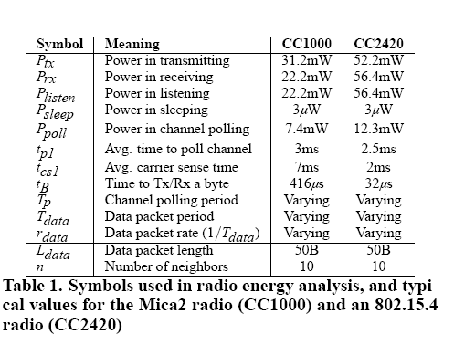
Power Measurements

Slide 7
WSN Communication Patterns
Broadcast:: e.g., Base station transmits to all sensor nodes in WSN.
Multicast:: sensor transmits to a subset of sensors (e.g. cluster head to cluster nodes)
Convergecast:: when a group of sensors communicate to one sensor (BS, cluster head, or data fusion center).
Local Gossip:: sensor sends message to neighbor sensors.

Slide 8
Wireless Sensor Networks
Duty cycle:: ratio between listen time and the full listen-sleep cycle.
central approach – lower the duty cycle by turning the radio off part of the time.
Three techniques to reduce the duty cycle:
TDMA
Schedule contention periods
LPL (Low Power Listening)

Slide 9
Techniques to Reduce Idle Listening
TDMA requires cluster-based or centralized control.
Scheduling – ensures short listen period when transmitters and listeners can rendezvous and other periods where nodes sleep (turn off their radios).
LPL – nodes wake up briefly to check for channel activity without receiving data.
If channel is idle, node goes back to sleep.
If channel is busy, node stays awake to receive data.
A long preamble (longer than poll period) is used to assure than preamble intersects with polls.

Slide 10
AS-MAC Outline
Introduction to Wireless Sensor Networks (WSNs)
Related Work: Power Aware MAC Protocols
S-MAC, T-MAC, SCP-MAC
AS-MAC Design
Theoretical Analysis
Experiments
Conclusions

Slide 11
Power Aware MAC Protocols
1997
1998 PAMAS
1999
2000
2001 SMAC
2002 LPL NPSM
2003 TMAC TinyOS EMACs TRAMA Sift
2004 BMAC DMAC DSMAC LMAC WiseMAC
2005 PMAC ZMAC SP
2006 SCP-MAC
2007 Crankshaft
2008 AS-MAC
2010 BAS-MAC

Slide 12
Power Aware MAC Protocols
Three approaches to saving power:
1. TDMA: TRAMA, EMACs, LMAC
2. Schedule: PAMAS, SMAC, TMAC, DMAC, PMAC, SCP-MAC , Crankshaft, AS-MAC, BAS-MAC
3. Low Power Listening: LPL, BMAC, WiseMAC
Cross-Layering: SP, BSD

Slide 13
SMAC
All nodes periodically listen, sleep and wakeup. Nodes listen and send during the active period and turn off their radios during the sleep period.
The beginning of the active period is a SYNC period used to accomplish periodic synchronization and remedy clock drift.
Following the SYNC period, data may be transferred for the remainder of the active period using RTS/CTS for unicast transmissions.
Long frames are fragmented and transmitted as a burst.
SMAC controls the duty cycle to tradeoff energy for delay.
However, as density of WSN grows, SMAC incurs additional overhead in maintaining neighbors’ schedules.

Slide 14
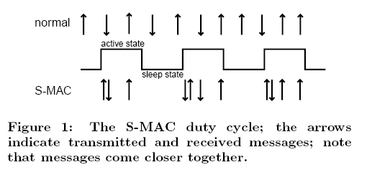
SMAC

Slide 15
TMAC
TMAC employs an adaptive duty cycle by using a very short listening window at the beginning of each active period.
After the SYNC portion of the active period, RTS/CTS is used in listening window. If no activity occurs, the node goes to sleep.
TMAC saves power at the cost of reduced throughput and additional delay.

Slide 16
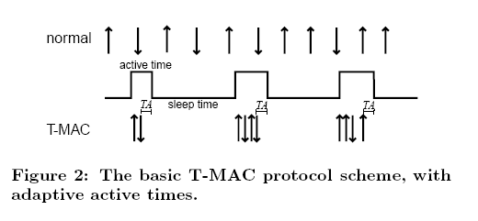
TMAC

Slide 17
Scheduled Channel Polling (SCP-MAC)
With channel polling (LPL scheme), receiver power efficiency is gained through increased cost to sender.
LPLs are very sensitive to tuning for neighborhood size and traffic rate.
By synchronizing channel polling times of all neighbors, long preambles are eliminated and ultra-low duty cycles (below the LPL 1-2% limits) are possible.

Slide 18
Scheduled Channel Polling (SCP-MAC)
The issue is knowing my neighbors’ schedule information.
SCP piggybacks schedule info on data packets when possible or a node broadcasts its schedule in a SYNC packet in synch period (as in SMAC)
Knowing schedules ➔ short wakeup tone.
Optimal synchronization reduces overhearing.

Slide 19
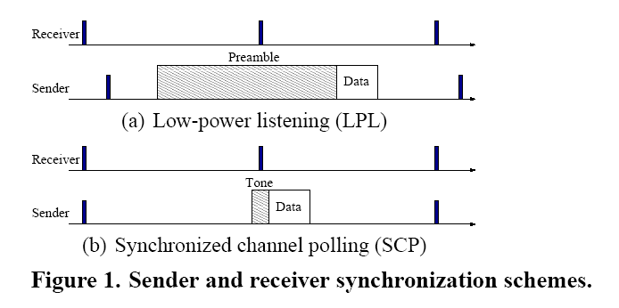
SCP-MAC

Slide 20
Problems with SCP-MAC
Overhearing avoidance on CC2420.
High contention means high packet loss and low throughput.
High delay
SCP-MAC addresses this issue with adaptive channel polling, but this only works with high loads.

Slide 21
Asynchronous Wake-up
Introduced in 802.11 protocols.
Designed to increase network robustness.
Nodes store the wakeup schedules of their neighbors.
Not intended to decrease energy consumption.

Slide 22
AS-MAC Outline
Introduction to Wireless Sensor Networks (WSNs)
Related Work: Power Aware MAC Protocols
S-MAC, T-MAC, SCP-MAC
AS-MAC Design
Theoretical Analysis
Experiments
Conclusions

Slide 23
AS-MAC Design
Nodes wake up periodically to receive packets.
Senders wake up according to the recipient’s schedule.
Two phases: initialization and periodic listening/sleep.

Slide 24
AS-MAC Initialization Phase
Used when a node joins the network.
AS-MAC uses two packet types: Hello and Data
Listen to channel for hello interval time, build neighbor table.
Once NT is built, initializing node picks its wakeup time based on those of its neighbors.
Strive for even distribution—new node’s wakeup is half the point of the longest interval among neighbors.

Slide 25
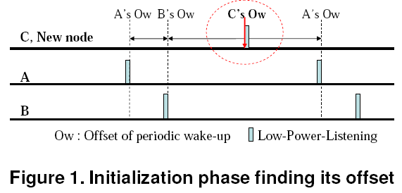
AS-MAC Initialization Phase

Slide 26
AS-MAC Neighbor Table
Address | Wakeup Interval | Clock Difference | Hello Interval | Wakeup Estimate
2 | 1000 | 462 | 60 | 250
3 | 1000 | 728 | 60 | 500
4 | 1000 | 102 | 60 | 750

Slide 27
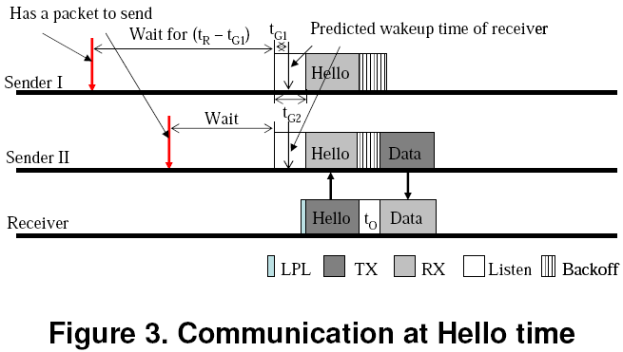
Periodic Listening Phase: Receiving
Periodically wake up and perform LPL
If channel is busy, receive. Otherwise, go back to sleep.
Occasionally send hello packets upon wakeup.

Slide 28
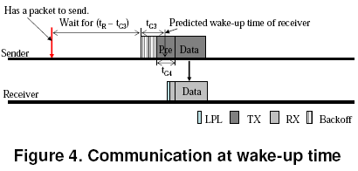
Periodic Listening Phase: Sending
Sleep until the recipient’s wakeup time.
Then transmit preamble followed by data:

Slide 29
Periodic Listening Phase: Contending
What happens if multiple senders wish to simultaneously send to the same recipient?
Slotted contention window
Before sending, a random slot in the contention window is selected and someone wins.
But – what if the same slot is chosen by multiple senders?:
Not addressed. In reality, this is usually a packet loss.

Slide 30
AS-MAC Broadcasting
1
5
BS
2
4
3
1
2
3
4
5

Slide 31
AS-MAC Broadcasting
1
5
BS
2
4
3
1
2
3
4
5

Slide 32
AS-MAC Broadcasting
1
5
BS
2
4
3
1
2
3
4
5

Slide 33
AS-MAC Broadcasting
1
5
BS
2
4
3
1
2
3
4
5

Slide 34
AS-MAC Broadcasting
1
5
BS
2
4
3
1
2
3
4
5

Slide 35
AS-MAC Broadcasting
1
5
BS
2
4
3
1
2
3
4
5

Slide 36
SCP-MAC Broadcast
1
5
BS
2
4
3

Slide 37
AS-MAC Outline
Introduction to Wireless Sensor Networks (WSNs)
Related Work: Power Aware MAC Protocols
S-MAC, T-MAC, SCP-MAC
AS-MAC Design
Theoretical Analysis
Experiments
Conclusions

Slide 38
Theoretical Analysis
Model: multi-hop CC2420 network rooted at sink
SCP-MAC {without collision avoidance, two-phase contention or adaptive channel polling}
Simple energy model:

Slide 39
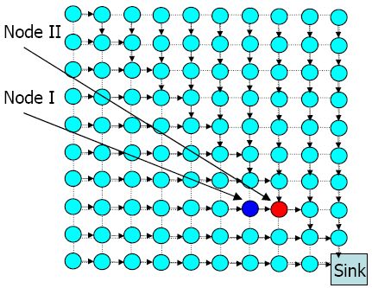
Theoretical Simulation Setup
100 nodes (10x10 grid)
-All nodes have the same wake-up interval
Fixed routing
Nodes only communicate with immediate neighbors
Node I: receives and forwards for 6 nodes; hears 126 transmissions in each sampling period.
Node II: receives and forwards for 63 nodes;
hears 143 transmissions in each sampling period.

Slide 40
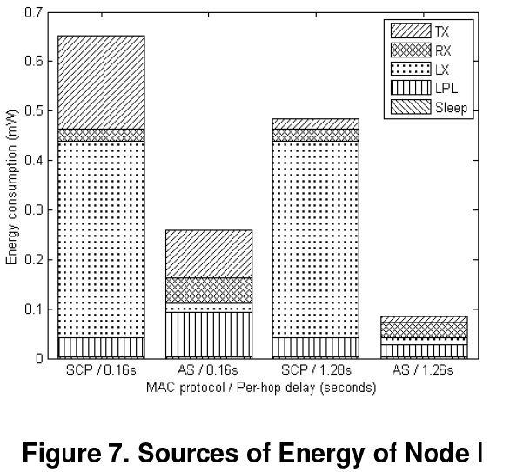
Theoretical Simulation Results
Overhearing

Slide 41
AS-MAC Outline
Introduction to Wireless Sensor Networks (WSNs)
Related Work: Power Aware MAC Protocols
S-MAC, T-MAC, SCP-MAC
AS-MAC Design
Theoretical Analysis
Experiments
Conclusions

Slide 42
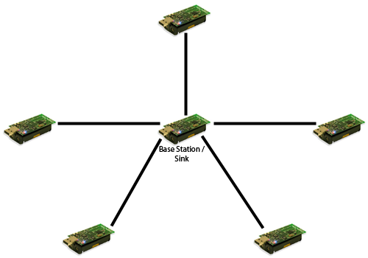
Experimental Evaluation
TinyOS implementation on MicaZ (CC2420) motes
Measured energy, latency and packet loss.
Single-hop star and multi-hop line topologies.

Slide 43
Measurement Methodology
Monitored changes in the state of the radio.
Done by modifying TinyOS’s CC2420 radio drivers.
Used timers to measure time in each state.
Computed energy by multiplying time in each state by energy consumed in that state.

Slide 44
Energy Experiment Methodology
Used a static initialization table (skip init phase).
Senders transmit to BS every 10 seconds, 10 times (200s experiment)
Wakeup interval 1 second.
60 second HELLO (AS) and SYNC (SCP) intervals.
Contention window of size 16
SCP-MAC’s optimizations disabled
Two-phase contention, adaptive channel polling

Slide 45
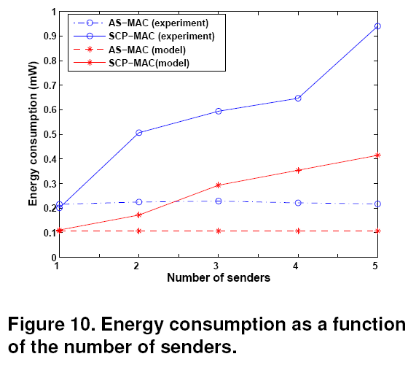
Energy vs Senders

Slide 46
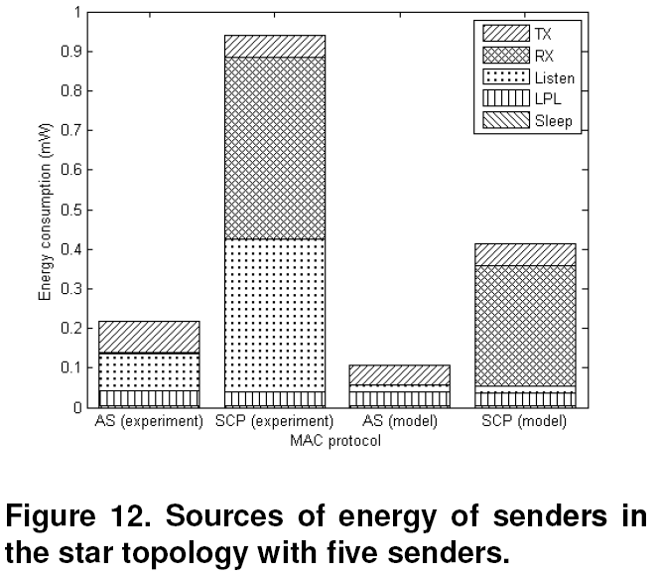
Star Topology (Five Senders)

Slide 47
Energy Consumption Analysis
SCP suffers badly from overhearing.
CC2420 packet-based radio amplifies this impact.
Theoretical model underestimated energy costs
Due to unrealistic estimates of hardware timing.

Slide 48
Packet Loss Experiments
Line topology with five nodes sending packets to sink at one end.
Experiments ran until ten packets from each node successfully received at the BS.
Size of contention window reduced to 4
To emphasize AS-MAC’s reduced contention vs SCP.
SCP’s Two-phase contention disabled.

Slide 49
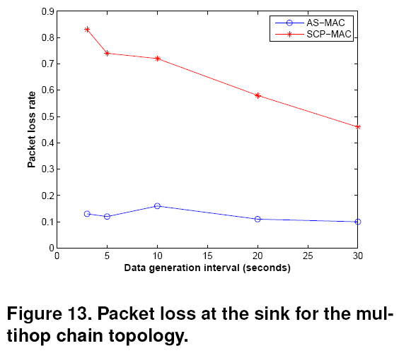
Packet Loss Experiment Results

Slide 50
Packet Loss Analysis
SCP-MAC experiences greater contention than AS-MAC.
This experiment was clearly designed to have AS-MAC crush SCP.
Disabling of two-phase contention unfair.
{above two bullets Andrew Keating’s are opinion!}

Slide 51
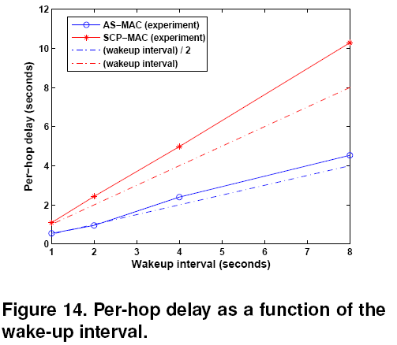
Delay Experiment Results

Slide 52
Memory Footprint
MicaZ: 4000 bytes RAM
SCP-MAC: 898 bytes
AS-MAC: 944 bytes
Neighbor table overhead

Slide 53
AS-MAC Outline
Introduction to Wireless Sensor Networks (WSNs)
Related Work: Power Aware MAC Protocols
S-MAC, T-MAC, SCP-MAC
AS-MAC Design
Theoretical Analysis
Experiments
Conclusions

Slide 54
Conclusions
Asynchronous coordination of receiving slots among neighbors can significantly reduce overhearing, contention and delay in some situations
Broadcasting inefficient, and scales poorly
A step forward, but there is still no “best” MAC protocol for all scenarios – tradeoffs exist

Slide 55
BAS-MAC
Broadcasting Asynchronous Scheduled MAC
MQP - Brian Bates and Andrew Keating
Added broadcast slot to wakeup periods
Frequency is adjustable
More versatile than AS-MAC

Slide 56
BAS-MAC Broadcasting
1
5
BS
2
4
3
B
1
2
3
4
5

Slide 57
Acknowledgement
All the slides specific to AS-MAC came from Andrew Keating’s presentation in CS577 in Fall 2009.

Slide 58
Questions
Thank You

