Slide 1
Inferring Internet Denial-of-Service Activity
David Moore, Colleen Shannon, Douglas J. Brown, Geoffrey M. Voelker, Stefan Savage
Presented by
Thangam Seenivasan & Rabin Karki

Slide 2
Simple Question
How prevalent are denial-of-service attacks in the Internet?

Slide 3
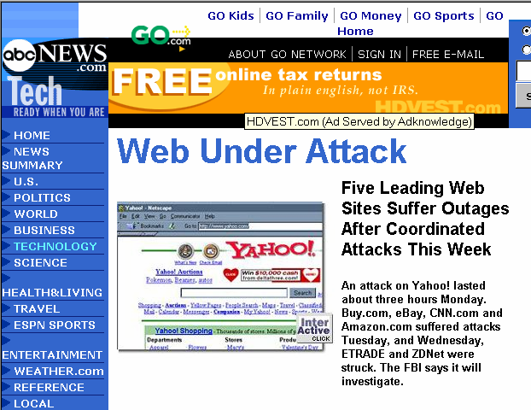
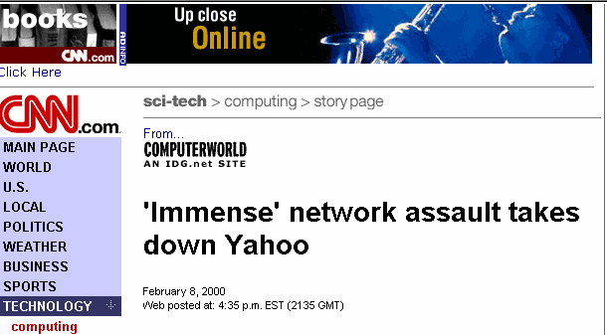
Why is it important?
Loss could total more than $1.2 billion
-analysts
DDOS attacks have become common
Borrowed from G.Voelkar’s presentation

Slide 4

Recent DDOS attack

Slide 5
Challenges
No quantitative data available about the prevalence of DOS attacks
Obstacles gathering DOS traffic data
  ISP consider such data private and sensitive
  Need to monitored from a large number of sites to obtain representative data

Slide 6
Solution
Backscatter Analysis
  Estimate prevalence of worldwide DOS attacks
  Traffic monitoring technique
  Conservative estimate on the prevalence
  Lower bound on the intensity of attacks

Slide 7
Outline
Background
Methodology
Attack detection and classification
Analysis of DOS

Slide 8
DOS attacks
An attempt to make a computer resource unavailable to its intended users
Classes of attacks
  Logic attacks (exploits software flaws)
    Ping-of-Death
  Resource attacks
    Sending a large number of spurious requests
This paper focuses only on resource attacks

Slide 9
Resource attacks
Network
  Overwhelm the capacity of network devices
  Attacker sends packets as rapidly as possible
CPU
  Load the CPU by requiring additional processing
  SYN flood
    For each SYN packet to a listening TCP port
      The host must search through existing connections
      Allocate new data structures
    Even a small SYN flood can overwhelm a remote host

Slide 10
Distributed attacks
More powerful attacks
  From multiple hosts
Attacker
Coordinated attack
Communication for
remote control
Runs a daemon
Compromised
Compromised
Compromised

Slide 11
IP Spoofing
Many attackers spoof IP source address
  To conceal their locations
Use random address spoofing
  To overcome blacklisting/filtering
This paper focuses solely on attacks with random address spoofing

Slide 12
Outline
Background
Methodology
Attack detection and classification
Analysis of DOS

Slide 13
Key Idea
Attackers spoof source address randomly
Victim, in turn respond to attack packets
Unsolicited responses (backscatter) equally distributed across IP address space
Received backscatter is evidence of an attacker elsewhere

Slide 14
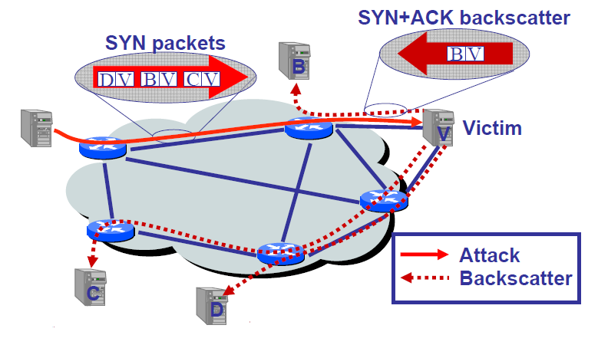
Backscattering
Attacker
Borrowed from G.Voelkar’s presentation

Slide 15
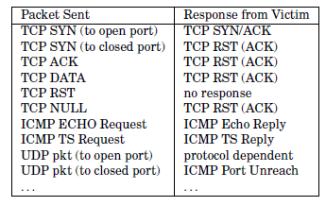
Typical victim responses

Slide 16
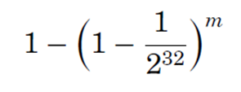

Backscatter Analysis
Probability of one given host on the Internet receiving at least one unsolicited response during an attack of m packets
Probability of n hosts receiving at least one of m packets

Slide 17

Backscatter Analysis
Monitor from n distinct hosts
Expected number of backscatter packets given an attack of m packets
These samples contain
  Identity of the victim
  Timestamp
  Kind of attack

Slide 18
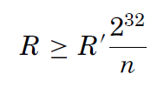
Backscatter Analysis
If arrival rate of unsolicited packets from a victim is R’
Extrapolated attack rate R on the victim is
packets per sec

Slide 19
Assumptions
Address uniformity
  attackers spoof source addresses at random
Reliable delivery
  Attack traffic and backscatter is delivered reliably
Backscatter hypothesis
  Unsolicited packets observed by the monitor represent backscatter

Slide 20
Limitation - Address uniformity
Many attacks do not use address spoofing
  ISPs increasingly employ ingress filtering
“Reflector attacks”
  Source address is specifically selected
Motivation for IP spoofing has been reduced
  Automated methods for compromising host
  DDOS attacks using true IP addresses
Each factor cause the analysis to underestimate
the total number of attacks

Slide 21
Limitation – Reliable delivery
Packets from attacker may be queued and dropped
Filtered and rate limited by a firewall
Some traffic do not elicit a response
Responses may be queued and dropped
Causes the analysis to underestimate
the total number of attacks and attack rate

Slide 22
Backscatter hypothesis
Any server in the Internet can send unsolicited packets
  Possible to eliminate flows consistently destined to a single host
Misinterpretation of random port scans as backscatters
Vast majority attacks can be differentiated from typical scanning activity
Provides a conservative estimate of current
denial-of-service activity

Slide 23
Outline
Background
Methodology
Attack detection and classification
Analysis of DOS

Slide 24
Attack detection and classification
Identify and extract backscatter packets from raw trace
Combine related packets into attack flows
  Based on victims IP address
Filter out some attack flows based on intensity, duration and rate

Slide 25
Extracting backscatter packets
Remove packets
  Involving legitimate hosts
  Packets that do not correspond to response traffic
  Remove TCP RST packets used for scanning
    These scans have sequential scanning patterns
    Remover RSTs with clearly non-random behavior
Remove duplicate packets
  Same <src IP, dst IP, protocol, src port, dst port> in the last five minutes

Slide 26
Flow-based classification
Flow-based identification
  Flow: Series of consecutive packets sharing the same victim IP address
  Flow lifetime: Timeout approach
    Defines when a flow begins and ends
    Packets arrive within a fixed timeout relative to the most recent packet in the flow – same flow
    More conservative timeout: long flows
    Shorter timeout: large number of short flows

Slide 27
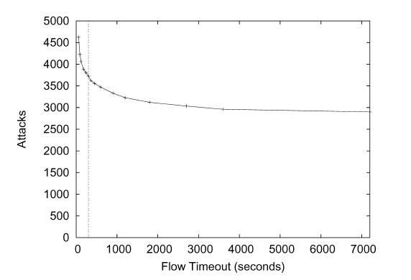
Flow timeout
300 seconds (5 minutes)

Slide 28
Filtering attack flows
Packet threshold
  Minimum number of packets necessary to classify it to be an attack
  Filter out short attacks which have negligible impact
Attack duration
  Time between first and last packet of a flow
  Filter out short attacks
Packet rate
  Threshold for maximum rate of packet arrivals
  Largest packet rate across 1-minute buckets

Slide 29
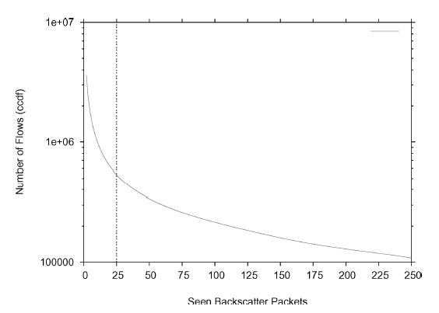
Packet threshold
25 packets

Slide 30
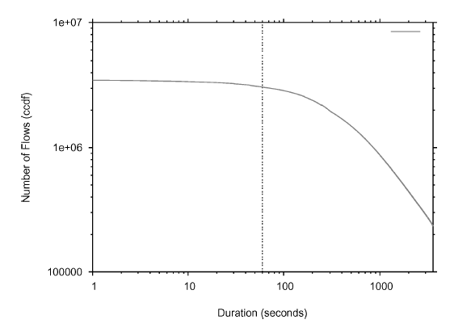
Attack duration
60 seconds

Slide 31
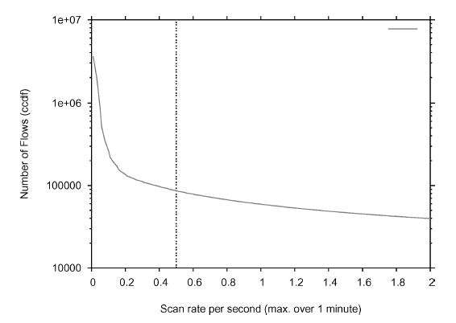
Packet rate
0.5 pps

Slide 32
Extracted Information
IP Protocol (TCP, UDP, ICMP)
TCP flag settings (SYN/ACKs, RSTs)
ICMP payload (copies of original packets)
Port settings (source and destination ports)
DNS information

Slide 33
Outline
Background
Methodology
Attack detection and classification
Analysis of DOS

Slide 34
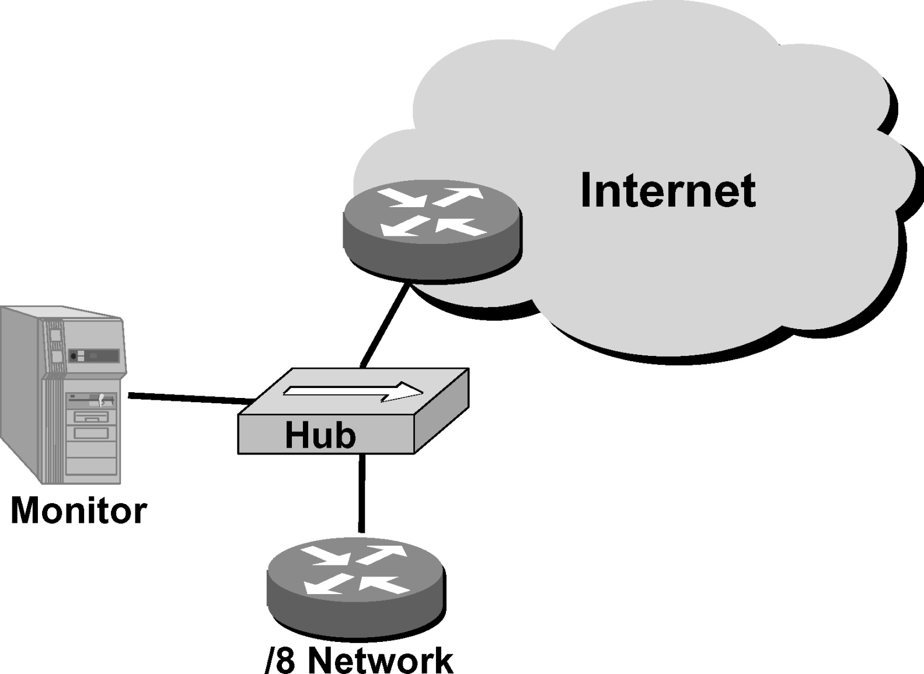
Analysis: Experimental Platform
Captures all the inbound traffic
via Hub
Sole ingress link
2²⁴ distinct IPs, 1/256 of the total Ipv4 address space

Slide 35
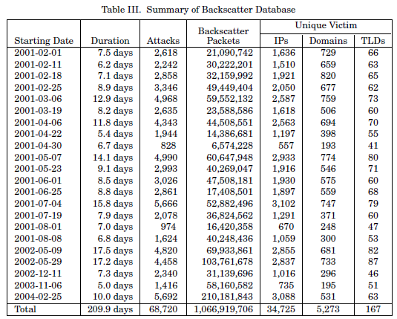
Summary of Attack Activity

Slide 36
Summary of Attack Activity
Collection done over a period of 3 years (Feb 1, 2001 – Feb 25, 2004).
Captured 22 traces of DoS activity.
Each trace roughly spans a week.
Total 68,700 attacks to 34,700 unique victim IPs.
1,066 million backscatter packets (≤1/256th of the total backscatter traffic generated)

Slide 37
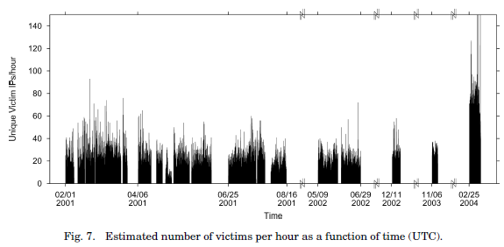
Summary of Attack Activity
No strong diurnal patterns, as seen in Web or P2P file sharing.
Rate of attack doesn’t change significantly over the period of time.
Attacks were not clustered on particular subnets.

Slide 38
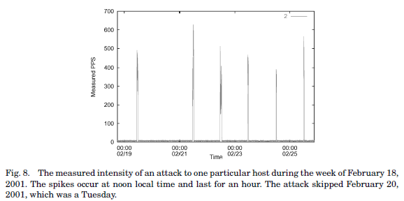
Summary of Attack Activity
Exhibits daily periodic behavior.
At the same time everyday, attack increases from est. 2,500 pps to 100,000-160,000 pps.
Attack persists for one hour before subsiding again.
Tuesdays off (suggests attacks are scripted).

Slide 39
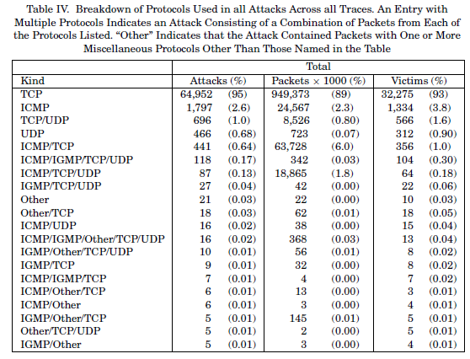
Attack Classification: Protocol

Slide 40
Attack Classification: Protocol
Table shows –
95% of attacks and 89% of packets use TCP protocol.
Distant second is ICMP with 2.6% of attacks.
Breakdown of TCP attacks shows most of the attacks target multiple ports.
Most popular individual target ports: HTTP (80), IRC (6667), port 0, Authd(113)

Slide 41
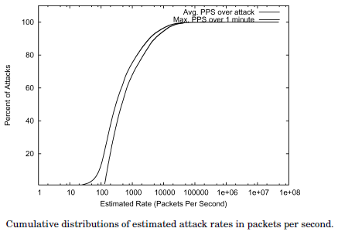
Attack Classification: Rate
500 SYN pps are enough to overwhelm a server.
65% attacks had 500 pps or higher.
4% attacks had ≥ 14,000 pps, enough to compromise attack-resistant firewalls.

Slide 42
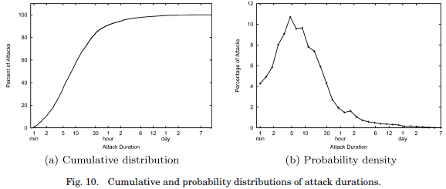
Attack Classification: Duration
60% attacks less than 10 min
80% are less than 30 min
2.4% are greater than 5 hrs
1.5% are greater than 10 hrs
0.53% span multiple days
PDF graph shows peak is at 5 min (10.8%), 10 min (9.7%)

Slide 43
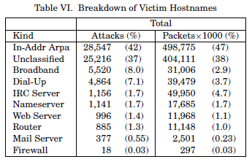
Victim Classification: Type

Slide 44
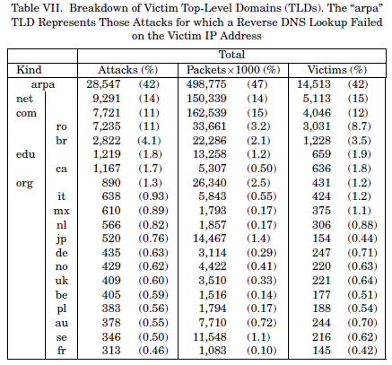
Victim Classification: TLD
Over 10% targeted com & net
1.3-1.7% targeted org & edu
11% were targeted to ro
4% to br

Slide 45
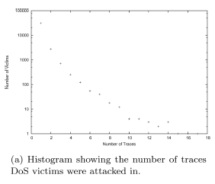
Victim Classification: Repeated Attacks
Most victims (89%) were attacked in only one trace.
Most of the remaining victims (7.8%) appear in two traces.
Victims can appear in multiple traces because of attacks that span trace boundaries.
3% victims appear in more than 3 traces, nevertheless.

Slide 46
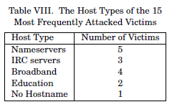
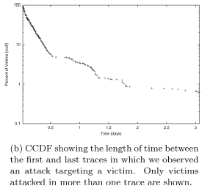
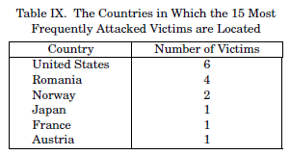
Victim Classification: Repeated Attacks
15 victims that appear in 10 or more traces

Slide 47
Validation
Nearly all of the packets attribute to the backscatter do not provoke a response, so these packets could not have been used to probe the monitored network.
Anderson-Darling test (a statistical test of whether there is evidence that a given sample of data did not arise from a given probability distribution) to determine if the distribution of destination addresses is uniform. Validated for most attacks at the 0.05 significance level.

Slide 48
Validation cont’d…
Duplicated portion of the analysis using data taken from several university-related networks in California.
  Although this is a much smaller dataset; for 98% of the victim IP recorded in this dataset, corresponding record was found at the same time in larger dataset.
Data from Asta Networks describing DoS attacks detected also qualitatively confirms the data in this paper.

Slide 49
Conclusions
Presented new technique called “backscatter analysis” for estimating DoS attack activity on the Internet.
Observed widespread DoS attacks distributed among many domains and ISPs.
Size and length of attacks were heavy tailed.
Surprising number of attacks directed at a few foreign countries. (or as we non-US citizens call them – home countries).
Witnessed over 68,000 attacks during 3 years, with little signs of abatement.

Slide 50
Questions?

