Slide 1
The War Between Mice and Elephants
Liang Guo and Ibrahim Matta
Boston University
ICNP 2001
Presented by
Thangam Seenivasan

Slide 2
Outline
Introduction
Analysis and Motivation
Architecture
Simulation Results
Discussion
Conclusion

Slide 3



TCP flows in the Internet
Long flow
Long flow
80%
20%
Long flow
Short flows

Slide 4
Is Internet fair?
In a fair network
  Short connections expect relatively fast service compared to long connections
Sometimes this is not the case with Internet
Why?

Slide 5
TCP
Fast retransmit
3 Dup Acks
Timeout
Fast recovery
Slow start
Slow start

Slide 6
Short TCP flows
1. Most short flows finish before slow start finish
cwnd
1
Transmission rate increases slowly
Does not get the fair share of the bandwidth
2
4
Slow start

Slide 7
Short TCP flows
2. Short flows have small congestion window
cwnd
Fast retransmit needs 3 dup ACKs
Small cwnd, not enough packets to activate dup Acks
So timeout happens
Timeout severely degrades the performance of TCP
1
2
timeout

Slide 8
Short TCP flows
3. Conservative Initial Timeout (ITO)
No sampling data available
Conservative timeout for (SYN, SYN-ACK) and 1st data packet
Disastrous effect on short connection performance if these packets lost
ITO
= 3 sec
timeout

Slide 9
Existing and proposed solution
Small cwnd &
Packet loss
ITO &
1st packet loss
Slow start
Reduce ITO
Use large initial window value
Get RTT from previous
records or neighbors
Reduce the loss probability these packets
Notes:
Reduce the probability of packet loss so that these scenarios don’t occur

Slide 10
Preferential treatment to short flows
Differentiated Services Architecture
  Classify flows into short and long flows
  Isolate packets from short flows
  Reduce the loss probability of these packets
With the help of
Active Queue Management
  RED In and Out (RIO)
    RED with two flow classes
    (short and long flows)
RIO-PS
RED In and Out with preferential treatment to short flows

Slide 11
Outline
Introduction
Analysis and Motivation
Architecture
Simulation Results
Discussion
Conclusion

Slide 12
Sensitivity of TCP flows to loss rate
RTO = 4 x RTT
Drops packet with
certain probability
RTT = 0.1 sec
ITO = 3 sec
Sender
P
Receiver
TCP
4 pkts
16 pkts
256 pkts
1024 pkts
4096 pkts
0.001
Short
flows
0.01
Long
flows
0.1

Slide 13
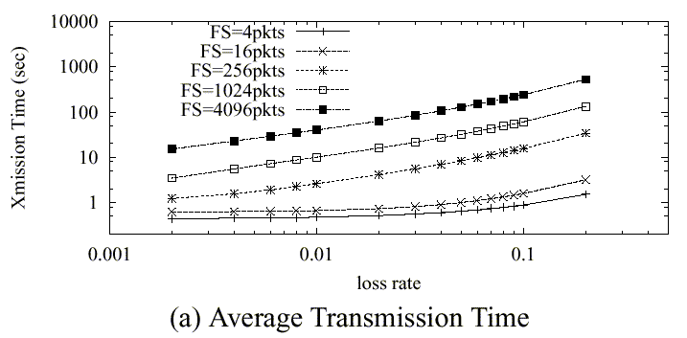
Average transmission time
No Loss
For short flows,
Xmission time increases drastically after certain loss rate

Slide 14
Variance of transmission times
Variation occurs across experiments because
  When loss rate is high, TCP enters exponential back-off phase
    Causes Significantly high variability in transmission time of each individual packet in a flow
  When loss rate is low, depending on when the loss happens
    Slow start phase – aggressive retransmission
    Congestion avoidance phase – less aggressive

Slide 15
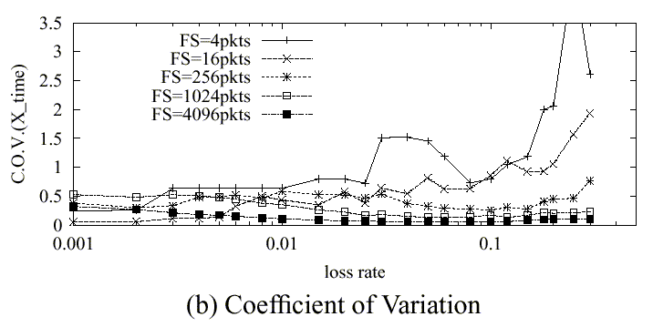
Variance of transmission times
COV = Standard deviation/mean
Variability in short flows
Due to 1.
Law of large numbers
Variability in long flows
Due to 2.
Loss in slow start or
congestion avoidance
Less variability in long flows
Loss in both slow start and
congestion avoidance

Slide 16
Conclusion and Motivation
Short flows are more sensitive to increase in loss probability
Variability of transmission time is closely related to fairness
Important to give preferential treatment to short flows
  Reduce the loss probability for short flows

Slide 17
Preferential treatment to short flows
Simulation – ns simulator
  10 long (10000-packet) TCP-Newreno
  10 short (100-packet) TCP-Newreno
  Competing over a 1.25Mbps link
Vary queue management policy
  Drop tail
  RED
  RIO-PS
    Reduce the loss probability of short flows

Slide 18
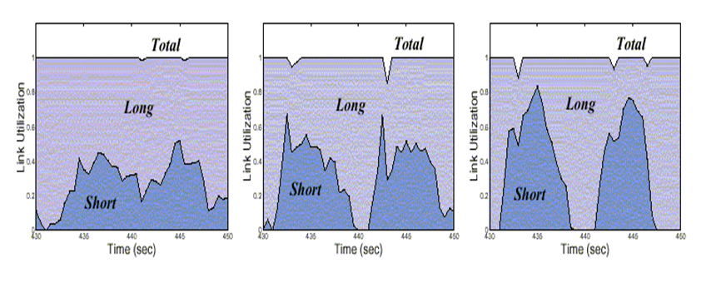
Link Utilization
Drop tail
RED
RIO-PS
Fails to give fair share to short flows
Favors flows with larger windows
More than fair share to short flows
Almost fair treatment to all flows

Slide 19
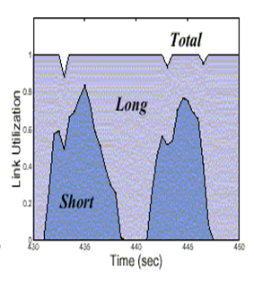
Link Utilization - RIO-PS
Short flows temporarily steal more bandwidth from long flows
In the long run, their early completion returns an equal amount of resources to long flows
It might enhance the transmission of long flows
  Less disturbed by short flow

Slide 20
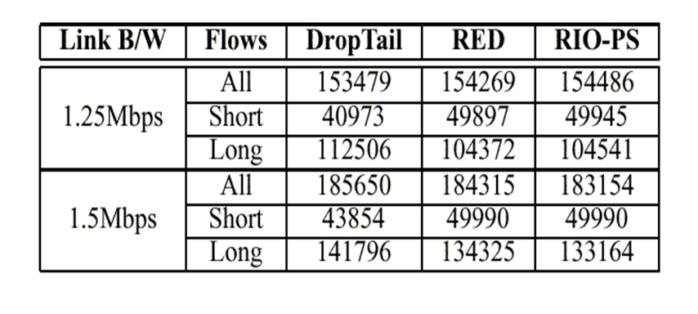
Network Goodput
More loaded network
RIO-PS has higher goodput
Less loaded network
DropTail performs slightly better
DropTail drops packets only when queue is full
unlike other schemes

Slide 21
Conclusion
Preferential treatment to short flows
  Faster response to short flows
  Improves the overall goodput

Slide 22
Outline
Introduction
Analysis and Motivation
Architecture
Simulation Results
Discussion
Conclusion

Slide 23
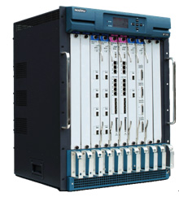
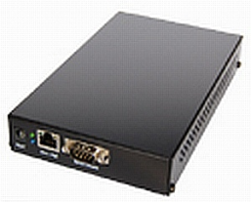
Diffserv Architecture
RIO-PS
Use RED In and Out
Preferential treatment to short flows
Edge Router
Core Router
- Classifies and tags packets as Short or Long
- Maintain per flow packet count

Slide 24
Edge Router – Packet classification
Threshold based approach
Maintains a counter for every flow
  Counts the number of packet per flow
Maintain threshold L_{t}
  When counter exceeds L_{t} – tag as long flow
  Else tag as short flow
Flow table is updated periodically – Every T_{u}
  If no packets from a flow in T_{u} time units, remove entry

Slide 25
Edge Router – Packet classification
Threshold L_{t} adjusted dynamically
  Balance the number of active short and long flows
Short-to-Long-Ratio (SLR)
  Configurable parameter
Every T_{c} adjust L_{t} to achieve the target SLR

Slide 26
Core Router – RIO-PS
RIO - RED with In (Short) and Out (Long)
Preferential treatment to short flows
  Short flows
    Packet dropping probability computed based on the average backlog of short packets only (Q_{short})
  Long flows
    Packet dropping probability computed based on the total average queue size (Q_{total})

Slide 27
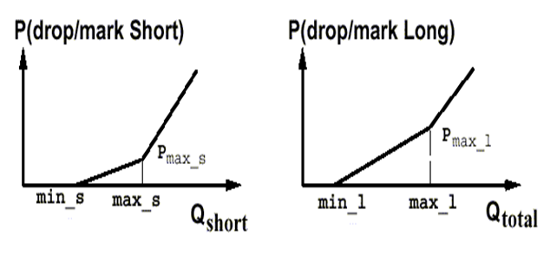
RIO-PS
Two separate sets of RED parameters for each flow class
Gentle RED
Less Packet dropping probability for short flows

Slide 28
Features of RIO-PS
Single FIFO queue is used for all packets
  Packet reordering will not happen
Inherits all properties of RED
  Protection of bursty flows
  Fairness within each class of traffic
  Detection of incipient congestion

Slide 29
Outline
Introduction
Analysis and Motivation
Architecture
Simulation Results
Discussion
Conclusion

Slide 30
Simulations setup
ns-2 simulations
Web traffic model
  HTTP 1.0
  Exponential inter-page arrival (mean 9.5 sec)
  Exponential inter-object arrival (mean 0.05 sec)
  Uniform distribution of objects per page (min 2 max 7)
  Object size; bounded Pareto distribution (min = 4 bytes, max = 200 KB, shape = 1.2)
  Each object retrieved using a TCP connection

Slide 31
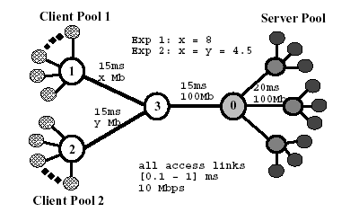
Simulation topology
Request
Response
Core Router
Edge Router

Slide 32
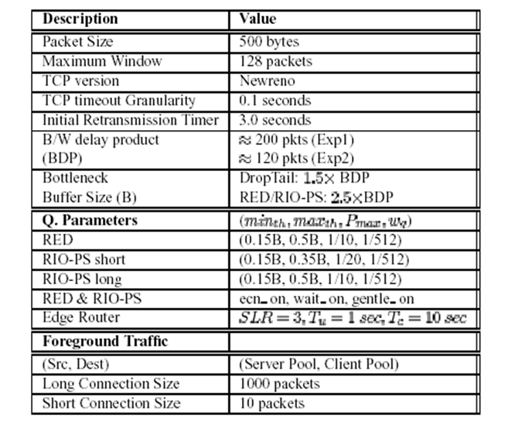
Network configuration

Slide 33
Simulations details
The load is carefully tuned to be close to the bottleneck link capacity
RIO parameters
  Short TCP flows are guaranteed around 75% of the total bandwidth in times of congestion
Experiments run 4000 seconds with a 2000 second warm-up period

Slide 34
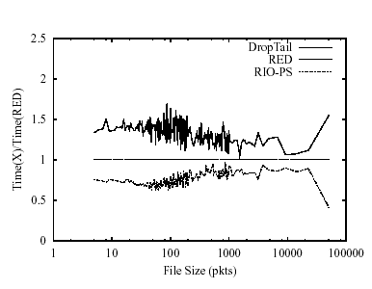
Average response time relative to RED
ITO = 3 sec
Average response time reduced by 25-30%
for short and medium sized flows

Slide 35
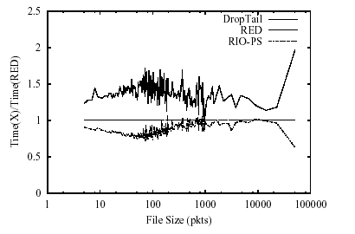
Average response time relative to RED
ITO = 1 sec
Average response time reduced by 10-15% for short flows
Average response time reduced by 15-25% for medium sized flows

Slide 36
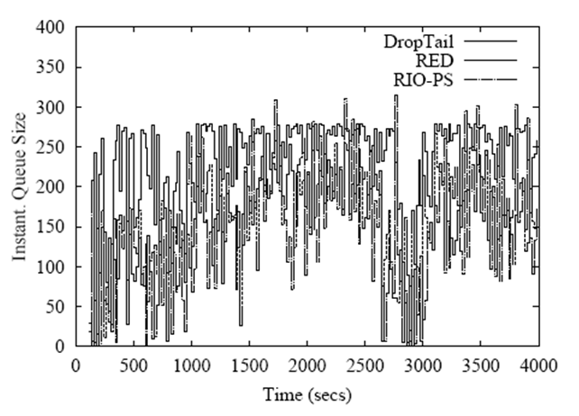
Instantaneous Queue Size
Load in the bottleneck link has high variability over time
due to the heavy-tailedness of the file size distribution

Slide 37
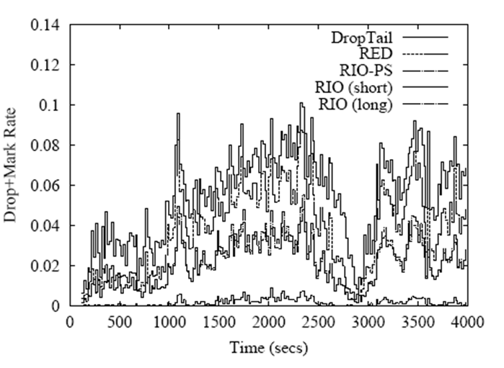
Instantaneous Drop/Mark rate
RIO-PS reduces the overall
drop/mark probability
Comes from the fact that
short flows rarely
experience loss
Also, Short TCP flows are not responsible for controlling congestion
because of the time scale at which they operate.
Preferential treatment to short flows does not hurt the network

Slide 38
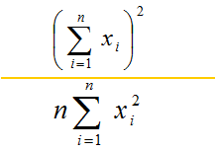
Study of Foreground Traffic
Periodically inject 10 short flows (every 25 seconds) and 10 long flows (every 125 seconds) as foreground TCP connections and record the response time for i_{th} connection
Fairness index
  For any give set of response times (x₁, .., x_{n}), the fairness index is

Slide 39
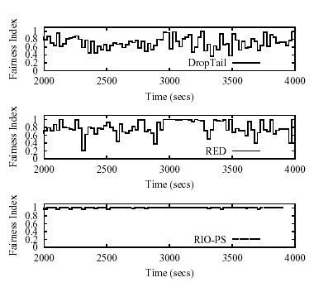
Fairness Index – Short Connections
More fair

Slide 40
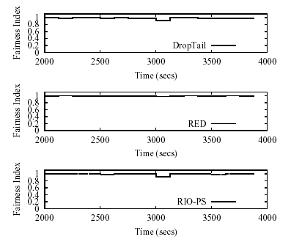
Fairness Index – Long Connections

Slide 41
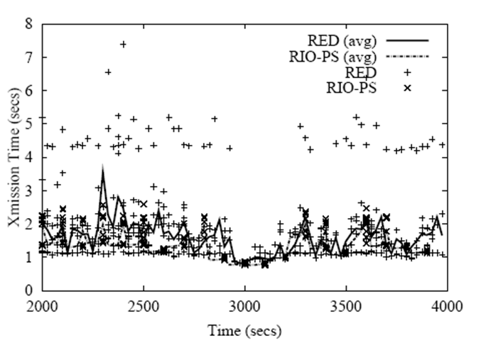
Transmission time – short connections
-Even with RED queues,
many short flows
experience loss
-Some lost first
packet and hence
timeout (3 sec)
RIO-PS
much less drops

Slide 42
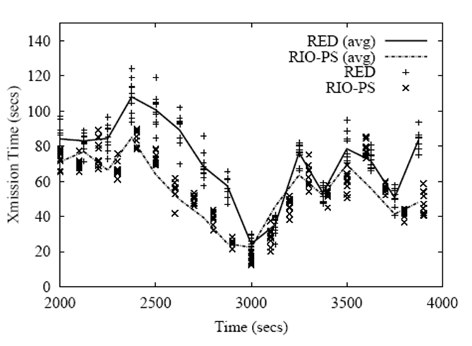
Transmission time – long connections
RIO-PS does not hurt
long flow
performance

Slide 43
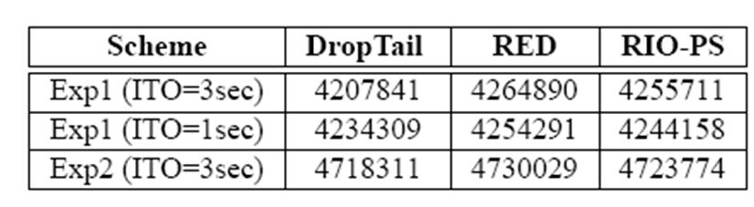
Goodput
RIO-PS does not hurt overall goodput
Slightly improves over DropTail

Slide 44
Outline
Introduction
Analysis and Motivation
Architecture
Simulation Results
Discussion
Conclusion

Slide 45
Discussion
Simulation Model
  Dumbbell and Dancehall (one-way traffic) model
  All TCP connections have same propagation delay
  Complicated topologies may impact the performance
Queue Policy
  RIO does not provide class based guarantee
  PI controlled RIO queue or proportional Diffserv gives better control over classified traffic

Slide 46
Discussion
Deployment Issues
  Edge routers need to maintain per flow state information.
  Edge router state maintenance and classification does not have a significant impact on the end to end performance.
  Incrementally deployable
    RIO-PS implemented only at bottleneck links
    Advanced edge devices may be placed in front of busy web server cluster

Slide 47
Discussion
Flow Classification
  Threshold based flow classification
  First few packets of long TCP flow treated same as short flows
  This mistake enhances performance
    First few packets of the long flow are similar to short flow and vulnerable to packet losses
    Makes the system fair to all TCP connections.

Slide 48
Discussion
Controller Design
  Edge load control is a topic of further research
  Preliminary results indicate performance is not sensitive to SLR
  SLR depends on T_{c} and T_{u}
  Smaller values of T_{c} and T_{u} may increase overhead
Malicious users
  Users can break their long transmission into small pieces to get fast service
  This is less likely due to the overhead of fragmentation and reassembly

Slide 49
Outline
Introduction
Analysis and Motivation
Architecture
Simulation Results
Discussion
Conclusion

Slide 50
Conclusion
TCP major traffic in the Internet
Proposed Scheme is a Diffserv like architecture
  Edge routers classifies TCP flow as long or short
  Core routers implements RIO-PS
Advantages
  Short flow performance improved in terms of fairness and response time.
  Long flow performance is also improved or minimally affected since short flows are rapidly served.
  System overall goodput is improved
  Flexible Architecture, can be tuned largely at edge routers

Slide 51
Acknowledgements
Thanks to Professor. Bob Kinicki, Matt Hartling and Sumit Kumbhar.
Some figures in this presentation are taken from their class presentation and modified.

