Slide 1
Performance Analysis of Orb
Rabin Karki and Thangam V. Seenivasan

Slide 2
Overview
What is Orb?
Why to study Orb?
Experiments
Future Steps

Slide 3
What is Orb?
Orb is a free software which enables users to access media files from their Home PC to any Internet connected device.
Launched in 2005. Over 7 million registered users .
Features:
  Allows to Share photos, video, audio
  watch TV , Internet Radio.
  Webcam Monitoring
  Can be used along with a gaming console.

Slide 4
Installation and Use
Host End
  Download Orb from http://www.orb.com/en/download_orb
  Install in host PC
Client End
  Open web browser and go to link https://mycast.orb.com/orb/html/login.html
  Login and access media files from anywhere in the world

Slide 5
How does Orb Stream?
Two methods of streaming
  Direct Streaming
  Streaming via Orb server
Direct Streaming
Streaming of the video content from the Host PC to the client directly.
Streaming via Orb server
Data sent from Host PC to the Orbstreaming server
Orb server redirects data to the client.

Slide 6
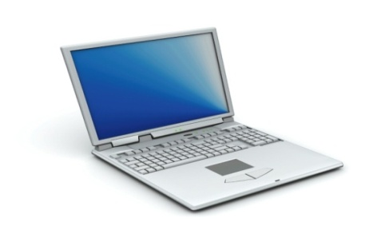
Direct Streaming and Streaming via Orb server
Orb Streaming Server
Indirect Streaming
Streaming Via Orb Server
Direct Streaming
Client
Host PC

Slide 7
Direct Streaming
Scenarios of Direct Streaming:
Host PC and Client are connected to the same LAN and share the same public IP address
Orb host PC connected to the Internet through a router with UPnP(Universal Plug and Play functionality) enabled.
Host Orb PC is not a part of a LAN and is directly connected to the broadband modem.

Slide 8
Overview
What is Orb?
Why to study Orb?
Experiments
Future Steps

Slide 9
Why Study Orb?
Orb different from typical Internet streaming
Typical video streaming:
  Video performance affected by downlink bandwidth to client
  High-end servers, reliable
Orb – video from Home PC has differences:
  Uplink bandwidth is important
  Home network configuration matters (i.e. wireless)
  Servers are off-the-shelf PCs
Difference may impact performance, use may impact Internet traffic

Slide 10
Overview
What is Orb?
Why to study Orb?
Experiments
Future Steps

Slide 11

Experimental Setup
ISP
Orb Server
Ethernet Cable
WPI LAN
Cross Cable
Router
Client PC
Host PC
We focus only on Direct Streaming

Slide 12
Router Setup
HOST PC
Router
Client PC
Host PC
eth1
eth0
Client PC
eth1
Router
eth0
Router has the Netem module
Netem used for network emulation

Slide 13
Experimental Setup
Host PC and Client PC Spec:
  RAM – 1 GB
  CPU speed – 2.80 GHz
  OS - Windows XP
Software on the host:
  Orb version - 2.51.0032
  Process Explorer
Software on Client:
  Media Tracker
Applications on both Client and Host PC:
  Wireshark
  Iperf
Router :
  SuSE-Linux 10.3 (2.6 kernel version)
  Two PCI cards
  Netem module

Slide 14
Set of Experiments Conducted
Analyze bandwidth calculation by Orb
Video quality measurements with MediaTracker
CPU and memory usage on the server

Slide 15
Bandwidth Estimation By Orb
Steps Followed
  Start Wireshark at the client
  Click on the ‘Control Panel’. Go to ‘Streaming speed’ and calculate the web speed and the upstream speed by clicking the ‘Recalculate button.
  Capture Wireshark trace on Client during web speed calculation.
  Wireshark run on the Host side to analyse how the host upstream is calculated.
  Analyze trace.

Slide 16
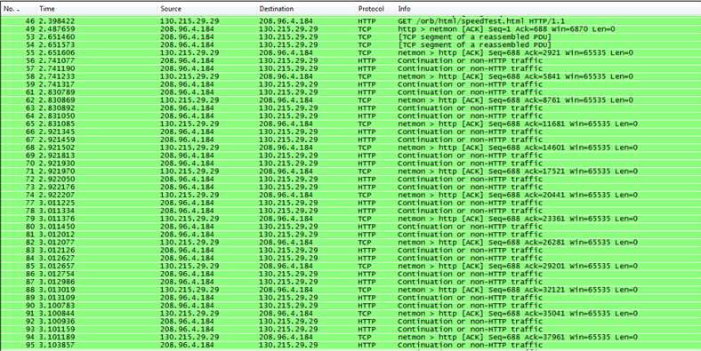
Client Web Speed Calculation Trace

Slide 17
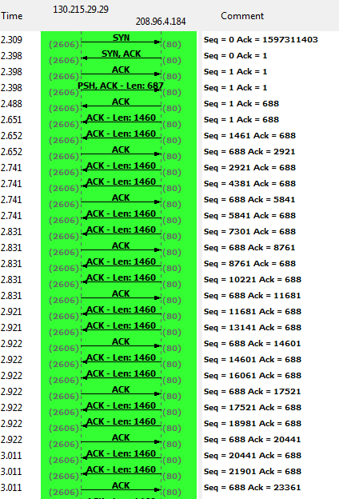
TCP Flow Graph- Client Web Speed

Slide 18
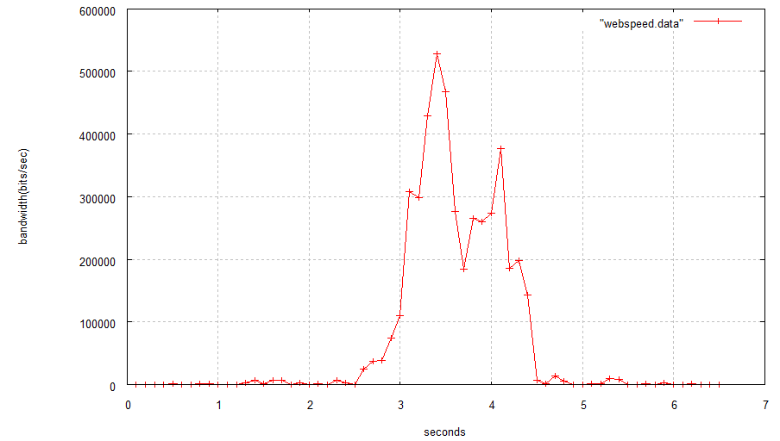
Client Web Speed Calculation
Client downloads 4Mb of data
Bandwidth = Data downloaded/ download time
Reported Web Speed = 2306 Kbps

Slide 19
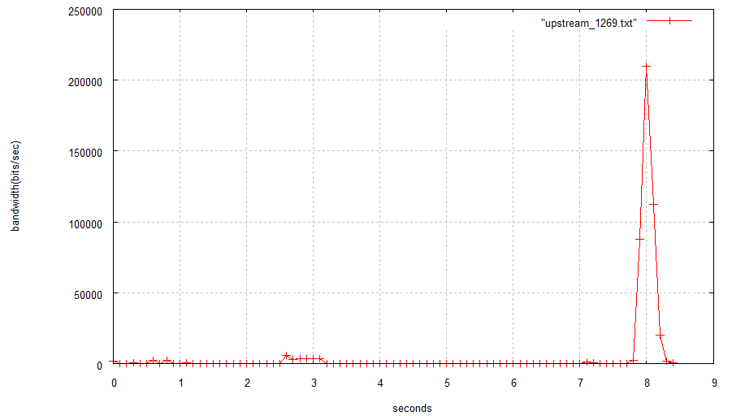
Upstream Speed Calculation
Host PC uploads 400Kb data to Orb Server
Upstream Speed calculated based on the upload time(~ 0.5 sec here)
Reported Upstream Speed = 1269 kbps

Slide 20
Video Quality Measurements
Videos used:
  WMV format
  Low quality video
    Resolution – 320*240, File size – 14.4 MB, Duration – 150 sec, bitrate -768 Kbps
  High quality video
    Resolution - 1280*720, File size – 29MB, Duration – 150 sec, bitrate -1546 Kbps
Metrics for measurement
  buffer Progress, bit rate, frame rate
Vary bandwidth to 1000 kbps, 750 kbps, 500 kbps and 250 kbps, measure performance

Slide 21
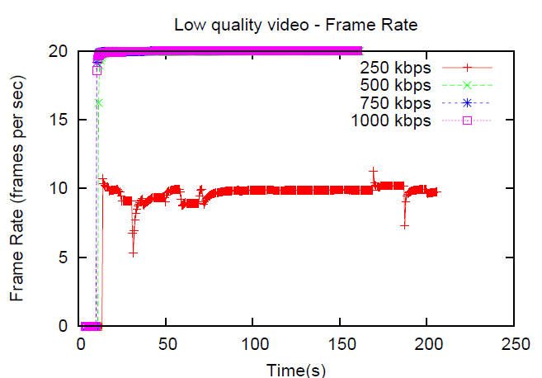
Frame rate – Low quality video
Orb does Temporal Scaling

Slide 22
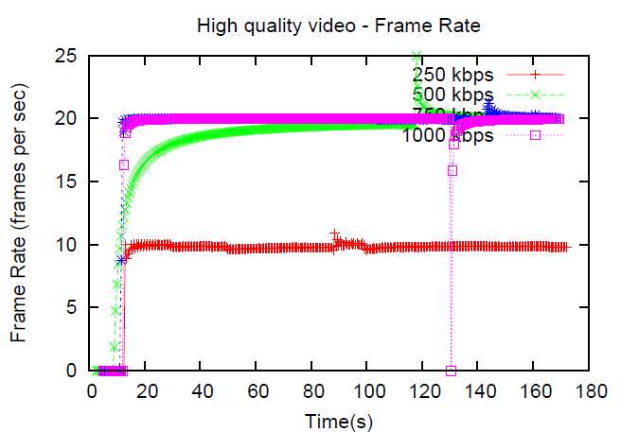
Frame rate – High quality video
Orb does Temporal Scaling

Slide 23
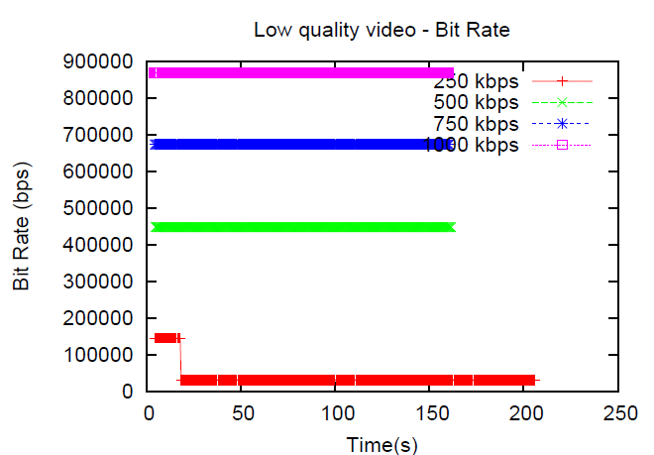
Bit rate – Low quality video
Orb does Spatial Scaling also

Slide 24
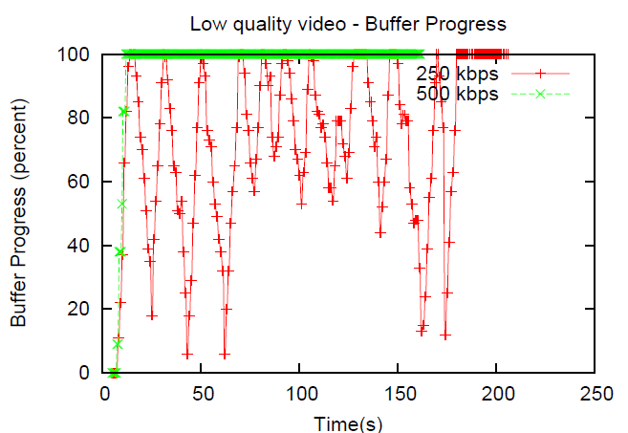
Buffer Progress – Low quality video

Slide 25
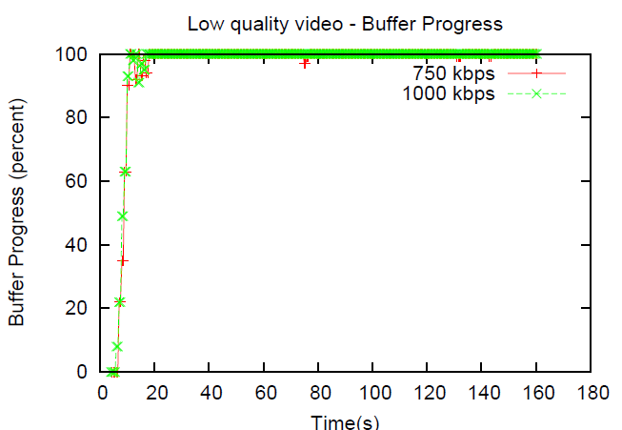
Buffer Progress – Low quality video

Slide 26
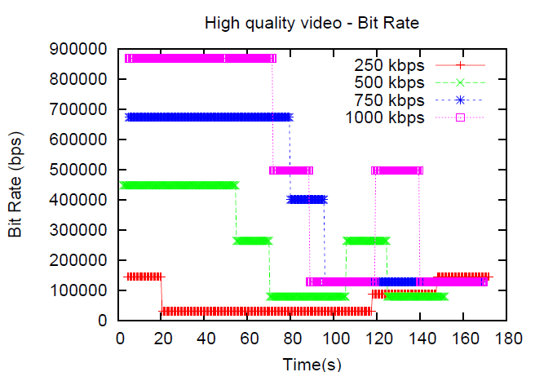
Bit rate – High quality video

Slide 27
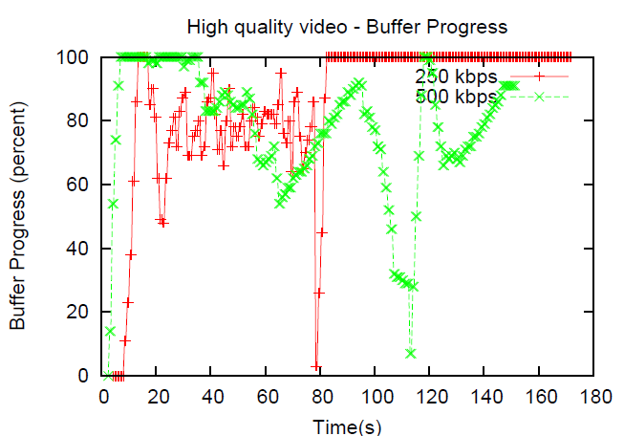
Buffer Progress – High quality video

Slide 28
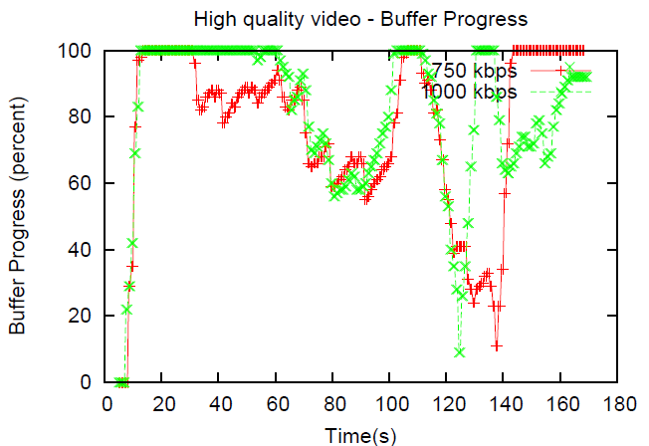
Buffer Progress – High quality video

Slide 29
CPU Usage at the Host PC
Orb uses ffmpeg library for real-time transcoding to suit the network conditions.
We measured the CPU usage at the Host PC for multiple source and destination formats.

Slide 30
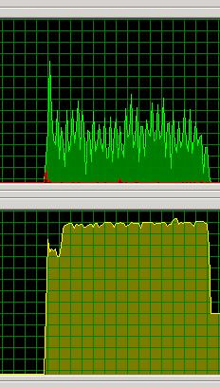
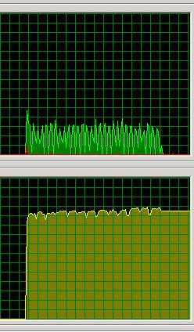
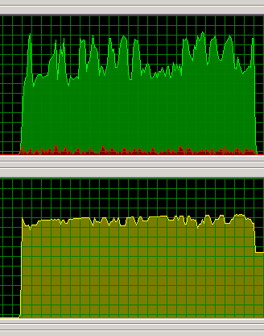
CPU Usage at the Host PC
Src: FLV
320x214
Dest: WMV
320x208
Src: FLV
320x214
Dest: FLV
312x208
Src: WMV (HQ)
1280x720
Dest: FLV
296x168

Slide 31

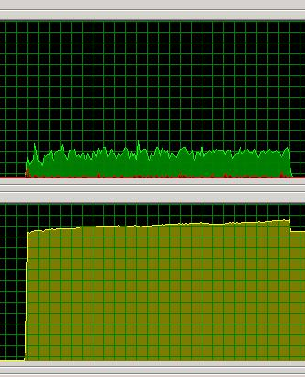
CPU Usage at the Host PC
Src: WMV (HQ)
1280x720
Dest: WMV
296x168
Src: WMV
320x240
Dest: FLV
312x208

Slide 32
Conclusion
Host upstream capacity crucial for video performance.
Orb adapts to change in bandwidth
  Bandwidth less than encoded bit rate
    Reduces Frame rate (Temporal scaling)
  Bandwidth more than encoded bit rate
    Sends at a higher rate
Host PC does transcoding
  Significant drain on CPU and memory

Slide 33
Overview
What is Orb?
Why to study Orb?
Experiments
Future Work

Slide 34
Future Work
Study video quality for different source and destination formats like flash, mov.
Measure the impact of loss and delay for different bandwidth settings.
Compare with Slingbox , Location free devices.

Slide 35
Thank You
Questions?

