Slide 1
Ultra-Low Duty Cycle MAC with Scheduled Channel Polling Wei Ye, Fabio Silva, and John Heidemann USC Information Sciences Institute
Presented by:
Murad Kaplan

Slide 2
Outline
Introduction.
Design of SCP-MAC.
Lower Bound of Energy Performance with Periodic Traffic.
Protocol Implementation.
Experimental Evaluation.
Related Work.

Slide 3
Introduction
Energy is a critical resource in battery-powered sensor networks.
Major sources of energy waste are idle listening, collision, overhearing, and control overhead.
Among them, idle listening is a dominant factor in most sensor network applications.
Central approach to reducing energy lost to idle listening is to lower the radio duty cycle.
Three approaches are generally used: TDMA, scheduled contention, or low-power listening.

Slide 4
Introduction (Cont’d)
TDMA is not considered, difficulties that arise in networks of peers (lack centralized or cluster-based control, and at very low duty cycles).

Slide 5
Introduction (Cont’d)
Schedule coordinated transmission and listen periods:
Seen in S-MAC, TMAC, and TRAMA.
Determines when a node should listen and when it should sleep.
Receiver, only listens to brief contention periods.
Senders, contend during these periods.
Only nodes participating in data transfer remain awake after contention periods, while others can then sleep.
Reduces energy.

Slide 6
Introduction (Cont’d)
Low-power listening (LPL):
Presented in WiseMAC and B-MAC.
Channel polling, nodes wake up very briefly to check channel activity without actually receiving data.
Long preamble, so senders rendezvous with receivers.
Consume much less energy than existing scheduled protocols.

Slide 7
Introduction (Cont’d)
low-power listening (LPL) – Problems:
Receiver and polling efficiency is gained at the much greater cost of senders.
Very sensitive to tuning for an expected neighborhood size and traffic rate because of the balance.
Challenging to adapt LPL directly to newer radios like 802.15.4.

Slide 8
Introduction (Cont’d)
Scheduled channel polling (SCP-MAC) !!!
Synchronize the channel polling times of all neighbors.
Eliminates long preambles in LPL for all transmissions.
Able to operate at ultra-low duty cycles when traffic is light.

Slide 9
Introduction (Cont’d)
SCP-MAC
Challenges:
Understanding the optimal behavior of both scheduling and channel polling separately and together.
Placing a lower bound on energy costs.
Developing a protocol that adapts to dynamically changing traffic patterns efficiently.
Understanding how these techniques apply both to existing (CC1000) and new (802.15.4, CC2420).

Slide 10
Outline
Introduction.
Design of SCP-MAC.
Lower Bound of Energy Performance with Periodic Traffic.
Protocol Implementation.
Experimental Evaluation.
Related Work.

Slide 11
Design of SCP-MAC
Designed with two main goals:
Pushing the duty cycle an order of magnitude lower than is practical with current MAC protocols.
Adapt to variable traffic loads common in many sensor network applications.
To meet these goals:
Combining scheduling with channel polling.
Deriving and employing optimal intervals for schedule synchronization based on worst-case clock drift.
Developing a new algorithm to dynamically adjust duty cycles in the face of busy networks and streaming traffic, reducing the latency in multi-hop networks.

Slide 12
Design of SCP-MAC (Cont’d)
Synchronized Channel Polling
Channel polling reduces the cost of discovering traffic.
Checking for the presence or absence of network activity is much cheaper than knowing what the activity is
SCP-MAC adopts channel polling from LPL approaches.
Unlike LPL, SCP-MAC synchronizes the polling times of all neighboring nodes.

Slide 13
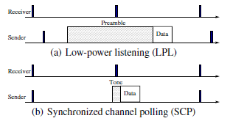
Design of SCP-MAC (Cont’d)
Synchronization reduces the cost of overhearing.
Synchronization SCP works efficiently for both unicast and broadcast traffic.
Short wakeup tones make SCP-MAC more robust to varying traffic load.

Slide 14
Design of SCP-MAC (Cont’d)
Adaptive Channel Polling and Multi-hop Streaming
A large set of applications mix periodic and bursty traffic or consist of unpredictable traffic mixes.
At times of heavy traffic, each hop in a scheduled MAC potentially adds additional latency and reduces throughput.

Slide 15
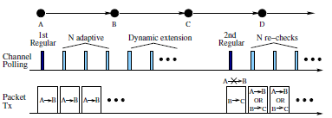
Design of SCP-MAC (Cont’d)
Adaptive Channel Polling and Multi-hop Streaming
To reduce multi-hop latency:
Detect bursty traffic and dynamically add additional, high-frequency polling slots to nodes on the path.

Slide 16
Design of SCP-MAC (Cont’d)
Adaptive Channel Polling and Multi-hop Streaming
Unlike prior approaches, this approach works over every hop on the path.
Unlike B-MAC optimizations and fast-path, this approach requires no explicit signaling.
Adaptive polling slots are dynamically added and extended as driven by traffic.
Regular polling slots are always reserved for new nodes to enter the high-rate polling and transmission quickly.

Slide 17
Design of SCP-MAC (Cont’d)
Other Optimizations
Two-Phase Contention:
Sender transmits a short wakeup tone timed to intersect with the receiver’s channel polling.
After waking up the receiver, the sender transmits the actual data packet.

Slide 18
Design of SCP-MAC (Cont’d)
Other Optimizations
Two-Phase Contention:
The two-phase contention lowers the collision probability compared to a single contention period of equal duration.
Splitting the contention with fewer slots so that SCP tolerates collisions on tone transmissions.
The wakeup tone only indicates network activity, not actual data.

Slide 19
Design of SCP-MAC (Cont’d)
Other Optimizations
Overhearing Avoidance Based on Headers:
Unnecessary overhearing can be a large energy cost in high-density networks.
SCP-MAC performs overhearing avoidance from MAC headers alone.

Slide 20
Outline
Introduction.
Design of SCP-MAC.
Lower Bound of Energy Performance with Periodic Traffic.
Protocol Implementation.
Experimental Evaluation.
Related Work.

Slide 21
Lower Bound of Energy Performance with Periodic Traffic
Models and Metrics:
Analysis focuses on the energy consumption by the radio, and does not model other components, such as the CPU or sensors.
Four stable radio states: transmitting, receiving, listening, and sleeping. Ptx, Prx, Plisten and Psleep
Expected energy consumption, per node:
E = Ecs+Etx+Erx+Epoll+Esleep
= Plistentcs+Ptxttx+Prxtrx+Ppolltpoll+Psleeptsleep

Slide 22
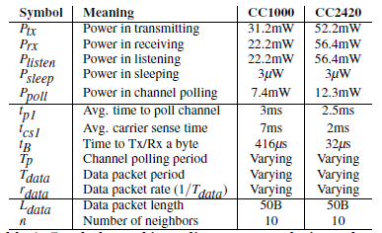
Models and Metrics (Cont’d)
Symbols used in radio energy analysis, and typical values for the Mica2 radio (CC1000) and an 802.15.4 radio (CC2420)

Slide 23
Models and Metrics (Cont’d)
Asynchronous Channel Polling: LPL
Energy consumption with asynchronous channel polling:
Er = (Plistentcs1+Ptx(Tp+tpkt)+nPrx(Tp/2+tpkt ))rdata +Ppolltp1/Tp+Psleep(1−(tcs1 +(n/2+1)Tp +(n+1)tpkt)rdata−tp1/Tp)
The optimal preamble length Tp for LPL:

Slide 24
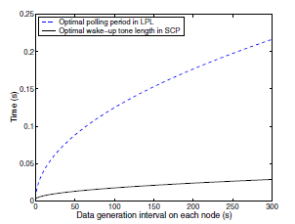
Models and Metrics (Cont’d)
Asynchronous Channel Polling: LPL
Optimal channel polling period in LPL (dotted), and wakeup-tone length in SCP (solid), given neighborhood size of 10

Slide 25
Models and Metrics (Cont’d)
Scheduled Channel Polling: SCP
Additional parameters in SCP-MAC

Slide 26
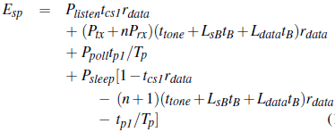
Models and Metrics (Cont’d)
Scheduled Channel Polling: SCP
Best Case: Perfect Piggybacking:
Energy consumption of the scheduled channel polling with piggybacked synchronization:

Slide 27
Models and Metrics (Cont’d)
Scheduled Channel Polling: SCP
Best Case: Perfect Piggybacking:
optimal polling period Tp for scheduled polling:

Slide 28
Models and Metrics (Cont’d)
Scheduled Channel Polling: SCP
Worst Case: All Explicit Synchronization
Energy consumption in scheduled channel polling with independent SYNC packets:
Optimal polling period for scheduled polling with independent SYNC packets:

Slide 29
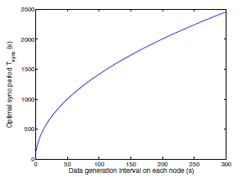
Models and Metrics (Cont’d)
Scheduled Channel Polling: SCP
Worst Case: All Explicit Synchronization
Optimal SYNC period for SCP-MAC

Slide 30
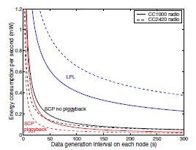
Models and Metrics (Cont’d)
Analysis of optimal energy consumption for LPL and SCP with and without piggyback for CC1000 (solid lines) and CC2420 (dashed)

Slide 31
Outline
Introduction.
Design of SCP-MAC.
Lower Bound of Energy Performance with Periodic Traffic.
Protocol Implementation.
Experimental Evaluation.
Related Work.

Slide 32
Protocol Implementation
Implementing SCP-MAC in TinyOS over the Mica2 motes with the CC1000 radio.
Describe the preliminary port to MicaZ motes with the CC2420 radio supporting IEEE802.15.4.

Slide 33
Protocol Implementation (Cont’d)
Software Architecture
Implementation breaks MAC functionality into
Four layers (separate TinyOS components):
Physical layer (PHY)
Basic CSMA layer,
LPL layer
SCP layer.
several parameters and options:
RTS/CTS handling
Overhearing avoidance
Adaptive channel polling.

Slide 34
Protocol Implementation (Cont’d)
Physical layer (PHY)
The bottom of the stack.
Handles the radio states (sending, listening, receiving, sleeping, and warming up).
Sends byte-by-byte with the Mica2
Sends packet-by-packet with the MicaZ
Implements and exports:
Interfaces for physical carrier sense
Transmission of the wakeup tone
CRC check
Time-stamping on transmitting and receiving of packets (to support time synchronization).

Slide 35
Protocol Implementation (Cont’d)
Basic CSMA Layer
Above the PHY.
Provides a common service to both LPL and SCP.
Includes preamble length as a parameter to packet transmission.
Responsible for performing carrier sense and random backoff.
Supports full RTS/CTS/DATA/ACK or simply
DATA/ACK.

Slide 36
Protocol Implementation (Cont’d)
LPL Layer
Implemented on top of the CSMA.
Periodically poll the channel and send the radio to sleep when there is no activity.
Adjusts preamble lengths on transmitted packets to ensure they intersect with polling frequency.

Slide 37
Protocol Implementation (Cont’d)
SCP Layer
Implemented above the LPL.
Uses basic LPL to bootstrap schedules with SYNC packets.
Coordinates packet transmission timing.
Implements the randomized contention window before wake-up tone transmission.

Slide 38
Protocol Implementation (Cont’d)
Interaction with TinyOS
Implementing a new timer in TinyOS to add support for dynamically adjusting timer values and asynchronous, low-jitter triggers.
Timer implementation is based on the 8-bit hardware counter on Mica2.
Runs independently from the CPU, allowing the CPU to sleep when no other activity is present.
Each timer event is about 0.4% the cost of a channel poll

Slide 39
Protocol Implementation (Cont’d)
Port to IEEE 802.15.4 Radio
SCP-MAC to run on the 802.15.4 radios found on the MicaZ hardware.
Challenges:
CC2420 is a packet-level radio, and the microcontroller cannot get bytelevel access.
Potentially affects the accuracy of time synchronization.
CC2420 limits the preamble length to 16 bytes with a default length of 4 bytes.

Slide 40
Protocol Implementation (Cont’d)
Port to IEEE 802.15.4 Radio
To implement long preambles:
Sequentially send multiple wakeup packets back to back.
Ensure that a receiver does not miss the “preamble” even if its channel polling time falls in a gap between the wakeup packets.
To reduce these gaps: pre-load the wakeup packet into the radio buffer before carrier sense, then resend the same packet from the buffer multiple times to make up a long preamble

Slide 41
Outline
Introduction.
Design of SCP-MAC.
Lower Bound of Energy Performance with Periodic Traffic.
Protocol Implementation.
Experimental Evaluation.
Related Work.

Slide 42
Experimental Evaluation
Optimal Setup with Periodic Traffic
Comparing the energy performance of SCP and LPL under optimal configuration with completely periodic.
MAC parameters vary based on network size and data rate.
Placing 10 nodes in a single hop network.
Each node periodically generates a 40B message (not including preamble).
Each node’s message generation interval from 50–300s.
Run each experiment for 5 message periods, generating 50 total messages over each experiment.

Slide 43
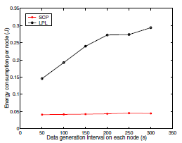
Experimental Evaluation (Cont’d)
Optimal Setup with Periodic Traffic
Mean energy consumption (J) for each node as traffic rate varies (assuming optimal configuration and periodic traffic)

Slide 44
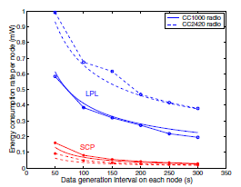
Experimental Evaluation (Cont’d)
Optimal Setup with Periodic Traffic
Mean energy consumption rate (J/s or W) for each node as traffic rate varies. The radios are the CC1000 (solid lines) and CC2420 (dashed)

Slide 45
Experimental Evaluation (Cont’d)
Performance with Unanticipated Traffic
In many applications the traffic load is less predictable (fire detection in forests).
Tuning LPL and SCP for a 0.3% duty cycle, polling every second.
All other parameters match the prior experiment.
Each node generates 20 100B long messages.

Slide 46
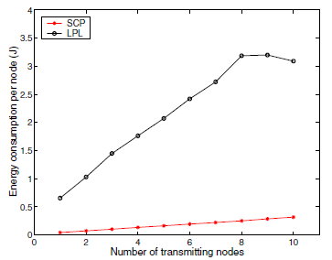
Experimental Evaluation (Cont’d)
Performance with Unanticipated Traffic
Energy consumptions on heavy traffic load with very low duty cycle configurations

Slide 47
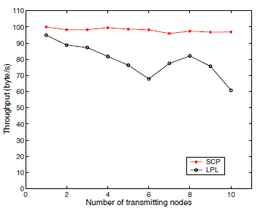
Experimental Evaluation (Cont’d)
Performance with Unanticipated Traffic (two-phase contention)
Throughput on heavy traffic load with very low duty cycle configurations

Slide 48
Experimental Evaluation (Cont’d)
Performance in a Multi-hop Network
9-hop linear network with 10 nodes.
Adaptive channel polling is designed to reduce latency.
All packets are sent as unicast without RTS/CTS.
Acknowledgments with up to three retries.

Slide 49
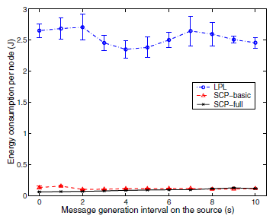
Experimental Evaluation (Cont’d)
Performance in a Multi-hop Network
Mean energy consumption per node for multihop experiments (20 packets over 9 hops)

Slide 50
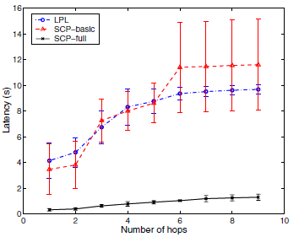
Experimental Evaluation (Cont’d)
Performance in a Multi-hop Network
Mean packet latency over 9 hops at the heaviest load

Slide 51
Outline
Introduction.
Design of SCP-MAC.
Lower Bound of Energy Performance with Periodic Traffic.
Protocol Implementation.
Experimental Evaluation.
Related Work.

Slide 52
Related Work
Power-save mode in IEEE 802.11 synchronizes wakeup times of nodes in a single-hop network.
S-MAC developed a fully distributed algorithm to synchronize the wakeup schedules of nodes in a multi-hop network.
T-MAC improves S-MAC by reducing the wakeup duration controlled by an adaptive timer.
WiseMAC can reduce the preamble length after an initial unicast packet with a long preamble.

Slide 53
Related Work (Cont’d)
TDMA, second class of MAC protocols.
LEACH and BMA.
LMAC and TRAMA.
ZMAC, proposed a hybrid protocol to combine TDMA with CSMA.

Slide 54
Thanks !

