Slide 1
CARA: Collision-Aware Rate Adaptation for IEEE 802.11 WLANs
Presented by
Eric Wang

Slide 2
Outline
Introduction
Related Work
Preliminaries
CARA
Performance Evaluation
Conclusion and Future Work

Slide 3
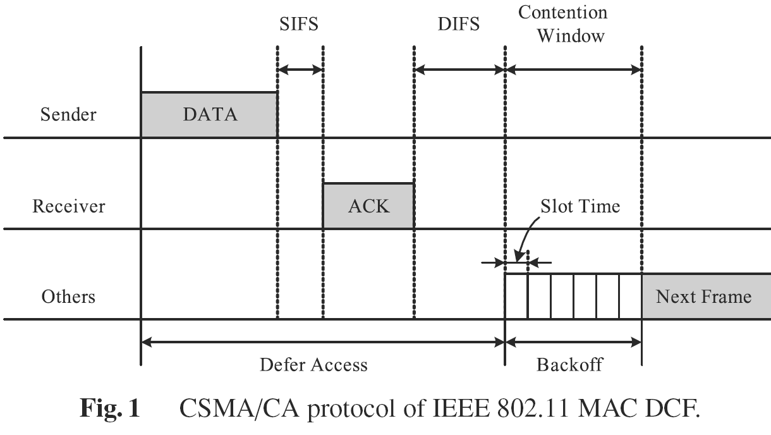
Basic CSMA/CA

Slide 4
Introduction
802.11 no rate adaption scheme
Most open-loop adaption schemes don’t consider collision
Malfunction when collisions happen
CARA
Combines RTS/CTS exchange with CCA
Collision vs. channel errors
No change to current 802.11 standard

Slide 5
Outline
Introduction
Related Work
Preliminaries
CARA
Performance Evaluation
Conclusion and Future Work

Slide 6
Related Work
Rate adaption scheme classifications:
Closed-loop
Receiver feedback of desired rate by RTS/CTS
Transmitter adapts rate accordingly
Costly! Waste of bandwidth.
Open-loop
Further classified into two categories

Slide 7
Open-loop rate adaption
Subcategory 1
Decides transmission rate by local channel est.
eg. ACK frame receptions
Usually good performance as closed-loop
Extra implementation efforts.
Subcategory 2
Make use of local ACK information.
Simple implementation

Slide 8
Rate adaption Scheme issues
When to increase
Transmitter adaptively changes rate over time
When to decrease
Open-loop scheme malfunctions during collision
No differentiate between collision and channel errors
Thus, decrease over-aggressively.

Slide 9
Preliminaries
CSMA/CA
DCF, PCF
CCA
RTS/CTS exchange
Useful in highly-contending WLAN
ARF
Timing function and missing ACK frame
CARA

Slide 10
Outline
Introduction
Related Work
Preliminaries
CARA
Performance Evaluation
Conclusion and Future Work

Slide 11
CARA
Adopts two methods to differentiate collisions from channel errors:
RTS probing (mandatory)
CCA detection (optional)

Slide 12
Identifying collision via RTS probing
RTS probing is mandatory
Assume transmission error negligible
Small size, robust transmission rate
Failure of RTS transmission indicates collision
After RTS/CTS exchange
Data transmission error caused by channel errors
No misinterpretation
Overhead of adding RTS/CTS is large
RTS probing: enables RTS/CTS exchange only when transmission failure of data frames happens

Slide 13
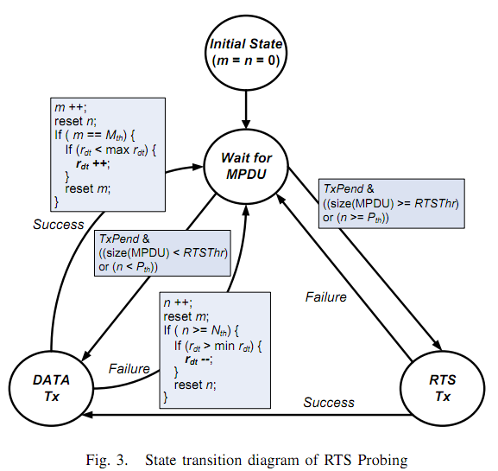
State Transition Diagram

Slide 14
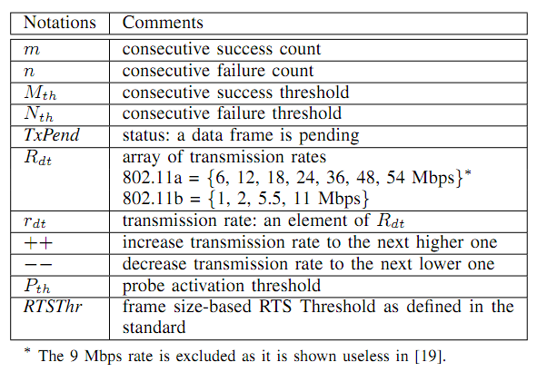
State Transition Diagram

Slide 15
RTS probing mechanism
Data frame transmitted without RTS/CTS
If transmission failed, activate RTS/CTS exchange for next transmission. If retransmission failed, lower transmission rate
If transmission successful, stays at same rate and send next data frame without RTS/CTS

Slide 16
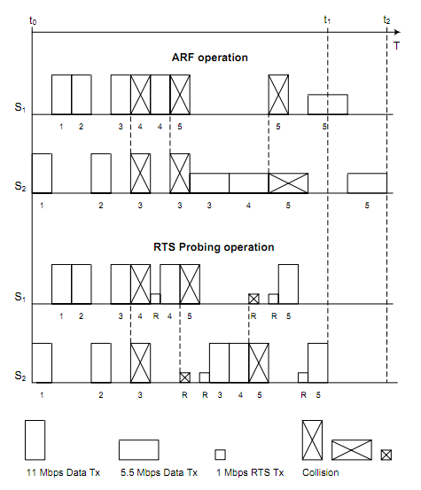
ARF vs. RTS probing

Slide 17
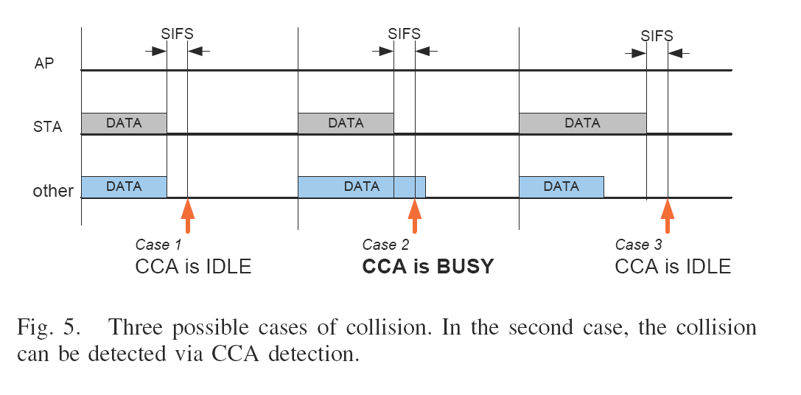
Identifying Collision via CCA Detection

Slide 18
CCA detection
Case 1 & 3: CCA not helping
Because CCA cannot be sure whether collision happened
RTS Probing is launched later.
Case 2: CCA helping
no need to activate RTS/CTS exchange.
Collision detected!
Retransmit the data.

Slide 19
Outline
Introduction
Related Work
Preliminaries
CARA
Performance Evaluation
Conclusion and Future Work

Slide 20
ns-2 simulation details
20dBm transmit power
Static stations; 1500 octet MAC payload
BER vs SNR curves measured in AWGN (Additive White Gaussian Noise) environment without fading.
Set background noise to -96dBm
Simulate indoor settings
Use Ricean fading model for multi-path fading time-varying wireless conditions.

Slide 21
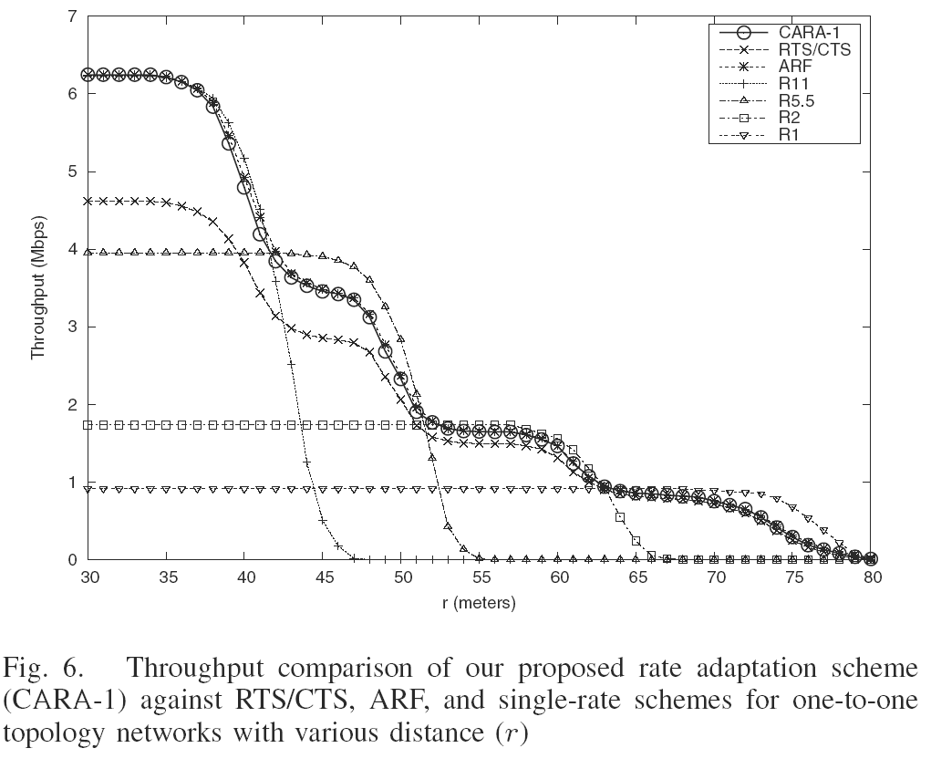
Results for One-to-One topology
One station continuously
transmitting to another.
X :Physical distance (meters)
Y :Throughput (Mbps)

Slide 22
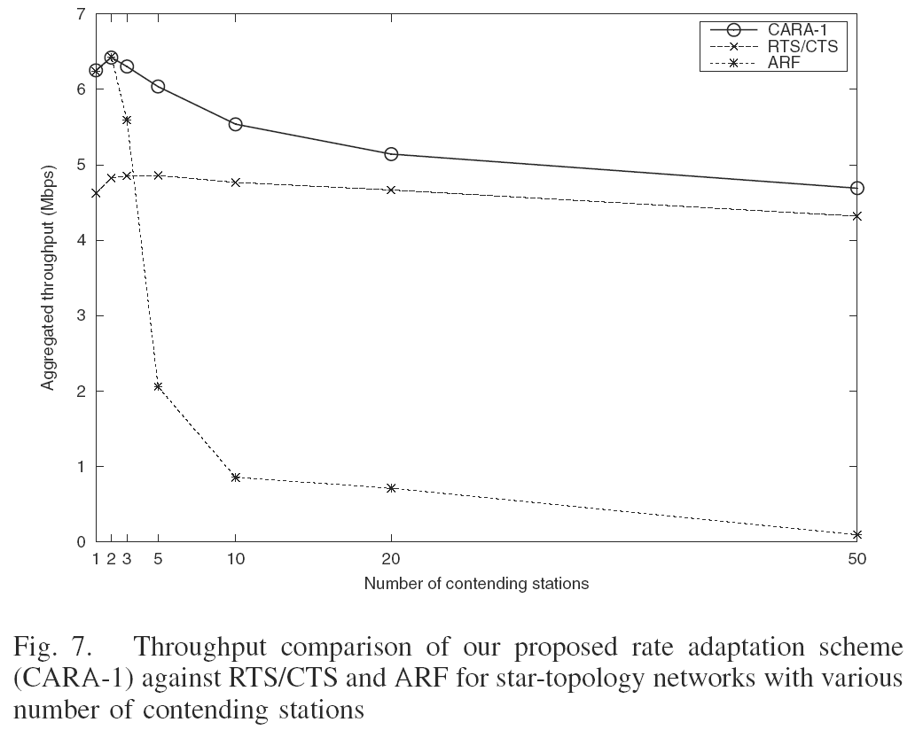
Results for Star Topology with varing number of contending stations
Various number of
contending stations
are evenly placed on
a circle around AP
within 10 meters.
Two reasons for ARF
ill behavior:
Collision vs. channel errors
Performance anomaly

Slide 23
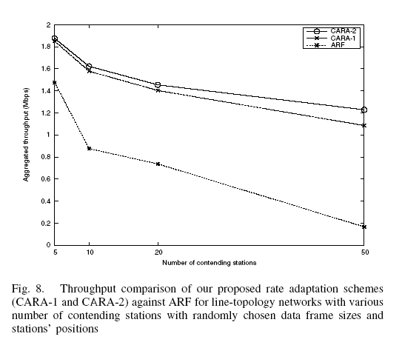
Results for Line Topology with random data frame sizes and random station positions
Performance gap
becomes larger:
CCA becomes more
helpful.

Slide 24
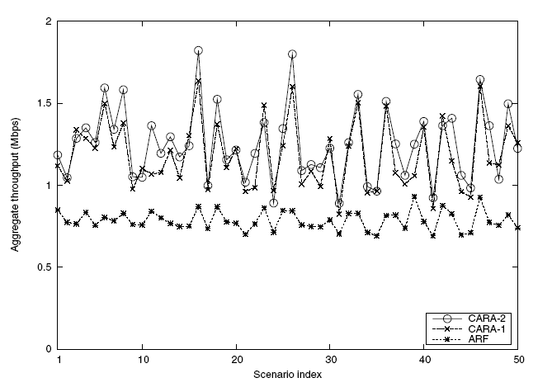
Results for random topologies with time-varying wireless channel
50 different scenarios
When 10 stations
contend
Random locations
Random data size
CARA 1 > CARA 2 ?
CCA succeeds but
failed to transmit
data, delaying
adaptation.

Slide 25
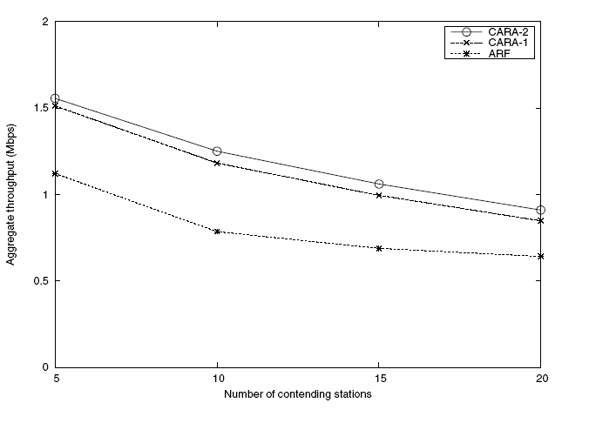
Averaged result with various contending stations

Slide 26
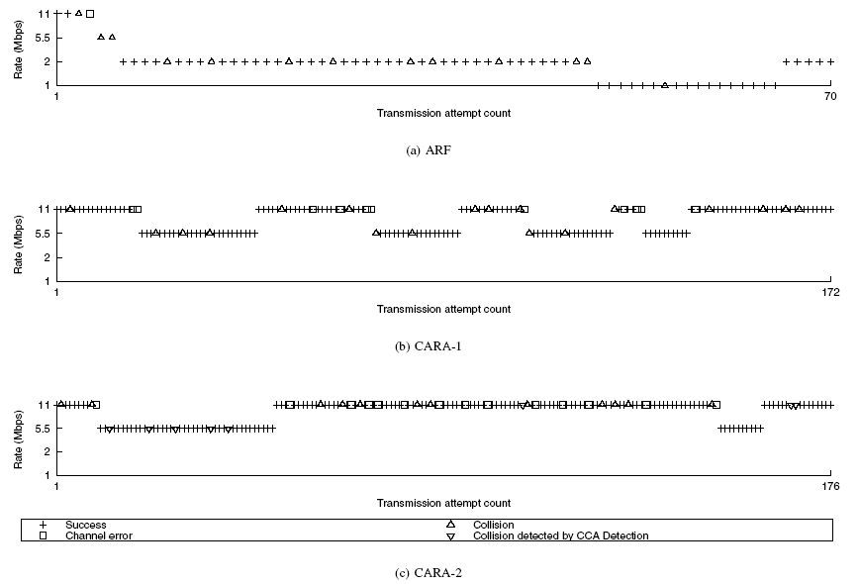
Results for random topologies with time-varying wireless channel

Slide 27
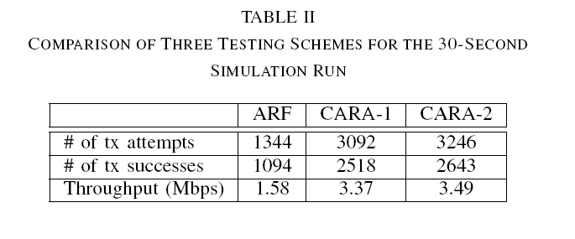
Transmission rate adaptation over time

Slide 28
Summary
RTS probing is very efficient in differentiating collisions from channel errors.
Why CARA outperforms ARF
CARA-2 with CCA detection outperforms CARA-1 when data transmission durations are different among contending stations.
Collision aware rate adaptation scheme are needed due to bad performance of ARF.

Slide 29
Outline
Introduction
Related Work
Preliminaries
CARA
Performance Evaluation
Conclusion and Future Work

Slide 30
Conclusion
CARA is more likely to make correct rate adaptation decisions than ARF.
CARA requires no change to the 802.11 standard (unlike RBAR).
CARA significantly outperforms ARF in all simulated multiple contending environments.

Slide 31
Future work
Look at changes to the increase rate algorithm [CARA-RI].
Study optimization of operational CARA parameters.
Address possibility of hidden terminal detection [CARA-HD].
Built a working CARA prototype using MadWIFI driver.

