Slide 1
Wireless Sensor Networks (WSNs)
CS577
Advanced Computer Networks

Slide 2
WSN Outline
Introduction
Mote Revolution
Wireless Sensor Network (WSN) Applications
WSN Details
Types of Wireless Sensor Networks (WSNs)
Tiered Architectures
Dynamic Cluster Formation
Power-Aware MAC Protocols
S-MAC, T-MAC, LPL, X-MAC
The Internet of Things

Slide 3
Wireless Sensor Networks
A distributed connection of nodes that coordinate to perform a common task.
In many applications, the nodes are battery powered and it is often very difficult to recharge or change the batteries.
Prolonging network lifetime is a critical issue.
Sensors often have long period between transmissions (e.g., in seconds).
Thus, a good WSN MAC protocol needs to be energy efficient.

Slide 4
WSN Outline
Introduction
Mote Revolution
Wireless Sensor Network (WSN) Applications
WSN Details
Types of Wireless Sensor Networks (WSNs)
Tiered Architectures
Dynamic Cluster Formation
Power-Aware MAC Protocols
S-MAC, T-MAC, LPL, X-MAC
The Internet of Things

Slide 5
WSN Applications
Environmental/ Habitat Monitoring
Scientific, ecological applications
Non-intrusiveness
Real-time, high spatial-temporal resolution
Remote, hard-to-access areas
Acoustic detection
Seismic detection
Surveillance and Tracking
Military and disaster applications
Reconnaissance and Perimeter control
Structural monitoring (e.g., bridges)

Slide 6
WSN Applications
“Smart” Environments
Precision Agriculture
Manufacturing/Industrial processes
Inventory (RFID)
Process Control
Smart Grid
Medical Applications
Hospital/Clinic settings
Retirement/Assisted Living settings

Slide 7
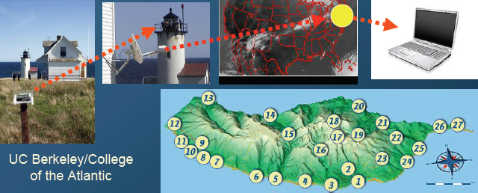
Environment Monitoring
Great Duck Island
150 sensing nodes deployed throughout the island relay data temperature, pressure, and humidity to a central device.
Data was made available on the Internet through a satellite link.

Slide 8
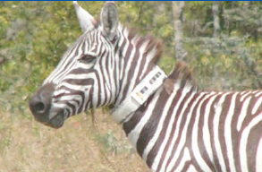
Habitat Monitoring
The ZebraNet Project
Collar-mounted sensors with GPS
Use peer-to peer info communication
monitor zebra movement in Kenya
Margaret Martonosi
Princeton University

Slide 9
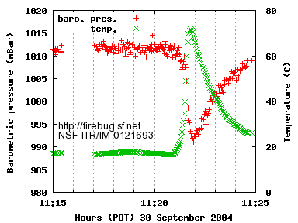
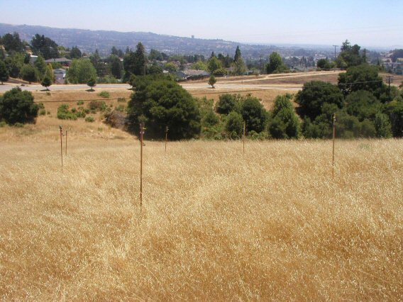
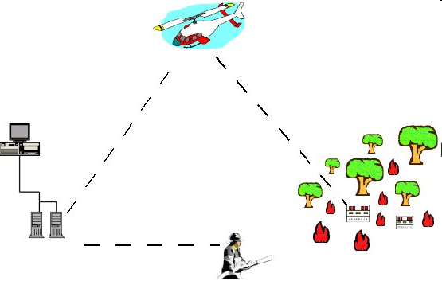
FireBug
[Nuwan Gajaweera]
Wildfire Instrumentation System Using Networked Sensors.
Allows predictive analysis of evolving fire behavior.
Firebugs: GPS-enabled, wireless thermal sensor motes based on TinyOS that self-organize into networks for collecting real time data in wild fire environments.
Software architecture: Includes several interacting layers (Sensors, Processing of sensor data, Command center).
A project by University of California, Berkeley CA.
Advanced Computer Networks Wireless Sensor Networks
9
Notes:
Sensors : Thermal, light, pressure, GPS, Accelerometer
More can be done here (overview of the protocol)

Slide 10
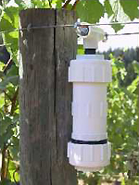
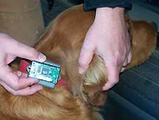
Precision Agriculture
The “Wireless Vineyard”
Sensors monitor temperature, moisture
Roger the dog collects the data
Richard Beckwith
Intel Corporation

Slide 11
Camalie Vineyards
Case Study in Crossbow Mote Deployment
Copyright 2006 Camalie Vineyards, Not to be reproduced without written permission

Slide 12
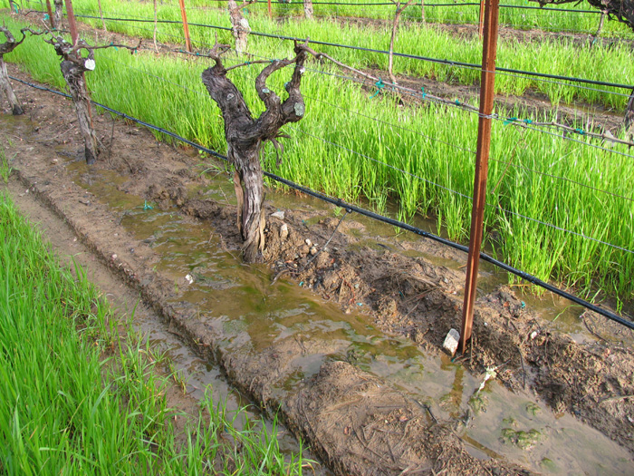
Water in the Vineyard

Slide 13
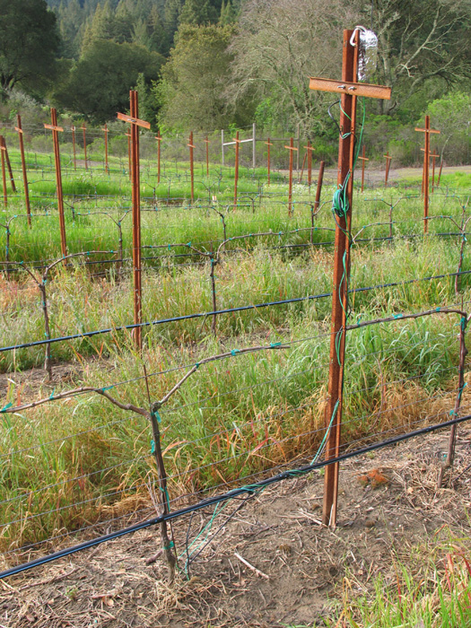
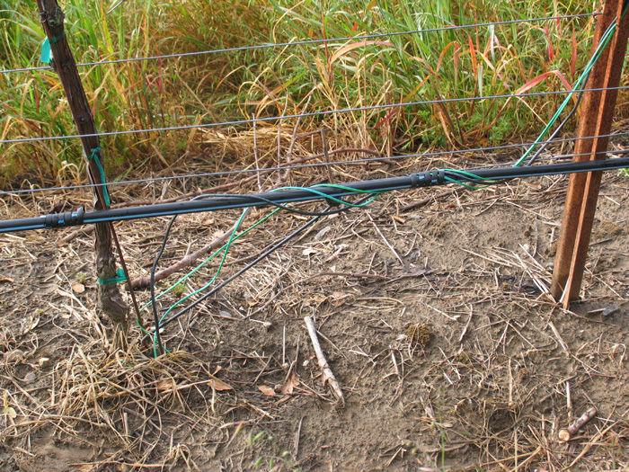
Vineyard Installation
At each Mote location:
2 soil moisture sensors
12” and 24” depth
1 soil temp sensor to calibrate
soil moisture sensors

Slide 14
Power Supply
2 month max battery life now with 10 minute sampling interval.
Decided to use solar power, always there when doing irrigation. Solar cell $10 in small quantities and need a $.50 regulator.

Slide 15
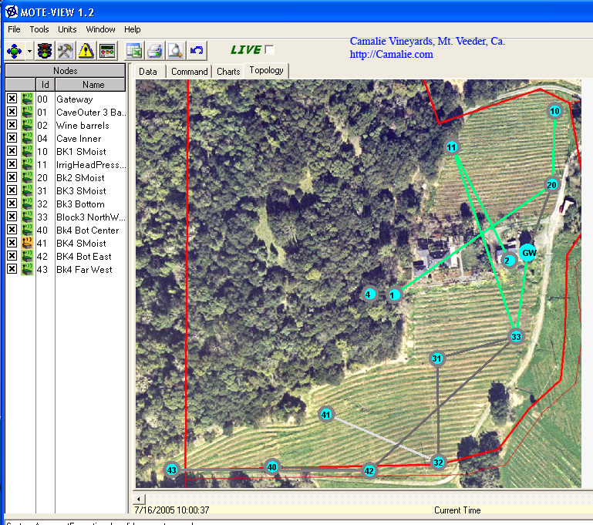
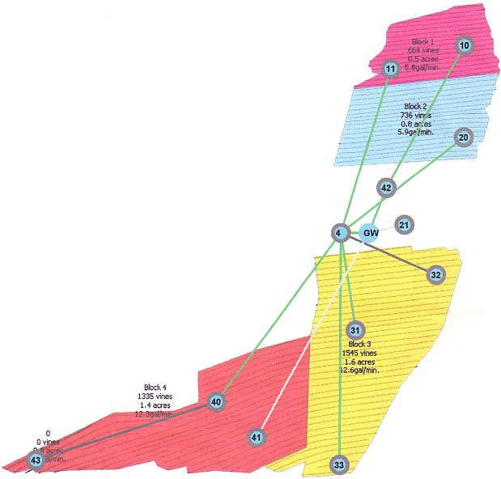
Network Maps
13 nodes late 2005, 18 nodes in 2006
Irrigation Block Map

Slide 16
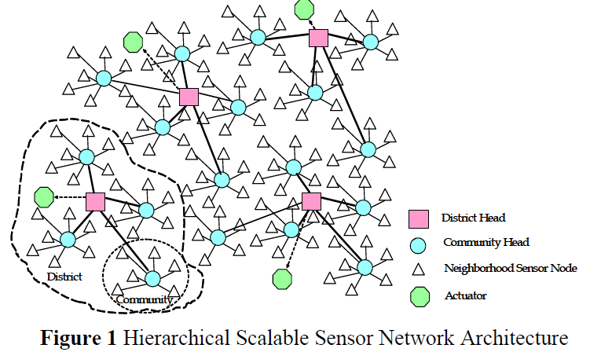
A Vision for Wireless MIS
[DS-MAC]
Concept includes smart phone platforms
to streamline continuous monitoring.
16

Slide 17
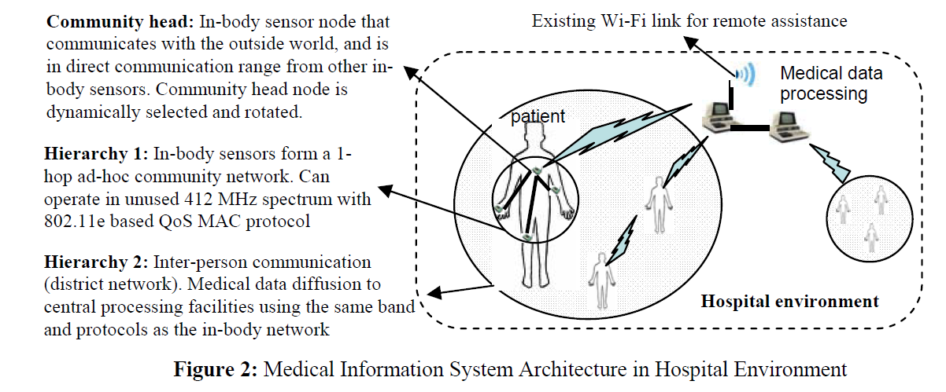
A Vision for Wireless MIS
[DS-MAC]
Health surveillance region provides a multi-hop path
from body sensor networks to central data log and
processing nodes.
17

Slide 18
WSNs for Assisted Living
Alarm-Net
University of Virginia
Berkeley Fall Detection System

Slide 19
WSNs for Assisted Living

Slide 20
WSNs for Assisted Living
Two-Tiered
WSN
Architecture

Slide 21
Berkeley Fall Detection System

Slide 22
Berkeley Fall Detection System

Slide 23
WSN Outline
Introduction
Mote Revolution
Wireless Sensor Network (WSN) Applications
WSN Details
Types of Wireless Sensor Networks (WSNs)
Tiered Architectures
Dynamic Cluster Formation
Power-Aware MAC Protocols
S-MAC, T-MAC, LPL, X-MAC
The Internet of Things

Slide 24
Wireless Sensor Networks
Another attribute is scalability and adaptability to change in network size, node density and topology.
In general, nodes can die, join later or be mobile.
Often high bandwidth is not important.
Nodes can take advantage of short-range, multi-hop communication to conserve energy.

Slide 25
Wireless Sensor Networks
Sources of energy waste:
Idle listening, collisions, overhearing and control overhead and overmitting.
Idle listening dominates (measurements show idle listening consumes between 50-100% of the energy required for receiving.)
Idle listening:: listen to receive possible traffic that is not sent.
Overmitting:: transmission of message when receiver is not ready.

Slide 26
Power Measurements

Slide 27
WSN Communication Patterns
Broadcast:: e.g., Base station transmits to all sensor nodes in WSN.
Multicast:: sensor transmit to a subset of sensors (e.g. cluster head to cluster nodes)
Convergecast:: when a group of sensors communicate to one sensor (BS, cluster head, or data fusion center).
Local Gossip:: sensor sends message to neighbor sensors.

Slide 28
Wireless Sensor Networks
Duty cycle:: ratio between listen time and the full listen-sleep cycle.
central approach – lower the duty cycle by turning the radio off part of the time.
Three techniques to reduce the duty cycle:
TDMA
Scheduled contention periods
LPL (Low Power Listening)

Slide 29
Techniques to Reduce Idle Listening
TDMA requires cluster-based or centralized control.
Scheduling – ensures short listen period when transmitters and listeners can rendezvous and other periods where nodes sleep (turn off their radios).
LPL – nodes wake up briefly to check for channel activity without receiving data.
If channel is idle, node goes back to sleep.
If channel is busy, node stays awake to receive data.
A long preamble (longer than poll period) is used to assure than preamble intersects with polls.

Slide 30
WSN Outline
Introduction
Mote Revolution
Wireless Sensor Network (WSN) Applications
WSN Details
Types of Wireless Sensor Networks (WSNs)
Tiered Architectures
Dynamic Cluster Formation
Power-Aware MAC Protocols
S-MAC, T-MAC, LPL, X-MAC
The Internet of Things

Slide 31
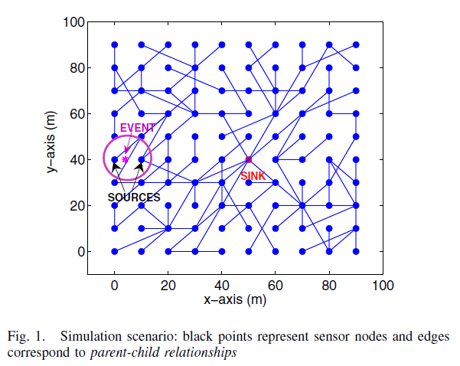
Tree Routing
[ Cuomo]

Slide 32
Tiered WSN Architectures
[ Stathopoulos]

Slide 33
Dynamic Cluster Formation
Wireless Sensor Networks

Slide 34
Choosing Cluster Heads/ Forming Clusters
Two-tier scheme:
A fixed number of cluster heads that communicate with BS (base station).
Nodes in cluster communicate with head (normally TDMA).
TDMA allows fixed schedule of slots for
sensor to send to cluster head and receive head transmissions.
BS

Slide 35
Choosing Cluster Heads/ Forming Clusters
Periodically select new cluster heads to minimize power consumption and maximize WSN lifetime.
More complex problem when size of cluster changes dynamically.
As time goes by, some sensor nodes die!
Not worried about coverage issues!
X
X
X
BS
X
X

Slide 36
Dynamic Cluster Formation
TDMA cluster algorithms:
LEACH, Bluetooth, …
Rick Skowyra’s MS thesis:
‘Energy Efficient Dynamic Reclustering Strategy for WSNs’
‘Leach-like’ with a fitness function and periodic reclustering.
He designed a distributed genetic algorithm to speed the recluster time.

Slide 37
Power-Aware MAC Protocols
Wireless Sensor Networks

Slide 38
Power Aware MAC Protocols
1997
1998 PAMAS
1999
2000 SMACS
2001 S-MAC CSMA/ARC
2002 LPL NPSM STEM
2003 DE-MAC EMACs Sift T-MAC
2003 TinyOS-MAC
2004 AI-LMAC B-MAC D-MAC DSMAC
2004 L-MAC MS-MAC TA WiseMAC
2005 Bit-MAC FLAMA M-MAC P-MAC
2005 RateEst-MAC SeeSaw Z-MAC

Slide 39
Power Aware MAC Protocols
2006 PSM SCP-MAC SS-TDMA TRAMA
2006 X-MAC
2007 C-MAC Crankshaft MH-MAC ML-MAC
2007 RMAC Sea-MAC
2008 AS-MAC DS-MAC DW-MAC Koala
2008 RI-MAC W-MAC
2009 ELE-MAC MD-MAC ME-MAC RA-MAC
2009 Tree-MAC WUR-MAC
2010 A-MAC BuzzBuzz MiX-MAC NPM
2010 PE-MAC VL-MAC
2011 AdaptAS-MAC BAS-MAC Contiki-MAC EM-MAC
2011 MC-LMAC

Slide 40
Power Aware MAC Protocols
Three approaches to saving power:
1. TDMA: TRAMA, EMACs, L-MAC
2. Schedule: PAMAS, S-MAC, T-MAC, D-MAC, PMAC, SCP-MAC, Crankshaft, AS-MAC
3. Low Power Listening: LPL, B-MAC, WiseMAC, X-MAC
**Newest approaches include
4. Receiver Initiated: RI-MAC, A-MAC

Slide 41
Sensor-MAC (S-MAC)
All nodes periodically listen, sleep and wakeup. Nodes listen and send during the active period and turn off their radios during the sleep period.
The beginning of the active period is a SYNC period used to accomplish periodic synchronization and remedy clock drift {nodes broadcast SYNC frames}.
Following the SYNC period, data may be transferred for the remainder of the fixed-length active period using RTS/CTS for unicast transmissions.

Slide 42
Sensor-MAC (S-MAC)
Long frames are fragmented and transmitted as a burst.
SMAC controls the duty cycle to tradeoff energy for delay.
However, as density of WSN grows, SMAC incurs additional overhead in maintaining neighbors’ schedules.

Slide 43
S-MAC

Slide 44
Timeout-MAC (T-MAC)
TMAC employs an adaptive duty cycle by using a very short listening window at the beginning of each active period.
After the SYNC portion of the active period, RTS/CTS is used in a listening window. If no activity occurs within a timeout interval (15 ms), the node goes to sleep.
TMAC saves power at the cost of reduced throughput and additional delay.

Slide 45
T-MAC

Slide 46
LPL and SCP-MAC

Slide 47
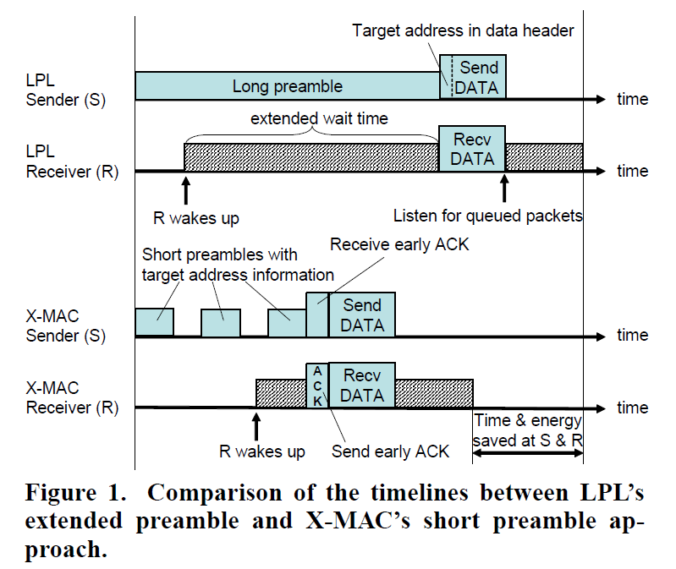
X-MAC

Slide 48
X-MAC
X-MAC is an LPL variant that aims to address:
Overhearing, excessive preamble and incompatibility with packetizing radios (e.g.,CC2420).
Uses strobed preambles where preambles contain receiver(s) address information.
Addresses multiple transmitters to one receiver by having subsequent transmitters view the ACK, back-off and then send without any preamble.

Slide 49
WSN Outline
Introduction
Mote Revolution
Wireless Sensor Network (WSN) Applications
WSN Details
Types of Wireless Sensor Networks (WSNs)
Tiered Architectures
Dynamic Cluster Formation
Power-Aware MAC Protocols
S-MAC, T-MAC, LPL, X-MAC
The Internet of Things

Slide 50
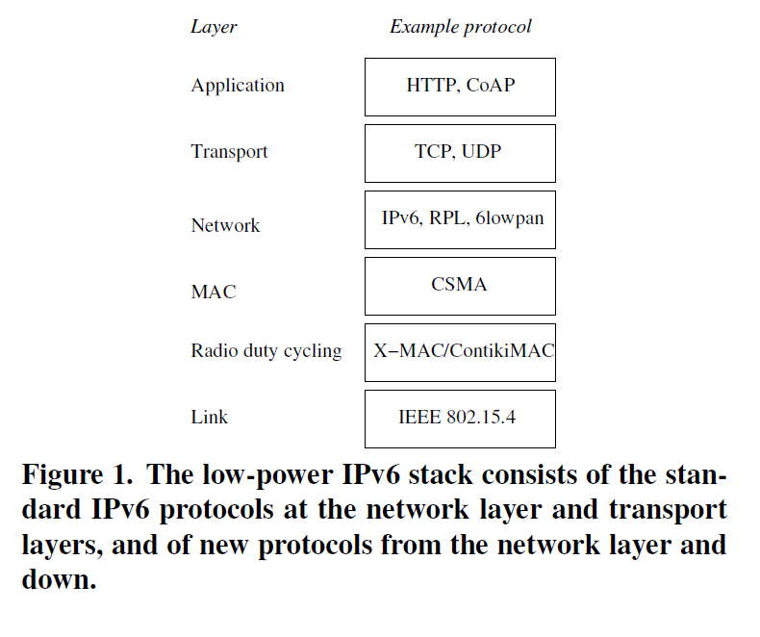
(Preview) Internet of Things

Slide 51
WSN Summary
Introduction
Mote Revolution
Wireless Sensor Network (WSN) Applications
WSN Details
Types of Wireless Sensor Networks (WSNs)
Tiered Architectures
Dynamic Cluster Formation
Power-Aware MAC Protocols
S-MAC, T-MAC, LPL, X-MAC
The Internet of Things

