Slide 1
An In-depth Study of LTE: Effect of Network Protocol and Application Behavior on Performance
Authors: Junxian Huang, Feng Qian, Yihua Guo, Yuanyuan Zhou, Qiang Xu, Z. Morley Mao, Subhabrata Sen, Oliver Spatscheck
CS577
Brett Levasseur

Slide 2
Outline
Introduction
LTE Data And Local Testbed
LTE Network Characteristics
Abnormal TCP Behavior
Bandwidth Estimation
Network Applications in LTE
Conclusions
Questions

Slide 3
Introduction
Previously observed LTE network characteristics
Higher bandwidths
Lower RTT
TCP underutilizes links
This work examines
Measurements from real LTE network
TCP bandwidth estimation algorithm
Power management

Slide 4
LTE Network
UE – User Equipment
RAN – Radio Access Network
CN – Core Network
Monitor – Author’s data collection point
PEP – Performance Enhancing Proxy

Slide 5
LTE Network
PEP – Not part of normal CN
Intercepts TCP traffic on ports 80 and 8080
Splits end to end TCP connection to two
UE to PEP
PEP to server
Performs compression and caching
Internet
HSS
PGW
MME
SGW
RAN
[Dahlman]

Slide 6
LTE Data
Covered 22 eNBs in a US city
Collection from 10/12/2012 - 10/22/2012
Collected
IP and transport headers
64 bit timestamps per packet
HTTP headers
3.8 billion packets
2.9 TB of traffic (324 GB of headers)

Slide 7
Local Test Bed
UE
Samsung Galaxy S III
Android 4.0.4 / Linux Kernel 3.0.8
Server
2GB RAM / 2.4 GHz Intel Core 2 CPU
Ubuntu 12.04 / Linux Kernel 3.2.0-36-generic
TCP CUBIC
Measured TCP throughput and RTT
Used two different LTE networks

Slide 8
Outline
Introduction
LTE Data And Local Testbed
LTE Network Characteristics
Abnormal TCP Behavior
Bandwidth Estimation
Network Applications in LTE
Conclusions
Questions

Slide 9
Measurements
Majority of traffic is TCP
Majority of the remainder is UDP
TCP Flows (95.3 %) | HTTP (80/8080) 50.1%
 | HTTPS (443) 42.1%
TCP Bytes (97.2%) | HTTP (80/8080) 76.6%
 | HTTPS (443) 14.8%

Slide 10
TCP Flow Size

Slide 11
TCP Flow Size
UL Flows | 90%, less than 2.9 KB
 | 10.9% have no uplink
 | Top 0.1% (by payload) account for 63.9% of total bytes
 | 73.6% of the top flows are images
DL Flows | 90%, less than 35.9 KB
 | 11.3% have no downlink
 | Top 0.6% (by payload) account for 61.7% of total bytes
 | Top 5% (by payload size) | Payload >= 85.9 KB
 |  | 80.3% use HTTP
 |  | 74.4% video or audio

Slide 12
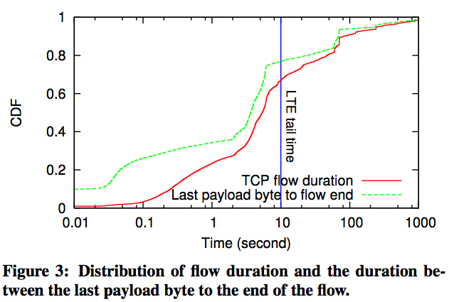
TCP Flow Duration

Slide 13
TCP Flow Duration
Flows | Duration
48.1% | < 5 seconds
6.8% | >= 3 minutes
2.8% | >= 10 minutes
Flows | Termination
86.2% | TCP FIN
5.4% | TCP RESET
8.5% | TCP SYN (did not connect properly)

Slide 14
Tail Time
10 seconds between last transmission and the UE radio being turned off

Slide 15
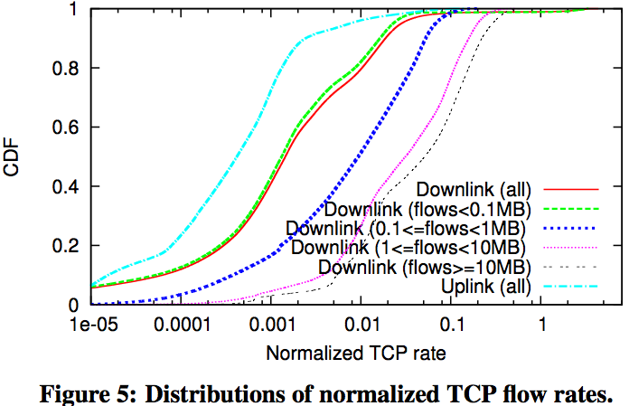
TCP Flow Rate
Better flow rate
Larger flows send faster than smaller flows
Flow duration and rate are more negatively correlated than on Internet backbone

Slide 16
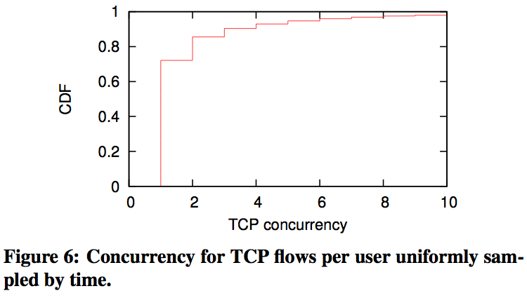
TCP Concurrency
72.1% of the time there is only one active TCP flow
Possibly higher for smartphones

Slide 17
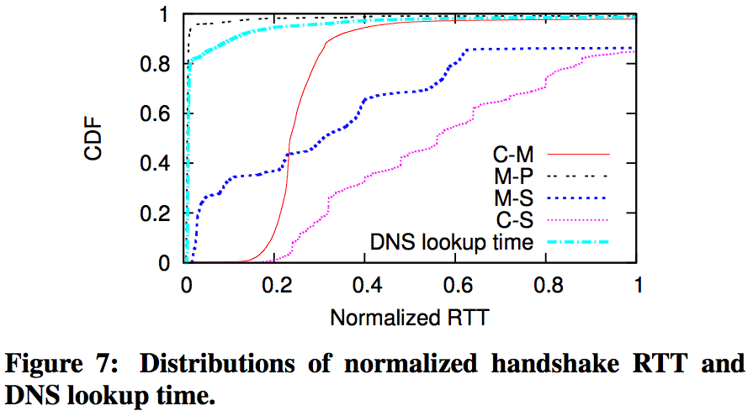
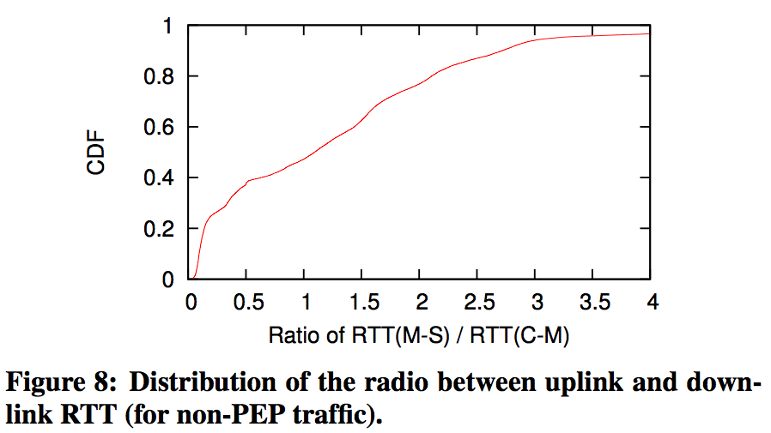
RTT
Better
RTT
C-M = Client to monitor
M-P = Monitor to PEP
M-S = Monitor to server
C-S = Client to server
RTT to M-S > C-M
RTT Monitor to server > than client to monitor
Indicates wireless link is not largest delay factor

Slide 18
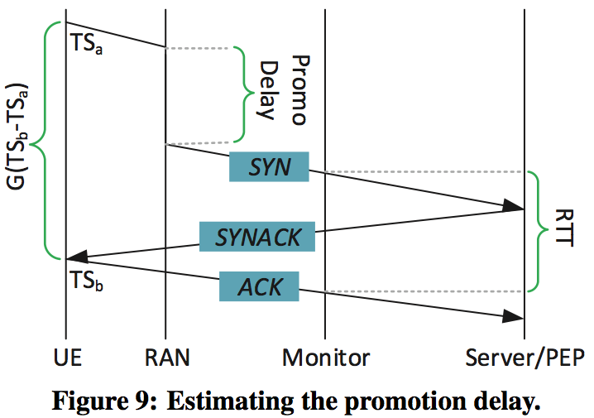
LTE Promotion Delay
Time to turn radio on
G(TS_{b} - TS_{a}) = RTT seen by UE
G – Inverse ticking frequency of UE’s clock
Percentile | Promotion Delay
25% | 319ms
50% | 435ms
75% | 558ms

Slide 19
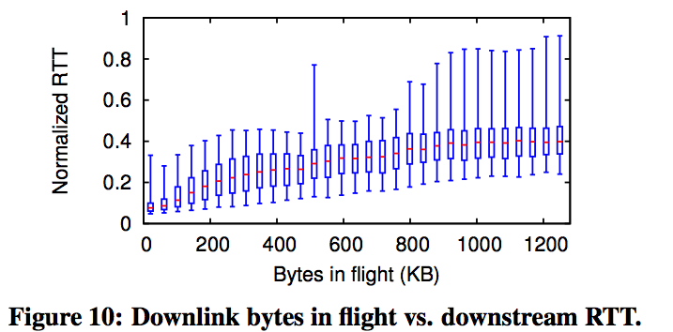
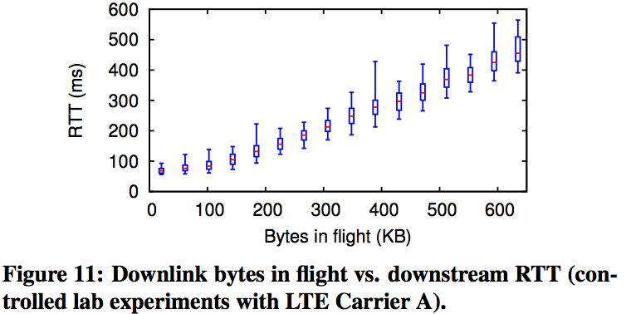
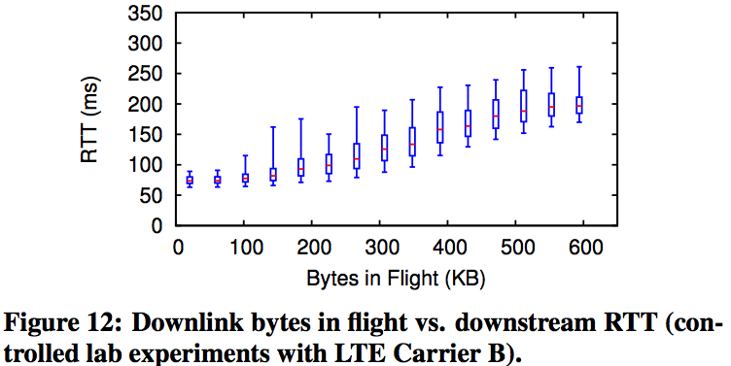
Queuing Delay

Slide 20
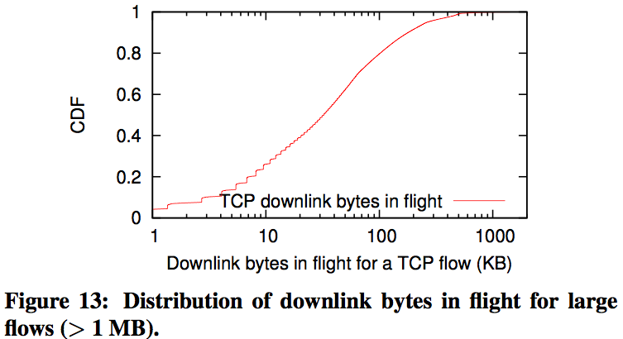
Queuing Delay
10% of large flows have > 200 KB in-flight
Leads to
Queue delay
Longer RTT
Created by long flows but impacts short flows

Slide 21
TCP Retransmission Rate
38.1% of flows have no retransmission
0.06% is the median of flows with retransmission
Physical/MAC layer retransmission reduced transport layer retransmission
Study does not look at LTE RLC layer retransmissions

Slide 22
Measurement History
LTE outperforms 3G, WiMAX and WiFi
4GTest LTE is higher than measurements
Possibly due to rate limiting at remote server

Slide 23
Outline
Introduction
LTE Data And Local Testbed
LTE Network Characteristics
Abnormal TCP Behavior
Bandwidth Estimation
Network Applications in LTE
Conclusions
Questions

Slide 24
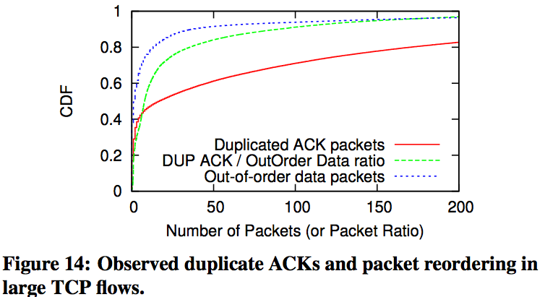
Duplicate ACKs
Medians
17 Dup ACKs
2 out of order packets
Over 29% of flows have > 100 Dup ACKs
Ratio Dup ACK / out of order
24.7% of flows over 25
Some up to 5,000
1 out of order packet can cause many Dup ACKs
Notes:
Large flows (down link)
Longer than 5 sec
Larger than 1MB
0.3% of flows
47.7% of data

Slide 25
Undesired Slow Start
Undesired Slow Start – Large RTT triggers RTO
Author’s measure undesired slow start with
Where is average downlink throughput from t₁ ms to t₂ ms after last Dup ACK
R_{ss} > 1.5 in slow start
20.1% of large flows have >= 1 lost packet
12.3% of all large flows have >= 1 lost packet

Slide 26
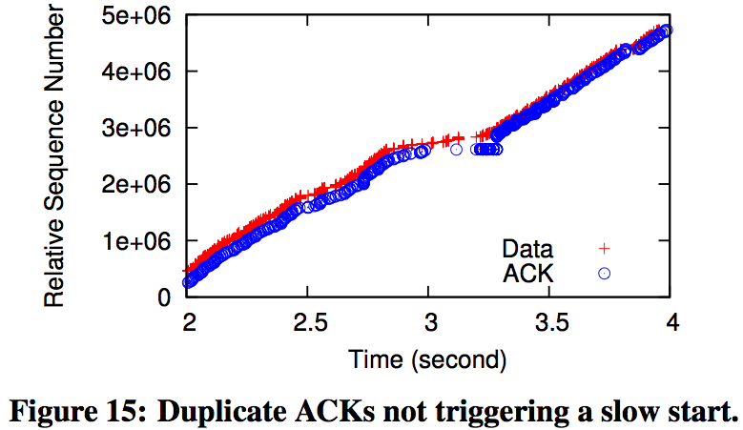
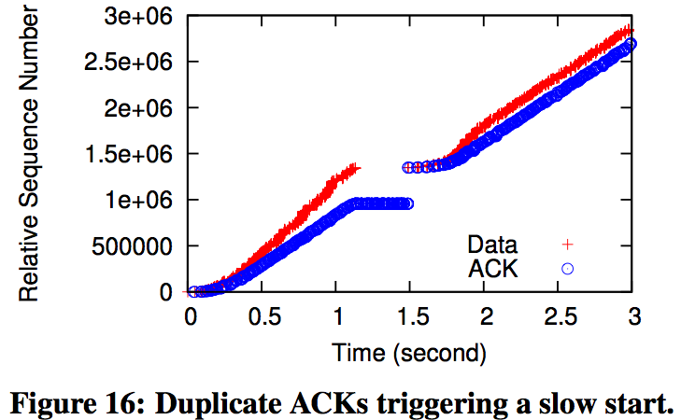
Undesired Slow Start
R_{ss} = 3.5
R_{ss} = 1.0

Slide 27
Mitigate Undesired Slow Start
Update RTO from duplicate ACKs with SACK
Take difference between SACK window of two consecutive duplicate ACKs
82.3% of flows used SACK in dataset
< 1% of flows had packet reordering
Update RTO from duplicate ACKs without SACK
Assume duplicate ACKs in response to data packets in order
Prevent > 95% of observed undesired slow starts

Slide 28
Outline
Introduction
LTE Data And Local Testbed
LTE Network Characteristics
Abnormal TCP Behavior
Bandwidth Estimation
Network Applications in LTE
Conclusions
Questions

Slide 29
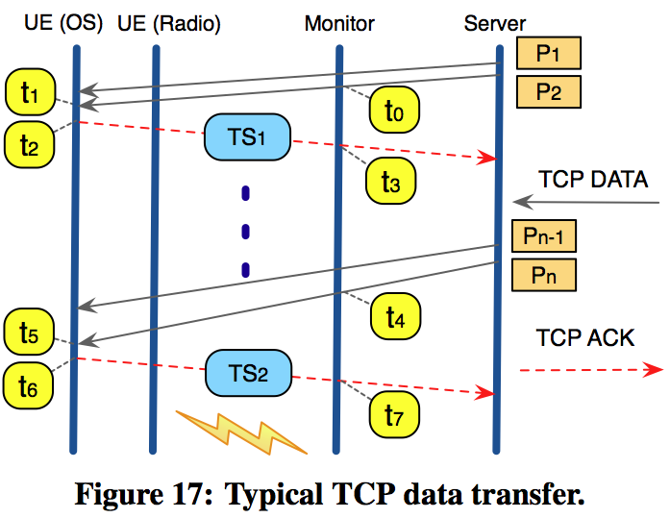
TCP Transmission Rate
Sending Rate from Monitor
Receive Rate at UE

Slide 30
TCP Timestamps
Replace t₁ and t₅ with t₂ and t₆
t₂ and t₆ originate at UE
Replace t₂ and t₆ with TCP Timestamps
Infer G

Slide 31
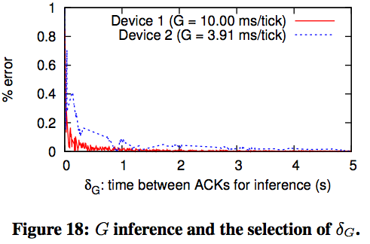
Estimation Accuracy
For accurate G
t₇ – t₃ >
Error rate of G drops as grows
At = 3 seconds error rate < 0.1%

Slide 32
Estimation Accuracy
With = 3 seconds the error rate of inferred G < 0.1% for the majority of flows
If G is unknown it is estimated from its formula
Flows | G
5.9% | NA
57.3% | 1ms/tick
36.4% | 10ms/tick
0.4% | 100ms/tick

Slide 33
Estimation Summary
G is known or inferred
Calculate R_{snd}
If R_{snd} >= C AND packets in order AND no duplicates AND last packet is not delayed ACK
R_{rcv} calculated
If C too small – underestimate
If C too large – not enough samples
C = 30Mbps

Slide 34
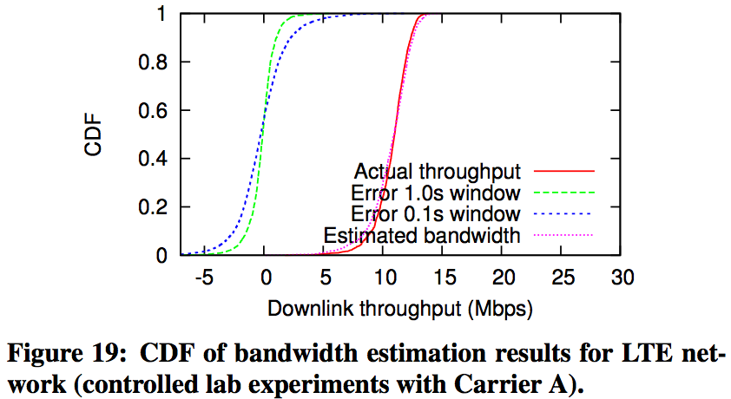
Validation
Compare server side estimate and UE trace
1 sec sample window average error rate is 7.9%
0.1 sec sample window average error rate has higher variation

Slide 35
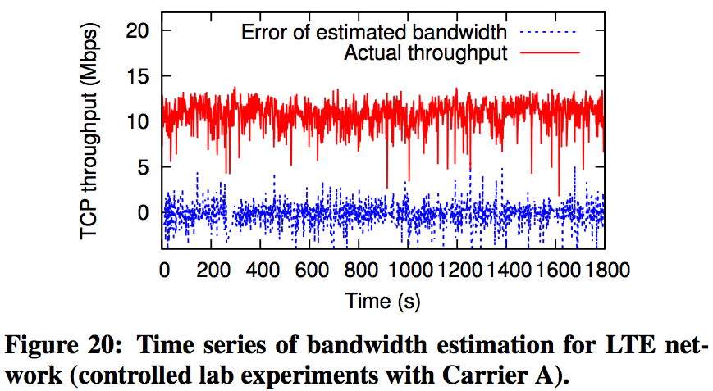
Validation
Actual throughput is UE perceived throughput
Used 1 sec sample window
Actual throughput varies around 10Mbps
Error varies by +- 1 Mbps

Slide 36
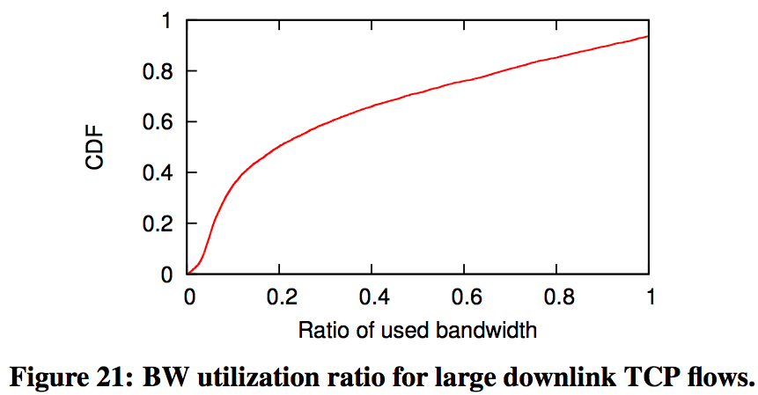
Large Flow Utilization
Median ratio 19.8%
71.3% of large flows < 50% utilization
6.4% use more bandwidth than estimated
Average ratio 34.6%
Low utilization, flows last longer
Higher radio usage
Notes:
Bandwidth estimation ran on large TCP flows
> 5 seconds, > 1 MB
Flow split into 250ms windows
1 bandwidth estimation per window

Slide 37
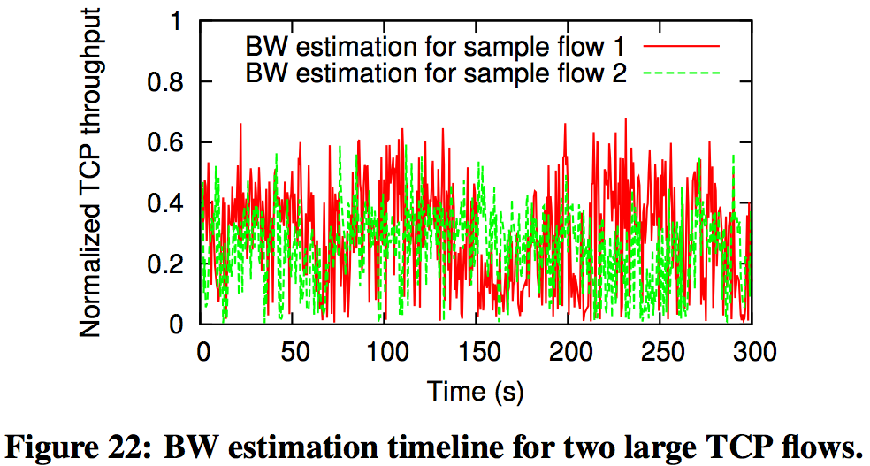
LTE Bandwidth Variation
Two large flows
Two different users
Two different times
Bandwidth varies over time
Condition of the wireless link
Movement
Resource scheduling

Slide 38
RTT & Throughput
Experiments with modifiable RTT
Used iptables to redirect packets to scheduler
Scheduler changes available bandwidth similar to observed LTE
Scheduler injects delays to impact RTT
Under small RTT TCP utilizes 95% of the bandwidth
RTT > 400ms utilization drops below 50%

Slide 39
Outline
Introduction
LTE Data And Local Testbed
LTE Network Characteristics
Abnormal TCP Behavior
Bandwidth Estimation
Network Applications in LTE
Conclusions
Questions

Slide 40
HTTP Characterization
HTTP Content | % of traffic
Video | 37.8%
Images | 19.5%
Text | 11.8%
Zip | 8.3%
Audio | 6.5%
Other | 5.6%
Unknown | 10.5%
12.9% of video content is octet-streams generated mostly by video players

Slide 41
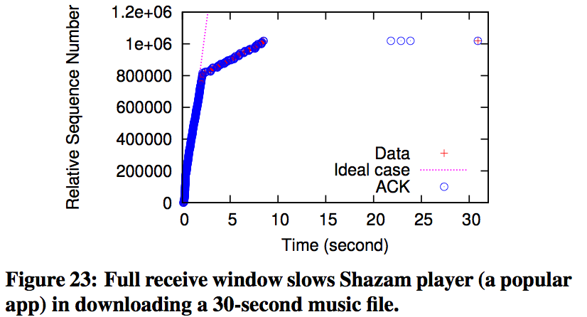
TCP Receive Window
Shazam app on iOS
30s, 1 MB audio
0s – 2s 3Mbps
Recv window full
2s – 9s < 300 Kbps
Download could have been done in 2.5s
Connection not closed until 30s
If receive window did not fill up

Slide 42
TCP Receive Window
Receive Window around 131,712 +- 600 bytes
True for > 90% of iOS, Android and Windows Phone flows
Applications not reading from receive buffer quickly enough
52.6% of downlink TCP flows experience full receive window
91.2% of these bottleneck happens in initial 10% of the flow duration

Slide 43
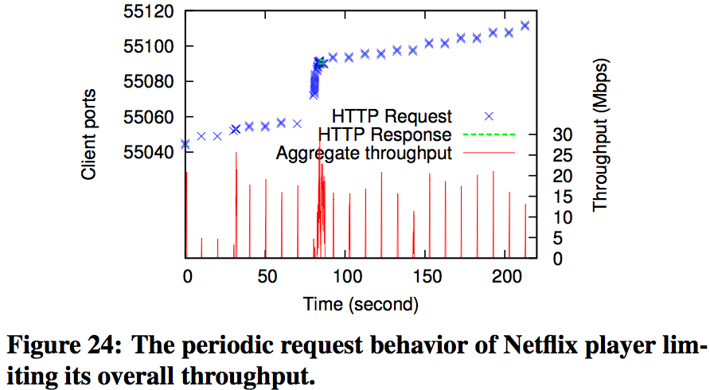
Application Design
Netflix on iOS
Multiple HTTP byte-range requests
Many short HTTP responses
< 1s
1 – 4MB
Periodic requests leaves radio idle

Slide 44
Discussion
Manufactures reduce TCP receive window
Decreases buffer bloat
Underutilizes network
Use application buffers
Relieves TCP buffers
Allows radio interface to close sooner
Increase amount downloaded per request, decrease number of requests

Slide 45
Conclusions
Not updating RTT from Dup ACKs causes performance issues with single packet loss
Bandwidth estimation algorithm
71.3% of large flows have < 50% utilization
High variation of network bandwidth
cwnd too slow to adjust
TCP receive window throttles 52.6% of downlink flows
App design underutilizes bandwidth

Slide 46
Questions

Slide 47
References
Huan J. et all, An In-depth Study of LTE: Effect of Network Protocol and Application Behavior on Performance. SIGCOMM 2013.
Dahlman E. et all, 4G LTE/LTE-Advanced for Mobile Broadband. Academic Press, 2011.

