Slide 1
The War Between Mice and Elephants (by Liang Guo and Ibrahim Matta) Treating Short Connections fairly against Long Connections when they compete for Bandwidth.
Advanced Computer Networks
CS577 – Fall 2013
WPI, Worcester.
Presented by Pankaj Didwania
Sep.24th, 2013

Slide 2
Outline
Introduction
Analyzing Short TCP Flow Performance
Sensitivity Analysis
Preferential Treatment
Proposed Architecture and Mechanism
The Architecture
Edge Router – Packet Classification and State Maintenance
– Core Router : Preferential Treatment to Short Flows
Contd…

Slide 3
Outline - Contd…
Simulation
Simulation Setup
Experiment 1 : Single Client Set
Experiment 2 : Unbalanced Requests
Discussion
Comments on Simulation Model
The Queue Management Policy
– Deployment Issues
– Flow Classification
– Controller Design
– Malicious Users
Conclusion and Future Work

Slide 4
Introduction
This paper highlights and resolves the 80-20 rule as applicable to Internet traffic.
80% of the traffic is actually carried by a small number of connections
– the Elephants.
And only the remaining 20%, large number of connections are very small in size or lifetime
– the Mice.

Slide 5
Introduction contd…
Short TCP Flows vs. Long TCP Flows, an example.
In a Fair Network: the Short Connections expect faster service in comparison with their Long counterparts.
However this is not true for Internet scenarios.
Let’s see why and what the authors recommend.

Slide 6
TCP characteristics
TCP was originally designed for elephants.
TCP slow start: Sending windows gets initiated at a minimum value without considering available network resources.
TCP couples error control with congestion control.
TCP depends upon timeout (vs. duplicate ACK mechanism) to detect packet loss for Short connection.

Slide 7
TCP characteristics
TCP relies on its own packet samples to estimate an retransmission timeout (RTO) value.
TCP uses conservatively estimated initial timeout (ITO) for the first control and data packets.
This causes TCP flows to be more conservative for short connections and tend to get less than their fair share.

Slide 8
Approach
Preferential treatment to ensure prompt responses to short TCP flows.
Threshold based classification method.
Active Queue Management (AQM) – RIO at core routers.
Differentiated Services (Diffserv) architecture at the edge of networks.
This approach achieves better goodput than traditional Drop Tail or RED policies.
RIO guarantees ordered delivery of packets.

Slide 9
Related Work
Authors :
- study interaction between long and short flows.
- propose to isolate long and short flows.
- discover that ‘class based flow isolation’ in combination with ‘threshold based classification’ at the edge cause packet reordering and severely degrade TCP performance.
- propose to push the bandwidth(load) control to the edges of the network.

Slide 10
Analyzing Short TCP Flow Performance
Relationship between loss rate and TCP flow transmission.
Sensitivity Analysis for Short and Long TCP flows.
Preferential Treatment to Short TCP Flows.

Slide 11
Sensitivity Analysis for Short and Long TCP flows
In this section authors provide the analytical results on the transmission time for TCP flows of different sizes.
It is observed that the average transmission time of short flows is not very sensitive to loss when the loss rate is relatively small. But it increases drastically as loss rate becomes larger (when persistent congestion happens).

Slide 12
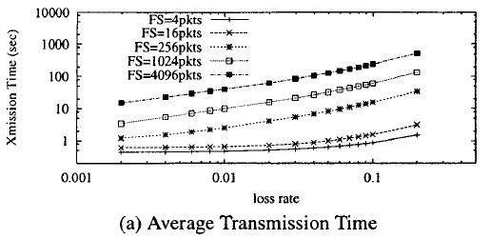
Sensitivity Analysis…
Figure gives in a log-log plot the average total latency with avg RTT = 0.1 second, avg. RTO = 4 x RTT and the default initial retransmission timer ITO = 3 seconds, for a TCP flow of a fixed size FS for various loss rates.

Slide 13
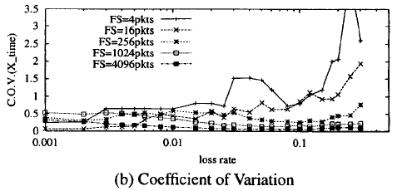
Sensitivity Analysis…
Figure plots C.O.V. against loss rate. Notice the trend - for small size TCP flows, increasing the loss probability can lead to increased variability, while for long TCP flows, large loss rate reduces the variability of transmission times.

Slide 14
Sensitivity Analysis…
When Loss rate is high, TCP congestion control is more likely to enter the exponential back-off phase.
When Loss rate is low, depending on when the packet loss occurs TCP can either transmit a significant amount of packets in slow-start phase or have to transmit them in the less aggressive congestion avoidance phase.
Since the first source of variability is on individual packets of a flow, the law of large numbers indicates that its impact is more significant on short flows.
The second source of variability is more pronounced for long flows since most short flows finish their transmission in slow-start phase.
Authors thus conclude that reducing the loss probability is more critical to help short TCP flows experience less variations in transmission(response) time.

Slide 15
Preferential Treatment to Short TCP Flows
Authors simulate the following scenario
-Using ns Simulator
-10 Long(10000 packet) TCP-Newreno flows
-10 Short(100-packet) TCP-Newreno flows
-Competing for bandwidth over a 1.25 Mbps link
-Authors then vary the queue management policy at the bottleneck link and measure the instantaneous portion of bandwidth taken by each class of flows to show the effect of preferential treatment.
-The results of Drop Tail Queue, RED Queue and the proposed RIO-PS(RIO with preferential treatment to Short flows) in the plot.
(left to right on the next slide).

Slide 16
Preferential Treatment to Short TCP Flows…
-Drop Tail Queue, RED Queue and the proposed RIO-PS (left to right).

Slide 17
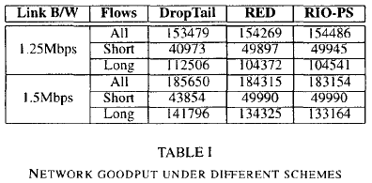
Preferential Treatment to Short TCP Flows…
-Table below gives measured network goodput over the 500 seconds simulation period.
-The table also shows the measured goodput for a less loaded network with bottleneck link bandwidth of 1.5 Mbps

Slide 18
Proposed Scheme: Architecture & Mechanisms
Architecture
Edge Router: Packet Classification and State Maintenance
Core Router: Preferential Treatment to Short Flows.

Slide 19
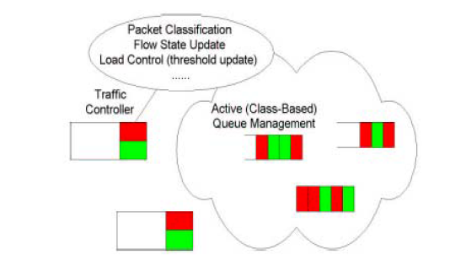
Architecture
This section covers the detailed implementation of the proposed scheme including the network architecture and the supporting mechanisms required to differentiate between short and long flows.

Slide 20
Edge Router : Packet Classification and State Maintenance
ERs determine whether the packet is coming from a long or short flow.
A threshold(Lt) based approximation method is used to mark them short vs. long.
The per-flow state information are (softly) maintained to detect the termination of flow. The flow hash table is updated periodically every Tu time units.
ER adjusts threshold dynamically using Short-to-Long Ratio(SLR), a ratio between the number of active short and long flows.

Slide 21
Core Router: Preferential Treatment to Short Flows
Authors choose RIO (RED with In & Out) policy.
RIO conforms to the DiffServ Specification.
Only a single FIFO queue is used for all packets.
RIO inherits all features of RED including protection of bursty flows.
RIO performs soft prioritization, keeping benefits from statistical multiplexing.

Slide 22
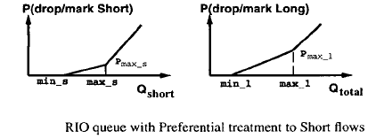
Early dropping/marking function of an RIO queue

Slide 23
Simulation
Simulation Setup
Experiment 1: Single Client Set
Experiment 2: .Unbalanced Requests

Slide 24
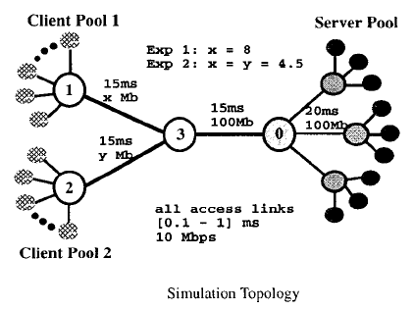
Simulation
Topology : 0 = Edge Router; 1,2,3 = Core Routers.

Slide 25
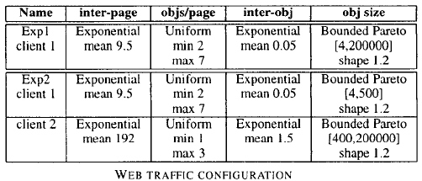
Simulation
Distribution of inter-page and inter-object time (in seconds), page size and object size(in packets).

Slide 26
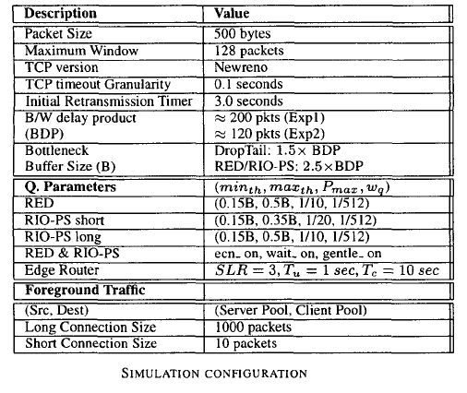
Simulation
Detailed Simulation Configuration :

Slide 27
Experiment 1
Single Client Set

Slide 28
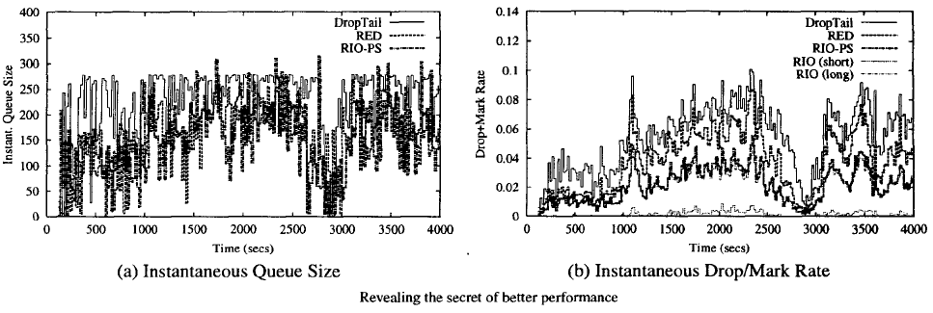
Experiment 1 …
Instantaneous queue size and drop rate in the last 20 seconds for the case of 3-seconds ITO

Slide 29
Experiment 1 …
Fairness Index of response time

Slide 30
Experiment 1 …
Transmission time for each individual connection and their ensemble average

Slide 31
Experiment 1 …
Network Goodput

Slide 32
Discussion
Comments on Simulation Model
The Queue Management Policy
Deployment Issues
Flow Classification
Controller Design
Malicious Users

Slide 33
Discussion
The simulation presented in this paper uses 'DumbBell and DanceHall' (one-way traffic) and all TCP connections have similar end-to-end propagation delays.

Slide 34
Discussion
To be conformant to existing DiffServ implementations authors chose RIO like AQM policy to be used at core routers.

Slide 35
Discussion
The proposed scheme requires edge devices to be able to perform per-flow state maintenance and per-packet processing.

Slide 36
Discussion
The proposed scheme involves Controller design issues at different places and timescales.

Slide 37
Discussion
One concern regarding the proposed scheme may be that users are then encouraged to break long transmissions into small pieces so that they can enjoy faster services.

Slide 38
Conclusions and Future Work
Performance of majority of TCP flow is improved.
The performance of few TCP long flows is also enhanced.
The overall Goodput of the system is improved.
The proposed architecture is extremely flexible and can be largely tuned at the edge routers.
Authors currently investigating an approach that integrates size-aware traffic management at both the network and transport layers.

Slide 39
Questions & Class Discussion
Questions
Suggestions
Professor Comments
Others
Thanks!!

Slide 40
References:
Paper by Liang Guo, Ibrahim Matta.
Prof. Kinicki – WPI CSFQ paper.
Review document : Preeti Phadnis

