Slide 1
TCP Cubic
CS577
Brett Levasseur

Slide 2
Outline
Introduction
TCP BIC
TCP CUBIC

Slide 3
Introduction
TCP grows cwnd too slowly for large bandwidth connections
New TCP Variant needed
Almost 1.4 hours to take up ½ possible cwnd
1,250 byte packets
ssthresh ~ 8000 bytes
100ms RTT

Slide 4
BIC
Binary Increase Congestion Control (BIC)
New variables and constants
Wmax, Wmin, Smax, Smin
Goals
Grow cwnd faster without overshooting
Stability
Scalability
Fair to multiple TCP flows

Slide 5
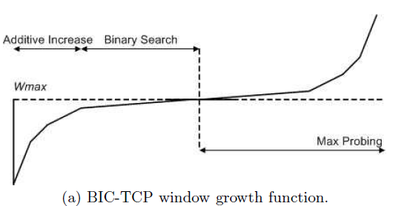
BIC
Additive Increase
Increase cwnd by Smax
Binary Search
Grow by half distance to Wmax
Max Probing
Find new Wmax
Reduce cwnd by factor of β during loss

Slide 6
BIC
ACK (Binary Search)
If cwnd < Wmax
cwnd += (Wmax – cwnd) / 2
Else
cwnd += cwnd - Wmax
Recovery
If cwnd < Wmax
Wmax = cwnd * (1 – ß / 2)
Else
Wmax = cwnd
cwnd *= 1 - ß
[Qian He]
cwnd | Compare | Grow
0 | 128 > Smax | 64
64 | 96 > Smax | 64
128 | 64 = Smax | 64
192 | Smin < 32 | 32
224 | Smin < 16 | 16
240 | Smin < 8 | 8
248 | Smin < 4 | 4
252 | Smin >= 2 | NA
Smax = 64
Smin = 2
Wmax = 256
Wmin = 0

Slide 7
BIC Example
Wmax = 256
cwnd
Wmin = 0
RTT
[Qian He]

Slide 8
BIC Problems
Complicated algorithm
Requires different concave and convex algorithms
BIC cwnd growth too aggressive
Especially with short RTT and low speed links
Not fair enough

Slide 9
CUBIC
Simpler cubic function than BIC algorithms
Growth function less aggressive than BIC
CUBIC has 3 cwnd growth modes

Slide 10
TCP-friendly
Determine how normal TCP would grow cwnd
Get average window size under AIMD
For TCP:
t – Elapsed time
If Wtcp(t) > W(t) then cwnd = Wtcp(t)
Good for small RTT

Slide 11
Concave Mode
cwnd >= Wtcp(t) and cwnd < Wmax
C is a scaling factor
t time since packet loss
Wmax window before packet loss
K time period to increase cwnd to Wmax
cwnd +=

Slide 12
Convex Mode (Max Probing)
Increase cwnd slowly at first
Gradually increase cwnd growth
Look for new Wmax
Same formula as Concave mode
cwnd +=

Slide 13
Packet Loss
Reduce window by factor of β
Update K
Fast Convergence
Lower cwnd to account for new TCP flows
Keep previous Wmax as Wlast_max
If Wmax < Wlast_max then assume new flow

Slide 14
Questions

Slide 15
References
S. Ha, I. Rhee, L. Xu. CUBIC: A New TCP-Friendly High-Speed TCP Variant.
Q. He. CUBIC. http://web.cs.wpi.edu/~rek/Adv_Nets/Fall2013/Cubic.pptx

