Slide 1
TCP CUBIC in ns-3
CS577
Brett Levasseur

Slide 2
Outline
Introduction
CUBIC
CUBIC in Linux
ns-3 Implementation
Results
Conclusions

Slide 3
Introduction
TCP grows cwnd too slowly for large bandwidth connections
New TCP Variant needed
Almost 1.4 hours to take up ½ possible cwnd
1,250 byte packets
ssthresh ~ 8000 bytes
100ms RTT

Slide 4
CUBIC
BIC was first attempt
CUBIC simplified and improved upon BIC
Grow cwnd slower around loss events

Slide 5
CUBIC Basics
cwnd growth
Packet loss
C | CUBIC parameter
t | Elapsed time from the last window reduction
K | Time period to increase W to Wmax
W | Current cwnd
Wmax | cwnd at last window reduction
β | Window decrease constant

Slide 6
CUBIC Basics
Wmax
W(t=0)
At loss event set Wmax, reduce cwnd by β and calculate K

Slide 7
CUBIC Basics
K
W(t=K)
W(t=2)
W(t=1)
cwnd grows back to K when t = K

Slide 8
CUBIC in Linux
Not implemented as in the CUBIC paper
cwnd grows in increments of segment sizes
Custom method for calculating cube roots
Checks for error conditions
Unit scaling

Slide 9
Growing cwnd
Linux only grows cwnd by full segments
CUBIC can grow cwnd less than full segment
Same impact by increasing amount of time between updates
0 | 0
1 | 0.25
2 | 0.5
3 | 0.75
4 | 1
0 | 0
4 | 1

Slide 10
Scaling in CUBIC
Most scaling is related to time
Variable ‘t’ measured with TCP timestamps
Timestamps use clock cycles to increment
Units are called jiffies in the Linux Kernel
Number of milliseconds in a jiffy depends on the CPU’s clock
Scaling required to get time units correct

Slide 11
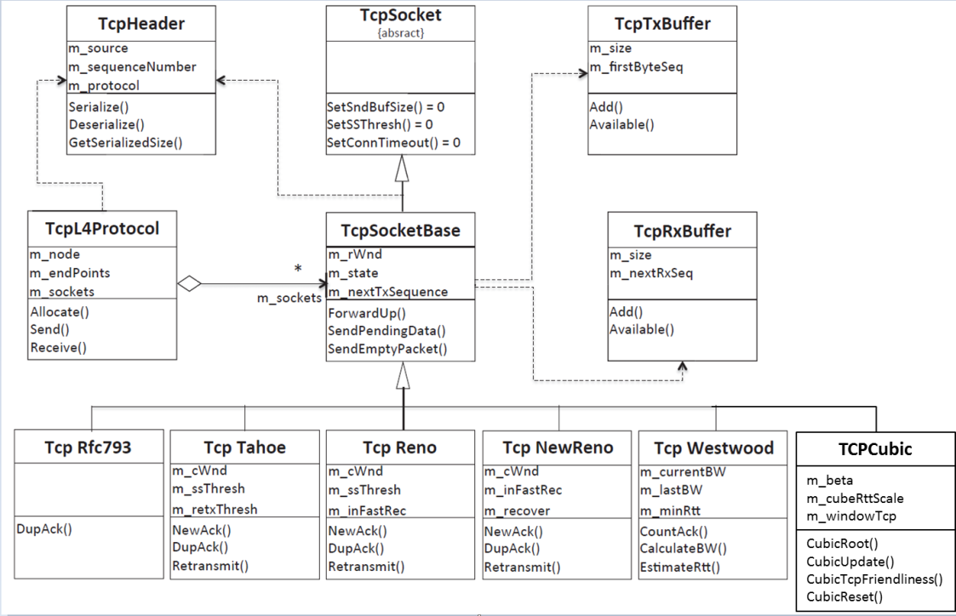
ns-3 Implementation
Object oriented design
Generic TCP defined
TCP variants are extended from base
TCP headers and buffers provided
Added TcpCubic object
tcp-cubic.cc
tcp-cubic.h

Slide 12
ns-3 Methods
NewAck – called for every new ACK received
Normal cwnd updates in slow start
CUBIC updates otherwise
DupAck – called for every duplicate ACK received
Normal operation when < 3 duplicates
For 3 duplicate ACKs reduce cwnd

Slide 13
CUBIC Methods
CubicRoot – Find the cubic root of a number
Based on Linux Kernel implementation
CubicUpdate – Calculate the cwnd target for CUBIC
CubicTcpFriendliness – Change the cwnd target for TCP Friendliness
CubicReset – Reset CUBIC parameters

Slide 14
CUBIC Flow
NewAck
CubicUpdate
CubicRoot
CubicTcp
Friendliness
If outside slow start
Set K for loss event
Check TCP
Friendliness
Recommended cwnd growth

Slide 15
Issues
ns-3 does not have TCP timestamps
Simulation clock used instead
Requires adjustments to calculating ‘t’ due to different units
Could remove the use of jiffy code but much of the Linux implementation relies on scaling factors based on the system clock

Slide 16
Results
Compare to real world CUBIC example
Examine simulation results
Verify cwnd reduction
Verify cwnd growth in relation to Wmax
Compare simulated CUBIC to simulated NewReno

Slide 17
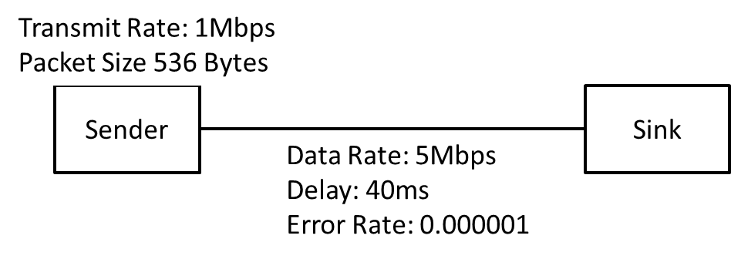
Simulation Scenario
Simple sender and sink topology
Packet sizes 536 bytes
Transmission rate 1Mbps
Delay 40ms
Error rate – Causes lost packets at the receiver

Slide 18
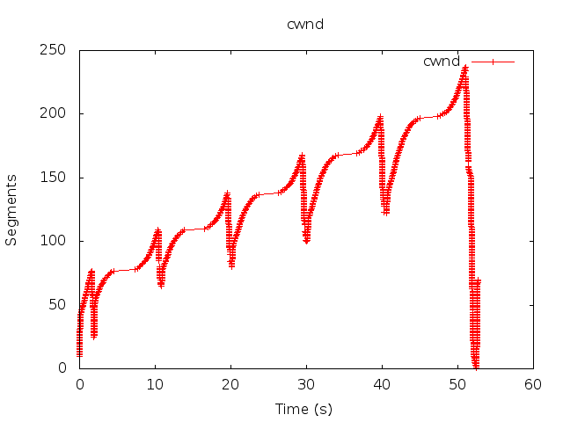
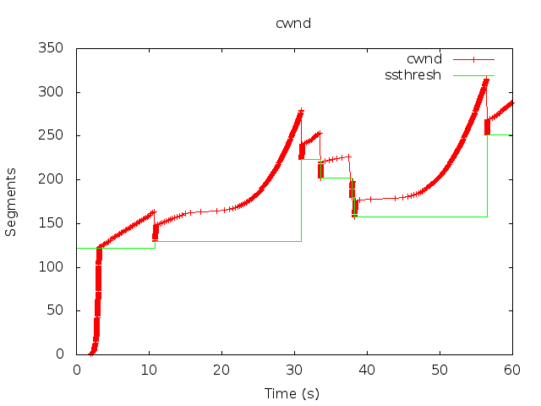
Measurements
Measurement and simulation have similar CUBIC curve
Number of segments similar

Slide 19
Packet Loss
Before loss cwnd = 216
After loss cwnd = 172
β = 819
BICTCP_BETA_SCALE = 1024

Slide 20
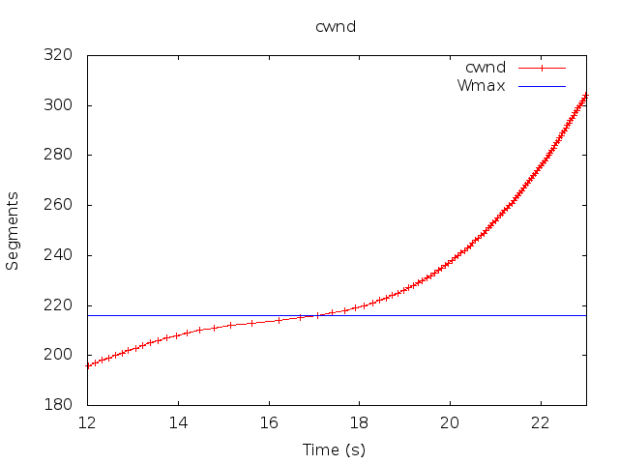
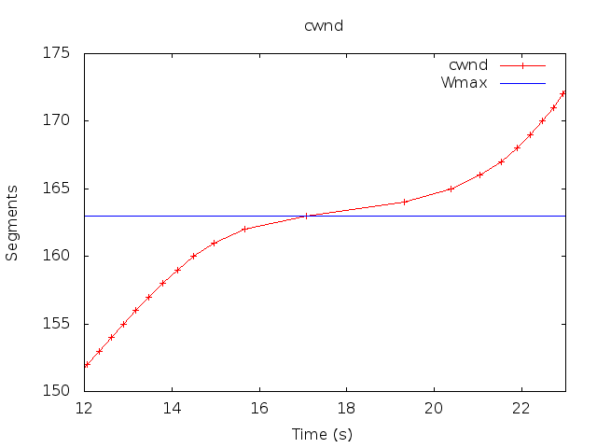
CUBIC Growth
convex
concave &
convex
concave
Before and after additional scaling of ‘t’
More work is needed for using simulator clock with ‘t’

Slide 21
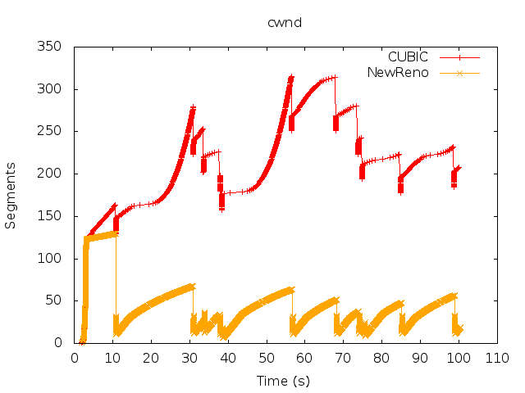
NewReno Comparison
Same simulation run with CUBIC and NewReno
Both increment the same under slow start
CUBIC grows cwnd faster
CUBIC handles packet loss better than NewReno

Slide 22
Conclusions
Created a CUBIC implementation in ns-3
Similar cwnd growth to actual CUBIC measurements
Current version outperforms NewReno
Scaling adjustments required

Slide 23
Questions

