Slide 1
Congestion Control for High Bandwidth-Delay Product Networks
Dina Katabi, Mark Handley and Charlie Rohrs
SIGCOMM2002 Pittsburgh
Presenter – Bob Kinicki

Slide 2
Outline
Reasons for a NEW protocol
Internet Trends
TCP Problems
Previous Related Research
XCP Design Rationale
eXplicit Control Protocol (XCP)
Sender, Receiver, Router
Stability Analysis
XCP Performance Study Using ns-2 Simulations
XCP Issues
Conclusions and Critique

Slide 3
Internet Trends
Internet “High Speed” of 10 to 100 Mbps upgraded to current “High Speed” of 10 to 100 Gbps.
+ Potential end-to-end delays increased due to satellite transmissions and last hop wireless retransmissions (the spread of modern RTTs has increased).
→ BDP (Bandwidth Delay Product) increased dramatically!!
Since packet drops occur over wireless links, dropping is NOT an unambiguous implicit indicator of congestion.

Slide 4
Problems with TCP
TCP becomes oscillatory and prone to instability as BDP increases.
TCP is inherently biased against flows with high RTTs (satellite links).
AIMD in TCP responds very slowly to available high capacities.
With majority of short web flows (TCP mice) and over-provisioned router buffers, higher available link capacity does not necessarily improve the transfer delay of mice flows.

Slide 5
Previous Related Work
“Round up the usual suspects” of AQM schemes
1993 RED {including ECN}
1998 CSFQ*
1999 SRED
2001 ARED
2001 REM*
2001 PI Controller*
2001 AVQ*
Good performance involves parameter tuning for these schemes.
* utilize control theory with fluid flow models and feedback loops.

Slide 6
XCP Design Rationale
Packet loss is a poor signal of congestion.
A binary signal of ONLY presence or absence of congestion.
Congestion signaling should indicate the degree of congestion.
The dynamics of congestion control is abstracted as a control loop with feedback delay (Figure 14 in Appendix).

Slide 7
XCP Design Rationale
These control systems become unstable for large feedback delays (i.e., large flow RTTs).
How exactly should feedback depend on delay to establish system stability?
Robustness to congestion needs to be independent of number of flows.
Efficient link utilization needs expressive feedback.
Expressive feedback in ‘coupled systems’ led to per flow state (Unscalable!!).
Solution – uncouple efficiency from fairness.

Slide 8
eXplicit Control Protocol (XCP)
XCP involves a joint design of XCP end-system Hosts and XCP routers.
XCP is a window-based congestion control protocol intended for best effort traffic (namely, it does not involve different QoS metrics).
Sources use cwnd, congestion window, similar to TCP.
Routers interact with flows and provide explicit feedback to source hosts.

Slide 9
XCP Congestion Header
Sending Host
fills
H_cwnd
Sending Host
initializes
Routers
Update
H_rtt
H_feedback
H_cwnd :: sender’s current congestion window (cwnd)
H_rtt :: sender’s current rtt estimate
H_feedback:: Initialized to desired increase in cwnd.
Modified by routers along path to directly control senders’ congestion windows.
[Dion 03]

Slide 10
XCP Sender
Maintains a congestion window of outstanding packets (cwnd) and its own estimate of round trip time (rtt)*.
Initialization steps:
In first packet of flow, H_rtt set to zero.
H_feedback is set to the desired window increase.
For a desired rate r:
H_feedback = ( r * rtt – cwnd) / # packets in current congestion window
When ACKs arrive, positive feedback increases cwnd and negative feedback reduces cwnd:
cwnd = max(cwnd + H_feedback, s)
where s is packet size.
XCP must also respond to packet losses {although they are rare}.
* Note – rtt and RTT are different in Katabi notation!!
[Dion 03]

Slide 11
XCP Receiver
XCP Receiver is similar to a TCP Receiver.
When XCP Receiver ACKs a packet, it copies received congestion header from data packet into the ACK packet.

Slide 12
XCP Router
XCP router operates on top of dropping policy (e.g., DropTail or RED) and computes feedback such that system converges to optimal efficiency and min-max fairness.
Aggregate Feedback
XCP Router
Efficiency Controller
Φ
Fairness Controller
XCP packet
XCP packet*
* modified H_feedback
[Dion 03]

Slide 13
XCP Router
Both XCP controllers make a single control decision per control interval.
d (the average RTT) :: the XCP control interval is computed using information in the congestion header.
XCP router maintains a per link estimation-control timer that is set to d.
Upon timeout, router updates its estimates and control decisions.

Slide 14
The Efficiency Controller (EC)
persistent queue size
Φ = α * d * S - β * Q
0.226 based on stability analysis
0.4 based on stability analysis
spare capacity (input traffic rate – link capacity)
average RTT (feedback delay)
EC maximizes link utilization while minimizing drop rate and persistent queues. This MIMD algorithm increases the traffic rate proportionally to the spare capacity.
EC does not care about fairness (does not need flow id).
Φ :: aggregate feedback computed once each control interval is then used as feedback to add or subtract bytes that the aggregate traffic transmits.
Q = minimum queue seen by the arriving packet during last propagation delay (avg. RTT – local queuing delay).
[Dion 03]

Slide 15
The Fairness Controller (FC)
FC apportions the aggregate feedback to individual packets (flows) to achieve fairness.
Uses AIMD algorithm to promote fairness.
When Φ > 0, allocate so the increase in throughput of all flows is the same.
When Φ < 0, allocate so the decrease in a flow’s throughput is proportional to its current throughput.
When Φ = 0, uses bandwidth shuffling to prevent convergence stalling.

Slide 16
Bandwidth Shuffling
Bandwidth Shuffling :: simultaneous allocation and deallocation of flow sending rate such that the total traffic rate does not change, yet the throughput of each individual flow gradually approaches its fair share.
The shuffled traffic is computed as:
h = max (0, γ * y - | |)
where y is the input traffic during d and γ is set to 0.1 {This implies that 10% of the traffic is redistributed according to AIMD.}
Φ

Slide 17
Per-Packet Feedback
FC computes per-packet feedback:
H_feedback_{i} = p_{i} – n_{i} (3)
Basic Idea
p_{i} (the per-packet positive feedback (when Φ > 0)) is proportional to the square of the i^{th} flow’s rtt and inversely proportional to its congestion window divided by its packet size.
n_{i} (the per-packet negative feedback (when Φ < 0)) should be proportional to its packet size (s_{i}) and the i^{th} flow’s rtt .
Proportional constants and are estimated every d and used during the following control interval.

Slide 18
Stability Analysis
Theorem 1. Suppose the round trip delay is d. If the parameters α and β satisfy:
Then the system is stable (independent of delay, capacity and number of flows).

Slide 19
XCP Performance
Authors study XCP performance via an extensive series of ns-2 simulations.
They compare XCP against the ‘usual AQM suspects’ (RED, REM, AVQ and CSFQ) with ECN enabled.
Simulation results substantiate the stability analysis claims of independence of XCP with respect to capacity, feedback delay and number of flows.

Slide 20
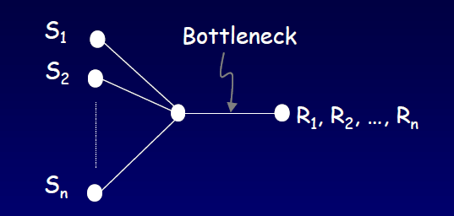
Single Bottleneck Topology
Reverse
Traffic
ns-2 simulation details
Packet size = 1000 bytes; buffer = BDP;
Long-lived FTP flows are homogeneous with equivalent RTTs.
Simulation running times always longer than 300 RTTs.
[Katabi 02]

Slide 21
Figure 4 (top) Utilization vs Bottleneck Capacity
50 long-lived TCP flows
50 flows in reverse direction (two -way traffic)
80 ms. round-trip propagation delay
Regardless of AQM scheme, bottleneck utilization for TCP degrades as capacity increases
XCP is near optimal!
Bottleneck Utilization
[Dion 03]
Bottleneck Capacity (Mbps)

Slide 22
Figure 4 (bottom): Drops vs Bottleneck Capacity
TCP CSFQ ECN drops
XCP never drops packets

Slide 23
Figure 5 Utilization vs. Delay
Bottleneck capacity fixed at 150 Mbps.
All other parameters and flow characteristics are the same as in Figure 4.
XCP keeps utilization high while TCP degrades with increased propagation delay (regardless of AQM scheme).
Bottleneck Utilization
[Dion 03]
Round-Trip Propagation Delay (sec.)

Slide 24
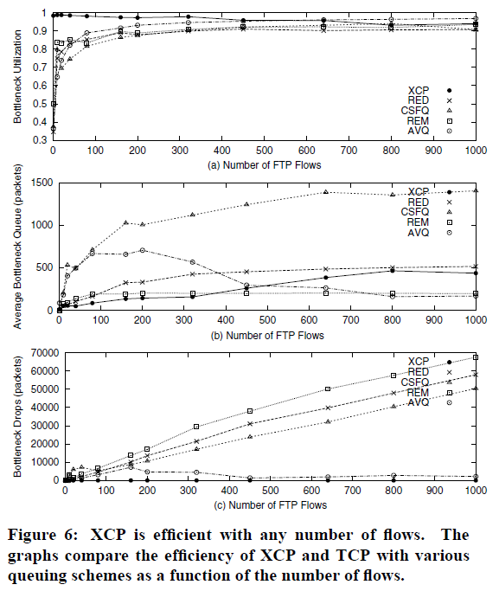
Figure 6
Impact of
Number of Flows
50 long-lived TCP flows
50 flows in reverse direction
80 ms. round-trip propagation delay
150 Mbps capacity
Claim: XCP increased queue size as number of flows increase is due to its high fairness!
XCP utilization
XCP queue grows
XCP drops

Slide 25
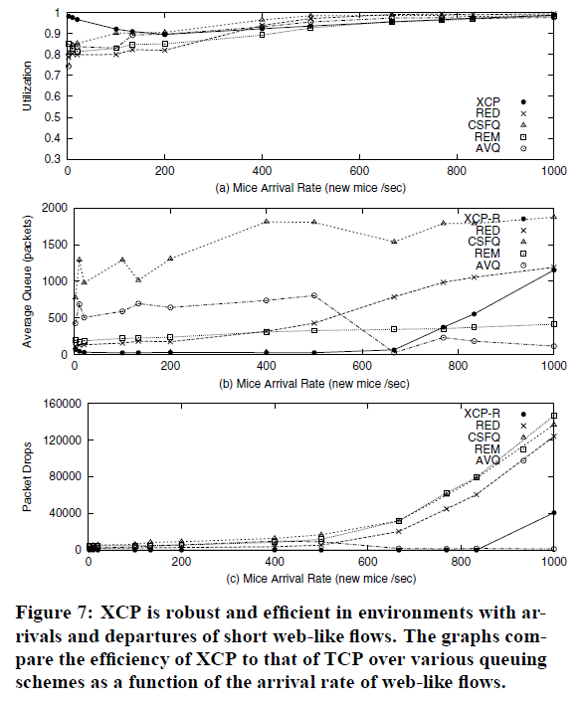
Figure 7
Impact of Short Web-Like Traffic
50 long-lived TCP flows
50 flows in reverse direction
80 ms. round-trip propagation delay
150 Mbps capacity
Short flows:
Poisson process arrivals
Transfer size – Pareto distribution with 30 packet mean and shape = 1.35
XCP eventually drops

Slide 26
Simplified Figure 8 [TCP == RED]
[Katabi 02]

Slide 27
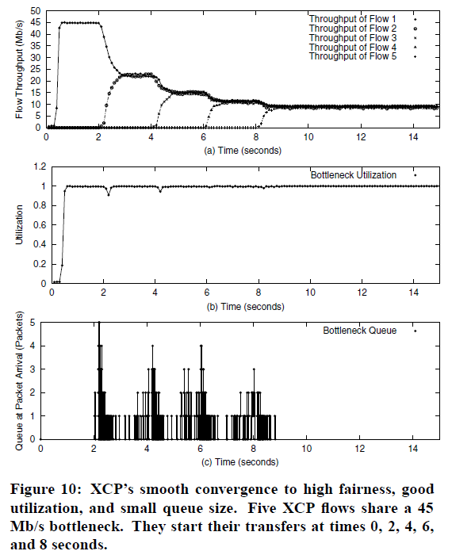
Figure 10
XCP Convergence
Dynamics
5 long-lived flows with 2-sec staggered start times.
45 Mbps capacity
Common 40 ms RTT
XCP maintains min-max fairness without harming utilization.

Slide 28
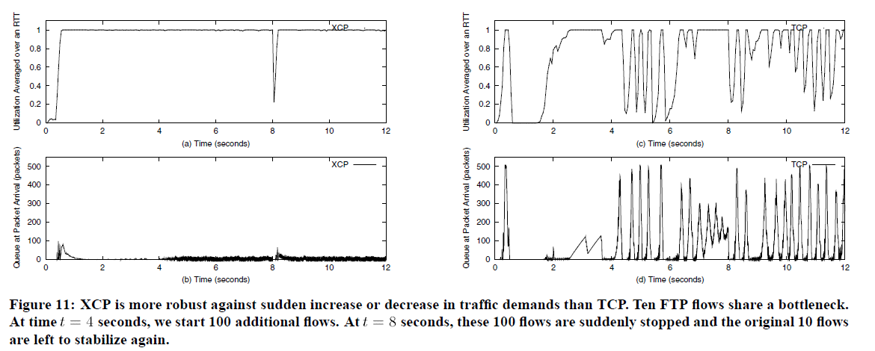
Figure 11 Robustness to Sudden Changes in Traffic Demand
Flow Characteristics
10 long-lived FTP flows share 100 Mbps bottleneck capacity.
All flows have 40 ms. RTTs. TCP flows traverse RED router.

Slide 29
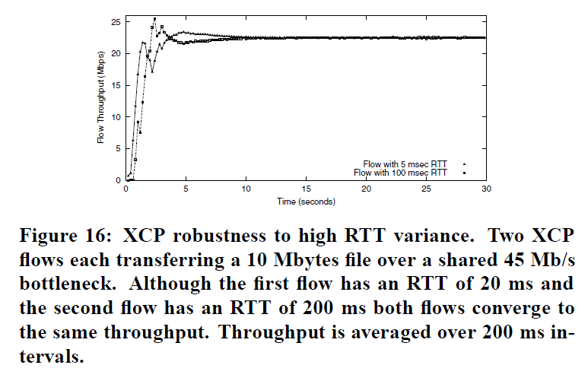
High RTT Variance

Slide 30
XCP Issues
1. Source ‘cheating’
How to handle misbehaving XCP sources that lie about RTT and do not use correct sending rate?
XCP needs ‘policying agent’ in edge XCP router.
2. How to deploy XCP?
Use island concept (called cloud-based) similar to CSFQ.
Authors do consider gradual deployment with TCP.
3. How to deal with UDP?
Encapsulate TCP and UDP into an XCP flow at ingress to island and use egress router as XCP receiver.
→ Ingress router must retain XCP state info for each flow.

Slide 31
XCP Issues
4. How to be TCP-friendly?
For XCP to co-exist on deployment with TCP RED at router, authors offer WFQ scheme for T-queue and X-queue.
Problem :: WFQ is stateful and does not scale!
This means XCP valuable only if its deployment eliminates TCP flows which dominate the current Internet (~90%).

Slide 32
Conclusions
New high speed links in Internet cause flow BDPs to grow.
Usual AQM suspects, even with control theory, have trouble with stability when feedback delay gets high.
XCP decouples efficiency from fairness with two controllers in the XCP router.
XCP fairness mechanism with bandwidth shuffler converges faster than TCP to fair allocation.

Slide 33
XCP Critique
Deploying XCP means taking TCP out of the Internet!!
Paper includes no simulations with UDP. (Remember – this was the strength of the CSFQ scheme.)
XCP forgets about advertised window in TCP (i.e., how does XCP adjust if receiver buffering is limited?).
Later researchers (Low 2005) worry about restricted XCP utilizations (~80%) when all flows do not share the same bottleneck link. Additionally, with bad parameter choices a flow may only receive a small fraction of its min-max fairness (see Yang 2010 for proposed iXCP improvement).

Slide 34
XCP Critique (cont.)
The implicit XCP trust of the Sender host enables denial-of-service attacks from malicious hosts.
How does XCP perform if packets are dropped downstream (especially last-hop wireless LANS)?
Other recent researchers point out that the inability to effectively determine available capacity in WLANs (with dynamic rate adaptation) cause XCP to over-allocate link capacity among the flows.

Slide 35
Acknowledgements
[Dion 03] Used a few figures and modified a few slides from Chris Dion’s student presentation in CS577 (Spring 2003).
[Katabi 02] Used a couple of figures/slides from Dina Katabi’s SIGCOMM02 presentation.

Slide 36
Questions ??
Thanks!

